Slide 1
Topic 7
The if statement
Comparing numbers and strings
Multiple alternatives
Nested branches
Problem solving: flowcharts
Problem solving: test cases
Boolean variables and operators
Application: input validation
Chapter summary

Slide 2
Boolean Variables and Operators
Sometimes you need to evaluate a logical condition in one part of a program and use it elsewhere.
To store a condition that can be true or false, you use a Boolean variable
Variables of type bool can hold exactly two values, false or true.
not strings.
not integers; they are special values, just for Boolean variables.
BUT actually false is zero, and any non-zero value is treated as true.
Big C++ by Cay Horstmann
Copyright © 2012 by John Wiley & Sons. All rights reserved

Slide 3
The Boolean Operator && (and)
In C++, the && operator (called and) yields true only when both conditions are true.
if (temp > 0 && temp < 100)
{
cout << "Liquid";
}
If temp is within the range, then both the left-hand side and the right-hand side are true, making the whole expression’s value true.
In all other cases, the whole expression’s value is false.
0
100
Big C++ by Cay Horstmann
Copyright © 2018 by John Wiley & Sons. All rights reserved

Slide 4
The Boolean Operator || (or)
The || operator (called or) yields the result true if at least one of the conditions is true.
This is written as two adjacent vertical bar symbols.
if (temp <= 0 || temp >= 100)
{
cout << "Not liquid";
}
If either of the expressions is true, the whole expression is true.
The only way “Not liquid” won’t appear is if both of the expressions are false.
0
100
Big C++ by Cay Horstmann
Copyright © 2018 by John Wiley & Sons. All rights reserved

Slide 5
The Boolean Operator ! (not)
Sometimes you need to invert a condition with the logical not operator.
The ! operator takes a single condition and evaluates to true if that condition is false and to false if the condition is true.
if (!frozen) { cout << "Not frozen"; }
“Not frozen” will be written only when frozen contains the value false.
!false is true.
Big C++ by Cay Horstmann
Copyright © 2018 by John Wiley & Sons. All rights reserved

Slide 6
Boolean Operator Truth Tables
This information is traditionally collected into a table called a truth table, where A and B denote bool variables or Boolean expressions.
A | B | A && B |  | A | B | A || B |  | A | !A
true | true | true |  | true | true | true |  | true | false
true | false | false |  | true | false | true |  | false | true
false | true | false |  | false | true | true
false | false | false |  | false | false | false
Big C++ by Cay Horstmann
Copyright © 2018 by John Wiley & Sons. All rights reserved

Slide 7
Boolean Operator Examples: Table 6 (Part 1)
Table 6 Boolean Operators
Expression | Value | Comment
0 < 200 && 200 < 100 | false | Only the first condition is true. Note that the < operator has a higher precedence than the && operator.
0 < 200 || 200 < 100 | true | The first condition is true.
0 < 200 || 100 < 200 | true | The || is not a test for “either-or”. If both conditions are true, the result is true.
0 < 200 < 100 | true | Error: The expression 0 < 200 is true, which is converted to 1. The expression 1 < 100 is true. You never want to write such an expression; see Common Error 3.5.
Big C++ by Cay Horstmann
Copyright © 2018 by John Wiley & Sons. All rights reserved

Slide 8
Boolean Operator Examples: Table 6 (Part 2)
Expression | Value | Comment
-10 && 10 > 0 | true | Error: –10 is not zero. It is converted to true. You never want to write such an expression; see Common Error 3.5.
0<x && x<100 || x== -1 | (0<x && x<100) || x== -1 | The && operator has a higher precedence than the || operator.
!(0 < 200) | false | 0 < 200 is true, therefore its negation is false.
frozen == true | frozen | There is no need to compare a Boolean variable with true.
frozen == false | !frozen | It is clearer to use ! than to compare with false.
Big C++ by Cay Horstmann
Copyright © 2018 by John Wiley & Sons. All rights reserved

Slide 9
Common Error – Combining Multiple Relational Operators
Consider the expression
if(0 <= temp <= 100)…
This looks just like the mathematical test:
0 ≤ temp ≤ 100
Unfortunately, it is not. It will compile OK, but will not run the way you expect.
DO NOT USE THAT SYNTAX IN C++. INSTEAD, USE the Boolean && operator to combine two pair compares:
if(0 <= temp && temp <= 100)…
Big C++ by Cay Horstmann
Copyright © 2012 by John Wiley & Sons. All rights reserved

Slide 10
Combining Multiple Relational Operators
Another common error, along the same lines, is to write
if (x && y > 0) ... // Error
instead of
if (x > 0 && y > 0) ...
(x and y are ints)
Big C++ by Cay Horstmann
Copyright © 2018 by John Wiley & Sons. All rights reserved

Slide 11
Confusing && and || Conditions
It is quite common that the individual conditions are nicely set apart in a bulleted list, but with little indication of how they should be combined.
Our tax code is a good example of this.
Big C++ by Cay Horstmann
Copyright © 2018 by John Wiley & Sons. All rights reserved

Slide 12
Common Error – Confusing && and || Conditions
Consider these instructions for filing a tax return.
You are of single filing status if any one of the following is true:
You were never married.
You were legally separated or divorced on the last day of the tax year.
You were widowed, and did not remarry.
Is this an && or an || situation?
Since the test passes if any one of the conditions is true, you must combine the conditions with the or operator.
Big C++ by Cay Horstmann
Copyright © 2018 by John Wiley & Sons. All rights reserved

Slide 13
Confusing && and || Conditions, continued
Elsewhere, the same instructions:
You may use the status of married filing jointly if all five of the following conditions are true:
Your spouse died less than two years ago and you did not remarry.
You have a child whom you can claim as dependent.
That child lived in your home for all of the tax year.
You paid over half the cost of keeping up your home for this child.
You filed a joint return with your spouse the year he or she died.
&& or an ||?
Because all of the conditions must be true for the test to pass, you must combine them with an &&.
Big C++ by Cay Horstmann
Copyright © 2018 by John Wiley & Sons. All rights reserved

Slide 14
Short Circuit Evaluation
When does an expression become true or false?
expression && expression && expression && …
With &&’s, we can stop after finding the first false.
expression || expression || expression || …
With ||’s, we can stop after finding the first true.
This is called short circuit evaluation
Big C++ by Cay Horstmann
Copyright © 2018 by John Wiley & Sons. All rights reserved

Slide 15
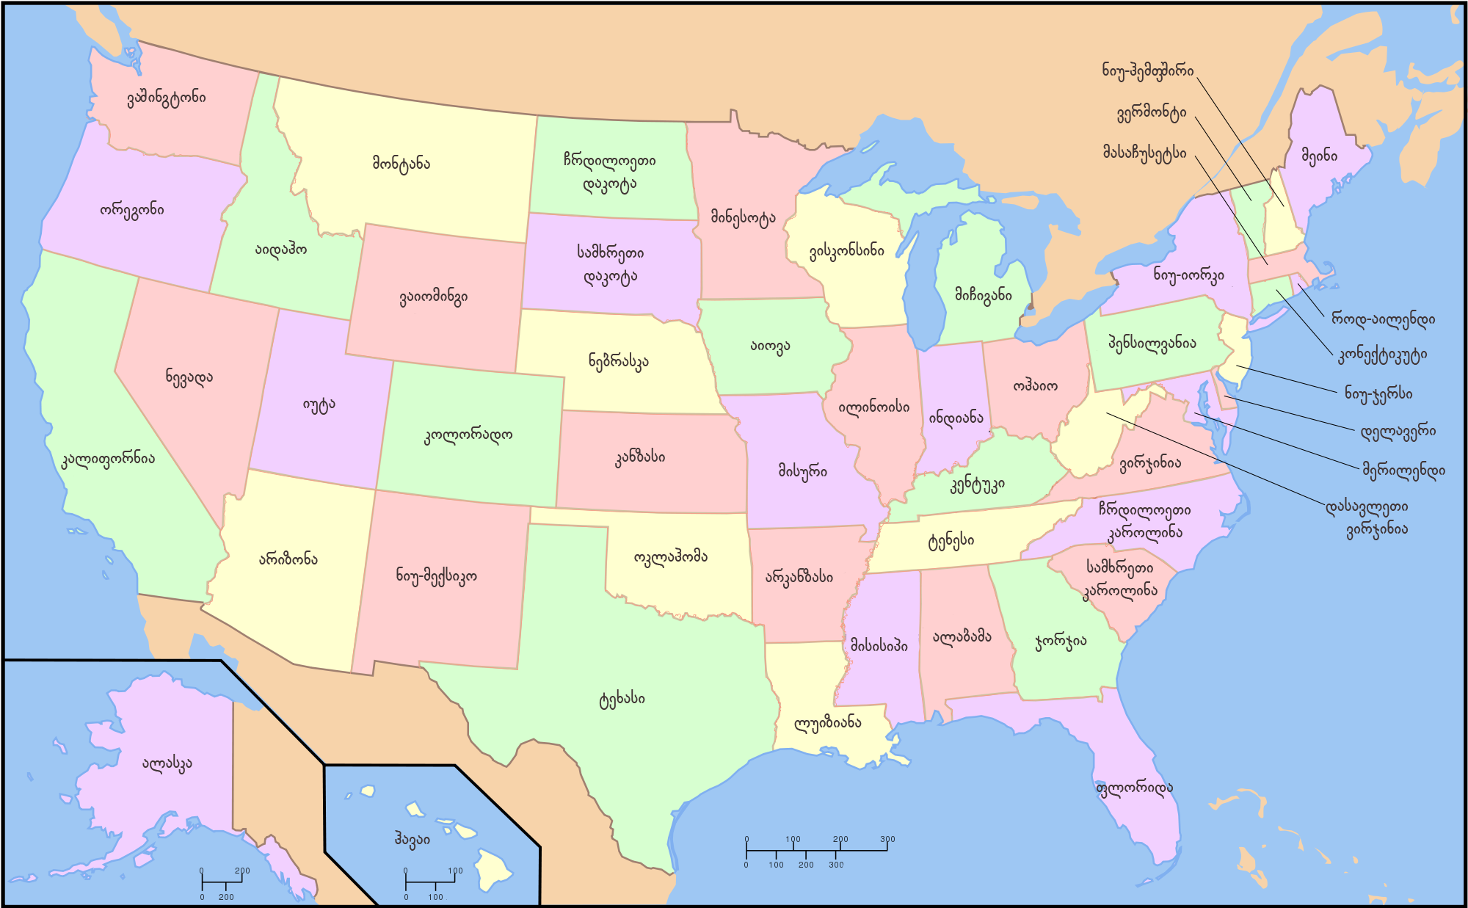
DeMorgan’s Law
Suppose we want to charge a higher shipping rate if we don’t ship within the continental United States. Picture is from https://upload.wikimedia.org/
shipping_charge = 10.00;
if (!(country == "USA"
&& state != "AK"
&& state != "HI"))
shipping_charge = 20.00;
This test is a little bit complicated.
DeMorgan’s Law to the rescue!
Big C++ by Cay Horstmann
Copyright © 2018 by John Wiley & Sons. All rights reserved
Notes:
(country == "USA"
&& state != "AK"
&& state != "HI") means USA mainland

Slide 16
DeMorgan’s Law, continued
DeMorgan’s Law allows us to rewrite complicated not/and/or messes so that they are more clearly read.
shipping_charge = 10.00;
if (country != "USA"
|| state == "AK"
|| state == "HI")
shipping_charge = 20.00;
Ah, much nicer.
But how did they do that?
Big C++ by Cay Horstmann
Copyright © 2018 by John Wiley & Sons. All rights reserved
Notes:
(country != "USA"
|| state == "AK"
|| state == "HI")
means country other than USA or AK or HI

Slide 17
Another example
Let temp be temperature of water.
(temp > 0 && temp < 100) means the water is liquid.
(!(temp > 0 && temp < 100)) means the water is not liquid. The condition can be simplified as
(temp <= 0 || temp >= 100)

Slide 18
DeMorgan’s Law Equivalencies
DeMorgan’s Law:
!(A && B) is the same as !A || !B
(change the && to || and negate all the terms)
!(A || B) is the same as !A && !B
(change the || to && and negate all the terms)
Big C++ by Cay Horstmann
Copyright © 2018 by John Wiley & Sons. All rights reserved

Slide 19
Simplification Examples: DeMorgan's, et al
Simplify the following logical conditions:
int n; bool b; //definition of variables
n < 5 || n == 5
n <= 5 && n != 5
n <= 5 && n >= 5
n <= 5 || n >= 5
!(n <= 5)
!!b
b == true
b == false

