Slide 1
Switch statement

Slide 2
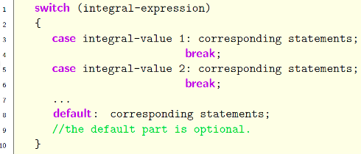
Switch statement structure
Switch statement is another (and easier) way to represent SOME nested if-else statement.

Slide 3

Switch statement: more details
Only integral expression can be used after keyword switch.
Only integral value can be used after keyword case.
Starting from Java 1.70, we can use String in switch statement, but not in the old version.

Slide 4
Switch Statement: more details II
Statement break; means to jump out the switch-block (enclosed by { and }).
In each case, there is a colon : after each value, enter break;
Statement break; right before the closing } can be omitted.
default: means all the rest cases, it is optional.
However, if default: is present, it must be put in the end of all other cases.

Slide 5
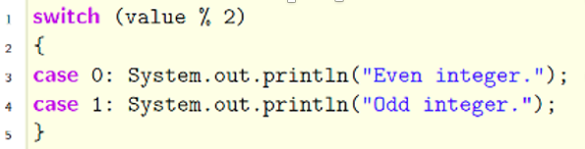
Warning: missing not-the-last break;
What is wrong with the following code? It is supposed to find out whether an int is odd or even.

Slide 6

Traffic light
Check the state of traffic light, if it is green, then print out “go!”; if it is red, then print out “stop.”; if it is yellow, then print out “slow down.”.
Print “stop.”
if color is red
Print “slow down.”
if color is yellow
Print “go!”
if color is green

Slide 7
Use String in Switch Statement: cautious
The following code only works in Java 1.70 and above.
switch (color) {
case "red": System.out.println("stop");
break;
case "green": System.out.println("Go");
break;
case "yellow": System.out.println("slow down.");
break;
default: System.out.println("Wrong color");
break; //the last break; can be omitted.
}

Slide 8
Numerical grade to letter grade
Given a numerical grade in [0, 100], translate them into letter grade (A, B, C, D, F).
Use char variable to hold the letter grade.
Letter A can be represented by ‘A’ (enclosed in single quotes).

Slide 9
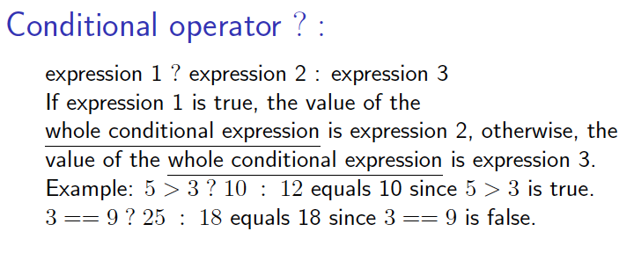
Conditional operator ? :

Slide 10
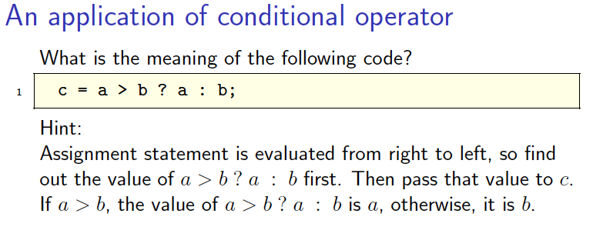
Application of conditional operator

Slide 11
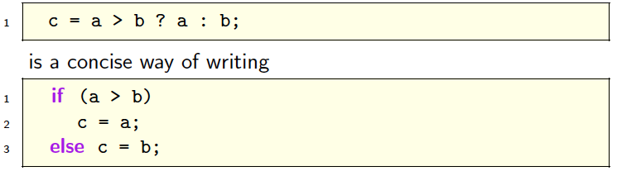
Application of conditional operator

