Slide 1
Topic 3
Variables
Arithmetic
Input and output
Problem solving: first do it by hand
Strings
Chapter summary

Slide 2
Input
Sometimes the programmer does not know what should be stored in a variable – but the user does.
The programmer must get the input value from the user
Users need to be prompted -- how else would they know they need to type something?
Prompts are done in output statements
The keyboard needs to be read from
This is done with an input statement
Big C++ by Cay Horstmann
Copyright © 2018 by John Wiley & Sons. All rights reserved

Slide 3
Input with cin >>
The input statement
To read values from the keyboard, you input them from an object called cin.
The "double greater than" operator >> denotes the “send to” command.
cin >> bottles; is an input statement. Of course, the variable bottles must be defined earlier.
Big C++ by Cay Horstmann
Copyright © 2018 by John Wiley & Sons. All rights reserved

Slide 4
Input with cin >> to multiple variables
You can read more than one value in a single input statement:
cout << "Enter the number of bottles and cans: ";
cin >> bottles >> cans;
The user can supply both inputs on the same line:
Enter the number of bottles and cans: 2 6
Alternatively, the user can press the Enter key or tab key after each input, as cin treats all blank spaces the same
Big C++ by Cay Horstmann
Copyright © 2018 by John Wiley & Sons. All rights reserved

Slide 5
Formatted Output
When you print an amount in dollars and cents, you want it to be rounded to two significant digits.
You learned earlier how to round off and store a value but, for output, we want to round off only for display.
A manipulator is something that is sent to cout to specify how values should be formatted.
To use manipulators, you must include the iomanip header in your program: #include <iomanip> and of course using namespace std; is also needed
Big C++ by Cay Horstmann
Copyright © 2018 by John Wiley & Sons. All rights reserved

Slide 6
Formatted Output for Dollars and Cents: setprecision()
Which do you think the user prefers to see on her gas bill?
Price per liter: $1.22
or
Price per liter: $1.21997
Big C++ by Cay Horstmann
Copyright © 2018 by John Wiley & Sons. All rights reserved

Slide 7
Formatted Output Examples: Table 7
Output Statement | Output | Comment
cout << 12.345678; | 12.3457 | By default, a number is printed with 6 significant digits.
cout << fixed << setprecision(2) << 12.3; | 12.30 | The fixed and setprecision manipulators control the number of digits after the decimal point.
cout << ":" << setw(6) << 12; | : 12 | Four spaces are printed before the number, for a total width of 6 characters.
cout << ":" << setw(2) << 123; | :123 | If the width not sufficient, it is ignored.
cout << setw(6) << ":" << 12; | :12 | The width only refers to the next item. Here, the : is preceded by five spaces.
Big C++ by Cay Horstmann
Copyright © 2018 by John Wiley & Sons. All rights reserved

Slide 8
Formatted Output, Dollars and Cents
You can combine manipulators and values to be displayed into a single statement:
price_per_liter = 1.21997;
cout << fixed << setprecision(2)
<< "Price per liter: $"
<< price_per_liter << endl;
This code produces this output:
Price per liter: $1.22
Big C++ by Cay Horstmann
Copyright © 2018 by John Wiley & Sons. All rights reserved

Slide 9
Formatted Output with setw() to Align Columns
Use the setw manipulator to set the width of the next output field.
The width is the total number of characters, including digits, the decimal point, and spaces.
If you want aligned columns of certain widths, use the setw() manipulator.
For example, if you want a number to be printed, right justified, in a column that is eight characters wide, you use
<< setw(8)
before EVERY COLUMN's DATA.
Big C++ by Cay Horstmann
Copyright © 2018 by John Wiley & Sons. All rights reserved

Slide 10
Exercise: Formatting Examples
Given
int quantity = 10;
double price = 19.95;
What do the following statements print? (show leading spaces as underscores _ )
cout << "Quantity:" << setw(4) << quantity;
cout << "Price:" << fixed << setw(8) <<
setprecision(2) << price;
cout << "Price:" << fixed << setprecision(2) << price;
cout << fixed << setprecision(3) << price;
cout << fixed << setprecision(1) << price;

Slide 11
Formatted Output, Another Example
This code:
price_per_ounce_1 = 10.2372;
price_per_ounce_2 = 117.2;
price_per_ounce_3 = 6.9923435;
cout << setprecision(2);
cout << setw(8) << price_per_ounce_1;
cout << setw(8) << price_per_ounce_2;
cout << setw(8) << price_per_ounce_3;
cout << "--------" << endl;
produces this output:
10.24
117.20
6.99
--------
Big C++ by Cay Horstmann
Copyright © 2018 by John Wiley & Sons. All rights reserved

Slide 12
setprecision versus setw: Persistence
There is a notable difference between the
setprecision and setw manipulators.
Once you set the precision, that precision is used for all floating-point numbers until the next time you set the precision.
But setw affects only the next value.
Subsequent values are formatted without added spaces.
Big C++ by Cay Horstmann
Copyright © 2018 by John Wiley & Sons. All rights reserved

Slide 13
A Complete Program for Volumes
ch02/volume2.cpp
#include <iostream>
#include <iomanip>
using namespace std;
int main()
{
// Read price per pack
cout << "Please enter the price for a six-pack: ";
double pack_price;
cin >> pack_price;
// Read can volume
cout << "Please enter the volume for each can (in ounces): ";
double can_volume;
cin >> can_volume;
Big C++ by Cay Horstmann
Copyright © 2018 by John Wiley & Sons. All rights reserved

Slide 14
A Complete Program for Volumes (continued)
// Compute pack volume
const double CANS_PER_PACK = 6;
double pack_volume = can_volume * CANS_PER_PACK;
// Compute and print price per ounce
double price_per_ounce = pack_price / pack_volume;
cout << fixed << setprecision(2);
cout << "Price per ounce: " << price_per_ounce << endl;
return 0;
}
Sample Program Run:
Please enter the price for a six-pack: 2.95
Please enter the volume for each can (in ounces): 12
Price per ounce: 0.04
Big C++ by Cay Horstmann
Copyright © 2018 by John Wiley & Sons. All rights reserved

Slide 15
Topic 4
Variables
Arithmetic
Input and output
Problem solving: first do it by hand
Strings
Chapter summary

Slide 16
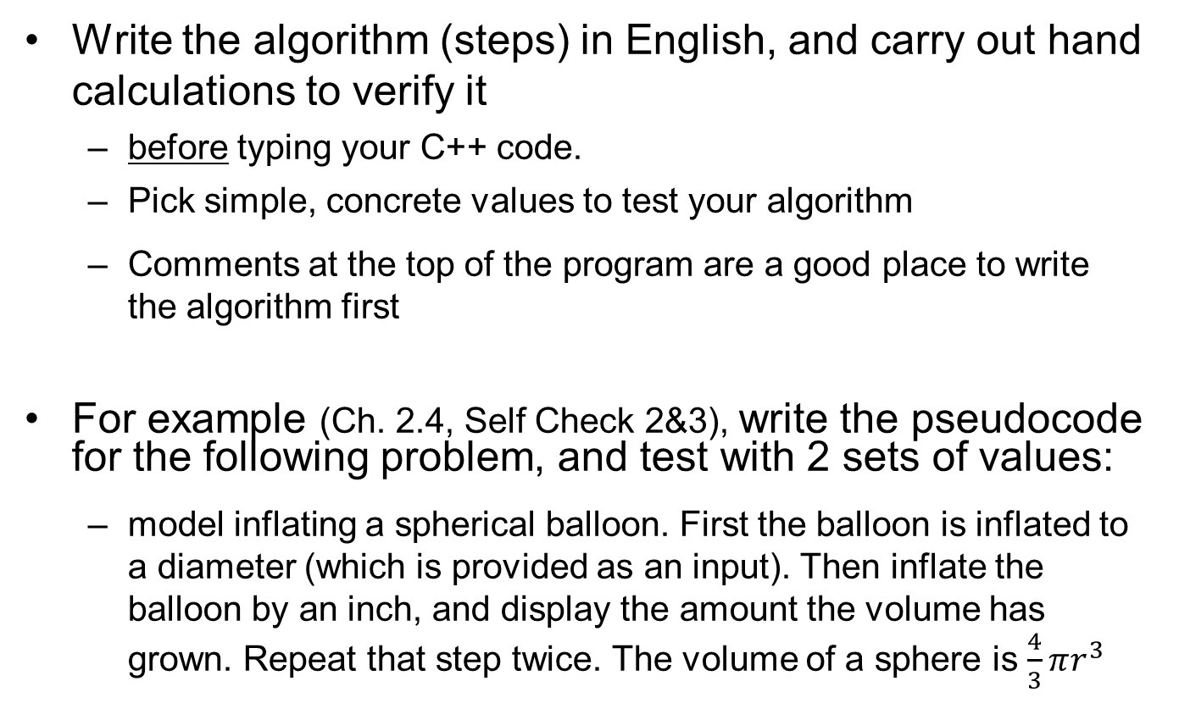
Problem Solving: Before you write C++, do it by hand
Write the algorithm (steps) in English, and carry out hand calculations to verify it
before typing your C++ code.
Pick simple, concrete values to test your algorithm
Comments at the top of the program are a good place to write the algorithm first
For example (Ch. 2.4, Self Check 2&3), write the pseudocode for the following problem, and test with 2 sets of values:
model inflating a spherical balloon. First the balloon is inflated to a diameter (which is provided as an input). Then inflate the balloon by an inch, and display the amount the volume has grown. Repeat that step twice. The volume of a sphere is $\frac{4}{3}πr^{3}$

Slide 17
Topic 5
Variables
Arithmetic
Input and output
Problem solving: first do it by hand
Strings
Chapter summary

Slide 18
Strings
Strings are sequences of characters: "Hello world"
Include the string header, so you can create variables to hold strings:
#include <iostream>
#include <string>
using namespace std;
...
string name = "Harry"; // literal string "Harry" stored
Big C++ by Cay Horstmann
Copyright © 2018 by John Wiley & Sons. All rights reserved

Slide 19
String Initializations
String variables are automatically initialized to the empty string if you don’t initialize them:
string response; // literal string "" stored
"" is called the empty or null string.
Big C++ by Cay Horstmann
Copyright © 2018 by John Wiley & Sons. All rights reserved

Slide 20
Concatenation of Strings
Use the + operator to concatenate strings; that is, put them together to yield a longer string.
string fname = "Harry";
string lname = "Morgan";
string name = fname + lname; //need a space!
cout << name << endl;
name = fname + " " + lname; //got a space
cout << name << endl;
The output will be
HarryMorgan
Harry Morgan
Big C++ by Cay Horstmann
Copyright © 2018 by John Wiley & Sons. All rights reserved

Slide 21
Common Error – Concatenation of literal strings
string greeting = "Hello, " + " World!";
// will not compile
Literal strings cannot be concatenated. And it’s pointless anyway, just do:
string greeting = "Hello World!";
Big C++ by Cay Horstmann
Copyright © 2018 by John Wiley & Sons. All rights reserved

Slide 22
String Input
You can read a string from the console:
cout << "Please enter your name: "; string name; cin >> name;
When a string is read with the >> operator, only one word is placed into the string variable. For example, suppose the user types
Harry Morgan
as the response to the prompt. Only the string "Harry" is placed into the variable name.
Big C++ by Cay Horstmann
Copyright © 2018 by John Wiley & Sons. All rights reserved

Slide 23
String Input
You can use another input string to read the second word:
cout << "Please enter your name: "; string fname, lname; cin >> fname >> lname;
//fname gets Harry, lname gets Morgan
Big C++ by Cay Horstmann
Copyright © 2018 by John Wiley & Sons. All rights reserved

Slide 24
String Functions
The length member function yields the number of characters in a string.
Unlike the sqrt or pow function, the length function is invoked with the dot notation: int n = name.length();
Big C++ by Cay Horstmann
Copyright © 2018 by John Wiley & Sons. All rights reserved

Slide 25
substr Function
Once you have a string, you can extract substrings by using the substr member function.
s.substr(start, length) returns a string that is made from the characters in the string s, starting at character start, and containing length characters. (start and length are integers)
NOTE: the first character has an index of 0, not 1.
string greeting = "Hello, World!";
string sub = greeting.substr(0, 2);
// sub contains "He"
Big C++ by Cay Horstmann
Copyright © 2018 by John Wiley & Sons. All rights reserved

Slide 26
Another Example of the substr Function
string greeting = "Hello, World!";
string w = greeting.substr(7, 5); // w contains "World" (not the !)
"World" is 5 characters long but…
Why is 7 the position of the “W” in "World"?
Why is the "W" not @ 8?
Because the first character has an index of 0, not 1.
Big C++ by Cay Horstmann
Copyright © 2018 by John Wiley & Sons. All rights reserved

Slide 27
String Data Representation & Character Positions
H e l l o , W o r l d !
0 1 2 3 4 5 6 7 8 9 10 11 12
In most computer languages, the starting position 0 means “start at the beginning.”
The first position in a string is labeled 0, the second 1, and so on. And don’t forget to count the space character after the comma—but the quotation marks are not stored.
The position number of the last character is always one less than the length of the string.
Big C++ by Cay Horstmann
Copyright © 2018 by John Wiley & Sons. All rights reserved

Slide 28
String Character Positions
H e l l o , W o r l d !
0 1 2 3 4 5 6 7 8 9 10 11 12
string greeting = "Hello, World!";
string w = greeting.substr(7); // w contains "World!"
If you do not specify how many characters to the substr() function, you get all the rest.
Big C++ by Cay Horstmann
Copyright © 2018 by John Wiley & Sons. All rights reserved

Slide 29
String Operations Examples: Table 8
Statement |  | Result | Comment
 | string str = "C"; str = str + "++"; | str is set to "C++" | When applied to strings,+ denotes concatenation.
 | string str = "C" + "++"; | Error | Error: You cannot concatenate two string literals.
 | cout << "Enter name: "; cin >> name; (User input: Harry Morgan) | name contains "Harry" | The >> operator places the next word into the string variable.
 | cout << "Enter name: "; cin >> name >> last_name; (User input: Harry Morgan) | name contains "Harry", last_name contains "Morgan" | Use multiple >> operators to read more than one word.
 | string greeting = "H & S"; int n = greeting.length(); | n is set to 5 | Each space counts as one character.
 | string str = "Sally"; string str2 = str.substr(1, 3); | str2 is set to "all" | Extracts the substring of length 3 starting at position 1. (The initial position is 0.)
 | string str = "Sally"; string str2 = str.substr(1); | str2 is set to "ally" | If you omit the length, all characters from the position until the end are included.
 | string a = str.substr(0, 1); | a is set to the initial letter in str | Extracts the substring of length 1 starting at position 0.
 | string b = str.substr(str.length() - 1); | b is set to the last letter in str | The last letter has position str.length() - 1. We need not specify the length.
Big C++ by Cay Horstmann
Copyright © 2018 by John Wiley & Sons. All rights reserved

Slide 30
String Functions, Complete Program Example
#include <iostream>
#include <string>
using namespace std;
int main()
{
cout << "Enter your first name: ";
string first;
cin >> first;
cout << "Enter your significant other's first name: ";
string second;
cin >> second;
string initials = first.substr(0, 1)
+ "&" + second.substr(0, 1);
cout << initials << endl;
return 0;
}
ch02/initials.cpp
Big C++ by Cay Horstmann
Copyright © 2018 by John Wiley & Sons. All rights reserved

Slide 31

Representing Characters: Unicode
Printable characters in a string are stored as
bits in a computer, just like int and double variables
The bit patterns are standardized:
ASCII (American Standard Code for Information Interchange) is 7 bits long, specifying 2⁷ = 128 codes:
26 uppercase letters A through Z + 26 lowercase letters a through z
10 digits
32 typographical symbols such as +, -, ', \...
34 control characters such as space, newline, and 32 others for controlling printers and other devices.
Unicode, which has replaced ASCII in most cases, is 21 bits
superset of ASCII; the first 128 codes match
The extra bits allow many more characters (2²¹ > 2x10⁶), required for worldwide languages
About 136,000 characters have been assigned so far
UTF-8 is the 8-bit subset of Unicode, and UTF-16 is 16-bit, often used by websites and compilers

Slide 32
Topic 6
Variables
Arithmetic
Input and output
Problem solving: first do it by hand
Strings
Chapter summary

Slide 33
Chapter Summary Part 1
Write variable definitions in C++.
• A variable is a storage location with a name.
• When defining a variable, you MUST specify the type of its values.
And you should also specify an initial value:
int x=0;
• Use the int type for numbers that cannot have a fractional part.
• Use the double type for floating-point numbers.
Big C++ by Cay Horstmann
Copyright © 2018 by John Wiley & Sons. All rights reserved

Slide 34
Chapter Summary Part 2
• An assignment statement stores a new value in a variable, replacing the previously stored value.
• The assignment operator = does not denote mathematical equality.
• You cannot change the value of a variable that is defined as const.
• Use comments to add explanations for humans who read your code. The compiler ignores comments.
Big C++ by Cay Horstmann
Copyright © 2018 by John Wiley & Sons. All rights reserved

Slide 35
Chapter Summary Part 3
Use the arithmetic operations in C ++
• Use * for multiplication and / for division.
• The ++ operator adds 1 to a variable; the -- operator subtracts 1.
• If both arguments of / are integers, the quotient is an int, and the remainder is discarded.
• The % operator computes the remainder of an integer division.
• Assigning a floating-point variable to an integer drops the fractional part.
• The C++ <cmath> library defines many math functions such as sqrt (square root) and pow (raising to a power).
Big C++ by Cay Horstmann
Copyright © 2018 by John Wiley & Sons. All rights reserved

Slide 36
Chapter Summary Part 4
Write programs that read user input and write formatted output.
• Use the >> operator to read a value and place it in a variable.
int x=0;
cout << "Enter value for x: ";
cin >> x;
• You use manipulators to specify how OUTPUT values should be formatted.
const double PI=3.14159265;
cout << "Pi =" << setprecision(8) << setw(10) << PI<< endl;
Carry out hand calculations when developing an algorithm, before typing your C++ code.
• Pick concrete values for a typical situation to use in a hand calculation, to very algorithm correctness.
Big C++ by Cay Horstmann
Copyright © 2018 by John Wiley & Sons. All rights reserved

Slide 37
Chapter Summary Part 5: Strings
Write programs that process strings.
Strings are sequences of characters
Use the + operator to concatenate strings; that is, put them together to yield a longer string.
string s1= "hello", s2= " world";
string s3 = s1 + s2; //s3 gets "hello world"
The length member function yields the number of characters in a string. A member function is invoked using the dot notation:
int len =s1.length();
Use the substr member function to extract a substring:
string s3 = s1.substr(0,2); //s3 gets "he"
Big C++ by Cay Horstmann
Copyright © 2018 by John Wiley & Sons. All rights reserved

