Slide 1
Topic 2
Variables
Arithmetic
Input and output
Problem solving: first do it by hand
Strings
Chapter summary

Slide 2
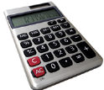
Arithmetic Operators
C++ has the same arithmetic operators as a calculator:
* for multiplication: a * b (not a . b or ab as in math)
/ for division: a / b (not ÷ or a fraction bar as in math)
+ for addition: a + b
- for subtraction: a – b
Big C++ by Cay Horstmann
Copyright © 2018 by John Wiley & Sons. All rights reserved

Slide 3
Arithmetic Operator Precedence
Just as in regular algebraic notation, * and / have higher precedence than + and –.
In a + b / 2, the b / 2 happens first.
Big C++ by Cay Horstmann
Copyright © 2018 by John Wiley & Sons. All rights reserved

Slide 4
Increment and Decrement
Changing a variable by adding or subtracting 1 is so common that there is a special shorthand for these:
The increment and decrement operators.
count++; // add 1 to count
count--; // subtract 1 from count
Example:
What is the value of variable count after the code below?
int count = 3;
count--;
count = count + 2;
count++;
Big C++ by Cay Horstmann
Copyright © 2018 by John Wiley & Sons. All rights reserved

Slide 5
Increment and C++
C++ was based on C and so it’s one better than C, right?
Guess how C++ got its name!
Big C++ by Cay Horstmann
Copyright © 2018 by John Wiley & Sons. All rights reserved

Slide 6
Integer Division and Remainder
The % operator computes the remainder of an integer division.
It is called the modulus operator (also modulo and mod)
It has nothing to do with the % key on a calculator
Big C++ by Cay Horstmann
Copyright © 2018 by John Wiley & Sons. All rights reserved

Slide 7
Integer Division and Remainder Example
You want to determine the value in dollars and cents stored in the piggy bank.
You obtain the dollars through an integer division by 100.
The integer division discards the remainder.
To obtain the remainder (the cents), use the % operator:
int pennies = 1729;
int dollars = pennies / 100; // Sets dollars to 17
int cents = pennies % 100; // Sets cents to 29
(yes, 100 is a magic number)
Big C++ by Cay Horstmann
Copyright © 2018 by John Wiley & Sons. All rights reserved

Slide 8
More Integer Division and Remainder Examples
What is the result from each of the following?
_______ 27 / 4
_______ 27.0 / 4
_______ 27 % 4
_______ -27 % 4
_______ 27 % 10
_______ 27 % 2

Slide 9
Integer division vs. Division
When both dividend (3) and divisor (2) are integers
3 / 2 = 1 (Why???)
When at least one of dividend and divisor is a real number (number with decimals)
3. / 2 = 1.5
3 / 2.0 = 1.5
3.0 / 2.0 = 1.5
Why do we need integer division?

Slide 10
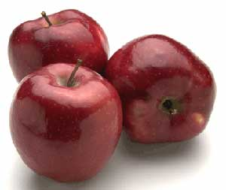
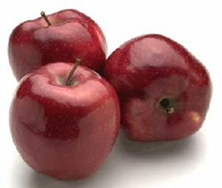


Integer Division and Remainder
6 kids with 10 apples
Apples cannot be cut into pieces
How many apple(s) can a kid get?
How many apples are left?
It is like no decimal part.

Slide 11



Integer Division and Remainder
6 kids with 10 apples
Apples cannot be cut into pieces
How many apple(s) can a kid get? 1
How many apples are left? 4

Slide 12
Integer Division and Remainder
6 kids with 10 apples
Apples cannot be cut into pieces
How many apple(s) can a kid get? 10 / 6 = 1
How many apples are left? 10 % 6 = 4

Slide 13
Integer Division and Remainder
Integer division: When both dividend (say, 10) and divisor (say, 6) are integers, discard fraction part of division result. So 10 / 6 = 1.
How many apple(s) can a kid get? 10 / 6 = 1
How many apples are left? 10 % 6 = 4

Slide 14
Integer Division and Remainder
123 minutes = ? Hours ? minutes

Slide 15
Integer Division and Remainder
123 minutes = ? Hours ? Minutes
Solution:
How many whole hours does 123 minutes have?
One hour = 60 minutes.
123 / 60 = 2 hours
(2) After the above 2 hours, how many more minutes does 123 minutes have?
123 – 60 * 2 = 3. (* means multiplication in Java) or we use remainder operator %:
123 % 60 = 3 minutes

Slide 16

Integer Division and Remainder
Similarly, computer keeps track of system time…
Starting from 1 January 1970 00:00:00, there were 100000000 seconds elapsed, what was that time?
1 Jan 1970 00:00:00 + 100,000,000 secs = ? Years ? Days ? Hours ? Minutes ? seconds
Notes:
Need a little tricky method to calculate from days to month and number of days in month, it will depends on flat year or not.

Slide 17
Integer Division and Remainder
(1) 100000000 secs = ? minutes ? seconds
100000000 / 60 = 1666666 minutes
100000000 % 60 = 40 seconds.
(2) 1666666 minutes = ? Hours ? minutes
1666666 / 60 = 27777 hours
1666666 % 60
= 1666666 – 60 * 27777
= 46 minutes

Slide 18
Integer Division and Remainder
(1) 100000000 secs = 1666666 mins 40 secs
(2) 1666666 mins = 27777 Hours 46 mins
(3) 27777 hours = ? Days ? hours
27777 / 24 = 1157 days
27777 % 24 = 27777 – 1157 * 24 = 9 hours
(4) 1157 days = ? Years ? days
1157 / 365 = 3 years
1157 % 365 = 1157 – 3 * 365 = 62 days
Notes:
public class TimeElapse {
/**
* Sample output:
* 100000000 seconds is equivalent to
3 years 62 days 9 hours 46 minutes 40 seconds
*/
public static void main(String[] args) {
// TODO Auto-generated method stub
int secs = 100000000;
int mins = secs / 60;
int remSecs = secs % 60;
int hours = mins / 60;
int remMins = mins % 60;
int days = hours / 24;
int remHours = hours % 24;
int years = days / 365;
int remDays = days % 365;
System.out.println(secs + " seconds is equivalent to ");
System.out.println(years + " years " + remDays + " days " + remHours + " hours " + remMins + " minutes "
+ remSecs + " seconds");
}
}

Slide 19
Integer Division and Remainder
Starting from 1 January 1970 00:00:00, there were 100,000,000 seconds elapsed, what was that time?
(1) 100000000 secs = 1666666 mins 40 secs
(2) 1666666 minutes = 27777 Hours 46 minutes
(3) 27777 hours = 1157 Days 9 hours
(4) 1157 days = 3 Years 62 days
The time was 1973 March 3, 09: 46: 40.
Notes:
//A version uses the concepts of constant variables.
/*
* convert seconds to yy years dd days hh hours mm minutes ss seconds
* We skip the month since different months have different days.
* The 60th days in a year can be March 1st (non-leap year)
* or Feb 29 (leap year).
* Partially verified by http://www.easysurf.cc/utime.htm.
Sample input/output:
100000000 seconds = 3 years 62 days 9 hours 46 minutes 40 seconds
*/
public class ModuloExamples {
public static void main(String[] args) {
// TODO Auto-generated method stub
final int SECS_PER_MIN = 60;
final int MINS_PER_HOUR = 60;
final int HOURS_PER_DAY = 24;
final int DAYS_PER_YEAR = 365;
int totalSecs = 100000000;
int secs = totalSecs % SECS_PER_MIN;
int totalMins = totalSecs / SECS_PER_MIN;
int mins = totalMins % MINS_PER_HOUR;
int totalHours = totalMins / MINS_PER_HOUR;
int hours = totalHours % HOURS_PER_DAY;
int totalDays = totalHours / HOURS_PER_DAY;
int days = totalDays % DAYS_PER_YEAR;
int years = totalDays / DAYS_PER_YEAR;
System.out.print(totalSecs + " seconds = ");
System.out.println(years + " years " + days + " days " + hours + " hours " +
mins + " minutes " + secs + " seconds");
}
}

Slide 20
Integer Division and Remainder
100000000 secs
1666666 mins 40 secs
27777 hrs 46 mins
1157 days 9 hrs
3 Years 62 days

Slide 21
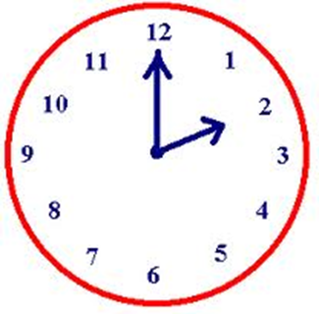
Remainder operator %
What time in the afternoon for 14:00 ?
What time in the afternoon for 17:00 ?
14 % 12 = 2

Slide 22

Remainder operator % Example
You are at top of a round roller coaster, which turns another 380 degree in the next few minutes. What will be your new position?

Slide 23
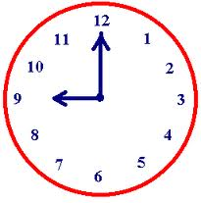

Remainder Operator % Example 2
Now is 9am. After 5 hours, it is 2pm.
(9 + 5 ) % 12 = 2
+ 5 hours

Slide 24
Converting Floating-Point Numbers to Integers
When a floating-point value is assigned to an integer variable, the fractional part is discarded:
double price = 2.55;
int dollars = price;
// Sets dollars to 2
You probably want to round to the nearest integer. To round a positive floating-point value to the nearest integer, add 0.5 and then convert to an integer:
int dollars = price + 0.5; // Rounds to the nearest integer
Big C++ by Cay Horstmann
Copyright © 2018 by John Wiley & Sons. All rights reserved

Slide 25
Powers and Roots
What about this?
Inside the parentheses is easy:
1 + (r / 100)
But that raised to the n?
Big C++ by Cay Horstmann
Copyright © 2018 by John Wiley & Sons. All rights reserved

Slide 26
Powers and Roots – #include <cmath>
In C++, there are no symbols for powers and roots. To compute them, you must call functions.
The C++ library defines many mathematical functions such as sqrt (square root) and pow (raising to a power).
To use the functions in this library, called the cmath library, you must place the line: #include <cmath> at the top of your program file.
It is also necessary to include using namespace std; at the top of your program file.
Big C++ by Cay Horstmann
Copyright © 2018 by John Wiley & Sons. All rights reserved

Slide 27
Example of pow() function call
The power function has the base followed by a comma
followed by the power to raise the base to:
pow(base, exponent)
Using the pow function:
double balance = b * pow(1 + r / 100, n);
Big C++ by Cay Horstmann
Copyright © 2018 by John Wiley & Sons. All rights reserved

Slide 28

Powers and Roots Examples: Table 5
Mathematical Expression | C++ Expression | Comments
 | (x + y) / 2 | The parentheses are required; x + y/ 2 computes x + (y/2) .
 | x * y / 2 | Parentheses are not required; operators with the same precedence are evaluated left to right. xy as a math expression is x*y in C++
 | pow(1 + r / 100, n) | Remember to add #include <cmath> to the top of your program.
 | sqrt(a * a + b * b) | a * a is simpler than pow(a, 2).
 | (i + j + k) / 3.0 | If i, j, and k are integers, using a denominator of 3.0 forces floating-point division.
Big C++ by Cay Horstmann
Copyright © 2018 by John Wiley & Sons. All rights reserved

Slide 29
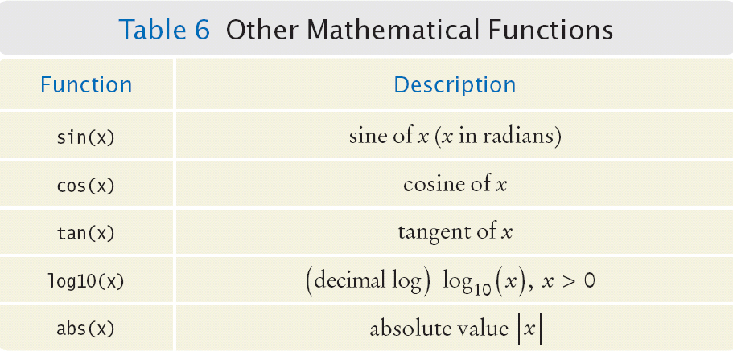
Other Mathematical Functions (from <cmath>): Table 6
Example:
double population = 73693997551.0;
double decimal_log = log10(population);
Big C++ by Cay Horstmann
Copyright © 2018 by John Wiley & Sons. All rights reserved

Slide 30
Math Function Examples
Compute the result of each:
_______ pow(10, 3)
_______ sqrt(100)
_______ abs(3 - 10)
_______ log10(1000)
_______ max(3, -10)
_______ cos(3.1415926535)
_______ tan(M_PI/4)
//M_PI constant is defined in cmath library

Slide 31
Common Error – Unintended Integer Division
If both arguments of / are integers, the remainder is discarded: 7 / 3 is 2, not 2.5
but 7.0 / 4.0 7 / 4.0 7.0 / 4
all yield 1.75.
Big C++ by Cay Horstmann
Copyright © 2018 by John Wiley & Sons. All rights reserved

Slide 32
Common Error – Unintended Integer Division, cont.
It is unfortunate that C++ uses the same symbol: / for both integer and floating-point division. These are really quite different operations.
It is a common error to use integer division by accident. Consider this segment that computes the average of three integers:
cout << "Please enter your last three test scores: ";
int s1;
int s2;
int s3;
cin >> s1 >> s2 >> s3;
double average = (s1 + s2 + s3) / 3; //ERROR
cout << "Your average score is " << average << endl;
Big C++ by Cay Horstmann
Copyright © 2018 by John Wiley & Sons. All rights reserved

Slide 33
More on Unintended Integer Division
What could be wrong with that?
Of course, in math the exact average of s1, s2, and s3 is (s1+ s2+ s3) / 3
Here, however, the / denotes integer division because
both (s1+s2+s3)and 3 are integers.
For example, if the scores add up to 14, the average = 4.
Yes, the result of the integer division of 14 by 3 is 4, and the fractional 0.66667 is discarded.
That integer 4 is then moved into the double variable average.
Big C++ by Cay Horstmann
Copyright © 2018 by John Wiley & Sons. All rights reserved

Slide 34
Avoiding Unintended Integer Division
The remedy is to make the numerator or denominator into a floating-point number:
double total = s1 + s2 + s3;
double average = total / 3;
or
double average = (s1 + s2 + s3) / 3.0;
Big C++ by Cay Horstmann
Copyright © 2018 by John Wiley & Sons. All rights reserved

Slide 35
Common Error – Unbalanced Parentheses
Consider the expression
(-(b * b - 4 * a * c) / (2 * a)
What is wrong with it?
The parentheses are unbalanced. This is very common with complicated expressions.
Big C++ by Cay Horstmann
Copyright © 2018 by John Wiley & Sons. All rights reserved

Slide 36
Unbalanced Parentheses – A Solution
The Muttering Method
Count starting with 1 at the 1st parenthesis add one for each left paren( and subtract one for each right paren )
- ( b * b - ( 4 * a * c ) ) ) / 2 * a )
1 2 1 0 -1 -2
If your count is not 0 when you finish, or if you ever drop to -1, then…
STOP, something is wrong.
Big C++ by Cay Horstmann
Copyright © 2018 by John Wiley & Sons. All rights reserved

Slide 37
Common Error – Forgetting Header Files
Every program that carries out input or output needs the <iostream> header.
If you use mathematical functions such as sqrt, you need to include <cmath>.
If you forget to include the appropriate header file, the compiler will not know symbols such as
cout or sqrt.
If the compiler complains about an undefined function or symbol, check your header files.
Big C++ by Cay Horstmann
Copyright © 2018 by John Wiley & Sons. All rights reserved

Slide 38
Including the Right Header Files
Sometimes you may not know which header file to include.
Suppose you want to compute the absolute value of an integer using the abs function.
As it happens, this version of abs is not defined in the <cmath> header but in <cstdlib>.
How can you find the correct header file?
Why do you think Tim Berners-Lee invented going online?
Use a reference site on the Internet such as: http://www.cplusplus.com, or just Google "C++ abs()"
Big C++ by Cay Horstmann
Copyright © 2018 by John Wiley & Sons. All rights reserved

Slide 39
Spaces in Expressions
It is easier to read
x1 = (-b + sqrt(b * b - 4 * a * c)) / (2 * a);
than
x1=(-b+sqrt(b*b-4*a*c))/(2*a);
Itreallyiseasiertoreadwithspaces!
So always use spaces around all operators: + - * / % =
Big C++ by Cay Horstmann
Copyright © 2018 by John Wiley & Sons. All rights reserved

Slide 40
Spaces in Expressions: Unary Minus, Parentheses
However, don’t put a space after a unary minus: that’s a – used to negate a single quantity like this: -b
That way, it can be easily distinguished from a binary minus, as in a - b
It is customary not to put a space between a function name and the parentheses.
Write sqrt(x)
not sqrt (x)
Big C++ by Cay Horstmann
Copyright © 2018 by John Wiley & Sons. All rights reserved

Slide 41
Casts
Occasionally, you need to store a value into a variable of a different type, or print it in a different way.
A cast is a conversion from one type (such as int)
to another type (such as double).
For example, how to print or capture an exact quotient from two int variables?
int x= 25;
int y = 10;
cout << "The quotient is " << x / y;
//gives int quotient of 2, not what we want
Big C++ by Cay Horstmann
Copyright © 2018 by John Wiley & Sons. All rights reserved

Slide 42
Casts Convert Variable Types
The cast conversion syntax:
static_cast<newtype>( data_to_convert)
For example, to get an exact quotient, we cast one of the int variables to a double before dividing
int x= 25;
int y = 10;
cout << x / static_cast<double>(y);
//gives double quotient of 2.5
An older version of the cast conversion syntax also works, but its use is discouraged:
(newtype)data_to_convert
cout << x / (double)y;
//gives double quotient of 2.5
Big C++ by Cay Horstmann
Copyright © 2018 by John Wiley & Sons. All rights reserved

Slide 43
Combining Assignment and Arithmetic
In C++, you can combine arithmetic and assignments.
For example, the statement
total += cans * CAN_VOLUME;
is a shortcut for
total = total + cans * CAN_VOLUME;
Similarly,
total *= 2;
is another way of writing
total = total * 2;
Many programmers prefer using this form of coding.
Big C++ by Cay Horstmann
Copyright © 2018 by John Wiley & Sons. All rights reserved

