Slide 1

Chapter Three: Decisions

Slide 2
Chapter Goals
To be able to implement decisions using if statements
To learn how to compare integers, floating-point numbers, and strings
To understand the Boolean data type
To develop strategies for validating user input
Big C++ by Cay Horstmann
Copyright © 2018 by John Wiley & Sons. All rights reserved

Slide 3
Topic 1
The if statement
Comparing numbers and strings
Multiple alternatives
Nested branches
Problem solving: flowcharts
Problem solving: test cases
Boolean variables and operators
Application: input validation
Chapter summary

Slide 4
The if Statement
The if statement is used to implement a decision.
When a condition is fulfilled, one set of statements is executed.
Otherwise, another set of statements is executed.
Like a fork in the road
Big C++ by Cay Horstmann
Copyright © 2018 by John Wiley & Sons. All rights reserved

Slide 5
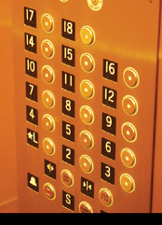
The if Statement: Elevator Example
We must write the code to control the elevator.
How can we skip the 13th floor?
Big C++ by Cay Horstmann
Copyright © 2018 by John Wiley & Sons. All rights reserved

Slide 6
if() Elevator Example Code
If the user inputs 20, the program must set the actual floor to 19.
Otherwise, we simply use the supplied floor number.
We need to decrement the input only under a certain condition:
cin >> floor;
int actual_floor;
if (floor > 13) //never put a semicolon after the parentheses!!
{
actual_floor = floor - 1; //
}
else
{
actual_floor = floor;
}
Big C++ by Cay Horstmann
Copyright © 2018 by John Wiley & Sons. All rights reserved

Slide 7
Syntax of the if() Statement
if (condition)//never put a semicolon after the parentheses!!
{
statement1; //executed if condition is true
}
else //the else part is optional
{
statement2; //executed if condition false
} //braces are optional but recommended

Slide 8
The if Statement, Example without an else
Here is another way to write this code:
We only need to decrement when the floor is greater than 13.
We can set actual_floor before testing:
int actual_floor = floor;
if (floor > 13)
{
actual_floor--;
} // No else needed
(And you’ll notice we used the decrement operator this time.)
Big C++ by Cay Horstmann
Copyright © 2018 by John Wiley & Sons. All rights reserved

Slide 9
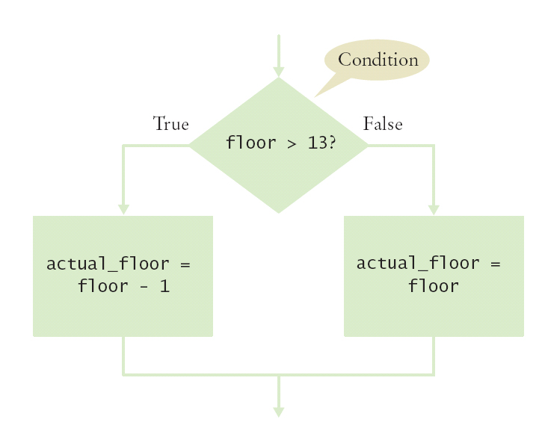
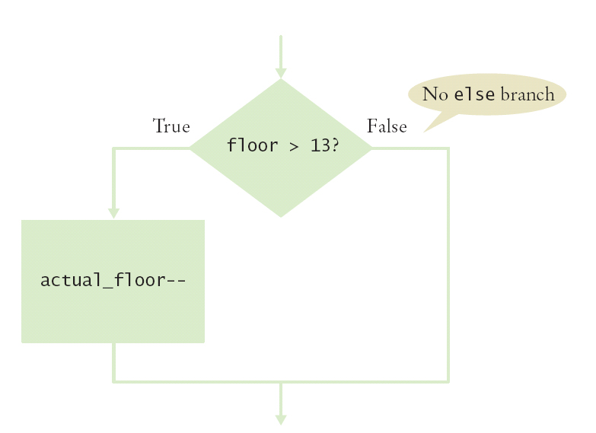
The if Statement Flowcharts
With else Without else
Big C++ by Cay Horstmann
Copyright © 2018 by John Wiley & Sons. All rights reserved

Slide 10
The if Statement – A Complete Elevator Program
#include <iostream>
using namespace std;
int main()
{
int floor;
cout << "Floor: ";
cin >> floor;
int actual_floor;
if (floor > 13)
{
actual_floor = floor - 1;
}
else
{
actual_floor = floor;
}
cout << "The elevator will travel to the actual floor "
<< actual_floor << endl;
return 0;
}
ch03/elevator1.cpp
Big C++ by Cay Horstmann
Copyright © 2018 by John Wiley & Sons. All rights reserved

Slide 11
The if Statement – Brace Layout
Making your code easy to read is good practice.
Lining up braces vertically helps.
if (floor > 13)
{
floor--;
}
Big C++ by Cay Horstmann
Copyright © 2018 by John Wiley & Sons. All rights reserved

Slide 12
The if Statement – Brace Layout, continued
As long as the ending brace clearly shows what it is closing, there is no confusion.
if (floor > 13) {
floor--;
}
Some programmers prefer this style—it saves a physical line in the code.
Big C++ by Cay Horstmann
Copyright © 2018 by John Wiley & Sons. All rights reserved

Slide 13
The if Statement – Always Use Braces
When the body of an if statement consists of a single statement, you need not use braces:
if (floor > 13)
floor--;
However, it is a good idea to always include the braces:
the braces makes your code easier to read, and
you are less likely to make errors such as …
Big C++ by Cay Horstmann
Copyright © 2018 by John Wiley & Sons. All rights reserved

Slide 14
The if Statement – Common Error – The Do-nothing Statement
if (floor > 13) ; // ERROR ?
{
floor--;
}
This is not a compiler error.
The compiler does not complain.
It interprets this if statement as follows:
If floor is greater than 13, execute the do-nothing statement. (semicolon by itself is the do nothing statement)
Then execute the code enclosed in the braces.
Any statements enclosed in the braces are no longer a part of the if statement.
Big C++ by Cay Horstmann
Copyright © 2018 by John Wiley & Sons. All rights reserved

Slide 15
The if Statement – Indent when Nesting
Block-structured code has the property that nested statements are indented by one or more levels.
int main()
{
int floor;
...
if (floor > 13)
{
floor--;
}
...
return 0;
}
0 1 2
Indentation level
Big C++ by Cay Horstmann
Copyright © 2018 by John Wiley & Sons. All rights reserved

Slide 16
Indent when Nesting
Using the tab key is a way to get this indentation
but …
not all tabs are the same width!
Luckily most development environments have settings to automatically convert all tabs to spaces.
The IDE may also automatically indent your nested statements.
Big C++ by Cay Horstmann
Copyright © 2018 by John Wiley & Sons. All rights reserved

Slide 17
?: The Conditional Operator
C++ has the conditional operator of the form
condition ? value1 : value2
The value of that expression is either value1 if the test passes or value2 if it fails.
Big C++ by Cay Horstmann
Copyright © 2018 by John Wiley & Sons. All rights reserved

Slide 18
The Conditional Operator vs. an if()
For example, we can compute the actual floor number as
actual_floor = floor > 13 ? floor - 1 : floor;
which is equivalent to
if (floor > 13)
{
actual_floor = floor - 1;
}
else
{
actual_floor = floor;
}
Big C++ by Cay Horstmann
Copyright © 2018 by John Wiley & Sons. All rights reserved

Slide 19
The if Statement – Removing Duplication
if (floor > 13)
{
actual_floor = floor - 1;
cout << "Actual floor: " << actual_floor << endl;
}
else
{
actual_floor = floor;
cout << "Actual floor: " << actual_floor << endl;
}
Do you find anything redundant in this code?
Big C++ by Cay Horstmann
Copyright © 2018 by John Wiley & Sons. All rights reserved

Slide 20
The if Statement – Duplication Removed
if (floor > 13)
{
actual_floor = floor - 1;
}
else
{
actual_floor = floor;
}
cout << "Actual floor: " << actual_floor << endl;
You can remove the duplication by moving the two identical cout statements outside of and after the braces, and of course deleting one of the two.
Big C++ by Cay Horstmann
Copyright © 2018 by John Wiley & Sons. All rights reserved

Slide 21
Topic 2
The if statement
Comparing numbers and strings
Multiple alternatives
Nested branches
Problem solving: flowcharts
Problem solving: test cases
Boolean variables and operators
Application: input validation
Chapter summary

Slide 22
Relational Operators: Table 1
C++ | Math Notation | Description
> | > | Greater than
>= | ≥ | Greater than or equal
< | < | Less than
<= | ≤ | Less than or equal
== | = | Equal
!= | ≠ | Not equal
Relational operators are used to compare numbers and strings, inside the () of if().
Big C++ by Cay Horstmann
Copyright © 2018 by John Wiley & Sons. All rights reserved

Slide 23
Relational Operator Examples: Table 2 (Part 1)
Expression | Value | Comment
3 <= 4 | true | 3 is less than 4; <= tests for “less than or equal”.
3 =< 4 | Error | The “less than or equal” operator is <=, not =<. The “less than” symbol comes first.
3 > 4 | false | > is the opposite of <=.
4 < 4 | false | The left-hand side of < must be strictly smaller than the right-hand side.
4 <= 4 | true | Both sides are equal; <= tests for “less than or equal”.
Big C++ by Cay Horstmann
Copyright © 2018 by John Wiley & Sons. All rights reserved

Slide 24
Relational Operator Examples: Table 2 (Part 2)
Expression | Value | Comment
3 == 5-2 | true | == tests for equality.
3 != 5-1 | true | != tests for inequality. It is true that 3 is not 5 – 1.
3 = 6 / 2 | Error | Use == to test for equality.
1.0 / 3.0 == 0.333333333 | false | Although the values are very close to one another, they are not exactly equal. See Common Error 3.3.
"10" > 5 | Error | You cannot compare a string to a number.
Big C++ by Cay Horstmann
Copyright © 2018 by John Wiley & Sons. All rights reserved

Slide 25
Relational Operators – Some Notes
The == operator is initially confusing to beginners.
In C++, = already has a meaning, namely assignment
The == operator denotes equality testing:
floor = 13; // Assign 13 to floor
// Test whether floor equals 13
if (floor == 13)
You can compare strings as well:
if (input == "Quit") ...
Big C++ by Cay Horstmann
Copyright © 2018 by John Wiley & Sons. All rights reserved

Slide 26
Common Error – Confusing = and ==
The C++ language allows the use of = inside tests.
To understand this, we have to go back in time.
The creators of C, the predecessor to C++, were very frugal thus C did not have true and false values.
Instead, they allowed any numeric value inside a condition with this interpretation:
0 denotes false any non-0 value denotes true.
In C++ you should use the bool values true and false
Big C++ by Cay Horstmann
Copyright © 2018 by John Wiley & Sons. All rights reserved

Slide 27
Confusing = and ==
Furthermore, in C and C++ assignments have values.
The value of the assignment expression floor = 13 is 13.
These two features conspire to make a horrible pitfall:
if (floor = 13) …
is legal C++.
The code sets floor to 13, and since that value is not zero, the condition of the if statement is always true.
SO… Use only == inside tests.
Use = outside tests.
Big C++ by Cay Horstmann
Copyright © 2018 by John Wiley & Sons. All rights reserved

Slide 28
Kinds of Error Messages
Error messages are fatal.
The compiler will not translate a program with one or more errors.
Warning messages are advisory.
The compiler will translate the program, but there is a good chance that the program will not do what you expect it to do.
So check the warnings, and fix your code if possible to eliminate the warnings
Big C++ by Cay Horstmann
Copyright © 2018 by John Wiley & Sons. All rights reserved

Slide 29
Common Error – Exact Comparison of Floating-Point Numbers
Roundoff errors
Floating-point numbers have only a limited precision.
Calculations can introduce roundoff errors.
Given r=2,
Does == 2 ?
Let’s see (by writing code, of course) …
Big C++ by Cay Horstmann
Copyright © 2018 by John Wiley & Sons. All rights reserved

Slide 30
Exact Comparison of Floating-Point Yields Unexpected Value
double r = sqrt(2.0);
if (r * r == 2)
{
cout << "sqrt(2) squared is 2" << endl;
}
else
{
cout << "sqrt(2) squared is not 2 but "
<< setprecision(18) << r * r << endl;
}
This program displays:
sqrt(2) squared is not 2 but 2.00000000000000044
Big C++ by Cay Horstmann
Copyright © 2018 by John Wiley & Sons. All rights reserved

Slide 31
How to Compare Floating-Point Numbers
Roundoff errors – a solution
Close enough will do.
ε is the Greek letter epsilon, a letter used to denote a very small quantity
Big C++ by Cay Horstmann
Copyright © 2018 by John Wiley & Sons. All rights reserved

Slide 32
Comparison of Floating-Point Numbers: Tolerance
It is common to set ε to 10^{–14} when comparing double numbers:
const double EPSILON = 1E-14;
double r = sqrt(2.0);
if (fabs(r * r - 2) < EPSILON)
{
cout << "sqrt(2) squared is approximately ";
}
Include the <cmath> header to use sqrt and the fabs function which gives the absolute value.
Big C++ by Cay Horstmann
Copyright © 2018 by John Wiley & Sons. All rights reserved

Slide 33
Lexicographical Ordering of Strings
Comparing strings uses “lexicographical” order to decide which is larger or smaller or if two strings are equal. “Dictionary order”
string name = "Tom";
if (name < "Dick")...
The test is false because “Dick”
would come before “Tom”
if they were words in a dictionary.
Big C++ by Cay Horstmann
Copyright © 2018 by John Wiley & Sons. All rights reserved

Slide 34
Comparing Strings
When comparing two strings, you compare the first letters of each word, then the second letters, and so on, until:
one of the strings ends
you find the first letter pair that doesn’t match.
If one of the strings ends, the longer string is considered the “larger” one.
Big C++ by Cay Horstmann
Copyright © 2018 by John Wiley & Sons. All rights reserved

Slide 35
String Comparison Proceeds Letter by Letter
We compare letter by letter, starting at the left.
For example, compare "car" with "cart".
c a r
c a r t
The first three letters match, and we reach the end of the first string – making it less than the second.
Therefore "car" ss before "cart" lexicographically.
When you reach a mismatch, the string containing the “larger” character is considered “larger”.
Big C++ by Cay Horstmann
Copyright © 2018 by John Wiley & Sons. All rights reserved

Slide 36
Topic 3
The if statement
Comparing numbers and strings
Multiple alternatives
Nested branches
Problem solving: flowcharts
Problem solving: test cases
Boolean variables and operators
Application: input validation
Chapter summary

Slide 37
Multiple Alternatives Need Multiple Nested if() Statements
Table 3 Richter Scale
Value | Effect
8 | Most structures fall
7 | Many buildings destroyed
6 | Many buildings considerably damaged, some collapse
4.5 | Damage to poorly constructed buildings
In the case of the Richter Scale for earthquake magnitude, there are five branches:
one each for the four descriptions of damage, and a "default" fifth one for no destruction (not shown).
Big C++ by Cay Horstmann
Copyright © 2018 by John Wiley & Sons. All rights reserved

Slide 38
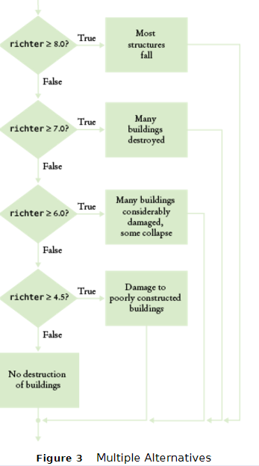
Flowchart for the Richter Scale Code

Slide 39
Multiple Alternatives (Richter Scale Code)
if (richter >= 8.0)
{
cout << "Most structures fall";
}
else if (richter >= 7.0)
{
cout << "Many buildings destroyed";
}
else if (richter >= 6.0)
{
cout << "Many buildings considerably damaged, some collapse";
}
else if (richter >= 4.5)
{
cout << "Damage to poorly constructed buildings";
}
else
{
cout << "No destruction of buildings";
}
. . .
Big C++ by Cay Horstmann
Copyright © 2018 by John Wiley & Sons. All rights reserved

Slide 40
Multiple Alternatives – Order of Tests
Because of this execution order, when using multiple if statements, pay attention to the order of the conditions.
Big C++ by Cay Horstmann
Copyright © 2018 by John Wiley & Sons. All rights reserved

Slide 41
Multiple Alternatives – Wrong Order of Tests
if (richter >= 4.5) // Tests in wrong order
{
cout << "Damage to poorly constructed buildings";
}
else if (richter >= 6.0)
{
cout << "Many buildings considerably damaged, some collapse";
}
else if (richter >= 7.0)
{
cout << "Many buildings destroyed";
}
else if (richter >= 8.0)
{
cout << "Most structures fall";
}
Suppose the value of richter is 7.1. Because we tested small first with a >=, the first statement is (wrongly) printed.
Big C++ by Cay Horstmann
Copyright © 2018 by John Wiley & Sons. All rights reserved

Slide 42
The switch Statement vs. the if statement
Below is a complicated if() statement to choose a text string to assign based on the value of an int variable:
int digit;
… //digit variable gets set here by some code
if (digit == 1) { digit_name = "one"; }
else if (digit == 2) { digit_name = "two"; }
else if (digit == 3) { digit_name = "three"; }
else if (digit == 4) { digit_name = "four"; }
else if (digit == 5) { digit_name = "five"; }
else if (digit == 6) { digit_name = "six"; }
else if (digit == 7) { digit_name = "seven"; }
else if (digit == 8) { digit_name = "eight"; }
else if (digit == 9) { digit_name = "nine"; }
else { digit_name = ""; }
Big C++ by Cay Horstmann
Copyright © 2018 by John Wiley & Sons. All rights reserved

Slide 43
The switch Statement
The switch statement is an alternative to nested if() else statements. But switch is at least as awkward to code as nested if() else:
int digit; //switch can only test int and char types
… //digit variable gets set here by some code
switch(digit)
{
case 1: digit_name = "one"; break;
case 2: digit_name = "two"; break;
case 3: digit_name = "three"; break;
case 4: digit_name = "four"; break;
case 5: digit_name = "five"; break;
case 6: digit_name = "six"; break;
case 7: digit_name = "seven"; break;
case 8: digit_name = "eight"; break;
case 9: digit_name = "nine"; break;
default: digit_name = ""; break; //taken if none of the above
}
Big C++ by Cay Horstmann
Copyright © 2018 by John Wiley & Sons. All rights reserved

Slide 44
break statements in the switch statement
Every branch of the switch must be terminated by a break statement. And each branch must terminate with a semicolon.
break tells the machine to skip down to the end of the switch statement, because a match was found.
If the break is missing, execution falls through to the next branch, and so on, until finally a break or the end of the switch is reached.
In practice, this fall-through behavior is rarely useful, and
it is a common cause of errors.
If you accidentally forget the break statement, your program compiles but executes unwanted code. Try it and see!
Big C++ by Cay Horstmann
Copyright © 2018 by John Wiley & Sons. All rights reserved

Slide 45
Topic 4
The if statement
Comparing numbers and strings
Multiple alternatives
Nested branches
Problem solving: flowcharts
Problem solving: test cases
Boolean variables and operators
Application: input validation
Chapter summary

Slide 46
Nested Branches – Taxes
In the United States different tax rates are used depending on the taxpayer’s marital status – single rates are higher.
Married taxpayers add their income together and pay taxes on the total. See the IRS table below from a recent year:
Table 4 Federal Tax Rate Schedule
If your status is Single and if the taxable income is | the tax is | of the amount over
at most $32,000 | 10% | $0
over $32,000 | $3,200 + 25% | $32,000
If your status is Married and if the taxable income is | the tax is | of the amount over
at most $64,000 | 10% | $0
over $64,000 | $6,400 + 25% | $64,000
Big C++ by Cay Horstmann
Copyright © 2018 by John Wiley & Sons. All rights reserved

Slide 47
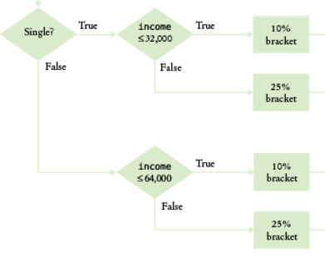
Flowchart for Tax Table Decisions

Slide 48
Nested Branches – Taxes – Complete Code part 1
#include <iostream>
#include <string>
using namespace std;
int main()
{
const double RATE1 = 0.10;
const double RATE2 = 0.25;
const double RATE1_SINGLE_LIMIT = 32000;
const double RATE1_MARRIED_LIMIT = 64000;
double tax1 = 0;
double tax2 = 0;
double income;
cout << "Please enter your income: ";
cin >> income;
cout << "Please enter s for single, m for married: ";
string marital_status;
cin >> marital_status;
Big C++ by Cay Horstmann
Copyright © 2018 by John Wiley & Sons. All rights reserved

Slide 49
Nested Branches – Taxes (Code part 2)
if (marital_status == "s")
{
if (income <= RATE1_SINGLE_LIMIT)
{
tax1 = RATE1 * income;
}
else
{
tax1 = RATE1 * RATE1_SINGLE_LIMIT;
tax2 = RATE2 * (income - RATE1_SINGLE_LIMIT);
}
}
else
Big C++ by Cay Horstmann
Copyright © 2018 by John Wiley & Sons. All rights reserved

Slide 50
Nested Branches – Taxes (Code part 3)
{
if (income <= RATE1_MARRIED_LIMIT)
{
tax1 = RATE1 * income;
}
else
{
tax1 = RATE1 * RATE1_MARRIED_LIMIT;
tax2 = RATE2 * (income - RATE1_MARRIED_LIMIT);
}
}
double total_tax = tax1 + tax2;
cout << "The tax is $" << total_tax << endl;
return 0;
}
Big C++ by Cay Horstmann
Copyright © 2018 by John Wiley & Sons. All rights reserved

Slide 51
Hand-Tracing
A very useful technique for understanding whether a program works correctly is called hand-tracing.
You simulate the program’s activity on a sheet of paper.
You can use this method with pseudocode or C++ code.
Big C++ by Cay Horstmann
Copyright © 2018 by John Wiley & Sons. All rights reserved

Slide 52
Hand-Tracing, How to
Looking at your pseudocode or C++ code,
Use a marker, such as a paper clip, (or toothpick from an olive) to mark the current statement.
“Execute” the statements one at a time.
Every time the value of a variable changes, cross out the old value, and write the new value below the old one.
Big C++ by Cay Horstmann
Copyright © 2018 by John Wiley & Sons. All rights reserved

Slide 53
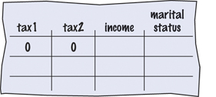
Hand-Tracing the Tax Program
int main()
{
const double RATE1 = 0.10;
const double RATE2 = 0.25;
const double RATE1_SINGLE_LIMIT = 32000;
const double RATE1_MARRIED_LIMIT = 64000;
double tax1 = 0;
double tax2 = 0;
Big C++ by Cay Horstmann
Copyright © 2018 by John Wiley & Sons. All rights reserved

Slide 54
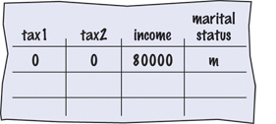
Hand-Tracing, Filling in the Trace Table
double income;
cout << "Please enter your income: ";
cin >> income;
Assume user typed 80000.
cout << "Please enter s for single, m for married: ";
string marital_status;
cin >> marital_status;
The user typed m
Big C++ by Cay Horstmann
Copyright © 2018 by John Wiley & Sons. All rights reserved

Slide 55
Hand-Tracing #2
if (marital_status == "s")
{
if (income <= RATE1_SINGLE_LIMIT)
{
tax1 = RATE1 * income;
}
else
{
tax1 = RATE1 * RATE1_SINGLE_LIMIT;
tax2 = RATE2 * (income - RATE1_SINGLE_LIMIT);
}
}
else //this branch is taken because marital_status != "s"
Big C++ by Cay Horstmann
Copyright © 2018 by John Wiley & Sons. All rights reserved

Slide 56
Hand-Tracing #3
else
{
if (income <= RATE1_MARRIED_LIMIT)
{
tax1 = RATE1 * income;
}
else
{
tax1 = RATE1 * RATE1_MARRIED_LIMIT;
tax2 = RATE2 * (income - RATE1_MARRIED_LIMIT);
}
}
double total_tax = tax1 + tax2;
Big C++ by Cay Horstmann
Copyright © 2018 by John Wiley & Sons. All rights reserved

Slide 57
Hand-Tracing #4
else
{
if (income <= 64000) //this branch is skipped, false
{
tax1 = RATE1 * income;
}
else //this branch is taken
{
tax1 = RATE1 * RATE1_MARRIED_LIMIT;
tax2 = RATE2 * (income - RATE1_MARRIED_LIMIT);
}
}
double total_tax = tax1 + tax2;
Big C++ by Cay Horstmann
Copyright © 2018 by John Wiley & Sons. All rights reserved

Slide 58
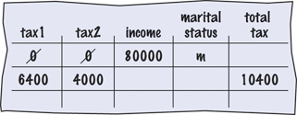
Hand-Tracing #5
else
{
if (income <= RATE1_MARRIED_LIMIT)
{
tax1 = RATE1 * income;
}
else //executed
{
tax1 = RATE1 * RATE1_MARRIED_LIMIT;
tax2 = RATE2 * (income - RATE1_MARRIED_LIMIT);
}
}
double total_tax = tax1 + tax2; //always executed
Big C++ by Cay Horstmann
Copyright © 2018 by John Wiley & Sons. All rights reserved

Slide 59
Topic 5
The if statement
Comparing numbers and strings
Multiple alternatives
Nested branches
Problem solving: flowcharts
Problem solving: test cases
Boolean variables and operators
Application: input validation
Chapter summary

Slide 60
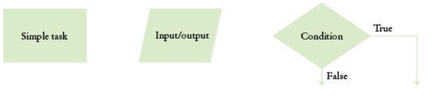
Creating Flowcharts
Drawing a flowchart can help you understand and code a decision problem
Though they can get too large in some cases, so use pseudocode if the flowchart grows too long.
Use the 3 standard flowchart boxes:
Rectangle = simple task
Parallelogram = input/output
Diamond = decision (or condition)
Label the lines out of the diamond with the true/false value
To avoid spaghetti code (overly complex branching)
Never point an arrow inside another branch

Slide 61
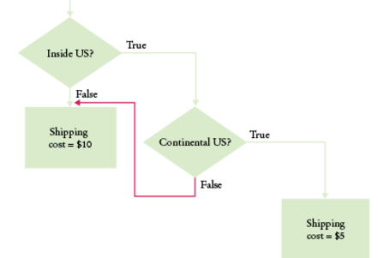
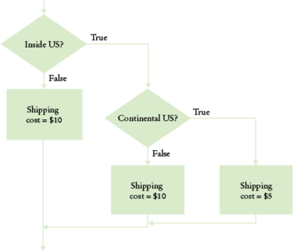
Don't Draw an Arrow to Another Branch Arrow
The version on the left shares the "shipping cost=$10" task box, but leads to complex code, which is not easily modified if say, the cost for one of the decisions changed.
Add the extra box and avoid the double branch (red arrow), as shown on the right.

Slide 62
Topic 6
The if statement
Comparing numbers and strings
Multiple alternatives
Nested branches
Problem solving: flowcharts
Problem solving: test cases
Boolean variables and operators
Application: input validation
Chapter summary

Slide 63
Prepare Test Cases Ahead of Time
To test your program, you cannot try out all possible inputs
If the program correctly computes one or two tax amounts in a given bracket, then we can assume it is correct.
You should also test on the boundary conditions, at the endpoints of each bracket
this tests the < vs. <= situations.
Big C++ by Cay Horstmann
Copyright © 2018 by John Wiley & Sons. All rights reserved

Slide 64
Test Cases, Boundary Values
Here are some possible test cases for the tax program:
Test Case Expected Output Comment
30,000 s 3,000 10% bracket
72,000 s 13,200 3,200 + 25% of 40,000
50,000 m 5,000 10% bracket
10,400 m 16,400 6,400 + 25% of 40,000
32,000 m 3,200 boundary case
0 s 0 boundary case
Big C++ by Cay Horstmann
Copyright © 2018 by John Wiley & Sons. All rights reserved

Slide 65
The Dangling else
When an if statement is nested inside another if statement, the following error may occur.
Can you find the problem with the following?
double shipping_charge = 5.00;
// $5 inside continental U.S.
if (country == "USA")
if (state == "HI")
shipping_charge = 10.00;
// Hawaii is more expensive
else // Pitfall!
shipping_charge = 20.00;
// As are foreign shipments
Big C++ by Cay Horstmann
Copyright © 2018 by John Wiley & Sons. All rights reserved

Slide 66
The Dangling else Problem
The indentation level seems to suggest that the else is grouped with the test country == "USA".
Unfortunately, that is not the case.
The compiler ignores all indentation and matches the else with the preceding if.
double shipping_charge = 5.00;
// $5 inside continental U.S.
if (country == "USA")
if (state == "HI")
shipping_charge = 10.00;
// Hawaii is more expensive
else // Pitfall!
shipping_charge = 20.00;
// As are foreign shipments
Big C++ by Cay Horstmann
Copyright © 2018 by John Wiley & Sons. All rights reserved

Slide 67
The Dangling else Problem – The Solution
So, is there a solution to the dangling else problem.
You can put one statement in a block, inside braces.
double shipping_charge = 5.00;
// $5 inside continental U.S.
if (country == "USA")
{
if (state == "HI")
shipping_charge = 10.00;
// Hawaii is more expensive
}
else
shipping_charge = 20.00;
// As are foreign shipments
Big C++ by Cay Horstmann
Copyright © 2018 by John Wiley & Sons. All rights reserved

Slide 68
Topic 7
The if statement
Comparing numbers and strings
Multiple alternatives
Nested branches
Problem solving: flowcharts
Problem solving: test cases
Boolean variables and operators
Application: input validation
Chapter summary

Slide 69
Boolean Variables and Operators
Sometimes you need to evaluate a logical condition in one part of a program and use it elsewhere.
To store a condition that can be true or false, you use a Boolean variable
Variables of type bool can hold exactly two values, false or true.
not strings.
not integers; they are special values, just for Boolean variables.
BUT actually false is zero, and any non-zero value is treated as true.
Big C++ by Cay Horstmann
Copyright © 2012 by John Wiley & Sons. All rights reserved

Slide 70
Boolean Variables
Here is a definition of a Boolean variable, initialized to false:
bool failed = false;
It can be set by an intervening statement so that you can use the value later in your program to make a decision:
// Only executed if failed has
// been set to true
if (failed)
{
...
}
Big C++ by Cay Horstmann
Copyright © 2018 by John Wiley & Sons. All rights reserved

Slide 71
Boolean Operators Motivation
Suppose you need to write a program that processes temperature values, and you want to test whether a given temperature corresponds to liquid water.
At sea level, water freezes at 0 degrees Celsius and boils at 100 degrees.
Water is liquid if the temperature is greater than zero and less than 100.
This not a simple test condition.
Big C++ by Cay Horstmann
Copyright © 2018 by John Wiley & Sons. All rights reserved

Slide 72
Boolean Operators
When you make complex decisions, you often need to combine Boolean values.
An operator that combines Boolean conditions is called a Boolean operator.
Boolean operators take one or two Boolean values or expressions and combine them into a resultant Boolean value.
Big C++ by Cay Horstmann
Copyright © 2018 by John Wiley & Sons. All rights reserved

Slide 73
The Boolean Operator && (and)
In C++, the && operator (called and) yields true only when both conditions are true.
if (temp > 0 && temp < 100)
{
cout << "Liquid";
}
If temp is within the range, then both the left-hand side and the right-hand side are true, making the whole expression’s value true.
In all other cases, the whole expression’s value is false.
Big C++ by Cay Horstmann
Copyright © 2018 by John Wiley & Sons. All rights reserved

Slide 74
The Boolean Operator || (or)
The || operator (called or) yields the result true if at least one of the conditions is true.
This is written as two adjacent vertical bar symbols.
if (temp <= 0 || temp >= 100)
{
cout << "Not liquid";
}
If either of the expressions is true, the whole expression is true.
The only way “Not liquid” won’t appear is if both of the expressions are false.
Big C++ by Cay Horstmann
Copyright © 2018 by John Wiley & Sons. All rights reserved

Slide 75
The Boolean Operator ! (not)
Sometimes you need to invert a condition with the logical not operator.
The ! operator takes a single condition and evaluates to true if that condition is false and to false if the condition is true.
if (!frozen) { cout << "Not frozen"; }
“Not frozen” will be written only when frozen contains the value false.
!false is true.
Big C++ by Cay Horstmann
Copyright © 2018 by John Wiley & Sons. All rights reserved

Slide 76
Boolean Operator Truth Tables
This information is traditionally collected into a table called a truth table, where A and B denote bool variables or Boolean expressions.
A | B | A && B |  | A | B | A || B |  | A | !A
true | true | true |  | true | true | true |  | true | false
true | false | false |  | true | false | true |  | false | true
false | true | false |  | false | true | true
false | false | false |  | false | false | false
Big C++ by Cay Horstmann
Copyright © 2018 by John Wiley & Sons. All rights reserved

Slide 77
Boolean Operator Examples: Table 6 (Part 1)
Table 6 Boolean Operators
Expression | Value | Comment
0 < 200 && 200 < 100 | false | Only the first condition is true. Note that the < operator has a higher precedence than the && operator.
0 < 200 || 200 < 100 | true | The first condition is true.
0 < 200 || 100 < 200 | true | The || is not a test for “either-or”. If both conditions are true, the result is true.
0 < 200 < 100 | true | Error: The expression 0 < 200 is true, which is converted to 1. The expression 1 < 100 is true. You never want to write such an expression; see Common Error 3.5.
Big C++ by Cay Horstmann
Copyright © 2018 by John Wiley & Sons. All rights reserved

Slide 78
Boolean Operator Examples: Table 6 (Part 2)
Expression | Value | Comment
-10 && 10 > 0 | true | Error: –10 is not zero. It is converted to true. You never want to write such an expression; see Common Error 3.5.
0<x && x<100 || x== -1 | (0<x && x<100) || x== -1 | The && operator has a higher precedence than the || operator.
!(0 < 200) | false | 0 < 200 is true, therefore its negation is false.
frozen == true | frozen | There is no need to compare a Boolean variable with true.
frozen == false | !frozen | It is clearer to use ! than to compare with false.
Big C++ by Cay Horstmann
Copyright © 2018 by John Wiley & Sons. All rights reserved

Slide 79
Common Error – Combining Multiple Relational Operators
Consider the expression
if(0 <= temp <= 100)…
This looks just like the mathematical test:
0 ≤ temp ≤ 100
Unfortunately, it is not. It will compile OK, but will not run the way you expect.
DO NOT USE THAT SYNTAX IN C++. INSTEAD, USE the Boolean && operator to combine two pair compares:
if(0 <= temp && temp <= 100)…
Big C++ by Cay Horstmann
Copyright © 2012 by John Wiley & Sons. All rights reserved

Slide 80
Combining Multiple Relational Operators
Another common error, along the same lines, is to write
if (x && y > 0) ... // Error
instead of
if (x > 0 && y > 0) ...
(x and y are ints)
Big C++ by Cay Horstmann
Copyright © 2018 by John Wiley & Sons. All rights reserved

Slide 81
Confusing && and || Conditions
It is quite common that the individual conditions are nicely set apart in a bulleted list, but with little indication of how they should be combined.
Our tax code is a good example of this.
Big C++ by Cay Horstmann
Copyright © 2018 by John Wiley & Sons. All rights reserved

Slide 82
Common Error – Confusing && and || Conditions
Consider these instructions for filing a tax return.
You are of single filing status if any one of the following is true:
You were never married.
You were legally separated or divorced on the last day of the tax year.
You were widowed, and did not remarry.
Is this an && or an || situation?
Since the test passes if any one of the conditions is true, you must combine the conditions with the or operator.
Big C++ by Cay Horstmann
Copyright © 2018 by John Wiley & Sons. All rights reserved

Slide 83
Confusing && and || Conditions, continued
Elsewhere, the same instructions:
You may use the status of married filing jointly if all five of the following conditions are true:
Your spouse died less than two years ago and you did not remarry.
You have a child whom you can claim as dependent.
That child lived in your home for all of the tax year.
You paid over half the cost of keeping up your home for this child.
You filed a joint return with your spouse the year he or she died.
&& or an ||?
Because all of the conditions must be true for the test to pass, you must combine them with an &&.
Big C++ by Cay Horstmann
Copyright © 2018 by John Wiley & Sons. All rights reserved

Slide 84
Short Circuit Evaluation
When does an expression become true or false?
expression && expression && expression && …
With &&’s, we can stop after finding the first false.
expression || expression || expression || …
With ||’s, we can stop after finding the first true.
This is called short circuit evaluation
Big C++ by Cay Horstmann
Copyright © 2018 by John Wiley & Sons. All rights reserved

Slide 85
DeMorgan’s Law
Suppose we want to charge a higher shipping rate if we don’t ship within the continental United States.
shipping_charge = 10.00;
if (!(country == "USA"
&& state != "AK"
&& state != "HI"))
shipping_charge = 20.00;
This test is a little bit complicated.
DeMorgan’s Law to the rescue!
Big C++ by Cay Horstmann
Copyright © 2018 by John Wiley & Sons. All rights reserved

Slide 86
DeMorgan’s Law, continued
DeMorgan’s Law allows us to rewrite complicated not/and/or messes so that they are more clearly read.
shipping_charge = 10.00;
if (country != "USA"
|| state == "AK"
|| state == "HI")
shipping_charge = 20.00;
Ah, much nicer.
But how did they do that?
Big C++ by Cay Horstmann
Copyright © 2018 by John Wiley & Sons. All rights reserved

Slide 87
DeMorgan’s Law Equivalencies
DeMorgan’s Law:
!(A && B) is the same as !A || !B
(change the && to || and negate all the terms)
!(A || B) is the same as !A && !B
(change the || to && and negate all the terms)
Big C++ by Cay Horstmann
Copyright © 2018 by John Wiley & Sons. All rights reserved

Slide 88
Simplification Examples: DeMorgan's, et al
Simplify the following logical conditions:
int n; bool b; //definition of variables
n < 5 || n == 5
n <= 5 && n != 5
n <= 5 && n >= 5
n <= 5 || n >= 5
!(n <= 5)
!!b
b == true
b == false

Slide 89
Topic 8
The if statement
Comparing numbers and strings
Multiple alternatives
Nested branches
Problem solving: flowcharts
Problem solving: test cases
Boolean variables and operators
Application: input validation
Chapter summary

Slide 90
Input Validation with if Statements
Let’s return to the elevator program to consider input validation.
Assume that the elevator panel has buttons labeled 1 through 20 (but not 13!).
Possible illegal inputs:
The number 13
Zero or a negative number
A number larger than 20
A value that is not a sequence of digits, such as five
In each of these cases, we will give an error message and exit the program.
Big C++ by Cay Horstmann
Copyright © 2018 by John Wiley & Sons. All rights reserved

Slide 91
Input Validation with if Statements: Code
It is simple to guard against an input of 13, or outside the range of floors:
if (floor == 13)
{
cout << "Error: "
<< " There is no thirteenth floor." << endl;
return 1;
}
if (floor <= 0 || floor > 20)
{
cout << "Error: "
<< " The floor must be between 1 and 20."
<< endl;
return 1;
}
Big C++ by Cay Horstmann
Copyright © 2018 by John Wiley & Sons. All rights reserved

Slide 92
Using return to exit the program upon Error
The statement:
return 1;
immediately exits the main function and therefore terminates the program.
It is a convention to return the value 0 if the program completes normally, and a non-zero value when an error is encountered.
Big C++ by Cay Horstmann
Copyright © 2018 by John Wiley & Sons. All rights reserved

Slide 93
Input Validation: cin.fail()
What if the user does not type a number in response to the prompt?
‘F’ ‘o’ ‘u’ ‘r’ is not an integer response.
When
cin >> floor;
is executed, and the user types in a bad input, the integer variable floor is not set.
Instead, the input stream cin is set to a failed state.
Big C++ by Cay Horstmann
Copyright © 2018 by John Wiley & Sons. All rights reserved

Slide 94
Example of cin.fail()
You can call the fail() member function to test for that failed state.
So you can test for bad user input this way:
if (cin.fail())
{
cout << "Error: Not an integer." << endl;
return 1;
}
In a later chapter, we will explain how to clear the failed state, so further input can be taken.
Big C++ by Cay Horstmann
Copyright © 2018 by John Wiley & Sons. All rights reserved

Slide 95
Input Validation with if Statements – Elevator Program
#include <iostream>
using namespace std;
int main()
{
int floor;
cout << "Floor: ";
cin >> floor;
// The following statements check various input errors
if (cin.fail())
{
cout << "Error: Not an integer." << endl;
return 1;
}
if (floor == 13)
{
cout << "Error: There is no thirteenth floor." << endl;
return 1;
}
if (floor <= 0 || floor > 20)
{
cout << "Error: The floor must be between 1 and 20." << endl;
return 1;
}
ch03/elevator2.cpp
Big C++ by Cay Horstmann
Copyright © 2018 by John Wiley & Sons. All rights reserved

Slide 96
Input Validation with if Statements – Elevator Program, Pt.2
// Now we know that the input is valid
int actual_floor;
if (floor > 13)
{
actual_floor = floor - 1;
}
else
{
actual_floor = floor;
}
cout << "The elevator will travel to the actual floor "
<< actual_floor << endl;
return 0;
}
Big C++ by Cay Horstmann
Copyright © 2018 by John Wiley & Sons. All rights reserved

Slide 97
Topic 9
The if statement
Comparing numbers and strings
Multiple alternatives
Nested branches
Problem solving: flowcharts
Problem solving: test cases
Boolean variables and operators
Application: input validation
Chapter summary

Slide 98
Chapter Summary Part #1
The if() statement implements a decision.
• The if() statement allows a program to carry out different actions depending on the nature of the data to be
processed.
Implement comparisons of numbers and objects.
• Relational operators (< <= > >= == !=) are used to compare
numbers and strings.
• Lexicographic order is used to compare strings.
"car" is less than "cart"
Complex decisions require multiple if()…else statements.
• Multiple alternatives are required for decisions that have
more than two cases.
• When using multiple if() statements, pay attention to the
order of the conditions.
Big C++ by Cay Horstmann
Copyright © 2018 by John Wiley & Sons. All rights reserved

Slide 99
Chapter Summary Part #2
Implement decisions whose branches require further
decisions.
• When a decision statement is contained inside the branch of
another decision statement, the statements are nested.
• Nested decisions are required for problems that have >=2 levels of decision making, such as the tax code.
Draw flowcharts to visualize control flow in a program.
• Flow charts are made up of elements for tasks, input/
outputs, and decisions.
• Each branch of a decision can contain tasks and further
decisions.
• Never point an arrow inside another branch.
Big C++ by Cay Horstmann
Copyright © 2018 by John Wiley & Sons. All rights reserved

Slide 100
Chapter Summary Part #3
Design test cases for your programs.
• Each branch of your program should be tested.
• Design test cases before implementing a program.
Use the bool data type to store and combine conditions
that can be true or false.
• C++ has two Boolean operators that combine conditions:
&& (and) and || (or).
• To invert a condition, use the ! (not) operator.
• The && and || operators use short-circuit evaluation:
As soon as the value is determined, no further
conditions are evaluated.
• Use De Morgan’s law to simplify combinations:
!(A && B) is the same as !A || !B
!(A || B) is the same as !A && !B
Big C++ by Cay Horstmann
Copyright © 2018 by John Wiley & Sons. All rights reserved

Slide 101
Chapter Summary Part #4
Apply if() statements to detect whether input is valid.
• When reading a value, check that it is within the required
range.
• Use the fail() function to test whether the input stream has
failed:
if (cin.fail())
{
cout << "Error: Not an integer." << endl;
return 1;
}
Big C++ by Cay Horstmann
Copyright © 2018 by John Wiley & Sons. All rights reserved

