Slide 1
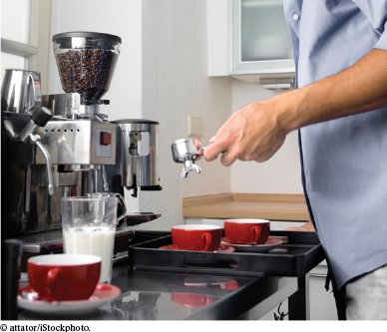
Chapter Five: Functions

Slide 2
Chapter Goals
To be able to implement functions
To become familiar with the concept of parameter passing
To appreciate the importance of function comments
To develop strategies for decomposing complex tasks into simpler ones
To be able to determine the scope of a variable
To recognize when to use value and reference parameters

Slide 3
Topic 1
Functions as black boxes
Implementing functions
Parameter passing
Return values
Functions without return values
Reusable functions
Stepwise refinement
Variable scope and globals
Reference parameters
Recursive functions

Slide 4
What Is a Function? Why Functions?
A function is a sequence of instructions with a name.
A function packages a computation into a form that can be easily understood and reused.

Slide 5
Calling a Function
A programmer calls a function to have its instructions run.
int main()
{
double z = pow(2, 3);
...
}
By using the expression: pow(2, 3) main calls the pow function, asking it to compute 2³.
The main function is temporarily suspended.
The instructions of the pow function execute and compute the result.
The pow function returns its result back to main, and the main function resumes execution.

Slide 6
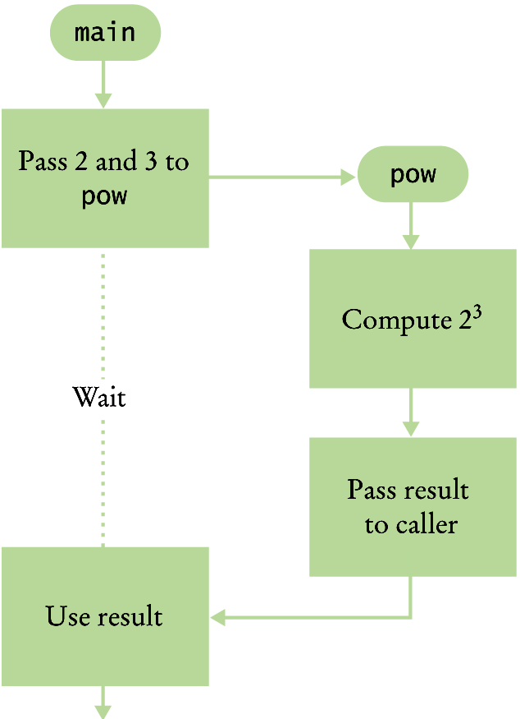
Flowchart: Calling a Function
Execution flow
during a
function call

Slide 7
Parameters
int main()
{
double z = pow(2, 3);
...
}
When another function calls the pow function, it provides “inputs”, such as the values 2 and 3 in the call pow(2, 3).
In order to avoid confusion with inputs that are provided by a human user (cin >>), these values are called parameter values.
The “output” that the pow function computes is called the return value (not output using <<).

Slide 8
An Output Statement Does Not Return a Value
output ≠ return
The return statement does not display output
Rather, it causes execution to resume in the calling program and ends the called function.
return may also pass a “value” back to the calling program
An output statement using << communicates only with the user running the program.

Slide 9
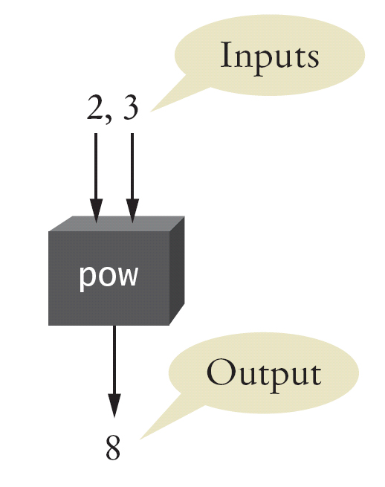
The Black Box Concept
You can think of a function as a “black box” where you can’t see what’s inside but you know what it does.
How did the pow function do its job?
You don’t need to know.
You only need to know its specification.

Slide 10
Topic 2
Functions as black boxes
Implementing functions
Parameter passing
Return values
Functions without return values
Reusable functions
Stepwise refinement
Variable scope and globals
Reference parameters
Recursive functions

Slide 11
Implementing Functions
Example: Calculate the volume of a cube
When writing this function, you need to:
• Pick a good, descriptive name for the function
• Give a type and a name for each parameter. There will be one parameter for each piece of information the function needs to do its job.
• Specify the type of the return type:
double cube_volume(double side_length)
Then write the body of the function, as statements enclosed in braces
{ }

Slide 12
cube_volume Function
The comments at the top are the standard Java format which you should follow for any function you write (even in C++). They can be processed by the Doxygen program to automatically generate documentation of your function libraries.
/**
Computes the volume of a cube.
@param side_length the side length of the cube
@return the volume
*/
double cube_volume(double side_length)
{
double volume = side_length * side_length * side_length;
return volume;
}

Slide 13
Test your Functions
You should always test the function.
You’ll write a main function to do this.
#include <iostream>
using namespace std;
/**
Computes the volume of a cube.
@param side_length the side length of the cube
@return the volume
*/
double cube_volume(double side_length)
{
double volume = side_length * side_length * side_length;
return volume;
}
ch05/cube.cpp

Slide 14
A Testbench Program (main)
int main()
{
double result1 = cube_volume(2);
double result2 = cube_volume(10);
cout << "A cube with side length 2 has volume "
<< result1 << endl;
cout << "A cube with side length 10 has volume "
<< result2 << endl;
return 0;
}

Slide 15
Topic 3
Functions as black boxes
Implementing functions
Parameter passing
Return values
Functions without return values
Reusable functions
Stepwise refinement
Variable scope and globals
Reference parameters
Recursive functions

Slide 16
Parameter Passing
When a function is called, a parameter variable is created for each value passed in.
Each parameter variable is initialized with the corresponding parameter value from the call.
int hours = read_value_between(1, 12);
. . .
int read_value_between(int low, int high)
1
12

Slide 17
Parameter Passing, cube_volume example
Here is a call to the cube_volume function:
double result1 = cube_volume(2);
Here is the function definition:
double cube_volume(double side_length)
{
double volume = side_length * side_length * side_length;
return volume;
}
We’ll keep up with their variables and parameters: result1 side_length volume

Slide 18
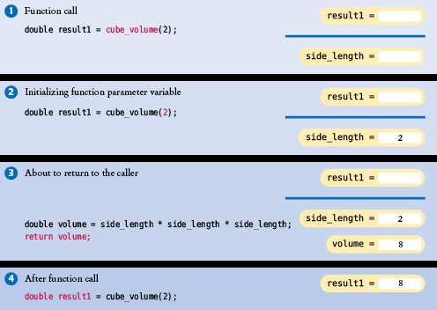
Parameter Passing
In the calling function (main), the variable result1 is declared. When the cube_volume function is called, the parameter variable side_length is created & initialized with the value that was passed in the call (2).
After the return statement, the local variables side_length and volume disappear from memory.

Slide 19
Topic 4
Functions as black boxes
Implementing functions
Parameter passing
Return values
Functions without return values
Reusable functions
Stepwise refinement
Variable scope and globals
Reference parameters
Recursive functions

Slide 20
Return Values
The return statement ends the function execution. This behavior can be used to handle unusual cases.
What should we do if the side length is negative?
We choose to return a zero and not do any calculation:
double cube_volume(double side_length)
{
if (side_length < 0) return 0;
double volume = side_length * side_length * side_length;
return volume;
}

Slide 21
Return Values: Shortcut
The return statement can return the value of any expression.
Instead of saving the return value in a variable and returning the variable, it is often possible to eliminate the variable and return a more complex expression:
double cube_volume(double side_length)
{
return side_length * side_length * side_length;
}

Slide 22
Common Error – Missing Return Value
Your function always needs to return something.
The code below calculates the cube only for a “reasonable” positive input, but consider what is returned if the call passes in a negative value!
You need to ensure all paths of execution include a return statement. So the code below needs an else with its own return after the if, to return perhaps a flag of -1.
double cube_volume(double side_length)
{
if (side_length >= 0)
{
return side_length * side_length * side_length; }
}

Slide 23
Function Declarations (Prototype Statements)
It is a compile-time error to call a function that the compiler does not know
just like using an undefined variable.
So define all functions before they are first used
But sometimes that is not possible, such as when 2 functions call each other
Therefore, some programmers prefer to include a definition, aka "prototype" for each function at the top of the program, and write the complete function after main(){}
A prototype is just the function header line followed by a semicolon:
double cube_volume(double side_length);
The variable names are optional, so you could also write it as: double cube_volume(double);

Slide 24
Function Declarations – Complete Program
#include <iostream>
using namespace std;
// Declaration of cube_volume
double cube_volume(double side_length);
int main()
{
double result1 = cube_volume(2); // Use of cube_volume
double result2 = cube_volume(10);
cout << "A cube with side length 2 has volume "<< result1<< endl;
cout << "A cube with side length 10 has volume "<< result2<< endl;
return 0;
}
// Definition of cube_volume
double cube_volume(double side_length)
{
return side_length * side_length * side_length;
}

Slide 25
Steps to Implementing a Function
Describe what the function should do.
EG: Compute the volume of a pyramid whose base is a square.
Determine the function’s “inputs”.
EG: height, base side length
Determine the types of the parameters and return value.
EG: double pyramid_volume(double height, double base_length)
Write pseudocode for obtaining the desired result.
volume = 1/3 x height x base length x base length
Implement the function body.
{ double base_area = base_length * base_length;
return height * base_area / 3;
}
Test your function
Write a main() to call it multiple times, including boundary cases

Slide 26
Complete Code for the Pyramid Function, with Testbench
#include <iostream>
using namespace std;
/** Computes the volume of a pyramid whose base is a square.
@param height the height of the pyramid
@param base_length length of one side of the pyramid’s base
@return the volume of the pyramid
*/
double pyramid_volume(double height, double base_length)
{
double base_area = base_length * base_length;
return height * base_area / 3;
}
int main()
{
cout << "Volume: " << pyramid_volume(9, 10) << endl;
cout << "Expected: 300";
cout << "Volume: " << pyramid_volume(0, 10) << endl;
cout << "Expected: 0";
return 0;
}

Slide 27
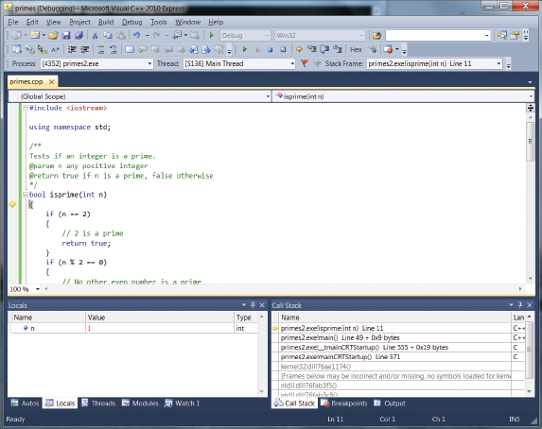
Using the IDE Debugger to Debug Functions
Your IDE includes a debugger that:
Allows execution of the program one statement at a time
Shows intermediate values of local function variables
Sets “breakpoints” to allow stopping the program at any line to examine variables
These features greatly speed your correcting your code.
Microsoft Visual Studio IDE / Debugger shown above, with next line to be executed shown by yellow arrow in the Breakpoint margin at left.

Slide 28
Using the IDE Debugger: Typical Session
Typical debug session:
Set a breakpoint early in the program, by clicking on a line in the source code
Start execution with the “Run” button
When the code stops at the breakpoint, examine variable values in the variables window
Step through the code one line at a time or one function at a time, continuing to compare variable values to what you expected
Determine the error in the code and correct it, then go to step 1.

Slide 29
Topic 5
Functions as black boxes
Implementing functions
Parameter passing
Return values
Functions without return values
Reusable functions
Stepwise refinement
Variable scope and globals
Reference parameters
Recursive functions

Slide 30
Functions Without Return Values
Consider the task of writing a string with the following format around it. Any string could be used.
For example, the string "Hello" would produce:
-------
!Hello!
-------

Slide 31
Functions Without Return Values – The void Type
This kind of function is called a void function.
void box_string(string str)
Use a return type of void to indicate that a function does not return a value.
void functions are used to simply do a sequence of instructions
– They do not return a value to the caller.

Slide 32
void Type Example
void box_string(string str)
{
int n = str.length();
for (int i = 0; i < n + 2; i++){ cout << "-"; }
cout << endl;
cout << "!" << str << "!" << endl;
for (int i = 0; i < n + 2; i++) { cout << "-"; }
cout << endl;
}
Note that this function doesn’t compute any value. It performs some actions and then returns to the caller – without returning a value. (The return occurs at the end of the block.)

Slide 33
Calling void Functions
Because there is no return value, you cannot use box_string in an expression.
You can make this call kind of call:
box_string("Hello");
but not this kind:
result = box_string("Hello");
// Error: box_string doesn’t
// return a result.

Slide 34
Early Return from a void Function
If you want to return from a void function before reaching the end, you use a return statement without a value. For example:
void box_string(string str)
{
int n = str.length();
if (n == 0) {
return;
}
. . . // None of the statements after this // in the box_string function
// will be executed
// Return immediately

Slide 35
Topic 6
Functions as black boxes
Implementing functions
Parameter passing
Return values
Functions without return values
Reusable functions
Stepwise refinement
Variable scope and globals
Reference parameters
Recursive functions

Slide 36
Designing Functions – Turn Repeated Code into Functions
When you found you have written nearly identical code multiple times,
you should write a function to replace the redundant code.

Slide 37
Repeated Code Example
Consider how similar the following statements are:
int hours;
do
{
cout << "Enter a value between 0 and 23:";
cin >> hours;
} while (hours < 0 || hours > 23);
int minutes;
do
{
cout << "Enter a value between 0 and 59: ";
cin >> minutes;
} while (minutes < 0 || minutes > 59);

Slide 38
Turn Repeated Code into Functions
Move the common behavior into one function.
int read_int_up_to(int high)
{
int input;
do
{
cout << "Enter a value between "
<< "0 and " << high << ": ";
cin >> input;
} while (input < 0 || input > high);
return input;
}

Slide 39
Function Calls That Replace Repeated Code
Then we can use this function as many times as we need:
int hours = read_int_up_to(23);
int minutes = read_int_up_to(59);
Note how the code has become much easier to understand.
And we are not rewriting code
– code reuse!

Slide 40
Topic 7
Functions as black boxes
Implementing functions
Parameter passing
Return values
Functions without return values
Reusable functions
Stepwise refinement
Variable scope and globals
Reference parameters
Recursive functions

Slide 41
Stepwise Refinement
One of the most powerful strategies for problem solving is the process of stepwise refinement.
To solve a difficult task, break it down into simpler tasks.
Then keep breaking down the simpler tasks into even simpler ones, until you are left with tasks that you know how to solve.

Slide 42
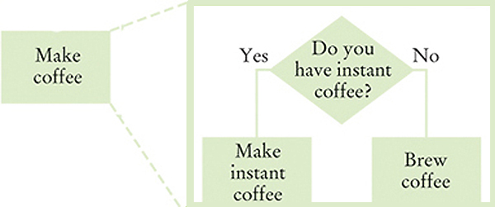
Stepwise Refinement Example: Coffee Making
The “make coffee” problem can be broken into: if we have instant coffee, we can make that but if not, we can brew coffee (maybe these will have parts)

Slide 43
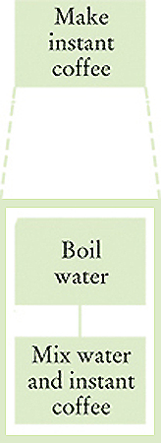
Stepwise Refinement #2
Making instant coffee breaks into: 1. Boil Water
2. Mix (stir if you wish) (Do these have sub-problems?)

Slide 44
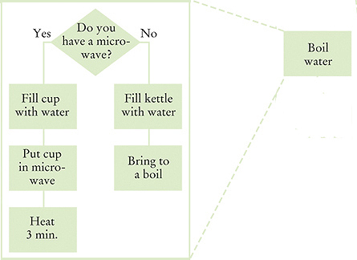
Stepwise Refinement #3
Boiling water appears not to be so easy. Many steps, but none have sub-steps.

Slide 45
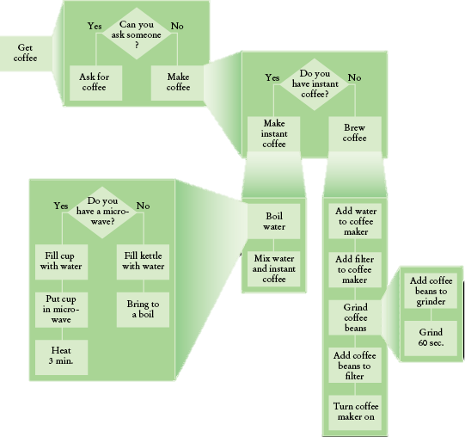
Stepwise Refinement – The Complete Process Shown
To write the “get coffee” program, write functions for each sub-problem.

Slide 46
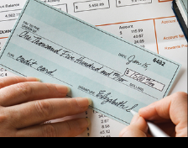
Stepwise Refinement Example #2: Paycheck Printing
We will write a program to take a dollar amount as a int input and produce the text equivalent of the $$ amount, to print the English amount line on a check.

Slide 47
Sub Problem #1: int to text 0…9
Of course we will write a function to solve this sub-problem.
/**
Turns a number into its English name.
@param number a positive integer < 1,000
@return the name of number (e.g., "two hundred seventy four")
*/
string int_name(int number)
Notice that we started by writing only the comment and the first line of the function. Also notice that the constraint of < $1,000 is announced in the comment.

Slide 48
Stepwise Refinement
If the number is between 1 and 9, we need to compute "one" … "nine".
In fact, we need the same computation again for the hundreds (“two” hundred).
Any time you need to do something more than once, turn that task into a function:
/**
Turns a digit into its English name.
@param digit an integer between 1 and 9
@return the name of digit (“one”...nine”)
*/
string digit_name(int digit)

Slide 49
Stepwise Refinement: Another Function for Teens
Numbers between 10 and 19 are special cases.
Let’s have a separate function teen_name that converts them into strings "eleven", "twelve", "thirteen", and so on:
/**
Turns a number between 10 and 19 into its English name.
@param number an integer between 10 and 19
@return the name of the number (“ten” ... “nineteen”)
*/
string teen_name(int number)

Slide 50
Stepwise Refinement: Add a Function for Tens
Next, suppose that the number is between 20 and 99. Then we show the tens as "twenty", "thirty", …, "ninety". For simplicity and consistency, put that computation into a separate function:
/**
Gives the name of the tens part of a number between 20 and 99.
@param number an integer between 20 and 99
@return the name of the tens part of the number ("twenty"..."ninety")
*/
string tens_name(int number))

Slide 51
Stepwise Refinement: Hundreds
Now suppose the number is at least 20 and at most 99.
If the number is evenly divisible by 10, we use tens_name, and we are done.
Otherwise, we print the tens with tens_name and the ones with digit_name.
If the number is between 100 and 999,
then we show a digit, the word "hundred", and the remainder as described previously.

Slide 52
Stepwise Refinement – The Pseudocode
part = number (The part that still needs to be converted)
name = "" (The name of the number starts as the empty string)
If part >= 100
name = name of hundreds in part + " hundred"
Remove hundreds from part
If part >= 20
Append tens_name(part) to name
Remove tens from part.
Else if part >= 10
Append teen_name(part) to name
part = 0
If (part > 0)
Append digit_name(part) to name.

Slide 53
Stepwise Refinement – Analyzing the Pseudocode
This pseudocode has a number of important improvements over the descriptions and comments.
It shows how to arrange the order of the tests, starting with the comparisons against the larger numbers
It shows how the smaller number is subsequently processed in further if statements.
On the other hand, this pseudocode is vague about:
The actual conversion of the pieces, just referring to “name of hundreds” and the like.
Spaces—it would produce strings with no spaces: “twohundredseventyfour”

Slide 54
Stepwise Refinement – Pseudocode to C++
Now for the real code. The last three cases are easy so let’s start with them:
if (part >= 20)
{
name = name + " " + tens_name(part);
part = part % 10;
}
else if (part >= 10)
{
name = name + " " + teen_name(part);
part = 0;
}
if (part > 0)
{
name = name + " " + digit_name(part);
}

Slide 55
Stepwise Refinement – Pseudocode to C++ (part 2)
Finally, the case of numbers between 100 and 999. Because part < 1000, part / 100 is a single digit, and we obtain its name by calling digit_name. Then we add the “hundred” suffix:
if (part >= 100)
{
name = digit_name(part / 100) + " hundred";
part = part % 100;
}

Slide 56
The Complete Code for the Check Printer (part 1)
// ch05/intname.cpp
#include <iostream>
#include <string>
using namespace std;
/**
Turns a digit into its English name.
@param digit an integer between 1 and 9
@return the name of digit ("one" ... "nine")
*/
string digit_name(int digit)
{
if (digit == 1) return "one";
if (digit == 2) return "two";
if (digit == 3) return "three";
if (digit == 4) return "four";
if (digit == 5) return "five";
if (digit == 6) return "six";
if (digit == 7) return "seven";
if (digit == 8) return "eight";
if (digit == 9) return "nine";
return "";
}

Slide 57
The Complete Code for the Check Printer (part 2)
/**
Turns a number between 10 and 19 into its English name.
@param number an integer between 10 and 19
@return the name of the given number ("ten" ... "nineteen")
*/
string teens_name(int number)
{
if (number == 10) return "ten";
if (number == 11) return "eleven";
if (number == 12) return "twelve";
if (number == 13) return "thirteen";
if (number == 14) return "fourteen";
if (number == 15) return "fifteen";
if (number == 16) return "sixteen";
if (number == 17) return "seventeen";
if (number == 18) return "eighteen";
if (number == 19) return "nineteen";
return "";
}

Slide 58
The Complete Code for the Check Printer (part 3)
/**
Gives the name of the tens part of a number between 20 and 99.
@param number an integer between 20 and 99
@return the name of the tens part of the number ("twenty" ... "ninety")
*/
string tens_name(int number)
{
if (number >= 90) return "ninety";
if (number >= 80) return "eighty";
if (number >= 70) return "seventy";
if (number >= 60) return "sixty";
if (number >= 50) return "fifty";
if (number >= 40) return "forty";
if (number >= 30) return "thirty";
if (number >= 20) return "twenty";
return "";
}

Slide 59
The Complete Code for the Check Printer (part 4)
/**
Turns a number into its English name.
@param number a positive integer < 1,000
@return the name of the number (e.g. "two hundred seventy four")
*/
string int_name(int number)
{
int part = number; // The part that still needs to be converted
string name; // The return value
if (part >= 100)
{
name = digit_name(part / 100) + " hundred";
part = part % 100;
}
if (part >= 20)
{
name = name + " " + tens_name(part);
part = part % 10;
}

Slide 60
The Complete Code for the Check Printer (part 5)
else if (part >= 10)
{
name = name + " " + teens_name(part);
part = 0;
}
if (part > 0)
{
name = name + " " + digit_name(part);
}
return name;
}
int main()
{
cout << "Please enter a positive integer: ";
int input;
cin >> input;
cout << int_name(input) << endl;
return 0;
}

Slide 61
Good Design – Keep Functions Short
There is a certain cost for writing a function:
You need to design, code, and test the function.
The function needs to be documented.
You need to spend some effort to make the function reusable rather than tied to a specific context.
So it’s tempting to write long functions to minimize their number and the overhead
BUT as a rule of thumb, a function that is too long to fit on a single screen should be broken up.
into other functions
Long functions are hard to understand and to debug

Slide 62
Tracing Functions
When you design a complex set of functions, it is a good idea to carry out a manual walkthrough before entrusting your program to the computer.
This process is called tracing your code.
You should trace each of your functions separately.

Slide 63
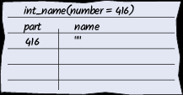
Tracing Functions: Example with int_name function
Here is the call: … int_name(416) …
string int_name(int number)
{
int part = number; // The part that still needs
// to be converted
string name; // The return value, initially ""
Take an index card and write the name of the function and the names and values of the parameter variables, plus a table to show variable values at each step:

Slide 64
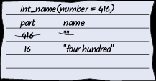
Tracing Functions: Midway Through
name has changed to
name + " " + digit_name(part / 100) + "hundred“
which is the string "four hundred",
part has changed to part % 100, or 16.
Cross out the old values and write the new ones.

Slide 65
Tracing Functions: Add a new Card for Each Function Called
If digit_name’s parameter had been complicated, you would have started another sheet of paper to trace that function call.
Your work table will probably be covered with sheets of paper (or envelopes) by the time you are done tracing!

Slide 66
Tracing Functions: An Error Found
Why is part set to 0?
if (part >= 20)…
else if (part >= 10) {
name = name + " " + teens_name(part);
part = 0;
}
if (part > 0)
{
name = name + " " + digit_name(part);
}
After the if-else statement ends, name is complete. The test in the following if statement needs to be “fixed” so that part of the code will not be executed
- nothing should be added to name.

Slide 67
Stubs
When writing a larger program, don’t try to implement and test all functions at once.
Temporarily implement the functions yet to be written as trivial “stubs”
A stub is a function that returns a simple value that is sufficient for testing another function.
It might also write a debug message on the screen to help you see the order of execution.

Slide 68
Stub Examples
Here are examples of stub functions.
/**
Turns a digit into its English name.
@param digit an integer between 1 and 9
@return the name of digit (“one” ... “nine”)
*/
string digit_name(int digit)
{
return "mumble";
}
/**
Gives the name of the tens part of a number between 20 and 99.
@param number an integer between 20 and 99
@return the tens name of the number (“twenty” ... “ninety”)
*/
string tens_name(int number)
{
return "mumblety";
}

Slide 69
Stub Execution
If you combine these stubs with the completely written int_name function and run the program testing with the value 274, this will the result:
Please enter a positive integer: 274
mumble hundred mumblety mumble
which shows that the basic logic of the int_name function is working correctly.
Now that you have tested int_name, you would “unstubify” another stub function, then another...

Slide 70
Topic 8
Functions as black boxes
Implementing functions
Parameter passing
Return values
Functions without return values
Reusable functions
Stepwise refinement
Variable scope and globals
Reference parameters
Recursive functions

Slide 71
Variable Scope
You can only have one main function but you can have as many variables and parameters spread amongst as many functions as you need.
Can different variables have the same name in different functions?
YES! (though it is a bad practice to intentionally do so)
How does the compiler keep track of variables of the same name?
By analyzing their SCOPE

Slide 72
Variable Scope is Limited to the Code Block
A variable or parameter that is defined within a function or other statement is visible from the point at which it is defined until the end of the block.
Ie, from the first appearance of the variable until the next closing curly brace ( or the end of the statement).
This area is called the scope of the variable.

Slide 73
Variable Scopes Don’t Overlap
The scope of a variable is the part of the program in which it is visible.
Because scopes do not overlap, a name in one scope cannot conflict with any name in another scope.
A name in one scope is “invisible” in another scope

Slide 74
Variable Scope Example
double cube_volume(double side_len)
{
double volume = side_len * side_len * side_len;
return volume; //this volume is local to this function
// and it disappears at the completion of the return
}
int main()
{
double volume = cube_volume(2);
cout << volume << endl;
return 0;
}
Each volume variable is defined in a separate function.
Coincidentally in this code, the 2 variables have the same value (8), but that is not usually the case with variables of the same name in different scopes.

Slide 75
Variable Scope and Blocks
Variables defined inside a block are local to that block, and have no meaning outside the {} of the block.
Example:
for(int i=0; i<5; i++)
cout << i << endl;
// “i“ exists only until the closing ; of the for() statement
A function names a block.
Recall that variables and parameters do not exist after the function is over—because they are local to that block.

Slide 76
Variable Scope Errors
It is not legal to define two variables or parameters with the same name in the same scope.
For example,
int test(double volume)
{
double volume = cube_volume(2); //ERROR
double volume = cube_volume(10); //ERROR
// ERROR: cannot define another volume variable
// ERROR: or variable with same name as input
// parameter in the same scope
...
}

Slide 77
Variable Scope – Nested Blocks
However, you can define another variable with the same name in a nested block.
double withdraw(double balance, double amount)
{
if (...)
{
double amount = 10; ...
}
...
}
a variable named amount local to the if’s block
– and a parameter variable named amount.
But this is a confusing construct, and is discouraged.

Slide 78
Global Variables
A global variable is one that is defined outside of any function, and thus is visible to all functions
All the variables we have used so far are called “local”
Generally, global variables are not a good idea
Because they are seen by all functions, determining which functions are interacting by changing them becomes tricky when debugging
Some situations require global variables, such as a shared time-of-day clock in an embedded control system

Slide 79
Global Variable Example
int balance = 10000; // A global variable
void withdraw(double amount)
{
if (balance >= amount)
{
balance = balance - amount;
}
}
int main()
{
withdraw(1000);
cout << balance << endl;
return 0;
}

Slide 80
Global Variable Pitfalls
In the previous program there is only one function that updates the balance variable.
But there could be many, many, many functions that might need to update balance each written by any one of a huge number of programmers in a large company.
Then we would have a problem.

Slide 81
Avoiding the Global Variable
//A better way to code the previous banking example,
// eliminating the global variable
// Function returns new balance after a withdrawal
double withdraw(double balance, double amount)
{
return balance - amount;
//negative balance will indicate overdraft
}
int main()
{
int balance = 10000; // local variable
balance = withdraw(balance, 1000);
cout << “Balance = “ << balance << endl;
return 0;
}

Slide 82
Self-Check: Global Variable Example #2
What does this program print? (Answer: 4 16)
#include <iostream>
using namespace std;
int p;
int contribute(int f)
{
if (f != 0) { p = p * f; }
return p;
}
int main()
{
int n = 2;
p = n;
n = contribute(n);
contribute(p);
cout << n << " " << p << endl;
return 0;
}
As you can see, the global variable p makes it difficult to follow the program flow.

Slide 83
Topic 9
Functions as black boxes
Implementing functions
Parameter passing
Return values
Functions without return values
Reusable functions
Stepwise refinement
Variable scope and globals
Reference parameters
Recursive functions

Slide 84
Reference Parameters: Motivation
Suppose you would like a function to get the user’s last name and ID number.
The variables for this data are in your scope.
But you want the function to change them for you.
If you want to write a function that changes the value of a parameter, you must use a reference parameter.

Slide 85
Reference Parameter Example
Consider a function that simulates withdrawing a given amount of money from a bank account, provided that sufficient funds are available.
If the amount of money is insufficient, a $10 penalty is deducted instead.
The function would be used as follows:
double harrys_account = 1000;
withdraw(harrys_account, 100);
// Now harrys_account is 900
withdraw(harrys_account, 1000);
// Insufficient funds.
// Now harrys_account is 890

Slide 86
The Function without Reference Parameters Can’t Do It
Here is a first attempt:
void withdraw(double balance, double amount)
{
const double PENALTY = 10;
if (balance >= amount)
{
balance = balance - amount;
}
else
{
balance = balance - PENALTY;
}
}
But this doesn’t work, because a function cannot modify its input parameter value in the calling program.

Slide 87
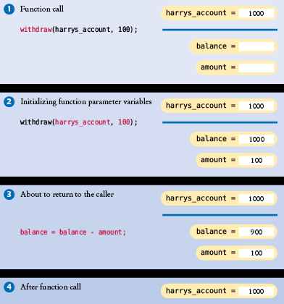
Withdraw Function Parameter
balance is a “value” parameter
as all C++ function parameters are by default.
A COPY of the value of the main program’s variable is provided to the function, not the location of the variable itself. Thus withdraw changes its local balance but that does not effect the value of the variable harrys_account in the scope of main
Even if the variables had the same name, still the copy in main would not be changed by the call.

Slide 88
Reference Parameters Provide the Solution
A reference parameter, indicated by &, “refers” to a variable that is supplied in a function call.
“refers” means that during the execution of the function, the reference parameter name is another name for the caller’s variable. This is how a function can change non-local variables: changes to its reference parameters actually are changes to the variable in the calling function.
A reference parameter is actually the memory address of the caller’s variable.

Slide 89
Reference Parameter Function Header: &
To indicate a reference parameter, you place an & after the type name.
To indicate a value parameter, you do not place an & after the type name.
void withdraw(double& balance, double amount)

Slide 90
Reference Parameter: Function Code
Here is correct code, using reference parameters:
void withdraw(double& balance, double amount)
{
const int PENALTY = 10;
if (balance >= amount)
{
balance = balance - amount;
}
else
{
balance = balance - PENALTY;
}
}
Let’s see this in action.

Slide 91
Reference Parameter: Testbench Code
int main()
{
double harrys_account = 1000;
double sallys_account = 500;
withdraw(harrys_account, 100);
// Now harrys_account is 900
withdraw(harrys_account, 1000); // Insufficient funds
// Now harrys_account is 890
withdraw(sallys_account, 150);
cout << "Harry's account: " << harrys_account << endl;
cout << "Sally's account: " << sallys_account << endl;
return 0;
}

Slide 92
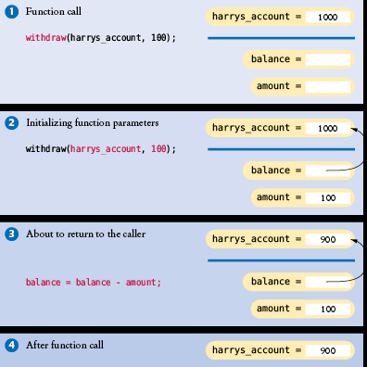
Diagram of Variable Values with Reference Parameter
void withdraw(double& balance, double amount)
With balance as a reference parameter, the withdraw function changes the value of harrys_account in the main program.
The type double& is pronounced:
reference to double or
double ref

Slide 93
Reference Parameter Arguments Must be Variables
A reference parameter must always be called with a variable.
It would be an error to supply a number:
withdraw(1000, 500); // Error: reference parameter must be a variable
The reason is clear—the function modifies the reference parameter, but it is impossible to change the value of a number.
For the same reason, you cannot supply an expression:
withdraw(harrys_account + 150, 500); //Error

Slide 94
Prefer Return Values to Reference Parameters
Some programmers use reference parameters as a mechanism for setting the result of a function.
For example:
void cube_volume(double side_length, double& volume)
{
volume = side_length * side_length * side_length;
}
However, this function is less convenient than our previous cube_volume function.

Slide 95
Why We Prefer Return Values to Reference Parameters
void cube_volume(double side_length, double& volume)
{
volume = side_length * side_length * side_length;
}
This function cannot be used in expressions such as:
cout << cube_volume(2)

Slide 96
But You Can “Return” Multiple Values via References
The return statement can return only one value.
If caller wants more than two values, then the only way to do this is with reference parameters (one for each wanted value).
For example:
void powers(double x, double& square, double& cube)
{
square = x * x;
cube = square * x;
}

Slide 97
Constant References
It is not very efficient to have a value parameter that is a large object (such as a string value).
Copying the object into a parameter variable is less efficient than using a reference parameter.
With a reference parameter, only the location of the variable, not its value, needs to be transmitted to the function.

Slide 98
Constant Reference Example
You can instruct the compiler to give you the efficiency of a reference parameter and the meaning of a value parameter, by using a constant reference:
void shout(const string& str)
{
cout << str << "!!!" << endl;
}
This is more efficient than
having str be a value parameter.

Slide 99
Topic 10
Functions as black boxes
Implementing functions
Parameter passing
Return values
Functions without return values
Reusable functions
Stepwise refinement
Variable scope and globals
Reference parameters
Recursive functions

Slide 100
Recursive Functions
A recursive function is a function that calls itself.
Recursion may provide a simpler implementation than a function that iterates (loops) to calculate an answer
By calling itself (and the new copy calling itself), multiple iterations are automatically created and handled by the computer hardware’s function-call-stack mechanism
For example, to print a text triangle:
[]
[][]
[][][]
[][][][]
Using a function we’ll define as:
void print_triangle(int side_length

Slide 101
Recursive Function Example
[]
[][]
[][][]
[][][][]
The function call would be:
print_triangle(4);
Pseudocode of a recursive version, for an arbitrary side length:
If side length < 1, return.
Else, call print_triangle with side length = side length -1.
Then print a line consisting of side length [] symbols

Slide 102
Recursive Function C++ Code
void print_triangle(int side_length)
{
if (side_length < 1) { return; }
print_triangle(side_length - 1);
for (int i = 0; i < side_length; i++)
{
cout << "[]";
}
cout << endl;
}
A recursive function works by calling itself with successively simpler input values

Slide 103
Recursive Function Rules
Two requirements ensure that the recursion is successful:
Every recursive call must simplify the task in some way.
There must be special cases to handle the simplest tasks directly.
The print_triangle function calls itself again with smaller and smaller side lengths. Eventually the side length must reach 0, and the function stops calling itself.

Slide 104
Tracing the Calls to the Recursive Function
The call print_triangle(4) calls print_triangle(3).
The call print_triangle(3) calls print_triangle(2).
The call print_triangle(2) calls print_triangle(1).
The call print_triangle(1) calls print_triangle(0).
The call print_triangle(0) returns, doing nothing.
The call print_triangle(1) prints [].
The call print_triangle(2) prints [][].
The call print_triangle(3) prints [][][].
The call print_triangle(4) prints [][][][].

Slide 105
How to Think Recursively
Just focus on reducing the problem to a simpler one with a call to the same function with smaller inputs
And include the exit case with no additional call, when the input reaches the limit, so that the recursion eventually stops
Example: summing the digits of an int input such as 1729:
Break the input into parts that can themselves be inputs to the problem
Save & remove the last digit and re-call with the remaining digits as input
Save it with %10 and remove it with /10.
2. Combine the solutions with simpler inputs into a solution of the original problem.
Total that saved digit plus the return from the call
Return the total
3. Find solutions to the simplest inputs (the stopping points).
Terminate recursion when input=0
4. Combine the simple cases and the reduction step.

Slide 106
How to Think Recursively: the Code and a Trace
int digit_sum(int n)
{
// Special case for terminating the recursion
if (n == 0) { return 0; }
// General case
return digit_sum(n / 10) + n % 10;
}
The call digit_sum(1729) calls digit_sum(172).
The call digit_sum(172) calls digit_sum(17).
The call digit_sum(17) calls digit_sum(1).
The call digit_sum(1) calls digit_sum(0).
The call digit_sum(0) returns 0.
The call digit_sum(1) returns 1.
The call digit_sum(17) returns 1+7 = 8
The call digit_sum(172) returns 8+2 = 10
The call digit_sum(1729) resumes and returns 10+9 = 19.

Slide 107
CHAPTER SUMMARY (Part 1)
Understand functions, arguments, and return values.
A function is a named sequence of instructions.
Arguments are supplied when a function is called.
The return value is the result that the function computes.
Be able to implement functions.
When defining a function, you provide a name for the function, a variable for each argument, and a type for the result.
Function comments explain the purpose of the function, the meaning of the parameter variables and return value, as well as any special requirements.
Describe the process of parameter passing.
Parameter variables hold the argument values supplied in the function call.
Describe the process of returning a value from a function.
The return statement terminates a function call and yields the function result.

Slide 108
CHAPTER SUMMARY (Part 2)
Design and implement functions without return values.
Use a return type of void to indicate that a function does not return a value.
Develop functions that can be reused for multiple problems.
Eliminate replicated code or pseudocode by defining a function.
Design your functions to be reusable. Supply parameter variables with values that can vary when the function is reused.
Apply the design principle of stepwise refinement.
Decompose complex tasks into simpler ones.
When you discover that you need a function, write a description of the parameter variables and return values.
A function may require simpler functions to carry out its work.

Slide 109
CHAPTER SUMMARY (Part 3)
Determine the scope of variables in a program.
The scope of a variable is the part of the program in which it is visible.
A variable in a nested block shadows a variable with the same name in an outer block.
A local variable is defined inside a function. A global variable is defined outside a function.
Avoid global variables in your programs.
Describe how reference parameters work.
Modifying a value parameter has no effect on the caller.
A reference parameter refers to a variable that is supplied in a function call.
Modifying a reference parameter updates the variable that was supplied in the call.
Understand recursive function calls and implement recursive functions.
A recursive computation solves a problem by using the solution of the same problem with simpler inputs.
For a recursion to terminate, there must be special cases for the simplest inputs.
The key to finding a recursive solution is reducing the input to a simpler input for the same problem.
When designing a recursive solution, do not worry about multiple nested calls. Simply focus on reducing a problem to a slightly simpler one.

