Slide 1

Chapter Six: Arrays and Vectors
Slides by Evan Gallagher

Slide 2
Chapter Goals
To become familiar with using arrays and vectors to collect values
To learn about common algorithms for processing arrays and vectors
To write functions that receive and return arrays and vectors
To be able to use two-dimensional arrays

Slide 3
Topic 1
Arrays
Common array algorithms
Arrays / functions
Problem solving: adapting algorithms
Problem solving: discovering algorithms
2D arrays
Vectors
Chapter Summary

Slide 4
Using Vectors
When you need to work with a large number of values – all together, the vector construct is your best choice.
By using a vector you
can conveniently manage collections of data
do not worry about the details of how they are stored
do not worry about how many are in the vector
a vector automatically grows to any desired size

Slide 5
Using Arrays
Arrays are a lower-level construct
The array is
less convenient
but sometimes required
for efficiency
for compatibility with older software

Slide 6
Using Arrays and Vectors
In both vectors and arrays, the stored data is of the same type
Think of a sequence of data:
32 54 67.5 29 35 80 115 44.5 100 65
(all of the same type, of course)
(storable as doubles)

Slide 7
Example Task with Several Numbers
32 54 67.5 29 35 80 115 44.5 100 65
Which is the largest in this set?
(You must look at every single value to decide.)

Slide 8
Problem: Each Number as a Separate Variable Name
32 54 67.5 29 35 80 115 44.5 100 65
So you would create a variable for each,
of course!
int n1, n2, n3, n4, n5, n6, n7, n8, n9, n10;
Then what ???

Slide 9
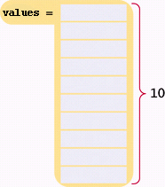
Using Arrays and Vectors
You can easily visit each element in an array or in a vector,
checking and updating a variable holding the current maximum
Arrays store data with a single name and a subscript, like in math vectors.
We can declare an array as:
double values[10];
An “array of double”
Ten elements of double type stored under one name as an array.

Slide 10
Defining Arrays with Initialization
When you define an array, you can specify the initial values:
double values[] = { 32, 54, 67.5, 29, 35, 80, 115, 44.5, 100, 65 };
32.0
54.0
67.5
29.0
35.0
80.0
115.0
44.5
100.0
65.0

Slide 11
Array Syntax Examples: Table 1
int numbers[10]; | An array of ten integers.
const int SIZE = 10; int numbers[SIZE]; | It is a good idea to use a named constant for the size.
int size = 10; int numbers[size]; | Caution: the size must be a constant. This code will not work with all compilers.
int squares[5] = { 0, 1, 4, 9, 16 }; | An array of five integers, with initial values.
int squares[] = { 0, 1, 4, 9, 16 }; | You can omit the array size if you supply initial values. The size is set to the number of initial values.
int squares[5] = { 0, 1, 4 }; | If you supply fewer initial values than the size, the remaining values are set to 0. This array contains 0, 1, 4, 0, 0.
string names[3]; | An array of three strings.

Slide 12
Accessing an Array Element
An array element can be used like any variable.
To access an array element, you use the notation:
values[i]
where i is the index.
The first element in the array is at index i=0, NOT at i=1.

Slide 13
Array Element Index
To access the element at index 4 using this notation: values[4]
4 is the index.
double values[10];
...
cout << values[4] << endl;
The output will be 35.0.
(Again because the first subscript
is 0, the output for index=4 is the 5th
element)
32.0
54.0
67.5
29.0
35.0
80.0
115.0
44.5
100.0
65.0

Slide 14
Array Element Index for Writing
The same notation can be used to change the element.
values[4] = 17.7;

Slide 15
Array Element Indices are between 0 and Length-1
That is, the legal elements for the values array are:
values[0], the first element
values[1], the second element
values[2], the third element
values[3], the fourth element
values[4], the fifth element
...
values[9], the tenth and last legal element recall: double values[10];
The index must be >= 0 and <= 9.
0, 1, 2, 3, 4, 5, 6, 7, 8, 9 is 10 numbers.

Slide 16
Partially-Filled Arrays – Capacity
How many elements, at most, can an array hold?
We call this quantity the capacity.
For example, we may decide a problem usually needs ten or 11 values, but never more than 100.
We would set the capacity with a const:
const int CAPACITY = 100;
double values[CAPACITY];

Slide 17
Partially-Filled Arrays – Current Size
But how many actual elements are
there in a partially filled array?
We will use a companion variable to hold that amount:
Suppose we add four elements to the array?
const int CAPACITY = 100;
double values[CAPACITY];
int current_size = 0; // array is empty

Slide 18
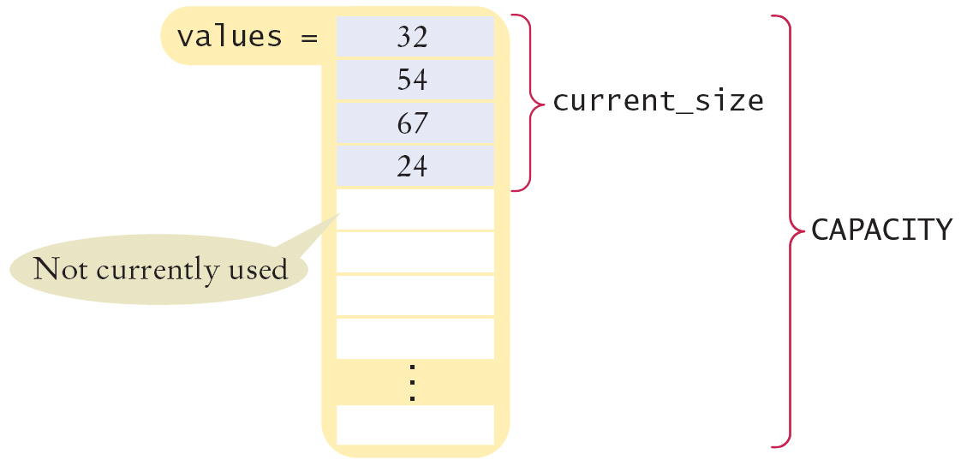
Partially-Filled Arrays – Companion Variable for Size
const int CAPACITY = 100;
double values[CAPACITY];
current_size = 4; // array now holds 4

Slide 19
Partially-Filling an Array – Code Loop
The following loop fills an array with user input.
Each time the size of the array changes we update the size variable:
const int CAPACITY = 100;
double values[CAPACITY];
int size = 0; double input;
while (cin >> input)
{
if (size < CAPACITY)
{
values[size] = x;
size++;
}
}
When the loop ends, the companion variable size has the number of elements in the array.

Slide 20
Partially-Filled Arrays – Output
How would you print the elements in a partially filled array?
By using the current_size companion variable.
for (int i = 0; i < current_size; i++)
{ cout << values[i] << endl;
}
When i is 0, values[i] is values[0], the first element

Slide 21
Using Arrays – Visiting All Elements
To visit all elements of an array, use a for loop, whose counter is the array index:
const int CAPACITY =10;
for (int i = 0; i < CAPACITY; i++) { cout << values[9] << endl;
}
When i is 0, values[i] is values[0], the first element.
When i is 1, values[i] is values[1], the second element.
When i is 2, values[i] is values[2], the third element. …
When i is 9, values[i] is values[9], the tenth and last legal element.

Slide 22
Illegally Accessing an Array Element – Bounds Error
A bounds error occurs when you access an element outside the legal set of indices:
cout << values[10]; //error! 9 is the last valid index
Doing this can corrupt data or cause your program to terminate.

Slide 23
Use Arrays for Sequences of Related Values
Recall that the type of every element must be the same.
That implies that the “meaning” of each stored value is the same.
int scores[NUMBER_OF_SCORES];
But an array could be used improperly:
double personal_data[3];
personal_data[0] = age;
personal_data[1] = bank_account;
personal_data[2] = shoe_size;
Clearly these doubles do not have the same meaning!

Slide 24
Topic 2
Arrays
Common array algorithms
Arrays / functions
Problem solving: adapting algorithms
Problem solving: discovering algorithms
2D arrays
Vectors
Chapter Summary

Slide 25
Common Array and Vector Algorithms
There are many typical things that are done with sequences of values.
There many common algorithms for processing values stored in both arrays and vectors.
(We will get to vectors a bit later but the algorithms are the same)

Slide 26
Common Algorithms – Filling
This loop fills an array with zeros:
for (int i = 0; i < size; i++) { values[i] = 0; }
To fill an array with squares (0, 1, 4, 9, 16, ...).
for (int i = 0; i < size; i++) { squares[i] = i * i; }

Slide 27
Self-Check Exercise
Using a for loop, fill an array a with 0, 1, 2, 0, 1, 2, 0, 1, 2, 0, 1, 2, 0, 1, 2, 0, 1, 2
Hint: you’ll need to increment the loop index by 3, not by 1
for ( ; ; )
{
a[ ] = ;
a[ ] = ;
a[ ] = ;
}

Slide 28
Common Algorithms – Copying
Consider these two arrays:
int squares[5] = { 0, 1, 4, 9, 16 };
int lucky_numbers[5];
How can we copy the values from squares to lucky_numbers?
Let’s try what seems right and easy…
squares = lucky_numbers; …and wrong!
You cannot assign arrays!
The compiler will report a syntax error.

Slide 29
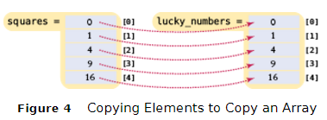
Common Algorithms – Copying Requires a Loop
/* you must copy each element individually using a loop! */
int squares[5] = { 0, 1, 4, 9, 16 };
int lucky_numbers[5];
for (int i = 0; i < 5; i++) { lucky_numbers[i] = squares[i]; }

Slide 30
Common Algorithms – Sum and Average Value
You have already seen the algorithm for computing the sum and average of a set of data. The algorithm is the same when the data is stored in an array.
double total = 0;
for (int i = 0; i < size; i++)
{
total = total + values[i];
}
The average is just arithmetic:
double average = total / size;

Slide 31
Common Algorithms – Maximum
To compute the largest value in a vector, keep a variable that stores the largest element that you have encountered, and update it when you find a larger one.
double largest = values[0]; for (int i = 1; i < size; i++) { if (values[i] > largest) { largest = values[i]; } }

Slide 32
Common Algorithms – Minimum
For the minimum, we just reverse the comparison.
double smallest = values[0]; for (int i = 1; i < size; i++) { if (values[i] < smallest) { smallest = values[i]; } }
These algorithms require that the array
contain at least one element.

Slide 33
Common Algorithms – Element Separators
When you display the elements of a vector, you may want to separate them, often with commas or vertical lines, like this:
1 | 4 | 9 | 16 | 25
Note that there is one fewer separator than there are numbers.
To print five elements, you need four separators.

Slide 34
Common Algorithms – Element Separator Code
Print the separator before each element except the initial one (with index 0):
1 | 4 | 9 | 16 | 25
for (int i = 0; i < size of values; i++) { if (i > 0) { cout << " | "; }
cout << values[i];
}

Slide 35
Common Algorithms – Linear Search
Find the position of a certain value, say 100, in an array:
int pos = 0;
bool found = false;
while (pos < size && !found)
{
if (values[pos] == 100) // looking for 100
{
found = true;
}
else
{
pos++;
}
}

Slide 36
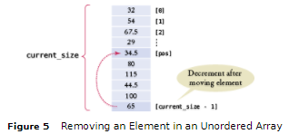
Common Algorithms – Removing an Element, Unordered
To remove the element at index i:
If the elements in the array are not in any particular order, simply overwrite the element to be removed with the last element, then shrink the size by 1.
values[pos] = values[current_size - 1];
current_size--;

Slide 37
Common Algorithms – Removing an Element, Ordered
The situation is more complex if the order of the elements matters.
Then you must move all elements following the element to be removed “down” (to a lower index), and then shrink the size of the vector by removing the last element.
for (int i = pos + 1; i < current_size; i++)
{
values[i - 1] = values[i];
}
current_size--;

Slide 38
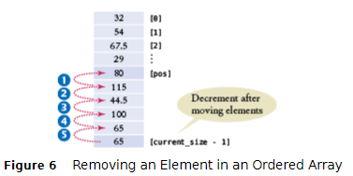
Common Algorithms – Removing an Element, Ordered
//removing the element at index “pos”
for (int i = pos + 1; i < current_size; i++)
{
values[i - 1] = values[i];
}
current_size--;

Slide 39
Common Algorithms – Inserting an Element Unordered
If the order of the elements does not matter, in a partially filled array (which is the only kind you can insert into), you can simply insert a new element at the end.
if (current_size < CAPACITY)
{
current_size++;
values[current_size - 1] = new_element;
}

Slide 40
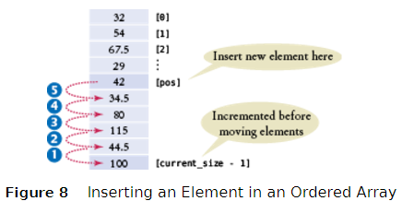
Common Algorithms – Inserting an Element Ordered
If the order of the elements does matter, it is a bit harder.
To insert an element at position i, all elements from that location to the end of the vector must be moved “out” to higher indices.
After that, insert the new element at the now vacant position [i].

Slide 41
Inserting an Element Ordered: Code
if (current_size < CAPACITY)
{
current_size++;
for (int i = current_size - 1; i > pos; i--)
{
values[i] = values[i - 1];
}
values[pos] = new_element;
}

Slide 42
Common Algorithms – Swapping Elements
Suppose we need to swap the values at positions i and j in the array. Will this work?
values[i] = values[j];
values[j] = values[i];
Look closely!
In the first line you lost – forever! – the value at i, replacing it with the value at j.
Then what?
Put’ j’s value back in j in the second line?
We end up with 2 copies of the [j] value, and have lost the [i]

Slide 43
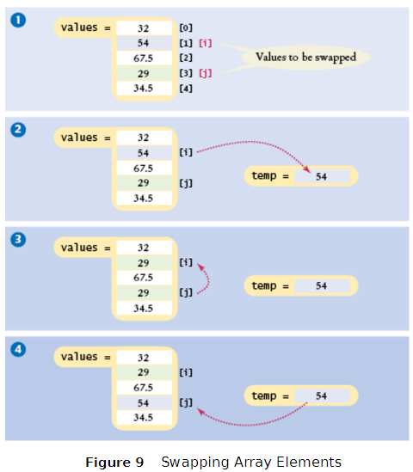
Code for Swapping Array Elements
//save the first element in
// a temporary variable
// before overwriting the 1st
double temp = values[i];
values[i] = values[j];
values[j] = temp;

Slide 44
Common Algorithms – Reading Input
If the know how many input values the user will supply, you can store them directly into the array:
double values[NUMBER_OF_INPUTS];
for (i = 0; i < NUMBER_OF_INPUTS; i++)
{
cin >> values[i];
}

Slide 45
Common Algorithms – Reading Unknown # of Inputs
When there will be an arbitrary number of inputs, things get more complicated.
But not hopeless.
Add values to the end of the array until all inputs have been made.
Again, the current_size variable will have the number of inputs.
double values[CAPACITY];
int current_size = 0;
double input;
while (cin >> input) //cin returns true until
// invalid (non-numeric) char encountered
{
if (current_size < CAPACITY)
{
values[current_size] = input;
current_size++;
}
}

Slide 46
Common Algorithms – Overflow Reading Input
Unfortunately it’s even more complicated:
Once the array is full, we allow the user to keep entering!
Because we can’t change the size of an array after it has been created, we’ll just have to give up for now.

Slide 47
Complete Program to Read Inputs and Report the Maximum
#include <iostream>
using namespace std;
int main() //read inputs, print out largest
{
const int CAPACITY = 1000;
double values[CAPACITY];
int current_size = 0;
cout << "Please enter values, Q to quit:" << endl;
double input;
while (cin >> input)
{
if (current_size < CAPACITY)
{
values[current_size] = input;
current_size++;
}
}

Slide 48
Complete Program to Read Inputs, part 2
double largest = values[0];
for (int i = 1; i < current_size; i++)
{
if (values[i] > largest)
{
largest = values[i];
}
}
for (int i = 0; i < current_size; i++)
{ //print each element, highlighting largest
cout << values[i];
if (values[i] == largest)
{
cout << " <== largest value";
}
cout << endl;
}
return 0;
}

Slide 49
Sorting with the C++ Library
Getting data into order is something that is often needed.
An alphabetical listing.
A list of grades in descending order.

Slide 50
Sorting with the C++ Library: the sort function
To sort the elements into ascending numerical order, you can call the sort library function from the <algorithm> library.
Recall our values array with the companion variable current_size.
#include <algorithm>
…
int main()
{
…
sort(values, values + current_size);

Slide 51
A Sorting Algorithm: Selection Sort
The following is an inefficient but simple sorting algorithm. It divides the array into a sorted section on the left and unsorted on the right, moving elements successively from right to left starting with the smallest element remaining in the unsorted section. The sort() function in the library is a much faster algorithm, but here is the selection sort:
for (int unsorted = 0; unsorted < size - 1; unsorted++)
{
// Find the position of the minimum
int min_pos = unsorted;
for (int i = unsorted + 1; i < size; i++)
{
if (values[i] < values[min_pos]) { min_pos = i; }
}
// Swap the minimum into the sorted area
if (min_pos != unsorted)
{
double temp = values[min_pos];
values[min_pos] = values[unsorted];
values[unsorted] = temp;
}
}
In a later chapter we’ll cover sorting algorithms in detail.

Slide 52
Searching Algorithms: Binary Search
There is a much faster way to search a sorted array than the linear search shown previously
"Binary search" repeatedly partitions the array in half, then ¼, then 1/8, etc…to find a match
bool found = false;
int low = 0, high = size - 1;
int pos = 0;
while (low <= high && !found)
{
pos = (low + high) / 2; // Midpoint of the subarray
if (values[pos] == searched_value)
{ found = true; }
else if (values[pos] < searched_value)
{ low = pos + 1; } // Look in second half
else { high = pos - 1; } // Look in first half
}
if (found)
{ cout << "Found at position " << pos; }

Slide 53
Topic 3
Arrays
Common array algorithms
Arrays / functions
Problem solving: adapting algorithms
Problem solving: discovering algorithms
2D arrays
Vectors
Chapter Summary

Slide 54
Arrays as Parameters in Functions
Recall that when we work with arrays we use a companion variable.
The same concept applies when using arrays as parameters:
You must pass the size to the function so it will know how many elements to work with.

Slide 55
Array Parameter Function Example
Here is the sum function with an array parameter: Notice that to pass one array, it takes two parameters.
double sum(double data[], int size) { double total = 0; for (int i = 0; i < size; i++) { total = total + data[i]; } return total; }

Slide 56
Array Parameters in Functions Require [] in the Header
You use an empty pair of square brackets after the parameter variable’s name to indicate you are passing an array.
double sum(double data[], int size)

Slide 57
Array Function Call Does NOT Use the Brackets!
When you call the function, supply both the name of the array and the size, BUT NO SQUARE BRACKETS!!
double NUMBER_OF_SCORES = 10;
double scores[NUMBER_OF_SCORES]
= { 32, 54, 67.5, 29, 34.5, 80, 115, 44.5, 100, 65 };
double total_score = sum(scores, NUMBER_OF_SCORES);
You can also pass a smaller size to the function:
double partial_score = sum(scores, 5);
This will sum over only the first five doubles in the array.

Slide 58
Array Parameters Always are Reference Parameters
When you pass an array into a function, the contents of the array can always be changed. An array name is actually a reference, that is, a memory address:
//function to scale all elements in array by a factor
void multiply(double values[], int size, double factor) { for (int i = 0; i < size; i++) { values[i] = values[i] * factor; } }
But never use an & with an array parameter – that is an error.

Slide 59
Arrays as Parameters but No Array Returns
You can pass an array into a function but
you cannot return an array.
However, the function can modify an input array, so the function definition must include the result array in the parentheses if one is desired.

Slide 60
Arrays as Parameters and Return Value
If a function can change the size of an array,
it should let the caller know the new size by returning it:
int read_inputs(double inputs[], int capacity)
{ //returns the # of elements read, as int
int current_size = 0;
double input;
while (cin >> input)
{
if (current_size < capacity)
{
inputs[current_size] = input;
current_size++;
}
}
return current_size;
}

Slide 61
Array Parameters in Functions: Calling the Function
Here is a call to the read_inputs function:
const int MAXIMUM_NUMBER = 1000;
double values[MAXIMUM_NUMBER];
int current_size =
read_inputs(values, MAXIMUM_NUMBER);
After the call, the current_size variable specifies how many were added.

Slide 62
Function to Fill or Append to an Array
Or it can let the caller know by using a reference parameter:
void append_inputs(double inputs[], int capacity,
int& current_size)
{
double input;
while (cin >> input)
{ if (current_size < capacity)
{
inputs[current_size] = input;
current_size++;
}
}
}
Note this function has the added benefit of either filling an empty array or appending to a partially-filled array.

Slide 63
Array Functions Example
The following program uses the preceding functions to read values from standard input, double them, and print the result.
• The read_inputs function fills an array with the input values. It returns the number of elements that were read.
• The multiply function modifies the contents of the array that it receives, demonstrating that arrays can be changed inside the function to which they are passed.
• The print function does not modify the contents of the array that it receives.

Slide 64
Array Functions Example Code, Part 1
#include <iostream>
using namespace std;
//ch06/functions.cpp
/**
Reads a sequence of floating-point numbers.
@param inputs an array containing the numbers
@param capacity the capacity of that array
@return the number of inputs stored in the array
*/
int read_inputs(double inputs[], int capacity)
{
int current_size = 0;
cout << "Please enter values, Q to quit:" << endl;
bool more = true;
while (more)
{

Slide 65
Array Functions Example Code, part 2
double input;
cin >> input;
if (cin.fail())
{
more = false;
}
else if (current_size < capacity)
{
inputs[current_size] = input;
current_size++;
}
}
return current_size;
}

Slide 66
Array Functions Example Code, part 3
/**
Multiplies all elements of an array by a factor.
@param values a partially filled array
@param size the number of elements in values
@param factor the value with which each element is multiplied
*/
void multiply(double values[], int size,
double factor)
{
for (int i = 0; i < size; i++)
{
values[i] = values[i] * factor;
}
}
/**
Prints the elements of a vector, separated by commas.
@param values a partially filled array
@param size the number of elements in values
*/
void print(double values[], int size)
{
for (int i = 0; i < size; i++)
{
if (i > 0) { cout << ", "; }
cout << values[i];
}
cout << endl;
}

Slide 67
Array Functions Example Code, part 4
int main()
{
const int CAPACITY = 1000;
double values[CAPACITY];
int size = read_inputs(values, CAPACITY);
multiply(values, size, 2);
print(values, size);
return 0;
}

Slide 68
Constant Array Parameters
When a function doesn’t modify an array parameter, it is considered good style to add the const reserved word, like this:
double sum(const double values[], int size)
The const reserved word helps the reader of the code, making it clear that the function keeps the array elements unchanged.
If the implementation of the function tries to modify the array, the compiler issues a warning.

Slide 69
Topic 4
Arrays
Common array algorithms
Arrays / functions
Problem solving: adapting algorithms
Problem solving: discovering algorithms
2D arrays
Vectors
Chapter Summary

Slide 70
Problem Solving: Adapting Algorithms
Recall that you saw quite a few
(too many?)
algorithms for working with arrays.
Suppose you need to solve a problem that does not exactly fit any of those?
What to do?
No, “give up” is not an option!
You can adapt algorithms you already know to produce a new algorithm.

Slide 71
Problem Example: Summing Quiz Scores
Consider this problem:
Compute the final quiz score from a set of quiz scores,
but be nice:
drop the lowest score.

Slide 72
Adapting Algorithms: Three that We Know
Calculate the sum:
double total = 0; for (int i = 0; i < size of values; i++) { total = total + values[i]; }
Find the minimum:
double smallest = values[0]; for (int i = 1; i < size of values; i++) { if (values[i] < smallest) { smallest = values[i]; } }
Remove an element:
values[pos] = values[current_size - 1]; current_size--;

Slide 73
Adapting Algorithms: A Glitch in Combining Those Three
values[pos] = values[current_size - 1]; current_size--;
This algorithm removes by knowing the position of the element to remove…
…but…
double smallest = values[0]; for (int i = 1; i < size of values; i++) { if (values[i] < smallest) { smallest = values[i]; } }
That’s not the position of the smallest –
it IS the smallest.

Slide 74
Algorithm to Find the Position
Here’s another algorithm I know that does find the position:
int pos = 0;
bool found = false;
while (pos < size of values && !found)
{
if (values[pos] == 100) // looking for 100
{
found = true;
}
else
{
pos++;
}
}

Slide 75
Adapting the Minimum Algorithm to Report the Position
Combining the minimum value algorithm with the position-finder:
int smallest_position = 0; for (int i = 1; i < size of values; i++) { if (values[i] < values[smallest_position]) { smallest_position = i; } }

Slide 76
Final Answer for Adapting Algorithms
Aha! Here is the algorithm:
1. Find the position of the minimum
2. Remove it from the array
3. Calculate the sum (will be without the lowest score)
4. Calculate the final score

Slide 77
Topic 5
Arrays
Common array algorithms
Arrays / functions
Problem solving: adapting algorithms
Problem solving: discovering algorithms
2D arrays
Vectors
Chapter Summary

Slide 78
Discovering Algorithms by Manipulating Physical Objects
What if you come across a problem for which you cannot find an algorithm you know and you cannot figure out how to adapt any algorithms?
you can use a technique called:
MANIPULATING PHYSICAL OBJECTS
better know as:
playing around with things.

Slide 79
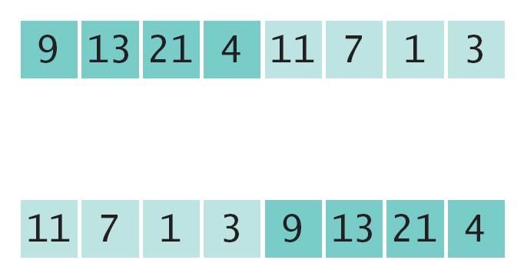
Manipulating Physical Objects: Example Problem
Here is a problem:
You are given an array whose size is an even number. You are to switch the first and the second half.
Before:
After:

Slide 80

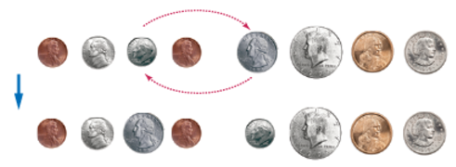
Manipulating Physical Objects: Coins
We’ll use 8 coins as a model for our 8-elements of the array
We can swap coins like we’d swap array elements:

Slide 81
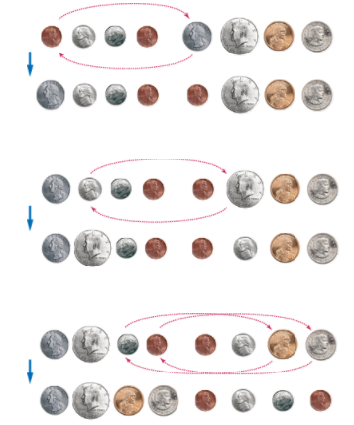
Swapping Coins: the Algorithm
We find that by swapping the
1st and 4th coins, and
2nd and 5th
3rd and 6th
And 4th and 8th
We have swapped the first half of the 8 with the last

Slide 82
Translating the Manipulations to Code
Pseudocode:
i = 0
j = size / 2
While i < size / 2
Swap elements at positions i and j.
i++
j++
Translating to C++ is left as a Programming Exercise at the end of the chapter

Slide 83
Self Check: Practice Manipulating Objects
Using physical objects such as coins to represent array elements, determine the purpose of the function below:
void transform(int array[], int length)
{
int position = 0;
for (int k = 1; k < length; k++)
{
if (array[k] < array[position])
{
position = k;
}
}
int temp = array[position];
while (position > 0)
{
array[position] = array[position – 1];
position--;
}
array[0] = temp;
}
ANSWER: copies the smallest value to the first array location and shifts other elements so no values are lost.

Slide 84
Topic 6
Arrays
Common array algorithms
Arrays / functions
Problem solving: adapting algorithms
Problem solving: discovering algorithms
2D arrays
Vectors
Chapter Summary

Slide 85
Two-Dimensional Arrays
It often happens that you want to store collections of values that have a two-dimensional layout.
Such data sets commonly occur in financial and scientific applications.
An arrangement consisting of tabular data (rows and columns of values) is called:
a two-dimensional array, or a matrix

Slide 86
Two-Dimensional Array Example
Consider the medal-count data from the 2014 Winter Olympic skating competitions:
Country | Gold | Silver | Bronze
Canada | 0 | 3 | 0
Italy | 0 | 0 | 1
Germany | 0 | 0 | 1
Japan | 1 | 0 | 0
Kazakhstan | 0 | 0 | 1
Russia | 3 | 1 | 1
South Korea | 0 | 1 | 0
United States | 1 | 0 | 1

Slide 87
Defining Two-Dimensional Arrays
C++ uses an array with two subscripts to store a 2D array.
const int COUNTRIES = 8; const int MEDALS = 3; int counts[COUNTRIES][MEDALS];
An array with 8 rows and 3 columns is suitable for storing our medal count data.

Slide 88
Defining Two-Dimensional Arrays – Initializing
Just as with one-dimensional arrays, you cannot change the size of a two-dimensional array once it has been defined.
But you can initialize a 2-D array:
int counts[COUNTRIES][MEDALS] =
{
{ 0, 3, 0 },
{ 0, 0, 1 },
{ 0, 0, 1 },
{ 1, 0, 0 },
{ 0, 0, 1 },
{ 3, 1, 1 },
{ 0, 1, 0 }
{ 1, 0, 1 }
};

Slide 89
Self Check: Declaring 2D Arrays
Write the code statement to declare an array "a" of integers with the specified properties.
Initialize elements to zero unless otherwise specified.
With 3 rows and 2 columns:
With 2 rows and 3 columns:
With 2 rows and 2 columns, containing 1 when the row and column index are the same:

Slide 90
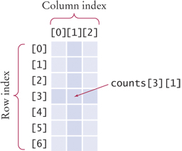
Two-Dimensional Arrays – Accessing Elements
// copy to value what is currently // stored in the array at [3][1] int value = counts[3][1];
// Then set that position in the array to 8
counts[3][1] = 8;

Slide 91
Nested Loop to Print All Elements in a 2D Array
for (int i = 0; i < COUNTRIES; i++)
{
// Process the ith row
for (int j = 0; j < MEDALS; j++)
{
// Process the jth column in the ith row
cout << setw(8) << counts[i][j];
}
// Start a new line at the end of the row
cout << endl;
}

Slide 92
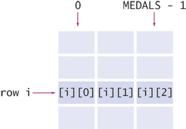
Computing Row and Column Totals
We must be careful to get the right indices.
For each row i, we must use the column indices: 0, 1, … (MEDALS -1)

Slide 93
Computing Row and Column Totals: Code Example
Column totals:
Let j be the silver column:
int total = 0; //loop to sum down the rows for (int i = 0; i < COUNTRIES; i++) { total = total + counts[i][j]; }

Slide 94
Two-Dimensional Array Parameters
When passing a two-dimensional array to a function,
you must specify the number of columns as a constant when you write the parameter type, so the compiler can pre-calculate the memory addresses of individual elements.
This function computes the total of a given row.
const int COLUMNS = 3;
int row_total(int table[][COLUMNS], int row)
{
int total = 0;
for (int j = 0; j < COLUMNS; j++)
{
total = total + table[row][j];
}
return total;
}

Slide 95
Two-Dimensional Array Parameter Columns Hardwired
That function works for only arrays of 3 columns.
If you need to process an array
with a different number of columns, like 4,
you would have to write
a different function
that has 4 as the parameter.

Slide 96
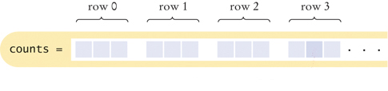
Two-Dimensional Array Storage
What’s the reason behind this?
Although the array appears to be two-dimensional,
the elements are still stored as a linear sequence.
counts is stored as a sequence of rows, each 3 long.
So where is counts[3][1]?
The offset (calculated by the compiler) from the start of the array is
3 x number of columns + 1

Slide 97
Two-Dimensional Array Parameters: Rows
The row_total function did not need to know the number of rows of the array.
If the number of rows is required, pass it in:
int column_total(int table[][COLUMNS], int rows, int col)
{
int total = 0;
for (int i = 0; i < rows; i++)
{
total = total + table[i][col];
}
return total;
}

Slide 98
Two-Dimensional Array Parameters: Complete Code (1)
#include <iostream>
#include <iomanip>
#include <string>
using namespace std;
const int COLUMNS = 3;
/**
Computes the total of a row in a table.
@param table a table with 3 columns
@param row the row that needs to be totaled
@return the sum of all elements in the given row
*/
double row_total(int table[][COLUMNS], int row)
{
int total = 0;
for (int j = 0; j < COLUMNS; j++)
{
total = total + table[row][j];
}
return total;
}

Slide 99
Two-Dimensional Array Parameters: Complete Code (2)
int main()
{
const int COUNTRIES = 8;
const int MEDALS = 3;
string countries[] =
{"Canada","Italy","Germany","Japan", "Kazakhstan", "Russia", "South Korea", "United States"};
int counts[COUNTRIES][MEDALS] =
{
{ 0, 3, 0 },
{ 0, 0, 1 },
{ 0, 0, 1 },
{ 1, 0, 0 },
{ 0, 0, 1 },
{ 3, 1, 1 },
{ 0, 1, 0 }
{ 1, 0, 1 }
};

Slide 100
Two-Dimensional Array Parameters: Complete Code (3)
cout << " Country Gold Silver Bronze Total"
<< endl;
// Print countries, counts, and row totals
for (int i = 0; i < COUNTRIES; i++)
{
cout << setw(15) << countries[i];
// Process the ith row
for (int j = 0; j < MEDALS; j++)
{
cout << setw(8) << counts[i][j];
}
int total = row_total(counts, i);
cout << setw(8) << total << endl;
}
return 0;
}

Slide 101
Practice It: 2D Array Parameters
Insert the missing statement. The function should return the result of adding the values in the first row of the 2D array received as argument.
int add_first_row(int array[][MAX_COLS], int rows, int cols)
{
int sum = 0;
for (int k = 0; k < cols; k++)
{
sum = sum + _________________;
}
return sum;
}

Slide 102
Arrays – Fixed Size is a Drawback
The size of an array cannot be changed after it is created.
You have to get the size right – before you define an array.
The compiler has to know the size to build it. and a function must be told about the number elements and possibly the capacity.
It cannot hold more than it’s initial capacity.
Next we'll discuss vectors, which have variable size and some other programmer-friendly features lacking in arrays.

Slide 103
Topic 7
Arrays
Common array algorithms
Arrays / functions
Problem solving: adapting algorithms
Problem solving: discovering algorithms
2D arrays
Vectors
Chapter Summary

Slide 104
Vectors
The vector type was added to C++ to improve upon the array. Like the string type, it combines built-in member functions with data.
A vector
is not fixed in size when it is created
AND
you can keep putting things into it
forever!
(Until your computer runs out of RAM.)

Slide 105
Declaring Vectors
When you declare a vector, you specify the type of the elements like you would with an array, but the type must be preceded by the word vector.
vector<double> data;
The element type must be in angle brackets. Other examples:
vector<int> counts;
vector<string> team_names;
By default, a vector is empty when created.

Slide 106
Declaring an non-empty Vector
You can specify the initial size.
You still must specify the type of the elements.
For example, here is a definition of a
vector of doubles whose initial size is 10.
vector<double> data(10);
This is very close to the data array we used earlier.

Slide 107
Vector Examples: Table 2
vector<int> numbers(10); | A vector of ten integers.
vector<string> names(3); | A vector of three strings.
vector<double> values; | A vector of size 0.
vector<double> values(); | Error: Does not define a vector.
vector<int> numbers; for (int i = 1; i <=10; i++) { numbers.push_back(i);} | A vector of ten integers, filled with 1, 2, 3, ..., 10.
vector<int> numbers(10); for (int i = 0; i < numbers.size(); i++) { numbers[i] = i + 1;} | Another way of defining a vector of ten integers 1, 2, 3, ..., 10.
vector<int> numbers = { 1, 2, 3, 4, 5, 6, 7, 8, 9, 10 }; | This syntax is supported with C++ 11 and above.

Slide 108
Accessing Elements in Vectors
You can access the elements in a vector the same way as in an array, using an [index].
vector<double> values(4);
//display the forth element
cout << values[3] << end;
HOWEVER…
It is an error to access a element that is not in a vector.
vector<double> values(4);
//display the fifth element
cout << values[4] << end; //ERROR

Slide 109
vector push_back and pop_back
The function push_back puts a value into a vector:
values.push_back(32); //32 added to end of vector
The vector increases its size by 1.
pop_back removes the last value placed into the vector, and the size decreases by 1:
values.pop_back();

Slide 110
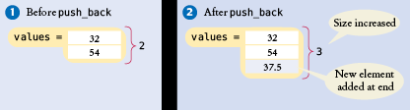
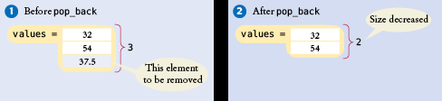
push_back Adds Elements and Increments size
// an empty vector
vector<double> values;
values.push_back(32)
// values.size() now is 1
values.push_back(54);
values.push_back(37.5);
// values.size() now is 3
values.pop_back(); //removes the 37.5 //values.size()==2

Slide 111
push_back with User Input
You can use push_back to put user input into a vector:
vector<double> values;
double input; while (cin >> input) {
values.push_back(input);
}

Slide 112
A Weakness of Arrays
With arrays, we must separately keep track of the current_size and the capacity. To display every element, we'd have to know the current size, assumed 10 below:
for (int i = 0; i < 10; i++) { cout << values[i] << endl;
}

Slide 113
vector size()
Vectors have the size member function which returns the current size of a vector. The vector always knows how many elements are in it and you can always ask it to give you that quantity by calling the size method:
for (int i = 0; i < values.size(); i++) { cout << values[i] << endl;
}

Slide 114
vector Parameters to Functions
The following function computes the sum of a vector of floating-point numbers:
double sum(vector<double> values) { double total = 0; for (int i = 0; i < values.size(); i++) { total = total + values[i]; } return total; }
This function visits the vector elements, but does not change them.
Unlike an array, a vector is passed by value (copied) to a function, not passed by reference.

Slide 115
vector Parameters – Changing the Values with &
If the function should change the values stored in the vector, then a vector reference must be passed, just like with int and double reference parameters. The & goes after the <type>:
void multiply(vector<double>& values, double factor) { for (int i = 0; i < values.size(); i++) { values[i] = values[i] * factor; } }

Slide 116
For Efficiency, a Constant vector Reference
Using a constant reference (Special Topic 5.2) for vector parameters avoids the need for the compiled code to copy the vector to feed the function, which could be inefficient
Works only for parameters the function does not want to modify:
double sum2(const vector<double>& values)
{ … }
// const & added for efficiency

Slide 117
vectors Returned from Functions
Sometimes the function should return a vector.
Vectors are no different from any other data types in this regard.
Simply declare and build up the result in the function and return it:
vector<int> squares(int n) { vector<int> result; for (int i = 0; i < n; i++) { result.push_back(i * i); } return result; }
The function returns the squares from 0² up to (n – 1) ² as a vector.

Slide 118
vector Algorithms (Copying): Vectors Can Be Assigned!
Vectors do not suffer the limitations of arrays, where we had to include a code loop to copy each element.
vector<int> squares;
for (int i = 0; i < 5; i++) { squares.push_back(i * i); }
vector<int> lucky_numbers; // Initially empty
lucky_numbers = squares; //vector copy
// Now lucky_numbers contains // the same elements as squares

Slide 119
vector Algorithms – Finding Matches
Suppose we want all the values in a vector that are greater than a certain value, say 100, in a vector.
Store them in another vector:
vector<double> matches;
const double MATCH=100;
for (int i = 0; i < values.size(); i++)
{
if (values[i] > MATCH)
{
matches.push_back(values[i]);
}
}

Slide 120
vector Algorithms – Removing an Element, Unordered
If you know the position of an element you want to remove from a vector in which the elements are not in any order, as you did in an array,
1. overwrite the element at that position with the last element
2. remove the last element with pop_back() which also makes the vector smaller.
int last_pos = values.size() - 1;
// Take the position of the last element
values[pos] = values[last_pos];
// Replace element at pos with last element
values.pop_back();
// Delete last element to make vector
// one smaller

Slide 121
vector Algorithms – Removing an Element, Ordered
If you know the position of an element you want to remove from a vector in which the elements are in some order…
As you did in an array,
move all the elements after that position,
then remove the last element to reduce the size.
for (int i = pos + 1; i < values.size(); i++)
{
values[i - 1] = values[i];
}
data.pop_back();

Slide 122
vector Algorithms – Inserting an Element, Unordered
When you need to insert an element into a vector whose elements are not in any order…
values.push_back(new_element);

Slide 123
vector Algorithms – Inserting an Element, Ordered
However when the elements in a vector are ordered, it’s a bit more complicated, like it was in the array.
If you know the position, say pos, to insert the new element,
as in the array version, you need to move all the elements “up”, but FIRST YOU GROW the vector by 1 to make room:
int last_pos = values.size() - 1;
values.push_back(values[last_pos]); //grow it
for (int i = last_pos; i > pos; i--)
{
values[i] = values[i - 1];
}
values[pos] = new_element;

Slide 124
vector Algorithms: Sorting with the C++ Library
Recall that you call the sort function to sort an array.
This can be used on vectors also.
The syntax for vectors uses 2 more built-in vector functions, which tell the address (a reference) to the first and last vector elements:
Don’t forget to
#include <algorithm>
sort(values.begin(), values.end());

Slide 125
Two Dimensional vectors: a vector of vectors
There are no 2D vectors, but if you want to store rows and columns, you can use a vector of vectors. For example, the medal counts of Section 6.6:
vector<vector<int>> counts;
//counts is a vector of rows. Each row is a vector<int>
You need to initialize it, to make sure there are rows and columns for all the elements.
for (int i = 0; i < COUNTRIES; i++)
{
vector<int> row(MEDALS);
counts.push_back(row);
}

Slide 126
vector of vectors
You can access the vector counts[i][j] in the same way as 2D arrays.
counts[i] denotes the ith row, and counts[i][j] is the value in the jth column of that row.
The advantage over 2D arrays:
vector row and column sizes don’t have to be fixed at compile time.
int countries = . . .;
int medals = . . .;
vector<vector<int>> counts;
for (int i = 0; i < countries; i++)
{
vector<int> row(medals);
counts.push_back(row);
}

Slide 127
vector of vectors: Determining the row/column sizes
To find the number of rows and columns:
vector<vector<int>> values = . . .;
int rows = values.size();
int columns = values[0].size();

Slide 128
Which to Use? vector or array?
For most programming tasks, vectors are easier to use than arrays. A vector:
can grow and shrink.
remembers its size.
Has handy built-in functions like
begin(), end()
push_back(), pop_back()
size()
at(): this is an alternative to the [] notation to choose an element, and includes bounds checking to detect invalid subscripts
Advanced programmers may prefer arrays for efficiency.
You still need to to use arrays if you work with older programs or use C without the "++", such as in microcontroller applications.

Slide 129
The Range-Based for Loop
C++ 11 and after added a convenient for() syntax to visiting all elements in a “range” in a vector. No index variable nor comparison is needed:
vector<int> values = {1, 4, 9, 16, 25, 36};
for (int v : values) //visits all elements
{
cout << v << " ";
}
If you want to modify elements, you must declare the loop variable as a reference:
for (int& v : values) // & allows modifying the vector elements
{
v++; //increment every element
}

Slide 130
The Range-Based for Loop also Works for Arrays
The range-based for loop also works for arrays. For example:
int primes[] = { 2, 3, 5, 7, 11, 13 };
for (int p : primes)
{
cout << p << " ";
}
However, the range based for will loop over the entire capacity of the array, whether it is filled or partially empty.
Finally, you can use auto instead of the element type, for either arrays or vectors:
for (auto p : primes)
{
cout << p << " ";
}

Slide 131
CHAPTER SUMMARY #1
Use arrays for collecting values.
•Use an array to collect a sequence of values of the same type.
•Individual elements in an array values are accessed by an integer index i, using the notation values[i].
•An array element can be used like any variable.
•An array index must be at least zero and less than the size of the array.
•A bounds error, which occurs if you supply an invalid array index, can corrupt data or cause your program to terminate.
•With a partially filled array, keep a companion variable for the current size.
Be able to use common array algorithms.
•To copy an array, use a loop to copy its elements to a new array.
•When separating elements, don’t place a separator before the first element.
•A linear search inspects elements in sequence until a match is found.
•Before inserting an element, move elements to the end of the array starting with the last one.
•Use a temporary variable when swapping two elements.

Slide 132
CHAPTER SUMMARY #2
Implement functions that process arrays.
•When passing an array to a function, also pass the size of the array.
•Array parameters are always reference parameters.
•A function’s return type cannot be an array.
•When a function modifies the size of an array, it needs to tell its caller.
•A function that adds elements to an array needs to know its capacity.
Be able to combine and adapt algorithms for solving a programming problem.
•By combining fundamental algorithms, you can solve complex programming tasks.
•Be familiar with the implementation of fundamental algorithms so that you can adapt them.
Discover algorithms by manipulating physical objects.
•Use a sequence of coins, playing cards, or toys to visualize an array of values.
•You can use paper clips as position markers or counters.

Slide 133
CHAPTER SUMMARY #3
Use two-dimensional arrays for data that is arranged in rows and columns.
•Use a two-dimensional array to store tabular data.
•Individual elements in a two-dimensional array are accessed by using two subscripts, array[i][j].
•A two-dimensional array parameter must have a fixed number of columns.
Use vectors for managing collections whose size can change.
•A vector stores a sequence of values whose size can change.
•Use the size member function to obtain the current size of a vector.
•Use the push_back member function to add more elements to a vector. Use pop_back to reduce the size.
•vectors can occur as function arguments and return values.
•Use a reference parameter (vector<int>&) to modify the contents of a vector.
•A function can return a vector.

