Slide 1
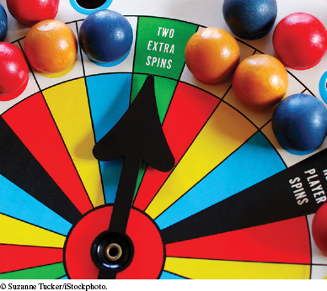
Chapter Seven: Pointers and Structures

Slide 2
Chapter Goals
To be able to declare, initialize, and use pointers
To understand the relationship between arrays and pointers
To be able to convert between string objects and character pointers
To become familiar with dynamic memory allocation and deallocation
To use structures to aggregate data items

Slide 3
Topic 1
Defining and using pointers
Arrays and pointers
C and C++ strings
Dynamic memory allocation
Arrays and vectors of pointers
Problem solving: draw a picture
Structures
Pointers and structures

Slide 4
Pointers
A variable contains a value,
but a pointer specifies where a value is located.
A pointer denotes the memory location of a variable

Slide 5
Pointer Usages
In C++, pointers are important for several reasons.
Pointers allow sharing of values stored in variables in a uniform way
Pointers can refer to values that are allocated on demand (dynamic memory allocation)
Pointers are necessary for implementing polymorphism, an important concept in object-oriented programming (later)

Slide 6
Harry Needs a Banking Program
Harry wants a program to manage bank deposits and withdrawals.
… balance += depositAmount …
… balance -= withdrawalAmount …
But not all deposits and withdrawals should be from the same bank.
By using a pointer,
it is possible to switch to a different account
without modifying the code for deposits and withdrawals.

Slide 7
Pointers to the Rescue
Harry starts with a variable for his account balance.
It should be initialized to 0 since there is no money yet.
double harrys_account = 0;
If Harry anticipates that he may someday use other
accounts, he can use a pointer to access any accounts.
So Harry also declares a pointer variable
named account_pointer :
double* account_pointer;
The type of this variable is “pointer to double”.

Slide 8
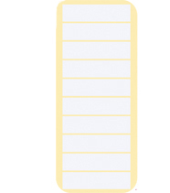
Addresses and Pointers
Every byte in RAM has an address as pictured here (this small RAM block is addressed 20266 through 20348, shown in groups of eight bytes)
harrys_account as a double, happens to be located at address 20300.
20266
20274
20292
20300
20308
20316
20324
20332
20340
20348
harrys_account 0

Slide 9
Pointer Initialization
When Harry declares a pointer variable, he initializes it to point to harrys_account:
double harrys_account = 0;
double* account_pointer = & harrys_account;
The & operator yields the location (address ) of a variable.
Taking the address of a double variable yields a value of type double* so everything fits together nicely.
account_pointer now contains the address of harrys_account

Slide 10
Pointers Also Reside in RAM
And, of course, account_pointer is somewhere in RAM, though we really don’t care where it is:
20266
20274
20292
20300
20308
20316
20324
20332
20340
20348
harrys_account
0
account_pointer
20300

Slide 11
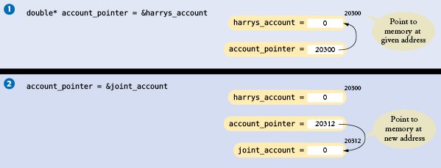
Addresses and Pointers
Harry wanted to use his account, but he found the balance was zero:
double harrys_account = 0; account_pointer = &harrys_account; //Picture #1
double joint_account = 1000;
To access his joint account hoping it still has a non-zero balance, Harry would change the pointer:
account_pointer = &joint_account; //Picture #2

Slide 12
Addresses and Pointers – and ARROWS
Do note that the computer stores numbers,
not arrows.

Slide 13
Accessing the Memory Pointed to by A Pointer Variable
The "dereferencing operator" * lets you use a pointer to get the data. Use *account_pointer as a substitute for the name of the variable the pointer points to:
// display the current balance
cout << *account_pointer << endl;
It can be used on the left and/or the right of an assignment:
// withdraw $100
*account_pointer = *account_pointer - 100;

Slide 14
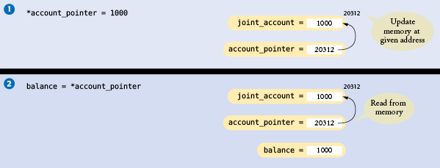
Harry Makes the Deposit
// deposit $1000 *account_pointer = *account_pointer + 1000;

Slide 15
Pointer Syntax Examples: Table 1, part 1
Assume the following declarations: int m = 10; // Assumed to be at address 20300 int n = 20; // Assumed to be at address 20304 int* p = &m;
Expression | Value | Comment
p | 20300 | The address of m.
*p | 10 | The value stored at that address.
&n | 20304 | The address of n.
p = &n; | p gets 20304 | Set p to the address of n.
*p | 20 | The value stored at the changed address.
m = *p; | m gets 20 | Stores 20 into m.

Slide 16
Pointer Syntax Examples: Table 1, part 2: Bad Syntax
Assume the following declarations: int m = 10; // Assumed to be at address 20300 int n = 20; // Assumed to be at address 20304 int* p = &m;
Expression | Value | Comment
m = p; | Error | m is an int value; p is an int* pointer. The types are not compatible.
&10 | Error | You can only take the address of a variable.
&p | The address of p, perhaps 20308 | Warning: This is the location of a pointer variable, not the location of an integer. You almost never want to use the address of a pointer variable.
double x = 0; p = &x; | Error | p has type int*, &x has type double*. These types are incompatible.

Slide 17
Errors Using Pointers – Uninitialized Pointer Variables
When a pointer variable is first defined, it is a random address.
Using that pointer (and its random address) is an error, until the pointer has been initialized.
double* account_pointer; // Forgot to initialize
*account_pointer = 1000; // ERROR! account_pointer
// contains an unpredictable value, program crashes
If you don't already know what the pointer will point to, initialize it with nullptr:
double* account_pointer = nullptr;
Trying to access data through a nullptr pointer will cause your program to terminate (but more gracefully than an uninitialized pointer would).

Slide 18
Harry’s Banking Program, part 1
// Here is the complete banking program
#include <iostream>
using namespace std;
int main()
{
double harrys_account = 0;
double joint_account = 2000;
double* account_pointer = &harrys_account;
*account_pointer = 1000; // Initial deposit
// Withdraw $100
*account_pointer = *account_pointer - 100;
// Print balance
cout << "Balance: " << *account_pointer << endl;

Slide 19
Harry’s Banking Program, part 2
// Change the pointer value so that the same
// statements now affect a different account
account_pointer = &joint_account;
// Withdraw $100
*account_pointer = *account_pointer - 100;
// Print balance (of joint account)
cout << "Balance: " << *account_pointer << endl;
return 0;
}

Slide 20
Practice It
Two groups jointly charter a bus and fill it with travelers. A variable
int count = 0;
is to be accessed through two pointers p and q.
Declare the pointer variable p. Do not initialize:
Initialize p with the address of count:
Complete this statement to check whether there is space in the bus for another passenger, using the pointer p:
if (________________ < CAPACITY)
Increment the value to which p points, using ++:
Declare the pointer variable q and initialize it with p:

Slide 21
Practice It More
Show the output of each of these code snippets. Answer "?" if the output cannot be determined:
int a = 1;
int b = 2;
int* p = &a;
cout << *p << " "; _________________
p = &b;
cout << *p << endl; _________________
int a = 15;
int* p = &a;
int* q = &a;
cout << *p + *q << endl; _________________
int a = 15;
int* p = &a;
cout << *p << " " << p << endl; ______________

Slide 22
Common Error: Confusing Data And Pointers: Where’s the *?
double* account_pointer = &joint_account;
account_pointer = 1000; // ERROR !
The assignment statement does not set the joint account balance to 1000.
It sets the pointer variable, account_pointer, to point to memory address 1000.

Slide 23
Error: Multiple Pointers Defined in a Single Statement
It is legal to define multiple variables together, like this:
int i = 0, j = 1;
This style is confusing when used with pointers:
double* p, q;
The * associates only with the first variable. That is, p is a double* pointer, and q is a double value.
To avoid any confusion, it is best to define each pointer variable separately:
double* p;
double* q;
Alternatively, you can move the * next to the variable name:
double *p, *q;

Slide 24
Function Arguments: Pointers vs. References
Recall that the & symbol is used for reference parameters:
void withdraw(double& balance, double amount)
{
if (balance >= amount)
balance = balance - amount;
}
A call of this function would be:
withdraw(harrys_checking, 1000);
We can accomplish the same thing using pointers:
void withdraw(double* balance, double amount)
{
if (*balance >= amount)
*balance = *balance - amount;
}
But the call will have to feed the function an address (pointer variable or reference):
withdraw(&harrys_checking, 1000);

Slide 25
Topic 2
Defining and using pointers
Arrays and pointers
C and C++ strings
Dynamic memory allocation
Arrays and vectors of pointers
Problem solving: draw a picture
Structures
Pointers and structures

Slide 26
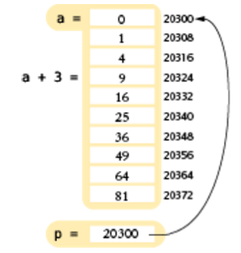
Arrays and Pointers
Pointers can help explain the peculiarities of arrays.
The name of the array is a pointer to the starting element.
int a[10];
You can capture the
address of the first
element in the array
in a pointer variable:
double* p = a;
// Now p points to a[0]

Slide 27
Pointer Arithmetic, and Array/Pointer Duality
You can use the array name a as you would a pointer:
These output statements are equivalent:
cout << *a;
cout << a[0];
Pointer arithmetic means adding integers to pointers (or to array names):
int* p = a;
p + 3 is a pointer to the array element with index 3
The expression: *(p + 3) means the same as p[3] and a[3]. This is "array/pointer duality".

Slide 28
The Array/Pointer Duality Law
This law explains why all C++ arrays start with an index of zero.
The pointer a (or a + 0) points to the starting element of the array.
That element must therefore be a[0].

Slide 29
Array / Pointer Examples: Table 2
Expression | Value | Comment
a | 20300 | Starting address of the array, here assumed 20300.
*a | 0 | The value stored at that address. (The array contains values 0, 1, 4, 9, ....)
a + 1 | 20308 | The address of the next double value in the array. A double occupies 8 bytes.
a + 3 | 20324 | The address of the element with index 3, obtained by skipping past 3 × 8 bytes.
*(a+3) | 9 | The value stored at address 20324.
a[3] | 9 | The same as *(a + 3) by array/pointer duality.
*a + 3 | 3 | The sum of *a and 3. Because there are no parentheses, the * refers only to a.
&a[3] | 20324 | The address of the element with index 3, the same as a + 3.

Slide 30
Array Parameters are Pointer Variables
Consider this function that computes the sum of all values in an array:
double sum(double a[], int size)
{
double total = 0;
for (int i = 0; i < size; i++)
{
total = total + a[i];
}
return total;
}

Slide 31
Syntactic Sugar
In the function header:
double sum(double a[], int size)
The C++ compiler considers a to be a pointer, not an array.
The expression a[i]is syntactic sugar for *(a + i).
syntactic sugar = a notation that is easy to read for humans
and that masks a complex implementation detail.

Slide 32
Equivalent Function Headers
That masked complex implementation detail:
double sum(double* a, int size)
is how we should define the first parameter
but
double sum(double a[], int size)
looks a lot more like we are passing an array.

Slide 33
Using a Pointer to Step Through an Array
With pointer arithmetic, we can step through an array without using the braces [ ]:
double sum(double* a, int size)
{
double total = 0;
double* p = a;
// p starts at the beginning of the array
for (int i = 0; i < size; i++)
{
total = total + *p;
// Add the value to which p points
p++;
// Advance p to the next array element
}
return total;
}

Slide 34
Common Error: Returning a Pointer to a Local Variable
Consider this bogus function that tries to return a pointer to an array containing two elements, the first and the last values of an array:
double* firstlast(const double values[], int size)
{
double result[2];
result[0] = values[0];
result[1] = values[size - 1];
return result; // Error! Points to a local array // that will evaporate as this function returns
}

Slide 35
Fixing the Pointer Return Error
The local variable
double result[2];
no longer exists when the function exits. Its contents will soon be overwritten by other function calls.
You can solve this problem by passing an array to hold the answer:
void firstlast(const double values[], int size, double result[])
{
result[0] = values[0];
result[1] = values[size - 1];
}
An alternative fix is to dynamically allocate the result[] array in the function using the new keyword, but we’ll save that for later in the chapter.

Slide 36
Program Clearly, Not Cleverly
Some programmers take pride in minimizing the number of instructions, even if the resulting code is hard to understand.
while (size > 0)
{
total = total + *p;
p++;
size--;
}
could be written as:
while (size-- > 0)
total = total + *p++;
Ah, so much better?

Slide 37
Program Clearly
Please do not use such terse programming style.
Your job as a programmer is not to dazzle other programmers with your cleverness, but to write code that is easy to understand and maintain.
For example, does
*p++;
mean increment the data that p points to, or increment the pointer address? Does it the increment happen before or after the data is accessed? You and the compiler may remember the rules for that syntax, but readers of your code might not.

Slide 38
Constant Pointers for Read-Only Variables and Arrays
A constant pointer:
const double* p = &balance;
cannot modify the value to which p points.
*p = 0; // Error
Of course, you can read the value:
cout << *p; // OK
A constant array parameter is equivalent to a constant pointer.
double sum(const double values[], int size)
double sum(const double* values, int size)
The function can use the pointer values to read the array elements, but it cannot modify them.

Slide 39
Topic 3
Defining and using pointers
Arrays and pointers
C and C++ strings
Dynamic memory allocation
Arrays and vectors of pointers
Problem solving: draw a picture
Structures
Pointers and structures

Slide 40
C and C++ Strings
C++ has two mechanisms for manipulating strings.
The string class
Supports character sequences of arbitrary length.
Provides convenient operations: concatenation (+), comparison (==, <, >)
C strings
Are arrays of type char
Provide a more primitive level of string handling.
Are from the C language (C++ was built from C).

Slide 41
char Type
The type char is an individual character.
char yes = 'y';
char no = 'n';
char maybe = '?';
char three = '3'; // not binary 3, // but the printer-printable ASCII char for
// the numeral. It happens to be binary
// 0110 0011 = 51 decimal!

Slide 42
Special Characters
'\n': newline
'\a': alert character – rings the bell
'\t': horizontal tab
'\0': null character (binary zero)
Etc…
These are still single (individual) characters:
the escape sequence characters. They control functions for a display or printer.

Slide 43
Character Literal Examples: Table 3
'y' | The character y
'0' | The character for the digit 0. In the ASCII code, '0' has the value 48.
' ' | The space character
'\n' | The newline character
'\t' | The tab character
'\0' | The null terminator of a string
"y" | Error: Not a char value, but a char array of 2 characters (includes a string terminator)

Slide 44
The Null Terminator Character and C Strings
The null character is special to C strings because it is always the last character in them:
"CAT" is really 4 characters, not 3:
'C' 'A' 'T' '\0'
The null terminator character indicates the end of a C string.
Literal strings are always stored as character arrays.

Slide 45
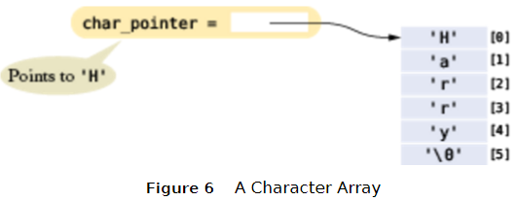
Character Arrays as Storage for C Strings
As with all arrays, a string literal can be assigned to a pointer variable that points to the initial character in the array:
char* char_pointer = "Harry";
// Points to the 'H'

Slide 46
Using the Null Terminator Character
Functions that operate on C strings rely on this terminator.
The strlen function (from the <cstring> library) returns the length of a C string. Here is the source:
int strlen(const char s[])
{
int i = 0;
// Count characters before
// the null terminator
while (s[i] != '\0') { i++; }
return i;
}
The call strlen("Harry") returns 5. The null terminator character is not counted as part of the “length” of the C string

Slide 47
Character Arrays
If you want to modify the characters in a C string, define a character array to hold the characters.
For example:
// An array of 6 characters
char c[] = "Harry";
You can modify the characters in the array:
c[0] = 'L'; //now c is Larry

Slide 48
Converting Between C and C++ Strings
The cstdlib header includes the function:
int atoi(const char s[])
The atoi function returns an int equivalent to a character array containing digits:
char* year = "2012";
int y = atoi(year);
y is the integer 2012

Slide 49
c_str() Function converts C++ string to a C string
OIder versions of the C++ <string> library lack an atoi().
The c_str member function offers an “escape hatch”, converting the C++ string to a char array:
string year = "2012";
int y = atoi(year.c_str());
Again, y is the integer 2012

Slide 50
Converting a C string to a C++ string
Converting from a C string to a C++ string is easy – the assignment operator (=) does it:
string name = "Harry";
Char* fred = "Fredrick";
string name2 = fred;

Slide 51
C++ Strings and the [] Operator
You can access individual characters in either a C-string or C++ string with the [] operator:
string name = "Harry";
name[3] = 'd'; //name now is Hardy
char c[] = "Mary";
c[3] = 'k'; // now is Mark

Slide 52
Example: Converting Case of a C++ string with toupper()
The toupper function is defined in the <cctype> header. It converts a lowercase char to uppercase. The tolower function does the opposite.
You can write a function that will return the uppercase version of a C++ string:
/**
Makes an uppercase version of a string.
@param str a string
@return a string with the characters in str converted to uppercase
*/
string uppercase(string str)
{
string result = str; // Make a copy of str
for (int i = 0; i < result.length(); i++)
{
// Convert each character to uppercase
result[i] = toupper(result[i]);
}
return result;
}

Slide 53
C String Functions from the <cstring> Library: Table 4
In this table, s and t are character arrays; n is an integer.
Function | Description
strlen(s) | Returns the length of s.
strcpy(t, s) | Copies the characters from s into t.
strncpy(t, s, n) | Copies at most n characters from s into t.
strcat(t, s) | Appends the characters from s after the end of the characters in t.
strncat(t, s, n) | Appends at most n characters from s after the end of the characters in t.
strcmp(s, t) | Returns 0 if s and t have the same contents, a negative integer if s comes before t in lexicographic order, a positive integer otherwise.

Slide 54
C++ strings are usually easier than the <cstring> Functions
Consider the task of concatenating 2 names into a string. The string class makes this easy:
string first = "Harry";
string last = "Smith";
string name = first + " " + last;
With C strings, it is much harder, as we have to worry about sizes of the arrays:
const int NAME_SIZE = 40;
char name[NAME_SIZE];
strncpy(name, first, NAME_SIZE - 1);
int length = strlen(name);
if (length < NAME_SIZE - 1)
{
strcat(name, " ");
int n = NAME_SIZE - 2 - length;
// Leave room for space, null terminator
if (n > 0)
{
strncat(name, last, n);
}
}

Slide 55
Topic 4
Defining and using pointers
Arrays and pointers
C and C++ strings
Dynamic memory allocation
Arrays and vectors of pointers
Problem solving: draw a picture
Structures
Pointers and structures

Slide 56
Dynamic Memory Allocation
You may not know beforehand how many values you need in an array.
To solve this problem, use dynamic memory allocation and ask the C++ run-time system to create new values whenever you need them.
The run-time system keeps a large storage area, called the free store or heap, that can allocate values and arrays of any type:
double *p = new double[n];
allocates an array of size n, and yields a pointer to the starting element. (Here n need not be a constant.)

Slide 57
Dynamic Memory Allocation Examples
You need a pointer variable to hold the pointer you get:
//get a single variable
double* account_pointer = new double;
//get an array variable
double* account_array = new double[n];
Now you can use account_array as an array.
The magic of array/pointer duality lets you use the array notation
account_array[i] to access the ith element.

Slide 58
Dynamic Memory Allocation: delete
When your program no longer needs the memory that you asked for with the new operator, you must return it to the heap using the delete operator for single areas of memory
(which you would probably never use anyway).
delete account_pointer;
delete[] account_array;

Slide 59
Don't Use a Pointer after delete
After you delete a memory block,
you can no longer use it.
The OS is very efficient – and quick – “your” storage space may already be used elsewhere.
delete[] account_array;
account_array[0] = 1000;
// NO! You no longer own the
// memory of account_array

Slide 60
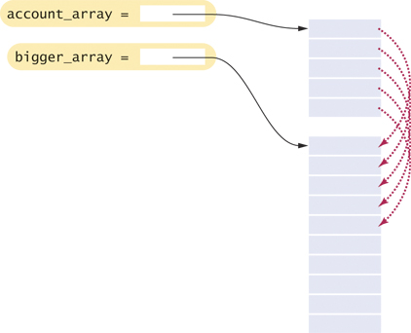
Dynamic Memory Allocation – Resizing an Array
Unlike static arrays, you can change the size of a dynamic array.
Make a new, bigger array and copy the old data:
//n = size of the original array
double* bigger_array = new double[2 * n];
for (int i = 0; i < n; i++)
{
bigger_array[i] = account_array[i];
}
delete[] account_array;
account_array = bigger_array;
n = 2 * n;

Slide 61
Dynamic Memory Allocation – THE RULES
Every call to new must be matched by exactly one call to delete.
Use delete[] to delete arrays. And always assign NULL to the pointer after that.
Don’t access a memory block (don't use the pointer) after it has been deleted.
If you don’t follow these rules, your program can
crash or run unpredictably
or worse…

Slide 62
Dynamic Memory Allocation – Common Errors: Table 5
Statements | Error
int* p; *p = 5; delete p; | There is no call to new int.
int* p = new int; *p = 5; p = new int; | The first allocated memory block was never deleted.
int* p = new int[10]; *p = 5; delete p; | The delete[] operator should have been used.
int* p = new int[10]; int* q = p; q[0] = 5; delete p; delete q; | The same memory block was deleted twice.
int n = 4; int* p = &n; *p = 5; delete p; | You can only delete memory blocks that you obtained from calling new.

Slide 63
Common Error: Dangling Pointers
It is a run-time error to use a pointer that points to memory that has already been deleted.
Such a pointer is called a dangling pointer.
Because the freed memory will be reused for other purposes, you can do real damage with a dangling pointer. For example:
int* values = new int[n];
// Process values
delete[] values; //values now dangling
// Some other work
values[0] = 42; //ERROR

Slide 64
Avoiding Dangling Pointers
To prevent a dangling pointer, assign the special value nullptr
To any pointer that you delete:
int* values = new int[n];
// Process values
delete[] values; //values now dangling
values = nullptr; //makes pointer safe

Slide 65
Common Error: Memory Leaks
A memory block that is never deallocated is called a memory leak.
If you allocate a few small blocks of memory and forget to deallocate them, this is not a huge problem.
When the program exits, all allocated memory is returned to the operating system.
Every call to new should have a matching call to delete.
But if your program runs for a long time, or if it allocates lots of memory (perhaps in a loop) without the deletes, then it can run out of memory and crash.

Slide 66
Topic 5
Defining and using pointers
Arrays and pointers
C and C++ strings
Dynamic memory allocation
Arrays and vectors of pointers
Problem solving: draw a picture
Structures
Pointers and structures

Slide 67
Arrays and Vectors of Pointers
When you have a sequence of pointers, you can place them into an array or vector.
An array and a vector of ten int* pointers are defined as
int* pointer_array[10];
vector< int* > pointer_vector(10);

Slide 68
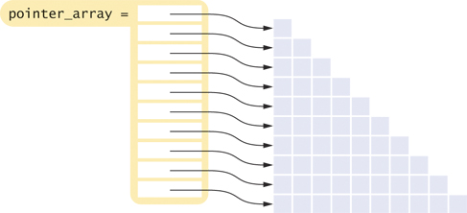
Arrays and Vectors of Pointers – A Triangular Array
In this array, each row is a different length. It would be inefficient to use a two-dimensional array,
because almost half of the elements would be wasted

Slide 69
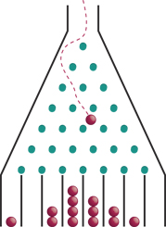
Program Example: A Galton Board
A Galton board consists of a pyramidal
arrangement of pegs and a row of bins
at the bottom.
Balls are dropped onto the top peg
and travel toward the bins.
At each peg, there is a 50 percent
chance of moving left or right.
The ball counts in the bins approximate a bell-curve distribution.

Slide 70
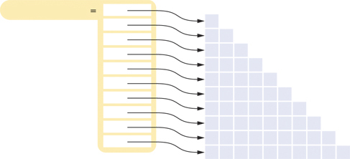
A Galton Board Simulation
We will simulate a board with ten rows of pegs.
Each row requires an array of counters.
The following statements initialize the triangular array:
int* counts[10];
for (int i = 0; i < 10; i++)
{
counts[i] = new int[i + 1];
}
counts

Slide 71
A Galton Board Simulation: Printing Rows
We will need to print each row:
// print all elements in the ith row
for (int j = 0; j <= i; j++)
{
cout << setw(4) << counts[i][j];
}
cout << endl;
counts
if i is 4

Slide 72
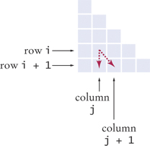
A Galton Board Simulation: Ball Bouncing on Pegs
We will simulate a ball bouncing through the pegs:
int r = rand() % 2;
// If r is even, move down,
// otherwise to the right
if (r == 1)
{
j++;
}
counts[i][j]++;

Slide 73
A Galton Board Simulation: Complete Code Part 1
#include <iostream>
#include <iomanip>
#include <cstdlib>
#include <ctime>
using namespace std;
int main()
{
srand(time(0));
int* counts[10];
// Allocate the rows
for (int i = 0; i < 10; i++)
{
counts[i] = new int[i + 1];
for (int j = 0; j <= 1; j++)
{
counts[i][j] = 0;
}
}

Slide 74
A Galton Board Simulation: Complete Code Part 2
const int RUNS = 1000;
// Simulate 1,000 balls
for (int run = 0; run < RUNS; run++)
{
// Add a ball to the top
counts[0][0]++;
// Have the ball run to the bottom
int j = 0;
for (int i = 1; i < 10; i++)
{
int r = rand() % 2;
// If r is even, move down,
// otherwise to the right
if (r == 1)
{
j++;
}
counts[i][j]++;
}
}

Slide 75
A Galton Board Simulation: Complete Code Part 3
// Print all counts
for (int i = 0; i < 10; i++)
{
for (int j = 0; j <= i; j++)
{
cout << setw(4) << counts[i][j];
}
cout << endl;
}
// Deallocate the rows
for (int i = 0; i < 10; i++)
{
delete[] counts[i];
}
return 0;
}

Slide 76
A Galton Board Simulation: Results
This is the output from a run of the program, with each number being a count of the balls that hit that peg in the triangle.
Note the bell-curve distribution of balls on the "bottom line":
1000
480 520
241 500 259
124 345 411 120
68 232 365 271 64
32 164 283 329 161 31
16 88 229 303 254 88 22
9 47 147 277 273 190 44 13
5 24 103 203 288 228 113 33 3
1 18 64 149 239 265 186 61 15 2

Slide 77
Topic 6
Defining and using pointers
Arrays and pointers
C and C++ strings
Dynamic memory allocation
Arrays and vectors of pointers
Problem solving: draw a picture
Structures
Pointers and structures

Slide 78
Problem Solving with Pointer Pictures
When designing programs that use pointers, you want to visualize how the pointers connect the data.
Draw the data blocks that will be accessed or modified through the pointers.
Then draw the pointer variables.
Finally, draw the pointers as arrows between those blocks. You may need to draw several diagrams that show how the pointers change.

Slide 79
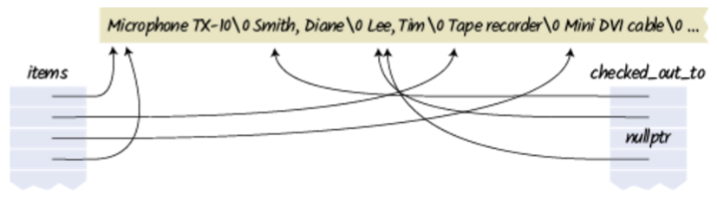
Problem Solving with Pointer Pictures: Example
The media center loans out equipment (microphones, cables, and so on)
We want to track the name of each item, and the name of the user.
All equipment and user names are in a long array of characters. New names are added to the end as needed.
Pointers to the equipment names are stored in an array of pointers called items.
A parallel array checked_out_to of pointers to user names. Sometimes, items can be checked out to the same user. Other items aren’t checked out at all—the user name pointer is nullptr.

Slide 80
Embedded Systems
An embedded system is a computer system that controls a device.
a processor and other hardware controlled by a computer program.
Unlike a personal computer, which is flexible and runs many different computer programs, the embedded system is tailored to a specific device.
increasingly common, in routers, washing machines, medical equipment, cell phones, automobiles, and spacecraft.
Probably programmed in C or C++
Unlike PCs, embedded systems are:
cost sensitive: sold in quantities of millions for low prices, having little memory and slow processor
mission critical: most must be reliable and bug-free, as changing their program code is non-trivial and can mean life/death in the case of cars and spacecraft
optimized to a particular task, which may require significant code streamlining to adapt a cheap CPU to a real-time need

Slide 81
Topic 7
Defining and using pointers
Arrays and pointers
C and C++ strings
Dynamic memory allocation
Arrays and vectors of pointers
Problem solving: draw a picture
Structures
Pointers and structures

Slide 82
Structures: User-defined Mixed Data Types
To group values of a single type together under a shared name, use an array or vector
To group different types together with one name, use a structured type
Like arrays, pointers prove quite useful with structures
Define a structure type with the struct reserved word:
struct StreetAddress //has 2 members
{
int house_number; //first member
string street_name;
};
StreetAddress white_house; //defines a variable of the type
// You use the “dot notation” to access members
white_house.house_number = 1600;
white_house.street_name = "Pennsylvania Avenue";

Slide 83
Structures: Assignment, but No Comparisons
Use the = operator to assign one structure value to another. All members are assigned simultaneously.
StreetAddress dest;
dest = white_house;
is equivalent to
dest.house_number = white_house.house_number;
dest.street_name = white_house.street_name;
However, you cannot compare two structures for equality.
if (dest == white_house) // Error
You must compare individual members to compare the whole struct:
if (dest.house_number == white_house.house_number
&& dest.street_name == white_house.street_name) // Ok

Slide 84
Structure Initialization
Structure variables can be initialized when defined, similar to array initialization:
struct StreetAddress
{
int house_number;
string street_name;
};
StreetAddress white_house = {1600, "Pennsylvania Avenue“}; // initialized
The initializer list must be in the same order as the structure type definition.

Slide 85
Functions and struct
Structures can be function arguments and return values.
For example:
void print_address(StreetAddress address)
{
cout << address.house_number << " " << address.street_name;
}
A function can return a structure. For example:
StreetAddress make_random_address()
{
StreetAddress result;
result.house_number = 100 + rand() % 100;
result.street_name = "Main Street";
return result;
}

Slide 86
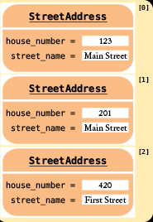
Arrays of Structures
You can put structures into arrays. For example:
StreetAddress delivery_route[ROUTE_LENGTH];
delivery_route[0].house_number = 123;
delivery_route[0].street_name = "Main Street";
You can also access a structure value in its entirety, like this:
StreetAddress start = delivery_route[0];
Of course, you can also form vectors of structures:
vector<StreetAddress> tour_destinations;
tour_destinations.push_back(white_house);

Slide 87
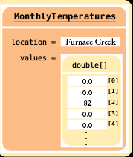
Structures with Array Members
Structure members can contain arrays. For example:
struct MonthlyTemperatures
{
string location;
double values[12];
};
To access an array element, first select the array member with the dot notation, then use brackets:
MonthlyTemperatures death_valley_noon;
death_valley_noon.values[2] = 82;

Slide 88
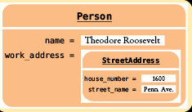
Nested Structures
A struct can have a member that is another structure. For example:
struct Person
{
string name;
StreetAddress work_address;
};
You can access the nested member in its entirety, like this:
Person theodore;
theodore.work_address = white_house;
To select a member of a member, use the dot operator twice:
theodore.work_address.street_name = "Pennsylvania Avenue";

Slide 89
Practice It: Structures
Write the code snippets to:
Declare a variable "a" of type StreetAddress.
Set it's house number to 2201.
Set the street to "C Street NW".

Slide 90
Topic 8
Defining and using pointers
Arrays and pointers
C and C++ strings
Dynamic memory allocation
Arrays and vectors of pointers
Problem solving: draw a picture
Structures
Pointers and structures

Slide 91
Structure Pointers for Dynamic Allocation
As with all dynamic allocations, you use the new operator:
StreetAddress* address_pointer = new StreetAddress;
The following is incorrect syntax for accessing a member of the structure:
*address_pointer.house_number = 1600; // Error
…because the dot operator has a higher precedence than the * operator. That is, the compiler thinks that you mean house_number is itself a pointer:
*(address_pointer.house_number) = 1600; // Error
Instead, you must first apply the * operator, then the dot:
(*address_pointer).house_number = 1600; // OK
Because this is such a common situation, an arrow operator -> exists to show struct member access via a pointer:
address_pointer->house_number = 1600; // OK – use this

Slide 92
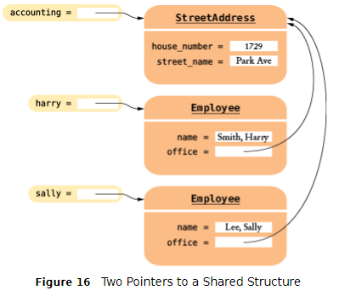
Structures with Pointer Members
Structures may need to contain pointer members. For example,
struct Employee
{
string name;
StreetAddress* office;
};
// defining 2 accounting employees:
StreetAddress accounting;
accounting.house_number = 1729;
accounting.street_name = "Park Avenue";
Employee harry;
harry.name = "Smith, Harry";
harry.office = &accounting;
Employee sally;
sally.name = "Lee, Sally";
sally.office = &accounting;

Slide 93
Structures and Pointers: Complete Code Example, Part 1
// sec08/streets2.cpp
#include <iostream>
#include <string>
using namespace std;
struct StreetAddress
{
int house_number;
string street_name;
};
struct Employee
{
string name;
StreetAddress* office;
};
void print_address(StreetAddress address)
{
cout << address.house_number << " " << address.street_name;
}

Slide 94
Structures and Pointers: Complete Code Example, Part 2
void print_employee(Employee e)
{
cout << e.name << " working at ";
print_address(*e.office);
}
int main()
{
cout << "A dynamically allocated structure" << endl;
StreetAddress* address_pointer = new StreetAddress;
address_pointer->house_number = 1600;
address_pointer->street_name = "Pennsylvania Avenue";
print_address(*address_pointer);
delete address_pointer;
cout << endl << "Two employees in the same office" << endl;
StreetAddress accounting;
accounting.house_number = 1729;
accounting.street_name = "Park Avenue";

Slide 95
Structures and Pointers: Complete Code Example, Part 3
Employee harry;
harry.name = "Smith, Harry";
harry.office = &accounting;
Employee sally;
sally.name = "Lee, Sally";
sally.office = &accounting;
cout << "harry: ";
print_employee(harry);
cout << endl;
cout << "sally: ";
print_employee(sally);
cout << endl;

Slide 96
Structures and Pointers: Complete Code Example, Part 4
cout << "After accounting office move" << endl;
accounting.house_number = 1720;
cout << "harry: ";
print_employee(harry);
cout << endl;
cout << "sally: ";
print_employee(sally);
cout << endl;
return 0;
}

Slide 97
Smart “shared” Pointers (C++ 11 and Later)
C++ 11 introduced a shared_ptr<> type that automatically reclaims memory that is no longer used. For example,
shared_ptr<StreetAddress> accounting(new StreetAddress);
accounting->house_number = 1729;
accounting->street_name = "Park Avenue";
Employee sally;
sally.name = "Lee, Sally";
sally.office = accounting;
Now the StreetAddress structure for the accounting office has two shared pointers pointing to it: accounting and sally.office. When both of these variables go away, then the structure memory is automatically deleted.
We discuss additional strategies for memory management in Chapter 13.

Slide 98
Chapter Summary, Part 1
Define and use pointer variables.
A pointer denotes the location of a variable in memory.
The type T* denotes a pointer to a variable of type T. int* p = nullptr; // can point to an int
The & operator yields the location of a variable.
int i=0;
int* p = &i; // p points to i
The * operator accesses the variable to which a pointer points.
cout << p; // prints value of i, pointed to by p
It is an error to use an uninitialized pointer.
The nullptr pointer does not point to any object.
Please initialize unknown pointers to nullptr

Slide 99
Chapter Summary, Part 2
Understand the relationship between arrays and pointers in C++.
The name of an array variable is a pointer to the starting element of the array.
Pointer arithmetic means adding an integer offset to an array pointer, yielding a pointer that skips past the given number of elements.
The array/pointer duality law:
a[n] is identical to *(a + n), where a is a pointer into an array and n is an integer offset.
When passing an array to a function, only the starting address is passed.
printf(a); //prints array a

Slide 100
Chapter Summary, Part 3
Use C++ string objects with functions that process character arrays
A value of type char denotes an individual character. Character literals are enclosed in single quotes.
A literal string (enclosed in double quotes) is an array of char values with a zero terminator.
Many library functions use pointers of type char*.
The c_str member function yields a char* pointer from a string object.
string s = “This is a C++ string object”;
char arr[] = s.c_str(); //copies C++ string to C-string
You can initialize C++ string variables with C strings.
string t = arr; //copies C-string to C++ string
You can access characters in a C++ string object with the [] operator.

Slide 101
Chapter Summary, Part 4
Allocate and deallocate memory in programs whose memory requirements aren’t known until run time.
Use dynamic memory allocation if you do not know in advance how many values you need.
The new operator allocates memory from the free store.
int* p = new int[50]; // allocate array of 50 ints
You must reclaim dynamically allocated objects with the delete or delete[] operator.
delete[] p; //done using our int array pointed to by p
p = nullptr; //set p to nullptr to avoid dangling pointer usage
Using a dangling pointer (a pointer that points to memory that has been deleted) is a serious programming error.
Every call to new should have a matching call to delete.

Slide 102
Chapter Summary, Part 5
Work with arrays and vectors of pointers.
Draw diagrams for visualizing pointers and the data to which they point.
Draw the data that is being processed, then draw the pointer variables. When drawing the pointer arrows, illustrate a typical situation.
Use structures to aggregate data items.
A structure combines member values into a single value.
Use the dot notation to access members of a structure.
Streetaddress home;
home.house_number = 1234;
When you assign one structure value to another, all members are assigned.
Work with pointers to structures.
Use the -> operator to access a structure member through a pointer
Streetaddress* p = new Streetaddress;
P->house_number = 1234;

