Slide 1

Chapter Nine: Classes

Slide 2
Chapter Goals
To understand the concept of encapsulation
To master the separation of interface and implementation
To be able to implement your own classes
To understand how constructors and member functions act on objects
To discover appropriate classes for solving programming problems
To distribute a program over multiple source files

Slide 3
Topic 1
Object oriented programming
Implementing a simple class
Specifying the public interface
Designing the data representation
Member functions
Constructors
Problem solving: tracing objects
Problem solving: discovering classes
Separate compilation
Pointers to objects
Problem solving: patterns for object data

Slide 4
Object-Oriented Programming
You have learned to structure programs into functions.
This is an excellent practice, but not good enough.
As programs get larger, it becomes increasingly difficult to maintain all the functions and separate datasets.
To solve this problem, computer scientists invented object-oriented programming
tasks are solved by collaborating objects.
An object is a set of data plus functions that manipulate the data
A "class" is a blueprint or template for an object, essentially a struct with functions added.
Did you know that you already are an Object Oriented Programmer?
string,cin,cout,streams are all classes or objects

Slide 5
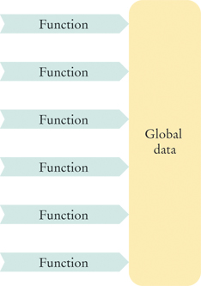
The Problem with Functional Programming
Functional programming is what you have done (mostly) so far, with a bunch of functions operating on a bunch of data, linked together only by your documentation and planning.
When some part of the data needs to be changed: to improve performance or to add new capabilities,
a large number of functions will have to be modified, and there is no mechanism to ensure correctness

Slide 6
Objects to the Rescue
Computer scientists noticed that functions work on related data so they invented:
Objects
where data and the functions that work with them are bundled together.
The C++ language syntax rules guarantee that changes to the class (object) data structure will be matched by changes in the built-in functions.
And these changes are "under the hood", hidden from users of your code. This hiding is known as "encapsulation".

Slide 7
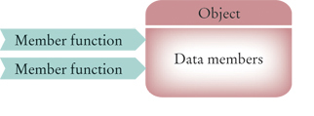
Object Terminology
Some new terminology.
The data stored in an object are called:
data members
The functions that work on data members are:
member functions
The list of member functions is the
public interface of the class.

Slide 8
Encapsulation and the Interface
When you use string or stream objects, you did not know their data members.
Encapsulation means that they are hidden from you.
But you were allowed to call member functions
such as substr, and you could use operators such as [] or >> (which are actually functions).
You were given an
interface
to the object.

Slide 9
Classes
A class describes a set of objects with the same behavior.
You would create the Car class to represent cars as objects.
To define a class,
you must specify the behavior
by providing implementations for the member functions,
and by defining the data members for the objects

Slide 10
Topic 2
Object oriented programming
Implementing a simple class
Specifying the public interface
Designing the data representation
Member functions
Constructors
Problem solving: tracing objects
Problem solving: discovering classes
Separate compilation
Pointers to objects
Problem solving: patterns for object data

Slide 11
Implementing a Simple Class
Let's make a class that models a tally counter
mechanical device that is used to count
for example, to find out how many people board a bus
When the operator pushes a button, the counter value advances by one.
We model this operation with a count function.
A counter has a display to show the current value
we use a get_value function instead.
A counter has another button to reset the count to 0
We use a reset function to model it.

Slide 12
Code for the Tally Counter Class: Interface
To make a class, we use syntax very similar to the struct to define the structure of the class, and then add a main program to use the class
class Counter
{
public:
void reset();
void count();
int get_value() const;
private:
int value;
};
In the public: area are the function prototype statements.
These are the "interface" of the class that can be used in main
In the private: area are the data members
By convention, we name our classes starting with a Capital letter
CamelCase

Slide 13
Code for the Tally Counter Class: Functions
We define the member functions immediately after the interface
They must be denoted as member functions by prefixing the function name with the class name followed by 2 colons:
void Counter::count()
{
value++;
}
void Counter::reset()
{
value = 0;
}
int Counter::get_value() const
{
return value;
}
The get_value() member function is required so that users can know the count
Users are NOT PERMITTED to access the (private) value variable
Only member functions can access private data

Slide 14
Code for the Tally Counter Class: main
int main() //define and use 2 Counter objects to test class
{
Counter tally;
tally.reset();
tally.count();
tally.count();
int result = tally.get_value();
cout << "Value of tally: " << result << endl;
tally.count();
tally.count();
result = tally.get_value();
cout << "Value of tally: " << result << endl;
Counter concert_counter;
concert_counter.reset();
concert_counter.count();
concert_counter.count();
concert_counter.count();
result = concert_counter.get_value();
cout << "Value of concert_counter: " << result << endl;
return 0;
}

Slide 15
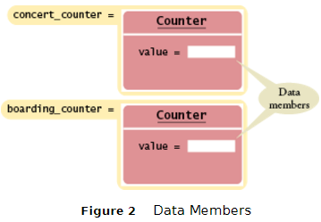
Class Debrief
Each object has its own private data members
As shown in Figure 2
Member functions are called with the dot notation, just like they were with the string and vector classes
tally.reset(); concert_counter.reset();
concert_counter.count();
Member functions which do not modify data have the word const as the last word of their prototype
int Counter::get_value() const
These are called "accessor" functions

Slide 16
Practice It: A Bug Class
Fill in the code below for a class Bug, to model a bug climbing a pole.
Each time the up() member function is called, the bug climbs 10 cm.
Whenever it reaches the top of the pole (at 100 cm), it slides back to the bottom.
Also implement a member function reset() that starts the Bug at the bottom
and a member function int get_position that returns the current position
See the textbook, Ch. 9 Section 2 Self-check 4, for the main() code to test the class.
#include <iostream>
using namespace std;
class Bug
{
public:
...
private:
int position = 0;
};
int Bug::get_position() const
{ ...}
void Bug::reset()
{ ...}
void Bug::up() // bug climbs 10 cm, and @ 100, resets back to position 0
{ ...}

Slide 17
Topic 3
Object oriented programming
Implementing a simple class
Specifying the public interface
Designing the data representation
Member functions
Constructors
Problem solving: tracing objects
Problem solving: discovering classes
Separate compilation
Pointers to objects
Problem solving: patterns for object data

Slide 18

Specifying the Public Interface of a Class
We will design a cash register class, starting with the public interface. The interface consists of all member functions that a user of the class may need.
By observing a real cashier working, we realize we need member functions to do the following:
• Clear the cash register to start a new sale.
• Add the price of an item.
• Get the total amount owed and the count
of items purchased.

Slide 19
Class Definition Syntax
To define a class you write:
class NameOfClass
{
public:
// the public interface
private:
// the data members
};

Slide 20
CashRegister class definition
class CashRegister
{
public:
void clear();
void add_item(double price);
double get_total() const;
int get_count() const;
private:
// data members will go here
};
It is legal to declare the private members before the public section, but most programmers place the public section first.
It is also legal to have private functions and public data members, but these rarely are appropriate.

Slide 21
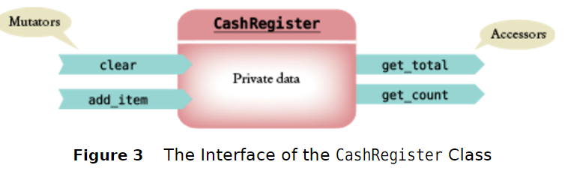
Member Functions: Accessors and Mutators
There are two kinds of member functions:
Mutator: modifies the data members of the object. For example,
void clear();
Accessor: does not modify data members. For example,
double get_total() const;

Slide 22
Accessors
This statement will print the current total:
cout << register1.get_total() << endl;

Slide 23
Common Error: (Shown in small font, enlarge to see)
Can you find the error?
class MysteryClass
{
public:
...
private:
...
} // ERROR: Forgot semicolon
int main()
{
...
}

Slide 24
Topic 4
Object oriented programming
Implementing a simple class
Specifying the public interface
Designing the data representation
Member functions
Constructors
Problem solving: tracing objects
Problem solving: discovering classes
Separate compilation
Pointers to objects
Problem solving: patterns for object data

Slide 25
Data Representation
Let’s continue with the design of CashRegister.
Each CashRegister object has member functions
get_count and get_total,
so it must store the item count of the sale that is rung up.
It must either store all entered prices (as a vector or array) and compute the total in the function call, or it must store the total.
Since the latter is simpler and adequate, we'll just store the total.

Slide 26
The Complete Cash Register Interface, with Data
class CashRegister
{
public:
void clear();
void add_item(double price);
double get_total() const;
int get_count() const;
private:
int item_count;
double total_price;
};

Slide 27
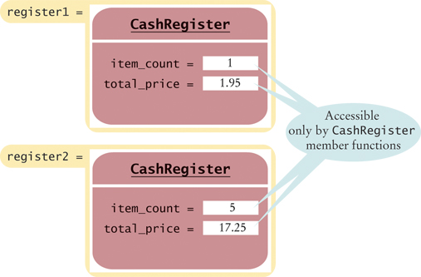
Example of Two CashRegister Objects with Data Members

Slide 28
Encapsulation Motivation
Because the data members are private, this won’t compile:
int main()
{
...
cout << register1.item_count;
// Error—use get_count() instead
}
The encapsulation mechanism guarantees:
1. We can write the mutator for item_count so that item_count cannot be set to a negative value.
If item_count were pubic, it could be directly set to a negative value by some misguided (or worse, devious) programmer.
2. If we need to change or improve implementation details later, these should not affect users of the public class interface.

Slide 29
Topic 5
Object oriented programming
Implementing a simple class
Specifying the public interface
Designing the data representation
Member functions
Constructors
Problem solving: tracing objects
Problem solving: discovering classes
Separate compilation
Pointers to objects
Problem solving: patterns for object data

Slide 30
Implementing the Member Functions
Now we have what the interface does,
and what the data members are,
what is the next step?
Implementing the member functions.

Slide 31
NOT a Member Function
void add_item(double price)
{
item_count++;
total_price = total_price + price;
}
Unfortunately this is NOT the add_item member function:
It is a separate function, just like you used to write.
It has no connection with the CashRegister class unless we prefix the function name in the header with CashRegister::

Slide 32
Member Functions
void CashRegister::add_item(double price)
{
item_count++;
total_price = total_price + price;
}
int CashRegister::get_count() const
{
return item_count;
}
/* NOTE that we do NOT declare the item_count or total_price variables in the member functions – they only get declared in the Class interface definition */

Slide 33
Implicit Parameters
In the member function call (in main):
register1.add_item(1.95);
The variable register1 is an implicit parameter to the member function. But you don’t include it in your code:
void CashRegister::add_item(double price)
{
item_count++;
total_price = total_price + price;
}
Whenever a member function accesses a variable in the Class’s data, the compiler automatically includes the implicit parameter and a dot (shown fictitiously in italics below):
void CashRegister::add_item(double price)
{
implicit parameter.item_count++;
implicit parameter.total_price =
implicit parameter.total_price + price;
}

Slide 34
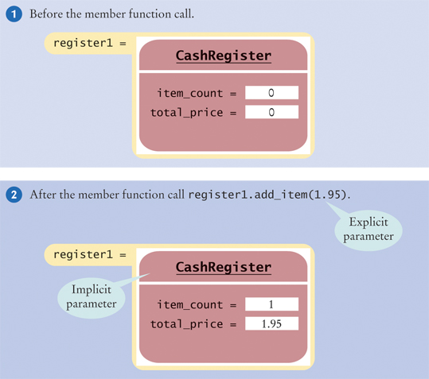
Implicit Parameters vs. Explicit

Slide 35
Calling a Member Function from a Member Function
We have already written the add_item member function
Let’s add a member function to add multiple copies of the same item to the total. This new function calls the single-unit function via a loop:
void CashRegister::add_items(int qnt, double prc)
{
for (int i = 1; i <= qnt; i++)
{
add_item(prc);
}
}

Slide 36
Calling a Member Function from Another: no Dot
When one member function calls another member function on the same object, you do not use the dot notation.
And, of course, the object remains an implicit parameter for both functions.
void CashRegister::add_items(int qnt, double prc)
{
for (int i = 1; i <= qnt; i++)
{
add_item(prc);
}
}

Slide 37
The Cash Register Program, Part 1
// sec05/cashregister.cpp
#include <iostream>
#include <iomanip>
using namespace std;
/**
A simulated cash register that tracks
the item count and the total amount due.
*/
class CashRegister
{
public:
/**
Clears the item count and the total.
*/
void clear();
/**
Adds an item to this cash register.
@param price the price of this item
*/
void add_item(double price);

Slide 38
The Cash Register Program, Part 2
/**
@return the total amount of the current sale
*/
double get_total() const;
/**
@return the item count of the current sale
*/
int get_count() const;
private:
int item_count;
double total_price;
};

Slide 39
The Cash Register Program , Part 3
void CashRegister::clear()
{
item_count = 0;
total_price = 0;
}
void CashRegister::add_item(double price)
{
item_count++;
total_price = total_price + price;
}
double CashRegister::get_total() const
{
return total_price;
}
int CashRegister::get_count() const
{
return item_count;
}

Slide 40
The Cash Register Program, Part 4 (NOT a member function)
/**
Displays the item count and total
price of a cash register.
@param reg the cash register to display
NOT a member function of the class !!
So the CashRegister must be passed as an
explicit parameter – is not implicit.
*/
void display(CashRegister reg)
{
cout << reg.get_count() << " $“
<< fixed << setprecision(2)
<< reg.get_total() << endl;
}

Slide 41
The Cash Register Program, main() and the output
int main()
{
CashRegister register1;
register1.clear();
register1.add_item(1.95);
display(register1);
register1.add_item(0.95);
display(register1);
register1.add_item(2.50);
display(register1);
return 0;
}
Program Run Output:
Item 1: $1.95
Item 2: $2.90
Item 3: $5.40

Slide 42
Practice It: The CashRegister
Trace through the function calls of main(), filling in this diagram of the values of register1’s data members:
int main()
{
CashRegister register1;
register1.clear();
register1.add_item(1.95);
display(register1);
register1.add_item(0.95);
display(register1);
register1.add_item(2.50);
display(register1);
return 0;
}
total_price | item_count

Slide 43
Programming Tip: const Correctness (1)
You should declare all accessor functions with the const reserved word.
For example, suppose you write:
class CashRegister
{
void display(); // Bad — no const
...
};
When you compile your code, no error is reported.

Slide 44
Programming Tip: const Correctness (2)
But suppose that another programmer uses your CashRegister class in a function:
void display_all(const CashRegister registers[])
{
for (int i = 0; i < NREGISTERS; i++)
{ registers[i].display(); }
}
For efficiency, that programmer declared the registers[] parameter as const.
But the call registers[i].display() will not compile. Because CashRegister::display is not tagged as const, the compiler suspects that the call may modify registers[i].

Slide 45
Topic 6
Object oriented programming
Implementing a simple class
Specifying the public interface
Designing the data representation
Member functions
Constructors
Problem solving: tracing objects
Problem solving: discovering classes
Separate compilation
Pointers to objects
Problem solving: patterns for object data

Slide 46
Constructors
A constructor is a member function that initializes the data members of an object.
The constructor is automatically called whenever an object is created.
CashRegister register1;
(You don’t see the function call nor the definition in the class, it but it’s there.)

Slide 47
Constructors: Motivation
By supplying a constructor, you can ensure that all data members are properly set before any member functions act on an object.
To understand the importance of constructors, consider:
CashRegister register1;
register1.add_item(1.95);
int count = get_count(); // May not be 1
Notice that the programmer forgot to call clear before adding items.

Slide 48
Constructor Code
You declare constructor functions in the class definition. There must be no return type, not even void.
The name of the constructor must be the same as the class:
class CashRegister
{
public:
CashRegister(); // A constructor
...
};
The constructor definition resembles other member functions:
CashRegister::CashRegister()
{
item_count = 0;
total_price = 0;
}

Slide 49
Default Constructors
If you do not write a constructor for your class, the compiler automatically generates one for you, which does nothing but allocate memory space for the data members.
The compiler does NOT provide safe initial data values, EXCEPT that string members are initialized to the empty string.
Default constructors are called when you define an object
and do not specify any parameters for the construction.
CashRegister register1;
Notice that you do NOT use an empty set of parentheses when you call the constructor followed by a new identifier to create the object.

Slide 50
Constructors with Parameters
Constructors can have parameters, and can be overloaded :
class BankAccount
{
public:
// “Default” constructor: Sets balance=0
BankAccount();
// Sets balance to initial_balance
BankAccount(double initial_balance);
// . . . Member functions omitted
private:
double balance;
};

Slide 51
Overloaded Constructors
When the same name is used for more than one function, then the functions are called overloaded. The compiler determines which to use, based on the parameter list of the call.
When you construct an object, the compiler chooses the constructor that matches the parameters that you supply:
BankAccount joes_account;
// Uses default constructor
BankAccount lisas_account(499.95);
// Uses BankAccount(double) constructor

Slide 52
Common Error: How (NOT) to Use the Constructor to Reset
You cannot call a constructor with dot notation to “reset” an object.
CashRegister register1;
...
register1.CashRegister(); // Syntax Error
The correct way to reset an object is to construct a new one and assign it to the old:
register1 = Cashregister(); //creates an
// unnamed object, then copies it to register1

Slide 53
Initialization Lists
When you construct an object whose data members are themselves objects, those objects are constructed by their class’s default constructor.
However, if a data member belongs to a class without a default constructor, you need to invoke the data member’s constructor explicitly.

Slide 54
Initialization Lists: Example (1)
A class to represent an item might not have a default constructor:
class Item:
public:
Item(string item_descript, double item_price);
// No other constructors
...
};
The Order class has an Item object as data:
class Order
{
public:
Order(string customer_name, string item_descript, double item_price);
...
private:
Item article;
string customer;
};

Slide 55
Initialization Lists Example (2)
The Order constructor must call the Item constructor.
This is done in the initializer list.
The initializer list goes after a colon, and before the opening brace of the constructor by putting the name of the data member followed by their construction arguments:
Order::Order(string customer_name, string item_description, double item_price)
: article(item_description, item_price)
{
customer = customer_name;
}

Slide 56
Initialization Lists Example (3)
Any other data members can also be initialized in the initializer list by putting their initial values in parentheses after their name, just like the class type data members. These must be separated by commas:
Order::Order(string customer_name,
string item_description,
double item_price)
: article(item_description, item_price),
customer(customer_name)
{
}
Notice there’s nothing to do in the body of the constructor now.

Slide 57
C++ 11 Adds Uniform Initialization Syntax
There are several syntactic variations to initialize variables:
double price = 19.25;
int squares[] = { 1, 4, 9, 16 };
BankAccount lisas_account(499.95);
C++ 11 introduces a uniform syntax, using braces and no equal sign, like this:
double price { 19.25 };
int squares[] { 1, 4, 9, 16 };
BankAccount lisas_account { 499.95 };
Use empty braces for default initialization:
double balance {}; // Initialized with zero
BankAccount joes_account {};
// Uses default constructor
Don’t expect to see this change adopted by most C++ programmers soon.

Slide 58
Topic 7
Object oriented programming
Implementing a simple class
Specifying the public interface
Designing the data representation
Member functions
Constructors
Problem solving: tracing objects
Problem solving: discovering classes
Separate compilation
Pointers to objects
Problem solving: patterns for object data

Slide 59
Tracing Objects
Recall how you hand traced code
to help you understand functions.
Adapting tracing for objects
will help you understand objects.
Grab some index cards, one for each object in the program.

Slide 60
Tracing Objects(2)
You know that the public: section is for others.
That’s where you’ll write methods for their use.
That will be the front of the card.
class CashRegister
{
public:
void clear();
void add_item(double price);
double get_total() const;
int get_count() const;
private:
int item_count;
double total_price;
};
...
CashRegister reg1;

Slide 61
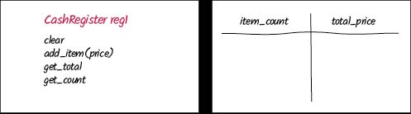
Tracing Objects(3)
You know that the private: section is for your data – they are not allowed to mess with it except through the public methods you provide.
That will be the back of the card.

Slide 62
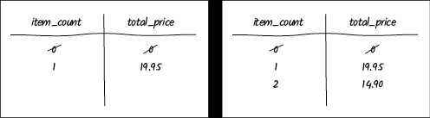
Tracing Objects(4)
CashRegister reg1;
CashRegister reg2;
reg1.addItem(19.95);
When each object is constructed, fill in the first line on the card table with the initial values.
Then, whenever a member function is called, cross out the old values and write in the new one values on that object's card...

Slide 63
Practice It: Tracing Objects
Grab some paper or index cards, and trace through the following program, using the CashRegister class implementation we have seen so far. Also record the outputs from the display() function:
int main()
{
CashRegister register1;
register1.clear();
CashRegister reg2;
reg2.clear();
register1.add_item(1.95);
reg2.add_item(0.95);
display(register1);
register1.add_item(3.95);
reg2.add_item(0.55);
register1.clear();
display(reg2);
return 0;
}

Slide 64
How to 9.1: Implementing a Class
Follow these steps to create a class, given a problem description:
Get an informal list of the responsibilities of your objects.
Specify the public interface.
Write the public: part of the class{} defintion
Document the public interface.
Add comments describing the class and each function: parameters, return value
Determine data members.
Implement constructors and member functions.
Test your class.
Write a main() that creates 2 objects and calls all class functions.

Slide 65
WORKED EXAMPLE 9.1: Bank Account Class
Problem Statement: Write a class for a bank account. Customers can deposit and withdraw, but if the balance falls <0, a $10 overdraft penalty is charged. At the end of the month, interest is added to the account. The interest rate can vary every month.
We'll follow the 6-step method from the preceding slide
Get an informal list of the responsibilities of your objects.
Deposit funds.
Withdraw funds.
Add interest.
There is a hidden responsibility as well. We need to be able to find out how much money is in the account
Get balance.

Slide 66
Bank Account Class(2)
2. Specify the public interface. (constructors and functions listed above)
class BankAccount
{
public:
BankAccount();
BankAccount(double initial_balance);
void deposit(double amount);
void withdraw(double amount);
void add_interest(double rate);
double get_balance() const;
private:
...
};

Slide 67
Bank Account Class(3)
3. Document the public interface (partial list shown below):
/**
A bank account whose balance can be changed by deposits and withdrawals.
*/
class BankAccount
{
public:
/**
Constructs a bank account with zero balance.
*/
BankAccount();
/**
Constructs a bank account with a given balance.
@param initial_balance the initial balance
*/
BankAccount(double initial_balance);

Slide 68
Bank Account Class(4)
4. Determine data members. Clearly we need to store the bank balance:
class BankAccount
{
...
private:
double balance;
};
Do we need to store the interest rate? No—it varies every month, and is supplied as an argument to add_interest.

Slide 69
Bank Account Class(5)
5. Implement constructors and member functions.
BankAccount::BankAccount()
{
balance = 0;
}
BankAccount::BankAccount(double initial_balance)
{
balance = initial_balance;
}
double BankAccount::get_balance() const
{
return balance;
}
void BankAccount::deposit(double amount)
{
balance = balance + amount;
}
// etc, etc…

Slide 70
Bank Account Class(6)
6. Test your class with a main() that calls all functions:
int main()
{
BankAccount harrys_account(1000);
harrys_account.deposit(500); // Balance $1500
harrys_account.withdraw(2000); // Balance $1490
harrys_account.add_interest(1);
// Balance $1490 + 14.90
cout << fixed << setprecision(2)
<< harrys_account.get_balance() << endl;
return 0;
}
Program Run
1504.90

Slide 71
Topic 8
Object oriented programming
Implementing a simple class
Specifying the public interface
Designing the data representation
Member functions
Constructors
Problem solving: tracing objects
Problem solving: discovering classes
Separate compilation
Pointers to objects
Problem solving: patterns for object data

Slide 72
Discovering Classes
When you solve a problem using classes, you need to determine the classes required based on the English (or other informal) problem description.
You may be able to reuse existing classes, or you may need to implement new ones.
To discover classes and member functions, look for the:
Nouns in the problem description: at least one of them will be a class. Classes almost always represent things (data), not actions.
Verbs: they will be the member functions. Functions do things to or with the data

Slide 73
Discovering Classes: Concepts
Generally, concepts from the problem domain, be it science, business, or a game, make good classes.
The name for such a class should be a noun that describes the concept.
Other frequently used classes represent system services such as files or menus.

Slide 74
Not Discovering Classes
What might not be a good class?
If you can’t tell from the class name what
an object of the class is supposed to do,
then you are probably not on the right track.

Slide 75
Classes: Bad/Good Example
For example, you might be asked to write a program that prints paychecks.
You start by trying to design a class PaycheckProgram.
What would an object of this class do? Lots, too much.
A better class would be:
class Paycheck

Slide 76
Paycheck Class
You can visualize a paycheck object.
You can then think about useful member functions of the Paycheck class, such as compute_taxes, that help you solve the problem.

Slide 77
“Has-a” relationship
When you analyze a problem description, you often find that you need multiple classes.
One of the fundamental relationships between classes is the “aggregation” relationship
(which is informally known as the “has-a” relationship).
Consider a quiz that is made up of questions.
Since each quiz has one or more questions, we say that the class Quiz aggregates the class Question

Slide 78

UML (Unified Modeling Language)
There is a standard notation to describe class relationships:
(Unified Modeling Language)
In the UML notation, aggregation is denoted by a line with a diamond-shaped symbol

Slide 79
UML Example: Quiz of Questions
The problem states that the Quiz object manages lots of Question objects.
The code follows directly, using a vector to mange the Questions:
class Quiz
{
...
private:
vector<Question> questions;
};

Slide 80
Discovering Classes: Review
In summary, when you analyze a problem description, you will want to carry out these tasks:
• Find the concepts that you need to implement as classes. Often, these will be nouns in the problem description.
• Find the responsibilities of the classes to encode as functions. Often, these will be verbs in the problem description.
• Find relationships between the classes that you have discovered.

Slide 81
Practice It: Discovering Classes
1. Suppose you are to design a software system to maintain the circulation system of a library. It has a list of library patrons and information on all items that can be borrowed by patrons, such as books, CDs, and DVDs. What are some classes you might create?
2. Suppose you are to design a software to maintain a collection of recipes. Each recipe will contain a list of ingredients as well as step-by-step instructions. Users should be able to find recipes that contain certain ingredients. What are some classes you might create?

Slide 82
Programming Tip 9.3 Make Parallel Vectors into Vectors of Objects
You might use vectors of the same length, each of which stores a part of what conceptually should be an object.
Instead, reorganize your program and use a single vector whose elements are objects.
For example, suppose an invoice contains a series of item descriptions and prices. You could keep two vectors:
vector<string> descriptions;
vector<double> prices;
Parallel vectors become a headache to ensure that the vectors always have the same length and that each slice is filled with values that actually belong together

Slide 83
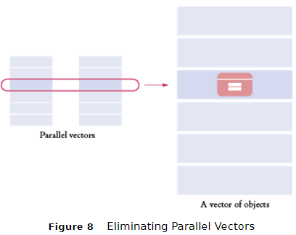
Make Parallel Vectors into Vectors of Objects
Instead of:
vector<string> descriptions;
vector<double> prices;
Make an Item class:
class Item
{
public:
...
private:
string description;
double price;
};
Replace the parallel vectors with a single vector:
vector<Item> items;

Slide 84
Topic 9
Object oriented programming
Implementing a simple class
Specifying the public interface
Designing the data representation
Member functions
Constructors
Problem solving: tracing objects
Problem solving: discovering classes
Separate compilation
Pointers to objects
Problem solving: patterns for object data

Slide 85
Separate Compilation
For small programs, all your code fits in a single file.
When your programs get larger or you work in a team, you will want to split your code into separate source files, because:
1. You don't want to wait for the compiler to keep translating code that doesn’t change. If your code is distributed over several source files, then only those files that you changed need to be recompiled.
2. On a team project, code is broken up so that each programmer can work on his/her files without conflict.
.

Slide 86
Separate Compilation: Header Files
If your program is composed of multiple files, some of these files will define data types or functions that are needed in other files.
There must be a path of communication between the files.
In C++, that communication happens through the inclusion of header files.
Yes, #include.

Slide 87
Separate Compilation: What to include
The code will be in two kinds of files:
header files (filename.h)
(which will be #include-ed)
source files (filename.cpp)
(which we usually do not #include)

Slide 88
Separate Compilation: Files
A header file contains
the interface:
Definitions of classes.
Definitions of constants.
Declarations of nonmember functions.
A source file contains
the implementation:
Definitions of member functions.
Definitions of nonmember functions.
May or may not contain main()

Slide 89
Separate Compilation: Example
cashregister.h
the interface – the class definition
cashregister.cpp
the implementation – all the member function definitions

Slide 90
Separate Compilation: cashregister.h
This is the header file, cashregister.h
Notice the #ifndef … #define at the top.
There is an ending #endif at the end of the file.
This makes sure the header is only included once, to prevent compiler errors such as "redefined".
#ifndef CASHREGISTER_H
#define CASHREGISTER_H
/**
A simulated cash register that tracks
the item count and the total amount due.
*/
class CashRegister …

Slide 91
Separate Compilation: .h file (cont)
…
private:
int item_count;
double total_price;
};
#endif
You include this header file whenever the definition of the CashRegister class is required.
Since this file is not a standard header file, you must enclose its name in quotes, not <...>, when you include it, like this:
#include "cashregister.h"

Slide 92
Separate Compilation: The Class .cpp file
Notice that the implementation file #includes its header file.
#include "cashregister.h"
CashRegister::CashRegister()
{
clear();
}
void CashRegister::clear()
{
item_count = 0;
total_price = 0;
}
Etc…

Slide 93
Separate Compilation: The .cpp file (2)
void CashRegister::add_item(double price)
{
item_count++;
total_price = total_price + price;
}
double CashRegister::get_total() const
{
return total_price;
}
int CashRegister::get_count() const
{
return item_count;
}

Slide 94
Separate Compilation: The main() Program (1)
#include <iostream>
#include <iomanip>
#include "cashregister.h"
using namespace std;
/**
Displays the item count and total
price of a cash register.
@param reg the cash register to display
*/
void display(CashRegister reg)
{
cout << reg.get_count() << " $“
<< fixed << setprecision(2)
<< reg.get_total() << endl;
}

Slide 95
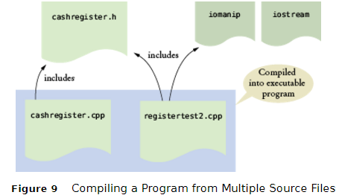
Separate Compilation: The main() Program (2)
int main()
{
CashRegister register1;
register1.clear();
register1.add_item(1.95);
display(register1);
register1.add_item(0.95);
display(register1);
register1.add_item(2.50);
display(register1);
return 0;
}

Slide 96
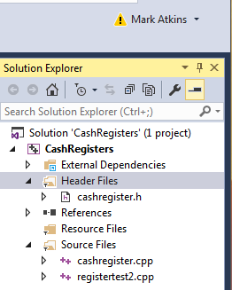
Separate Compilation: The Mechanics of the IDE
In an Integrated Development Environment, you must specify all the source files that need to be compiled/linked together
In Visual Studio, you should put the
.h file(s) into the Header Files
or Source Files folders of the Solution Explorer tree
.cpp files into the Source Files folder
In a command-line compiler, you can supply a “makefile” which lists the various files and their containing folders
Then you run the “make” utility to build the program .exe
See https://www.gnu.org/software/make/manual/ for details

Slide 97
Topic 10
Object oriented programming
Implementing a simple class
Specifying the public interface
Designing the data representation
Member functions
Constructors
Problem solving: tracing objects
Problem solving: discovering classes
Separate compilation
Pointers to objects
Problem solving: patterns for object data

Slide 98
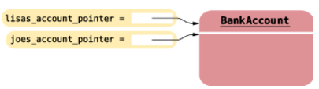
Pointers to Objects
Pointers to objects permit us to dynamically allocate them and to share objects.
CashRegister* register_pointer = new CashRegister;
BankAccount* lisas_account_pointer = new BankAccount(1000);
The new operator returns a pointer to the allocated object.
Now we can copy the pointer, without copying the object:
BankAccount* joes_account_pointer = lisas_account_pointer;
Remember to call the delete operator on the pointer before exiting the program, to reclaim the dynamic memory:
delete joes_account_pointer;

Slide 99
Pointers and the -> Operator
Given:
CashRegister* register_pointer = new CashRegister;
To invoke a member function on that object, you could call
(*register_pointer).add_item(1.95);
The parentheses are necessary because in C++ the dot operator takes precedence over the * operator. The expression without the parentheses would be a syntax error:
*register_pointer.add_item(1.95); // Error
The preferred syntax is the arrow operator:
register_pointer->add_item(1.95);

Slide 100
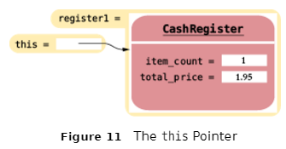
The this Pointer
Each member function of every class has a built-in parameter, called this, a pointer to the implicit parameter. (The object)
If you call
... register1.add_item(1.95) ...
then the this pointer has type CashRegister* and points to the register1 object.

Slide 101
The this Pointer: Example
You can use the this pointer inside the definition of a member function. For example,
void CashRegister::add_item(double price)
{
this->item_count++;
this->total_price = this->total_price + price;
}
However, you don't really need the this pointer in this case, as you saw in previous versions of the function.

Slide 102
The this Pointer: Motivation
The real reason to use the this pointer is to clarify duplicate variable nams, as either the data members or other explicit parameters to a function. For example, we might add a constructor to the class that carries over the previous day's total_price:
CashRegister::CashRegister(double total_price)
{
item_count =0;
this->total_price = total_price;
}
However, we recommend just giving the explicit parameter a different name (such as initial_total_price), to avoid the confusion that the above code might create.

Slide 103
Practice It: Object Pointers
Given
int n; string* p = nullptr;
Write the statements to implement the tasks. Answers shown in small font:
Task | Statement | Explanation
Dynamically allocates a string object and save the address in the pointer variable p. | p = new string; | The new operator allocates a new object from the free store and returns its address.
Deallocates the object that was allocated in the previous task. | delete p; | The delete operator deallocates the memory block with the given address.
Dynamically allocate a string object with contents "Hi"and save the address in the pointer variable p. | p = new string("Hi"); | You need to call a constructor to initialize the string object.
Invoke the length member function on the object that was allocated in the previous step and save the result in the integer variable n. | n = p->length(); | Use the -> operator to call a member function on a pointer to an object.

Slide 104
Practice It: Object Pointers and this
Write the constructor implementation of a Point class:
class Point
{
public:
Point(int x, int y);
// Member functions omitted
private:
int x;
int y;
};
Point::Point(int x, int y)
{
__________________
__________________
}

Slide 105
Topic 11
Object oriented programming
Implementing a simple class
Specifying the public interface
Designing the data representation
Member functions
Constructors
Problem solving: tracing objects
Problem solving: discovering classes
Separate compilation
Pointers to objects
Problem solving: patterns for object data

Slide 106
Keeping a Total
Many classes need to track a quantity that can go up or down as functions are called. Keep a data member that represents the current total.
double total_price;
Examples of what must be done to the total:
void CashRegister::add_item(double price)
{
total_price = total_price + price;
}
void CashRegister::clear()
{
total_price = 0;
}
double CashRegister::get_total()
{
return total_price;
}

Slide 107
Counting Events
For classes that need to count events, some examples:
int item_count; //Keep a counter
Increment the counter in those member functions that correspond to the events that you want to count.
void CashRegister::add_item(double price)
{
total_price = total_price + price;
item_count++;
}
You may need to clear the counter:
void CashRegister::clear()
{
total_price = 0;
item_count = 0;
}
There may or may not be a member function that reports the count to the class user.

Slide 108
Collecting Values
Some objects collect numbers, strings, or other objects. For example, each multiple-choice question has a number of choices. A cash register may need to store all prices of the current sale. Use a vector to store these, and a member function to add to the list:
class Question
{
. . .
private:
vector<string> choices;
. . .
};
void Question::add(string choice)
{
choices.push_back(choice);
}

Slide 109
Managing Properties of an Object
A property is a value of an object that an object user can set and retrieve. For example, a Student object may have a name and an ID.
An object property needs a getter and setter member functions. Provide a data member to store the property’s value:
class Student
{
public:
Student(string name_, int id_);
string get_name() const;
int get_id() const;
void set_name(string new_name);
private:
string name;
int id;
};
void Student::set_name(string new_name) // Includes Error checking
{
if (new_name.length() > 0) { name = new_name; }
}
Some properties should not change after initialization in the constructor, and thus need no setter function. For example, a student’s ID.

Slide 110
Modeling Objects with Distinct States(1)
Some objects’ behavior depends on what happened in the past. For example, a Fish object may look for food when it is hungry and ignore food after it has eaten.
Such an object needs a state variable to remember whether it has recently eaten.
Supply a data member that models the state, together with some constants for the state values:
class Fish
{
public:
const int NOT_HUNGRY = 0;
cont int SOMEWHAT_HUNGRY = 1;
const int VERY_HUNGRY = 2;
void eat();
void move();
private:
int hungry = NOT_HUNGRY;
};

Slide 111
Modeling Objects with Distinct States(2)
Determine which member functions change the state. If a fish has just eaten food, it won’t be hungry. But as the fish moves, it will get hungrier.
void Fish::eat()
{
hungry = NOT_HUNGRY;
. . .
}
void Fish::move()
{
if (hungry == VERY_HUNGRY)
{
cout << "Looking for food" << endl;
} else . . .
if (hungry < VERY_HUNGRY) { hungry++; }
}
Finally, determine where the state affects behavior. A fish that is very hungry will want to look for food first.

Slide 112
Describing the Position of an Object
Some objects move around during their lifetime, and they remember their current position. For example,
A train drives along a track and keeps track of the distance from the terminus.
A bug living on a grid crawls from one grid location to the next, in one of 4 directions.
If the object moves along a line, represent the position as a distance.
double distance_from_terminus;
If the object moves in a grid, remember its current location and direction in the grid:
int row, column;
int direction; // 0 = North, 1 = East, 2 = South, 3 = West
When you model a physical object such as a cannonball, you need to track both the position and the velocity, possibly in 2 or 3 dimensions.
double z_position, z_velocity;
There will be member functions that update the position. In the simplest case, you may be told by how much the object moves:
void Train::move(double distance_moved)
{
distance_from_terminus = distance_from_terminus + distance_moved;
}

Slide 113
Chapter Summary, Part 1
Understand the concepts of objects and classes.
•A class describes a set of objects with the same behavior.
An object is a collection of related data, like a struct, plus member functions that manipulate the data.
•Every class has a public interface: a collection of member functions through which the objects of the class can be manipulated.
•Encapsulation is the act of providing a public interface and private data and function internals, hiding implementation details.
•Encapsulation enables changes in the implementation without affecting users of a class.

Slide 114
Chapter Summary, Part 2
Understand data members and member functions of a simple class.
•The member functions of a class define the behavior of its objects.
•An object’s data members represent the state of the object.
•Each object of a class has its own set of data members.
•A member function can access the data members of the object on which it acts.
•A private data member can only be accessed by the member functions of its own class.

Slide 115
Chapter Summary, Part 3
Formulate the public interface of a class in C++.
•You can use member function declarations and function comments to specify the public interface of a class.
•A mutator member function changes the object on which it operates.
•An accessor member function does not change the object on which it operates. Use const with accessors.
Choose data members to represent the state of an object.
•An object holds data members that are accessed by member functions.
•Private data members can only be accessed by member functions of the same class, and we usually make all data private.

Slide 116
Chapter Summary, Part 4
Implement member functions of a class.
•Use the ClassName:: prefix when defining member functions.
•The implicit parameter is a reference to the object on which a member function is applied.
•Explicit parameters of a member function are listed in the function definition.
•When calling another member function on the same object, do not use the dot notation.
void CashRegister::add_items(int qnt, double prc)
{
for (int i = 1; i <= qnt; i++)
{
add_item(prc); //calling another member function
}
}

Slide 117
Chapter Summary, Part 5
Design and implement constructors.
•A constructor is called automatically when an object is created.
•The name of a constructor is the same as the class name.
•A default constructor has no arguments.
•A class can have multiple constructors. (“overloaded”)
•The compiler picks the constructor that matches the arguments.
•Be sure to initialize all number and pointer data members in a constructor.
class BankAccount
{
public:
// “Default” constructor: Sets balance=0
BankAccount();
// Sets balance to initial_balance
BankAccount(double initial_balance);
// . . . Member functions omitted
private:
double balance;
};

Slide 118
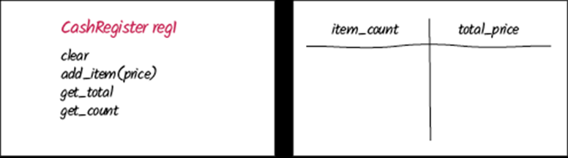
Chapter Summary, Part 6
Use the technique of object tracing for visualizing object behavior.
•Write the member functions on the front of a card, and the data member values on the back.
•Update the values of the data members when a mutator member function is called.

Slide 119
Chapter Summary, Part 7
Discover classes that are needed for solving a programming problem.
•To discover classes, look for nouns in the problem description.
•Concepts from the problem domain are good candidates for classes.
•Verbs in the description will inspire member functions required to manipulate the class data.
•A class aggregates another if its objects contain objects of the other class.
•Avoid parallel vectors by changing them into vectors of objects.

Slide 120
Chapter Summary, Part 8
Separate the interface and implementation of a class in header and source files.
•The code of complex programs is distributed over multiple files.
•Header files contain the definitions of classes and declarations of nonmember functions.
•Source files contain function implementations.

Slide 121
Chapter Summary, Part 9
Use pointers to objects and manage dynamically allocated objects.
•Use the new operator to obtain an object that is located on the free store.
•The new operator returns a pointer to the allocated object.
•When an object allocated on the free store is no longer needed, use the delete operator to reclaim its memory.
•Use the -> operator to invoke a member function through a pointer, or to access a private data member from the “this” pointer
•In a member function, the this pointer points to the implicit parameter.

Slide 122
Chapter Summary, Part 10
Use patterns to design the data representation of a class.
•An data member for the total is updated in member functions that increase or decrease the total amount.
•A counter that counts events is incremented in member functions that correspond to the events.
•An object can collect other objects in an array or vector.
•An object property can be accessed with a getter member function and changed with a setter member function.
•If your object can have one of several states that affect the behavior, supply a data member for the current state.
•To model a moving object, you need to store and update its position.

