Slide 1

Chapter Ten: Inheritance
Slides by Evan Gallagher

Slide 2
Chapter Goals
To understand the concepts of inheritance and polymorphism
To learn how to inherit and override member functions
To be able to implement constructors for derived classes
To be able to design and use virtual functions

Slide 3
Topic 1
Inheritance hierarchies
Implementing derived classes
Overriding member functions
Virtual functions and polymorphism

Slide 4
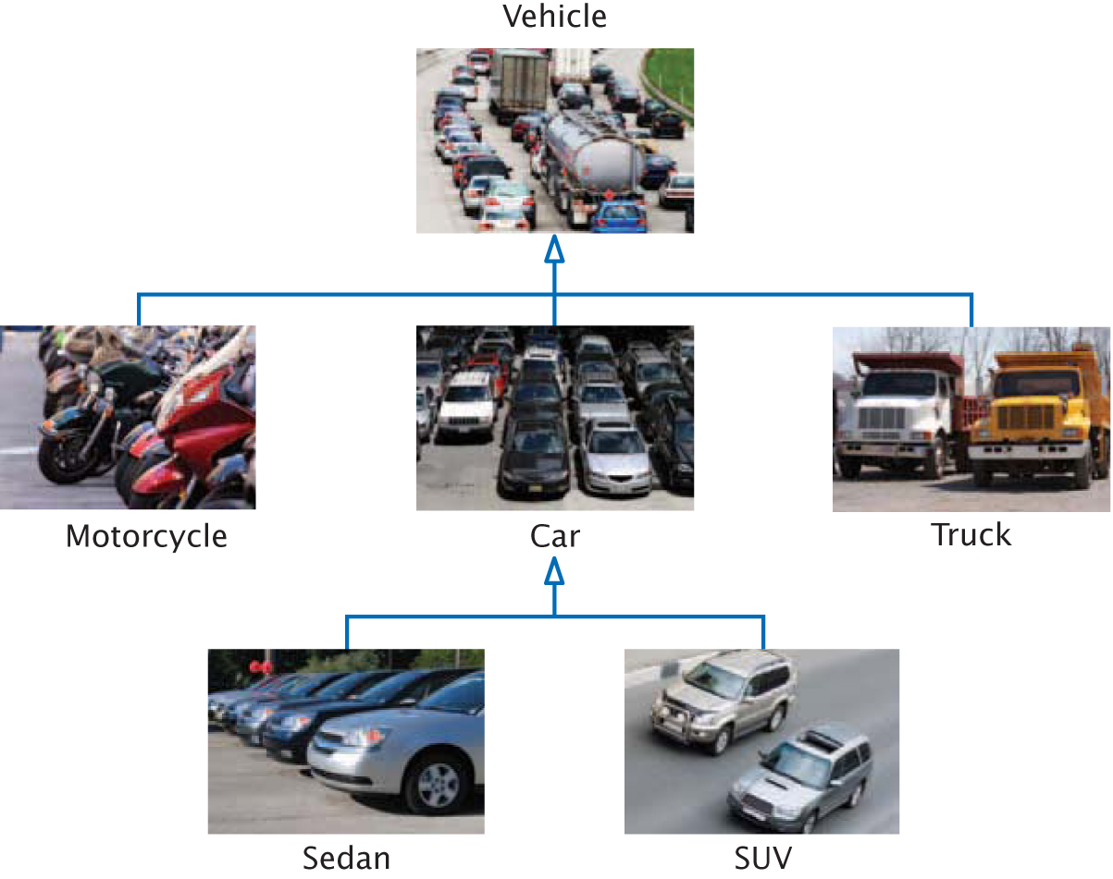
Inheritance Hierarchies

Slide 5
Inheritance
In object-oriented design, inheritance is a relationship between a more general class (called the base class) and a more specialized class (called the derived class).
The derived class inherits data and behavior from the base class.
Every car is a vehicle.
IS-A
denotes inheritance.

Slide 6
Inheritance: The IS-A Relationship
All Cars are Vehicles.
All Motorcycles are Vehicles.
All Sedans are Vehicles.
Vehicles is the base class.
Car is a derived class.
Truck derives from Vehicle

Slide 7
Everything a Vehicle Has is Inherited by Cars and Trucks
Everything about being
a Vehicle is inherited by
Cars and Trucks and
SUVs.
Those things specific
to Cars are only
inherited by Sedans
and SUVs.

Slide 8
The Substitution Principle
The substitution principle states that you can always use a derived-class object when a base-class object is expected.
Suppose we have an algorithm or function that manipulates a Vehicle object.
Since a car IS-A vehicle, we can supply a Car object to such an algorithm or function, and it will work correctly.

Slide 9
The Substitution Principle: streams
void process_input(istream& in);
You can call this function with an ifstream object or with an istream object.
Why?
Because istream is more general than ifstream.
void process_input(ifstream& in);
This works by inheritance:

Slide 10
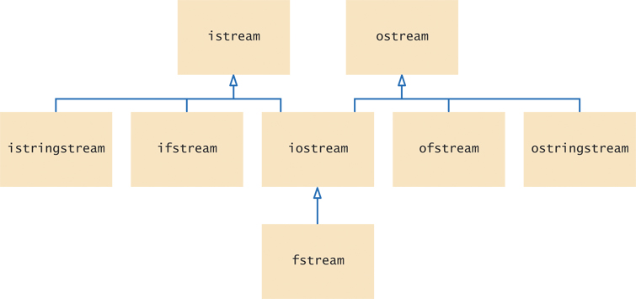
The C++ Stream Class Hierarchy
istream is the base class of ifstream.
ifstream, istringstream, and oistream all inherit data and functions from istream.

Slide 11
Class Hierarchy Example for a Quiz Question
Quizzes consist of different kinds of questions:
(We like multiple guess questions.)
Fill-in-the-blank
Choice (single or multiple)
Numeric (we’ll allow approximate answers to be OK)
Free response

Slide 12
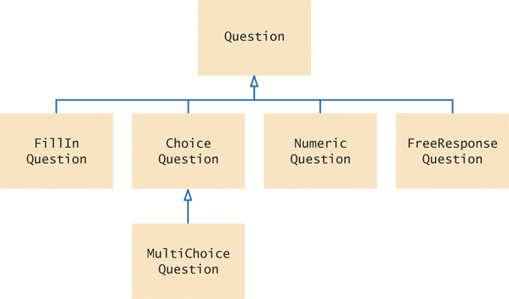
Question Hierarchy
Here is the UML diagram that resulted from our analysis:

Slide 13
The Base Class: Question
We want a object of Question type to work like this:
First, the programmer sets the question text and the correct answer in the Question object.
When a user takes the test, the programmer asks the Question to display the text of the question
The program gets the use’s response and passes it to the Question object for evaluation, to display true or false.

Slide 14
The Base Class Code: Question
class Question
{
public:
Question();
void set_text(string question_text);
void set_answer(string correct_response);
bool check_answer(string response) const;
void display() const;
private:
string text;
string answer;
};

Slide 15
Question Class & Test Program (1)
Here’s a complete program
to test our Question class.
// sec01/demo.cpp
#include <iostream>
#include <sstream>
#include <string>
using namespace std;
class Question
{
public:
/**
Constructs a question with empty text and answer.
*/
Question();

Slide 16
Question Class & Test Program (2)
/**
@param question_text the text of this question
*/
void set_text(string question_text);
/**
@param correct_response the answer to this question
*/
void set_answer(string correct_response);
/**
@param response the response to check
@return true if the response was correct,false otherwise
*/
bool check_answer(string response) const;
/**
Displays this question.
*/
void display() const;
private:
string text;
string answer;
};

Slide 17
Question Class & Test Program (3)
Question::Question()
{ //no need to initialize here, as strings default to empty
}:
void Question::set_text(string question_text)
{
text = question_text;
}
void Question::set_answer(string correct_response)
{
answer = correct_response;
}
bool Question::check_answer(string response) const
{
return response == answer;
}
void Question::display() const
{
cout << text << endl;
}

Slide 18
Question Class & Test Program (4)
int main()
{
string response;
// Show Boolean values as true, false
cout << boolalpha; // Notice this manipulator
Question q1;
q1.set_text("Who was the inventor of C++?");
q1.set_answer("Bjarne Stroustrup");
q1.display();
cout << "Your answer: ";
getline(cin, response);
cout << q1.check_answer(response) << endl;
return 0;
}

Slide 19
Practice It: Inheritance
Suppose you have designed an inheritance hierarchy that includes the following relationships:
Guitar is derived from Instrument
AcousticGuitar is derived from Guitar
ElectricGuitar is derived from Guitar
Given the declarations below, which of the objects CANNOT be passed to the function tune(Guitar& g)?
AcousticGuitar ag;
ElectricGuitar eg;
Guitar my_guitar;
Instrument my_instrument;

Slide 20
Topic 2
Inheritance hierarchies
Implementing derived classes
Overriding member functions
Virtual functions and polymorphism

Slide 21
Implementing Derived Classes
Now for those different kinds of questions.
Each of the different kinds of questions IS-A Question
so we code by starting with the base class (Question) and then we write code for what makes the different types special versions of more general Question type.

Slide 22
Derived Classes Inherit All Data and Functions from the Base
Through inheritance, each of the derived classes has the data members and member functions set up in class Question.
– plus “specialness” which is not inherited, but added in the definition of each derived class
(We don’t rewrite the member functions)
(code reuse in action)

Slide 23
Derived Classes: ChoiceQuestion
class ChoiceQuestion : public Question
{
public:
// New and changed member // functions will go here
private:
// Additional data members
// will go here
};
The : denotes interitance

Slide 24
ChoiceQuestion – Analysis of the Problem
After a programmer has set the question text and the several multiple choice answers the ChoiceQuestion object is asked to display something like:
In which country was the inventor of C++ born?
1: Australia
2: Denmark
3: Korea
4: United States

Slide 25
ChoiceQuestion must have:
ChoiceQuestion must have:
Storage for the various choices for the answer
Question has the question text and correct answer, not these
A member function for adding another choice
A display function
The designer of the Question class could not have known how to display this sort of multiple choice question. It only has the question itself, not the choices.
In the ChoiceQuestion class you will have to rewrite the display function display.
This is called overriding a member function.

Slide 26
Derived Classes: ChoiceQuestion Code
After specifying the class you are inheriting from, you only write the differences:
class ChoiceQuestion : public Question
{
public:
ChoiceQuestion();
void add_choice(string choice, bool correct);
void display() const;
private:
vector<string> choices;
};

Slide 27
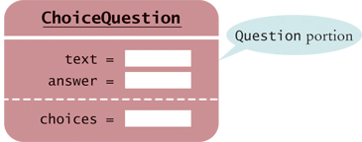
Derived Class Diagram
class Question
{
public:
Question();
void set_text(string question_text);
void set_answer(string correct_response);
bool check_answer(string response) const;
void display() const;
private:
string text;
string answer;
};
class ChoiceQuestion : public Question
{
public:
ChoiceQuestion();
void add_choice(string choice, bool correct);
void display() const;
private:
vector<string> choices;
};
ChoiceQuestion is one type,
made of two parts:
inherited (text, answer)
and new (choices).

Slide 28
Derived Classes Cannot Directly Read/Write Private Base Data
The derived class inherits all data members and all functions that it does not override.
Consider:
Choice_question choice_question;
choice_question.set_answer("2");
//calls public member function of base class
choice_question.answer = "2"; //ERROR
// will not compile – private data only accessible in member functions of base

Slide 29
Derived Classes and Private Data of the Base Class
This means that when you are writing the ChoiceQuestion member functions, you cannot directly access any private data members in Question.
The derived class functions, just like any other function, can only use the public interface of the base class.

Slide 30
add_choice Member Function
void ChoiceQuestion::add_choice(string choice, bool correct)
{
choices.push_back(choice);
if (correct) //change answer to this one's number
{
// Convert choices.size() to string
string num_str = to_string(choices.size());
// Set num_str as the answer, using public function:
set_answer(num_str);
}
}

Slide 31
Practice It: Derived Classes from Critter (1)
Here is the Critter class, from which we will derive others:
(file critter.h)
class Critter
{
public:
Critter(); //Constructs a critter at position 0 with blank history.
string get_history() const; /** @return the history */
void add_history(string event); /**Adds to the history
@param event the event to add to the history */
int get_position() const;
void move(int steps); // @param steps the number of steps to move.
void act(); //The action of this critter in one pass of simulation.
private:
int position;
vector<string> history;
};

Slide 32
Practice It: Derived Classes from Critter (2)
Define a class Sloth derived from Critter. Sloths alternate between eating and sleeping. Add the word "eat" or "sleep" to the history each time the act function is called.
#include <iostream>
using namespace std;
#include "critter.h"
/** A sloth eats and sleeps.*/
class Sloth : public Critter
{
public:
Sloth();
. . .
private:
. . .
};
Sloth::Sloth(){ . . .}

Slide 33
Practice It: Derived Classes from Critter (3)
Define a derived class NervousCritter from Critter. A nervous critter moves nervously between positions 0 and 1. In the act function, carry out the appropriate move.
#include <iostream>
using namespace std;
#include "critter.h"
/** A nervous critter moves back and forth between positions 0 and 1.*/
class NervousCritter . . .
{
public:
. . .
};
. . .

Slide 34
Common Error 10.1: Private Inheritance
Here is the class definition for ChoiceQuestion again.
It has one small error. Can you find it?
class ChoiceQuestion : Question
{
public:
ChoiceQuestion();
void add_choice(string choice, bool correct);
void display() const;
private:
vector<string> choices;
};

Slide 35
Common Error: Private Inheritance
If you do not specify public inheritance,
you get private inheritance.
class ChoiceQuestion : _________ Question
{
public:
ChoiceQuestion();
void add_choice(string choice, bool correct);
void display() const;
private:
vector<string> choices;
};
Private inheritance: only member functions of ChoiceQuestion get to call member functions of Question.
Whenever a main() invokes a Question member function on a ChoiceQuestion object, the compiler will flag it as an error:

Slide 36
Common Error: Replicating Base Class Members
A derived class has no direct access to base class private data. The following code therefore won't compile, with an “unknown identifier in this scope: text” error message:
ChoiceQuestion::ChoiceQuestion(string quest_txt)
{
text = quest_txt; //text is in the base class
}
When some programmers encounter that compiler error,
they just start hacking…

Slide 37
Common Error: Replicating Base Class Members (2)
And an “easy” fix seems to be to add the data member that the compiler is complaining about.
class ChoiceQuestion : public Question
{
ChoiceQuestion::ChoiceQuestion(string quest_txt)
...
private:
vector<string> choices;
string text; //hacking addition, a mistake
}
Now it compiles, but it doesn’t set the correct text! Such a ChoiceQuestion object has 2 data members named text. The constructor sets one, and the display function uses the other.
Instead of replicating a base-class data member, you need to call a member function to initialize it: set_text(quest_txt)

Slide 38
Inheritance Is For Behaviors, Not Values
Consider a program that tracks fuel efficiency of cars by logging the distance traveled and the refueling amounts.
Some cars are hybrids. Should you create a derived class HybridCar? Not in this application.
Hybrids don’t behave any differently than other cars when it comes to driving and refueling. They just have better MPG. A single Car class with a data member
double miles_per_gallon;
is entirely sufficient.
However, in a program showing repairs of different kinds of vehicles, you need a separate class HybridCar, as their repairs behave differently.

Slide 39
Calling the Base-Class Constructor (1)
A derived-class constructor can only initialize the data members of the derived class.
But the base-class data members also need to be initialized.
Unless you specify otherwise, the base-class data members are initialized with the default constructor of the base class.

Slide 40
Calling the Base-Class Constructor (2)
If you want to use another base-class constructor, you use an initializer list. For example, suppose the Question base class had a constructor setting the question text. Here is a derived-class constructor calling that base-constructor:
ChoiceQuestion::ChoiceQuestion(string question_text)
: Question(question_text)
{ . . .
}
The constructor of a derived class can supply arguments to a base-class constructor.
The base-class constructor acts before the derived class code inside the { }.

Slide 41
Topic 3
Inheritance hierarchies
Implementing derived classes
Overriding member functions
Virtual functions and polymorphism

Slide 42
Overriding Member Functions
Recall that our design requires that the display member function be rewritten in the ChoiceQuestion class.
This is called overriding a member function.
ChoiceQuestion’s display method needs to:
Display the question text.
Display the answer choices.

Slide 43
Overriding Member Functions (2)
The second part is easy – just a loop to print out the derived-class data members
int ChoiceQuestion::display() const
{
// Display the question text
...
// Display the answer choices
for (int i = 0; i < choices.size(); i++)
{
cout << i + 1 << ": "
<< choices[i] << endl;
}
}

Slide 44
Overriding Member Functions (3)
The first part seems easy too – call the display in Question:
int ChoiceQuestion::display() const
{
// Display the question text
display(); /* attempting to call Question’s display function */
// Display the answer choices
...
UNFORTUNATELY, this results in a recursive function with display() called from ChoiceQuestion by itself, instead of the base class display().

Slide 45
Overriding Member Functions (4)
The solution is to do what you said in the first place:
Call Question’s display by prefixing the function name with Question::
int ChoiceQuestion::display() const
{
// Display the question text
Question::display();
// Display the answer choices
...
}
Note that the override function does not necessarily have to call the base class’s function, unless it must use the base’s data members.

Slide 46
A Program With ChoiceQuestion (1)
// sec03/demo.cpp
#include <iostream>
#include <sstream>
#include <vector>
#include "question.h"
class ChoiceQuestion : public Question
{
public:
/**
Constructs a choice question with no choices.
*/
ChoiceQuestion();

Slide 47
A Program With ChoiceQuestion (2)
/**
Adds an answer choice to this question.
@param choice the choice to add
@param correct true if this is the correct choice, false otherwise
*/
void add_choice(string choice, bool correct);
void display() const;
private:
vector<string> choices;
};
ChoiceQuestion::ChoiceQuestion()
{
}

Slide 48
A Program With ChoiceQuestion (3)
void ChoiceQuestion::add_choice(string choice, bool correct)
{
choices.push_back(choice);
if (correct)
{
// Convert choices.size() to string
string num_str = to_string(choices.size());
set_answer(num_str);
}
}
void ChoiceQuestion::display() const
{
// Display the question text
Question::display();
// Display the answer choices
for (int i = 0; i < choices.size(); i++)
{
cout << i + 1 << ": " << choices[i] << endl;
}
}

Slide 49
A Program With ChoiceQuestion (4)
int main()
{
string response;
cout << boolalpha;
// Ask a basic question
Question q1;
q1.set_text("Who was the inventor of C++?");
q1.set_answer("Bjarne Stroustrup");
q1.display();
cout << "Your answer: ";
getline(cin, response);
cout << q1.check_answer(response) << endl;

Slide 50
A Program With ChoiceQuestion (5)
// Ask a choice question
ChoiceQuestion q2;
q2.set_text("In which country was the inventor of C++ born?");
q2.add_choice("Australia", false);
q2.add_choice("Denmark", true);
q2.add_choice("Korea", false);
q2.add_choice("United States", false);
q2.display();
cout << "Your answer: ";
getline(cin, response);
cout << q2.check_answer(response) << endl;
return 0;
}

Slide 51
A Program With ChoiceQuestion (6)
Program Run
Who was the inventor of C++?
Your answer: Bjarne Stroustrup
true
In which country was the inventor of C++ born?
1: Australia
2: Denmark
3: Korea
4: United States
Your answer: 2
true

Slide 52
Common Error: Forgetting the Base-Class Name
Don’t forget to use the BaseClass::memberFunction notation when you want to call a member function from the base class, when you are writing:
DerivedClass::memberFunction

Slide 53
Topic 4
Inheritance hierarchies
Implementing derived classes
Overriding member functions
Virtual functions and polymorphism

Slide 54
An Array of Questions?
In the main function of that last program, there was some repetitive code to display each question and check the responses.
It would be nicer if all questions were collected in a single array, though some are base Questions and some are ChoiceQuestions.
You could then loop to present them to the user:

Slide 55
First Attempt at Code for an Array of Questions
const int QUIZZES = 2;
Question quiz[QUIZZES];
quiz[0].set_text("Who was the inventor of C++?");
quiz[0].set_answer("Bjarne Stroustrup");
ChoiceQuestion cq;
cq.set_text("In which country was the inventor of C++ born?");
cq.add_choice("Australia", false);
...
quiz[1] = cq;
for (int i = 0; i < QUIZZES; i++)
{
quiz[i].display();
cout << "Your answer: ";
getline(cin, response);
cout << quiz[i].check_answer(response) << endl;
}

Slide 56
The Slicing Problem
However, is it really working?
Here’s a run of the program:
Who was the inventor of C++?
Your answer: Bjarne Stroustrup
true
In which country was the inventor of C++ born?
Your answer:
Where are the choices for the ChoiceQuestion?

Slide 57
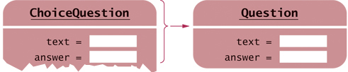

The Slicing Problem (2)
The array quiz holds Questions. The compiler realizes that a ChoiceQuestion is a special case of a Question. Thus it permits :
quiz[1] = cq;
However, a ChoiceQuestion object has 3 data members, whereas a Question has just 2. There is no room to store the derived-class data in the array.
That data simply gets sliced away when you assign a derived-class object to a base-class variable.

Slide 58
Use Pointers Instead
To access objects from different classes in a class hierarchy, use an array of pointers to objects instead of an array of objects.
(to avoid slicing).
Pointers to the various objects all have the same size:
the size of a memory address.

Slide 59
Pointers to Base and Derived Classes
Pointers to base classes can hold pointers to ANY object publicly derived from it
– as far down the inheritance chain as you want to go.
The opposite will not work:
Assigning a base pointer to a derived pointer location will generate a compiler error.

Slide 60
Pointers to Base and Derived Classes (2)
To manage all of these, use a
vector<Question*> qv;
or an array of
Question* quiz[2];
and store
only pointers to the different kinds of Questions
Fill-in-the-blank
Numeric Free response
Choice (single)
Choice (multiple – inherits from Choice (single)
Essay

Slide 61
Code for Pointers to Base and Derived Classes
Notice the use of new and -> :
Question* quiz[2];
quiz[0] = new Question;
quiz[0] -> set_text("Who was the inventor of C++?");
quiz[0] -> set_answer("Bjarne Stroustrup");
ChoiceQuestion* cq_pointer = new ChoiceQuestion;
cq_pointer -> set_text("In which country… …C++ born?");
cq_pointer -> add_choice("Australia", false);
...
quiz[1] = cq_pointer;

Slide 62
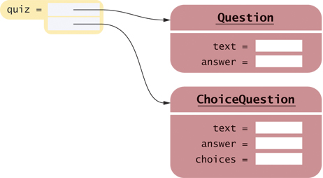
Diagram of Pointers to Base to Manage Base and Derived
Question* quiz[2];
quiz[0] = new Question;
quiz[1] = new ChoiceQuestion;

Slide 63
The Code to Display All the Questions in the Pointer Array
The code to present all questions – any kind of Question – is:
for (int i = 0; i < QUIZZES; i++)
{
quiz[i] -> display();
cout << "Your answer: ";
getline(cin, response);
cout << quiz[i] -> check_answer(response) << endl;
}

Slide 64
Virtual Functions: Motivation
When you call the display member function on a
Question* pointer that currently contains a pointer to a
ChoiceQuestion, you want the choices to be displayed.

Slide 65
Virtual Functions: Motivation (2)
But that’s not what happens.
For reasons of efficiency, by default, the call
quiz[i]->display();
always calls Question::display
because the type of quiz[i] is Question*.

Slide 66
Virtual Functions: Mechanism
In C++, you must alert the compiler that the function call needs to not be the default,
that the function should be the one in the thing pointed to.
(How?)
You use the virtual reserved word for this purpose.

Slide 67
Virtual Functions Must Be Declared in the Base Class
The virtual reserved word must be used in the base class.
class Question
{
public:
Question();
void set_text(string question_text);
void set_answer(string correct_response);
virtual bool check_answer(string response) const;
virtual void display() const;
private:
...
};
All functions with the same name and parameter types
in derived classes are then automatically virtual.

Slide 68
Virtual Functions: Derived Classes
Although not needed, it is considered good practice to write the virtual reserved word in the derived-class functions in the derived-class interface.
class ChoiceQuestion : public Question
{
public:
ChoiceQuestion();
void add_choice(string choice, bool correct);
virtual void display() const;
private:
...
};

Slide 69
You do NOT Write virtual in the Function Definition
You do not write virtual in the function definition, only in the interface header in the class xxx{}; statement:
void Question::display() const
{
cout << text << endl;
}
When a virtual function is called, the compiled code determines the type of the implicit parameter at run time. The appropriate function for that object is then called. For example:
quiz[i]->display();
always calls the function belonging to the actual type of the object to which quiz[i] points — either
Question::display or ChoiceQuestion::display.

Slide 70
Polymorphism
The quiz vector collects a mixture of all kinds of Questions.
Such a collection is called polymorphic
(literally, “of multiple shapes”).
Objects in a polymorphic collection have some commonality but are not necessarily of the same type.
Inheritance is used to express this commonality.
virtual functions enable variations in behavior.

Slide 71
Polymorphism (2)
Each object knows on its own how to carry out its specific version of these general tasks:
“Display the question”
(my way)
and
“Check a response”
(my way).

Slide 72
Polymorphism (3)
Suppose we want to have a new
kind of question for calculations, where we are willing to accept an approximate answer.
All we need to do is to define a new class NumericQuestion,
with its own check_answer function.
Then we can populate any quiz vector with a
mixture of plain questions, choice questions,
and these new numeric questions.
They will fit in just fine because:
they IS-A Questions.

Slide 73
Complete Program: Polymorphism & Virtual Functions (1)
// question.h
#ifndef QUESTION_H
#define QUESTION_H
#include <string>
using namespace std;
class Question
{
public:
/**
Constructs a question with empty question and answer.
*/
Question();
/**
@param question_text the text of this question
*/
void set_text(string question_text);
/**
@param correct_response the answer for this question
*/
void set_answer(string correct_response);

Slide 74
Complete Program: Polymorphism & Virtual Functions (2)
/**
@param response the response to check
@return true if the response was correct,
false otherwise
*/
virtual bool check_answer(string response) const;
/**
Displays this question.
*/
virtual void display() const;
private:
string text;
string answer;
};
#endif

Slide 75
Complete Program: Polymorphism & Virtual Functions (3)
// choicequestion.h
#ifndef CHOICEQUESTION_H
#define CHOICEQUESTION_H
#include <vector>
#include "question.h"
class ChoiceQuestion : public Question
{
public:
/**
Constructs a choice question with no choices.
*/
ChoiceQuestion();
/**
Adds an answer choice to this question.
@param choice the choice to add
@param correct true if this is the correct choice,
false otherwise
*/
void add_choice(string choice, bool correct); virtual void display() const;
private:
vector<string> choices;
};
#endif

Slide 76
Complete Program: Polymorphism & Virtual Functions (4)
// sec04/demo.cpp
#include <iostream>
#include "question.h"
#include "choicequestion.h"
int main()
{
string response;
cout << boolalpha;
// Make a quiz with two questions const int QUIZZES = 2;
Question* quiz[QUIZZES];
quiz[0] = new Question;
quiz[0]->set_text("Who was the inventor of C++?");
quiz[0]->set_answer("Bjarne Stroustrup");

Slide 77
Complete Program: Polymorphism & Virtual Functions (5)
ChoiceQuestion* cq_pointer = new ChoiceQuestion;
cq_pointer->set_text("In which country was the inventor of C++ born?");
cq_pointer->add_choice("Australia", false);
cq_pointer->add_choice("Denmark", true);
cq_pointer->add_choice("Korea", false);
cq_pointer->add_choice("United States", false);
quiz[1] = cq_pointer;
// Check answers for all questions
for (int i = 0; i < QUIZZES; i++)
{
quiz[i]->display();
cout << "Your answer: ";
getline(cin, response);
cout << quiz[i]->check_answer(response) << endl;
}
return 0;
}

Slide 78
Programming Tip 10.2: Don’t Use Type Tags
Some programmers build inheritance hierarchies with each object having a string tag to indicate its class. They then query that string:
if (q->get_type() == "Question")
{ // Do something
}
else if (q->get_type() == "ChoiceQuestion")
{ // Do something else
}
This is a poor strategy. If a new class is added, then all these queries need to be revised.
In contrast, the addition of a class NumericQuestion to our quiz program required no hierarchy rewrite because it uses virtual functions, not type tags.
Don’t add type tags to a hierarchy of classes -- use virtual functions instead.

Slide 79
Common Error 10.4: Slicing an Object Function Argument
It is legal to copy a derived-class object into a base-class variable. However, any derived-class information is lost in the process.
To avoid slicing, you can use pointers, as explained with the Quiz array.
Slicing also occurs when a function has a polymorphic parameter (that can belong to a base or a derived class).

Slide 80
References Avoid Slicing an Object Function Argument
An example of a poorly designed function that may slice away required data:
void ask(Question q) // Error
{
q.display();
cout << "Your answer: ";
getline(cin, response);
cout << q.check_answer(response) << endl;
}
If you call this function with a ChoiceQuestion object, then the parameter variable q is initialized with a copy of that object. But q is a Question object; the derived-class information is sliced away.
Instead, use a reference parameter for the object:
void ask(const Question& q)
Now only the address is passed to the function, no data is sliced away, and the virtual function display() works correctly.

Slide 81
Common Error 10.5: Failing to Override a Virtual Function
Two functions can have the same name, provided they differ in their parameter types – this is OVERLOADING, not overriding. For example,
class Question
{
public:
virtual void display() const;
virtual void display(ostream& out) const;
. . .
};
This differs from overriding, where a derived class function re-implements a base class function with the same name and the same parameter types.

Slide 82
Failing to Override a Virtual Function (2)
It is a common error to accidentally provide an overloaded function when you actually mean to override a function. Consider this scary example:
class ChoiceQuestion : public Question
{
public:
void display(); /* Does not override
Question::display() const */
. . .
};
The display member function in the Question class has subtly different parameters: the implicit parameter this is a const Question*, whereas in the ChoiceQuestion class, the implicit parameter is not const.

Slide 83
Override a Virtual Function (3) and the C++11 Fix
In C++ 11, you can use the reserved word override to tag any member function that should override a virtual function:
class ChoiceQuestion : public Question
{
public:
void display() override;
. . .
};
If the member function does not override a virtual function, the compiler generates an error. Then the programmer can realize the need to add the missing const reserved word.
The compiler also generates an error if you forget to declare the base class member function as virtual.

Slide 84
HOW TO 10.1: Developing an Inheritance Hierarchy (1)
When you work with classes, some of which are general and others more specialized, you want to organize them into an inheritance hierarchy.
Step 1: List the classes that are part of the hierarchy.
Step 2: Organize the classes into an inheritance hierarchy.
Step 3: Determine the common responsibilities.

Slide 85
HOW TO 10.1: Developing an Inheritance Hierarchy (2)
Step 4: Decide which functions are overridden in derived classes.
Step 5: Define the public interface of each derived class
Step 6: Identify data members.
Step 7: Implement constructors and member functions.
Step 8: Allocate objects on the free store and process them
For a first example of this process, see the textbook for a bank account class hierarchy. The following slides include another example.

Slide 86
WORKED EXAMPLE 10.1: Employee Hierarchy, Payroll (1)
Let's apply the 8-step Inheritance Hierarchy Method to:
Problem Statement: Implement payroll processing for 3 different kinds of employees:
• Hourly employees get paid an hourly rate, but if they work more than 40 hours per week, the excess is paid at “time and a half”.
• Salaried employees get paid their salary, no matter how many hours they work.
• Managers are salaried employees who get paid a salary and a bonus.
Compute the pay for a collection of employees:
For each employee, ask for the number of hours worked in a given week, then display the wages earned.

Slide 87
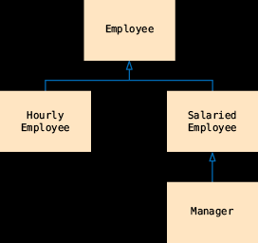
WORKED EXAMPLE 10.1: Employee Hierarchy, Payroll (2)
1: List the classes that are part of the hierarchy.
HourlyEmployee
SalariedEmployee
Manager
AND we need a base class that expresses the commonality among them: Employee.
2: Organize the classes into an inheritance hierarchy.
Here is the UML diagram:

Slide 88
WORKED EXAMPLE 10.1: Employee Hierarchy, Payroll (3)
3. Determine the common responsibilities of the classes.
We write pseudocode for processing the objects:
For each employee
Print the name of the employee.
Read the number of hours worked.
Compute the wages due for those hours.
We conclude that the Employee base class has these responsibilities:
Get the name.
Compute the wages due for a given number of hours.

Slide 89
WORKED EXAMPLE 10.1: Employee Hierarchy, Payroll (4)
4. Decide which functions are overridden in derived classes.
In our example, there is no variation in employee names, but salary is computed differently in each derived class. We will declare the weekly_pay member function as virtual in Employee.
class Employee
{
public:
Employee();
string get_name() const;
virtual double weekly_pay(int hours_worked) const;
...
private:
...
};

Slide 90
WORKED EXAMPLE 10.1: Employee Hierarchy, Payroll (5)
5. Define the public interface of each class.
Construct employees from their name and salary:
HourlyEmployee(string name, double wage);
SalariedEmployee(string name, double salary);
Manager(string name, double salary, double bonus);
These constructors need to set the name of the Employee base object. We will supply an Employee member function set_name for this purpose. In this simple example, no further member functions are required.

Slide 91
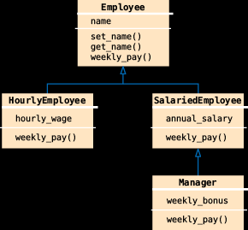
WORKED EXAMPLE 10.1: Employee Hierarchy, Payroll (6)
6. Identify data members.
List the data members for each class. If you find a data member that is common to all classes, be sure to place it in the base class.
All employees have a name. Therefore, the Employee class should have a data member name.
What about the salaries? Hourly employees have an hourly wage, whereas salaried employees have an annual salary. While it would be possible to store these values in a data member of the base class, it would not be a good idea.

Slide 92
WORKED EXAMPLE 10.1: Employee Hierarchy, Payroll (7a)
7. Implement constructors and member functions.
SalariedEmployee::SalariedEmployee(string name, double salary)
{
set_name(name);
annual_salary = salary;
}
Here we use a member function.
We invoke a base-class constructor for the Manager constructor:
Manager::Manager(string name, double salary, double bonus)
: SalariedEmployee(name, salary)
{
weekly_bonus = bonus;
}

Slide 93
WORKED EXAMPLE 10.1: Employee Hierarchy, Payroll (7b)
7. Implement constructors and member functions.
The weekly pay needs to be computed:
double HourlyEmployee::weekly_pay(int hours_worked) const
{
double pay = hours_worked * hourly_wage;
if (hours_worked > 40)
{
pay = pay + ((hours_worked - 40) * 0.5) * hourly_wage;
}
return pay;
}
double SalariedEmployee::weekly_pay(int hours_worked) const
{
const int WEEKS_PER_YEAR = 52;
return annual_salary / WEEKS_PER_YEAR;
}

Slide 94
WORKED EXAMPLE 10.1: Employee Hierarchy, Payroll (7c)
7. Implement constructors and member functions.
For Manager, we need to call the version of weekly_pay from the SalariedEmployee base class:
double Manager::weekly_pay(int hours) const
{
return SalariedEmployee::weekly_pay(hours) + weekly_bonus;
}

Slide 95
WORKED EXAMPLE 10.1: Employee Hierarchy, Payroll (8)
8. Allocate objects on the free store and process them.
In our sample program, we populate a vector of pointers and compute the weekly salaries:
vector<Employee*> staff;
staff.push_back(new HourlyEmployee("Morgan, Harry", 30));
...
for (int i = 0; i < staff.size(); i++)
{
cout << "Hours worked by "<< staff[i]->get_name()<< ": ";
int hours;
cin >> hours;
cout << "Salary: "<< staff[i]->weekly_pay(hours) << endl;
}
The complete code for this program is contained in worked_example_1/salaries.cpp.

Slide 96
Chapter Summary (1)
Explain inheritance, base class, and derived class.
• A derived class inherits data and behavior from a base class.
• You can always use a derived-class object in place of a base-class object.
Implement derived classes in C++.
• A derived class can override a base-class function by providing a new implementation.
• The derived class inherits all data members and all functions that it does not override.
• Unless specified otherwise, the base-class data members are initialized with the default constructor.
• The constructor of a derived class can supply arguments to a base-class constructor.
Manager::Manager(string name, double salary, double bonus)
: SalariedEmployee(name, salary)

Slide 97
Chapter Summary (2)
Describe how a derived class can override functions from a base class.
• A derived class can inherit a function from the base class, or it can override it by providing another implementation.
• Use BaseClass::function notation to explicitly call a base-class function.
Describe virtual functions and polymorphism.
• When converting a derived-class object to a base class, the derived-class data is sliced away.
• A derived-class pointer can be converted to a base-class pointer.
• When a virtual function is called, the version belonging to the actual type of the implicit parameter is invoked.
• Polymorphism (literally, “having multiple shapes”) describes objects that share a set of tasks and execute them in different ways.

