Slide 1
Introduce to method

Slide 2
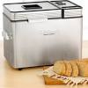
Input and return
Device concentrates on one useful task.
For example, a bread machine.
Input is like the materials needed to feed into the device for it to start working.
Return is like the results given to the user that uses the device.

Slide 3

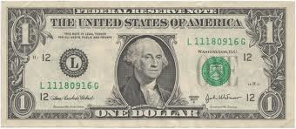
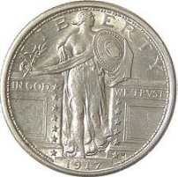
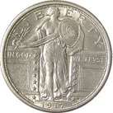
Input and Return: quarter changer
Input dollar bill and return quarters
one input,
one return
Notes:
Input: one dollar bill
Output: quarters

Slide 4


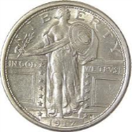
Input and Return: vending machine
two inputs,
one return
Input: money in bills and coins
Return: a metro card with that amount of money
Notes:
Inputs: metrocard, bills and coins
Return: refilled metrocard ticket

Slide 5

Input and Return: alarm clock
What is input?
What is the return?
We use alarm time as input, get some audio effect (alarm sound), but no physical return.
one input,
no return
Notes:
What is input: time
What is the return: none
Action taken: produce sound at that moment.
void alarm(Time alarmTime)
Write a program for it
Watch is a device without no input and no return.

Slide 6
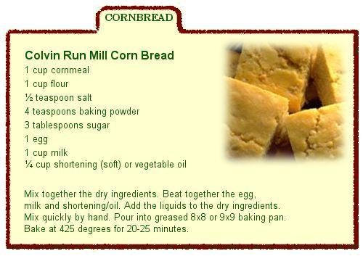
What is a method
A method like a recipe, it is a set of instructions that process the given input, and return something if necessary.
Return
Input
Process input
Notes:
http://www.fairfaxcounty.gov/parks/crm/images/recipe-cornbread.jpg
In a potluck, if I am responsible for a chocolate cake, I might cook it from scratch, or I might buy one from store directly. The point is, as long as I return you a chocolate cake, you do not need to care for the details that how I finish my job.

Slide 7
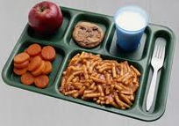
Components of method
A method has a meaningful name, normally as a verb.
zero, one, or many inputs
zero or one return
If we have more than one return, pack them in a composite type -- a structure composed of several types. So, the return is still one, but it contains many stuffs.
A method has some functionality.
One method normally concentrates only on one task.

Slide 8
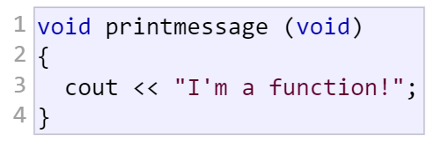


Existing methods with no input
Input: none
Return: none
Functionality: Print out a message to the screen.
printmessage
Input: none
Return: an integer
Functionality: return a random int.
rand
$$an integer$$
Notes:
clear method of string is
void clear()

Slide 9

Existing methods with one input
Input: a number
Return: the square root
Functionality: calculate the square root of input
sqrt
$$\sqrt{2}$$
2
Notes:
System.out.print method takes one input, has no return.
Math.sqrt takes one input, has one return.

Slide 10


Existing method with two inputs
pow(2, 3) order matters
pow(3, 2)
2
pow
$$2^{3}$$
3
3
pow
$$3^{2}$$
2
Notes:
Math.pow method takes two inputs, has one return.

Slide 11
Caller vs. callee
Callee: the method being called
Caller: the method that calls another method
The roles of caller and callee are relative.
main method calls isPrime method, and isPrime method can call isFactor method.
So, isPrime is both a caller and a callee

Slide 12
When a method is called
Caller saves
local variables
return point (what is the next instruction to run after finishing calling a method)
Caller passes parameter list to callee.
Caller yields control to callee.
Callee works with the input parameters and returns something if required.
Callee yields control to caller.
Caller continue to work from the return point.

Slide 13
An example on calling method
You call a pizza store. Tell them what kind of pizza you want.
Someone delivered a pizza to you.
You get the pizza, then continue to work with it: you may eat it, or bring it to a party, or study for the ingredients… whichever way you like for the pizza.
Start from 18th second: https://www.youtube.com/watch?v=D_5Ee4OTt1o
Questions: who is a caller and who is a callee?

Slide 14
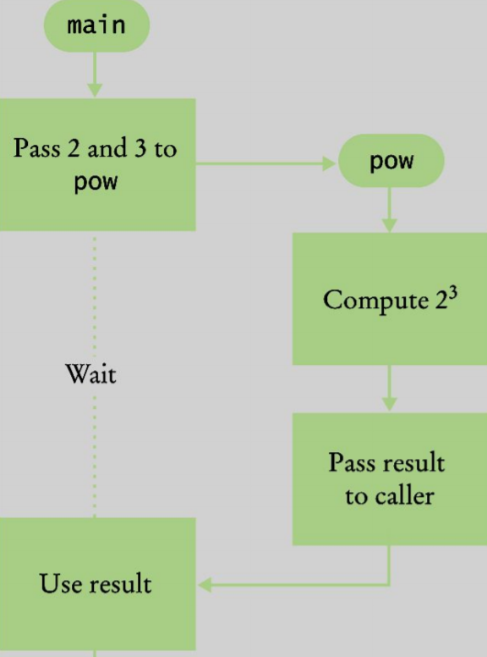
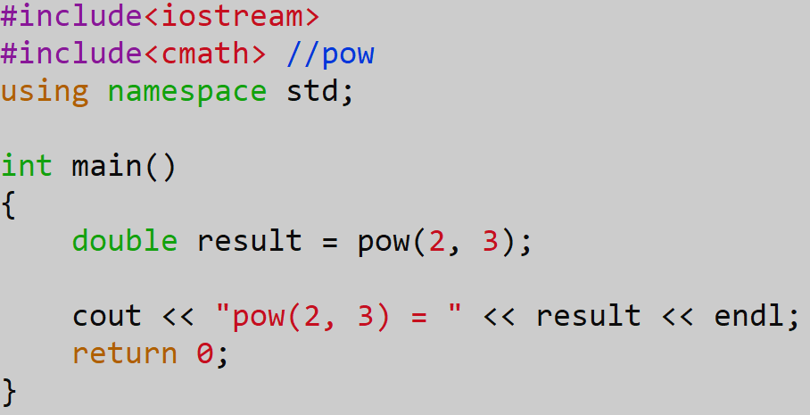
Relation between caller and callee
Given the following code.

Slide 15
Related: function in math
Definition: f(x) = x², where f is function name, x is parameter, and x² is the functionality of a function (aka, what a function can do).
Call the above function to find out f(3), it will return 3², which is 9.
In math, only work with numbers, but in computer, the types can range from int, double, char, …, to string, and so on.

Slide 16
Function in C++
In C++, when define a function,
return_type function_name(parameter_list)
//there can be 0, 1, or more parameters,
//parameter list is type parameter_name separated by comma (,)
{
//functionality, what to do with the parameters
}
In C++, to call a function
functionName(actual_parameter_list); //if return type is not void, can put the return of function to a variable with the same type as return type.

