Slide 1
Head and neck Squamous Cell Carcinoma (HNSCC)
Akansha, Kevin, and Tri

Slide 2
Review: Head and neck squamous cell carcinoma (HNSCC)
Johnson et al.
Notes:
Kevin:
Outline some of the major findings and potential holes related to HNSCC
Comprehensive literature review of current literature on HNSCC

Slide 3
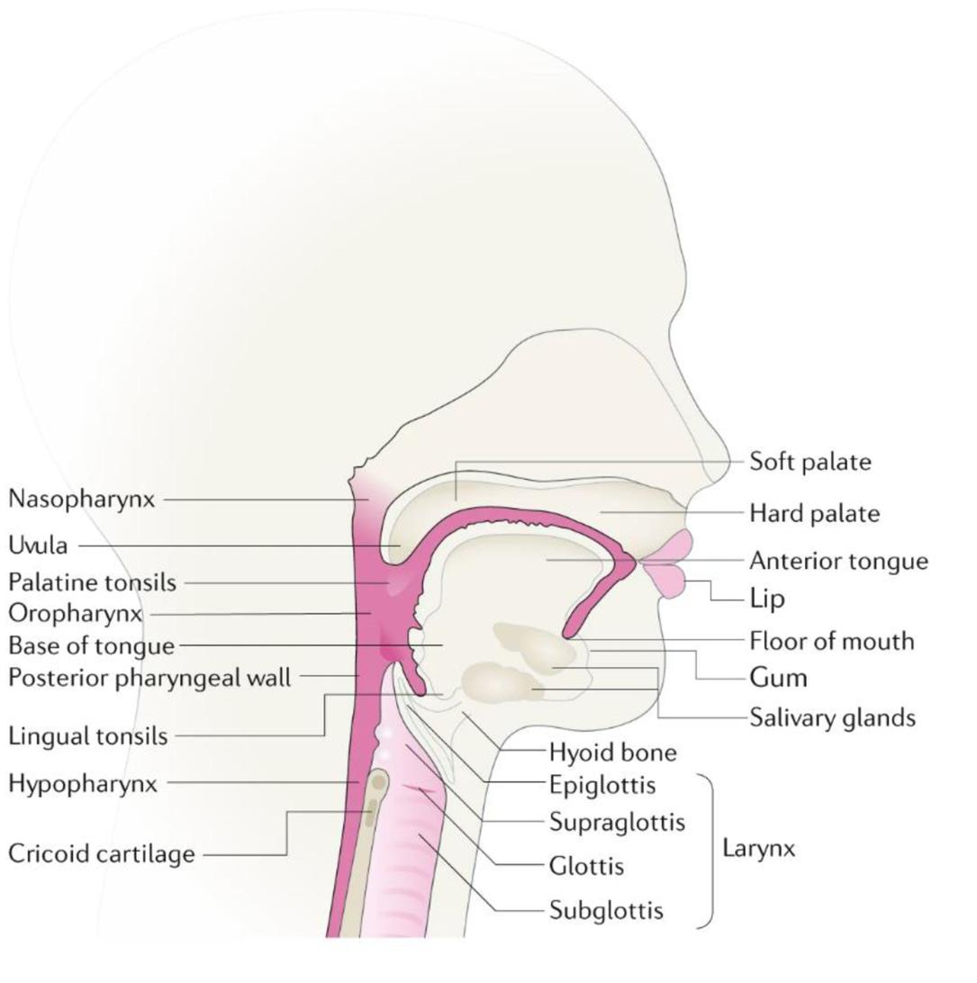
What Is HNSCC?
Sixth most common cancer worldwide
Most common in adults
  E.g median age at diagnosis of 66 years for HPV-negative HNSCC
30% expected increase by 2030
Arises from squamous cells, found in outer layer of skin and mucous membranes
Cancer develops in the mouth, nose, and throat (oral cavity)
Like other cancers, can spread to other parts such as lymph nodes or lungs
Notes:
Kevin

Slide 4
Risk Factors
Diverse range of risk factors:
  Tobacco consumption, alcohol consumption, exposure to environmental pollutants and infection with viral agents (HPV and EBV)
>35-fold higher risk of developing HNSCC for heavy users of tobacco and alcohol
Smokeless tobacco, areca nut, betel quid associated with increased risk for HSNCC
HPV-negative HNSCC or HPV-positive HNSCC
Notes:
Kevin

Slide 5
Risk Factors
HPV-negative HNSCC
Triggered by substance use
Tobacco consumption is the primary risk factor for development
Tobacco associated with inflammation in exposed tissue, producing of cytokines, chemokines and growth factors and promoting proliferation, angiogenesis, and carcinogenesis.
Alcohol synergizes with tobacco use to promote carcinogenesis
HPV-positive HNSCC
Infection with HPV increases risk for HNSCC
HPV infection is associated with most oropharyngeal cancers (>70%), less at other head and neck sites
HPV-positive HNSCC exhibits distinct differences from HPV-negative HNSCC in gene expression, mutational and immune profiles, and more
Notes:
Kevin

Slide 6
Genomics
Transcriptomics
More driven by loss of tumor suppressors as opposed to mutations and oncogenes
  Loss of 9p21 region: tumor-suppressing genes CDKN2A and ARF (stabilize p53)
  Progression from hyperplasia → dysplasia → carcinoma : loss of regions coding for p53
  Dysplasia → carcinoma, carcinoma →metastasis: loss of 11q13, 13q21, 14q32, 6p, 8, 4q27, 10q23
p-EMT: partial epithelial-mesenchymal transition
Single-cell analyses of primary and metastatic tumors reveals cells w/ p-EMT are localized to leading edge of tumors
Predictor of metastasis, tumor grade, and pathological features
Notes:
akansha

Slide 7
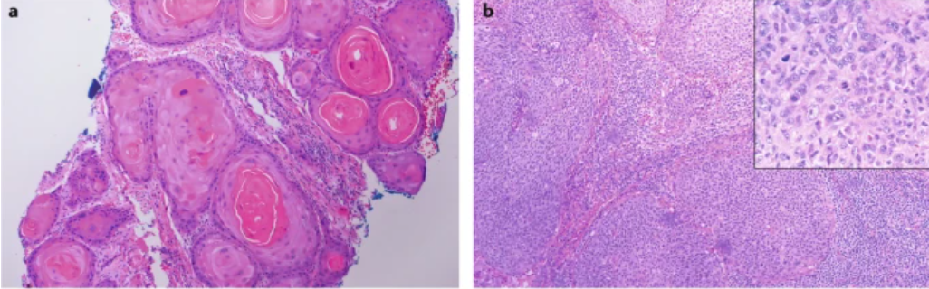
Diagnosis
Histopathology
  HNSCC must be established by biopsy of the primary tumour and/or neck mass
Followed by staging evaluation:
  complete head and neck examination with direct inspection of the oral cavity
  CT or MRI to establish the extent of disease
  chest CT to rule out distant metastatic disease
Notes:
Tri
- HPV-negative HNSCC is well-differentiated tumor (a), HPV-positive is not well-differentiated (b)
-In pt with tobacco-related HNSCC, a panendoscopy with anesthesia is also done to rule out a second-tobacco-related primary tumor in upper airway

Slide 8
Prevention
Primary Prevention
Avoidance of Tobacco, areca nut use, and other carcinogenic sources
HPV vaccination
Most cases of HNSCC would indeed be preventable with successful global elimination of tobacco use and implementation of HPV vaccination
Secondary Prevention
Screening
  Limited effect due to no validated tool existing for screening HPV-positive HNSCC
Notes:
Tri
- 2 Doses recommend for 15 under, 3 doses for 15+
-Low vaccination rates and increased in number of incidence signifies that herd immunity is far from reality

Slide 9
Treatment
Highly curative approach, while optimizing preservation of function
Use of a combination of surgery, radiation, immuno- and chemotherapy
Continually developing treatment, as demonstrated in research paper
Recommend treatment at high case facilities for improved survival rates
Notes:
Tri
-Curative approach looks like accurately evaluating the extent of disease prior to any therapy → avoid extra CRT and reduce risk of toxicity
-Depends on the location of the cancer, different methods will be used, or a combination of them
-Encourage pt with advanced HNSCC participate in clinical trials with strong biological rationale -> ex: research found new immunotherapy
-Multidisciplinary care requirements → found treatment at high-case # or academia facilities improve survival odds/wellness

Slide 10
Pembrolizumab With or Without Chemotherapy in Recurrent or Metastatic Head and Neck Squamous Cell Carcinoma: Updated Results of the Phase III KEYNOTE-048 Study
Harrington et al.
Notes:
akansha

Slide 11
Pembrolizumab as first-line treatment for HNSCC
Switch from EGFR-inhibitor cetuximab → programmed death 1 inhibitor pembrolizumab-chemotherapy drug clinical trial
Updating results for phase III of clinical trial, with progression-free survival analysis
Purpose:
Analyzing the efficacy of Pembrolizumab and pembrolizumab chemotherapy for HNSCC
Notes:
akansha

Slide 12
Methodology: Random allocation
Eligible patients were age ≥ 18 years with previously untreated R/M squamous cell carcinoma
Patients were randomly allocated 1:1:1
  pembrolizumab alone
  pembrolizumab plus platinum and 5-fluorouracil (pembrolizumab-chemotherapy)
  cetuximab plus platinum and fluorouracil (cetuximab-chemotherapy).
Primary endpoints were progression-free survival (PFS) and overall survival (OS). Secondary endpoints included objective response rate (ORR) and safety. Duration of response (DOR) was exploratory.
Notes:
kevin

Slide 13
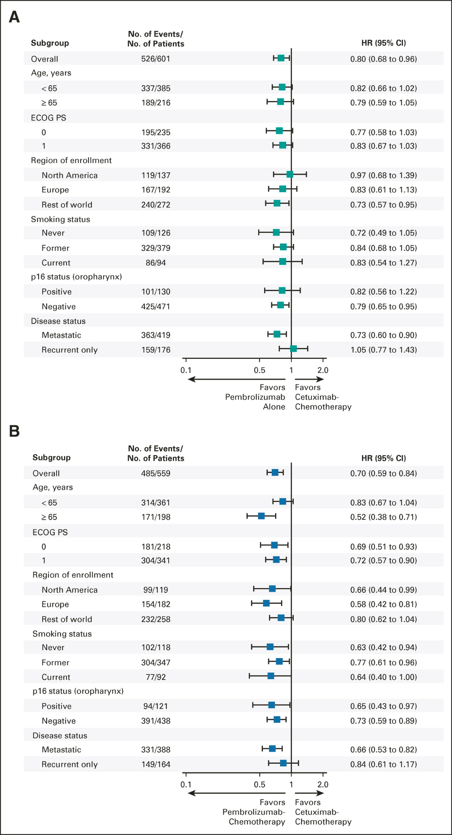
FIG 3: Subgroup Analysis of Overall Survival
Patients organized into subgroups. “No. of events” → “No. of deaths”
95% confidence intervals for overall survival (months)
Group A: Pembrolizumab-alone vs cetuximab-chemotherapy
Group B: Pembrolizumab-chemotherapy vs cetuximab-chemotherapy
Appears that pembrolizumab overall is favored over cetuximab-chemotherapy as confidence intervals typically lean left
Notes:
akansha

Slide 14
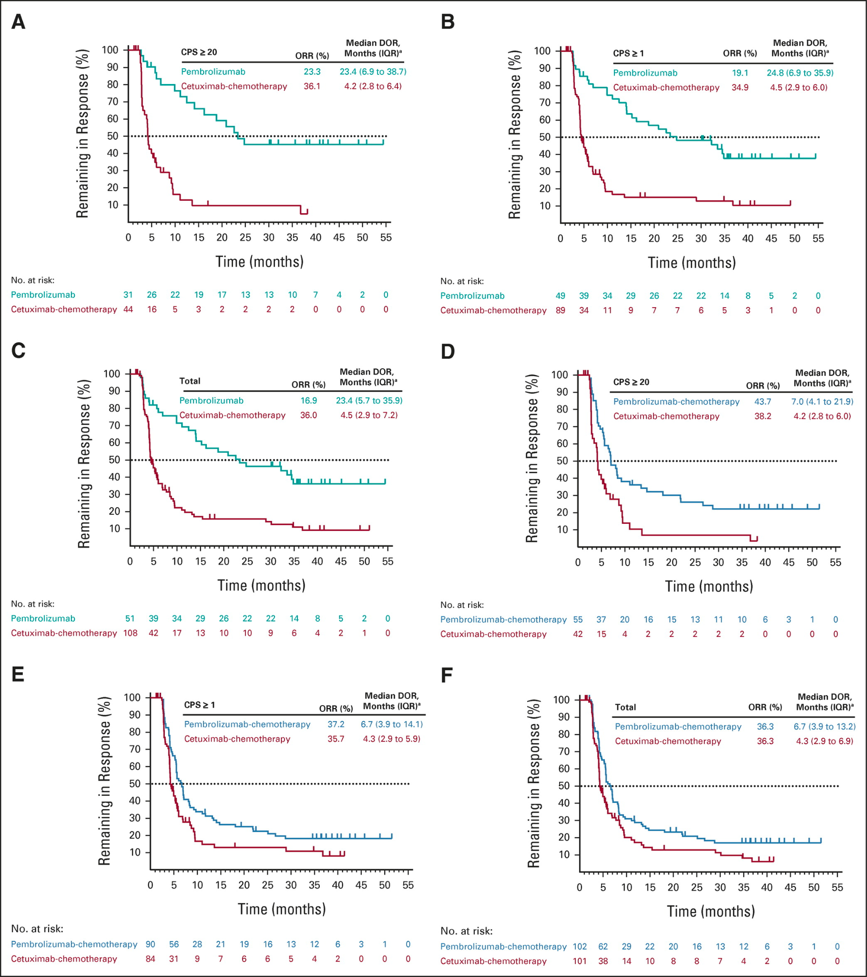
FIG 4: Kaplan-Meier for Duration of Response
A, B, C: pembrolizumab-alone vs. cetuximab-chemotherapy
D, E, F: pembrolizumab-chemotherapy vs cetuximab-chemotherapy
Pembrolizumab-chemotherapy and pembrolizumab-alone had higher ORR than cetuximab-chemotherapy
Notes:
akansha

Slide 15
Results and Conclusions
Results
Pembrolizumab alone prolonged OS vs. cetuximab-chemo (14.9 vs.10.3 months)
PFS2 on taxane therapy was longer with pembrolizumab compared to non-taxane therapy
Conclusion
With 4 years f/u, first-line pembrolizumab indicated better survival benefits vs. cetuximab-chemo in R/M HNSCC
Pt react better in subsequent treatment after pembrolizumab-based therapy
Notes:
Tri
OS = overall survival (time of treatment - time of death)
PFS2 = progression free survival of next treatment → (duration cancer doesn’t develop further)
Taxane = class of immunotherapeutic drug to stop cancer growth
R/M HNSCC = relapsed or metastasized

Slide 16
Further Research
Developing field:
Further work into the potential risk of E-Cigarettes
The oral microbiome, effect of oral health on oral cancers
Further research into the effectiveness of pembrolizumab-only treatments vs. pembrolizumab-chemotherapy
Effectiveness of current treatment on HPV-positive vs. HPV-negative cancers
Notes:
Kevin

