Slide 1
Credit Card Fraud Detection
Machine Learning Final Project
Student: ____________________
Course: ____________________
Notes:
Introduce yourself and project context. Mention this is an end-to-end pipeline from training to dashboard deployment.

Slide 2
Introduction: Problem & Objective
Credit card fraud creates major financial and trust risks
Need to catch fraudulent transactions early
Need to reduce false alerts for legitimate users
Objective: build a practical end-to-end ML fraud detection system
Notes:
Set business context and explain precision-recall tradeoff importance in fraud detection.

Slide 3
Dataset Overview
Source: Credit Card Fraud Detection dataset (Kaggle/ULB)
284,807 transactions total
492 fraud cases (0.17%)
Features used: V1–V28 + Amount | Target: Class
Notes:
Emphasize severe imbalance. Mention why this invalidates naive accuracy-based conclusions.

Slide 4
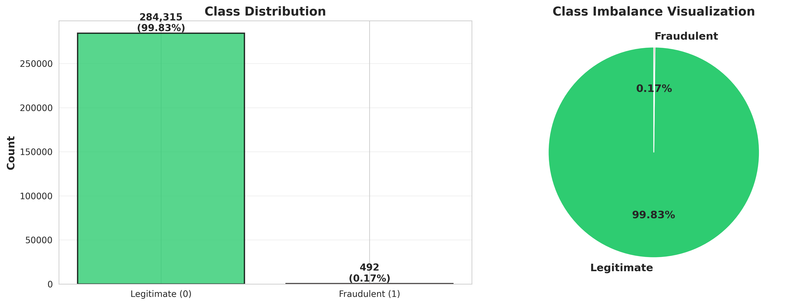
Data Insights: Class Imbalance & EDA
Notes:
Use this chart to motivate imbalance handling with SMOTE.

Slide 5
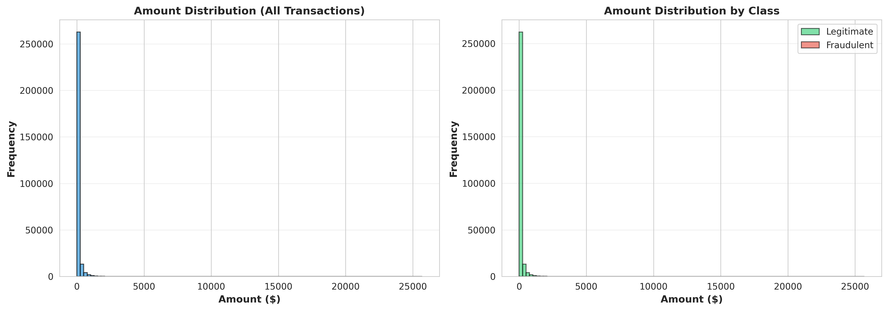
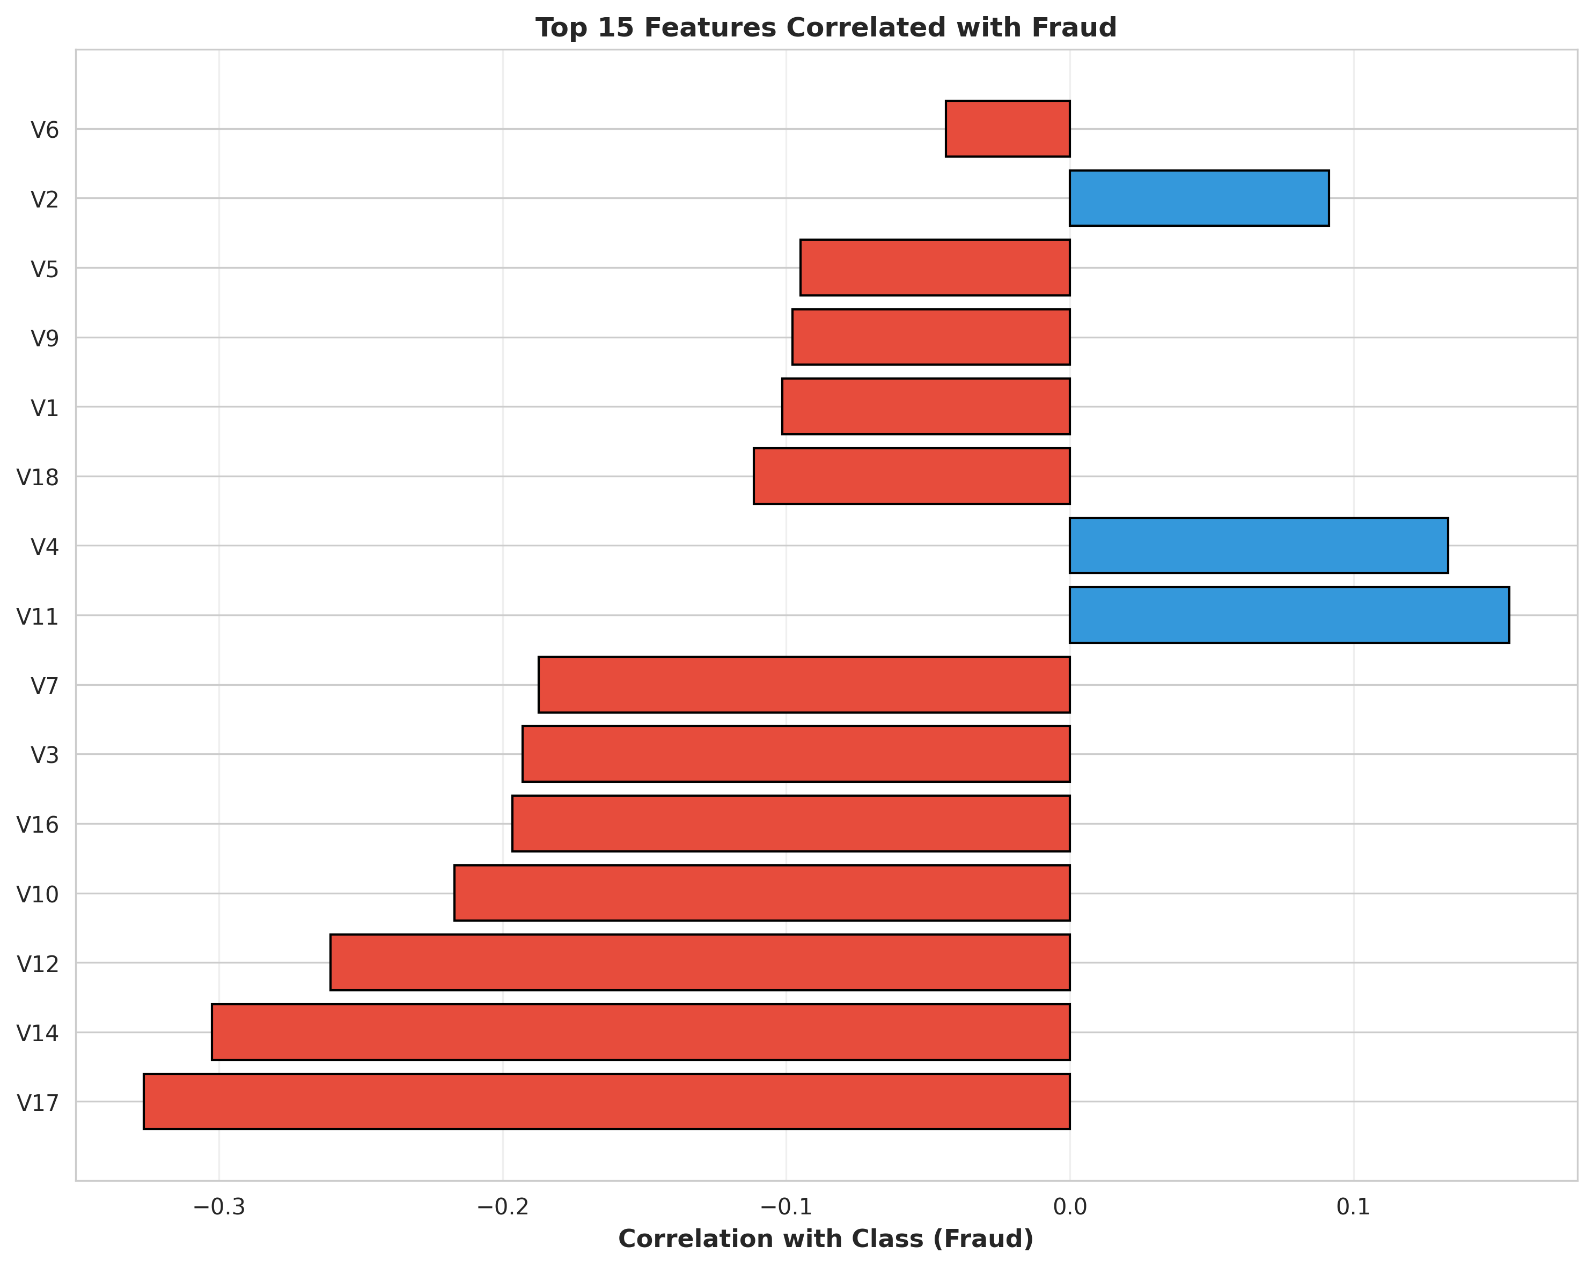
Data Insights: Amount & Correlations
Notes:
Summarize EDA findings only from real figures: skewed amounts and multi-feature fraud signal.

Slide 6
Methodology: Preprocessing & SMOTE
Data quality checks (duplicates/missing values)
Feature scaling with StandardScaler
Stratified train-test split for class preservation
SMOTE applied to training data to address imbalance
Leakage-safe evaluation on untouched test set
Notes:
Explain why SMOTE is applied to train only and why leakage prevention matters.

Slide 7
Models Trained
Logistic Regression (baseline linear model)
Random Forest (ensemble trees)
XGBoost (gradient boosting)
Randomized hyperparameter tuning in training pipeline
Notes:
Briefly explain rationale for each model family and practical runtime tuning strategy.

Slide 8
Comparative Analysis (Real Metrics)
Model | Precision | Recall | F1-score
Logistic Regression | 0.1051 | 0.8737 | 0.1876
Random Forest | 0.8987 | 0.7474 | 0.8161
XGBoost | 0.6696 | 0.7895 | 0.7246
Best Model: Random Forest | Highest F1-score: 0.8161
Notes:
Use this as the main evidence slide. Highlight that Random Forest is selected from actual outputs/metrics/model_comparison.csv by highest F1-score.

Slide 9
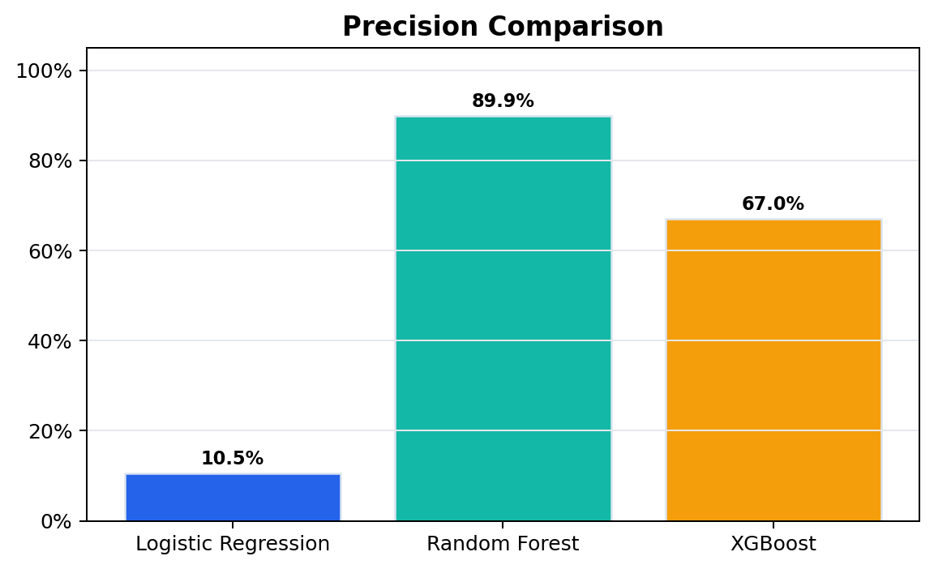
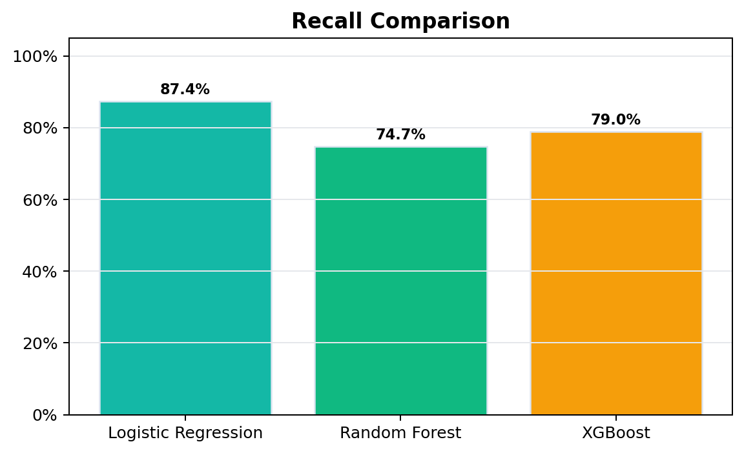
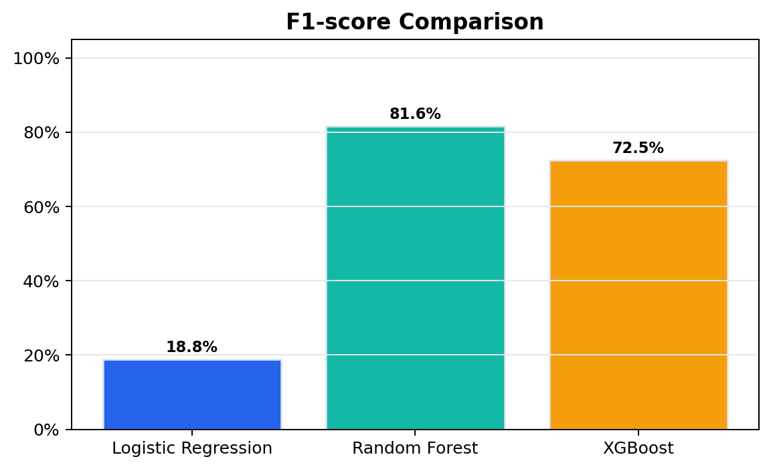
Visual Analytics: Metric Comparison
Notes:
Walk chart-by-chart and conclude Random Forest has strongest F1 balance in this run.

Slide 10
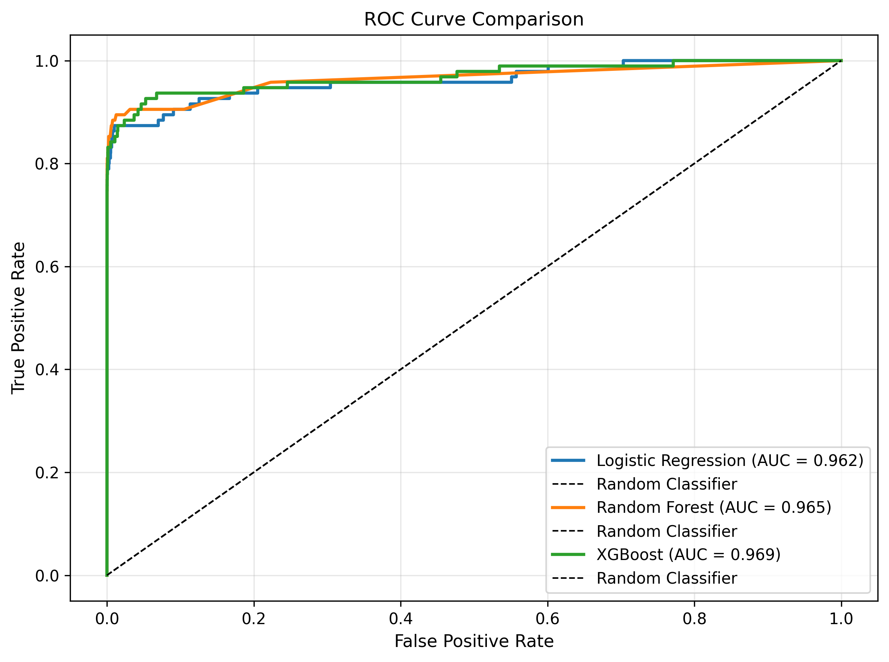
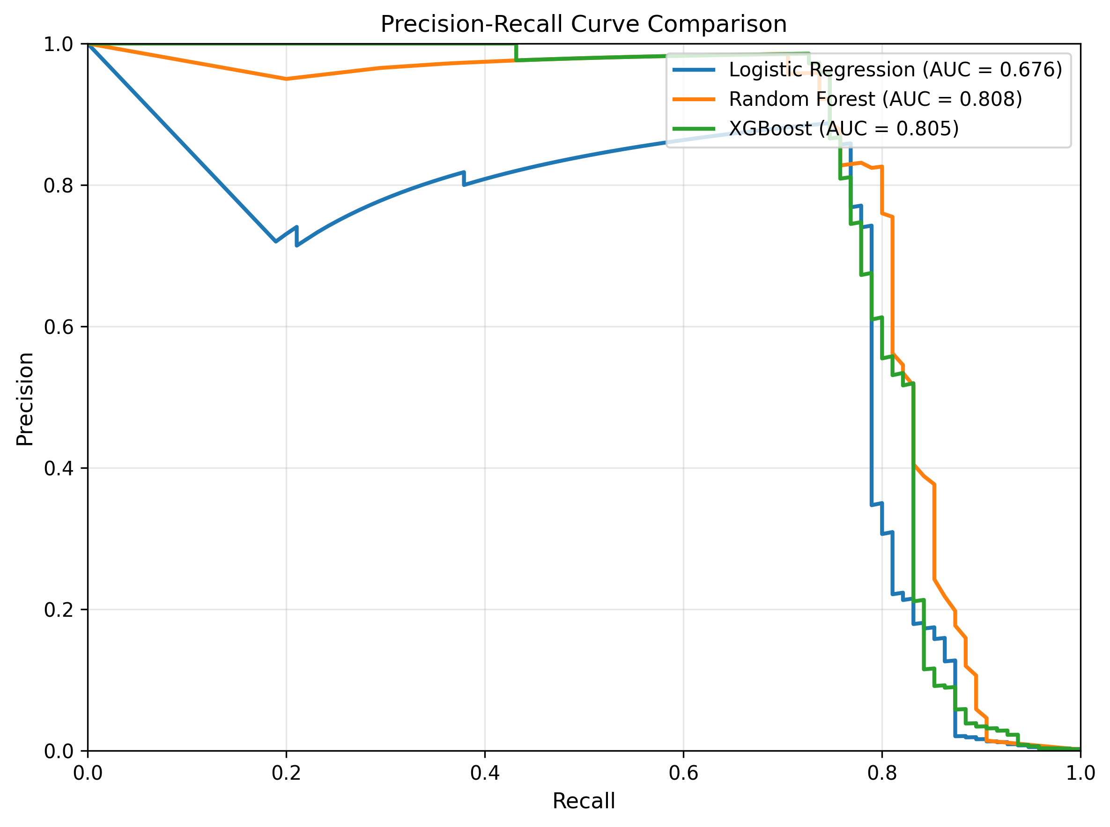
ROC & PR Curves
Notes:
Explain ROC and PR relevance for imbalanced classification.

Slide 11
System Demo (Gradio Dashboard)
Model comparison dashboard with metric cards
Single transaction prediction with fraud probability
Batch CSV upload with fraud/normal summary
Downloadable prediction results for reporting
Notes:
Live demo flow: model comparison section, single prediction, batch prediction + downloadable output.

Slide 12
Conclusion
End-to-end fraud detection system built and deployed with Gradio
Severe class imbalance handled using SMOTE
Best model by F1-score: Random Forest (0.8161)
Random Forest precision: 0.8987 | recall: 0.7474
Notes:
State final recommendation clearly and reference real metrics only.

Slide 13
Future Improvements
Threshold optimization based on business cost
Model explainability with SHAP/LIME
Probability calibration and ensemble stacking
Production monitoring, drift detection, and retraining
Notes:
Show roadmap from academic project to production maturity.

Slide 14
Q&A
Why not rely on accuracy?
Why SMOTE and how leakage was prevented?
Why Random Forest selected in final run?
How would you deploy this in production?
Notes:
Keep answers concise and tied to your actual pipeline outputs.

