Slide 1
Lab4: Multiplexors VS. Shift Registers
National Chiao Tung University
Chun-Jen Tsai
10/16/2015

Slide 2
Lab 4: Multiplexors v.s Shift Registers
In this lab, you will design a circuit to reuse an adder-tree circuit to compute the average value of a 2D 8×32 8-bit integer array
The final average value, rounded to an 8-bit integer, will be displayed using the LEDs
You are required to use two different coding styles (to be specified later) to implement the circuit, and you must compare the two designs from cost and performance perspectives
You will demo the design to your TA during the lab hours on 10/26

Slide 3
The System Behavior of Lab3
The system architecture you will construct is as follows:
At every clock cycle, the data selector selects one column of data registers and connect them to the adder tree
The accumulator accumulates the output from the adders, and after 32 clock cycles, it has the total sum of 256 data registers
The normalizer than compute the average for LED output
clock signal
data selector
an 8-input adder tree
(adder_tree.v)
accumulator
normalizer
…
to LEDs
a 8×32 8-bit register array (data_template.v)

Slide 4
Provided Code Modules in Lab4
In lab 4, you can download three Verilog files
adder_tree.v – the adder tree module that you can use to compute the sum of eight 8-bit signals
data_template.v – this is not a complete module! It merely shows you how the 2D data array is declared. Note that, although Verilog allows us to declare a 2D 8-bit register array, we still use eight 1D 8-bit register arrays to ensure portability
data.dat – Verilog code to initialize the 2D data array
You must write Verilog code for the rest of the system using two different types of data selectors
Write one Verilog program for each type; Do not integrate two different types in one program
This is called “design exploration” in digital circuit design

Slide 5
FPGA Circuit Resources
How does an FPGA implements a digital circuits
It does not simply use 2-input gates due to wiring and area efficiency cost issue
An FPGA has different types of basic circuit units
Gates
Multiplexors
Look-up Tables (LUTs)
Flip-flops
LUTs and flip-flops are the key logic elements for circuit implementation in an FPGA
An LUT is a small RAM with 4-bit or 6-bit (address) input and a single bit output

Slide 6
Flip-Flops and LUTs in FPGA
Traditionally, a “logic cell” in an FPGA contains a 4-bit input, 1-bit output LUT and a flip-flop
…
Logic cell
Interconnect
configuration bit
IOB
LC
LC
LC
IOB
Lookup Table
(LUT)
IOB
LC
LC
LC
IOB
D Q
LC output
IOB
LC
LC
LC
IOB
Interconnect
inputs | out
0 0 0 0 | 1
0 0 0 1 | 0
. . .
1 1 1 1 | 1

Slide 7
Logic Resource Usage
Any digital circuit designs must find a good tradeoff between performance and logic usage
It is important for you to understand the impact of different coding styles to
The amount of LUTs, flip-flops, BRAMs used
The length of critical path

Slide 8
Critical Path Length
In synchronous circuits, all combinational circuits take new input at a rising (or falling) edge of the clock signal and must produce a stable output before the next rising (or falling) edge of clock
A design contains many sub-circuits, the one with the longest time to produce stable output is the critical path
The length of the critical path determines the maximal working frequency of your logic
Clock signal
Input fetched from previous sub-circuit
output ready for fetching by next sub-circuit

Slide 9
Adder Tree
An adder tree is a combinational circuit to compute the sum of an array of numbers in a single clock cycle
input₀
D
Q
+
adder tree properties: • expensive • long signal path • O(log(n)) levels
input₁
D
Q
+
input₂
D
Q
+
input₃
D
Q
+
D
Q
sum
input₄
D
Q
+
input₅
D
Q
+
input₆
D
Q
+
input₇
D
Q
signal path

Slide 10
Mux-based Data Selector
An intuitive idea in Verilog to select different columns of data is to use multiplexors (i.e., if-then-else or case statements):
Blue wires connects the first column of registers to the adders
Red wires connects the last column of registers to the adders
The “Column” signal selects different columns at different clock cycles
Column
8×8-bit
5
…
8×8-bit
adder tree
…

Slide 11
Shift Register-based Data Selector
Another idea is to use shift-registers
The adder tree always connects to the last column of registers
The remaining columns will be shifted to the last column one-by-one at each clock cycles
…
8×8-bit
adder tree

Slide 12
Accumulator
The accumulator computes the total sum of a sequence of number in a sequential manner
One clock cycle per summation
The temporary result is stored in a 16-bit register because we have 256 8-bit values to add, so the maximum sum is 2¹⁶
Accumulator
16
sum
8
+
16
acc
reset

Slide 13
Normalizer
We have 256 input data, to compute their average, we must divide the total sum by 256
A simple 8-bit shifter can do the job
In hardware, you don’t actually “shift” the data bits, you just drop the LSBs!
However, we want to round the average to the nearest integer, so the we must add 128 to the total sum first
Normalizer
acc
16
+
>> 8
128

Slide 14
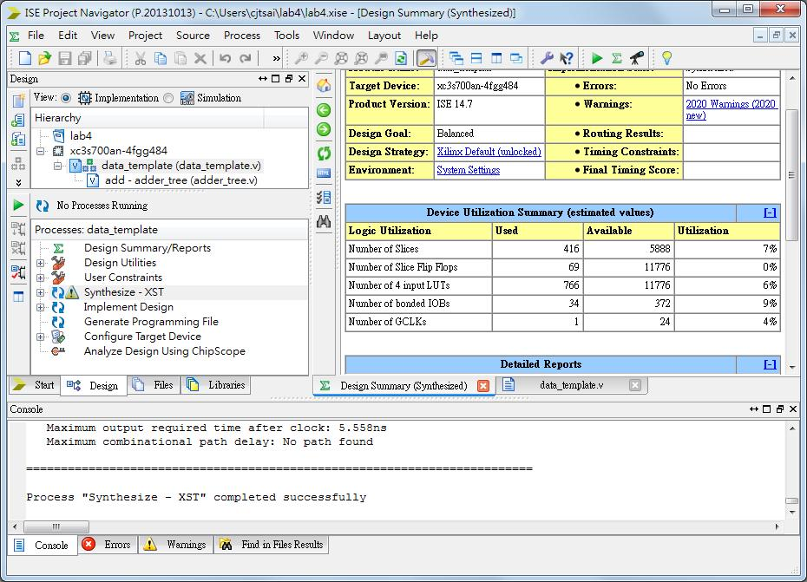
How to Check Logic Usages
Design summary in ISE shows logic usage:

Slide 15

How to Check Maximum Frequency
The console window shows the working frequency:

Slide 16
Notes on Demo
For the demo of this lab, you must implement the averaging system in two different styles: mux-based and shift register-based data selector
You must investigate the logic usage vs. performance tradeoff between your two coding styles and discuss them with your TA

