Slide 1
Lab3: Push Buttons and LED Control
National Chiao Tung University
Chun-Jen Tsai
10/10/2015

Slide 2
Lab 3: Push Buttons and LED Control
In this lab, you will use the Spartan-3E board to implement a simple I/O control circuit
There are 5 push-buttons and 8 LED lights on the board
You must design a synchronous circuit that reads the push-button inputs and use the inputs to increase/decrease the value of a 4-bit counter
You must display the counter value using the 8 LEDs in sign-extended 2’s complement binary format at any time
You will demo the design to your TA during the lab hours on 10/19

Slide 3
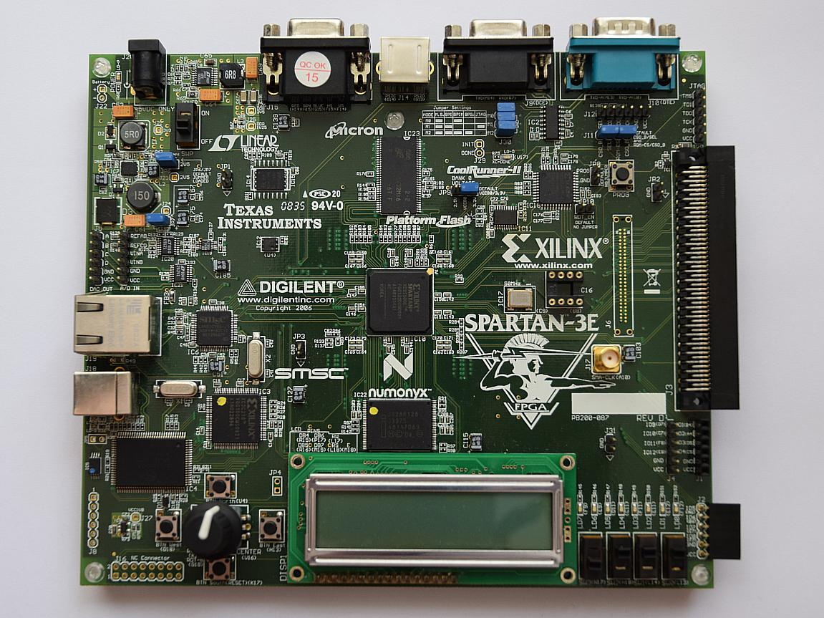
Buttons and LEDs on the Board
The Spartan-3E Starter Kit
Push Buttons
LEDs

Slide 4
The System Behavior of Lab3
Your circuit has a 4-bit counter register
The counter value is set to zero upon reset
The counter value is in 2’complement from –8 ~ 7
Two push-buttons are used to increase/decrease the counter:
Push the west/east buttons increase/decrease the counter by 1
If the counter value becomes grater than 7, it is truncated to 7; if the value is smaller than –8, it is set to –8
The south button is used to reset the counter to zero
The counter register value will be displayed in sign-extended binary format using the 8 LEDs at any time

Slide 5
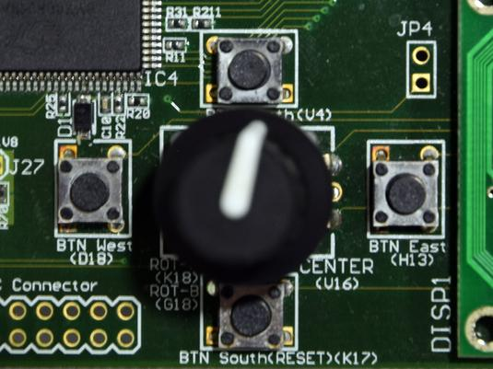
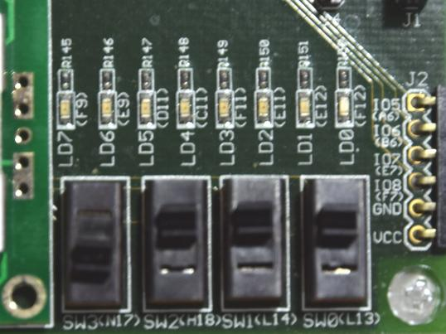
Push buttons and LEDs Control
When a push button is pressed, the following actions is applied to the counter register:
Use the LED lights to display the value of the counter register:
“on” means “1” and “off” means “0”. The most significant bit is LD7.
Counter + 1
Counter – 1
Counter reset

Slide 6
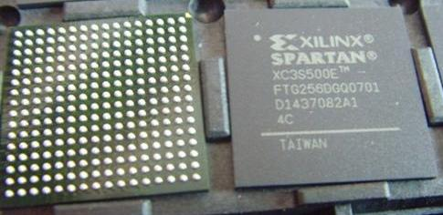
User I/O Pins of an FPGA IC
There are many “FPGA” pins that are used as user I/O pins: each pin connects to an I/O device such as the push-buttons or the LEDs:
Bottom-view of an FPGA IC (shows IC pins)
Top-view of an FPGA IC (shows IC markings)

Slide 7
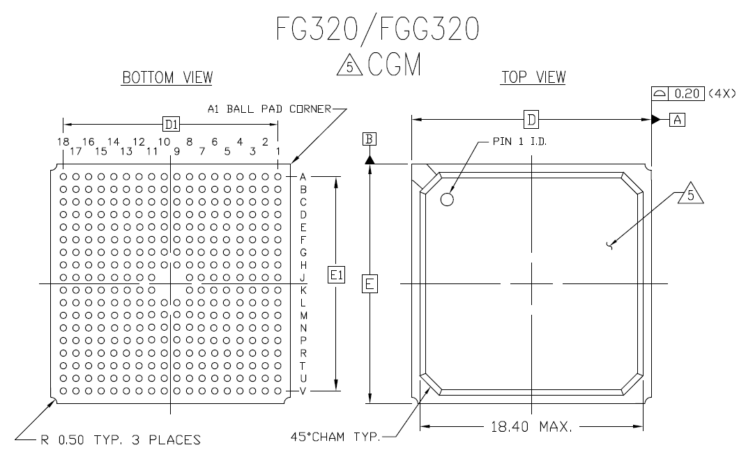
FPGA Pin Coordinates
Each pin at the bottom of the FPGA has a coordinate. For example, “K17” is the coordinate of the red pin of our Spartan-3E IC:
K17

Slide 8
Use the I/O Pin Signal in Verilog
To read/write the I/O pins, we must map the pin coordinates to Verilog signals in our code
User constraints are used to do the job
A user constraint is a text command that specifies the physical property in an HDL code. For example, for the four push-buttons, their mapping to Verilog signals can be as follows:
NET "BTN_EAST" LOC = "H13" | IOSTANDARD = LVTTL | PULLDOWN;
NET "BTN_NORTH" LOC = "V4" | IOSTANDARD = LVTTL | PULLDOWN;
NET "BTN_SOUTH" LOC = "K17" | IOSTANDARD = LVTTL | PULLDOWN;
NET "BTN_WEST" LOC = "D18" | IOSTANDARD = LVTTL | PULLDOWN;
Signal names to be used in your Verilog code!
IC pin coordinates
Signal type
Signal property

Slide 9
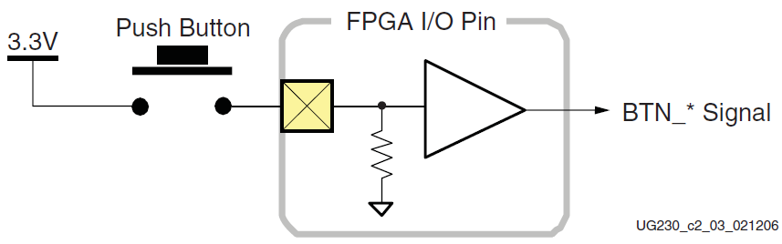
How to Read the Input Push-Button
The physical connection from an FPGA I/O pin to a push-button is as follows:
Ideally, when a push-button is pushed (the circuit is closed), the FPGA pin that connects to the button becomes high voltage and the corresponding signal in Verilog reads “1”, otherwise it reads “0”.
A buffer gate of the I/O pin
A pull-down resister

Slide 10

The Bouncing Problem
In reality, however, the signal value oscillates between 0 and 1 several times before it stabilizes. This is called the bouncing behavior of a hardware button.
The physical voltage values:
The actual digital signal:
Logic “high”
button bouncing period
voltage
Logic threshold
Signal value
Logic “low”
button pressed
time
button off
button on
time

Slide 11

The De-bouncing Circuit
To detect whether the button has been pressed, you cannot simply check the button signals:
This circuit will catch all the state changes during the bouncing period → a single button click will be treated as multiple clicks!
You must find a way to average-out the noises of the push-button signal during the bouncing period
Hint: you can use a shift register to accumulate the input signal; or a timer to wait out the bouncing period
always @(posedge clk, posedge reset) if (reset == 1)
button_north_is_pressed = 0;
else
button_north_is_pressed = (BTN_NORTH)? 1 : 0;

Slide 12
Turn On/Off the LEDs
The LEDs can be turned on or off by writing 1 or 0 to the corresponding Verilog signals (reg [7:0] LED):
NET "LED[7]" LOC = "F9" | IOSTANDARD = LVTTL | DRIVE = 8;
NET "LED[6]" LOC = "E9" | IOSTANDARD = LVTTL | DRIVE = 8;
NET "LED[5]" LOC = "D11" | IOSTANDARD = LVTTL | DRIVE = 8;
NET "LED[4]" LOC = "C11" | IOSTANDARD = LVTTL | DRIVE = 8;
NET "LED[3]" LOC = "F11" | IOSTANDARD = LVTTL | DRIVE = 8;
NET "LED[2]" LOC = "E11" | IOSTANDARD = LVTTL | DRIVE = 8;
NET "LED[1]" LOC = "E12" | IOSTANDARD = LVTTL | DRIVE = 8;
NET "LED[0]" LOC = "F12" | IOSTANDARD = LVTTL | DRIVE = 8;
FPGA I/O Pin
LED light
LED[?]

Slide 13
Clock and Reset Pins
For synchronous design, you need a clock signal for your circuit
The clock signal usually comes from an on-board oscillator
There is an FPGA pin that connects to the oscillator
For the Spartan-3E Starter board, the south push-button (K17) is used as the reset pin
The reset pin is connected to an active de-bouncing IC so you do not have to de-bounce its input!
NET "CLK" LOC = "C9" | IOSTANDARD = LVCMOS33;
# Define clock period for 50 MHz oscillator
NET "CLK" PERIOD = 20.0ns HIGH 40%;

Slide 14
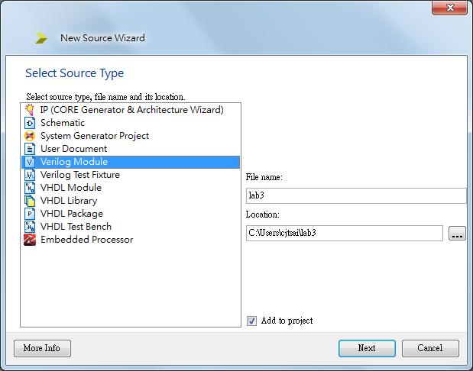
Create ISE Projects for the Board
As before, we create a new ISE project:

Slide 15
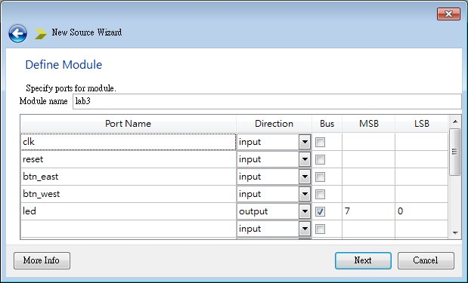
Specify I/O Ports
But this time, we specify the I/O ports of the module as follows:

Slide 16
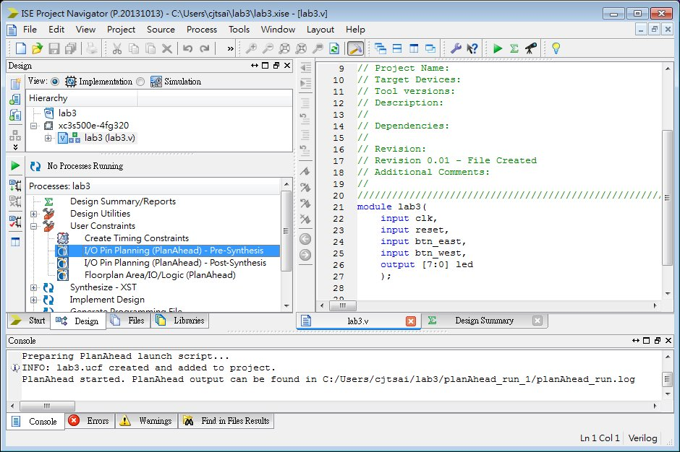
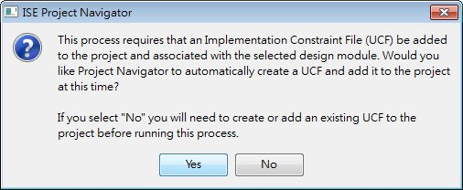
Create User Constraints
Select “I/O Pin Planning” to create user constraints:

Slide 17
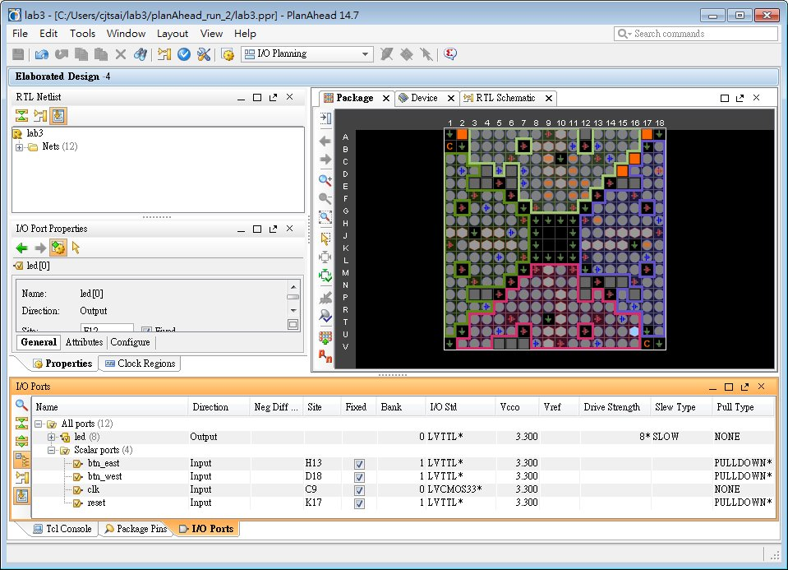
The User Constraint Editor
Assign the Verilog I/O ports to pin coordinates:

Slide 18
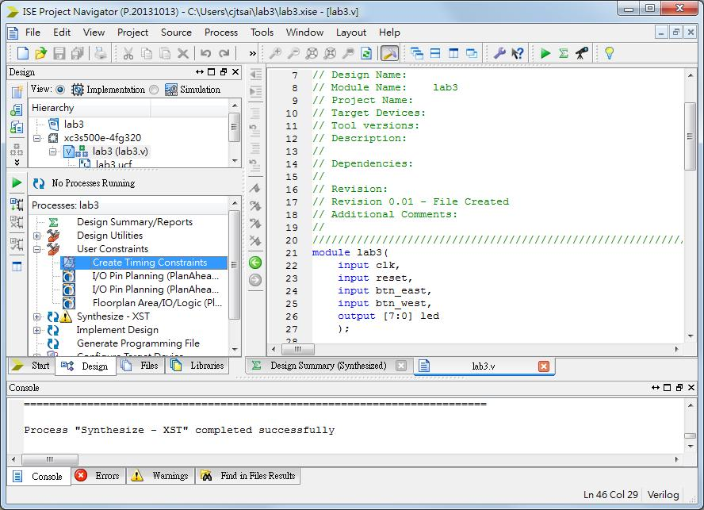
Adding Clock Signal Constraints (1/2)
Now, the signal “clk” has a default timing constraint, we can modify it once the design is ready for synthesis:

Slide 19
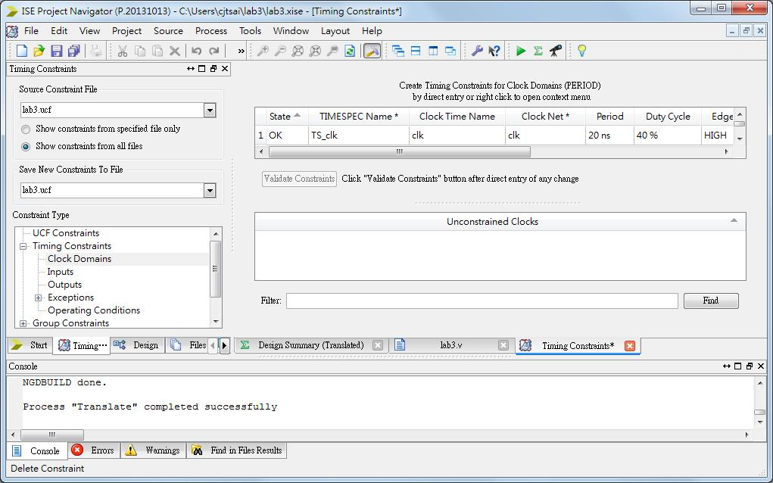
Adding Clock Signal Constraints (2/2)
The default constraint should work fine, but we can change the duty cycle to better match the board

Slide 20
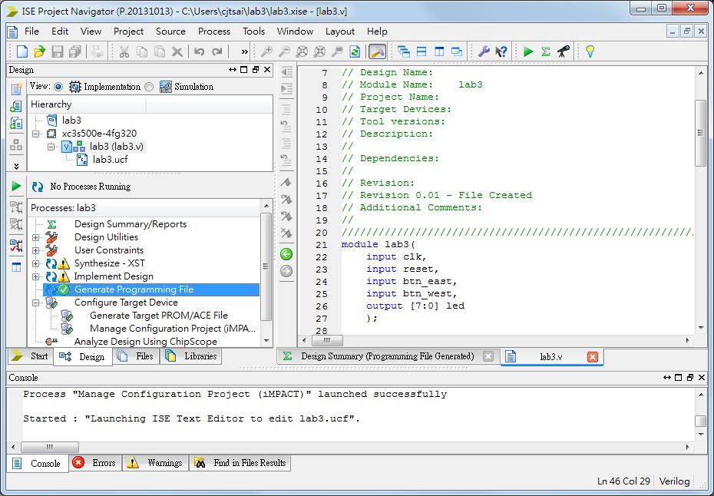
Generate the Programming File
Now, create the programming file “lab3.bit” for FPGA:
double-click this to generate *.bit file
double-click this to run the iMPACT tool

Slide 21
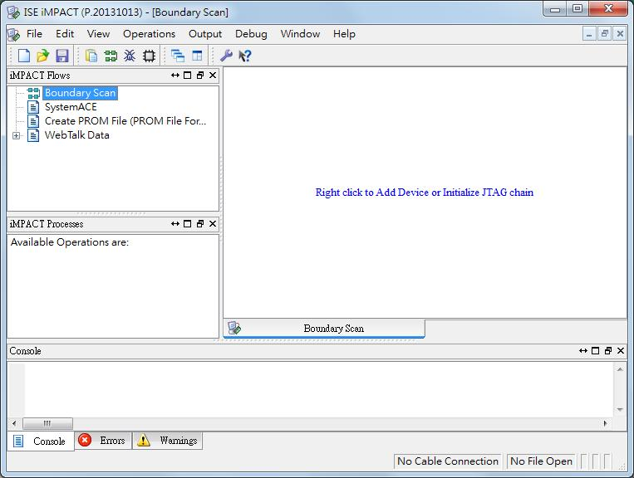
Downloading Your Circuit to the Board
To download your programming file into the FPGA, you must run the “iMPACT” tool:

Slide 22
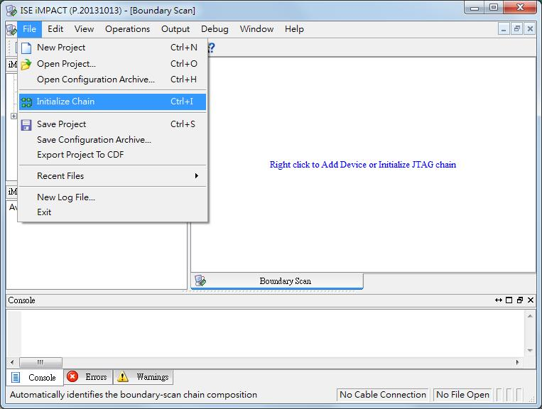
Detect the FPGA from iMPACT
Power on the board and initialize the JTAG chain:

Slide 23
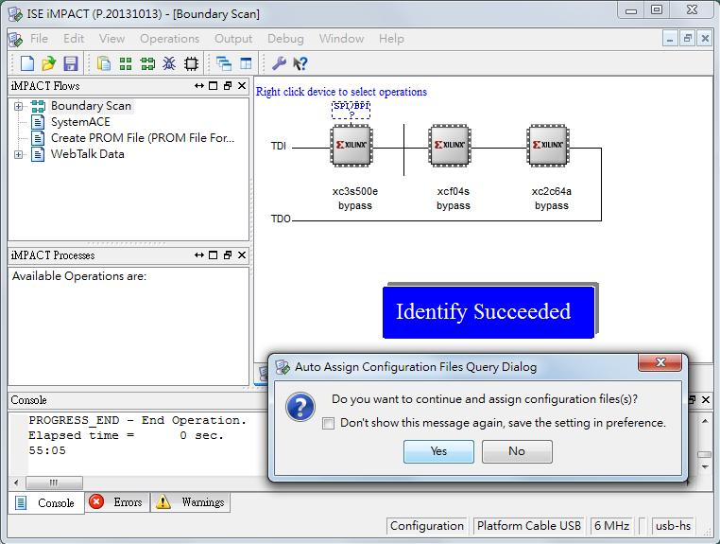
Assign the *.bit File to the FPGA
JTAG shows three IC’s, we only use the first one:

Slide 24
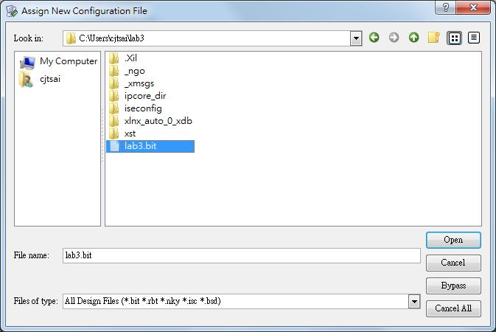
Browse to the *.bit File
Browse to your directory and select the bit file for Lab3:

Slide 25
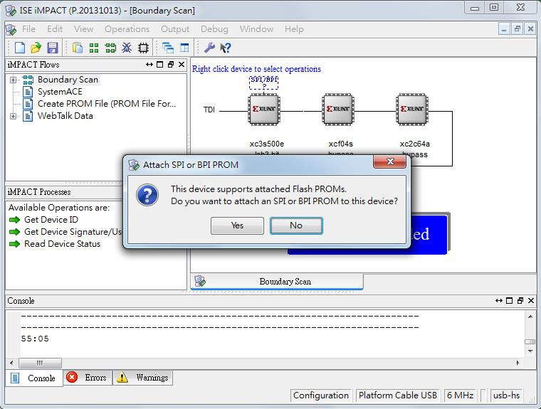
Skip Configuration from SPI ROM
We do not use the SPI flash to configure the FPGA

Slide 26
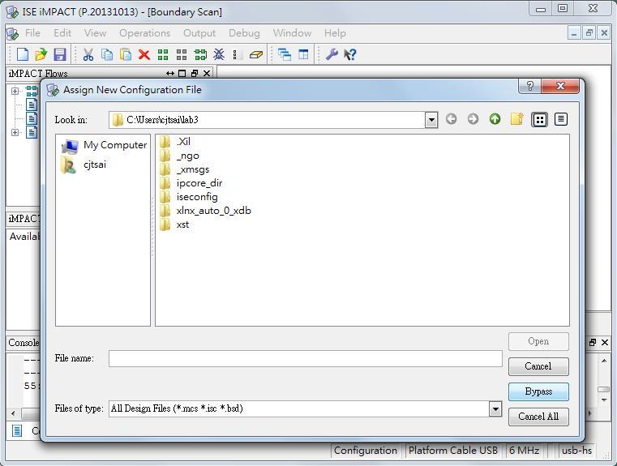
Bypass the Next Two IC’s
The next two IC’s in the JTAG chain are special flash memory → they are obsolete, bypass next two boxes!

Slide 27
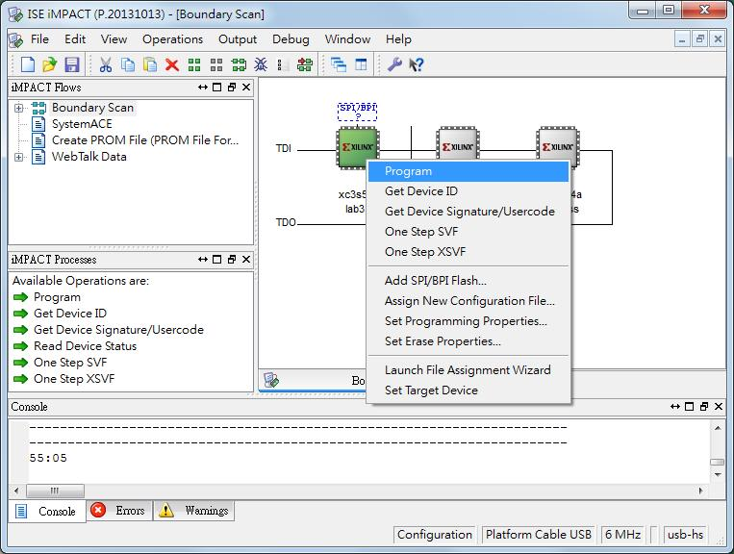
Program the FPGA
Finally, we can right-click the green IC to program it!

Slide 28
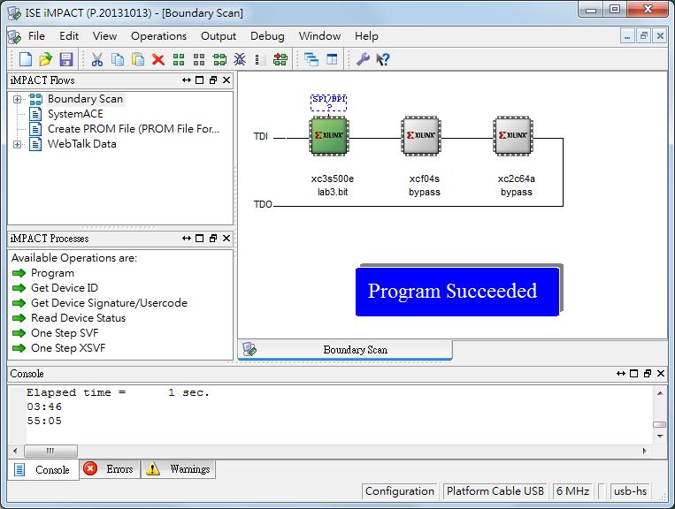
Test Your Design
You can now test your circuit by clicking the buttons:

Slide 29
Reference
Xilinx, Spartan-3E Starter Kit Board User Guide, UG230 (v1.0), March 9, 2006. Available from: http://www.xilinx.com/support/documentation/boards_and_kits/ug230.pdf

