Slide 1
Multi-Agent Reinforcement Learning with Shared Policy for Cloud Quota Management Problem
Tong Cheng∗, Hang Dong, Lu Wang, Bo Qiao, Si Qin, Qingwei Lin, Dongmei Zhang, Saravan Rajmohan, Thomas Moscibroda
Microsoft Research, Microsoft 365, Microsoft Azure
Notes:
WWW 23 industry track
title has two implicaitons
background or problem
method
novelty
multi-agent reformulation
shared policy technique

Slide 2

Quota Management Problem
quota: default limit of computing resources on cloud computing platforms
quota management system
desirable properties:
satisfy the expansion requests for users with growing demands
avoid large quota amount allocated to users with low demands on computing resources
maintain a reasonably fair balance among all the users on the quota management
Notes:
we aim to build QMS
expansion requests means that user could adjust their quota by negotiating with system
balancing demand and supply, like a resourece allocation problem
fair allocation

Slide 3
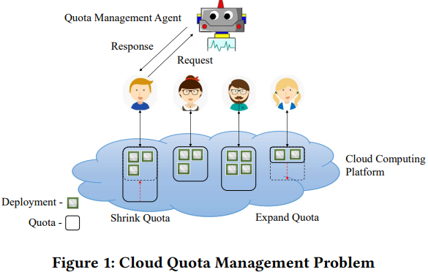
Example
4 users: Amy, Bob, Sam, David
quota: (8, 4, 6, 2)
deployment: (3, 3, 4, 2)
credit score: (0.37, 0.75, 0.67, 1.0)
request: (-4, 0, 0, +4)
response: (1.0, 0, 0, 0.5)
satisfaction ratio

Slide 4


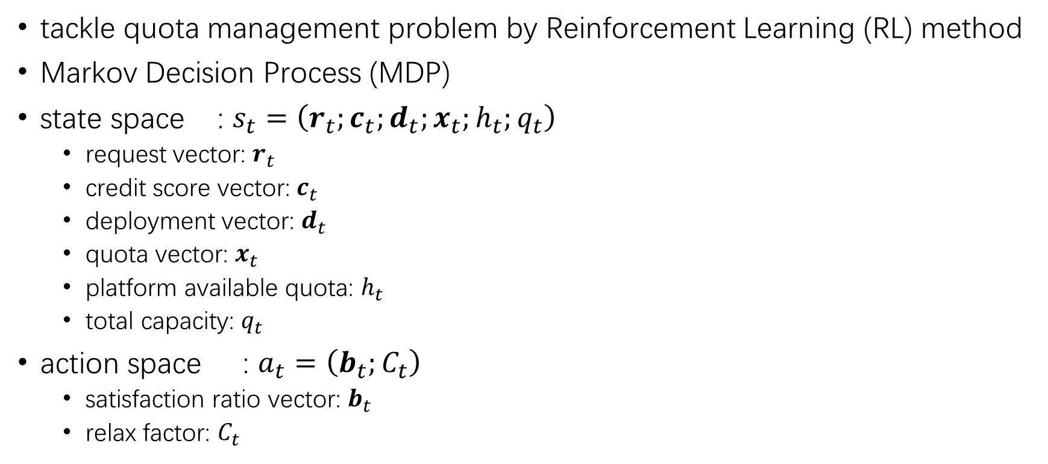
RL Formulation
tackle quota management problem by Reinforcement Learning (RL) method
Markov Decision Process (MDP)
state space : $s_{t}=\left(r_{t};c_{t};d_{t};x_{t};h_{t};q_{t}\right)$
request vector: $r_{t}$
credit score vector: $c_{t}$
deployment vector: $d_{t}$
quota vector: $x_{t}$
platform available quota: $h_{t}$
total capacity: $q_{t}$
action space : $a_{t}=\left(b_{t};C_{t}\right)$
satisfaction ratio vector: $b_{t}$
relax factor: $C_{t}$
Notes:
RL framework
elaborate the details about MDP
4 vectors and 2 scalars
where subscript means time step

Slide 5




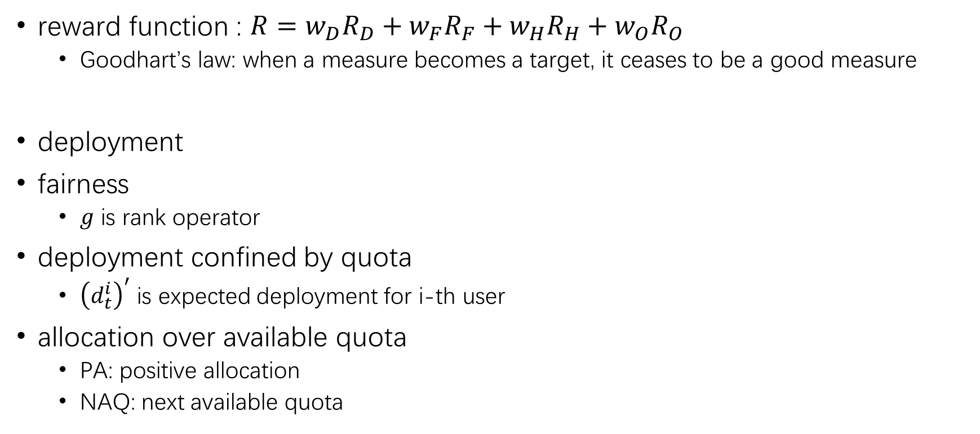
RL Formulation
reward function : $R=w_{D}R_{D}+w_{F}R_{F}+w_{H}R_{H}+w_{O}R_{O}$
Goodhart’s law: when a measure becomes a target, it ceases to be a good measure
deployment
fairness
$g$ is rank operator
deployment confined by quota
${\left(d_{t}^{i}\right)}^{′}$ is expected deployment for i-th user
allocation over available quota
PA: positive allocation
NAQ: next available quota
Notes:
weighted sum of four subcomponents, which are named as
intuitively, D and F are two optimization goals our RL method tries to reach
RH and RO could be regarded as reward penalty
specifically,
D user’s DR
F negative value of divergence beween credit and satisfaction ratio
negative value of divergence beween deployment and satisfaction ratio
divergence is defined as Lp norm between corresponding ranking vectors
if divergence is large, the fairness is small
deployment overflow , where for a user the incoming deployment is larger than current quota
local (user-level) penalty
allocation overflow, where the satisfaction ratio is too high to be precisely executed due to the lack of remaining quota
global penalty

Slide 6
Challenges
heterogeneous action space
user-level satisfaction ratio
system-level relax factor
high dimensional continuous action space
user level information in action
balance the system efficiency and fairness among users at the same time for a cloud computing platform.
Notes:
QMP, in the respective of RL
rendering the action space high dimensional

Slide 7







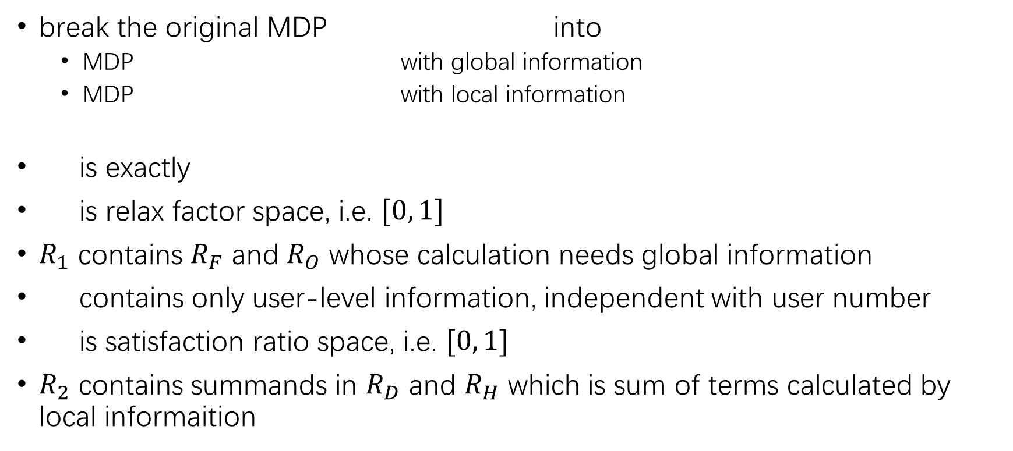
Multi-Agent with Shared Policy
break the original MDP into
MDP with global information
MDP with local information
is exactly
is relax factor space, i.e. $[0, 1]$
$R_{1}$ contains $R_{F}$ and $R_{O}$ whose calculation needs global information
contains only user-level information, independent with user number
is satisfaction ratio space, i.e. $[0, 1]$
$R_{2}$ contains summands in $R_{D}$ and $R_{H}$ which is sum of terms calculated by local informaition
Notes:
MASP abbr.
global MDP
local MDP
A1 dim = 1
global components, fairness reward, allocation overflow
S2 request, credit, deployment quota dim = 4
A2 dim = 1
local components, user DR, deployment overflow
MASP resolves heterogeneirty and high dimensional problem by this splitting method.
Shared policy means that all user shared one instead of N allocation policies.

Slide 8





Reward Communication
add reward communication mechanism (linear adjustment)
manually setting parameters is difficult
adaptive weighting method where $i$ is $1, 2$
momentum
hyperparameter
Notes:
in order to achieve balance among efficiency and fainess, we incorporate reward communication mechanism
specifically, linear adjustment
relative delta percentage of DR
scaled momentum

Slide 9
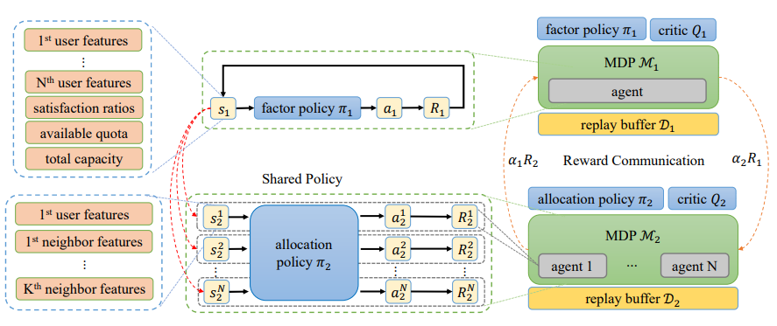
Framework

Slide 10
Baselines
random: action has uniform distribution over action space
fixed: constant satisfaction ratio
greedy: action is derived from the incoming deployment
e.x. for a given user,
quota 20, deployment 10, request 10, incoming delta deployment +5
satisfaction ratio is 0.5 under greedy policy (delta deployment / request)
DDPG: deep deterministic policy gradient
deterministic policy
SAC: soft actor critic
stochastic policy

Slide 11
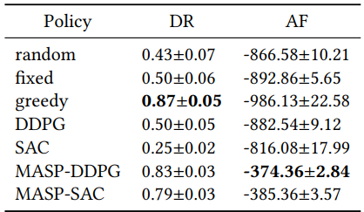
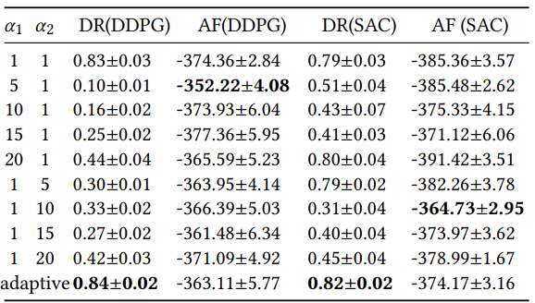
Experiments
Performance evaluation on deployment ratio (DR) and allocation fairness (AF).
For MASP-DDPG and MASP-SAC
almost performant to greedy in DR
dominant performance in AF
Ablation study for reward communication on MASP-DDPG and MASP-SAC.
adaptive method achieves better trade-off
Notes:
two tables for the evaluation of MASP

Slide 12
Conclusion
lower the learning barrier induced by heterogeneous action space
mitigate the curse of dimensionality of action space
achieve trade-off between efficiency and fairness
Notes:
has three advantages

Slide 13
Thanks for your attention!

Slide 14
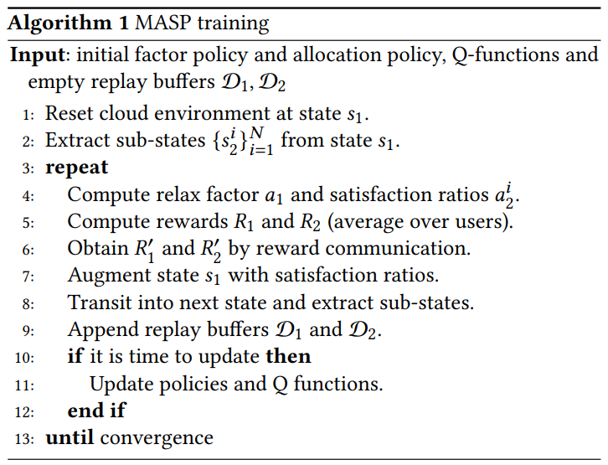
Algorithm

