Slide 1

SMuCo: Reinforcement Learning for Visual Control via Sequential Multi-view Total Correlation
Tong Cheng¹, Hang Dong², Lu Wang², Bo Qiao², Qingwei Lin², Saravan Rajmohan³, Thomas Moscibroda⁴
Nanyang Technological University¹, Microsoft AI², Microsoft 365³, Microsoft Azure⁴
Notes:
Hi, everyone! Thanks for joining this poster presentation. I’m Tong Cheng, a PhD student in NTU. This work was done during my internship in Microsoft research.
IJCAI 23
title has three implications:
reinforcement learning algorithm
visual control
SMTC
novelty
- SMTC

Slide 2
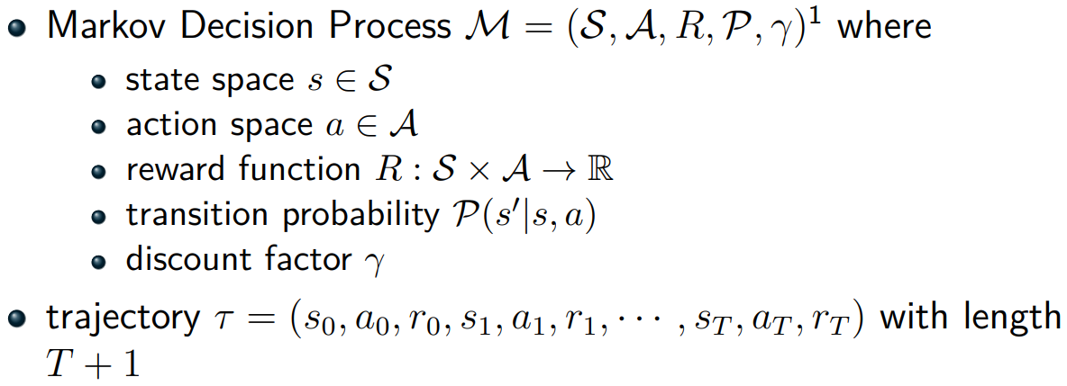
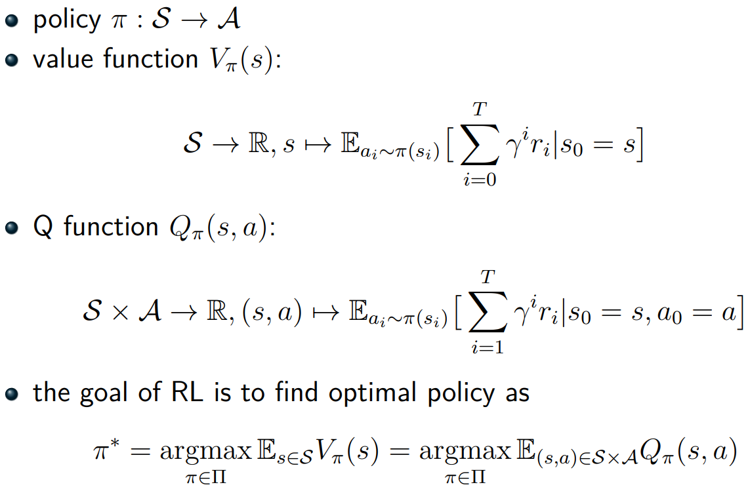
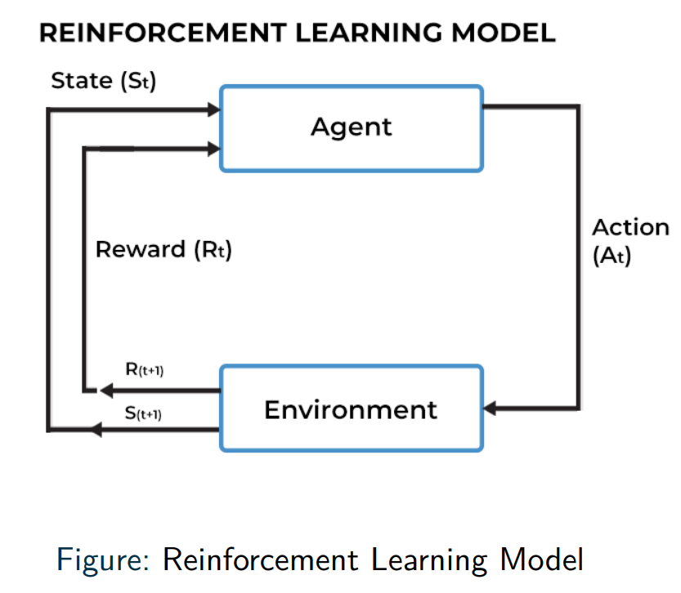
Preliminary

Slide 3
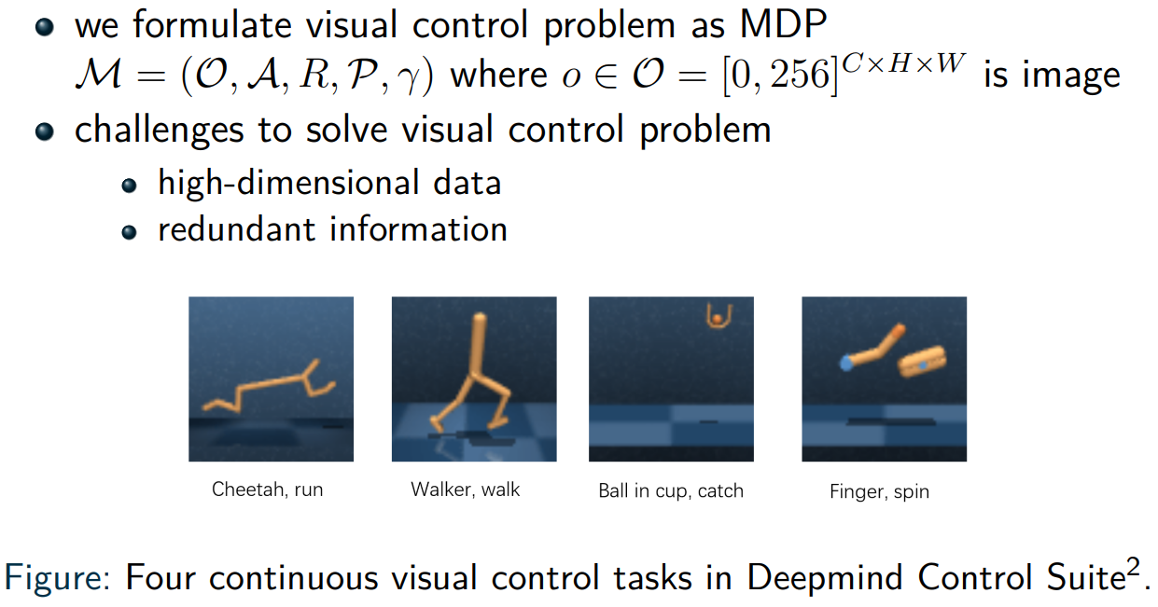
Visual Control Problem

Slide 4
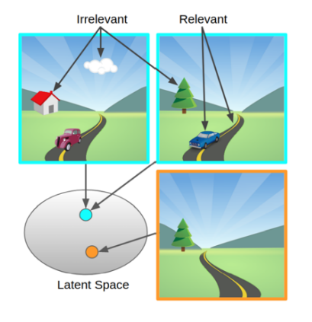


Learning Invariant Representations
Solution: transform image-based observation into state representation
Ideal properties for state representation:
Sufficiency
conciseness
task-relevant information
task-irrelevant information
multi-view data
predictability of future states
Our solution is to maximize sequential multi-view total correlation
cited from *.
*[2006.10742] Learning Invariant Representations for Reinforcement Learning without Reconstruction (arxiv.org)
Notes:
Visual control or learning from pixels is a reinforcement learning (RL) problem with states in the form of images.
one of the biggest challenges
in order to mitigate this issue, we focues on two directions
we observe that multi-view data are available in many application scenarios
and we can utilize them to help distinguish task-relevant information from task-irrelevant information that is independent of actions.
incorporate the predictability of future states on potential actions while discarding task-irrelevant visual details,

Slide 5
Visual Control Problem
Method: transform image-based observation into state representation
Challenge:
compress task-relevant information
remove task-irrelevant information
Ideal properties for state representation:
sufficiency
conciseness
Motivation: leveraging multi-view observation
Our Solution: maximize sequential multi-view total correlation
Figure 1: [2006.10742] Learning Invariant Representations for Reinforcement Learning without Reconstruction (arxiv.org)
Notes:
In this work, we aim to solve visual control problem using reinforcement learning algorithms.
Recently, there are quite a few works focusing on training intelligent agent on raw pixels instead of directly using physical information as states. For visual control problems, transform
Generally, there are two challenges for visual control problem.
Correspondingly, the ideal properties … are usually dubbed as sufficiency and conciseness.
We believe leveraging multi-view observation could further enhance performance of agent.

Slide 6
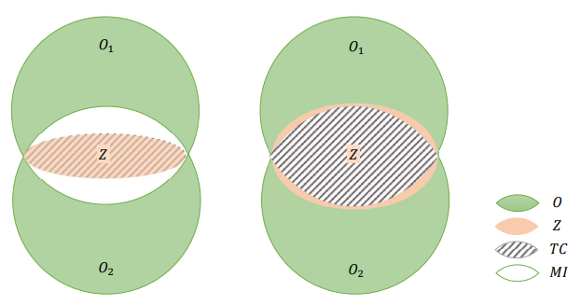

Multi-view Total Correlation
multi-view Total Correlation: TC
redundancy and dependency among a set of random variables
balance between sufficiency and conciseness
(a)
(b)
*Multi-View Representation Learning via Total Correlation Objective, Hwang et al., NIPS 2021
Notes:
Our story starts from a mathematical concept called total correlation.
For instance, in the figure we use size of area to denote the degree of information a random variable cover. In both cases (a) and (b), the shaded area is total correlation given two observation and a representation.
TC quantifies the redundancy and dependency among a set of random variables
sum of mutual information between single observation and representation
minus MI between multi-view obs and rep
Maximizing the expected total correlation between multi-view observation and representation can not only enforce informativeness but also guarantee sufficiency of the representation
left figure is an example of MVTC
area is the degree of information
green denotes observation while red denotes representation
shaded area is the MVTC

Slide 7


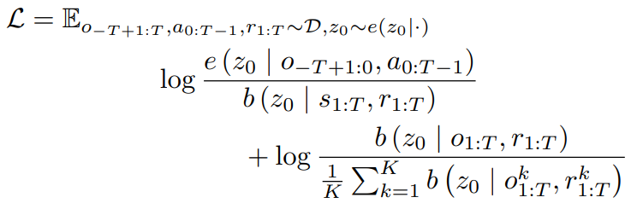
Predictive Informatics
PI-SAC*
temporal structure
conditional entropy bottleneck
*Predictive Information Accelerates Learning in RL, Lee et al., NeurIPS 2020
Notes:
Total correlation is time indifferent. However, reinforcement learning focuses on sequential decision-making problem.
PI-SAC, a previous SOTA method, includes temporal structure under conditional entropy bottleneck term.
Motivated by this technique, we want to extend multi-view total correlation into time-dependent one such that it also captures temporal structure.
in order to solve RL in visual control, we extend MVTC into sequential MVTC, abbr. SMuCo
in literature of PI-SAC, it incorporates TS under CEB method, whose formulation is briefed in the right formulas
likewise, sum of MI between single obs sequence and repr seq
minus MI between multi-view obs sequence and rep seq,
both on condition of action sequence

Slide 8
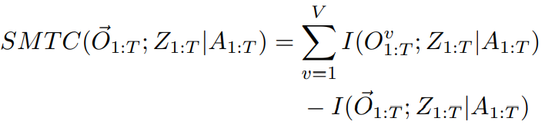
Sequential Multi-view Total Correlation
Motivated by Multi-view Total Correlation and Predictive Information
Extend TC into Sequential Multi-view Total Correlation

Slide 9
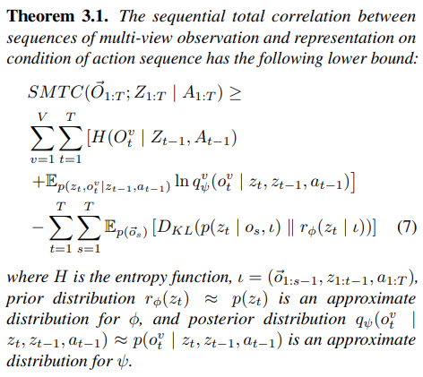




Encoder Surrogate Loss
Objective: maximize SMTC
SMTC: intractable to compute
Find a lower bound as surrogate loss
reconstruction term
expected logarithmic likelihood term
temporal constrastive term
Notes:
Our objective is to maximize SMTC.
Unfortunately, SMTC is intractable to compute. So, we need to find an appropriate lower bound as surrogate loss.
Theorem 3.1 shows such a computable lower bound. It consists of three terms, which we dub as reconstruction term, expected logarithmic likelihood term and temporal contrastive term.

Slide 10
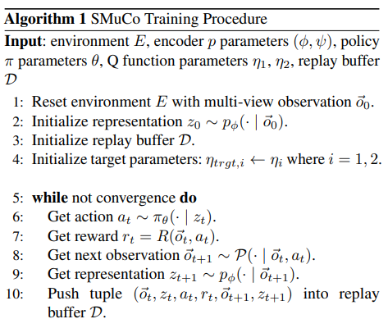
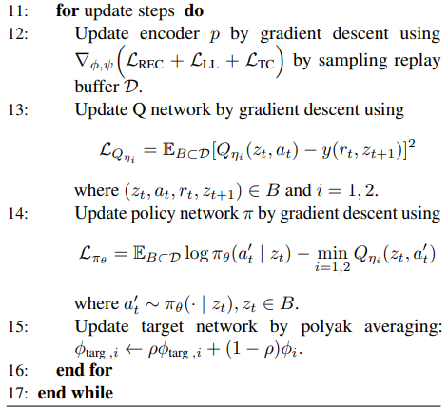
Visual Control with SMuCo
Notes:
Our algorithm is based on the backbone of SAC algorithm. One of the remarkable differences are that encoder is updated by gradient descent method over surrogate loss and output of encoder are used as physical state for downstream decision making.

Slide 11
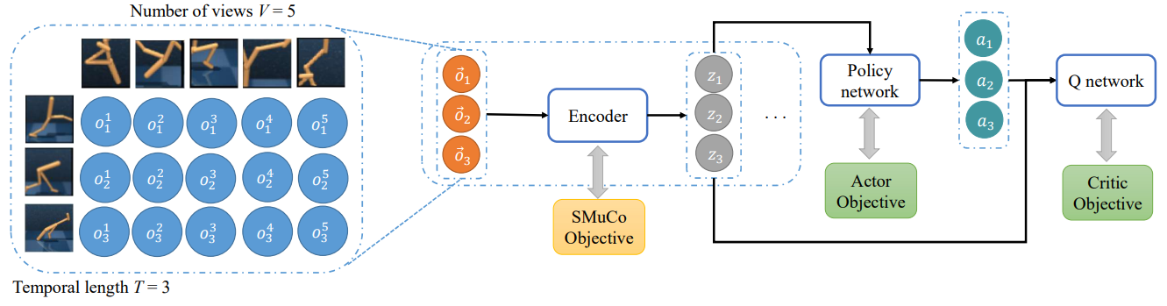
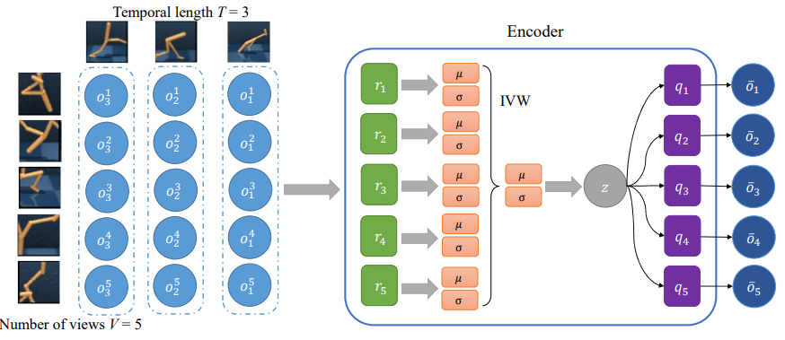
Frameworks
Encoder Architecture
Product of Expert (PoE)
Inverse Variance Weighted method (IVW)
Notes:
Here is the framework of SMuCo. Multi-view observations are collected during interaction with environments using fixed policy parameters. Then observation, action and reward tuples are sampled from replay buffer to update parameters of encoder, policy network and Q network.
For encoder architecture, we use product of expert and inverse variance weighted method to compute representations with least variance.
Mixture of experts technique uses multiple expert learners to divide a problem into homogeneous spaces.
In statistics, inverse-variance weighting is a method of aggregating two or more random variables to minimize the variance of the weighted average.

Slide 12
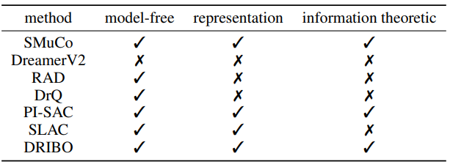
Baselines
DreamerV2: world model
RAD: augmentatoin
DrQ: data regularized
PI-SAC: predictive information
SLAC: stochastic latent variable
DRIBO: information bottleneck
Notes:
We use 6 SOTA methods as our baselines.
Here is a table summarizing three properties of these methods. In other words, by asking whether the algorithm is model-free? Whether the algorithm uses concise representations? Whether the algorithm optimizes an information theoretic loss function, we could give these methods a rough classification.

Slide 13
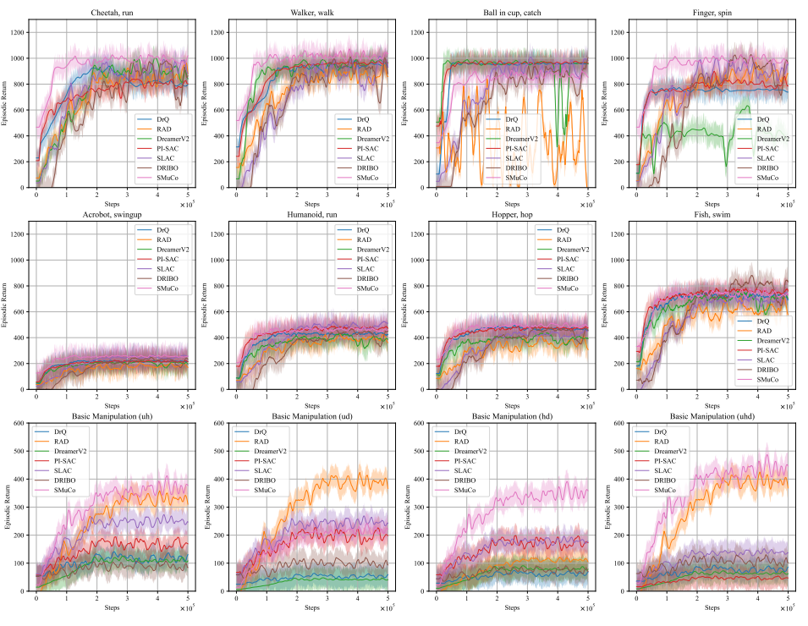
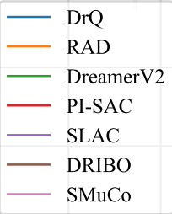
Performance Evaluation
Notes:
Here are our experimental results. In each diagram, we plot the expected cumulative rewards of different methods after certain training steps. First two rows depict tasks from DeepMind Control Suite. Last row depict basic manipulation task from Sapien project.
As we can see, our method outperforms on most of these tasks. However, it is not the best agent for Ball in cup, catch and basic manipulation (ud). After investigation, we found that multi-view observations do not vary too much under these tasks, causing our method less performant than other baselines.

Slide 14
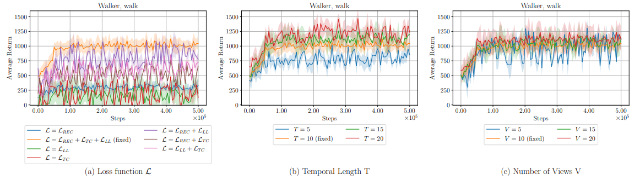
Ablation Study
Notes:
Here are three ablation study to found empirically best surrogate loss, temporal length and number of views, which are all hyperparameters of SMuCo.

Slide 15
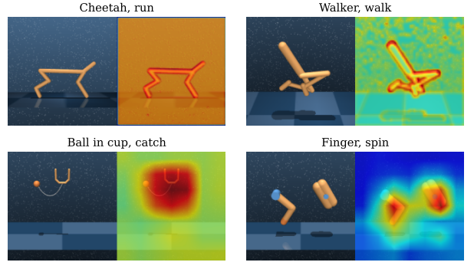
Spatial Attention Maps
cheetah, run
walker walk
ball in cup, catch
finger, spin
Figure 2. Spatial attention maps of representations from observations in four DMC tasks
Notes:
Additionally, we have also plotted spatial attention maps on four tasks. We observe that if the learned representation fits task-relevant information well enough, the performance of our method is relative good. Otherwise, it is relatively bad comparing with other SOTA methods.

Slide 16
Conclusion & Future Work
complete and concise representation of multi-view observations
sequential multi-view total correlation
find surrogate loss
handle unaligned multi-view observations and multi-modal observations
resolve partially-missing multi-view observations
Notes:
In conclusion, we aim to obtain … to enhance the performance of agent in visual control tasks. To achieve this goal, we propose SMTC to maximize. Since SMTC is intractable to compute, we find an appropriate surrogate loss by lowering bounding SMTC.
In the future, we aim to extend the algorithm to …. Furthermore, if multi-view observation is partially missing, our algorithm could become useless. Hence, we hope improved SMuCo could resolve this pain-point.

Slide 17
Thanks for your attention!

