Slide 1

unicef | for every child
Notes:
In this presentation we will be mainly focussed on child mortality and identifying causes for deaths.
The goal of this presentation is to find out how we can minimize the number of children dying every year.

Slide 2
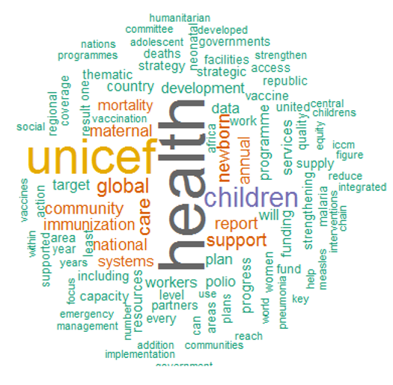
Organisation’s Vision
Founded in 11 December 1946
Works in over 190 countries
Focus on children’s health
Focus on children’s education
Focus on gender equality
Notes:
As you can see on the left, there is a word cloud containing the most frequent words that appeared in the annual reports for UNICEF from 2012-2016.
UNICEF is an organisation that was founded on 11 December 1946.
For more than 70 years, the organisation has been constantly working on improving the lives of children and the health of young people all over the world.

Slide 3
Sustainable Development Goals (SDGs)
“Every child survives and thrives”
“Every child learns”
“Every child is protected from violence and exploitation”
“Every child lives in a safe and clean environment”
“Every child has a fair chance in life”
Notes:
Regarding the Sustainable Development Goals (SDGs), the organisation’s actions mainly contributes towards the 3rd SDG,
“Good Health and Well-Being”.
Other notable Sustainable Development Goals (SDGs) that the organisation contributes to are the 4th and 5th SDG,
“Quality Education” and “Gender Equality” respectively.

Slide 4
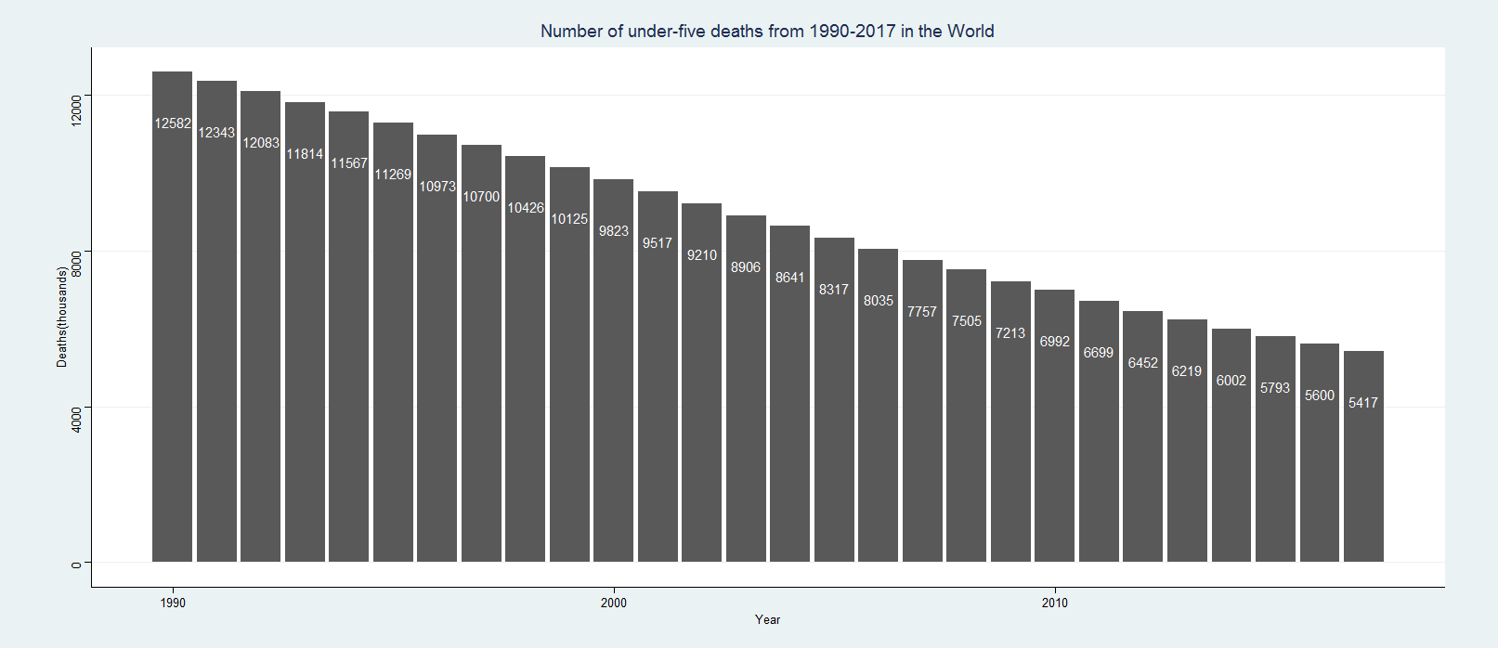
Trends in Child Mortality
Notes:
(7165/12582) * 100 = 57% (2SF)
From 1990 to 2017, there has been a constant decrease in overall deaths for under-fives.
If we were to directly compare the number of deaths in 1990 and 2017, there has been a decrease of 57% of under-five deaths.

Slide 5
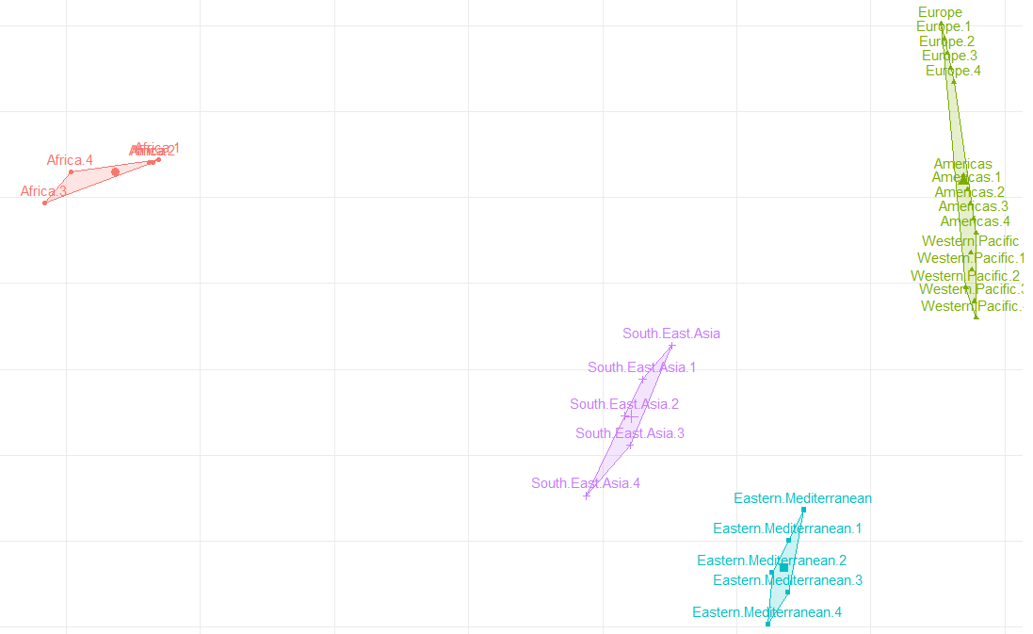
Cluster Analysis
Notes:
When applying cluster analysis to the under-five deaths data, we can identify that there are 4 distinct clusters. Europe, America, and Western Pacific have been combined into one cluster while the other regions are their own independent cluster.
The clustering method that was used was k-means clustering.

Slide 6
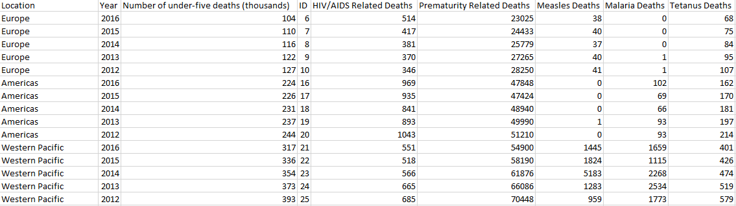
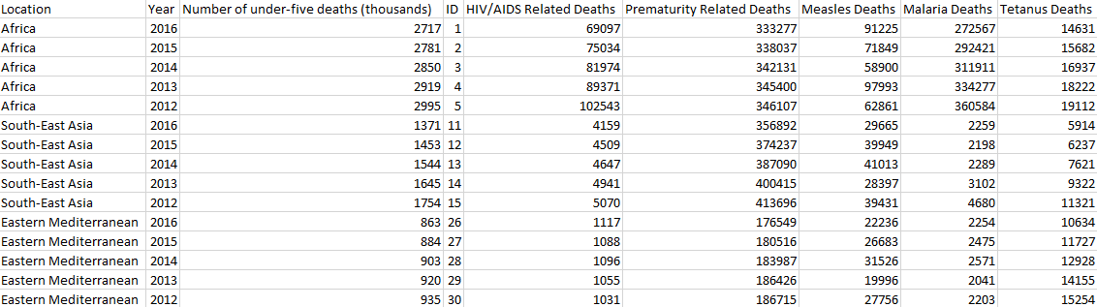
Cluster Analysis cont.
Notes:
So what makes Europe, America, and Western Pacific into one cluster? If we compare the data points, we can see that the data points in the top table are very similar in that they have low figures overall compared to the bottom table.

Slide 7
Distribution of under-five deaths
Notes:
Here we have a visualisation of the total number of under-five deaths.
Even though the child mortality percentage is decreasing, there is more that can be done to further minimize the deaths. In that case, which region is suffering the most from the under-five deaths?
Based on the cluster analysis in the previous slides, even if we combine the total number of deaths from the cluster of Europe, America, and Western Pacific, the overall percentage of under-five deaths is 12% of the world.
We can easily tell from inspection that Africa is contributing the most. If this is the case, what are the possible causes affecting under-five deaths? In the following 5 slides, you will see the relationships between the causes and number of deaths. We will apply linear regression in order to measure how much under-five deaths is affected by the causes.

Slide 8

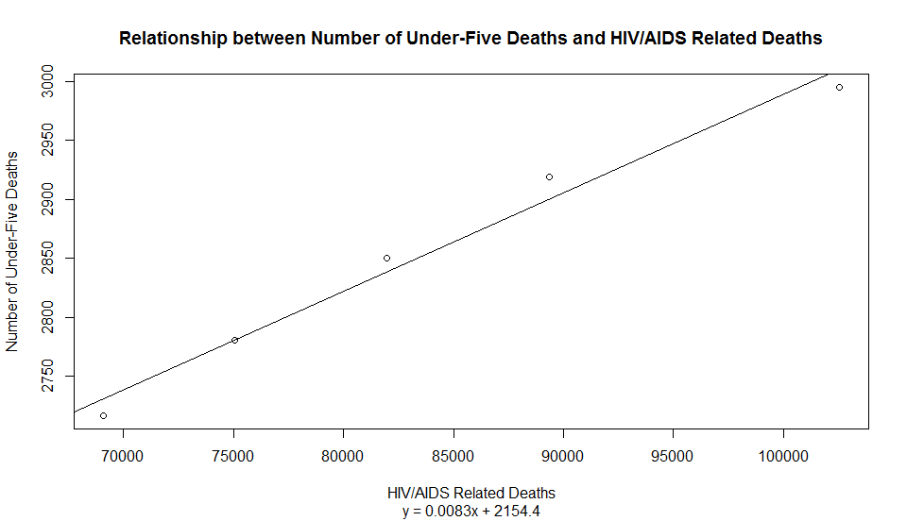
HIV / AIDS

Slide 9

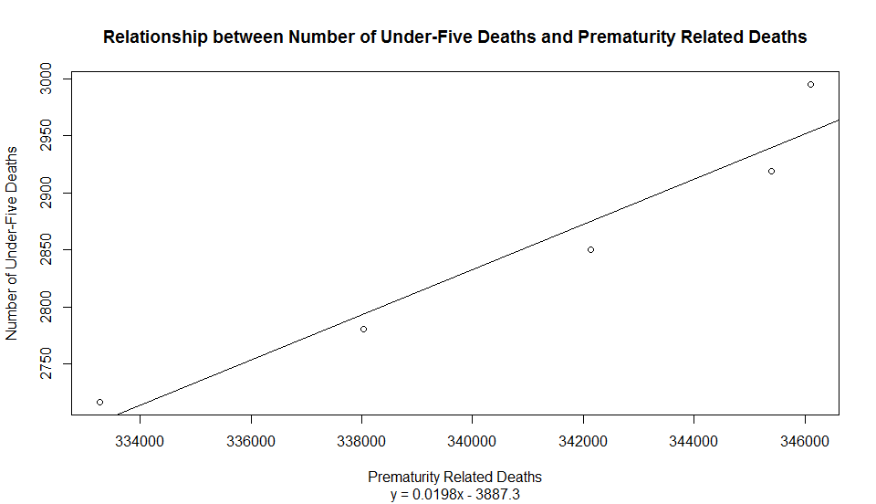
Prematurity

Slide 10

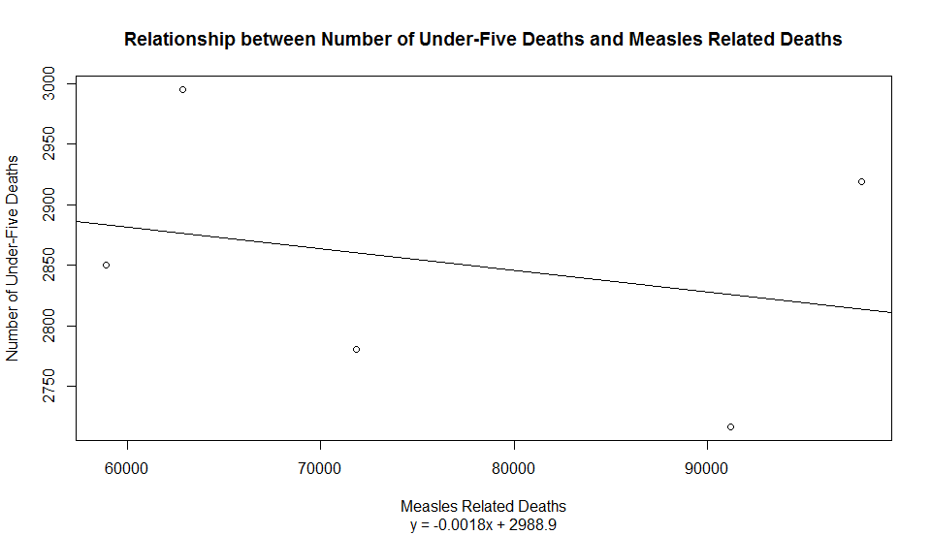
Measles

Slide 11

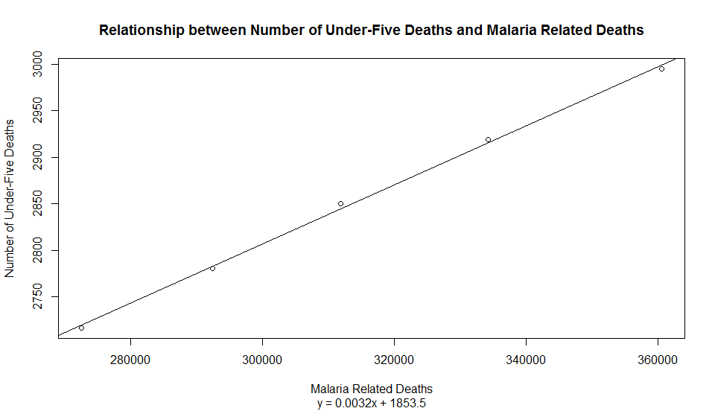
Malaria

Slide 12

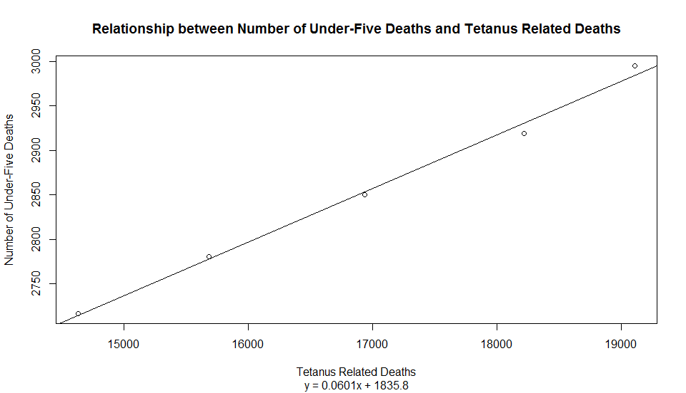
Tetanus

Slide 13
Notes:
Excluding Measles which obviously had a negative relationship with the number of under-five deaths, the remaining 4 causes we have chosen to discuss today have strong relationships based on the visualisations.

Slide 14
Correlation Coefficients
Notes:
However if we wanted to determine which of the 4 factors contributed the most towards under-five deaths, we will look at the correlation coefficient.
So what is the correlation coefficient? It is a value between -1 and 1 which determines the strength of the relationship between variables.
1 indicates that there is a strong positive relationship.
-1 indicates that there is a strong negative relationship.
0 indicates that there is no relationship at all.
Now looking at the correlation coefficients (which were created using excel), although the 4 factors have strong positive relationships with under-five deaths, Malaria has the strongest relationship with a value of 0.999(3SF)

Slide 15
Conclusion
Africa is the most affected region for under-five deaths
Europe, America, and Western Pacific have minimal contributions to under-five deaths
HIV/AIDS, Prematurity, Malaria, Tetanus have strong relationships with under-five deaths
Measles has a negative relationship with under-five deaths.
Malaria has the strongest relationship with under-five deaths
Notes:
Based on the information discussed today, UNICEF should focus on allocating more resources into Africa and more resources into treating Malaria.

Slide 16
Sources
UNICEF (2018). Annual Reports. Received from: https://www.unicef.org/reports
WHO. Number of Deaths(thousands), Retrieved from: http://apps.who.int/gho/data/view.main.CM1300N?lang=en
WHO. Number of Deaths by cause, Retrieved from: http://apps.who.int/gho/data/node.main.ChildMortREG1002015?lang=en

