Slide 1

Library System
------Design Pattern
Peng Dong
Tonghann Teng
Joy Zhou
__07/13/2016

Slide 2
Function Model Diagram
UI
Main page
Login page
Add Member page
Check out/in
Page
Member list page
Add book
page
Fine Record
System Controller
application
CheckoutRecord
LibraryMember
FineRecord
booking
Book
Magazin
LibraryAdmin
FineEntry
CheckoutEntry
Frame Work
FRCustomer
FRAdmine
FRRentRecord
FRFine
FRbooking
Item
FRItem
security
Common(FRIModel)
FRDBFacade
File Systems

Slide 3
Design Pattern
UI
application
State
Template
Singleton
Factory
Mediator
Frame Work
Observer
Visitor
Iterator
Facade
Strategy
Bridge
Adapter
Prototype
File Systems

Slide 4
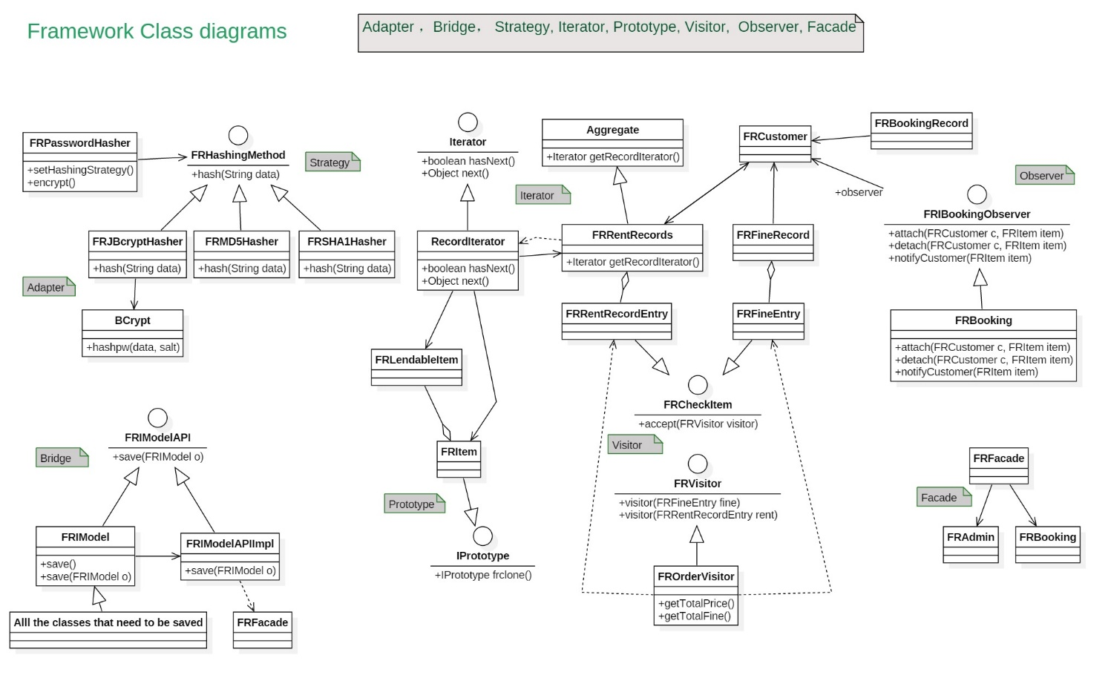
Framework Class Diagram

Slide 5
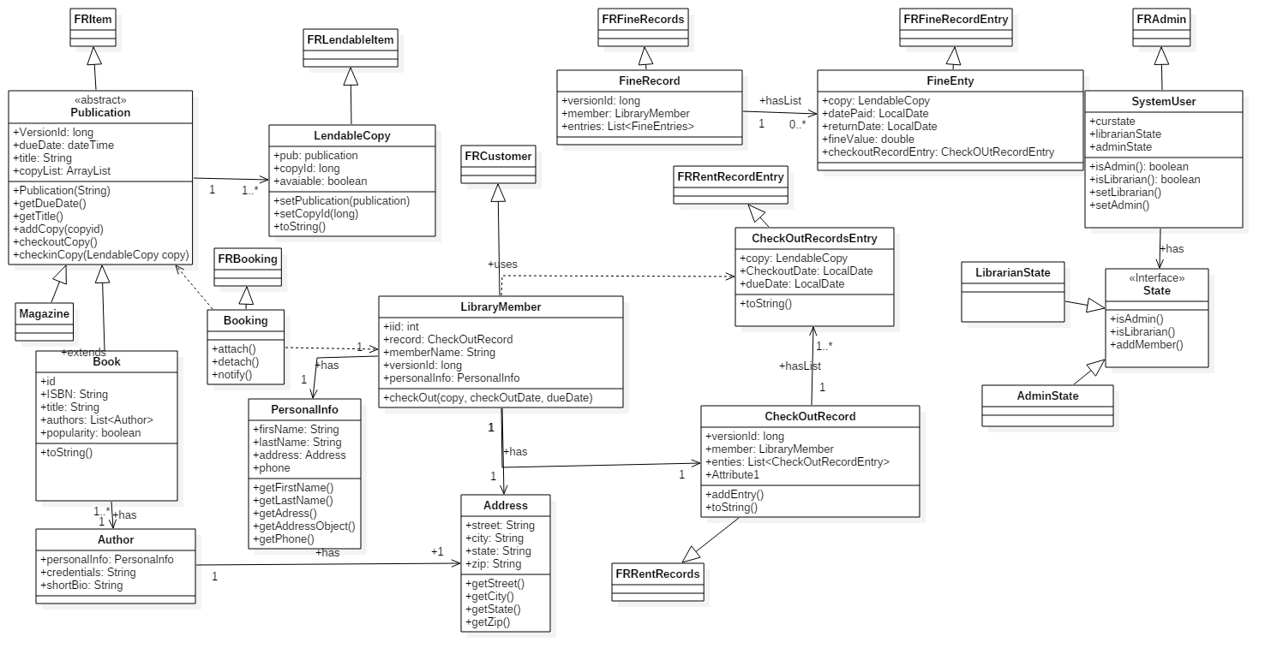
Application Class Diagram

Slide 6
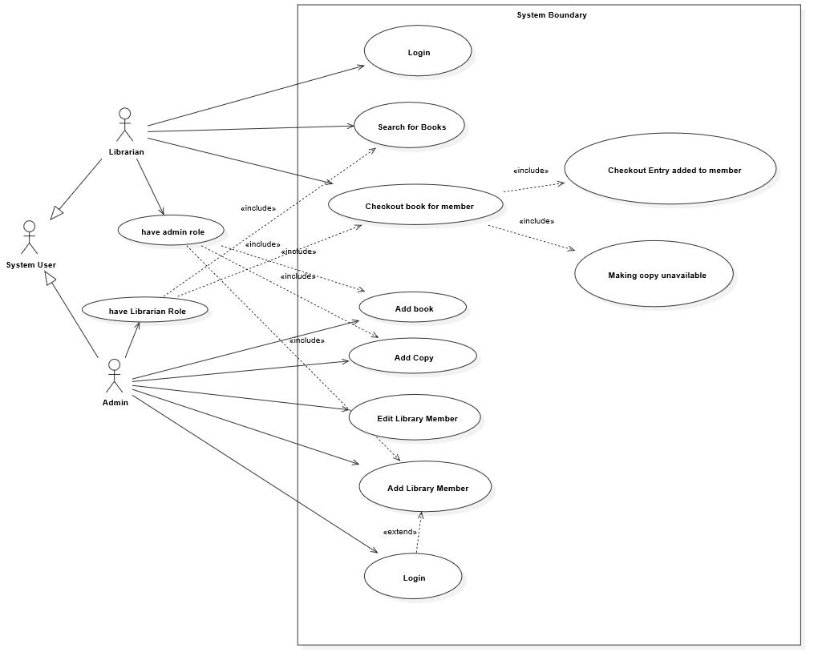
Fine User Case

Slide 7
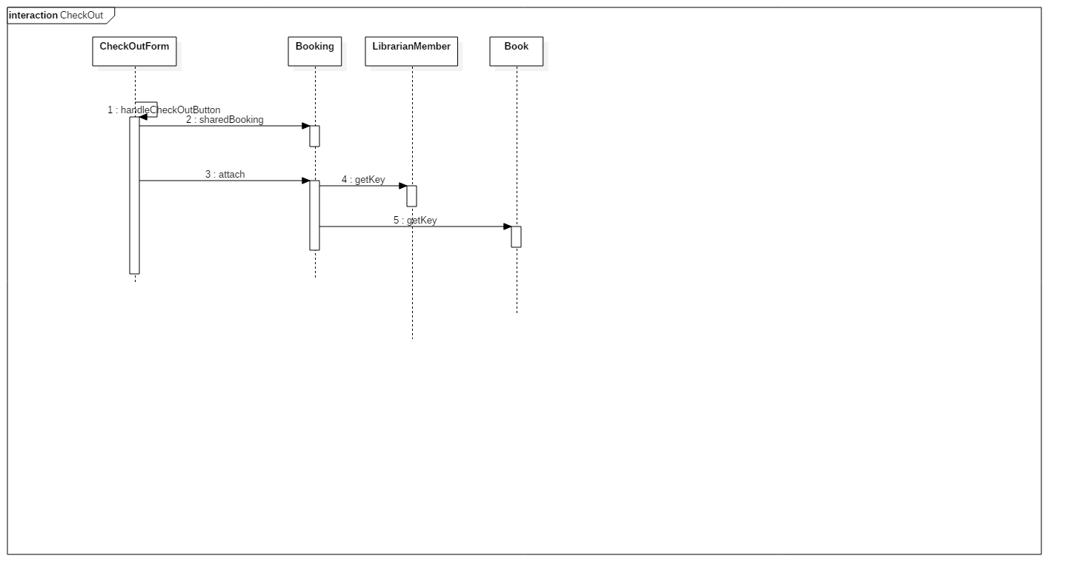
Booking User Case

Slide 8
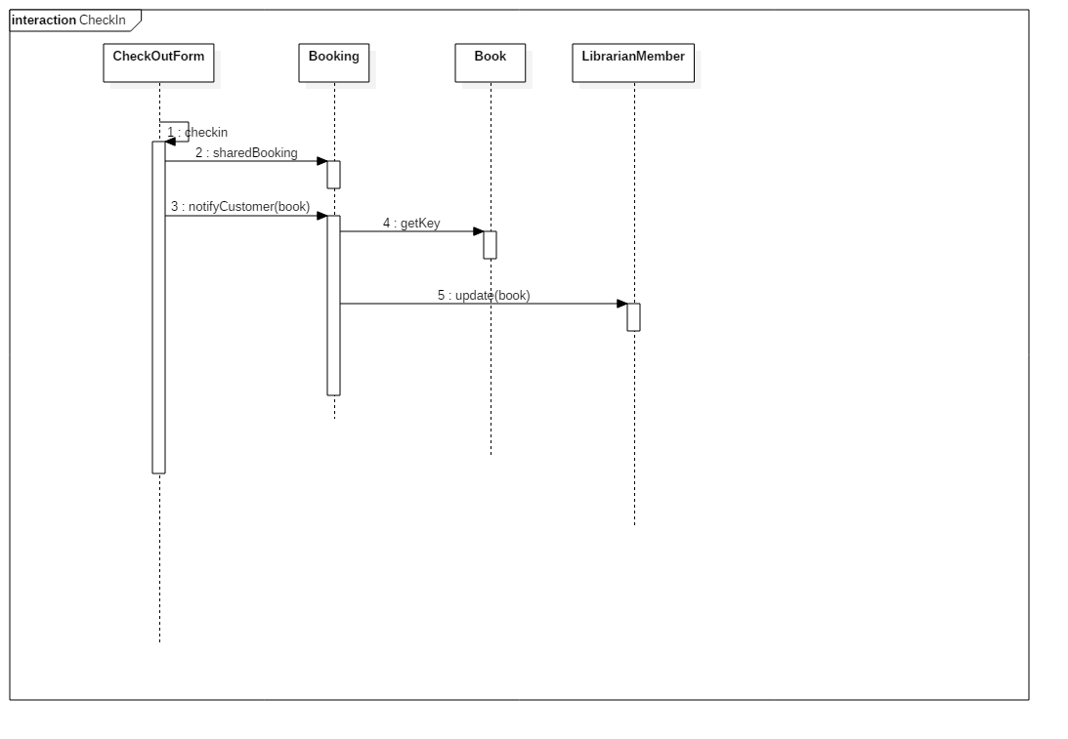
Booking User Case

Slide 9
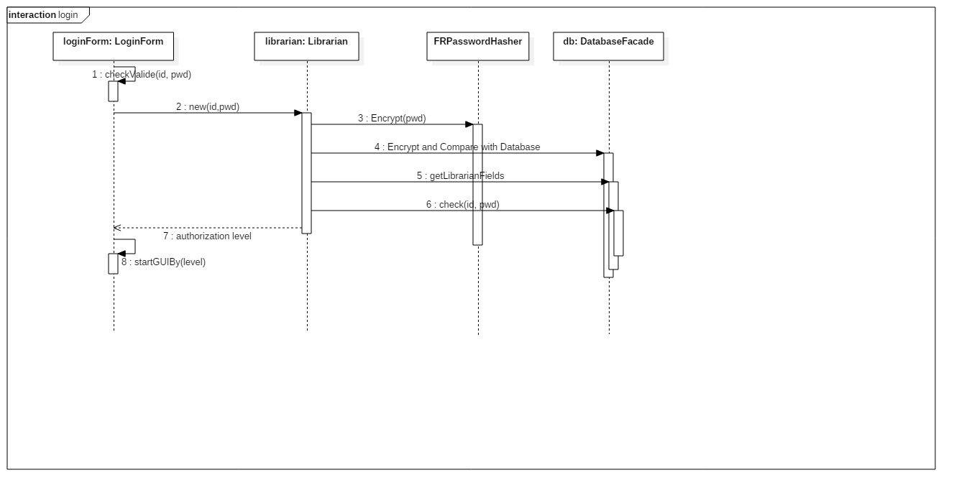
Login Sequence Diagram

Slide 10
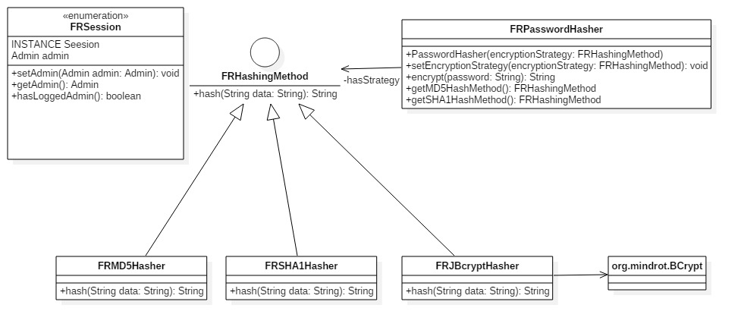
Security Class Diagram

Slide 11



