Slide 1
Library System
A Team Project for Modern Programming practices (MPP)
Members: Jivan Nepali, Mohmoud EI-Nouby, Peng Dong & Zelalem Getnet Belay

Slide 2
Presentation Agenda
Class Diagram depicting the Problem Description
Use cases Implemented
Design of the User Interface (UI)
DEMO

Slide 3
Class Diagram
Finalized Classes
Publication
LendableCopy
Book
CheckoutRecord
CheckoutRecordsEntry
PersonalInfo
Address
Author
LibraryMember
FineRecord
FineEntry
SystemUser
Final Version of Class Diagram

Slide 4
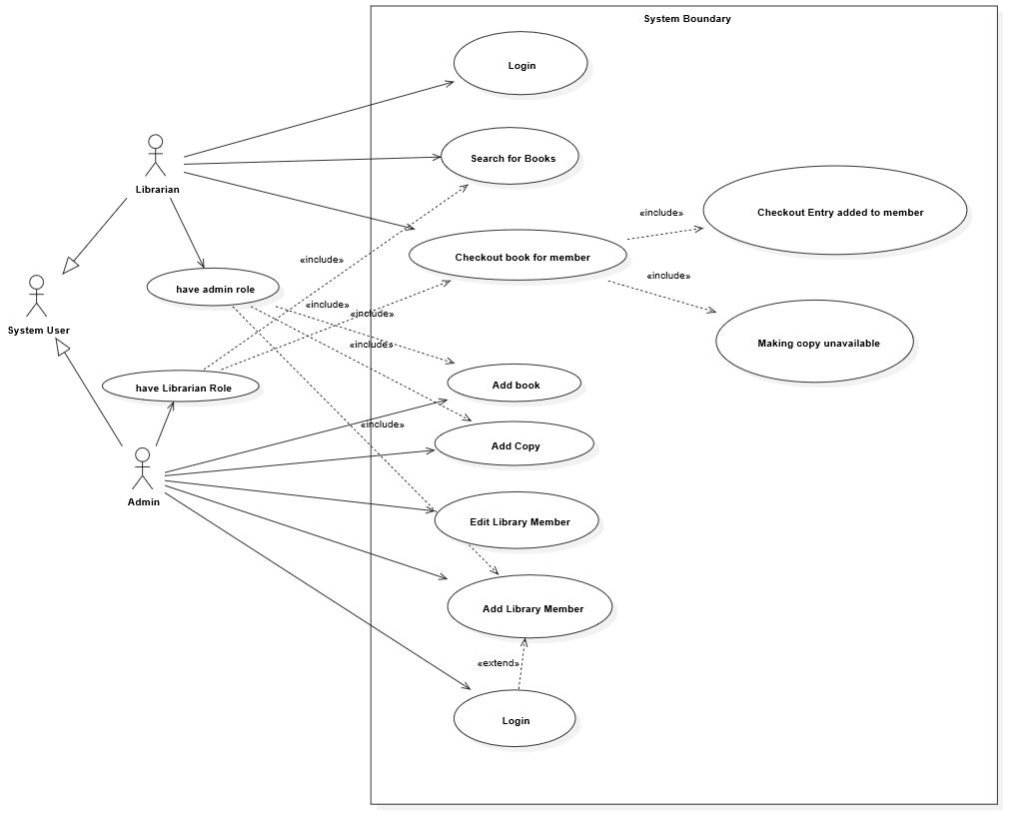
Use Cases Implemented
Features of Library System
User Login
Add/Edit Library Member to the System
Checkout a Book for a Library Member
Add a Copy of Existing Book to the Library System
Add a Book to the Library System
Print (to console) the Checkout Records of Library Member
Return/Check-in a Book for a Library Member^{Extra Feature}
Apply Library-Fine for late returns^{Extra Feature}

Slide 5
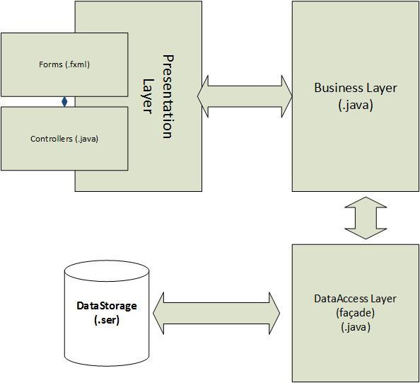
System Architecture

Slide 6
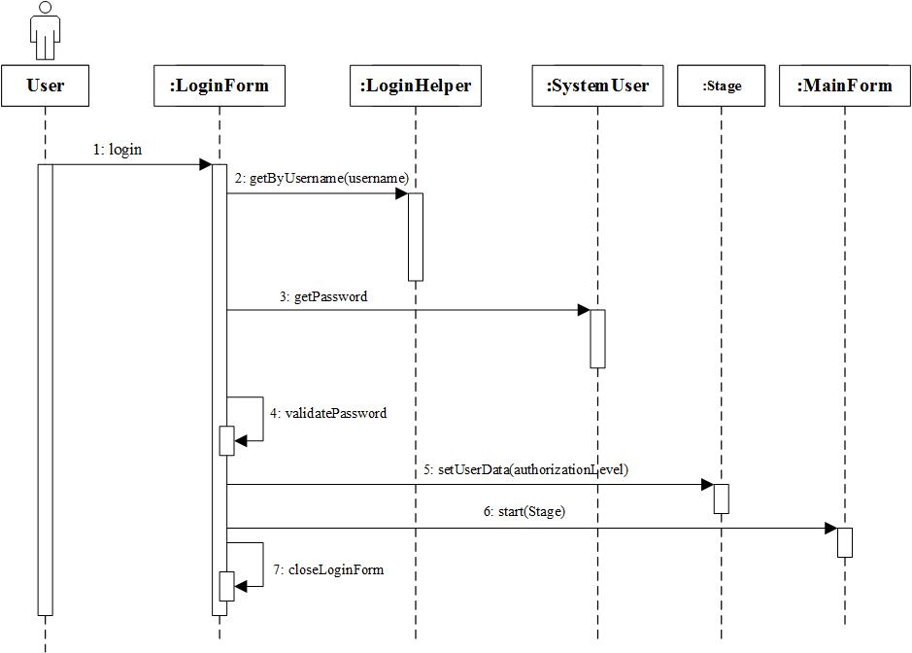
Use Case 1 – User Login

Slide 7
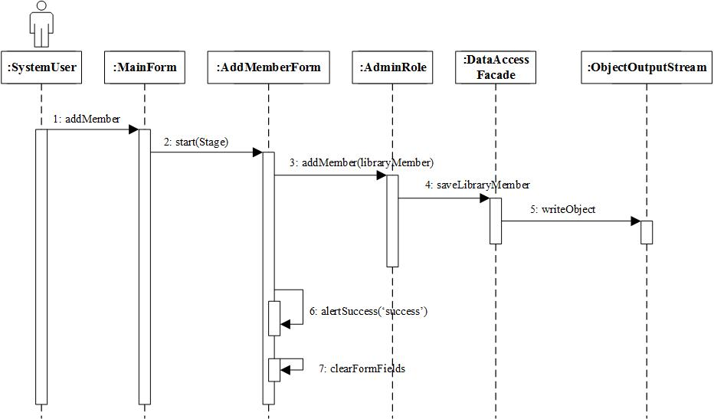
Use Case 2 – Adding Library Member

Slide 8
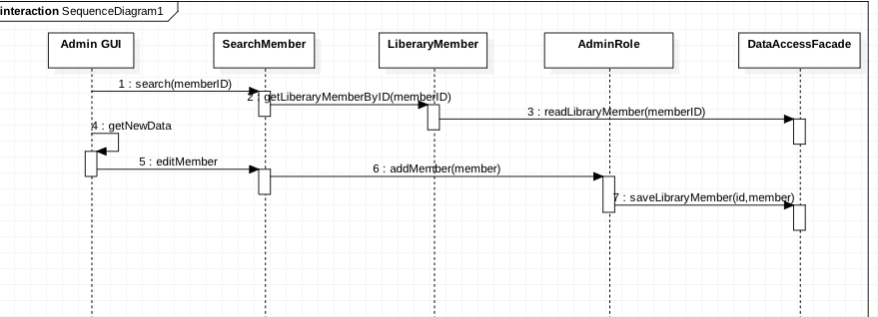
Use Case 2.1 – Editing Library Member

Slide 9
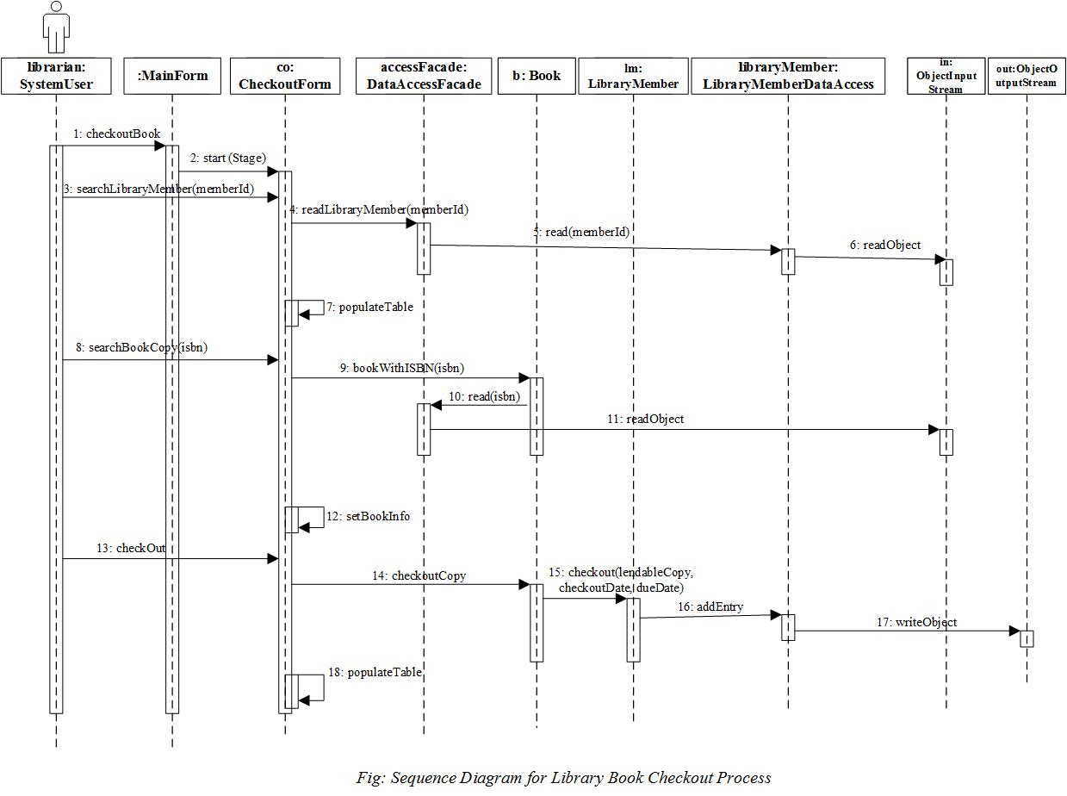
Use Case 3 – Checking out a Book

Slide 10
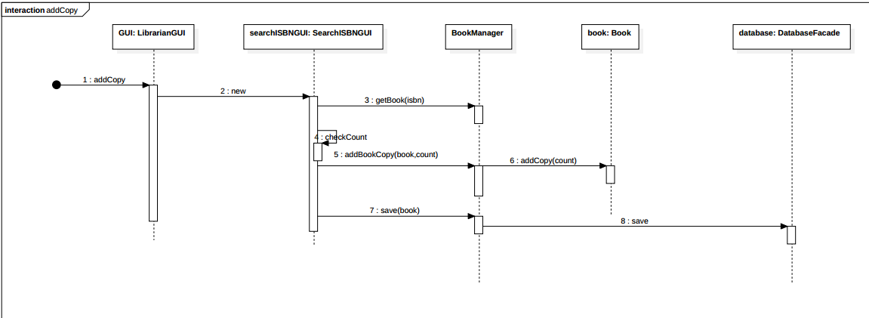
Use Case 4 – Adding a Copy of Existing Book

Slide 11
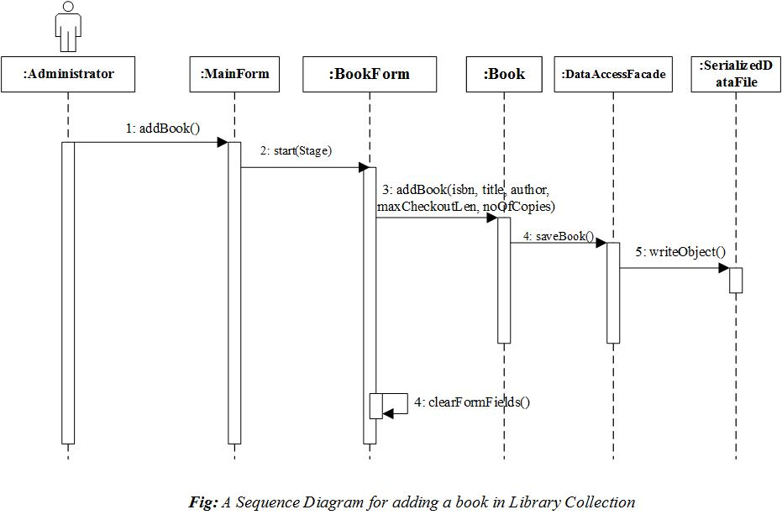
Use Case 5 – Adding a Book

Slide 12
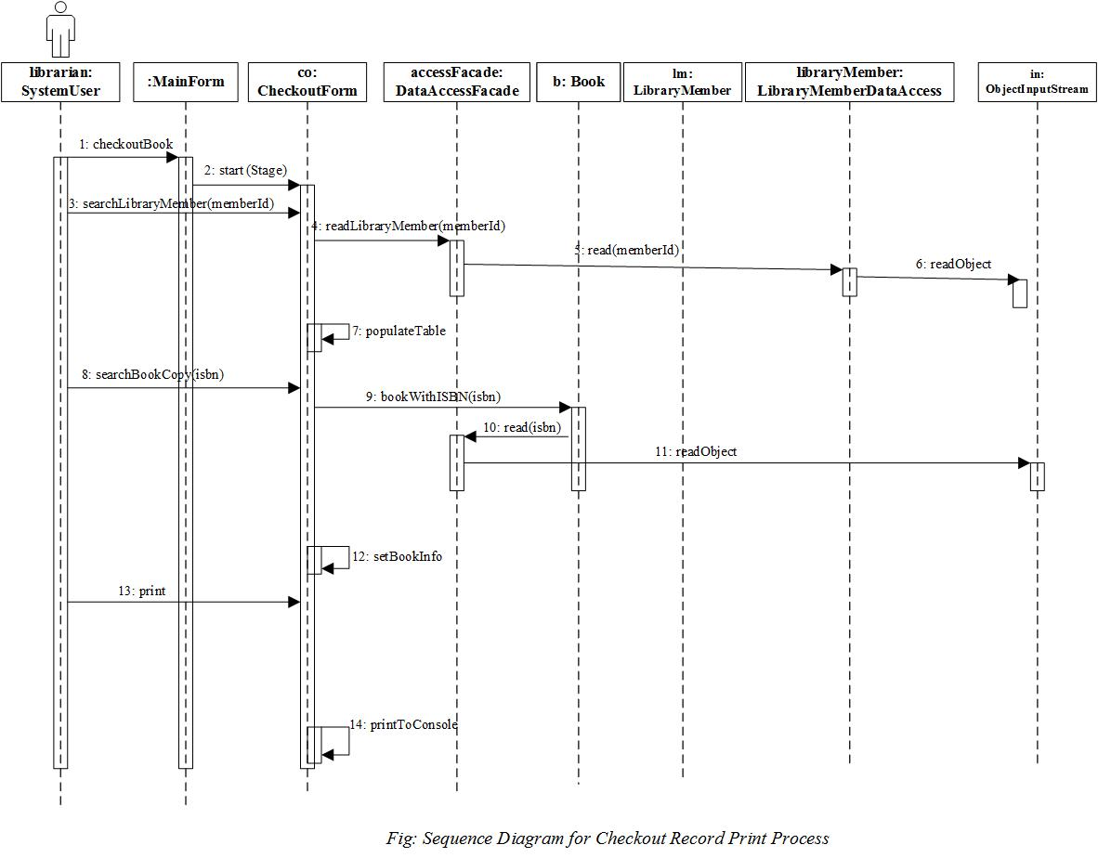
Use Case 6 – Print Checkout Record

Slide 13
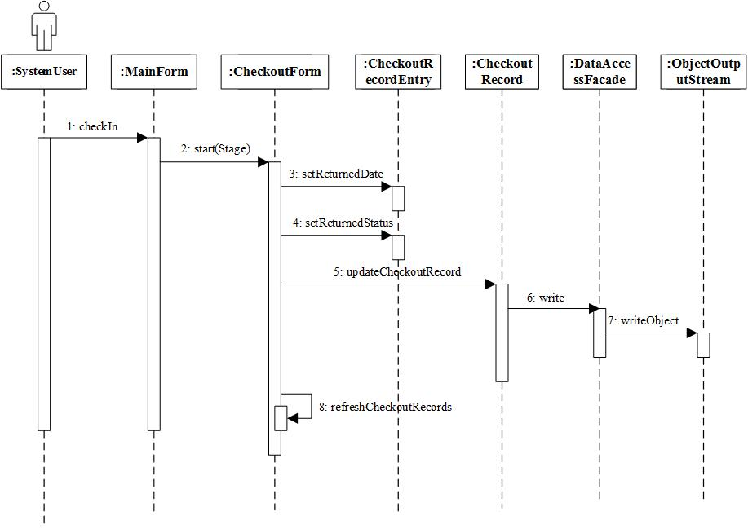
Use Case 7 – Return of Borrowed Book

Slide 14
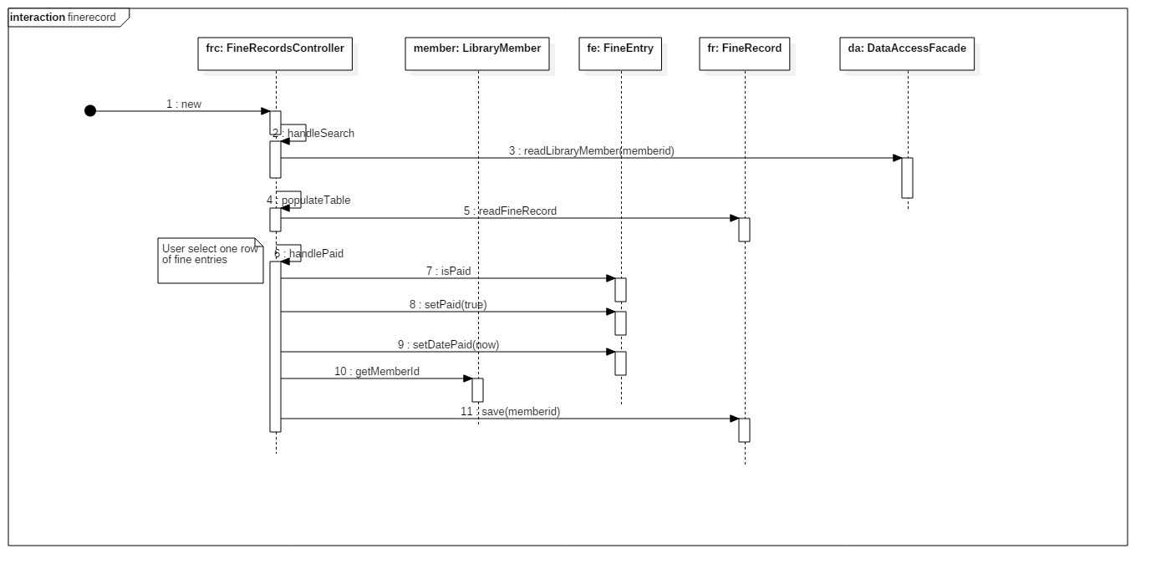
Use Case 8 – Library Fine for Late Return

Slide 15
Design of User Interface
Team Discussion for Basic Layout for the use cases
UI design on the Paper
Used SceneBuilder for Forms Design

Slide 16
DEMO

Slide 17


Questions & Answers Session

