Slide 1
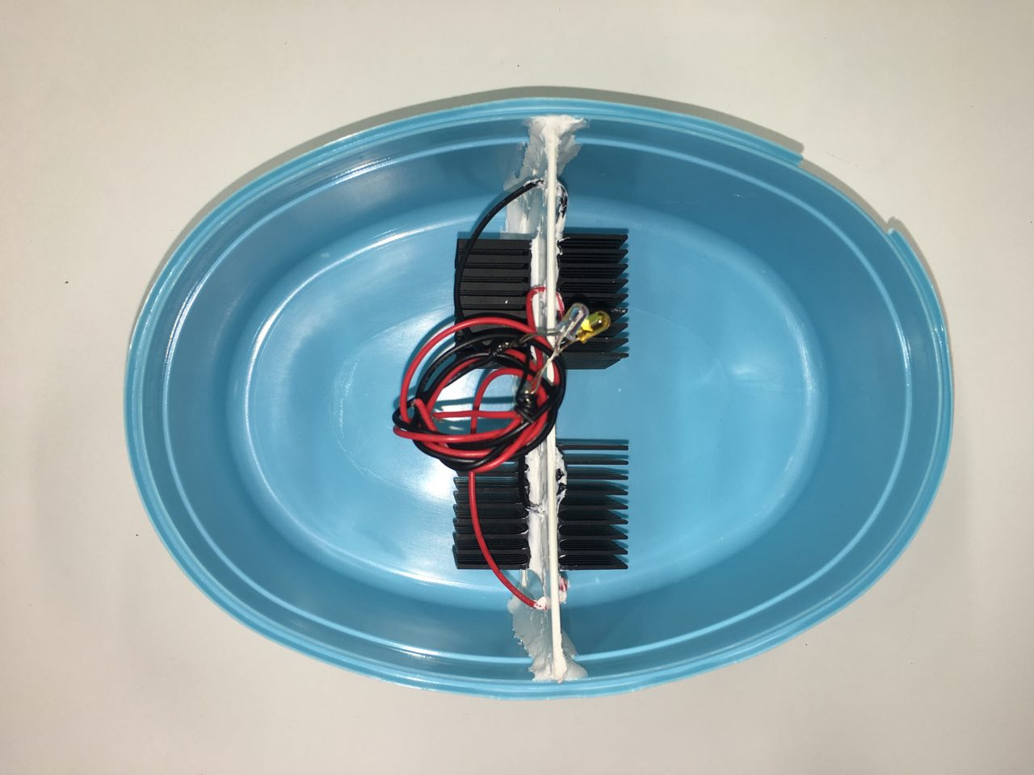
LED lights
PVC divider
current
measured
double-stacked water basin
hot water
(mixed shower water)
cold water
(room temp. water)
potential difference
measured
heat sinks
Peltier chip

