Slide 1
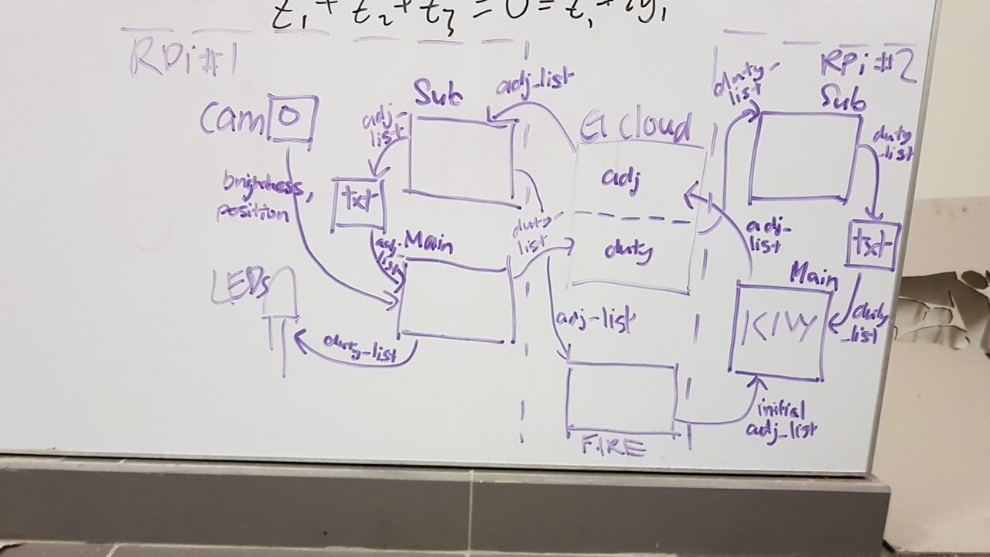

CLOUD MQTT SERVER
IP ADDRESS: 35.197.131.13
./cloud_dw_1d
list: adj_list
topic: adj_list
topic: duty_list
./camera_dw_1d/
./kivy_dw_1d/
duty_list_sub.py
adj_list_sub.py
duty_list.txt
adj_list.txt
during init
tlkh_camera.py
smart_lighting.py
cam_lights.py

