Slide 1
PIN 17
L298N
TOP LEFT
TOP RIGHT
PIN 22
FROM RASPBERRY PI
L298N
PIN 13
BOTTOM LEFT
BOTTOM RIGHT
PIN 21
Battery
RED: +3.3V BLACK: GND
GND
+6V

Slide 2
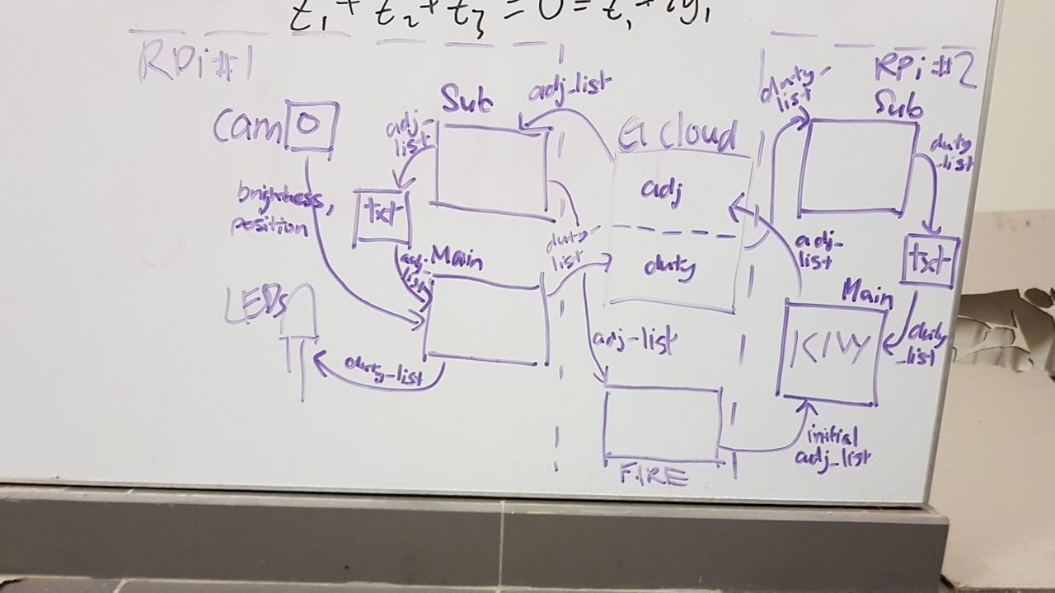

CLOUD MQTT SERVER
IP ADDRESS: 35.197.131.13
./cloud_dw_1d
list: adj_list
topic: adj_list
topic: duty_list
./camera_dw_1d/
./kivy_dw_1d/
duty_list_sub.py
adj_list_sub.py
duty_list.txt
adj_list.txt
during init
tlkh_camera.py
smart_lighting.py
cam_lights.py

