Slide 1

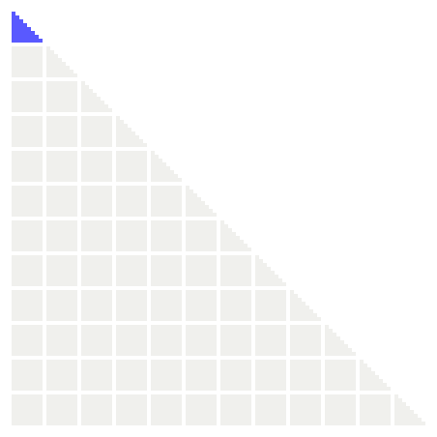
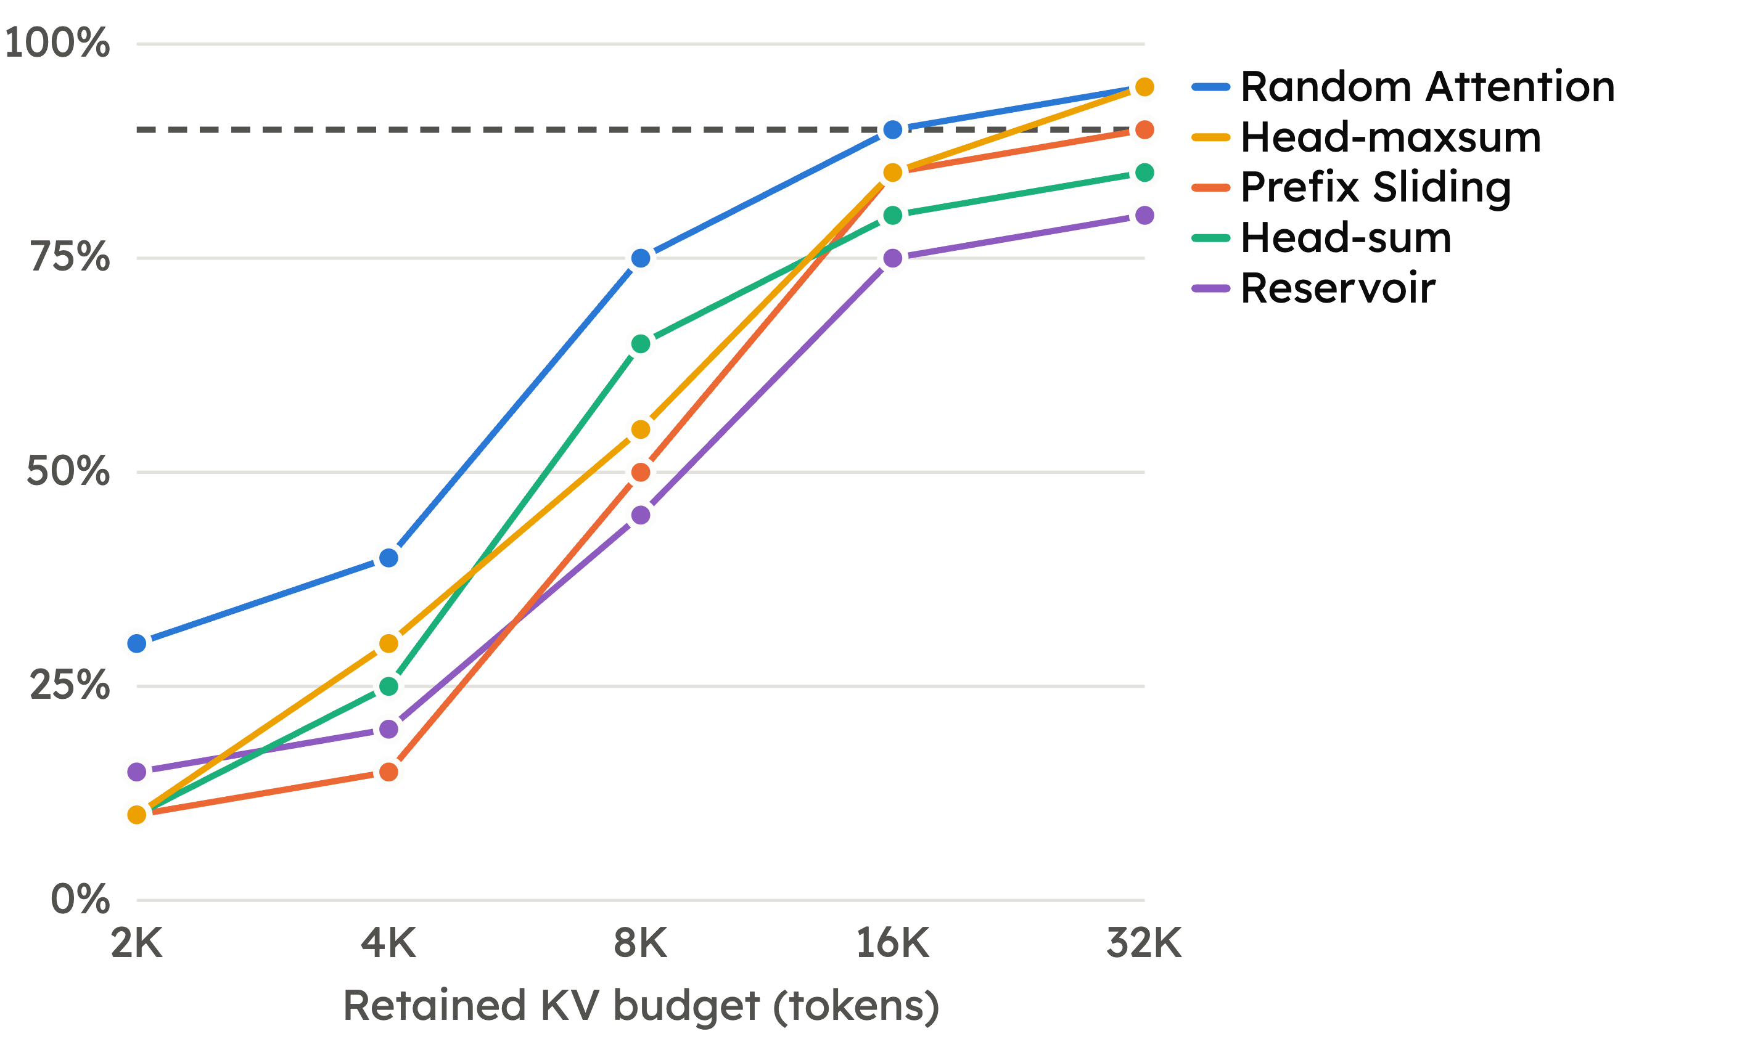

Comparing cache eviction policies (on gpt-oss-20b)
Problem: The memory of the KV cache of global attention scales with context length.
Solution: Evict some of the KV cache.
Policies
Protected
Run 5 AIME problems × 4 seeds at 2K–32K
Prefix Sliding
Random Attention
Reservoir
Head-sum
Head-maxsum
Chosen
Evicted
Replay 20 AIME traces against full cache
At 16K | Logprob diff. | Attention diff.
Random Attention | 0.048 | 0.065
Reservoir | 0.051 | 0.083
Prefix Sliding | 0.054 | 0.045
Head-sum | 0.043 | 0.062
Head-maxsum | 0.042 | 0.062
gpt-oss-20b on AIME 2026, 20 runs per point. Dashed: full cache.
Findings
Near full-cache accuracy is already achieved at 16K tokens
The eviction policy does not really matter

Slide 2
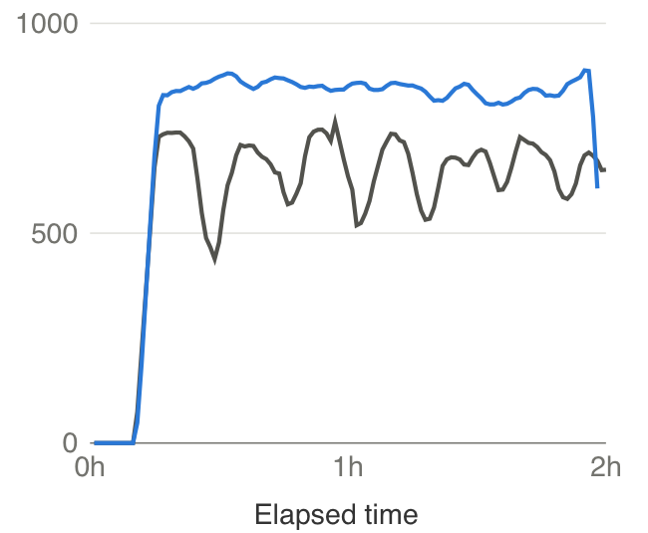
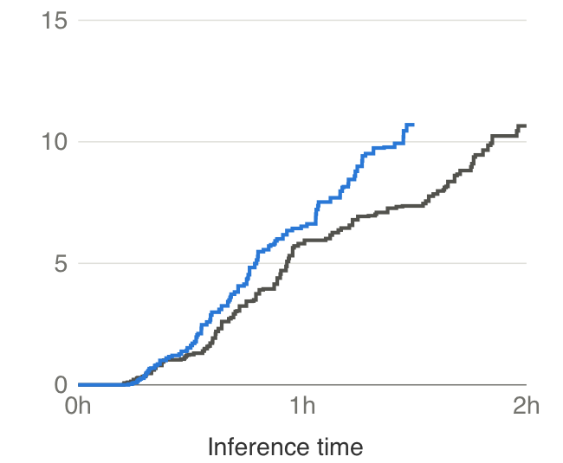
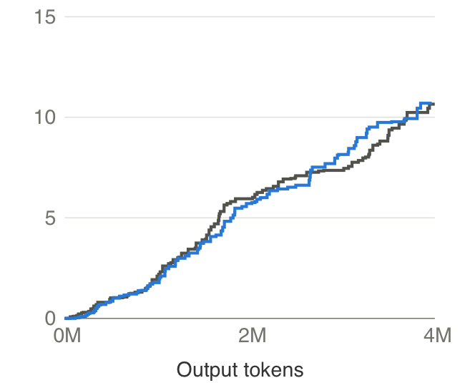
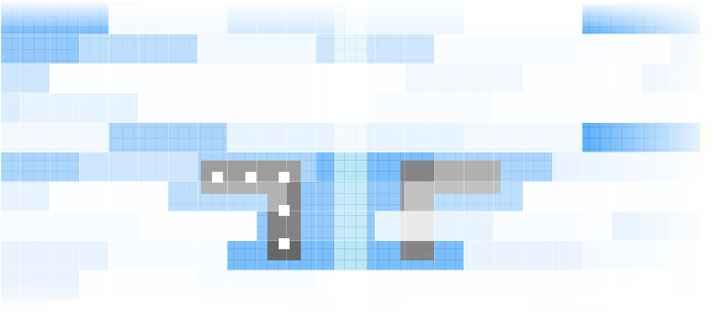
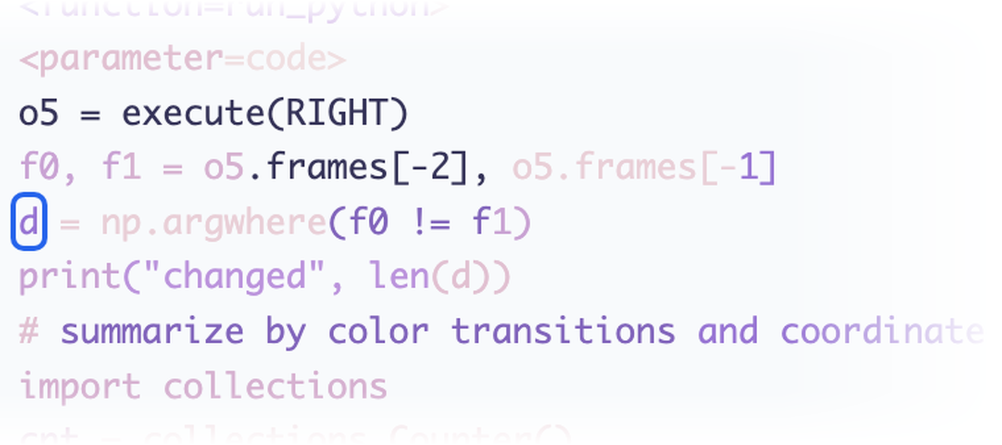

Cache eviction in ARC-AGI-3 (on Qwen3.8-Flash-Next)
Policy chosen
Decode throughput
Score over time
Score over tokens
Head-maxsum variant
Why evict
More sequences per GPU
No prefill between levels
Result
Higher throughput
Better overall score
First to 20 points, currently 25th place
Grey: Milestone 2 winning harness. Blue: my eviction run.
What the cache keeps
Key image features are retained
Important information is retained
Repetitive diffs are evicted

