Slide 1
EY Data Science Competition
Zheng Xingjian, Tong Hui Kang

Slide 2
Overview of the presentation
Understanding of the problem
Methodology including algorithms used
Findings and patterns
Opportunities to improve individual and team performance
Proposed applications for the data findings within the context of Smart Cities
Notes:
This is just a content page don’t explain this.

Slide 3
Understanding of the problem

Slide 4
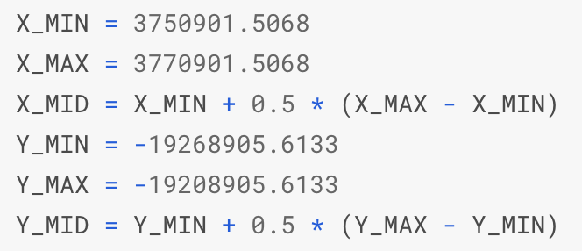
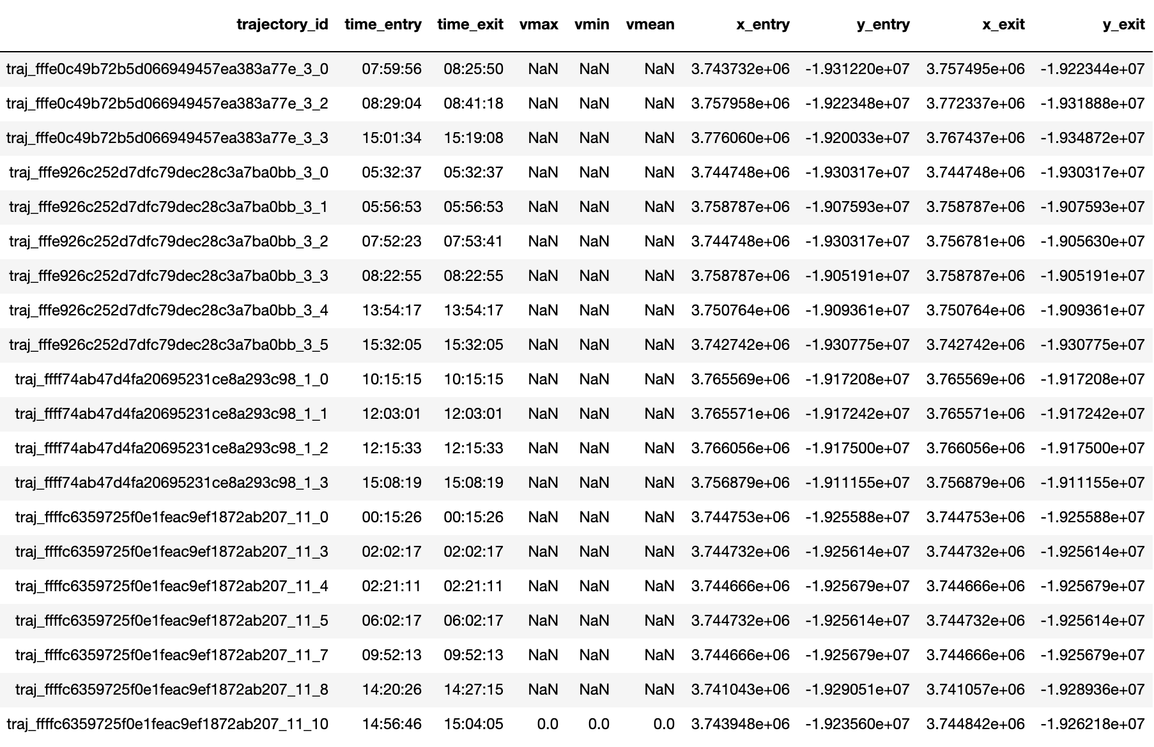
The raw dataset and objective
“Last seen inside/outside” - whether the last seen location (entry point of final trajectory) is inside or outside
“Stationary/Non stationary” Whether the duration of the last trajectory is zero
duration
last seen
target

Slide 5
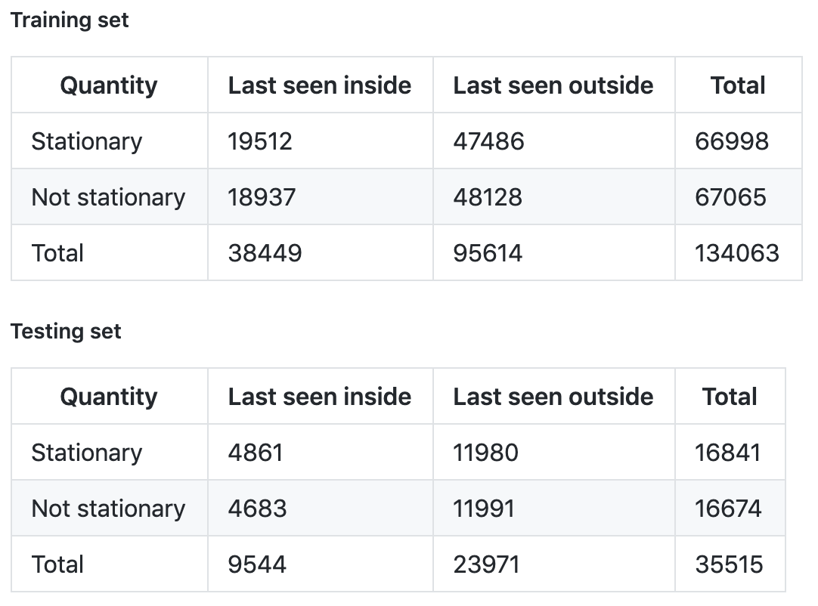
Basic analysis
“Last seen inside/outside” - whether the last seen location (entry point of final trajectory) is inside or outside
“Stationary/Non-stationary” Whether the duration of the last trajectory is zero
Notes:
** Find the values please

Slide 6
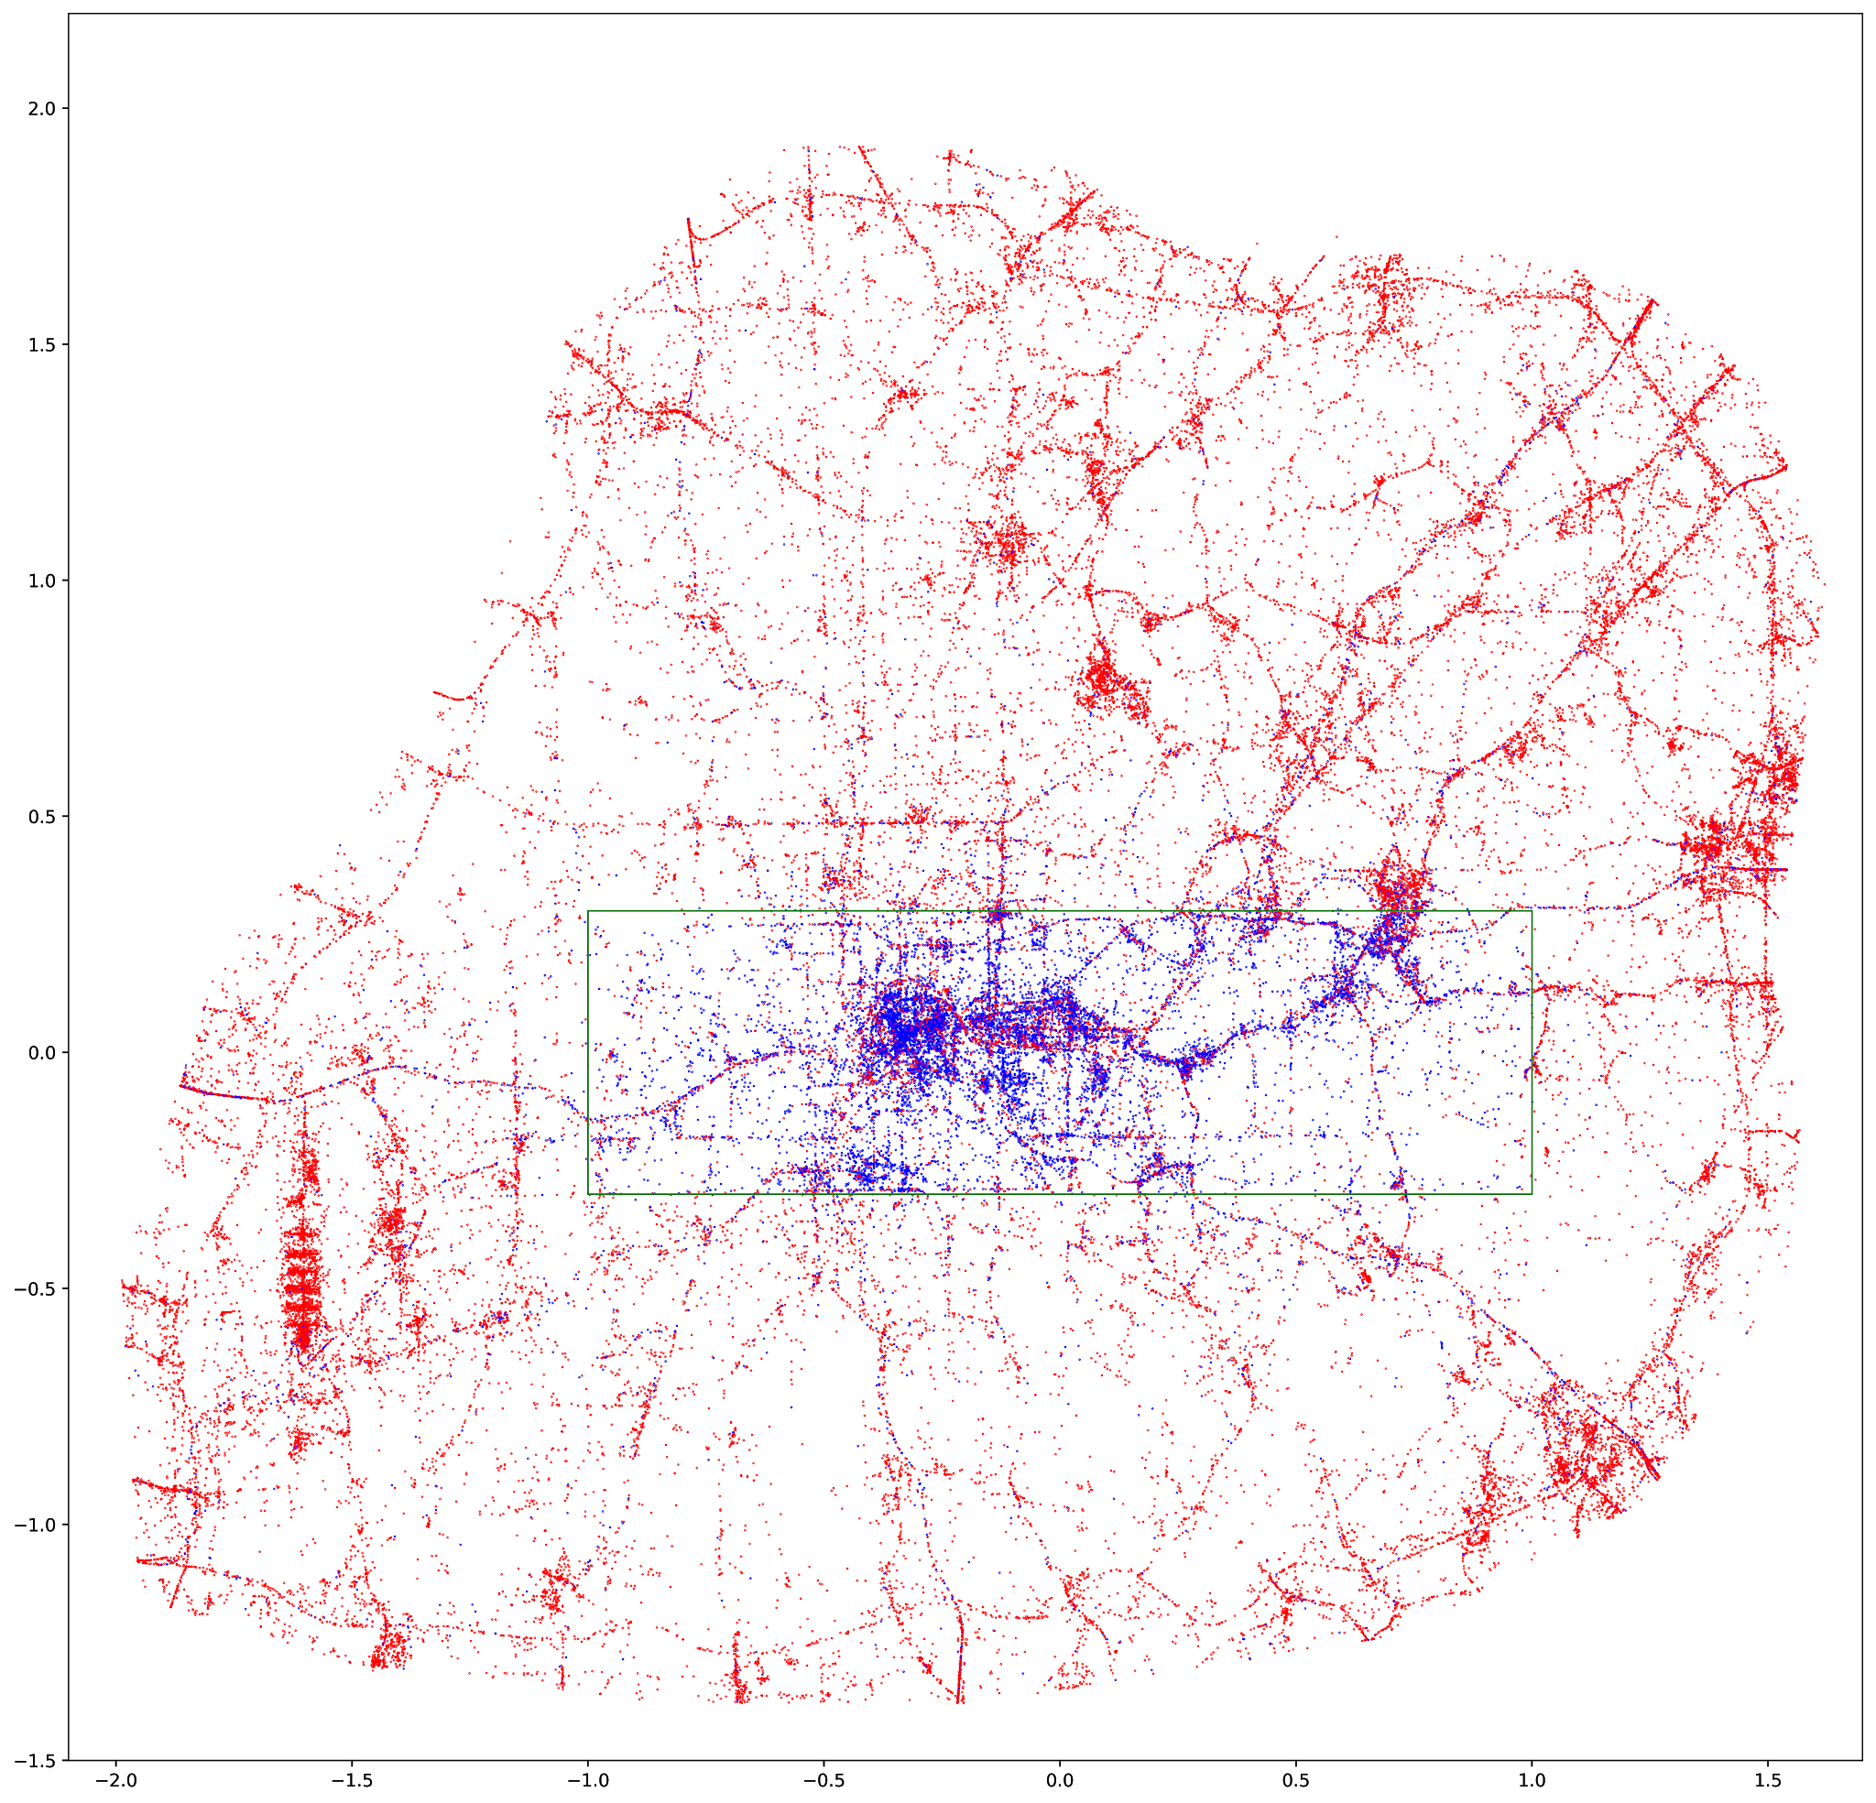
Visualisations
The box: city boundary Points: last seen locations
Blue ends up inside, target is True
Red ends up outside, target is False
Showing points that are non-stationary
Notes:
** get the picture with just the non-stationary

Slide 7
Methodology including algorithms used

Slide 8
Overview of
pipeline
LightGBM
Dataset
Raw features
Augmented
Features
Pipeline benefits
flexibility from modularity
minimise recomputation
Cluster
Features
Embedding
Features
Prediction
Notes:
*Changing the name “trivial features” to “augmented features” some time soon”

Slide 9
Preprocessing

Slide 10
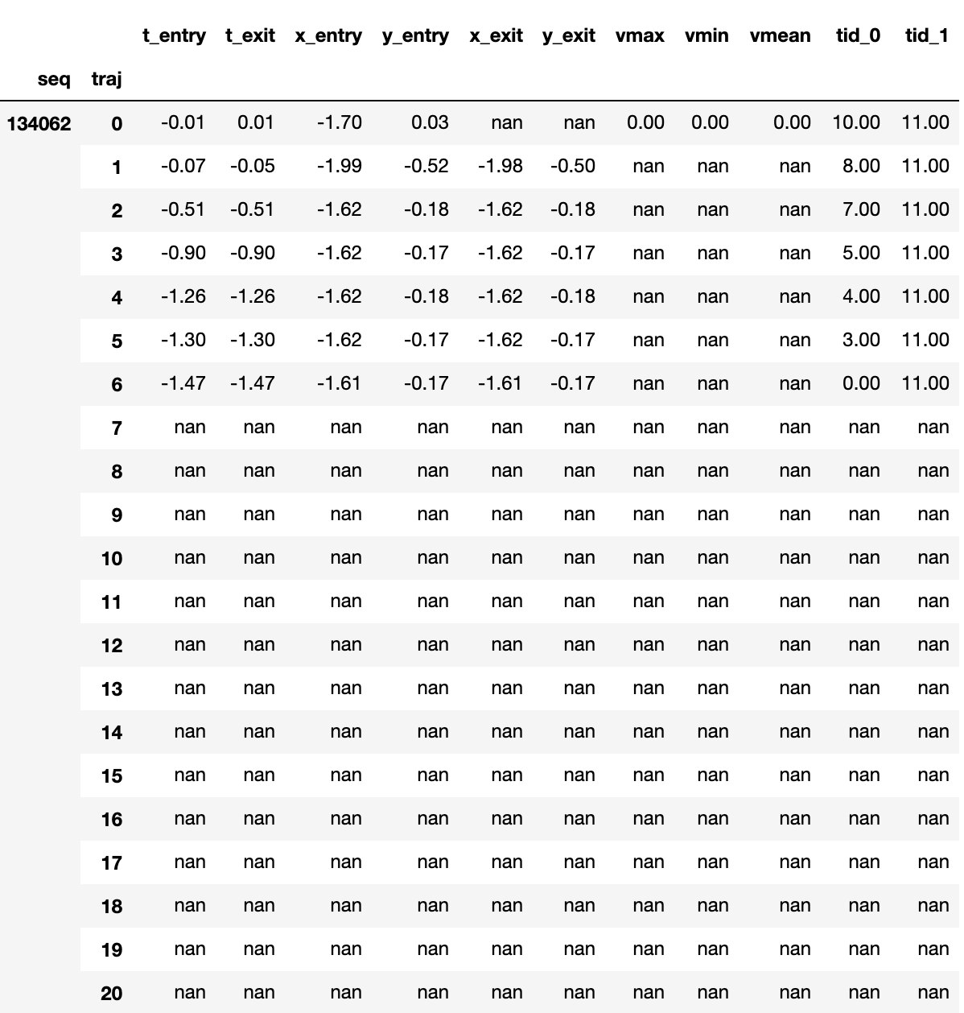
Transformation of the raw dataset
Notes:
Use corresponding dataset

Slide 11
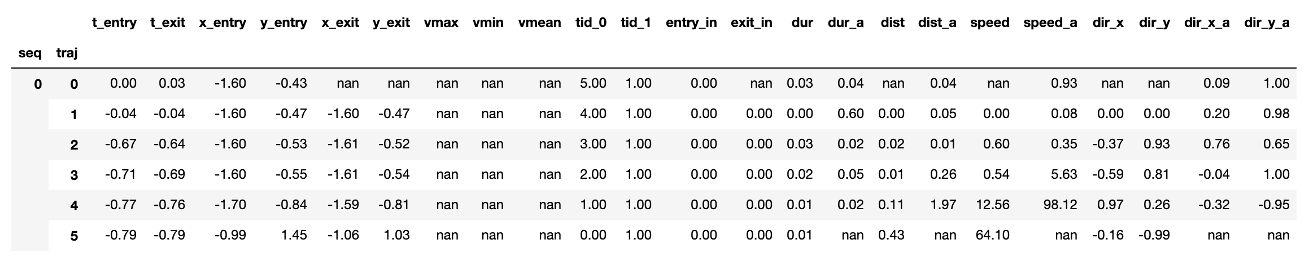
Augmented features
Is the point inside the city?
Raw
Augmented
?
?

Slide 12
Cluster feature
Weighted average of the targets of nearest 10 last seen points

Slide 13
ML models

Slide 14
Different models experimented
Uses raw features and some augmented features Without tuning parameters Predicts binary classification (better performance than predicting coordinates)
Linear neural network: 83.4 LSTM neural network: 81.3 SVM after PCA: 85.4
Baseline: 86.9 (regard final location as last seen location)
Gradient boosting: 88.7

Slide 15
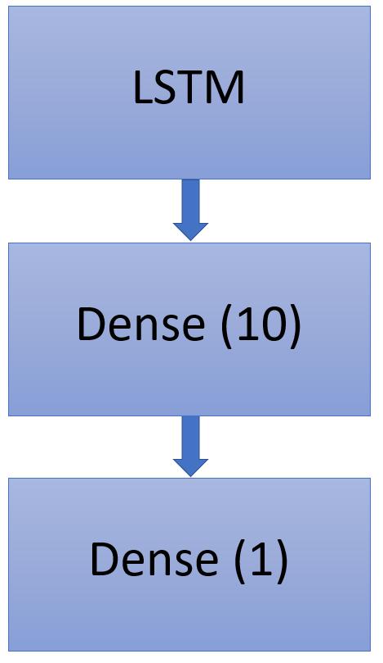
Embedding features
Feed the 10 hidden units of the last second layer to the lightGBM model.
Those numbers are considered as the embedding features, which memorize the sequential information found by the LSTM framework.

Slide 16
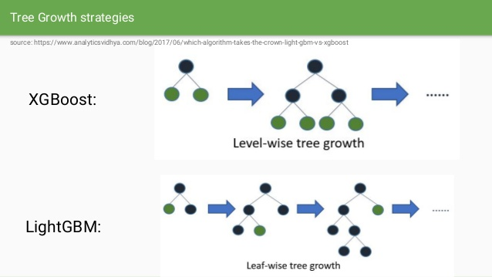
LightGBM
Implementation of gradient boosting method (combines many weak decision trees by boosting)
Compared with XGBoost, LightGBM is better at analyzing datasets containing many features. Our dataset has over 400 features.

Slide 17
Post-processing

Slide 18
Cross validation
Number of folds used is 10. - Trade-off between validation precision and training data size - No improvements when the number of folds used is 15

Slide 19
Ensemble
Three different boosting methods were tried - GBDT, DART, GOSS
Average of 10 GBDT predictions with different seed each: 89.3 (CV)
90/10 ensemble GBDT, DART and GOSS predictions: 89.3 (CV)
Notes:
Mention this was tried, but the result isn’t strong (?) Explain why this isn’t used?

Slide 20
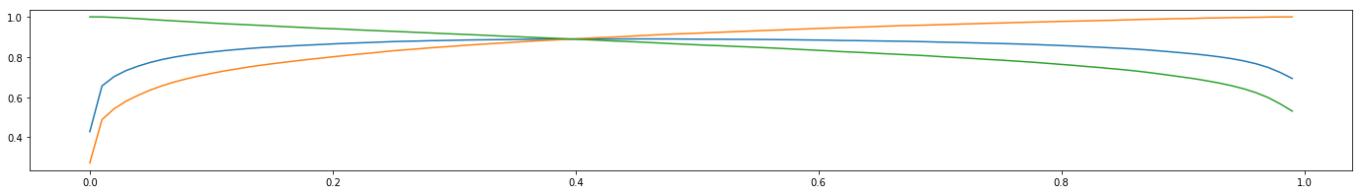
Threshold optimisation
We find out which threshold produce the best F1 for the training set.
LightGBM produces confidence (between zero to one), but the competition demands binary prediction (zero OR one)
precision
F1
recall

Slide 21
Your findings and patterns

Slide 22
Feature importance: split and gain
Split
Gain
Embedding features
Cluster features
Raw features
Augmented features
Log Abs
Log Abs
Notes:
** Please rearrange the features.

Slide 23
The most important features
Split
Gain
entry_in_0
dur_0
e8, e9
sum_entry_0
Log Abs
Log Abs
Notes:
** Please rearrange the features.

Slide 24
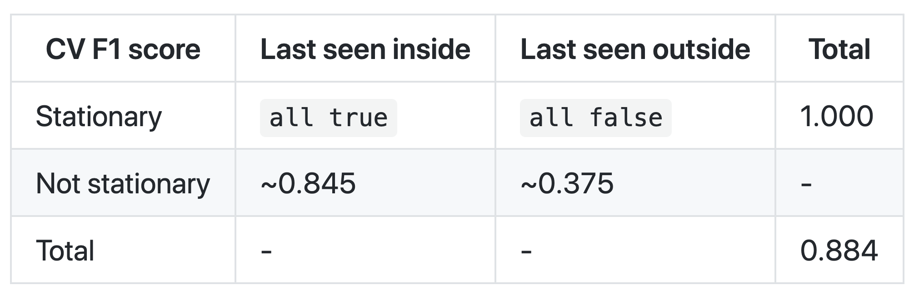
Stratified F1 score
Notes:
https://www.kaggle.com/huikang/eyn-df-lgbm-citysplit

Slide 25
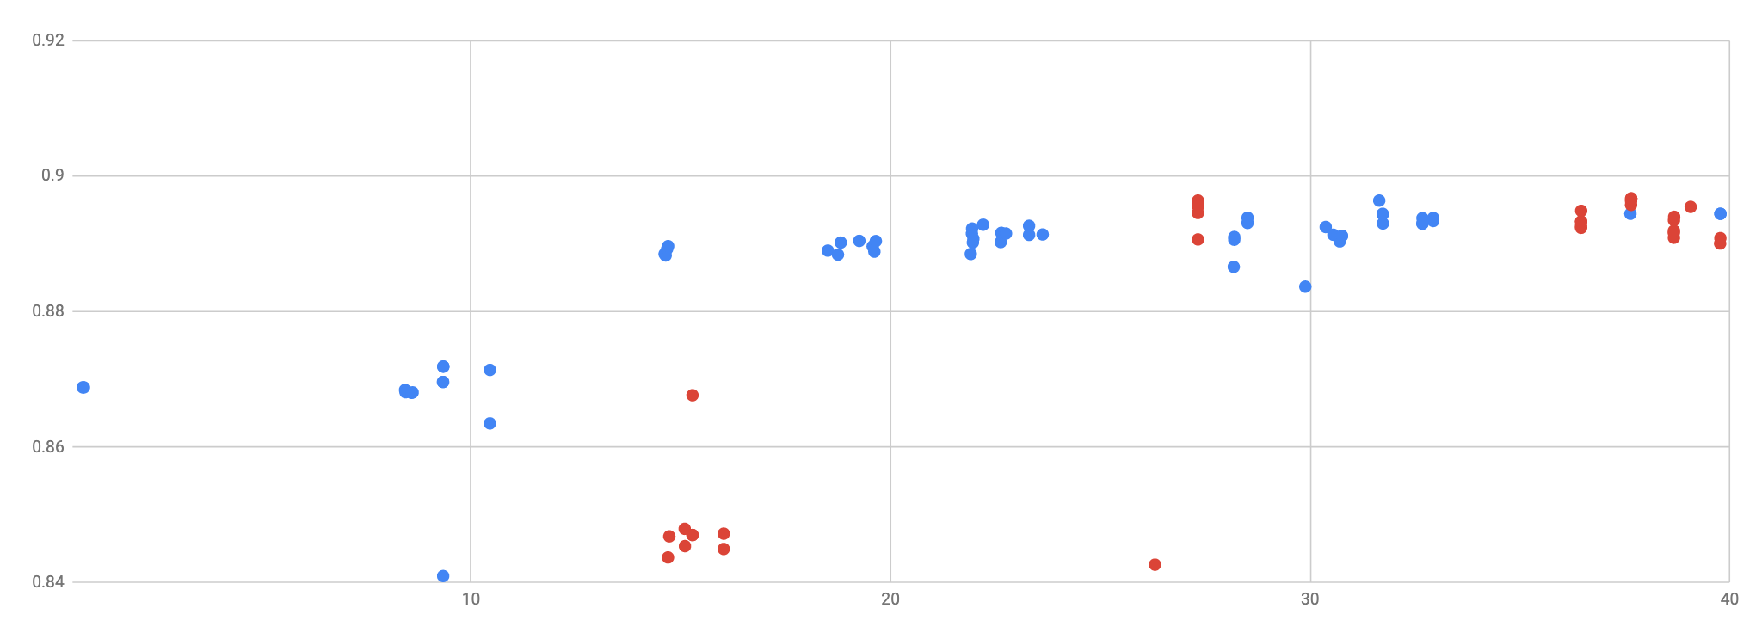
Journey of our public leaderboard score
Addition of “time dummy”
LightGBM
Ensemble Fine tuning
10 fold CV
Public LB F1 score
Use of clusters
Baseline
NN models
Days since start of competition
Notes:
Download and plot

Slide 26
Opportunities to improve performance

Slide 27
Improvements
Learn the theory. Study LightGBM, training with binary log-loss and F1 score. Is CV or public leaderboard better?
Better integration of roles. Coordinate exploratory experiments and building the data pipeline.
Hindsight discoveries. Data cleaning of impossible trajectories
More systematic documentation. Record how much each feature contribute how much to the score.
Parameter search. Requires writing scripts and resources more extensive than Kaggle kernels.
Notes:
** Will make nice icons for this

Slide 28
Your proposed applications for the data findings within the context of Smart Cities

Slide 29
Applications
Instead of predicting INDIVIDUALS which does not have better accuracy (Note the small difference from the 0.86881 baseline.)
We could find insights on the AGGREGATE city traffic - how many people are on the move in an area - the demand for public transport
Data science can be to understand transport patterns. More data is appreciated (is the point on a road or near a metro?)
Notes:
To do

Slide 30
The end
Thank you!
Questions please :D

