Slide 1
Value
fair
price
Benefit
P₃
NVC
P₂
P₁
Quality
0.03
0.05
0.15

Slide 2
Value
PVC
fair
price
Benefit
NVC
Quality
0.03
0.05
0.15
Q_{aware}
Q_{naive}

Slide 3
Value
PVC
fair
price
PIC
Benefit
NVC
Quality
0.03
0.05
0.15

Slide 4
Value
PVC
Benefit
NVC
Quality
0.03
0.05
0.15
Q_{aware}
Q_{naive}

Slide 5
Value
PVC
Benefit
NVC
Quality
0.03
0.05
0.15
Q_{aware}
Q_{naive}

Slide 6
Value
PVC
Benefit
PIC’
Quality
0.03
0.05
0.15

Slide 7
Graphs for economics

Slide 8









Price
SS
$$A$$
$$B$$
$$P_{1}$$
$$P$$
$$E$$
$$P_{2}$$
$$C$$
$$D$$
Quantity
DD
$$Q_{e}$$

Slide 9




Price
SS
$$P_{f}$$
$$P$$
$$P_{c}$$
Quantity
DD
$$Q_{dd}$$
$$Q_{e}$$
$$Q_{ss}$$

Slide 10






Price
SS
SS_{w} + tax
$$P_{2}$$
A
C
SS_{w}
B
D
$$P_{1}$$
Quantity
DD
$$Q_{s}$$
$$Q_{s^{′}}$$
$$Q_{d^{′}}$$
$$Q_{d}$$

Slide 12







Price/Cost
MC
ATC
$$C_{T}$$
AVC
$$P$$
$$C_{F}$$
AFC
Quantity
MR
DD=AR
$$Q_{π}$$

Slide 13

Price/Cost
MC
AC
$$P$$
Quantity
MR
DD=AR
$$Q_{π}$$

Slide 14


Price/Cost
MC
$$P$$
AC
Quantity
MR
DD=AR
$$Q_{π}$$

Slide 15


Price/Cost
MC
AC
$$P$$
Quantity
MR
DD=AR
$$Q_{π}$$

Slide 16


Price/Cost
MC
AC
$$P$$
MR = AR = DD
Quantity
$$Q_{π}$$

Slide 17
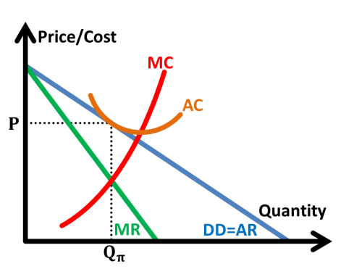
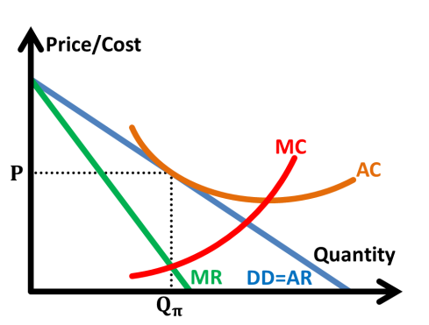
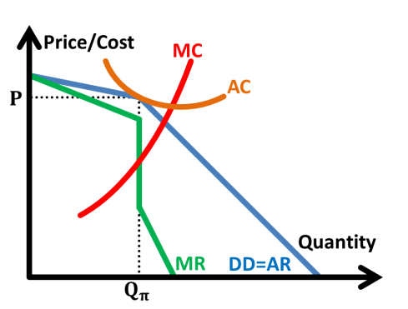
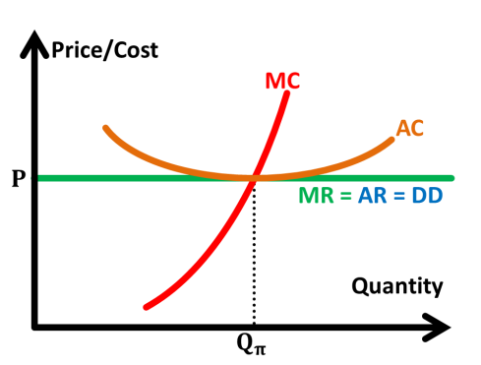

Slide 19




Price/Cost
$$A$$
MC
$$C$$
AC
$$B$$
Quantity
MR=DD=AR
$$Q_{π}$$

Slide 20




Price/Cost
$$P_{1}$$
$$P_{2}$$
MC
AC
$$P_{3}$$
MR
Quantity
DD=AR
$$Q_{π}$$

Slide 22



Price/Cost
MC
$$P$$
$$C$$
AC
Quantity
MR
DD=AR
$$Q_{π}$$

Slide 23


Price/Cost
MC
AC
$$P$$
Quantity
MR
DD=AR
$$Q_{π}$$

Slide 24
Price/Cost
Price/Cost
MC
AC
$$P$$
Quantity
MR
DD=AR
$$Q_{π}$$

Slide 26






Price
Price/Cost
SS
MC
SS’
MC’
AC
MR = AR = DD
$$P$$
$$P$$
AC’
$P$’
$P$’
MR’ = AR’
MR’
DD
Quantity
$$Q_{1}$$
$$Q_{2}$$
$$Q_{π}$$
$$Q_{π}^{′}$$

Slide 28



Price/Cost
MC
$$P$$
AC
$$P′$$
MR’
Quantity
DD=AR
MR
AR’
$$Q_{π}^{′}$$
$$Q_{π}$$

Slide 30


Price/Cost
MC
$$P$$
AC
Quantity
MR
DD=AR
$$Q_{π}$$
$$Q_{s}$$

Slide 31
Price/Cost
MC
$$P$$
AC
Quantity
MR
DD=AR
$$Q_{π}$$
$$Q_{s}$$

Slide 33


Cost/Benefit
PMC_{real}
PMC_{percieved}
Quantity
PMB
$$Q_{s}$$
$$Q_{e}$$

Slide 34
Cost/Benefit
SMC
PMC + tax
PMC
< EMC at Qs >
Quantity
PMB
$$Q_{s}$$
$$Q_{e}$$

Slide 35


Cost/Benefit
PMC
PMC + subsidy
< EMB at Qs >
Quantity
PMB
SMB
$$Q_{e}$$
$$Q_{s}$$

Slide 36







AE
Y
AE
$$c$$
$$d$$
$$a$$
$$b$$
Income
$$Y_{1}$$
$$Y_{e}$$
$$Y_{2}$$

Slide 37









AE₁
AE
Y
$$f$$
$$g$$
AE₀
$$d$$
$$e$$
$$b$$
$$c$$
$$a$$
Income
$$Y_{0}$$
$$Y_{1}$$

Slide 38


GPL
AS
AS
AD
RNO
$$Y_{f_{1}}$$
$$Y_{f_{2}}$$

Slide 39

GPL
AD
AS
AS
RNO
$$Y_{f}$$

Slide 40

GPL
AD
AD
AS
RNO
$$Y_{f}$$

Slide 42






consumer good
$$A$$
$$S$$
$$U$$
$$B$$
capital good
$$R$$
$$V$$

Slide 43
wheat
20
CPC
export
PPC
import
cloth
40

Slide 44
wheat
20
import
export
CPC
cloth
PPC
10

Slide 45
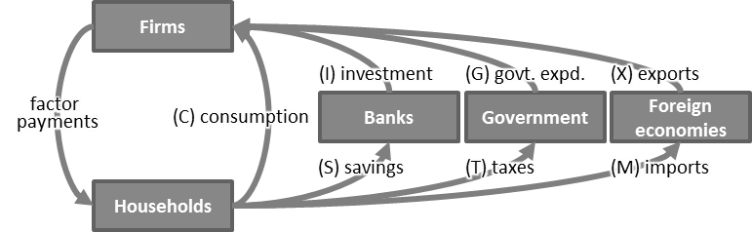
Firms
(I) investment
(G) govt. expd.
(X) exports
factor payments
(C) consumption
Banks
Government
Foreign economies
(S) savings
(T) taxes
(M) imports
Households

Slide 46
Firms
injections
(I) investment
(G) govt. expd.
(X) exports
factor payments
Banks
Government
Foreign economies
(C) consumption
(S) savings
(T) taxes
(M) imports
Households
withdrawals

