Slide 1
Team 14
NUS DATA SCIENCE
COMPETITION 2018
Wang Jie
Hui Kang
Terrence Tan
Ng Min Min

Slide 2
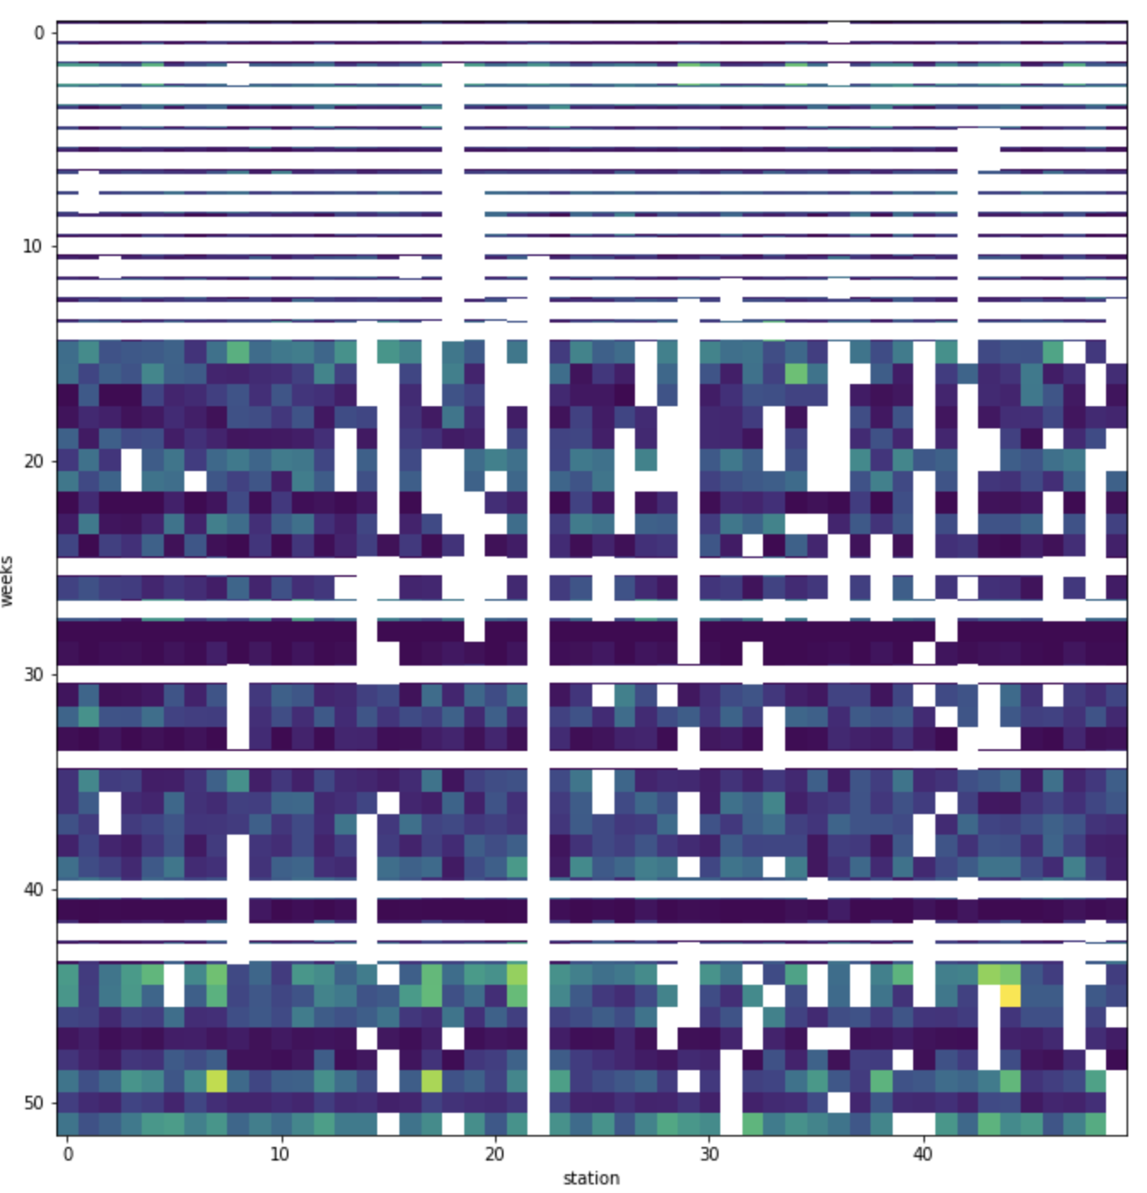
Data Given
White horizontal lines are weeks without radar data
A white pixel represents the week that a particular rain gauge has no value recorded

Slide 3
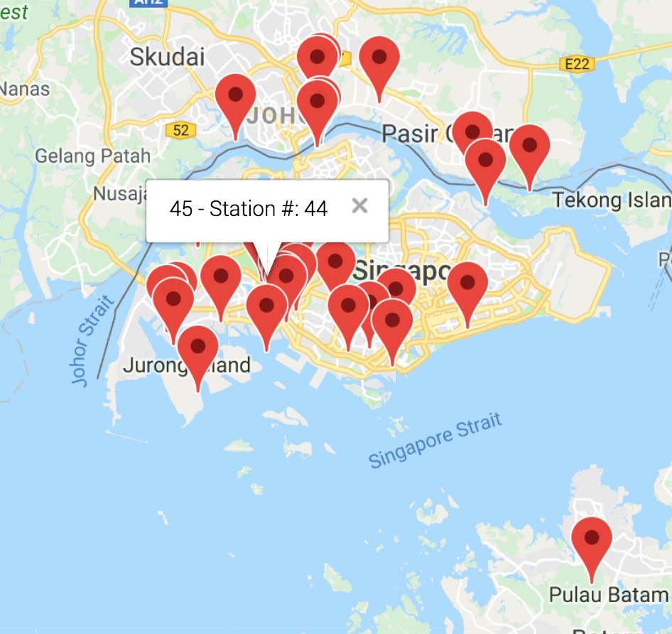
Output required
Prediction locations of the rain gauge (and how confident are we of the predictions)

Slide 4
Base model
Formula and values of A and B here

Slide 5
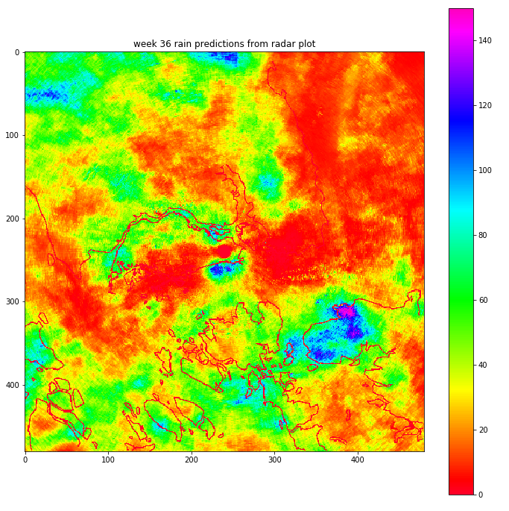
Rainfall Prediction
With the base model we predict the rainfall for every point in the map

Slide 6
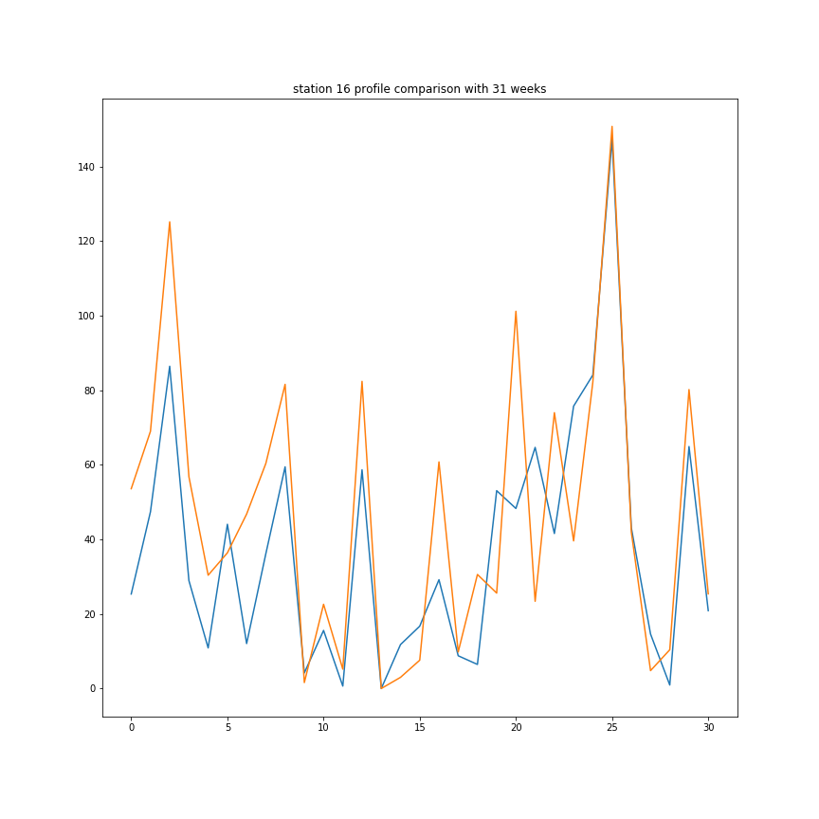
Profile fitting
This is the best predicted profile for station 16.
Blue is the recorded rainfall.
Orange is the predicted rainfall

Slide 7
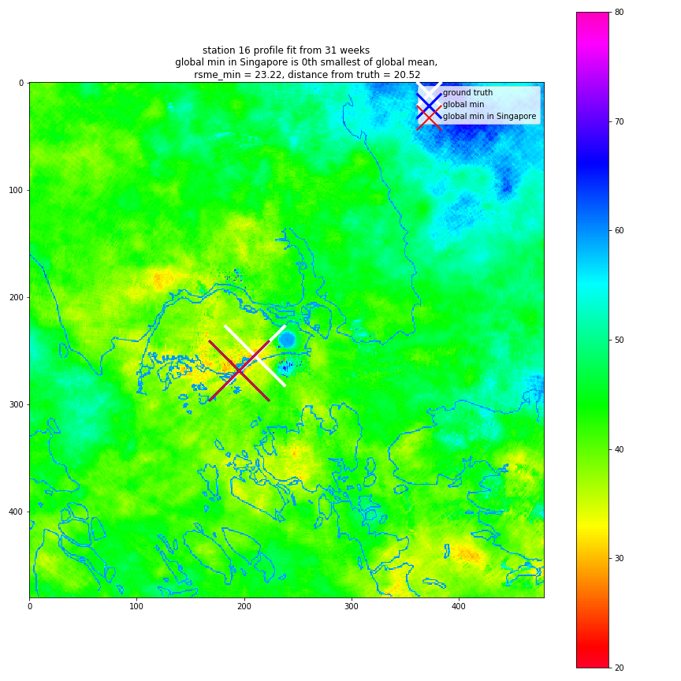
Results
The coordinate with the lowest RSME w.r.t. rain gauge data is the best possible location
Geofencing applied so that that point roughly lands in Singapore

Slide 8
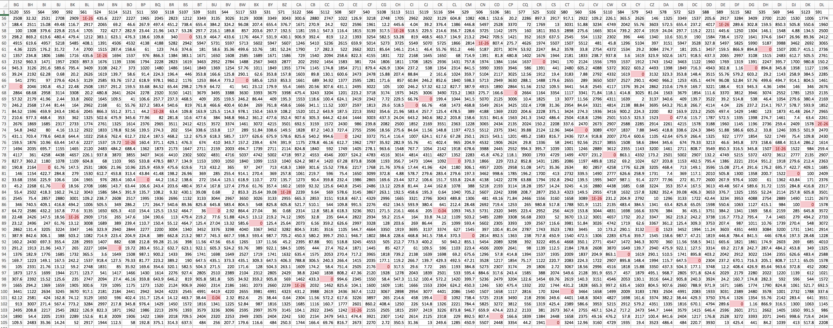
RAIN GAUGE LOCATION DATA FROM NEA

Slide 9
Modified model
Since we do not even have the ground truth for the radar plot, we will not improve the prediction model for rainfall. Not sure what are we improving.
Comparing our results with stations available on NEA.
They have 58 available stations. We should match the 49 effective stations to their 58 available stations.

Slide 10
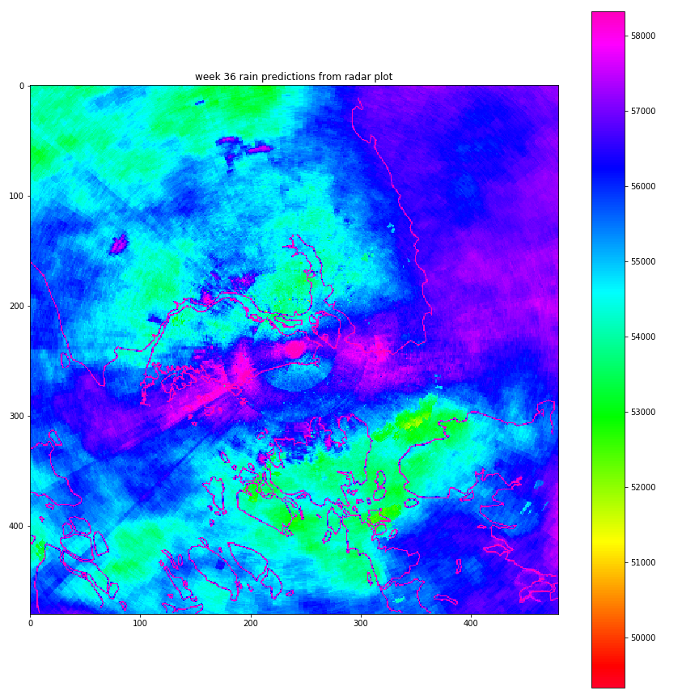
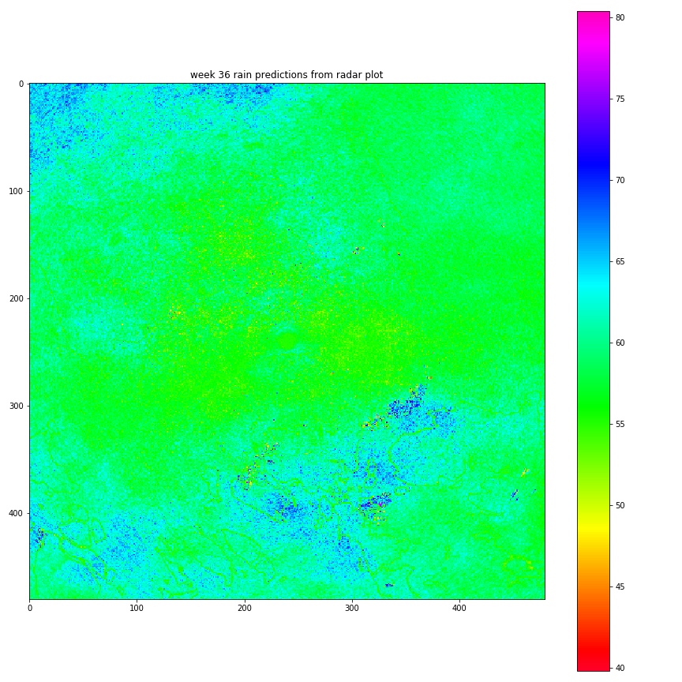
Rainfall Prediction (DL)
With the deep learning model we predict the rainfall for every point in the map

Slide 11
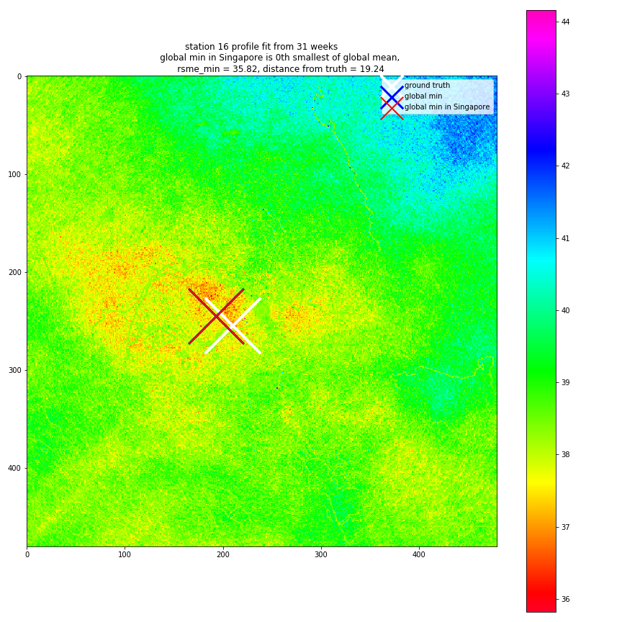
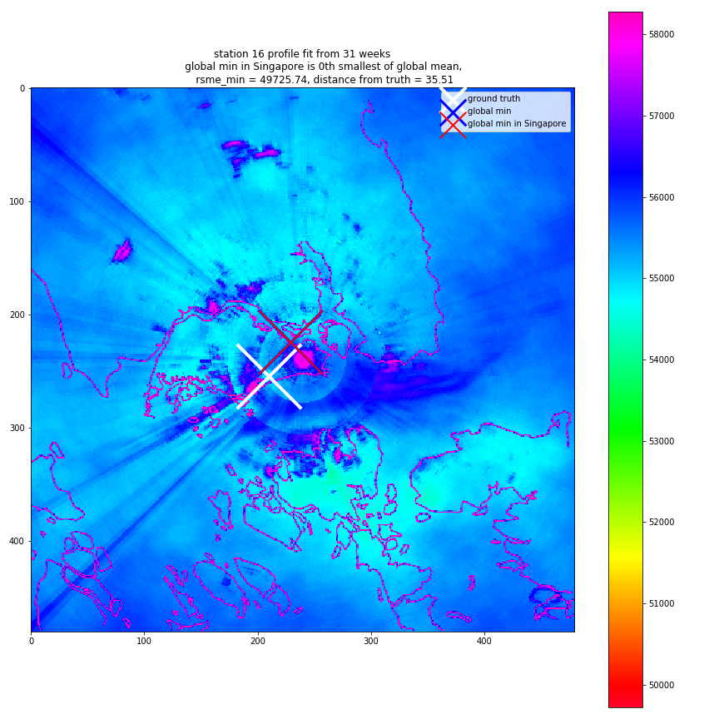
Results (DL)
The coordinate with the lowest RSME w.r.t. rain gauge data is the best possible location
Geofencing applied so that that point roughly lands in Singapore

Slide 12
Conclusion
We have a data pipeline.
We have good visuals.
We evaluated the base model w.r.t. available ground truths - and it is quite accurate
We did machine learning on the cloud

