Slide 1
EasyAgile
Development 1
周春晖
亓庆国
宁婧
李丝琦
夏雅楠
杨帆
马天瑶 1152735 ✓
Notes:
Good morning ereryone, our project is easyagile, my student number is 1152735, today I will show you our project developemnt progress

Slide 2
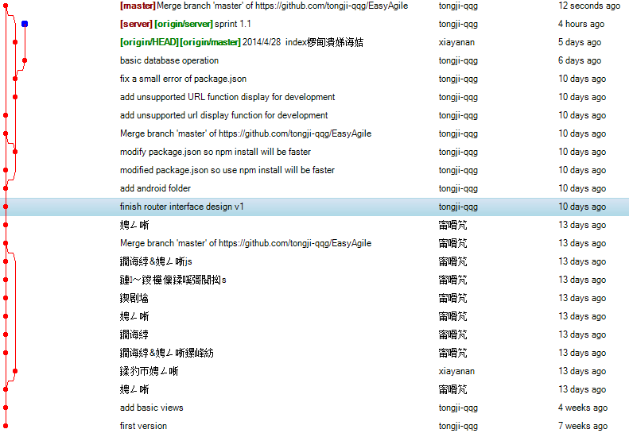
Github
24 commits
Notes:
Our project is delegated to github, From the very beginning, we have 24 commits till now.

Slide 3
Progress overview
index
user
project
android
router
socket
user
project
discuss
File repo
editor
Other platform API
Email
Message
task
user
project
sprint
topic
……
Notes:
I use color area to show our progress overview. The more color, more progress.

Slide 4
View layer
index
user
project
android
10 html pages
18 css plugins
25 js plugins， 4 self write js
Basic android login
Notes:
For the view layer, we have finish
10 html pages
18 css plugins
25 js plugins， 4 self write js
Basic android login

Slide 5
Link layer
router
socket
10 files
70 route rules
Notes:
For the link layer, we have finish:
10 files
70 route rules

Slide 6
Service layer
user
project
discuss
File repo
editor
Other platform API
Email
Message
9 files
46 service functions
Notes:
For the service layer, we have finish:
9 files
46 service functions

Slide 7
Data layer
task
user
project
sprint
topic
5 mongoose schemas
Notes:
For the data layer, we have finish:
5 mongoose schemas

Slide 8
Requirement implements
User register/login/logout
Create project
Show project
Create sprint
Create task
Delete task
Notes:
For the requirements, we have implememt:
User register/login/logout
Create project
Show project
Create sprint
Create task
Delete task

Slide 9
Demo
Notes:
Next I will show you project.

Slide 10
scripts
Notes:
As you know, our project use nodejs + mongodb, so environment dependents is nodejs V1.10 and mongodb v2.60.
We need to start mongodb at first. Then we can start our server.
After that, we can access our server by browser, the location is http://localhost:18080/;
This is our index page, we can login or register.
My database is installed just now, so, Let`s register a new user.
Then in the user page, we can logout
We choose yes, so we need to login again.
In this page, we can also create new project.
After that we can see there is a new project icon here, the page not refresh, because it is implemented by ajax.
Click this project icon to enter project page.
In the project main page, there should display some important project info and news.
Because once create a project, we are assumed in first sprint, so we can create tasks in this sprint.
Create task is very simple. We can drag it here to delete it. We can also drag it to change it`s

