Slide 2
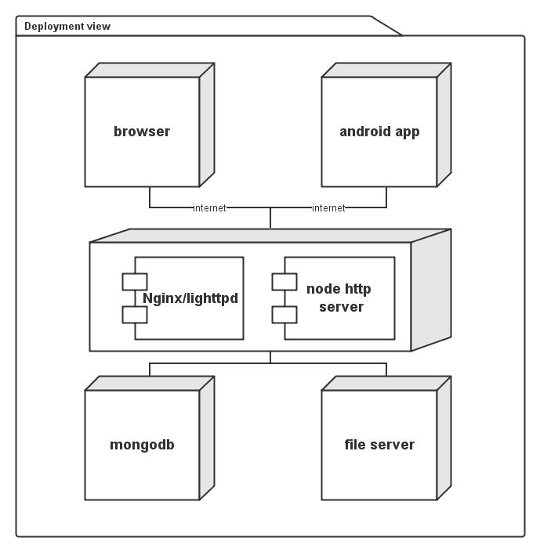
Deployment

Slide 3
System Architecture
index
user
project
android
router
socket
user
project
discuss
File repo
editor
Other platform API
Email
Message
dbpool
user
project
sprint
topic
……

Slide 4
REST + Ajax
Use service oriented architecture
Use session to store user login state
Use SSL for safety
Advantage
Server side provide restful API, for both browser and android app
Decoupling server side, web front end and android development
Notes:
REST + Ajax

Slide 5
View layer
index
user
project
android
Ejs template engine for server
Bootstrap for basic css
Bootstrap chart.js for charts
Bootstrap WYSIHTML5 for editor
Jquery for ajax
Jquery Full calendar for calendar
Jquery file upload for file repo
Anjularjs for front-end data binding
Socket.io for receive update info
-register
-login
-user info
-individual calendar
-messages
-project list
-settings
-project info
-file repo
-editor
-discussion
-team calendar
-sprint(taskboard, charts)
-settings
-login
-user info
-message
-individual calendar
-project list
-team calendar
-project info
-sprint

Slide 6
Socket.io + Ajax
Use socket.io to notify browser what to update
Browser use Ajax to update information
Advantage
Browser update timely, no need to refresh
Notes:
Session for user info
Socket + Ajax for update

Slide 7
Link layer
router
socket
-Manage browser user socket
-notify browser what to update
-using logic layer
-response user requests: ‘/’，’/user’,’/project’, ‘/API/…’
Express MVC for router
Socket.io for socket

Slide 8
Link Layer router Interface
Operation | URI | HTTP method | description
Get main page | / | Get | Return html
Get user page | /user | Get | Return html
Get project page | /project | Get | Return html
Login | /login | Post | Store userid, sessionid
New user | /API/u | Post | Need correct user info
Get user info | /API/u/:id | Get | Return json user info
Modify user info | /API/u/:id | Put | Need relative info
New project | /API/p | Post | Need correct project info
Get project info | /API/p/:id | Get | Return json project info
Modify project info | /API/p/:id | Put | Need relative info
Notes:
Interface, 具体细分URL需要根据数据量进一步细分，这里只做参考

Slide 9
Link Layer router Interface cont
Operation | URI | HTTP method | description
 | /API/u/t/:uid/:tid | Get , Put, Post, Delete | User task
 | /API/u/m/:uid/:mid | Get, Put, Post, Delete | User message
 | /API/p/f/:pid/:fid | Get, put, post, Delete | Project file
 | /API/p/d/:pid/:did | Get, put, post, Delete | Projest discuss
 | /API/p/e/:pid/:eid | Get, put, post, Delete | Project Editor
 | /API/p/s/:pid/:sid | Get, put, post, Delete | Project Sprint
 | /API/p/s/t/:pid/:sid/:tid | Get, put, post, Delete | Sprint task

Slide 10
Link Layer socket Interface
Method | Parameter | Return | Description
SendToUser | UserIDd:int, message:string | Void | Send message to a user
SendToProjectMember | projectID:int, whatToUpdate:string | Void | Send project update info

Slide 11
Logic layer
-login
-register
-task list
-schedule task
…
-create
-info
-sprint
-task
-Calendar…
-create
-modify
-comment
-delete
-upload
-delete
-download
-start
-finish
-download
user
project
discuss
File repo
editor
Other platform API
Email
Message
-verify user
-get information
-send email
-use socket
-send message
-update

Slide 12
Logic Layer User Interface
Method | Parameter | Return | Description
Login | name : string, password: string, callback : function(err, result) | Void | If success, err is null, result is userid, else err is not null.
Register | Name : string, password : string… callback : function(err, result) | Void | New a user in database
Tasklist | Userid : int, callback : function(err, result) | Void | Get all user tasks, return result in json format
scheduleTask | userid : int, taskid:id, change:json Callback : function(err, result) | Void | User schedult task
getUserInfo | Userid:int | userInfo
serUserInfo | Userid:int, userinfo: Userinfo Callback : function(err, result) | Void
Notes:
Interface

Slide 13
Logic Layer Project Interface
Method | Parameters | Return | description
New | projectinfo : ProjectInfo, Callback : function(err, result) | Void
inviteMemberByID | Userid : int, Message: string, Callback : function(err, result) | Void | Send message in web site
inviteMemberByEmail | Email : string, Message : string, Callback : function(err, result) | Void | Use email module send an invite message
getProjectInfo | Id:int | projectInfo | Json
setProjectInfo | Id:int, info : projectInfo Callback : function(err, result) | Void

Slide 14
Logic Layer Discuss Interface
Method | Parameters | Return | Description
createDiscussion | Userid:int, discusstion:string callback(err, result):function | Void | New a disscussion
modifyDiscusstion | Userid:int, disid:int, change:string, Callback(err,result):function | Void | Mod
Comment | Userid:int, disid:int, comment:string, callback(err, result) : function | Void | comment

Slide 15
Data layer
-connect
-authentication
-CRUD
dbpool
user
project
message
files
……

Slide 16
Thank you!

