Slide 1
EasyAgile
周春晖
亓庆国 1152688 ✓
宁婧
李丝琦
夏雅楠
杨帆
马天瑶

Slide 2
plan
Database design
Naming convention
Logic view of system

Slide 3
Database-mongoDB
MongoDB use bson format to store data easy transfer to json format data
More reference about mongoDB with nodejs

Slide 4
mongoDB
No join query
No foreign key，has document reference
Use document storage
Single document size should less than 16M
One to one: put one into another one
One to many: put many in one as array
Many to many: put one reference in another one as array, sometimes maybe two direction. Sometimes may add some redundant info for performance.
Notes:
这个限制是为了避免单个文档过大，完整读取时对内存或者网络带宽占用过高。根据目前MongoDB主开发人员的意思，他们不打算放开这个限制，但会随着计算资源相对成本的降低（内存更便宜，网络更快）而适度调高。
官方解释：
MongoDB limits the data size of individual BSON objects/documents. At the time of this writing the limit is 16MB. This limit is designed as a sanity-check; it is not a technical limit on document sizes. The thinking is that if documents are larger than this size, it is likely the schema is not ideal. Further it allows drivers to make some assumptions on the max size of documents. The concept is that the maximum document size is a limit that ensures each document does not require an excessive amount of RAM from the machine, or require too much network bandwidth to fetch. For example, fetching a full 100MB document would take over 1 second to fetch over a gigabit ethernet connection. In this situation one would be limited to 1 request per second. Over time, as computers grow in capacity, the limit will be adjusted upward.
16M ： 一行记录

Slide 5
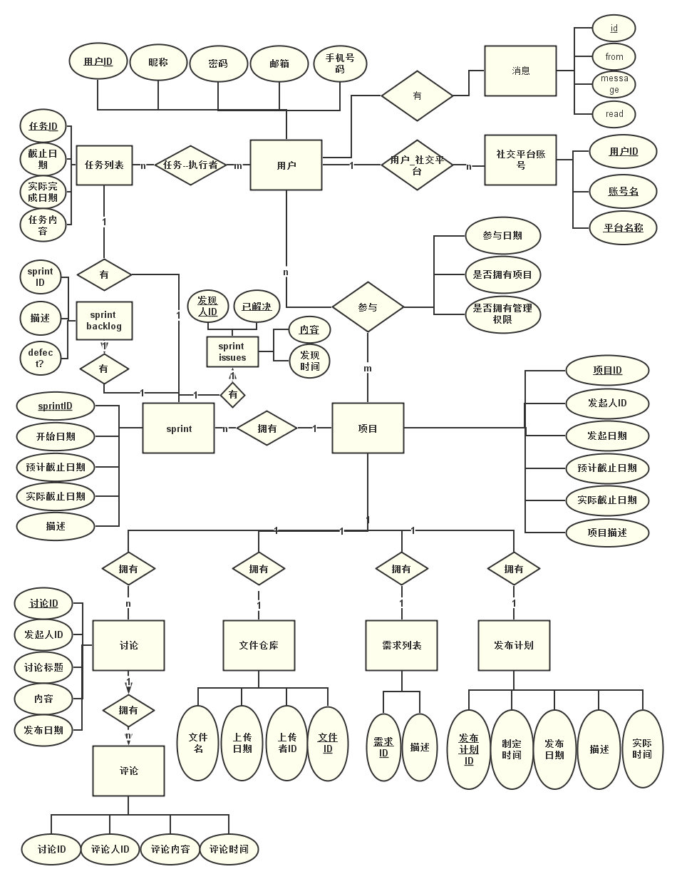
数据库ERD

Slide 6
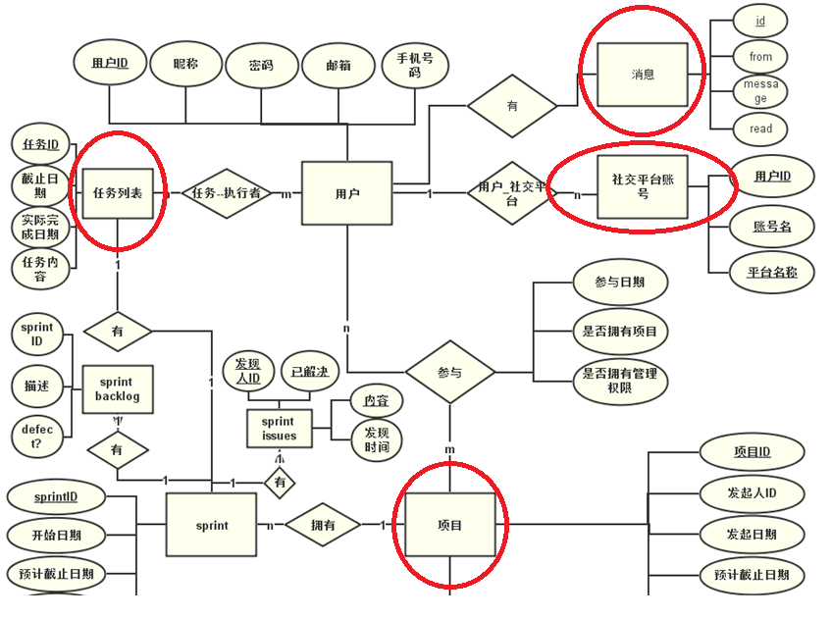
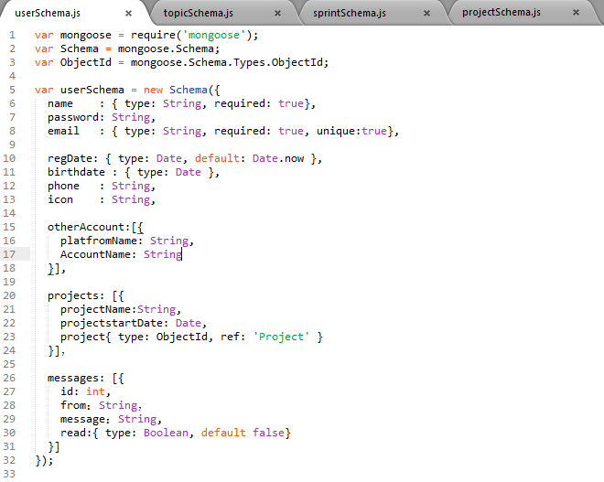
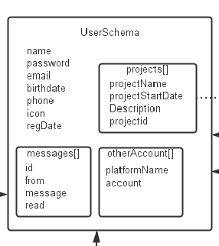
User schema

Slide 7
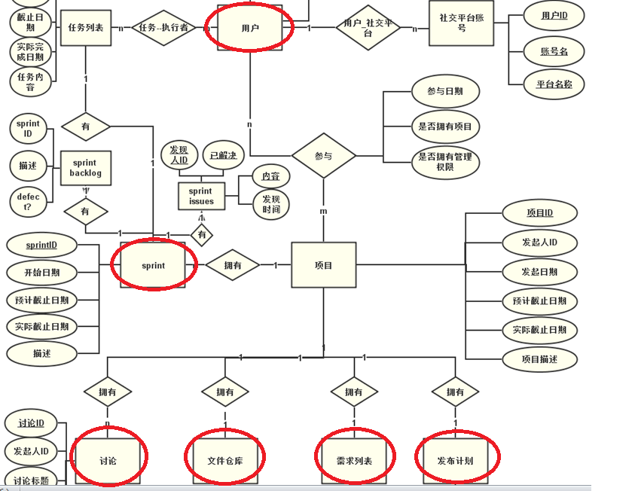
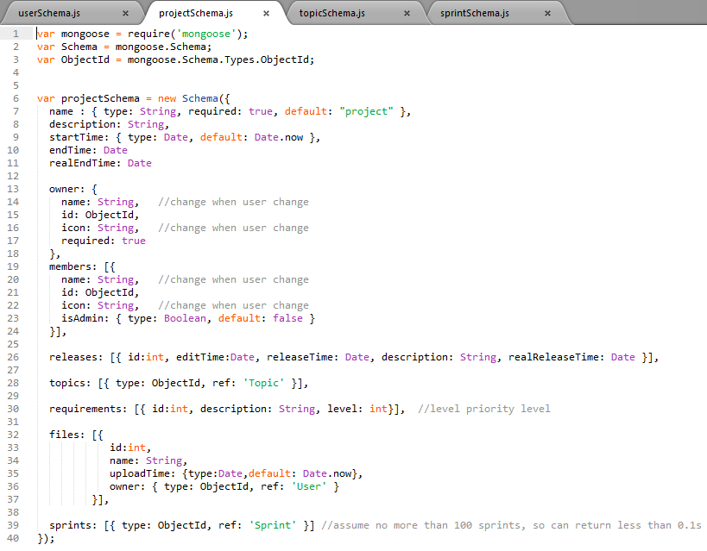
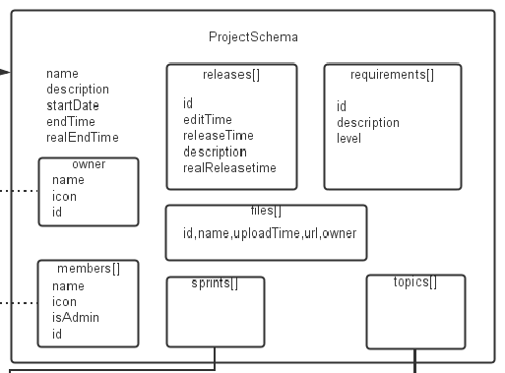
Project schema
Notes:
对于user和project之间的多对多关系，因为查询的频率会远大于修改，所以在这里使用冗余的方法。把user info 冗余存在project是可行的，假设一个人一年做十个项目，50年也才做500个，就算一个人参与了500个项目，当他修改个人信息，也只需要修改500次，假设一次修改1ms，不到0.5秒即可完成。而且大多数人的项目只是两位数的数量级。而查询的次数，每次获取项目信息都需要获取团队成员，每天的次数是1000的数量级，如果团队成员很多大于100，每次查询加起来会浪费很多时间，所以相比较之下，采用冗余的方法较好。

Slide 8
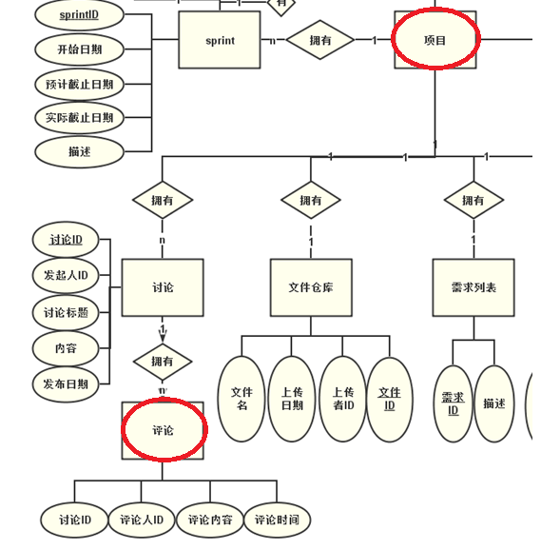
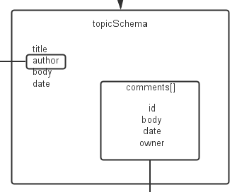
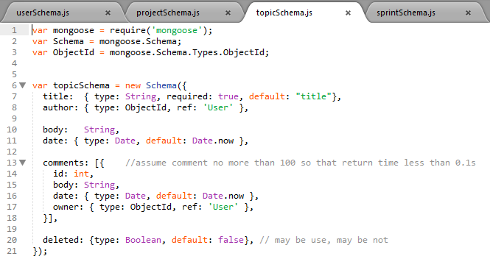
Topic schema

Slide 9
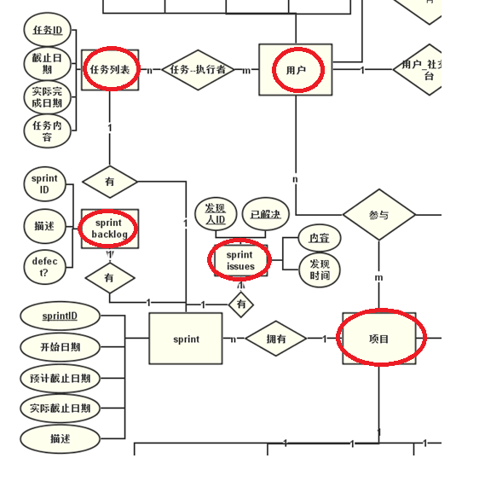
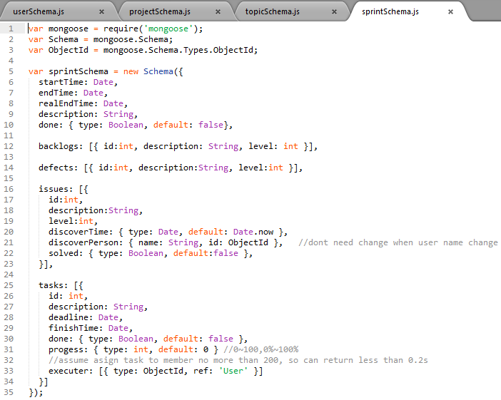
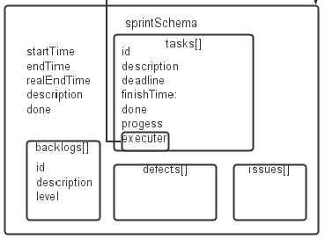
Sprint schema

Slide 10
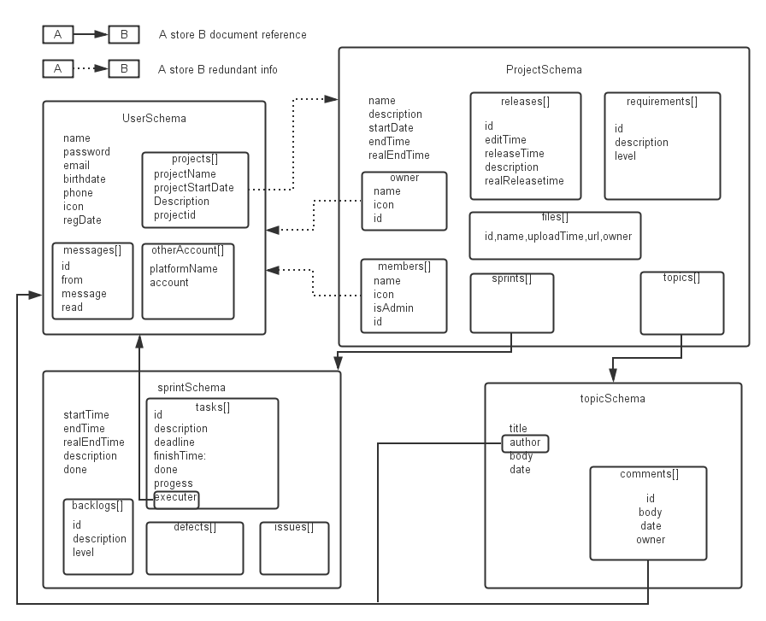
Document structure

Slide 11
backup strategy
Web site maintenance personnel manage backup
Choose idle time to backup
backup cycle should <= 1 week
Back up instruction
>mongodump -h dbhost -d dbname -o dbdirectory
Example: >mongodump -h 127.0.0.1 -d test -o c:\data\dump\

Slide 12
Naming conventions
Package : com.duapp.easyagile+packageName
Xml files : xml+fileName
Class : first letter in capital
Interfaces : I+interfaceName
Method : small hump type writing rules
Constants : Constant name in capital, constant names with English express its meaning, separate words underline
Variable : The Hungarian rule
Exception : exceptionName+exception

Slide 13
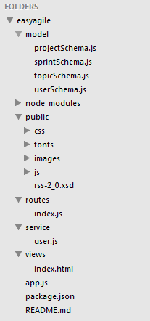
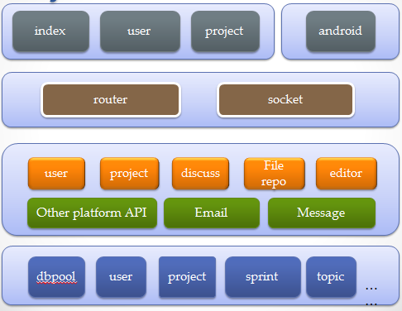
Logic view in 4+1 views
Javascript is not an oop language

Slide 14
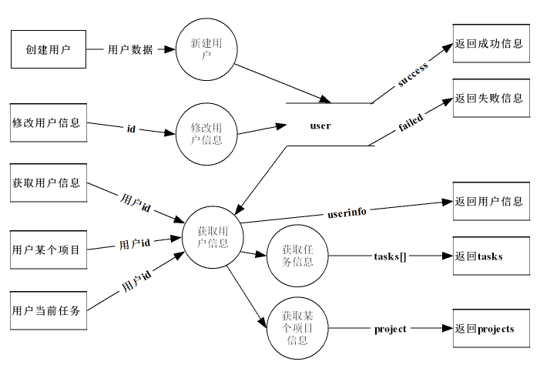
Logic view in 4+1 views

Slide 15
Thanks!

