Slide 1
Object-Oriented Analysis and Design -with UML 2, UP and design patterns
Software Architecture
Liu Yan
Givemeareason@gmail.com

Slide 2
Introduction
Software Architecture, Week 14
Design Principles and Design Patterns, Week 14
Common Used Designed Patterns, Week 15
Review, Week 16
Final Presentation, Week 16~17
Final Assignment,
Design Model, SAD and a Prototype
\\10.60.37.57\Publicfiles\CourseDocuments_课程文档\OOADwithUML_刘岩\@OOAD_with_UML_2013_Autumn\OOAD with UML Final Assignment

Slide 3
Content
Why and what?
Architecture Building Blocks
UML Architectural Views
Architectural Style
Software Architecture Document

Slide 4
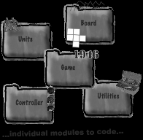
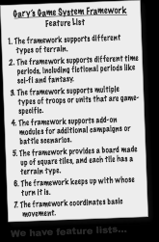
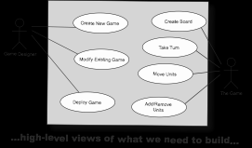
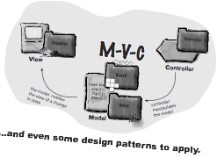
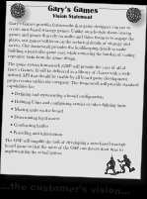
Chaos
If we just had a way to tie all of this information together we might be able to figure out what to do first.
We need an architecture!

Slide 5
Why Software Architecture?
Enables the software engineer to:
Analyze the effectiveness of the design in meeting its stated requirements
Consider architectural alternatives at a stage when making design changes is still relatively easy
Reduce the risks associated with the construction of the software
Provide key Abstractions in reasoning about design
Establish a Design Plan
Notes:
Software Architecture key Abstractions
Helps manage the manifold complexities inherent in today’s software projects
Specifies architectural drivers that respond to management and technical decisions
Provides a medium/forum for design tradeoffs
Software Architecture acts as a Design Plan
Facilitates communication among stakeholders
Focuses on early design decisions
Provides basis for software reuse
Analyze the effectiveness of the design in meeting its stated requirements

Slide 6
Architecture is …
The structure of your application or system
The most important (key) components of your system
The relationships between the parts of your system
The reason why you chose a particular component or representation of the relationships between your components
The design patterns you apply
All of the above!

Slide 7
Software Architecture Definitions
The large-scale motivations, constraints, organization, patterns, responsibilities, and connections [between components] of the system. Craig Larman 2003
The structure or structures of the system, which comprise software components, the externally visible properties of those components, and the relationships among them. Bass, et al, 1998

Slide 8
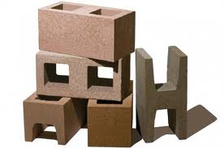
Architectural Building Blocks
Component – a unit of computation or a data store
Connector – an architectural element that models interactions among components and rules that govern those interactions
Configuration (or topology) – a connected graph (composite) of components and connectors which describe architectural structure
Notes:
In a little more detail:
Component – a unit of computation or a data store
Location of computation and state
Can be simple or composites
Connector – an architectural element that models interactions among components and rules that govern those interactions
Simple interactions -- procedure calls or shared variable access
Complex and semantically rich interactions -- client-server protocols
Configuration (or topology) – a connected graph (composite) of components and connectors which describe architectural structure
Proper connectivity
Concurrent and distributed properties
Adherence to design heuristics and style rules

Slide 9
Evolutionary Design
Designs evolve but not from the simple to the difficult
Evolutionary design means that we can add to it as we go
Incremental design
Flexible design
Iterative, incremental development
Unified Process
Architecture Centric
Use Case Driven
Iterative Process

Slide 10
Refine Software Architecture
[Early
Elaboration
Iteration]
[Inception
Iteration (Optional)]
Define a Candidate
Architecture
Perform
Architectural
Synthesis
Analyze Behavior
Identify Design
Refine the
Architecture
(Optional)
Elements
Architect
Design
Components
Design the
Database

Slide 11
The role of software architect
requirements
solutions
client,
user
architect
developers
creates
assess
assess
visualize
prescribe
appearance,
behavior
architectural design
construction,
cooperation

Slide 12
Review: 4+1 Views
Architecture is all about capturing the strategic aspects of the high-level concept of a system.
4+1 view
Create models that can be built and studied separately, but are still interrelated.
Logical View
Implementation View
Programmers
Analysts/Designers
Structure
Software management
Use-Case View
End-user
Functionality
Process View
Deployment View
System integrators
System engineering
Performance, scalability, throughput
System topology, delivery,
installation, communication
Notes:
The key phrase is “nearly independent,” meaning that models can be built and studied separately, but are still interrelated.
To understand the architecture of object-oriented systems, you need several complementary and interlocking views. An architectural view can be defined as a simplified description (an abstraction) of a system from a particular perspective or vantage point, covering particular concerns, and omitting entities that are not relevant to this perspective. Views are “slices” of models.
Each of the views below may have structural and behavioral aspects. Together, they represent the blueprints of a software system.
Use-case view exposing the requirements of the system
Logical view capturing the vocabulary of the problem space and the solution space
Process view modeling the distribution of the system’s processes and threads
Implementation view addressing the physical realization of the system
Deployment view focusing on system engineering issues
To address these different needs, Rational has defined the “4+1 view” architecture model.
Remember that not all systems require all views. The number of views is dependent on the system you’re building. For example, a single processor does not require a deployment view or a small program does not require an implementation view and so on.
Many interrelated models are needed to accurately describe a system.
Introduce the 4+1 views of architecture first.
It’s important that they understand from the beginning that the models created/read represent a specific view of the system.

Slide 13
UML Architectural Views
Logical Architecture – describes the system in terms of its organization in layers, packages, classes, interfaces and subsystems
To be followed shortly by an “action view” of this…
Deployment Architecture – describes the system in terms of the allocation of processes to processing units and network configurations
What it is.
What it does.
How it looks.
Notes:
A layer is a coarse grained grouping of classes packages or subsystems that has cohesive responsibility for a system aspect
Higher layers call upon the services of lower layers

Slide 14
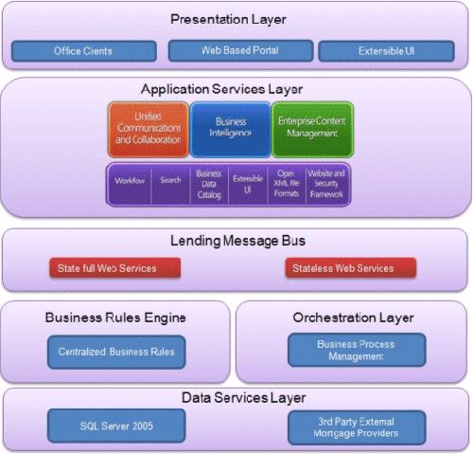
Logical Architecture: Examples

Slide 15
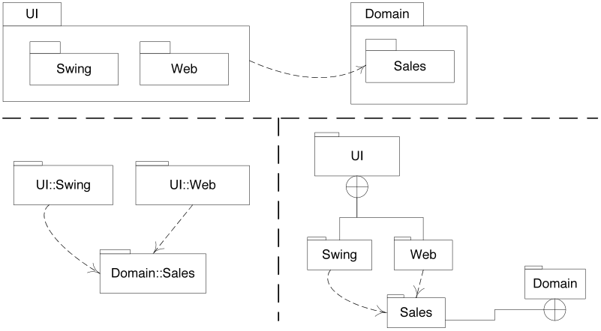
UML Diagrams of Package Design for grouping of related entities
Traditional Nested Notation
Fully-Qualified Notation
Cross-Circle Notation
A
<<uses>>
K
financial
regulatory

Slide 16
Package Diagram Example: Application Layer Context of a Course Registration System
<<layer>>
Application
Registration
<<layer>>
Business Services
External System
Interfaces
Security
University Artifacts
Secure Interfaces
GUI Framework

Slide 17
Example: Business Layer Context
<<layer>> Business Services
<<subsystem>>
<<subsystem>>
BillingSystem
CourseCatalogSystem
External System
Interfaces
Security
ObjectStore
GUI
Framework
<<subsystem>>
Security
Manager
Support
University
Secure
Interfaces
Artifacts
<<layer>> Middleware
com.odi
java.sql

Slide 18
UML Diagram of Component Design for Reusable and/or Replaceable Component
<<component>>
MathPack
MathPack
Two ways to denote component
<<component>>
StatsPack
Provided interface to be “called” by others
<<component>>
MathPack
Required interface to “call” others
component MathPack uses the required interface to access the provided interface of StatsPack component
<<component>>
MathPack
<<component>>
StatsPack

Slide 19
Modeling the composition of a Component
<<component>>
DrawFigures
Draw2D
Draw3D
<<delegate>>
ScreenDisplay
<<delegate>>
UnZipData
ZippedData
The delegate connector ties the component interface to one or more internal Components (in this case --- to UnZipData internal component)

Slide 20
Component Design may influence implementation
interface Drawfigures {
public unZipData( );
public pict draw_meth ( ) ;
}
class Draw2D implements Drawfigures
{ .
.
.
}
Class Draw3D implements Drawfigures
{ .
.
.
}
class Drawfigures {
.
.
protected unzipd data
.
public void unzip (zipd x, int cntrl ) ;
protected Draw2D ( );
protected Draw3D ( );
.
}
( B – more likely single Class implementation)
( A – java language interface implementation )

Slide 21
UML Deployment Diagram to Represent Physical Architecture
A Deployment Diagram shows:
Computational resource (nodes)
Communication path between computational resources
Artifacts that reside and execute on the computational resources
<<device>>
HP3100:ServerPC
<<CPU device>>
IBM201: Server
<<TCP/IP>>
<<artifact>>
AppCode
<< data base syst.>>
Oracle12:db
<<artifact>>
AppData
<<TCP/IP>>
<<artifact>>
DataTable
<<device>>
ClientPC
<<artifact>>
ScreenBrowser

Slide 22
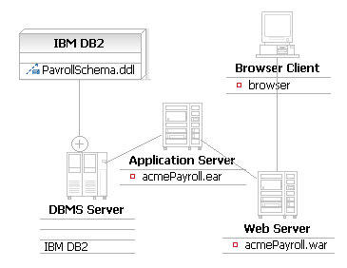
Example: Deployment Diagram

Slide 23
Architectural Style
An Architectural Style defines a set of rules that describe:
The properties of and constraints on its components
The way in which the components interact
Architectural Style is a High Level Design Pattern
Examples:
Implicit-invocation
Pipes-and-filters
Layered style
Repository style
Model-View-Controller (MVC)
…
Client
Layer_{n}
Client
Shared Data
Layer₂
Client
Layer₁
Controller
View
n
n
Model

Slide 24
Designing with Layers
Separation of concerns
Reduces coupling and dependencies; improves cohesion; increases reuse potential and clarity
Essential complexity is encapsulated
Can replace some layers with new implementations (e.g., platform independence)
Can distribute some layers
Can divide development within/across teams

Slide 25
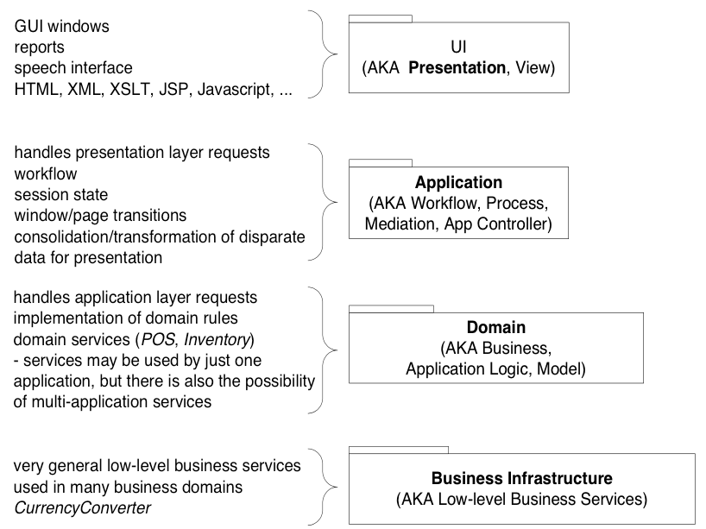
Common Layers in More Detail (1 of 2)

Slide 26
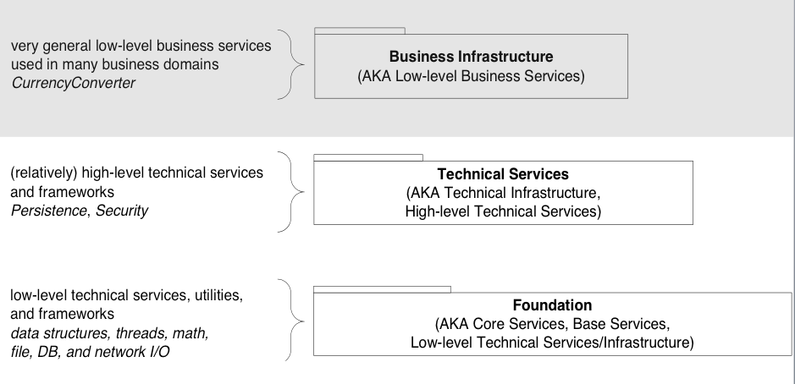
Common Layers in More Detail (2 of 2)
Systems will have many, but not necessarily all, of these
Notes:
Continued from previous page…gray area
- medium-level reusable infrastructure (e.g., persistence, security)
low-level reusable infrastructure (collection classes, math, network and file I/O)

Slide 27

Architecture Description
Software Architecture Document
Represents comprehensive overview of the architecture of the software system
Includes
Architectural Views
Goals and constraints
Requirements that architecture must support
Technical constraints
Change cases
Size and performance characteristics
Quality, extensibility, and portability targets
Notes:
The Software Architecture Document serves as a communication medium between the architect and other project team members regarding architecturally significant decisions which have been made on the project.
For more information, see Artifacts->Analysis and Design Artifact Set->Software Architecture Document in RUP.

Slide 28
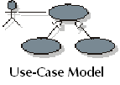

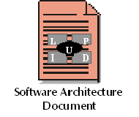
Architecture Description (cont.)
Views are pulled from other artifacts
Implementation Model
Design Model
Deployment Model
Notes:
In addition to its own data, the Software Architecture Document reports on architectural features contained in other artifacts. Note that both the Logical View and Process View are subsets of the Design Model.

Slide 29
Further Reading
http://msdn.microsoft.com/en-us/library/ee658117.aspx
Architectural Styles Slides
http://www.softwarearchitecturebook.com/svn/main/slides/ppt/05_Architectural_Styles.ppt

Slide 30
Final Assignment
Due Date, December 24, 2013
\\10.60.37.57\Publicfiles\CourseDocuments_课程文档\OOADwithUML_刘岩\@OOAD_with_UML_2013_Autumn\OOAD with UML Final Assignment

