Slide 1
The Past Future Tense 过去将来时

Slide 2
一、过去将来时的概念
表示从过去的时间看待将来要发生的动作或状态。即:过去将来时是“立足过去,着眼未来”的一种时态, 常用于宾语从句中。判断这种时态的依据是:要有表示过去的“动作”,而不是时间。
比较：
一般将来时:表示从现在的时间看将来将要发生的动作或状态

Slide 3
二、过去将来时的构成
1、would/should +v
2、was/were going to +v

Slide 4
人称 | 肯定句 | 否定句
一 | I/We should/would do | I/We should/would not do
二、三 | You/They/He/She/It would do | You/They/He/She/It would not do

Slide 5
人称
一
二、三
疑问句 | 疑问否定句
Should/Would I/we do? | Should/Would I/we not do?
Would you/they/he/she/it do? | Would you/they/he/she/it not do?

Slide 6
缩写形式：
肯定式：
I’d, you’d, he’d, she’d, we’d, they’d, it’d
否定式： I’d/you’d/he’d/she’d/we’d/they’d/it’d not或I/you/he/she/we/they/it wouldn’t 或I/we shouldn’t

Slide 7
三、常连用的时间状语：
the day after tomorrow→
next week→
tomorrow→
tomorrow evening→
this afternoon→
two days later
the next week
the following day
the next evening
that afternoon

Slide 8
四、一般过去将来时的用法
1.表示在过去某一时间看来将要发生
的动作或存在的状态
Last week he promised that he would
come, but he hasn’t arrived until now.
上周他答应来的，可直到现在还没到。
He said that he would wait for me at
the gate.
他说他将在大门口等我。

Slide 9
2.过去将来时常可用来表示过去习惯性的动作此时，不管什么人称，一律用would。
This door wouldn't open.
这扇门老是打不开。
Whenever he had time，he would do
some reading.
他一有时间，总是看书。
I would play with him when I was a child.
当我还是孩童时，总是和他一起玩。
You know I would come.
你知道我会来的。

Slide 10
3、come， go， leave， arrive， start等动词可用过去进行时代替过去将来时。
例如：
He said the train was leaving at six the next morning.
他说火车将于第二天早晨六点离开。
She told me she was coming to see me.
她告诉我她要来看我。

Slide 11
4、条件状语从句和时间状语从句中须用一般过去时代替过去将来时。
例如：
When she came I would let you know.
我不知道她什么时候来，但她来了我会告诉你。
The teacher said that it would be very difficult to make progress if I didn’t work hard.
老师说，如果我不努力学习的话，就很难取得进步。

Slide 12
5、过去将来时，用于虚拟语气中
If I were you, I would not do that.
要是我是你的话，我就不会那样做。
If he were here, he would show us how to do it.
如果他在这儿，他就会向我们展示该如何做了。

Slide 13
6、“was/ were about to +动词原形”,可以表示过去即将发生的事情。 如:
The US said that the war on Iraq was about to start in a week.
美国说伊拉克之战将在一周后打响。

Slide 14
五、过去将来时典型错误例析
1. 我们不知道他是否要在会上发言。
误：We didn’t know whether he is going to speak at the meeting.
正：We didn’t know whether he was going to speak at the meeting.
析：该句主句为过去时，且宾语从句表示从过去某个时间看来将要发生的动作，所以从句要用过去将来时态。

Slide 15
2. 老师问汤姆长大后准备干什么。
误：The teacher asked Tom what he was going to be when he would grow up.
正：The teacher asked Tom what he was going to be when he grew up.
析：在时间状语从句中，常用一般过去时表示在过去看来将要发生的动作。

Slide 16
3. 他们说如果下星期天不下雨他们就去农场。
误：They said that they were going to the farm if it would not rain the next Sunday.
正：They said that they were going to the farm if it didn’t rain the next Sunday.
析：在条件状语从句中，也常用一般过去时表示在过去看来将要发生的动作。

Slide 17
4. 王林打电话告诉她妈妈，她要买一些书
误：Wang Lin rang up to tell her mother that she should buy some books.
正：Wang Lin rang up to tell her mother that she would buy some books.
析：过去将来时可以由“助动词should/would+动词原形”构成，但should一般只用于第一人

Slide 18
5. 上次我见到你时，你正打算开始乘火车去西藏。
误：Last time I saw you， you had started to go to Tibet by train.
正：Last time I saw you， you were going to start to go to Tibet by train.
析：,表示过去即将发生的事情用“was/ were about to +动词原形” 结构。

Slide 19
六、典题欣赏
She said she _______ a meeting the next day.
A. had B. was having
C. will have D. was going to have
2. They were sure they ______ the football match.
A. won B. was winning C. win D. would win
3. They _______ a football match when I saw them.
A. had B. would have
C. are having D. were having
4. We asked him where he _______ the next week.
A. would go B. went C. is going D. were going
5. We ______ the Science Museum next week.
A. would visit B. will visit
C. is visiting D.is going to visit

Slide 20
6. —What did your son say in the letter?
—He told me that he ______ the Disney World the next day.
A. will visit B. has visited
C. is going to visit D. would visit
7. I hoped Tina ______ to my birthday party on time the next Wednesday.
A. to come B. is coming
C. will come D. was coming
8. Father said that he ______ me to Beijing the next year.
A. took B. would take
C. takes D. will take
9. We were not sure whether they ______ more vegetables.
A. are going to grow B. were going to grow
C. will grow D. have grown
10. She ______ to work when the telephone rang.
A. is going B. will go
C. was going D. is to go

Slide 21
The Past Perfect Tense 过去完成时
过去完成时的构成
助动词 had + 过去分词
(用于各种人称和数)
肯定句：主语 + had + 动词的过去分词
如：I had been here before you came.
否定句：主语 + hadn't + 动词的过去分词
如：I hadn't been here before you came.
一般疑问句：Had + 主语 + 动词的过去分词？
如：Had you been here before you came?
特殊疑问句：特殊疑问词 + had + 主语 + 动词的过去分词？
如：When had you been here?

Slide 22
2. 过去完成时态的含义:
2. 过去完成时态的含义:
主要是表示在过去某个时间,或是动作之前
已经发生或完成的动作.也就是：
过去的过去.

Slide 23
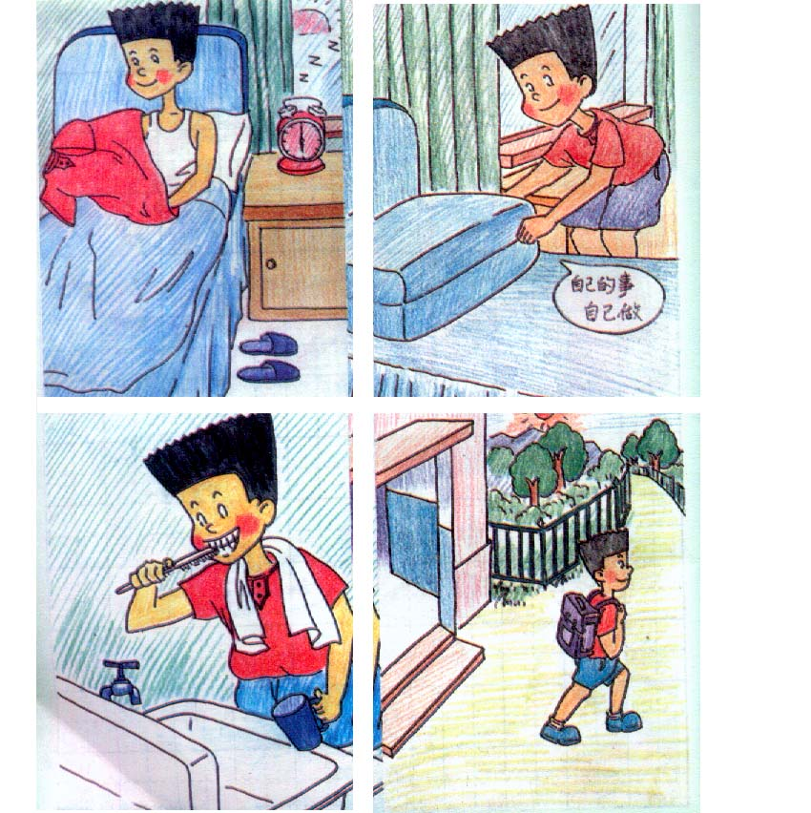

Last Sunday
now
6:30
9:00
got up
By the time Jim ________, his mom _______
had cleaned..

Slide 24

Last Sunday
6:50 9:00 now
got up
By the time Jim ________, his sister _______
had washed..

Slide 25
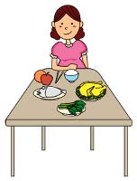
Last Sunday
now
8:30
9:00
got up
By the time Jim ________, his grandma _______
had eaten..

Slide 26

Last Sunday
now
8:30
9:00
got up
had gone…
By the time Jim ________, his dad _______

Slide 27
6:00
6:10
6:25
6:40
7:10
got up
took a shower
went to work
did sports
washed clothes
﹜
When
I did sports , I had gotten up .
By the time
﹜
When
I took a shower , I had done sports .
By the time
（到……时候，到……之前）后接一般过去时的句子，
主句用过去完成时。

Slide 28
她出去的时候,公共汽车已经开走了.
By the time she got outside, the bus had already left.
by the time 意思是 “到…的时候”,
相当于 when , 后接过去时的句子
时, 主语的谓语动词用过去完成时态.

Slide 29
过去完成时态的时间标志用法：

Slide 30
① by (到…为止) ＋ 过去时间
如：We had finished the article by last Monday.
② by the end of （到…末为止）＋ 过去时间
如：We had learned nine units by the end of last week.
③ before ＋ 过去时间
如：They had gone to school before 5:00 this morning.
④ before ＋ 从句（一般过去时）
如：The train had left before I got to the station.
⑤ when / by the time ＋ 从句（一般过去时）
如：When / By the time I got home, she had
already gone to bed.
此外，过去完成时还可用于宾语从句中。
如：He told a radio interviewer that he had run
out of money to buy old bikes.
﹋﹋
﹋﹋
﹋﹋
Notes:
﹋

Slide 31
到去年为止，我已经学了大约一千个英语单词。
① By the end of last year, I had learned about one thousand English words
② By the time he was twenty, he had won about ten medals
③ When I got there, they had already left
在他二十岁的时候，他已经赢了大约十块奖牌。
当我到那的时候，他们已经离开了。

Slide 32
用所给动词的适当形式填空：
1. By the end of last week, we _____________ (study) 9 units.
2. We _____________(reach) the station before
ten o’clock this morning.
3. When I got there, he _____________(play) tennis for
half an hour.
4. He said he ______never ______(see) such an exciting film before.
5. By the time she was five, she ____________（learn）
ten English songs.
6. When he came in, I ______ just ____________(finish) my
homework.
7. Before I ______(leave) home yesterday, I ______________
(clean) the house.
8. She told me that she ___________(read) the novel already.
9. Mr. Li ______________ (teach) for ten years before he
came here.
10.By the time I got to the cinema, the film ____________(be)
on for ten minutes.
had studied
had reached
had played
had seen
had learnt
had finished
left
had cleaned
had read
had taught
had been

Slide 33
一般过去时与过去将来时辨析
Last week they learned Lesson 12.
By the end of last week they had learned 3 units.

Slide 34
一般过去时与过去将来时辨析
看试卷

Slide 35
Thank you!

Slide 36
一、表示在过去动作之前已经发生的动作或存在的状态。
一、表示在过去动作之前已经发生的动作或存在的状态。
比如说，A事件发生在一个月前，而B事件发生两个月前，那么B事件比A事件还要早发生，它就要使用过去完成时。
例如：Most of the guest had left when he arrived at the party.
（即：客人在他到之前已经离开了。）
They had already had breakfast before they arrived at the hotel.
（即：吃饭在先，他们到达在后。）
【知识小结】在上面两个例句，虽然表达时间的连词不同（when当……时；before在……前），但两件事发生的先后顺序很明显。请同学们不要被when, before之类的词搞混淆了，关键要抓住两件事情的先后关系。

Slide 37
二、表达在过去某个确定的时间之前发生的事或状态。在过去某一时刻或动作以前完成了的动作，即“过去的过去”。可以用by,
例如：How many English films had you seen by the end of last term ?
【知识小结】在这个例句中，没有两个事件作比较。但是，它有一个明确的时间作参考，即last year明确了告诉我们是“过去”时间，而 by the end of last year说的是在last year之前完成的动作，因此它也是“过去的过去”，可以用过去完成时。

Slide 38
请仔细阅读下面的例句，注意时间的先后关系和动作的先后顺序：
I had finished writing my composition by 10:00 this morning.
（今天上午10：00点以前，我已经写完了我的作文。）
She had searched the internet for two hours when she found an ad for the Canon digital camera.
（当她找到了佳能数码照相机的广告时，她已经在因特网上查询了两个小时。）
I went over what I had written again and again so that I wouldn't make any mistakes.
（我一遍又一遍地检查了我所写的内容，以至我没有出现任何错误。）
The film had already begun when I got to the cinema .
（ 当我到电影院时，电影已经开始了。）

Slide 39
三、过去完成时还可以表示从过去某一时间开始，持续到过去另一时间的动作或状态。before等介词短语或一个时间状语从句来表示，也可以用一个表示过去的动作来表示，还可能通过上下文来表示。

Slide 40
例如：He had worked in the factory for five years before he moved here .
（ 在他搬到这儿以前，他已经在那家工厂工作了五年。）
I saw Li Ping yesterday . We had not seen each o ther since I left Beijing .
（ 我昨天看见李平了。自从我离开北京，我们就没见过面。）

Slide 41
By the time I got there, it had already finished.
When she got to the check-out, she realized she had left her purse at home.
He said he had never seen Xiao Wang before.
Ann had lived in a cottage for sixty years ever since she was born.
He arrived at 2∶30. He had been told to wait in the VIP lounge．

Slide 42
四、表示由过去的某一时刻开始，一直延续到过去另一时间的动作或状态，常和for, since构成的时间状语连用。
例如：I had been at the bus stop for 20 minutes when a bus finally came.
当车来的时候，我在车站已等了20分钟。
He said he had worked in that factory since 1949.
他说自从1949年以来他就在那家工厂工作。

Slide 43
五、叙述过去发生的事情，在已叙述了过去发生的事情后，反过来追述或补述以前发生的动作时，常使用过去完成时。
例如：Mr. Smith died yesterday. He had been a good friend of mine.
史密斯先生昨天去世了。他以前是我的好友。
I didn’t know a thing about the verbs, for I had not studied my lesson.
我对动词一无所知，因为我没有好好学习功课。

Slide 44
六、在含有定语从句的主从复合句中，如果叙述的是过去的事，先发生的动作常用过去完成时。
例如：I returned the book that I had borrowed.我已归还了我借的书。
She found the key that she had lost.她丢失的钥匙找到了。

Slide 45
七、在told, said, knew, heard, thought等动词后的宾语从句。 She said (that) she had never been to Paris. 过去完成时常常用在宾语从句（或间接引语）中，这时从句中的动作发生在主句表示的过去的动作之前。
例如：He said that he had known her well.他说他很熟悉她。
I thought I had sent the letter a week before.
我认为我一星期前就把信寄出去了。

Slide 46
八、在包含有when, until等连词的复合句中，如果主句谓语动词和从句谓语动词所表示的过去动作不是同时发生的，那么先发生的动作通常用过去完成时表示。
例如：When I woke up, it had already stopped raining.
我醒来时雨已停了。
She didn’t go to bed until she had finished he work.
她直到把工作做完之后才睡觉。
【注意】：如果两个动作紧接着发生，则常常不用过去完成时，特别是在包含before和after的复合句中，因为这时从句的动作和主句的动作发生的先后顺序已经非常明确，这时可以用一般过去时代替过去完成时。
例如：After he arrived in England, Marx worked hard to improve his English.
马克思到达英格兰之后，努力提高他的英语水平。

Slide 47
例如：When I woke up, it had already stopped raining.
我醒来时雨已停了。
She didn’t go to bed until she had finished he work.
她直到把工作做完之后才睡觉。
【注意】：如果两个动作紧接着发生，则常常不用过去完成时，特别是在包含before和after的复合句中，因为这时从句的动作和主句的动作发生的先后顺序已经非常明确，这时可以用一般过去时代替过去完成时。
例如：After he arrived in England, Marx worked hard to improve his English.
马克思到达英格兰之后，努力提高他的英语水平。

Slide 48
九、动词think, want, hope, mean, plan, intend等用过去完成时来表示过去未曾实现的想法，希望，打算或意图等。
例如：They had wanted to help but could not get there in time.
他们本来打算去帮忙，但没有及时赶到那里。
We had hoped to be able to come and see you .
我们本来希望能来看看你。

Slide 49
标题和包含图表的内容布局

Slide 50
包含表格的两栏内容布局
此处是第一个项目要点
此处是第二个项目要点
此处是第三个项目要点
类 | 组 1 | 组 2
类 1 | 82 | 95
类 2 | 76 | 88
类 3 | 84 | 90

Slide 51
标题和包含 SmartArt 的内容布局
步骤 1 标题
任务描述
步骤 2 标题
任务描述
步骤 3 标题
任务描述
任务描述
任务描述
任务描述

Slide 52
添加幻灯片标题 - 1

Slide 53
添加幻灯片标题 - 2

Slide 54
添加幻灯片标题 - 3

Slide 56
添加幻灯片标题 - 4

Slide 57
添加幻灯片标题 - 5

