Slide 1
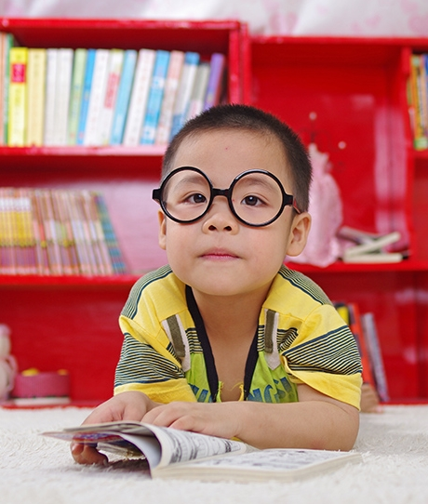
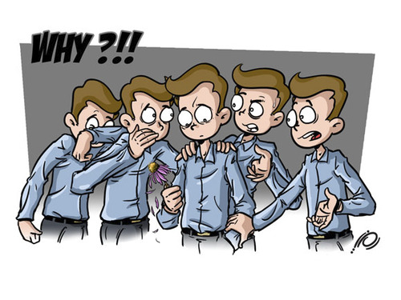
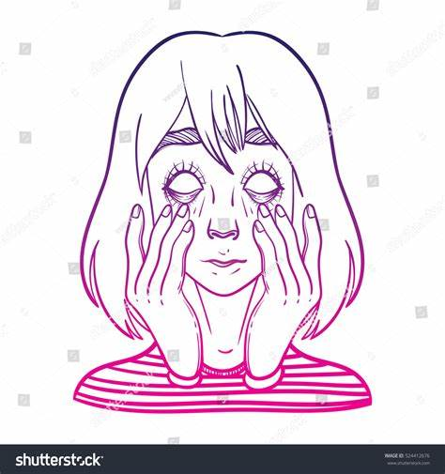
为什么学英语？
Tell me why?

Slide 2
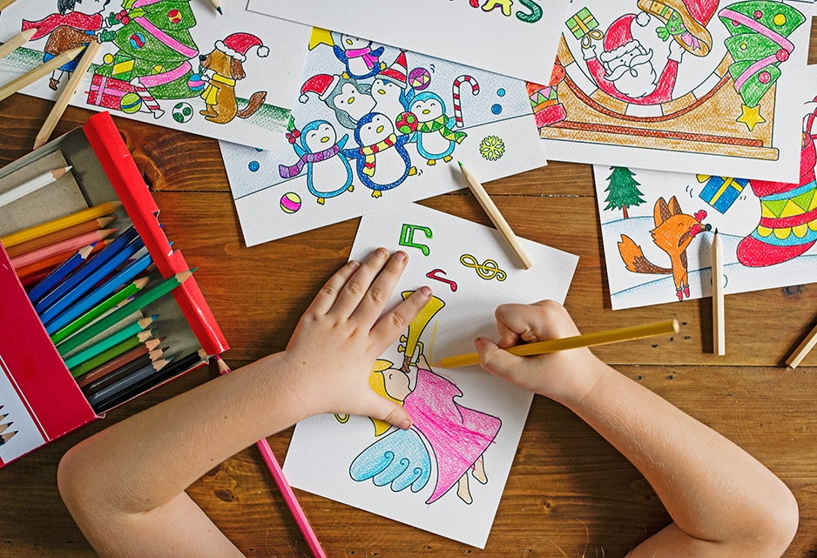
What is English?

Slide 3
English is a language.
Letters Words
sentences
Article
文字 词语
句子
文章

Slide 4
十大词性
1.代词 pro
2.数词 num.
3.冠词 art.
4.介词 pre.
5.连词 conj.
6.形容词 adj.
7.副词 adv.
8.动词 v.
9.名词 n.
10.感叹词 interj.
组成句子的关键

Slide 5
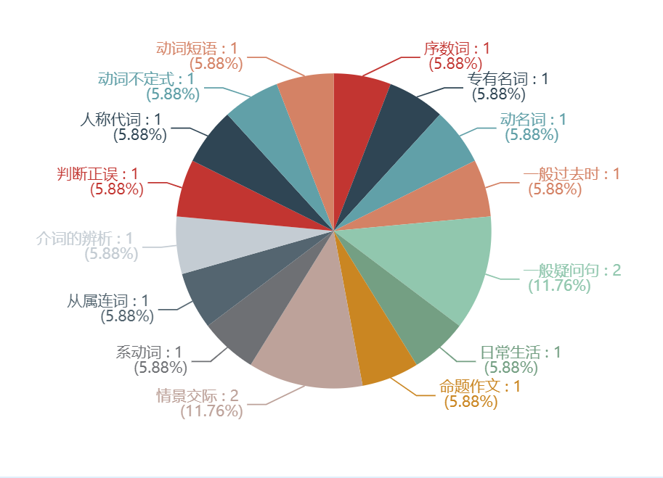
小升初考试分析
清晰知识点，抓住每一分

Slide 6
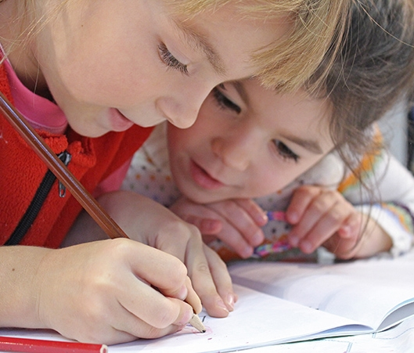
小升初重点难点突破
2020
4月份
代词和数词

Slide 7
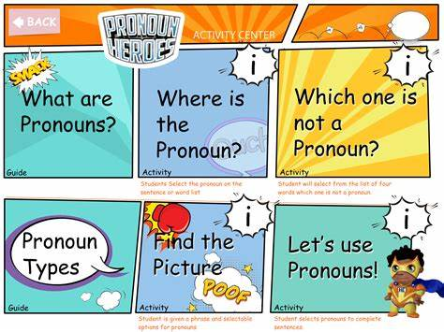
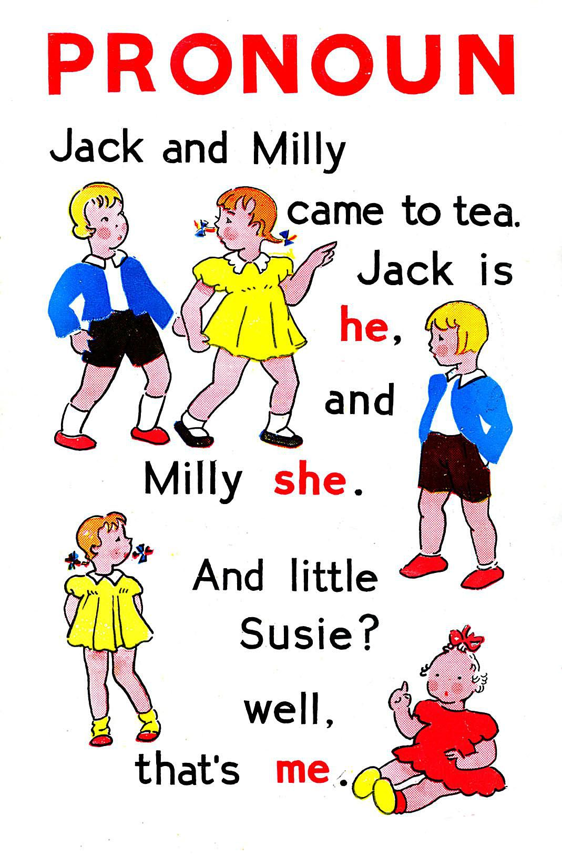
找代词
he she me

Slide 8
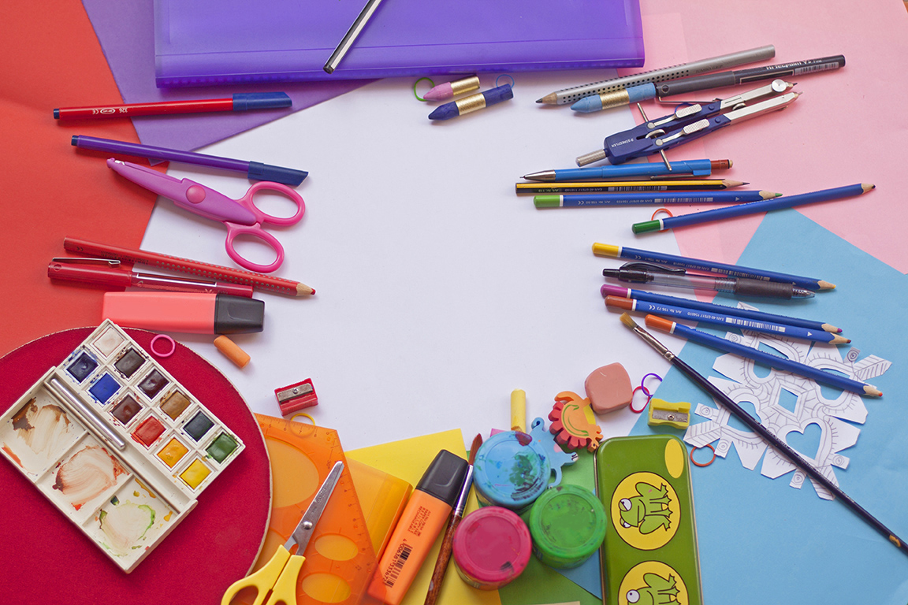
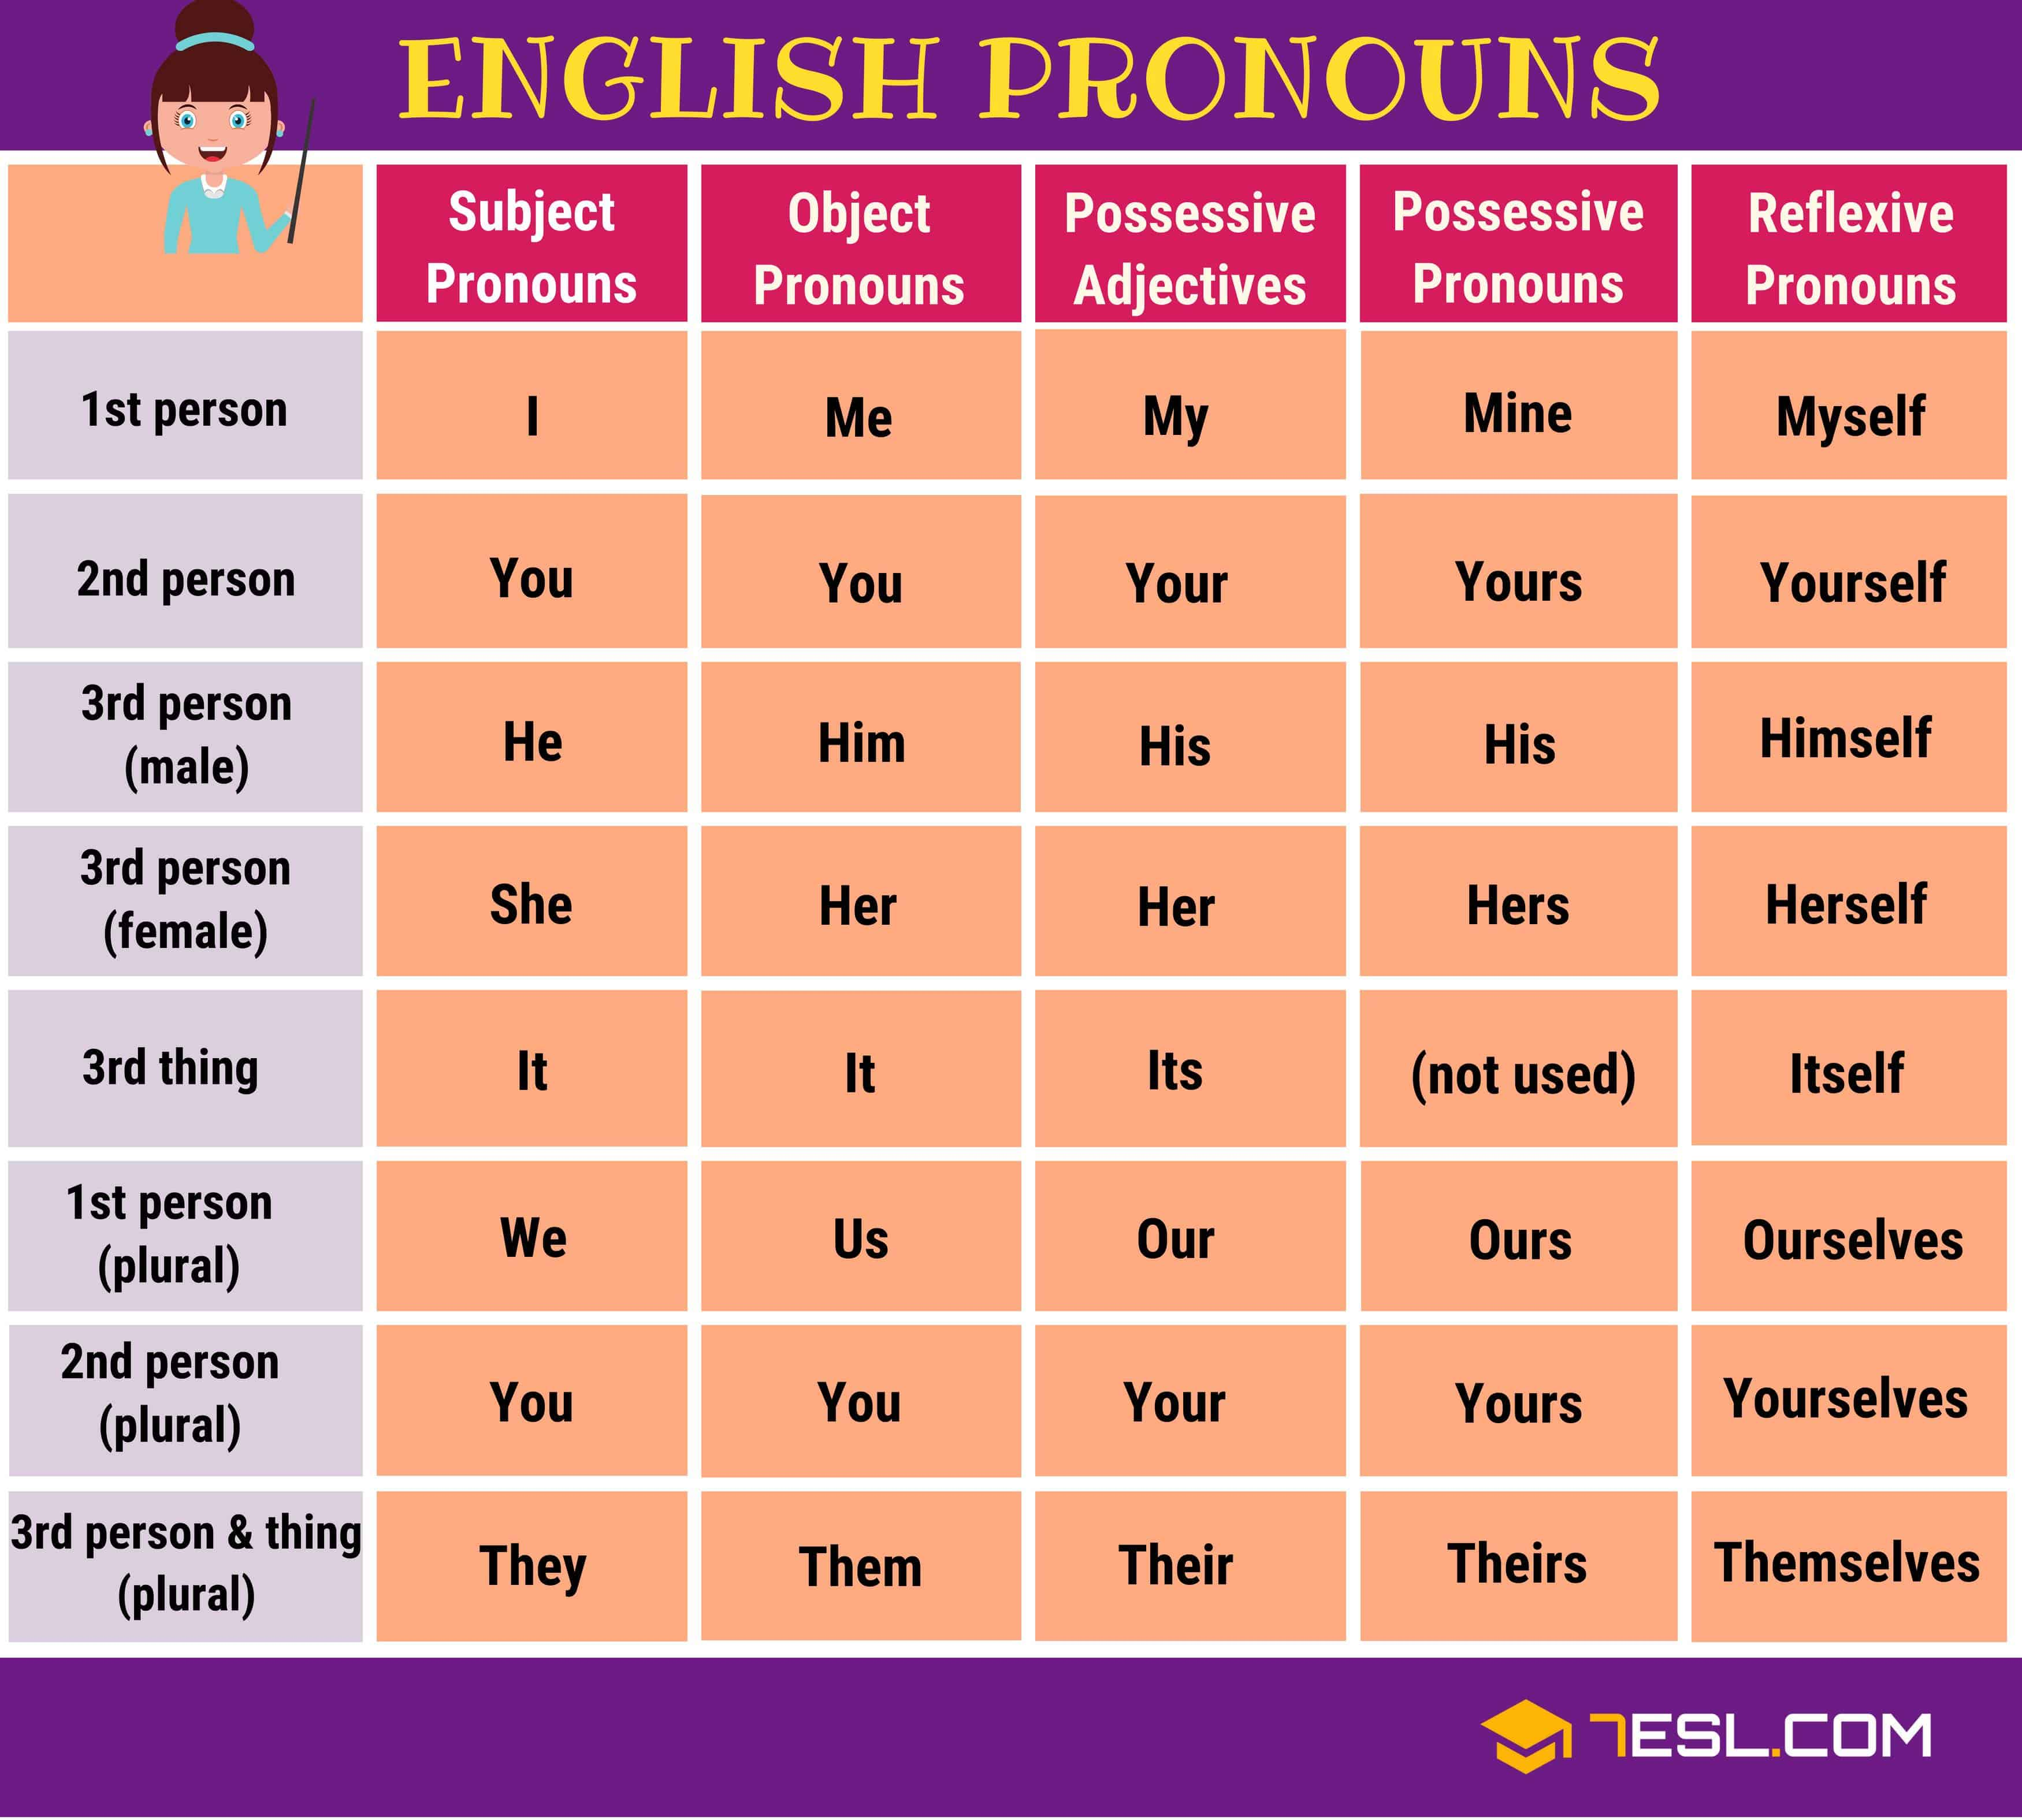
代词
词数有限，易分清，不易失分

Slide 9
代词使用的规则及易错点
一，人称代词在句中的位置和单复数的使用
1.人称代词作主语时用主格（y
ou的主格宾格拼写一样）
I am a student.
2.人称代词做动词或介词的宾语时用宾格
Can I help you?
I can write to him.
知识点清晰，不易混

Slide 10
例题
You can’t buy _______. He’s my friend.
A.him B.his C.he
Look at these giraffes. ______tall and thin.
A.It’s B.They’re C.They
It’s time for______to have lunch.
A.us B.we C.our
This shoes look beautiful.Can I _______?
A.Try on it. B.try it on C.try on them D. try them on

Slide 11
代词使用的规则及易错点
二，人称代词和物主代词细节区别
1.形容词性物主代词相当于形容词，只能至于名词前作定语，其人称、数和性别的变化取决于其所指代的名词
This is your pen.
2.名词性物主代词=形容词性物主代词+名词（ 可做主语，宾语和表语）
It is his book.=It is his book.(his book=his)

Slide 12
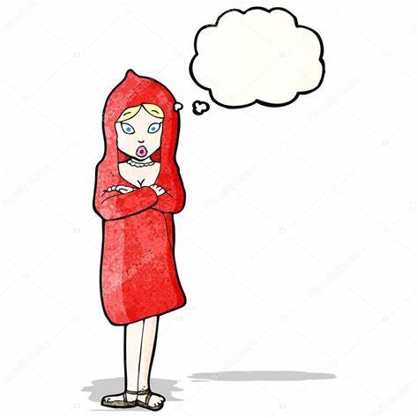
例题
Did you help _____ clean______room.
A.their；them B.them;them C.them;their
The red coat is______, not ______.
A.Her;his B.hers;his C.my;her

Slide 13
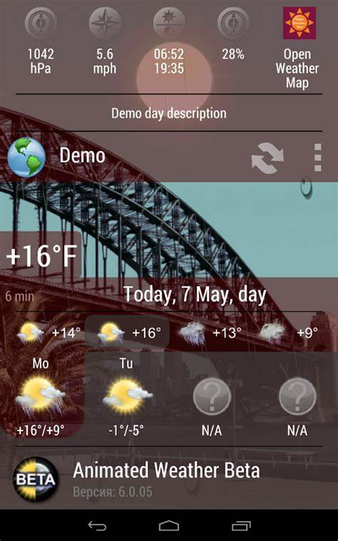


代词使用的规则及易错点
三.人称代词it可以表示”天气、温度、时间等含义“
It’s sunny today.
It’s 22degrees.
It’s nine o’clock.

Slide 14
代词使用的规则及易错点
四.人称代词并列时的顺序
1）单数并列 you , he/she and I(按照二三一规则）
2) 复数并列 we you they（按照一二三规则）
3) 男女并列 he she
4)若是做错事承担责任，把第一人称放在第一位 I and he
You, john and I can play football together.
We, you and they are all students.

Slide 15
例题
-His apple is bigger than_____.
A.me B.my C.mine
-Mr. Yang _______English this term.
A.teaches our B.teaches us C.Teachs us C.teach our
-______will be clear in Changsha.______will be a light wind.
A.It;there B.there;it Cthere;there

Slide 16
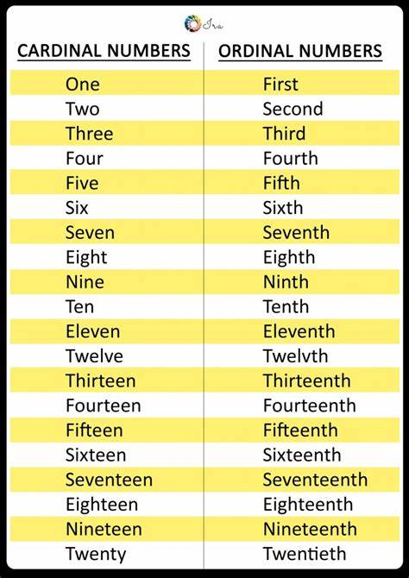
数词
一.分类
1.基数词（表示数量）
2.序数词（表示顺序）

Slide 17
数词
口诀 | 解说 | 举例
基变序，有规律，后边th加上去 | 在数词后面加th | four→fourth
一二三，特殊记，后面字母t,d,d | one,two,three特殊变 | first，second，third
八去t，九去e。整数中的y要变成ie | eight去掉t，nine去掉e。twenty去掉y变成twentieth | twentieth eight→eighth nine→ninth
f来把ve替 | five和twelve的ve要变成f | five→fifthtwelve→twelfth
若是遇到几十几，只变个位就可以 | 两位数或两位以上数字只变个位 | thirty-three→thirty-third
序数词前要加the我们一定要牢记 | 序数词前必须加the（上述原则中的除外） | thefirstday
妙背巧记

Slide 18
数词易错点
a.几十几的表达是
几十 +连字符 +一到九
thirty-one
b.Class one, Grade two, Page seven
c.标识楼层：first floor
具体日期：几月几号，几号用序数词February 2nd
d.关注一周的第一天Sunday：The first day of a week is Sunday.
e.the seventh page和page seven
拼写
用法累计
序数词使用场景
序数词和星期几的询问
注意序数词和基数词的区分

Slide 19
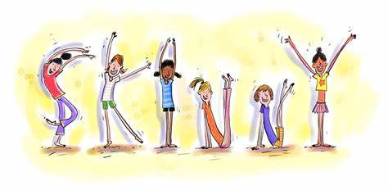
类型题
Thursday is the ______day of a week.
A.Third B.fourth C.fifth
What’s five and seven?
It’s_____.
A.nine B.ten C.twelve
International Children’s day is on the ______of June.
A.First B.fourth C.fifth

Slide 20
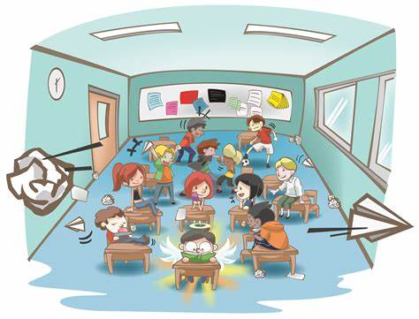
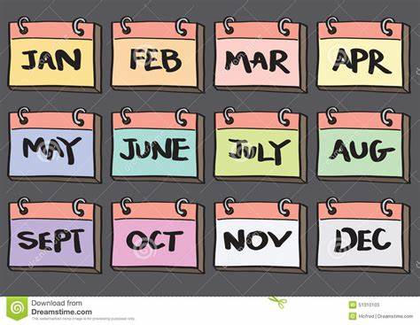
类型题
There are _______ students in our class.
A.fifty two B.fifty-two
The teacher’s office is on the ______ floor.
A.five B.fiveth C.fifth
September is the_____month of the year.
A.Nine B.nineth C.ninth

Slide 21
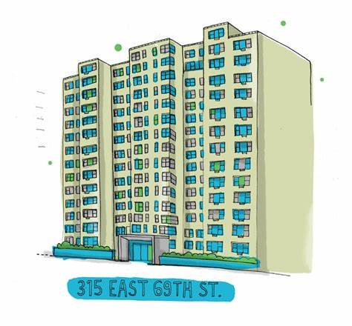
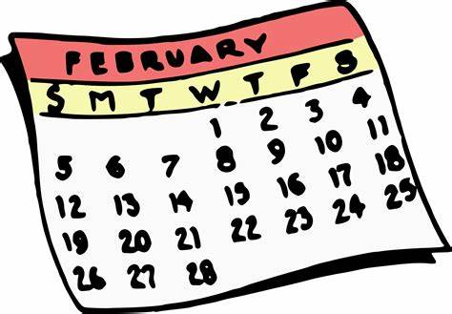
类型题
They live on _______floor.
A.twelve B.the twelve C.the twelfth
There are ______days in February.
A.20 B.29 C.28 D.Both B and C

Slide 22
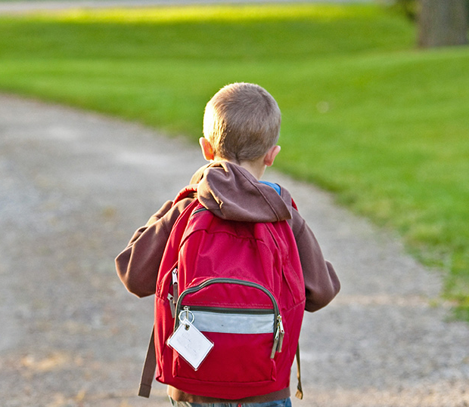
Thank you!
Kaylee

