Slide 1
Module 6A:
Textual Analysis: NLP

Slide 2
This lecture covers
1. NLP textual analysis overview
2. Details of textual analysis
3. Feature extraction techniques
Bag of words
TF-IDF
Word2Vec
4. Applications
Sentiment analysis using Word2Vec

Slide 3
1. Textual analysis overview

Slide 4
What is textual analysis?
Definition:
Textual analysis is the process of using computational techniques to extract information, patterns, and insights from unstructured text data.
It involves transforming text into a structured format for analysis, identifying patterns, trends, and relationships using NLP (Natural Language Processing) techniques
Textual analysis deals with unstructured data, requiring traditional machine learning algorithms (classification and clustering) and advanced deep learning models (e.g., transformers)
Purpose and goals:
Understand the context, sentiment, and key themes in textual data
Reveal hidden patterns and relationships that are not easily discernible through traditional data analysis

Slide 5
Types of textual analysis
Sentiment Analysis
Determines the emotional tone of text (positive, negative, neutral)
Topic Modeling
Uncovers hidden themes or topics within a collection of documents
Text Classification
Uncovers hidden themes or topics within a collection of documents
Named Entity Recognition (NER)
Identifies entities like names, dates, and locations in text
Summarization
Condenses lengthy texts into shorter versions

Slide 6
Textual analysis procedure (1)
Step 1: Text preprocessing, including tokenization, stopword removal, and stemming
Step 2: Feature extraction
To generate features of a text document, e.g., bag of words, text embedding

Slide 7
Textual analysis procedure (2)
Step 3: Text analysis and modeling
Traditional: sentiment analysis; NER (name entity recognition); text classification
Advanced model: Transformer
Step 4: Model evaluation
E.g., assessing accuracy
Step 5: Deployment

Slide 8
2. Details of textual analysis

Slide 9
Step 1: Collect data and preprocess data
Data sources for textual analysis
News articles
Social media (tweets, facebook posts)
Research papers and academic journals
Online reviews and blogs
Congressional hearings and reports

Slide 10
Preprocessing techniques (1)
Tokenization
“Breaking down text into tokens”: “Breaking”, “down”, “text”, “into”, “tokens”
Stopword removal
NLTK’s list of stopwords: https://gist.github.com/sebleier/554280
Lemmatization and stemming
Lemmatization: “breaking” → “break”; “tokens” -> “token”
Stemming: "running" → "run", "flies" → "fli"

Slide 11
Preprocessing techniques (2)
Lowercasing and normalization
normalization: “I’ll” → “I will”
Handling noise (punctuation, HTML tags)
Noise in text data refers to any irrelevant or extraneous information that does not contribute meaningful insights to the analysis.

Slide 12
Example
Preprocess the statement:
“Hello there! Welcome to FIN7047. This course, which is offered in Spring 2025, is designed to provide a good understanding of financial technology and cryptocurrency.”
Sometimes the preprocessing procedure is also called tokenization since it is the most important preprocessing step.

Slide 13
NLTK preprocessing procedure
!pip install nltk
import re
import string
from nltk.corpus import stopwords
from nltk.tokenize import word_tokenize
from nltk.stem import PorterStemmer, WordNetLemmatizer
import nltk
# Download necessary NLTK resources
nltk.download('punkt')
nltk.download('stopwords')
nltk.download('wordnet')
nltk.download('punkt_tab')
# Sample text
sample_text = """Hello there! Welcome to Finance 7047. This course, which is offered in the Spring 2025 semester,
is designed to provide a good understanding of Financial Technologies and Cryptocurrency."""
print(f"Original Text:\n{sample_text}\n")
# Step 1: Convert to Lowercase
lowercase_text = sample_text.lower()
print(f"After Lowercasing:\n{lowercase_text}\n")
# Step 2: Remove Punctuation
# Using regular expressions to remove punctuation marks
cleaned_text = re.sub(f"[{re.escape(string.punctuation)}]", "", lowercase_text)
print(f"After Removing Punctuation:\n{cleaned_text}\n")
# Step 3: Tokenization
# Split text into words (tokens)
tokens = word_tokenize(cleaned_text)
print(f"After Tokenization:\n{tokens}\n")
# Step 4: Remove Stopwords
# Load NLTK's list of English stopwords
stop_words = set(stopwords.words("english"))
filtered_tokens = [word for word in tokens if word not in stop_words]
print(f"After Removing Stopwords:\n{filtered_tokens}\n")
# Step 5: Stemming (Optional)
# Use Porter Stemmer to reduce words to their root form
stemmer = PorterStemmer()
stemmed_tokens = [stemmer.stem(word) for word in filtered_tokens]
print(f"After Stemming:\n{stemmed_tokens}\n")
# Step 6: Lemmatization (Alternative to Stemming)
# Use WordNet Lemmatizer to get the base form of words
lemmatizer = WordNetLemmatizer()
lemmatized_tokens = [lemmatizer.lemmatize(word) for word in filtered_tokens]
print(f"After Lemmatization:\n{lemmatized_tokens}\n")
# Final Preprocessed Text
final_text = " ".join(lemmatized_tokens)
print(f"Final Preprocessed Text:\n{final_text}")

Slide 14
Results
After Lowercasing:
hello there! welcome to Finance 7047. this course, which is offered in spring 2025, is designed to provide a good understanding of financial technologies and cryptocurrency.
After Removing Punctuation:
hello there! welcome to Finance 7047 this course which is offered in spring 2025 is designed to provide a good understanding of financial technologies and cryptocurrency
After Tokenization:
['hello', 'there', 'welcome', 'to', ‘finance', ‘7047', 'this', 'course', 'which', 'is', 'offered', 'in', 'the', ‘spring', ‘2025', 'is', 'designed', 'to', 'provide', 'a', ‘good', ‘understanding', ‘of', ‘financial', ‘technology', ‘and', ‘cryptocurrency']

Slide 15
Results
After Removing Stopwords:
['hello', 'welcome', ‘finance', ‘7047', 'course', 'offered', ‘spring', ‘2025', 'designed', 'provide', ‘good', ‘understanding', ‘financial', ‘technology', ‘cryptocurrency']
After Stemming:
['hello', 'welcom', 'financ', '7047', 'cours', 'offer', ‘spring', ‘2025', 'design', 'provid', 'good', 'understand', 'financi', 'technolog', 'cryptocurr’]
After Lemmatization:
['hello', 'welcome', 'finance', '7047', 'course', 'offered', ‘spring', ‘2025', 'designed', 'provide', 'good', 'understanding', 'financial', 'technology', 'cryptocurrency’]
Final Preprocessed Text:
hello welcome finance 7047 course offered spring 2025 designed provide good understanding financial technology cryptocurrency

Slide 16
Step 2: Feature extraction
Feature extraction methods transform raw text into numerical representations that can be used by machine learning models.
They capture the essential characteristics or features of the text to make it understandable for computational algorithms.
Bag of Words (BoW)
Term Frequency-Inverse Document Frequency (TF-IDF)
Word Embeddings (Word2Vec, GloV)
Will go over this in detail later.

Slide 17
Step 3: Text analysis and modeling
After converting text into features, the next step is to apply machine learning or deep learning models to extract insights, detect patterns, or make predictions.
Text classification
Text clustering
Sentiment analysis
Topic modeling
Named entity recognition
Text summarization
Language generalization

Slide 18
Sentiment analysis
Perform sentiment analysis on the following statements:
"I love this product! It’s absolutely fantastic.",
"This is the worst experience I have ever had.",
"I'm not very happy with the service.",
"The movie was great and very enjoyable!",
"I am extremely disappointed with the quality of this item.“
Textual analysis provides a sentiment score:
Positive, negative, neutral

Slide 19
TextBlob vs. NLTK
TextBlob
Lexicon-based sentiment analysis tool.
Use a predefined sentiment dictionary with positive and negative polarity value for words
Scoring: provides polarity (sentiment) and subjectivity scores
NLTK
Similar lexicon-based sentiment analysis tool
Advanced lexicon-based approach for sentiment only
Scoring: positive negative neutral and compound

Slide 20
Textblob for sentiment analysis
#!pip install textblob
from textblob import TextBlob
# Sample sentences
sentences = [
"I love this product! It’s absolutely fantastic.",
"This is the worst experience I have ever had.",
"I'm not very happy with the service.",
"The movie was great and very enjoyable!",
"I am extremely disappointed with the quality of this item."
]
# Perform sentiment analysis on each sentence
for sentence in sentences:
blob = TextBlob(sentence) # Create a TextBlob object
sentiment_score = blob.sentiment.polarity # Get the polarity score (-1 to 1)
# Determine sentiment based on polarity score
if sentiment_score > 0:
sentiment = "Positive"
elif sentiment_score < 0:
sentiment = "Negative"
else:
sentiment = "Neutral"
# Print the sentence and its corresponding sentiment
print(f"Sentence: {sentence}\nSentiment: {sentiment}\n")

Slide 21
Output
Sentence: I love this product! It’s absolutely fantastic.
Sentiment: Positive
Sentence: This is the worst experience I have ever had.
Sentiment: Negative
Sentence: I'm not very happy with the service.
Sentiment: Negative
Sentence: The movie was great and very enjoyable!
Sentiment: Positive
Sentence: I am extremely disappointed with the quality of this item.
Sentiment: Negative

Slide 22
Topic modeling
Topic modeling is a type of unsupervised machine learning used to discover hidden topics or themes within a large collection of text data.
The goal is to automatically identify and group words into different topics based on patterns in word co-occurrences.
Use the Latent Dirichlet Allocation (LDA) algorithm from the Scikit-Learn library.
The code breaks down the process step-by-step and displays the top words for each topic.

Slide 23
Python: topic modeling
from sklearn.feature_extraction.text import CountVectorizer
from sklearn.decomposition import LatentDirichletAllocation
import pandas as pd
# Sample documents for topic modeling
documents = [
"I love to eat pizza and pasta.",
"The economy is facing a downturn with rising unemployment.",
"Pizza and burgers are my favorite fast foods.",
"The government announced new policies to tackle inflation.",
"AI and machine learning are transforming the technology industry.",
"The stock market is experiencing a significant drop.",
"Artificial intelligence is changing how we interact with technology.",
"The economic impact of the pandemic has been severe."
]
# Step 1: Vectorize the text (Bag-of-Words)
# Use CountVectorizer to create the document-term matrix
vectorizer = CountVectorizer(stop_words='english') # Remove common English stopwords
X = vectorizer.fit_transform(documents)
# Step 2: Apply LDA to extract topics
lda = LatentDirichletAllocation(n_components=2, random_state=42) # Number of topics set to 2
lda.fit(X)
# Step 3: Display the top words in each topic
num_top_words = 5 # Number of top words to display for each topic
feature_names = vectorizer.get_feature_names_out() # Get the feature names (words)
# Create a dictionary to store top words for each topic
topics = {}
for topic_idx, topic in enumerate(lda.components_):
topics[f'Topic #{topic_idx + 1}'] = [feature_names[i] for i in topic.argsort()[:-num_top_words - 1:-1]]
# Convert to a DataFrame for easy display
topics_df = pd.DataFrame(topics)
# Display the DataFrame with the top words for each topic
print("Top Words in Each Topic:")
print(topics_df)

Slide 24
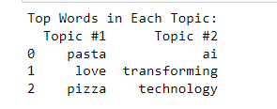
Output
You can input an article or a book, then preprocess the text, and perform topic modeling on the article

Slide 25
Step 4: Evaluation and Interpretation
Accuracy: Percentage of correctly predicted labels.
Precision, Recall, F1-Score: Metrics to evaluate the quality of classification.
Confusion Matrix: Visual representation of classification performance.
ROC-AUC (Receiver Operating Characteristic - Area Under Curve): Measures classification performance for binary classes.

Slide 26
Step 5: Application and deployment
Sentiment Analysis for customer feedback and social media monitoring.
Text Classification for spam detection, news categorization.
Chatbots and Conversational Agents for customer support.
Content Recommendation based on user preferences.
Automated Report Generation to summarize large documents.

Slide 27
3. feature extraction methods

Slide 28
Bag of Words (BoW)
Represents a text as a collection of word frequencies without considering grammar or word order.
How It Works? Creates a vocabulary of all the unique words in the text corpus and counts the occurrence of each word in a document.
Example:
Text: "The cat sat on the mat."
Vocabulary: ["cat", "mat", "on", "sat", "the"]
BoW Vector: [1, 1, 1, 1, 2] (frequency of each word in the text)

Slide 29
Python for BoW
from sklearn.feature_extraction.text import CountVectorizer
# Define a sample set of documents
documents = [
"The cat sat on the mat.",
"The dog barked loudly.",
"The cat chased the mouse.",
]
# Initialize the CountVectorizer
vectorizer = CountVectorizer()
# Fit the model and transform the documents into a BoW matrix
bow_matrix = vectorizer.fit_transform(documents)
# Convert the result into a dense matrix format and print it
print("BoW Matrix (Document-Term Matrix):\n", bow_matrix.toarray())
# Get the feature names (vocabulary)
print("Feature Names (Vocabulary):\n", vectorizer.get_feature_names_out())

Slide 30
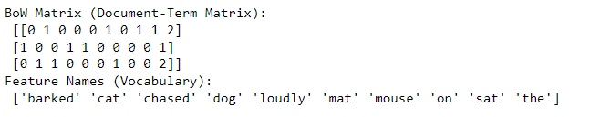
Output (BoWs)
The original documents:
"The cat sat on the mat.",
"The dog barked loudly.",
"The cat chased the mouse.",
This results in a BoW matrix, used in
Logistic regressions or decision tree for classification analysis
Clustering and topic modeling
Input for deep learning models

Slide 31
Read in a large file
Nakamoto (2008)
!pip install PyPDF2
import PyPDF2
# Read a large text file
file_path = 'nakamoto_2008_bitcoin.pdf'
# Open the PDF file
with open(file_path, 'rb') as file:
reader = PyPDF2.PdfReader(file)
# Extract text from the first page
page = reader.pages[0]
print(page.extract_text())
# Check a snippet of the document
print(large_document[:500]) # Display the first 500 characters

Slide 32
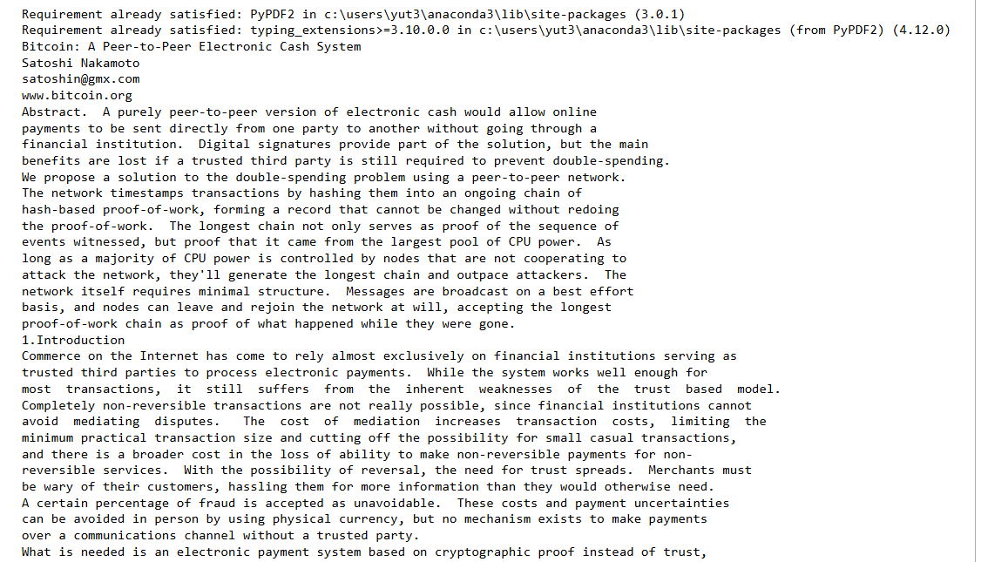

Slide 33
Term Frequency-Inverse Document Frequency (TF-IDF)
TF-IDF is a statistical measure used to evaluate the importance of a word in a document relative to a collection of documents (corpus).
TF: term frequency
IDF: inverse document frequency
TF: how frequently they occur in a specific document
IDF: how rare they are across all documents
This helps highlight more informative words and reduces the importance of commonly used words.

Slide 34
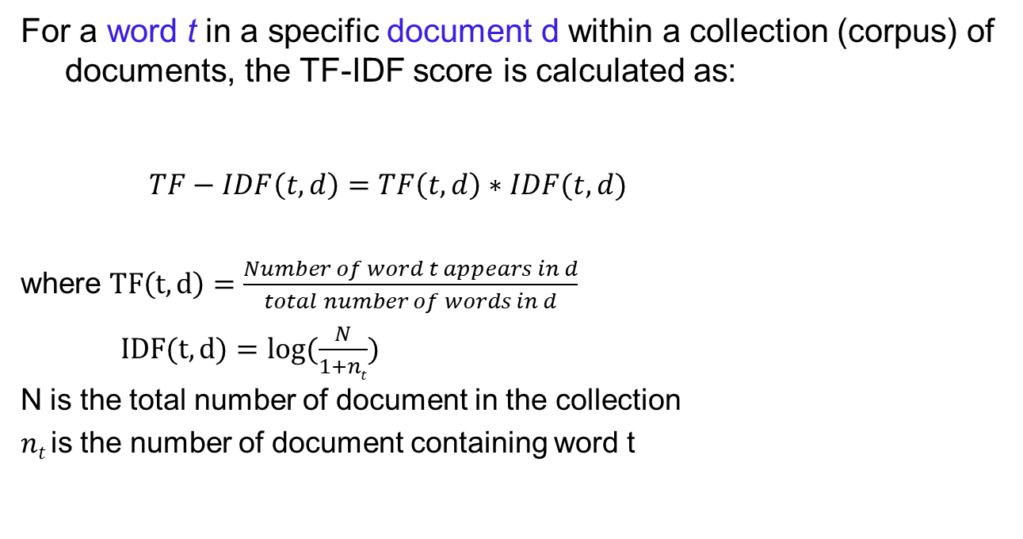
Measure
For a word t in a specific document d within a collection (corpus) of documents, the TF-IDF score is calculated as:
$TF−IDF\left(t,d\right)=TF\left(t,d\right)∗IDF(t,d)$
where $TF\left(t,d\right)=\frac{Number of word t appears in d}{total number of words in d}$
$IDF(t,d)=log⁡(\frac{N}{1+nt})$
N is the total number of document in the collection
$nt$is the number of document containing word t

Slide 35
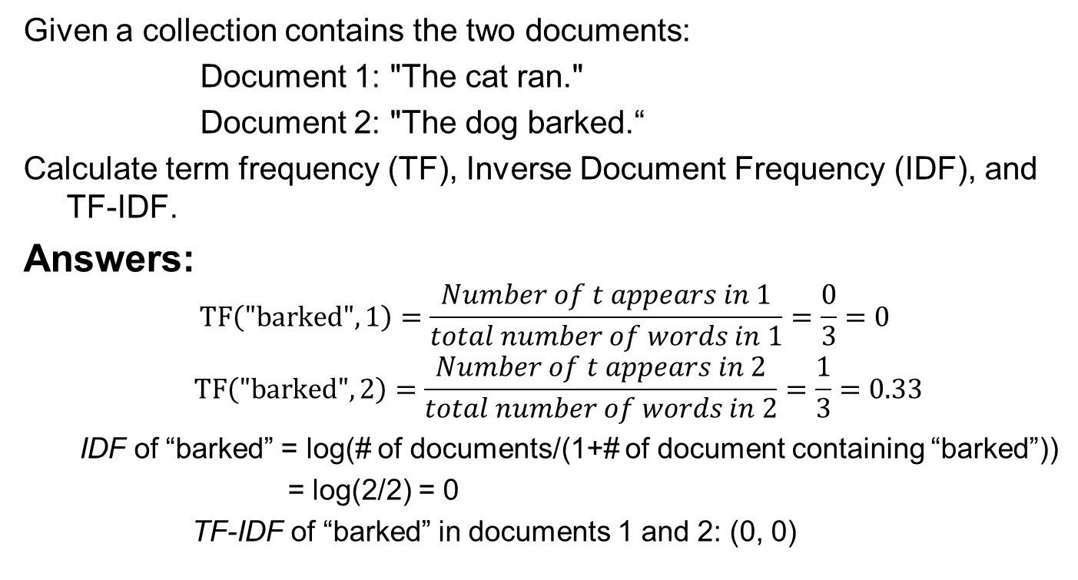
Example
Given a collection contains the two documents:
Document 1: "The cat ran."
Document 2: "The dog barked.“
Calculate term frequency (TF), Inverse Document Frequency (IDF), and TF-IDF.
Answers:
$$TF\left("barked",1\right)=\frac{Number of t appears in 1}{total number of words in 1}=\frac{0}{3}=0$$
$$TF\left("barked",2\right)=\frac{Number of t appears in 2}{total number of words in 2}=\frac{1}{3}=0.33$$
IDF of “barked” = log(# of documents/(1+# of document containing “barked”))
= log(2/2) = 0
TF-IDF of “barked” in documents 1 and 2: (0, 0)

Slide 36
Python codes
from sklearn.feature_extraction.text import TfidfVectorizer
import pandas as pd
import numpy as np
# Sample documents
documents = [
"The cat ran.",
"The dog barked.",
]
# Create the TF-IDF vectorizer
vectorizer = TfidfVectorizer()
# Fit and transform the documents into a TF-IDF matrix
tfidf_matrix = vectorizer.fit_transform(documents)
# Get the feature names (words in the vocabulary)
feature_names = vectorizer.get_feature_names_out()
# Calculate IDF values
idf_values = vectorizer.idf_
# Calculate Term Frequency (TF) matrix (convert TF-IDF matrix to TF by dividing by IDF values)
tf_matrix = tfidf_matrix.toarray() / idf_values
# Convert IDF, TF, and TF-IDF values to dataframes for easy visualization
idf_df = pd.DataFrame({'Word': feature_names, 'IDF': idf_values})
# TF values for each document
tf_df = pd.DataFrame(tf_matrix, columns=feature_names)
tf_df.insert(0, 'Document', [f'Document {i+1}' for i in range(len(documents))])
# TF-IDF values for each document (directly from tfidf_matrix)
tfidf_df = pd.DataFrame(tfidf_matrix.toarray(), columns=feature_names)
tfidf_df.insert(0, 'Document', [f'Document {i+1}' for i in range(len(documents))])
# Print IDF values
print("=== IDF Values ===")
print(idf_df)
# Print Term Frequencies (TF)
print("\n=== Term Frequency (TF) Values ===")
print(tf_df)
# Print TF-IDF values
print("\n=== TF-IDF Values ===")
print(tfidf_df)

Slide 37
How are TF-IDF scores used?
TF-IDF scores are text data used to analyze and interpret text.
Spam detection: identifying common words in spam emails
Sentiment analysis: words like “happy”, “amazing” get higher TF-IDF in positive reviews.

Slide 38
Word2Vec
Word2Vec is a word embedding technique that represents words as high-dimensional vectors, capturing semantic meanings and relationships between words based on their usage in a corpus.
It was developed by Tomas Mikolov at Google in 2013
Applies neural networks to learn word associations from large text datasets. The resulting word embeddings encode contextual information, making similar words (e.g., "king" and "queen") close in vector space.

Slide 39
Procedure
Preprocess the document
Initialize the Word2Vec model
CROW
Skip-Gram
Train the model
Extract the embedding
Perform text analysis using embedding

Slide 40
Embedding
An embedding is a dense vector representation of discrete data, like words or categories, that captures their relationships in a multi-dimensional space.
Words like "king", "queen", "man", and "woman" might be represented as (hypothetical):
king = [0.25, 0.80, 0.65]
queen = [0.28, 0.79, 0.67]
man = [0.9, 0.3, 0.4]
woman = [0.88, 0.32, 0.42]
The vectors for "king" and "queen" will be close to each other, indicating they are semantically similar.
“Man” and “woman” are similar.

Slide 41
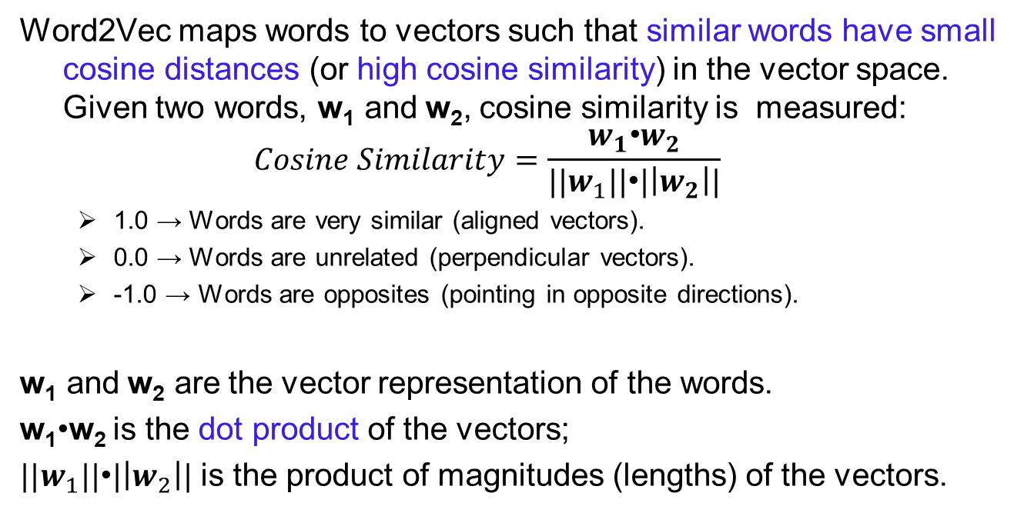
Cosine Similarity
Word2Vec maps words to vectors such that similar words have small cosine distances (or high cosine similarity) in the vector space. Given two words, w₁​ and w₂​, cosine similarity is measured:
$$Cosine Similarity=\frac{w_{1}\text{•}w_{2}}{{||w}_{1}||\text{•}|\left|w_{2}\right||}$$
1.0 → Words are very similar (aligned vectors).
0.0 → Words are unrelated (perpendicular vectors).
-1.0 → Words are opposites (pointing in opposite directions).
w₁​ and w₂​ are the vector representation of the words.
w₁​•w₂ is the dot product of the vectors;
${||w}_{1}||\text{•}|\left|w_{2}\right||$ is the product of magnitudes (lengths) of the vectors.

Slide 42
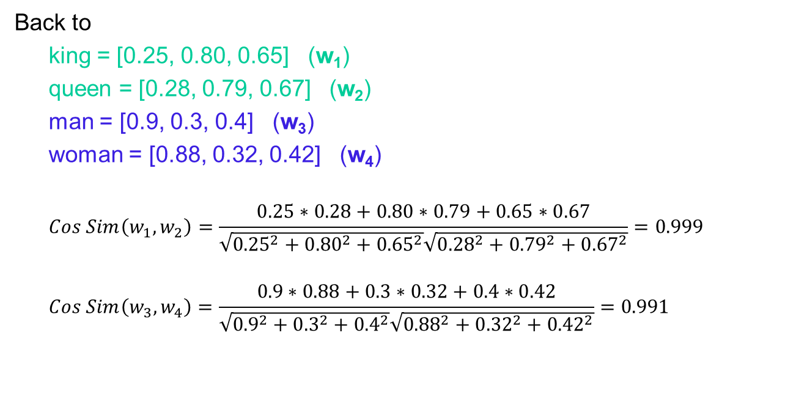
Examples
Back to
king = [0.25, 0.80, 0.65] (w₁)
queen = [0.28, 0.79, 0.67] (w₂)
man = [0.9, 0.3, 0.4] (w₃)
woman = [0.88, 0.32, 0.42] (w₄)
$$Cos Sim\left(w_{1},w_{2}\right)=\frac{0.25∗0.28+0.80∗0.79+0.65∗0.67}{\sqrt{{0.25}^{2}+{0.80}^{2}+{0.65}^{2}}\sqrt{{0.28}^{2}+{0.79}^{2}+{0.67}^{2}}}=0.999$$
$$Cos Sim\left(w_{3},w_{4}\right)=\frac{0.9∗0.88+0.3∗0.32+0.4∗0.42}{\sqrt{{0.9}^{2}+{0.3}^{2}+{0.4}^{2}}\sqrt{{0.88}^{2}+{0.32}^{2}+{0.42}^{2}}}=0.991$$

Slide 43
Example 1
Sentences
"The quick brown fox jumps over the lazy dog."
"I love natural language processing and machine learning."
"The dog chased the cat."
"The cat climbed the tree."
"Machine learning and deep learning are fascinating fields."
"The dog barked loudly at the intruder."
“Language models are crucial for natural language understanding."
For a given word (e.g., "dog"), the model identifies other words that are similar based on their vector representations.

Slide 44
Python codes
from sklearn.feature_extraction.text import TfidfVectorizer
from gensim.models import Word2Vec
from nltk.tokenize import word_tokenize
# Sample documents
documents = ["The cat ran.", "The dog barked."]
# Tokenize sentences for Word2Vec
tokenized_sentences = [word_tokenize(doc.lower()) for doc in documents]
# Train Word2Vec model
model = Word2Vec(sentences=tokenized_sentences, vector_size=50, window=3, min_count=1)
# Display vocabulary
print("Vocabulary:", list(model.wv.index_to_key))
# Find words similar to "dog"
print("Most similar to 'dog':", model.wv.most_similar("dog"))

Slide 45
Output
Vocabulary: ['.', 'the', 'barked', 'dog', 'ran', 'cat']
Most similar to 'dog': [('.', -0.014475265517830849), ('barked', -0.15515565872192383), ('the', -0.17424817383289337), ('ran', -0.20600518584251404), ('cat', -0.2091003954410553)]
Useful applications include:
Word Similarity: used in recommendation systems
Text Classification: Used in chatbots, sentiment analysis, and spam detection.

Slide 46
4. Nlp Applications

Slide 47
NLP analysis of crypto sentiment using TDM Studio
Using TDM Platform to perform sentiment analysis of Bitcoin market with the bag-of-words approach

Slide 49
Lecture summary
1. Textual analysis procedure
2. Examples of textual analysis
Sentiment analysis
Topic modeling
3. Three key feature extraction models
BoW, TF-IDF, Word2Vec
4. NLP application using TDM platform

