Slide 1
Location Privacy-Preserving Data Recovery for Mobile Crowdsensing
Tongqing Zhou^{1,2}, Zhiping Cai¹, Bin Xiao², Leye Wang³, Ming Xu¹, Yueyue Chen¹
1. National University of Defense Technology, China
2. The Hong Kong Polytechnic University, China
3. Hong Kong University of Science and Technology, China

Slide 2
Contents
Background
Design of our proposal
Evaluation

Slide 3
Background: Data recovery involved mobile crowdsensing (1)
Definition: A special form of mobile crowdsensing (MCS) that only senses a small number of subareas and leverages data recovery to infer the unsensed subareas.
Also called sparse MCS^{[1]}, or compressive crowdsensing^{[2]}.
Why introducing data recovery in MCS?
Limited budgets of application campaigners;
Large size of sensing areas;
Huge overall costs on energy and bandwidth.
[1] Wang L, Zhang D, Wang Y, et al. Sparse mobile crowdsensing: challenges and opportunities[J]. IEEE Communications Magazine, 2016, 54(7):161-167.
[2] Xu L, Hao X, Lane N D, et al. More with less: lowering user burden in mobile crowdsourcing through compressive sensing[C]// Ubicomp, 2015:659-670.
Notes:
So, data recovery takes a step further for efficient data collection and real world deployment

Slide 4
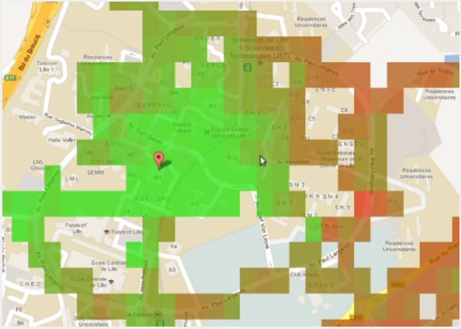
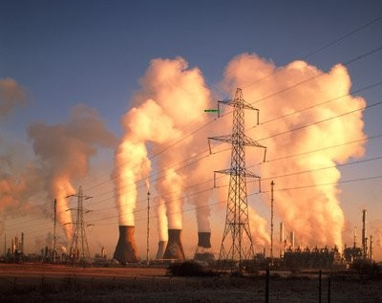

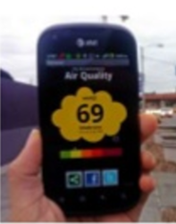
Background: Data recovery involved mobile crowdsensing (2)
Beneficial to the MCS applications in the urban scenarios.
Noise monitoring
Air pollution monitoring
Notes:
In fact, it can benefit

Slide 5
Background: Data recovery involved mobile crowdsensing (3)
A typical process of data recovery involved MCS.

Slide 6
Background: Privacy issues in MCS
Users’ location privacy is at risk when reporting sensory data with their actual locations^{[1][2]}.
Profiling users with their locations (e.g. home location, lifestyles);
Exposing users to unexpected surveillance and tracking.
Preserving users’ privacy is essential for attracting the mobile crowd to participate in the sensing tasks^{[3]}.
Users would be reluctant to participate if privacy is violated.
[1] Wang L, Zhang D, Yang D, et al. Differential Location Privacy for Sparse Mobile Crowdsensing[C]// ICDM, 2017:1257-1262.
[2] Huang C, Wang D, Zhu S. Where Are You From: Home Location Profiling of Crowd Sensors from Noisy and Sparse Crowdsourcing Data. Infocom, 2017.
[3] Ganti R K, Ye F, Lei H. Mobile crowdsensing: current state and future challenges[J]. IEEE Communications Magazine, 2011, 49(11).

Slide 7
Background: Related work
Roughly three categories:
Cloaking^{[1]};
Perturbation^{[2]};
Encryption^{[3]}.
[1] Pournajaf L, Xiong L, Sunderam V, et al. Spatial Task Assignment for Crowd Sensing with Cloaked Locations[C]// MDM, 2014:73-82.
[2] Ghinita G, Ghinita G, Shahabi C. A framework for protecting worker location privacy in spatial crowdsourcing[M]. VLDB Endowment, 2014.
[3] Alanwar A, Shoukry Y, Chakraborty S, et al. PrOLoc: resilient localization with private observers using partial homomorphic encryption: demo abstract[C]// IPSN, 2017:257-258.

Slide 8
However..
Though effective in privacy preservation, breaching the data correlation exploited in data recovery, thus impacting the inference of the situations in those unsensed subareas.
✗ Invalid input for data recovery (not a matrix).
✗ Deduction results are deviated.
✗ Invalid input for data recovery (not a matrix).

Slide 9

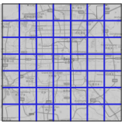
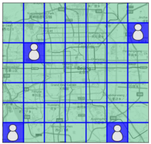
Our proposal: Correlation preserving location obfuscation (2)
62
62
22
27
22
27
31
?
36
31
36
27
22
27
22
55
55
62
55
55
62
36
31
?
36
31
Conjecture: the inherent data correlation required by CS for data recovery is the horizontal and vertical adjacency relations of non-zero elements in the sensory matrix.
Notes:
Our proposal achieve this goal with two fundamental techniques.
It is designed based a conjecture about

Slide 10
Our proposal: Correlation preserving location obfuscation (2)
62
62
22
27
22
27
31
?
36
31
36
27
22
27
22
55
55
62
55
55
62
36
31
?
36
31
How can the distributed participants cooperate with each other during obfuscation?
Notes:
How can we let participants in one row know that they are in one row? Doing this means
Also, how can we let them transform location to another row simultaneously? Doing this means

Slide 11
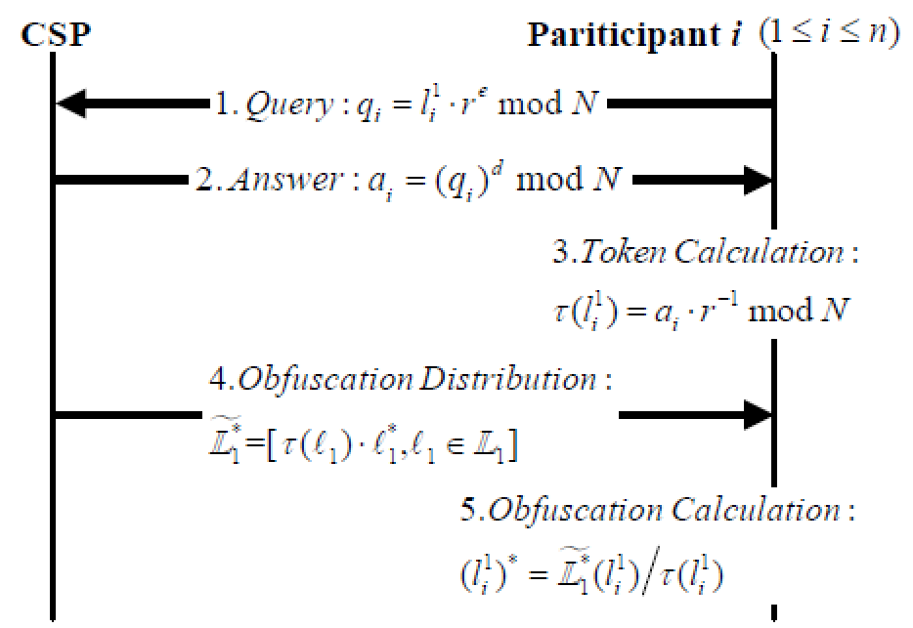
Our proposal: Correlation preserving location obfuscation (3)
Actual location
Random value
Crypto Service Provider
Ring Signature
Sign with its private key
Encryption of the obfuscated location
Obfuscated location
Notes:
In our work, we introduce ring signature technique to assign a unique token for each location.

Slide 12
Our proposal: Encrypted data recovery
Encrypting the sensory data to avoid location disclosure via inference attacks
Inference attacks: Using sensory data as quasi-identifier of ones’ location;
To Do: Designing an encryption approach that is homomorphic to compressive sensing based data recovery.
Secure computation based on two cryptographic primitives:
Additive homomorphic encryption (AHE) for the secure distribution of sensory data;
Integer vector homomorphic encryption (VHE) for compressive sensing operations on the ciphertexts.
Notes:
In addition to the obfuscation technique, we also propose an..
This is for that location can also be disclosed by using

Slide 13
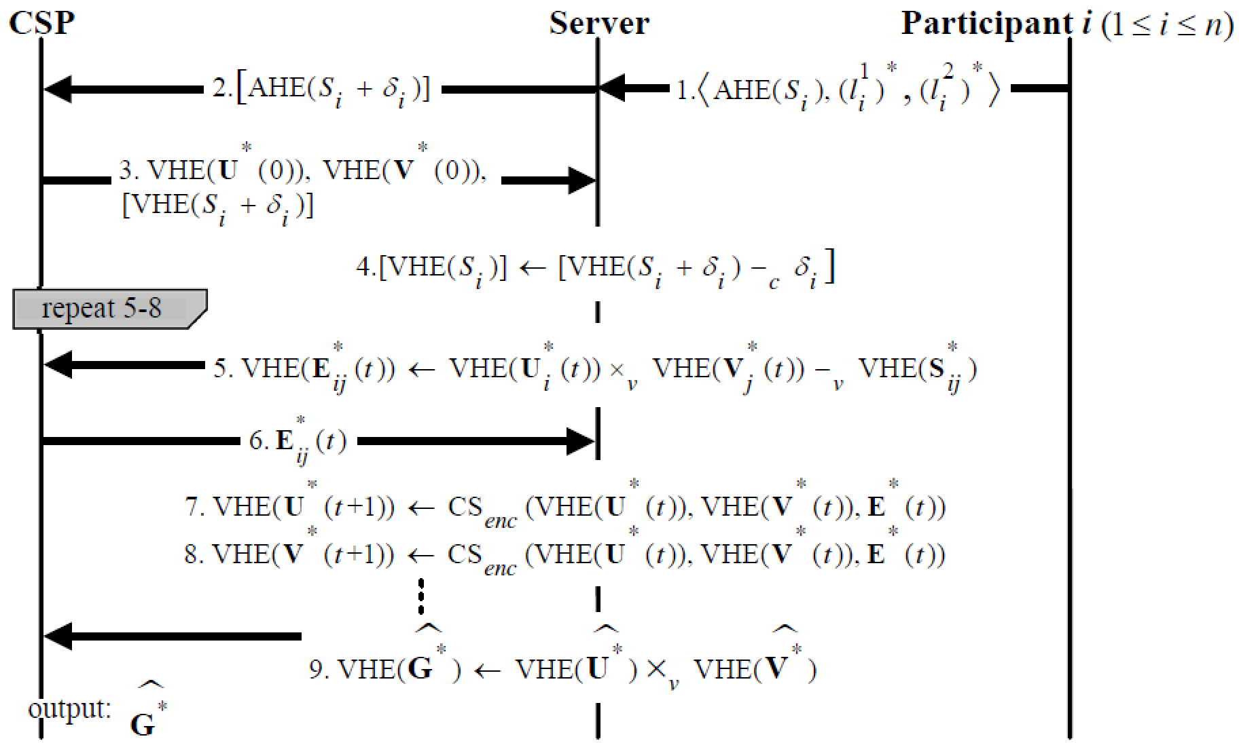
Our proposal: Encrypted data recovery
Constructing the VHE encryption for sensory data
Decomposing the CS process into 7 atomic vector operations;
Performing them based on VHE ciphertexts
Notes:
Because of the time limitation, we will not going into the details.

Slide 14
Evaluation
Datasets: Two real-world datasets taken from SensorScope^{[1]}.
Baseline: CS (compressive sensing), PPCS^{[2]}.
Metrics:
Recovery difference: differences between the data recovered by CS and privacy-preserving schemes;
Recovery error: differences between the real value of sensory data and the deduced value from the other data.
[1] François Ingelrest, Barrenetxea G, Schaefer G, et al. SensorScope: Application-specific sensor network for environmental monitoring[J]. ToSN, 2010, 6(2):1-32.
[2] Kong L, He L, Liu X Y, et al. Privacy-Preserving Compressive Sensing for Crowdsensing Based Trajectory Recovery[C]// ICDCS, 2015:31-40.

Slide 15
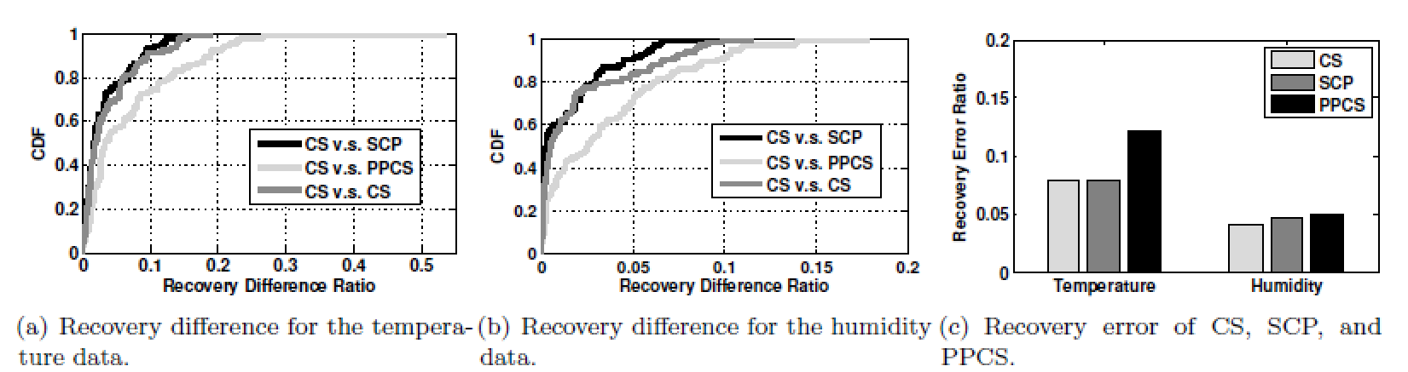
Evaluation: Some results

Slide 16
Thank you! zhoutongqing@nudt.edu.cn

Slide 17
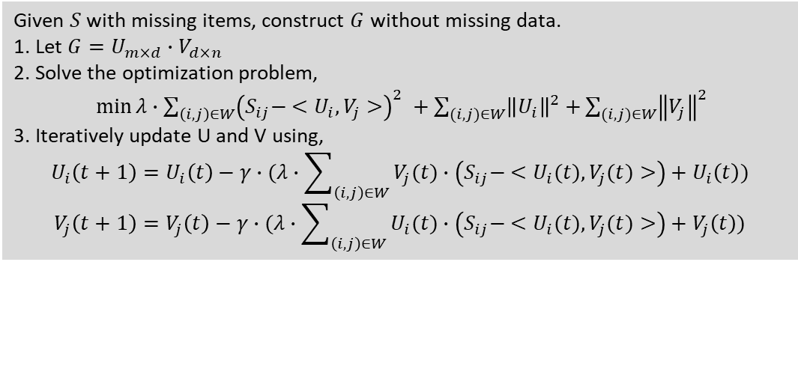
Backup: Conjecture on correlation preserving
Given $S$ with missing items, construct $G$ without missing data.
1. Let $G=U_{m×d}∙V_{d×n}$
2. Solve the optimization problem,
$\min{λ∙\sum_{\left(i,j\right)∈W}{{\left(S_{ij}− <U_{i},V_{j}>\right)}^{2} }+\sum_{(i,j)∈W}{{\left\|U_{i}\right\|}^{2}+}\sum_{(i,j)∈W}{{\left\|V_{j}\right\|}^{2}}}$
3. Iteratively update U and V using,
$$U_{i}\left(t+1\right)=U_{i}\left(t\right)−γ∙(λ∙\sum_{\left(i,j\right)∈W}{V_{j}(t)∙\left(S_{ij}− <U_{i}(t),V_{j}(t)>\right)}+U_{i}\left(t\right))$$
$$V_{j}\left(t+1\right)=V_{j}\left(t\right)−γ∙(λ∙\sum_{\left(i,j\right)∈W}{U_{i}(t)∙\left(S_{ij}− <U_{i}(t),V_{j}(t)>\right)}+V_{j}\left(t\right))$$
The process of compressive sensing (CS)
A conjecture on the inherent data correlation required by CS for data recovery:
the horizontal and vertical adjacency relations of non-zero elements in the sensory matrix
Preserving such correlation during obfuscation to maintain data recovery accuracy.

Slide 18
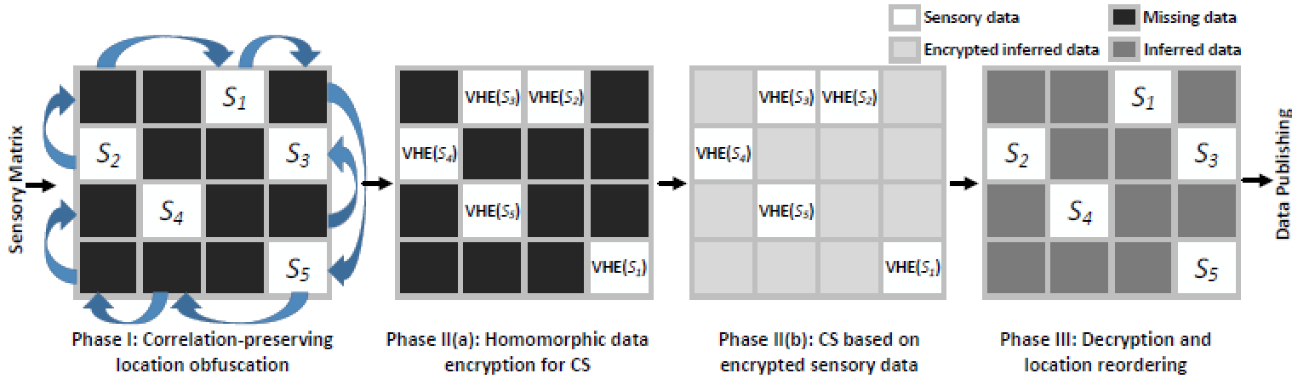
Backup: Putting it together

