Slide 1
Prediction of the Resource Consumption of Distributed Deep Learning Systems
Authors: Gyeongsik Yang, Changyong Shin, Jeunghwan Lee, Yeonho Yoo, and Chuck Yoo
Department of Computer Science and Engineering, Korea University, South Korea
Presenter: Dipak Acharya
HPC Seminar in Dept. of CSE at UNT on 10/12/2023
Gyeongsik Yang, Changyong Shin, Jeunghwan Lee, Yeonho Yoo, and Chuck Yoo. 2022. Prediction of the Resource Consumption of Distributed Deep Learning Systems. Proc. ACM Meas. Anal. Comput. Syst. 6, 2, Article 29 (June 2022), 25 pages. https://doi.org/10.1145/3530895

Slide 2
Background: Distributed Training (DT)
Gradients calculated by several workers is aggregated and applied to the entire model
Parameter server (PS) and all reduce
2 axes of complexities
01
GPUs
Parameter Servers
Same server GPUs or PCIe connected
40GbE or High speed RDMA
Training Settings
02
Models
Datasets
Hyperparameters
WorkLoads

Slide 3
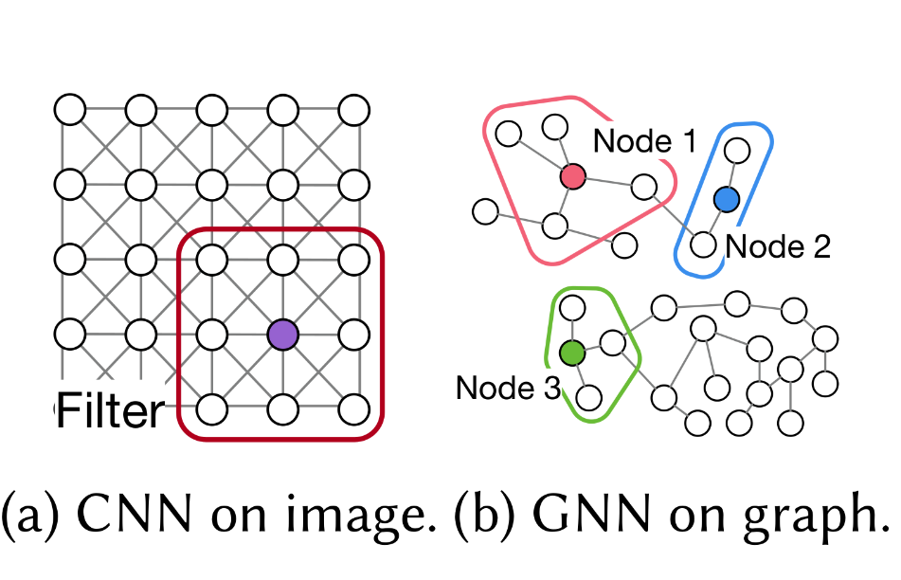
Background: Graph Neural Networks (GNN)
Node can have variable number of connections
Difficulty in neural network design
Solution:
Convert each node to fixed sized vectors (embeddings) using graph layers
Node embeddings aggregate information of neighbors within certain hops
By stacking n layers, we can aggregate information from n-hop neighbors
This n value is a GNN specific hyperparameter
To accommodate different node sizes, a fixed size vector (embedding) is created for graph
Use embeddings vector on traditional machine learning algorithm such as MLP

Slide 4
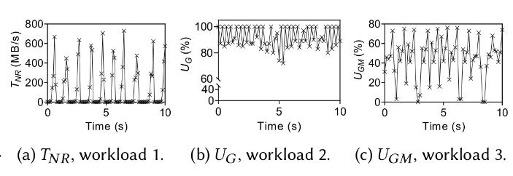
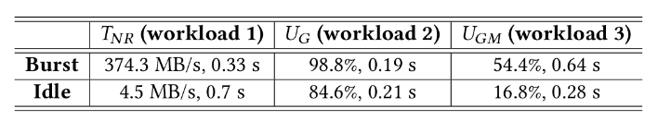
Motivating Example
Profiling resource consumption on 3 DT workloads
Each resource shows cyclic pattern of high and low consumption
4 key prediction resources were selected with 3 metrics (burst duration, idle duration and burst amount) for each
GPU utilization ( U_{G} )
GPU Memory Utilization ( U_{GM} )
Network Tx Throughput ( T_{NT} )
Network Rx Throughput ( T_{NR} )

Slide 5
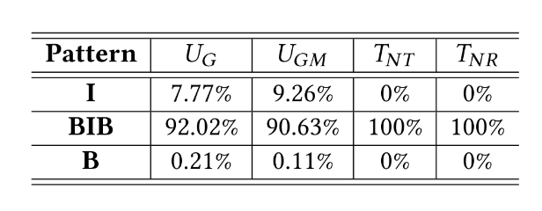
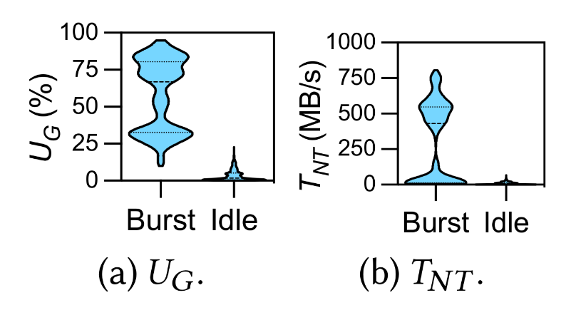
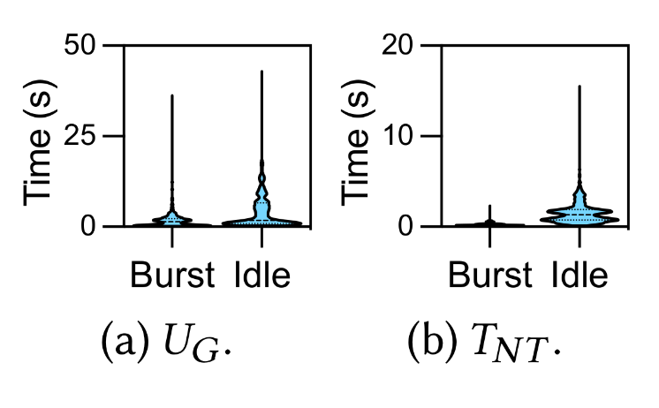
Motivation: Sensitivity to DT workloads
Workload = {model, dataset, hyperparameters}
Use clustering on profiled data to classify burst and idle data points
Most resources follow primarily BIB cyclic pattern (B: burst, I: idle)
Burst amount varies highly, Very sensitive to DT workloads
Idle amount varies relatively less
Both Burst duration and Idle duration have a high range for U_{G}
Burst duration is 88% shorter than Idle duration for T_{NT}
Burst duration is very sensitive for U_{G} and U_{GM}
Idle duration for sensitive for all types of resources

Slide 6
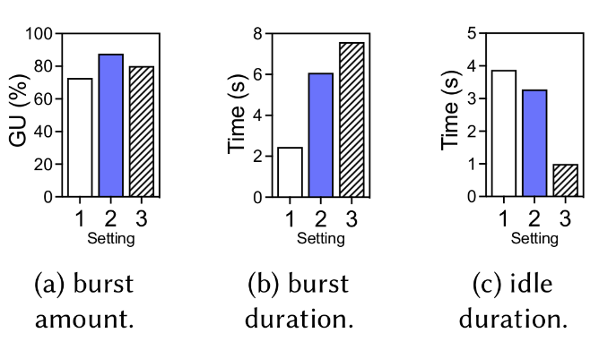
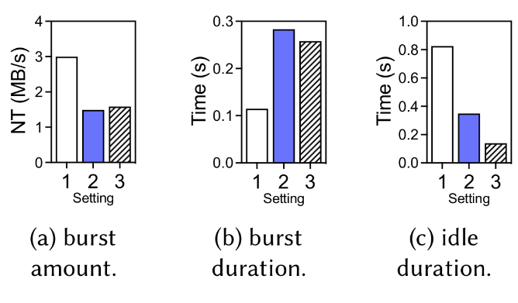
Motivation: Sensitivity to DT Settings
Settings = {GPUs, number of PS, workers, network Interconnections}
Three Settings tested on same workload (ResNet56 + CIFAR10, bs=512)
V100 - P1W2 / ho-PCIe
2080Ti - P2W2 / he-40G
Titan RTX - P2W2 / he-40G
Results show that resources are highly sensitivity to DT Settings

Slide 7
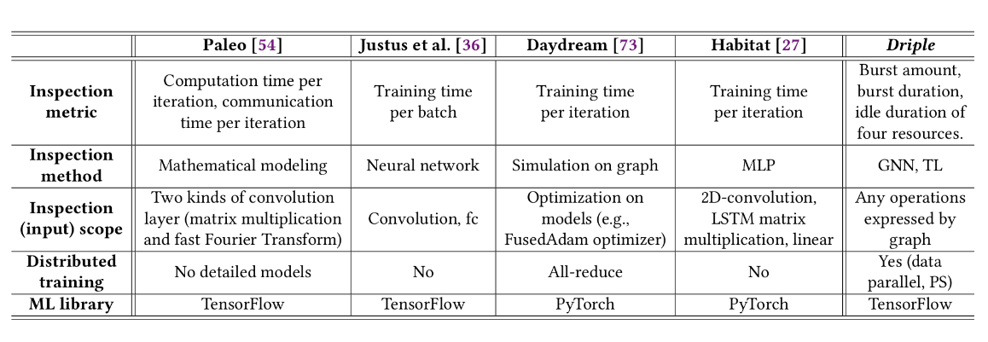
Related Work
Existing works:
Heavy focus on overall training time or iteration time, ignoring the actual resource utilization
Use of fixed size mathematical modeling, simulation or ML; limited prediction scope

Slide 8
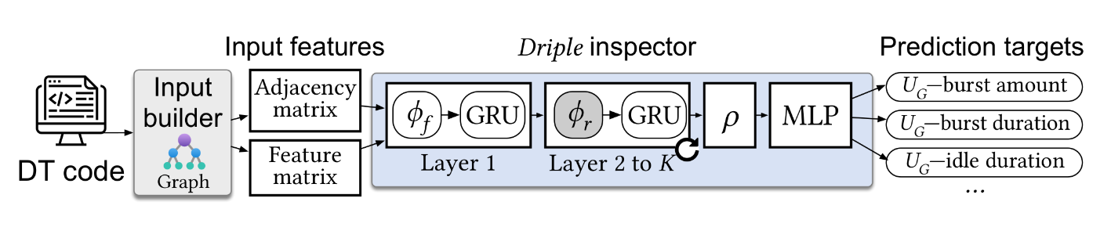
Driple Design
Input Builder
Driple Inspector

Slide 9
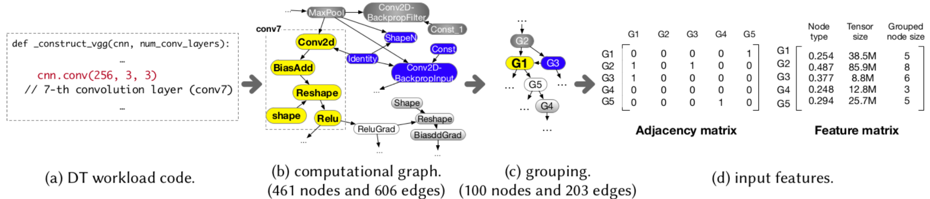
Input Builder
Notations: Graph = G(N, E), n_{i} ϵ (N), X_{n} is the features of node n, Ɲ( n_{i} ) is the immediate neighbourhood of node n_{i}
Each layer converted into low level operations, where operations become n in the Graph
Eg. ADD, MATMUL
Other components such as hyperparameters, constants, input data all become either node or edges of the graph
Edges from n_{i} to n_{j} = e_{ij} => Gives the execution order

Slide 10
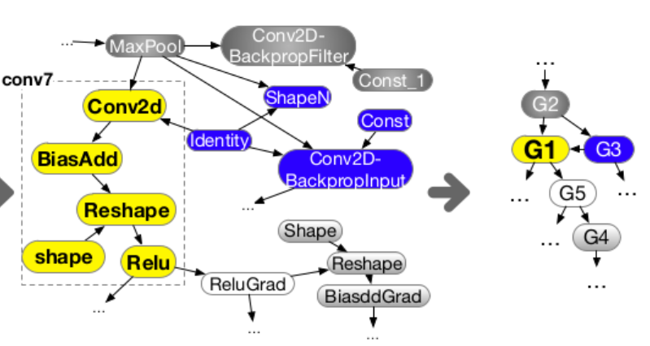
Input Builder: Grouping
A graph with m nodes is reduced into a graph of size M
Reduces the size of |N| and |E|;
Enables Batching (Batching requires all the graph in a batch having same number of nodes)
Uniform Grouping :
Same M for all batches
Proportional Grouping:
Sort the graphs based on m, then group by batch size
M = log₁₀v; v = average number of nodes in a batch
Grouping is done based on fluid Communities algorithm. Randomly selects M seed nodes and group remaining nodes around those

Slide 11
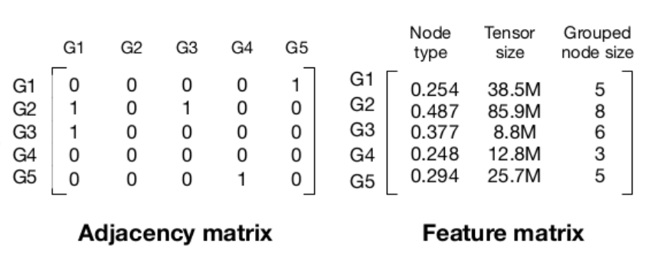
Input Builder (Cont.)
Features selected for X_{n} are:
Node type (frequency encoding)
Tensor Size
Grouped node size
Input features
Adjacency Matrix:
m x m matrix, m = |N|
Feature Matrix:
m x f matrix, f = |X_{n}|
X_{n} contains features, such as node type and tensor size.

Slide 12
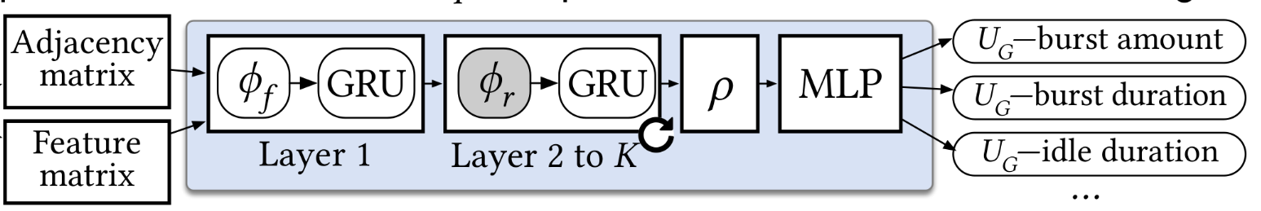

Driple Inspector
Graph Layers perform update function(𝜙)
First layer: 𝜙_{f}
Next Layers: 𝜙_{r} (Same weight/bias)
𝜙_{r} layers are repeated K times; K = m/2
Node embedding of node n_{i} for layer k is
Graph Convolutional Network (GCN), Uses normalized mean for aggregation update
Gated Recurrent Units (GRU) used after each graph layer, Reduces over-smoothing problem in deep neural networks

Slide 13

Driple Inspector (Cont.)
Graph Embedding (h_{Gl} ) for l^{th} graph in training data is produced by graph readout layer (ρ) after pooling
Set2set is used for pooling (Uses LSTM Neural Network)
MLP used on graph embeddings produced by ρ
3 Fully Connected Layers
12 Prediction targets for resources consumption metrics

Slide 14
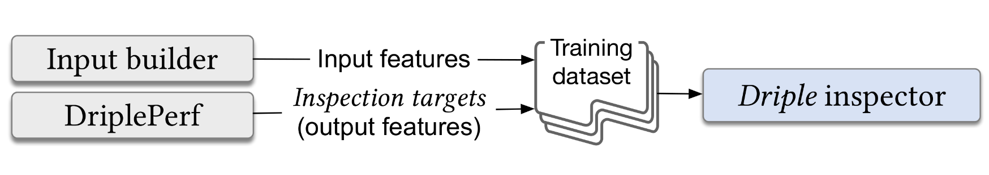
Training of Driple Inspector
Input builder generates the input features (graphs) for the inspector
DriplePerf generates the prediction targets for the data
Combining these two we can build the training data for Driple
DriplePerf: Measures the resource consumption by executing the DT code. Performs K means clustering to divide the data points into burst and idle points
The inspector is trained multiple iterations on the data produced by this way

Slide 15
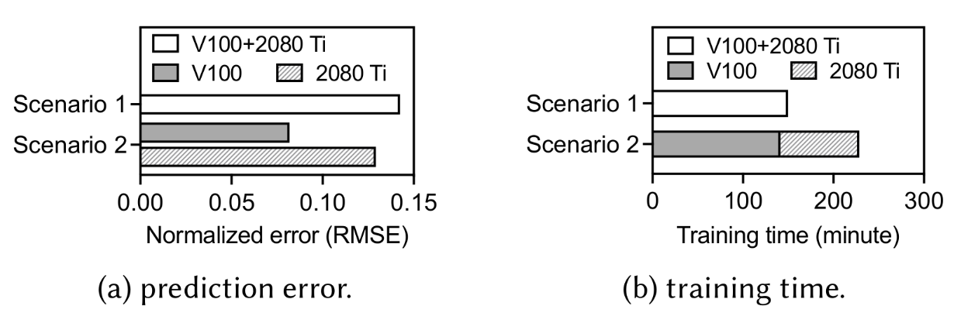
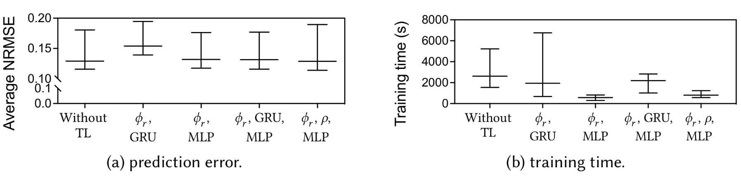
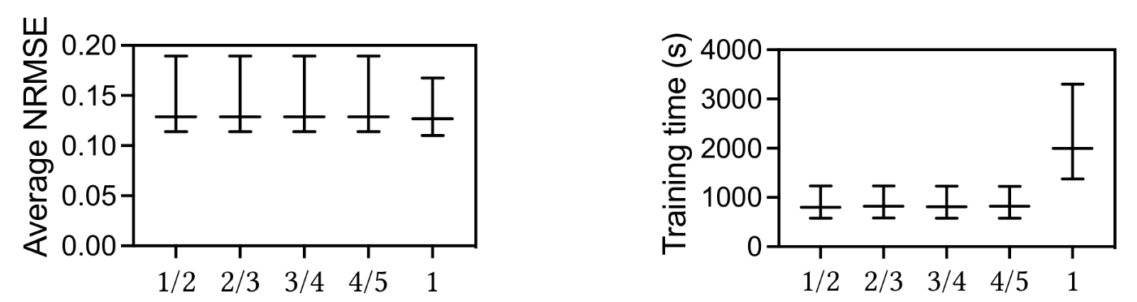
Transfer Learning (TL)
Common Inspector for different settings: low accuracy
Different inspector for each setting: High training time
Solution: Transfer Learning
Fine-Tuning TL:
(𝜙_{r} ,GRU) has lower accuracy compared to others, whereas (𝜙_{r} ,MLP) has lowest training time
So, (𝜙_{r} ,MLP) was selected for fine tuning
𝜙_{r} Partitioning:
𝜙_{r} Layers needs to be partitioned in layers that use pre trained inspector parameters and layers that update parameters on TL
By testing different ratios, it was selected to be ½

Slide 16
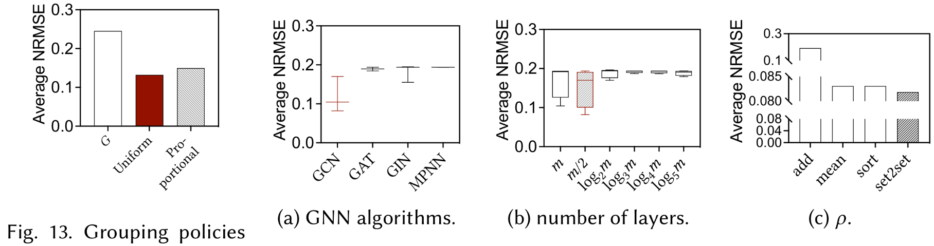
Evaluation: Design Choices of Driple
Metric Used: Normalized Root Mean Square Error (NRMSE) (average of 12 prediction targets)
Input builder(grouping): G(no grouping) has highest error, proportional has 46% lower, Uniform has 12 % lower
Inspector (GNN algorithm): GCN has the lowest average NRMSE
Inspector (K): Lowest average NRMSE given by m/2
Inspector (Readout Layer, ρ): Lowest average NRMSE given by set2set

Slide 17
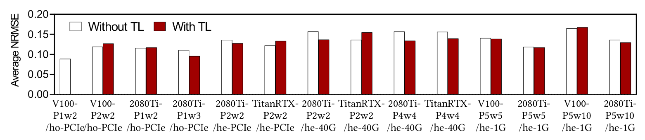
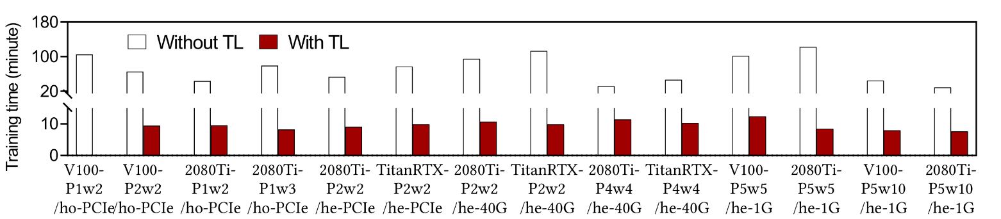
Evaluation: TL Effectiveness
TL on Inspector for V100-P1w2/ho-PCIe (Selected because it shows highest accuracy)
Average NRMSE is mostly similar or lower, Training time is highly reduced ( by 7.3X on average)

Slide 18
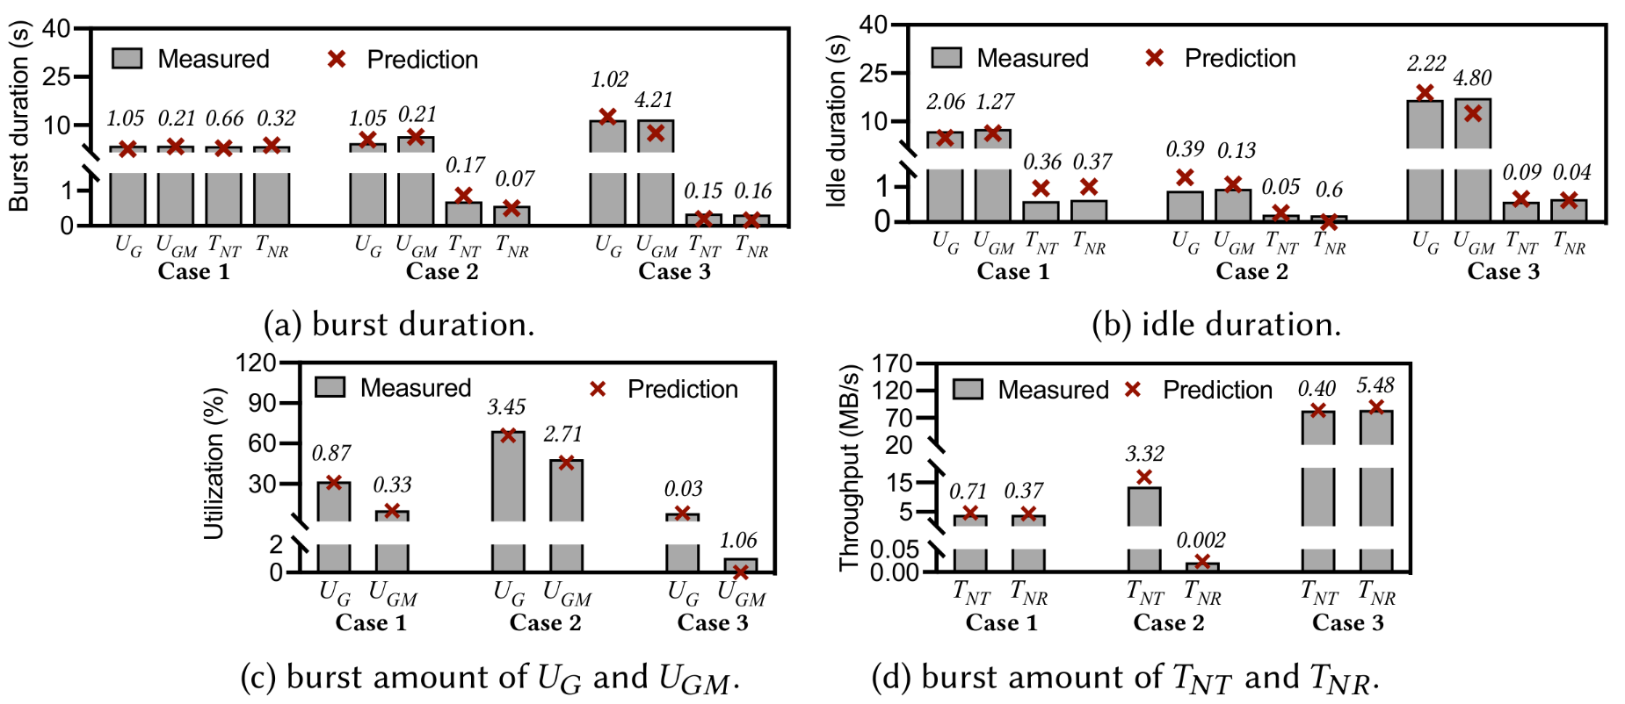
Evaluation: Prediction of Resource Consumption
On average, the percentage errors are 11%, 9%, 17%, and 15%, for 𝑈_{𝐺} , 𝑈_{𝐺𝑀} , 𝑇_{𝑁𝑇} , and 𝑇_{𝑁𝑅} , respectively.

Slide 19
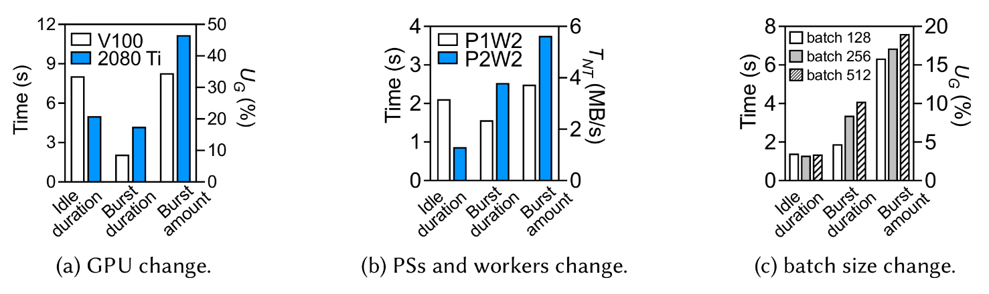
Evaluation: Applications of Driple
2080Ti has higher burst duration and lower idle duration, which means better U_{G} compared to V100
Increasing the parameter Server from 1 to 2 Increases burst duration and decreases idle duration, overall execution time stays the same
Observations for batch size change
Large Batch sizes can be handled
Increasing batch sizes increases execution time by lower factor, which implies using large batch size can reduce overall training time

Slide 20
Contributions
GNN for predicting resource consumption for deep learning using DT on variety of workloads and settings
Use 4 Key resources for prediction; For each resource, Driple predicts 3 metrics, burst amount, burst duration and idle duration
GPU utilization ( U_{G} )
GPU Memory Utilization ( U_{GM} )
Network Tx Throughput ( T_{NT} )
Network Rx Throughput ( T_{NR} )
Driple can achieve good prediction accuracy for resource consumption on variety of DT workloads and settings
Use of Transfer learning reduces the required dataset by up to 2.5X and training time by 7.3X while maintaining prediction accuracy of a model without transfer learning

Slide 21
Discussion
Use Driple on other DT strategies such as all reduce
Driple uses Tensorflow API for graph extraction, other libraries also use graph to store the model
Including resources of PS and workers other than U_{G} , U_{GM} , T_{NT} and T_{NR}
Node features to include
Reduce time for dataset generation
Boundary of TL

