Slide 1
Attention is All You Need: From Words to Worlds
Muhan Zhang
April 26, 2024, Group Seminar
University of North Texas

Slide 2


Slide 3
Outline
Background
Highlights of Transformer Model
Self-Attention and Multi-Head Attention
Model Architecture
Experimental Results
Summary

Slide 4
Background:
Sequence transduction models have traditionally relied on complex CNN or RNN architectures
CNNs have difficulty capturing long-range dependencies
RNNs suffer from limited computational parallelism and slow training
There is a need for more efficient and parallelizable models

Slide 5
Highlights of Transformer Model:
Entirely based on attention mechanism, without using convolution or recurrence
Highly parallelizable computation, allowing for very fast training
Surpasses previous models (including ensembles) on machine translation tasks
Generalizes well to other tasks such as English constituency parsing

Slide 6

Self-Attention and Multi-Head Attention:
FC
FC
FC
FC
with context
Self-attention
Notes:
https://arxiv.org/abs/1706.03762

Slide 7

FC
FC
FC
FC
Self-attention
FC
FC
FC
FC
Self-attention
https://arxiv.org/abs/1706.03762

Slide 8








Self-attention
$$b^{1}$$
$$b^{2}$$
$$b^{3}$$
$$b^{4}$$
$$a^{1}$$
$$a^{2}$$
$$a^{3}$$
$$a^{4}$$
Can be either input or a hidden layer

Slide 9

Self-attention
$$b^{1}$$
$$α$$
relevant?
$$a^{1}$$
$$a^{2}$$
$$a^{3}$$
$$a^{4}$$
Find the relevant vectors in a sequence

Slide 10








Self-attention
$$α$$
Additive
$$W$$
Dot-product
$$α$$
$$=q∙k$$
$$tanh$$
$$q$$
$$k$$
$$+$$
$$W^{q}$$
$$W^{k}$$
$$W^{q}$$
$$W^{k}$$

Slide 11














Self-attention
$$α_{1,2}=q^{1}∙k^{2}$$
$$α_{1,3}=q^{1}∙k^{3}$$
$$α_{1,4}=q^{1}∙k^{4}$$
attention score
$$α_{1,2}$$
$$α_{1,3}$$
$$α_{1,4}$$
$$q^{1}$$
query
$$k^{2}$$
key
$$k^{3}$$
$$k^{4}$$
$$a^{1}$$
$$a^{2}$$
$$a^{3}$$
$$a^{4}$$
$$q^{1}=W^{q}a^{1}$$
$$k^{2}=W^{k}a^{2}$$
$$k^{3}=W^{k}a^{3}$$
$$k^{4}=W^{k}a^{4}$$

Slide 12


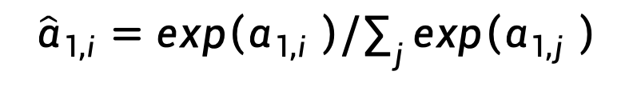





Self-attention
$${\hat{α}}_{1,i}=exp\left(α_{1,i} \right)/\sum_{j}{exp\left(α_{1,j} \right)}$$
$$α_{1,1}^{′}$$
$$α_{1,2}^{′}$$
$$α_{1,3}^{′}$$
$$α_{1,4}^{′}$$
Soft-max
$$α_{1,1}$$
$$α_{1,2}$$
$$α_{1,3}$$
$$α_{1,4}$$
$$q^{1}$$
$$k^{1}$$
$$k^{2}$$
$$k^{3}$$
$$k^{4}$$
$$a^{1}$$
$$a^{2}$$
$$a^{3}$$
$$a^{4}$$
$$q^{1}=W^{q}a^{1}$$
$$k^{2}=W^{k}a^{2}$$
$$k^{3}=W^{k}a^{3}$$
$$k^{4}=W^{k}a^{4}$$
$$k^{1}=W^{k}a^{1}$$

Slide 13

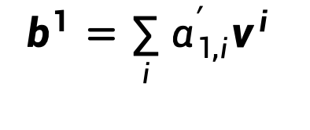







Self-attention
Extract information based on attention scores
$$b^{1}=\sum_{i}{α_{1,i}^{′}v^{i} }$$
$$b^{1}$$
$$α_{1,1}^{′}$$
$$α_{1,2}^{′}$$
$$α_{1,3}^{′}$$
$$α_{1,4}^{′}$$
$$q^{1}$$
$$k^{1}$$
$$v^{1}$$
$$k^{2}$$
$$v^{2}$$
$$k^{3}$$
$$v^{3}$$
$$k^{4}$$
$$v^{4}$$
$$a^{1}$$
$$a^{2}$$
$$a^{3}$$
$$a^{4}$$
$$v^{1}=W^{v}a^{1}$$
$$v^{2}=W^{v}a^{2}$$
$$v^{3}=W^{v}a^{3}$$
$$v^{4}=W^{v}a^{4}$$

Slide 14
Self-attention
parallel
$$b^{1}$$
$$b^{2}$$
$$b^{3}$$
$$b^{4}$$
$$a^{1}$$
$$a^{2}$$
$$a^{3}$$
$$a^{4}$$
Can be either input or a hidden layer

Slide 15
























Multi-head Self-attention
(2 heads as example)
$$q^{i,1}=W^{q,1}q^{i}$$
$$b^{i,1}$$
$$q^{i,2}=W^{q,2}q^{i}$$
$$q^{i,1}$$
$$q^{i,2}$$
$$k^{i,1}$$
$$k^{i,2}$$
$$v^{i,1}$$
$$v^{i,2}$$
$$q^{j,1}$$
$$q^{j,2}$$
$$k^{j,1}$$
$$k^{j,2}$$
$$v^{j,1}$$
$$v^{j,2}$$
$$q^{i}$$
$$k^{i}$$
$$v^{i}$$
$$q^{j}$$
$$k^{j}$$
$$v^{j}$$
$$q^{i}=W^{q}a^{i}$$
$$a^{i}$$
$$a^{j}$$

Slide 16

Multi-head Self-attention
(2 heads as example)
$$q^{i,1}=W^{q,1}q^{i}$$
$$b^{i,1}$$
$$q^{i,2}=W^{q,2}q^{i}$$
$$b^{i,2}$$
$$q^{i,1}$$
$$q^{i,2}$$
$$k^{i,1}$$
$$k^{i,2}$$
$$v^{i,1}$$
$$v^{i,2}$$
$$q^{j,1}$$
$$q^{j,2}$$
$$k^{j,1}$$
$$k^{j,2}$$
$$v^{j,1}$$
$$v^{j,2}$$
$$q^{i}$$
$$k^{i}$$
$$v^{i}$$
$$q^{j}$$
$$k^{j}$$
$$v^{j}$$
$$q^{i}=W^{q}a^{i}$$
$$a^{i}$$
$$a^{j}$$

Slide 17
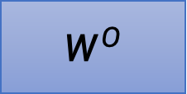

Multi-head Self-attention
(2 heads as example)
$$b^{i,1}$$
$$b^{i}$$
=
$$W^{O}$$
$$b^{i,2}$$
$$q^{i,1}$$
$$q^{i,2}$$
$$k^{i,1}$$
$$k^{i,2}$$
$$v^{i,1}$$
$$v^{i,2}$$
$$q^{j,1}$$
$$q^{j,2}$$
$$k^{j,1}$$
$$k^{j,2}$$
$$v^{j,1}$$
$$v^{j,2}$$
$$q^{i}$$
$$k^{i}$$
$$v^{i}$$
$$q^{j}$$
$$k^{j}$$
$$v^{j}$$
$$q^{i}=W^{q}a^{i}$$
$$a^{i}$$
$$a^{j}$$

Slide 18
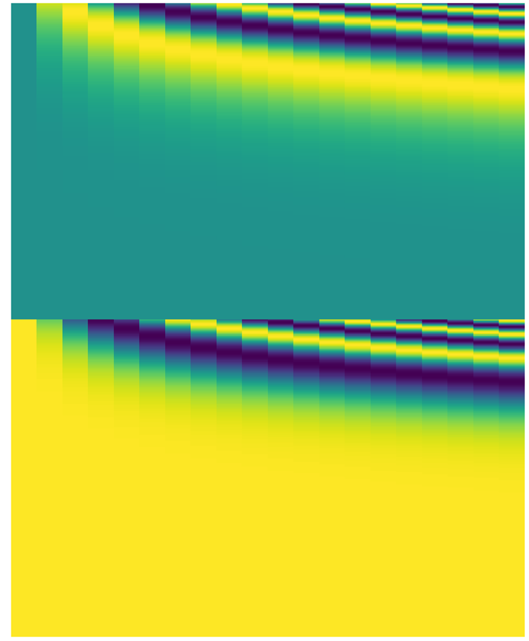

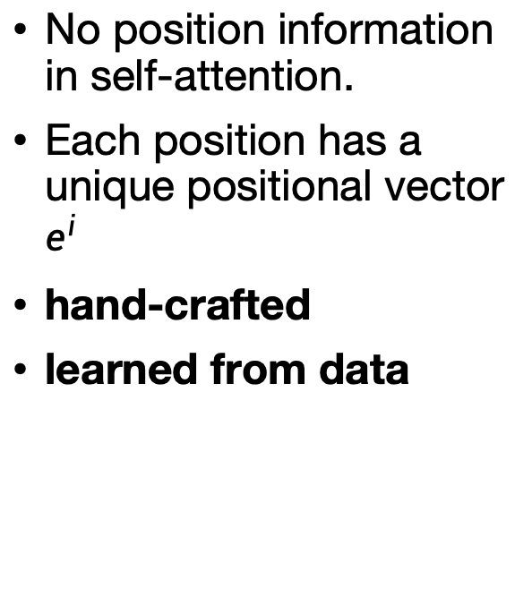
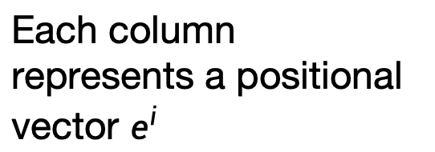
Positional Encoding
Each column represents a positional vector $e^{i}$
No position information in self-attention.
Each position has a unique positional vector $e^{i}$
hand-crafted
learned from data
$$q^{i}$$
$$k^{i}$$
$$v^{i}$$
$$e^{i}$$
+
$$a^{i}$$
-1
1

Slide 19
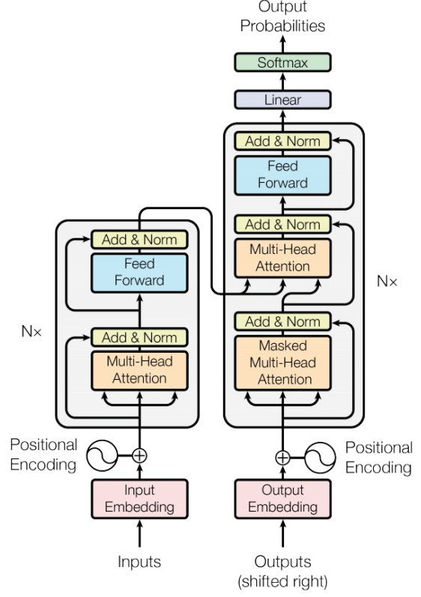
Model Architecture
output sequence
Encoder
Decoder
Input sequence
Sequence to Sequence Learning with Neural Networks
Transformer
https://arxiv.org/abs/1409.3215
https://arxiv.org/abs/1706.03762

Slide 20
Encoder
output sequence
Encoder
Decoder
Input sequence

Slide 21
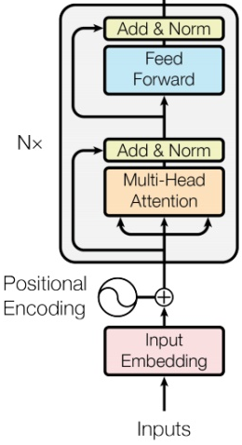








Encoder
Transformer’s Encoder
You can use RNN or CNN.
$$h^{1}$$
$$h^{2}$$
$$h^{3}$$
$$h^{4}$$
Encoder
$$x^{1}$$
$$x^{2}$$
$$x^{3}$$
$$x^{4}$$

Slide 22

$$h^{1}$$
$$h^{2}$$
$$h^{3}$$
$$h^{4}$$
Block
…
…
…
…
FC
FC
FC
FC
Block
Block
Self-attention
$$x^{1}$$
$$x^{2}$$
$$x^{3}$$
$$x^{4}$$

Slide 23




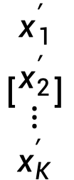



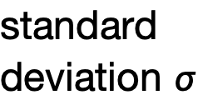
…
$$\left[\begin{aligned}x_{1}^{′} \\ x_{2}^{′} \\ ⋮ \\ x_{K}^{′}\end{aligned}\right]$$
$$x_{i}^{′}=\frac{x_{i}−m}{σ}$$
norm
Layer Norm
norm
norm
https://arxiv.org/abs/1607.06450
+
residual
$$a+b$$
$$\left[\begin{aligned}x_{1} \\ x_{2} \\ ⋮ \\ x_{K}\end{aligned}\right]$$
mean $m$
FC
standard deviation $σ$
$$b$$
+
$$a$$
Self-attention

Slide 24
$$h^{1}$$
$$h^{2}$$
$$h^{3}$$
$$h^{4}$$
Encoder
Residual
+ Layer norm
$$x^{1}$$
$$x^{2}$$
$$x^{3}$$
$$x^{4}$$

Slide 25
Decoder
output sequence
Encoder
Decoder
Input sequence

Slide 26

distribution
(Speech Recognition as example)
learn | 0.0
mach | 0.8
ine | 0.0
ing | 0.1
…… | ……
mach
Size V
max
(common characters)
softmax
Encoder
Decoder
( machine learning)
(special token)
START

Slide 27
mach
ine
learn
ing
max
max
max
max
Encoder
Decoder
(machine learning )
START
mach
ine
learn

Slide 28
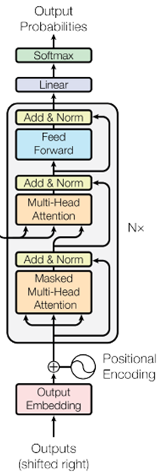
ignore the input from the encoder here
mach
ine
learn
ing
max
max
max
max
Decoder
START
mach
ine
learn

Slide 29
Encoder
Decoder

Slide 30
Self-attention
Masked Self-attention
$$b^{1}$$
$$b^{2}$$
$$b^{3}$$
$$b^{4}$$
$$a^{1}$$
$$a^{2}$$
$$a^{3}$$
$$a^{4}$$
Can be either input or a hidden layer

Slide 31







Self-attention
Masked Self-attention
$$b^{2}$$
$$α_{2,1}^{′}$$
$$α_{2,2}^{′}$$
$$α_{2,3}^{′}$$
$$α_{2,4}^{′}$$
$$q^{1}$$
$$k^{1}$$
$$v^{1}$$
$$q^{2}$$
$$k^{2}$$
$$v^{2}$$
$$q^{3}$$
$$k^{3}$$
$$v^{3}$$
$$q^{4}$$
$$k^{4}$$
$$v^{4}$$
$$a^{1}$$
$$a^{2}$$
$$a^{3}$$
$$a^{4}$$

Slide 32
distribution
Adding “Stop Token”
learn | 0.0
mach | 0.8
ine | 0.0
ing | 0.1
…… | ……
END | 0.0
Size V
(common characters)
softmax
Encoder
Decoder
(machine learning )
START

Slide 33
Autoregressive
Stop at here!
mach
ine
learn
ing
END
max
max
max
max
max
Encoder
Decoder
(machine learning )
START
mach
ine
learn
ing

Slide 34
Encoder-Decoder
output sequence
Encoder
Decoder
Input sequence

Slide 35
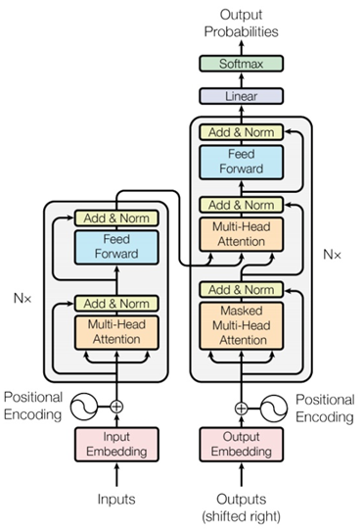
Transformer
Cross attention

Slide 36














FC
$$v$$
$$α_{1}^{′}$$
$$α_{2}^{′}$$
$$α_{3}^{′}$$
Cross attention
$$k^{1}$$
$$v^{1}$$
$$k^{2}$$
$$v^{2}$$
$$k^{3}$$
$$v^{3}$$
$$q$$
$$a^{1}$$
$$a^{2}$$
$$a^{3}$$
Encoder
Self-attention (Mask)
START

Slide 37


FC
$$v′$$
$$α_{1}^{′}$$
$$α_{2}^{′}$$
$$α_{3}^{′}$$
$$k^{1}$$
$$v^{1}$$
$$k^{2}$$
$$v^{2}$$
$$k^{3}$$
$$v^{3}$$
$$q′$$
$$a^{1}$$
$$a^{2}$$
$$a^{3}$$
Encoder
Self-attention (Mask)
START
mach

Slide 38
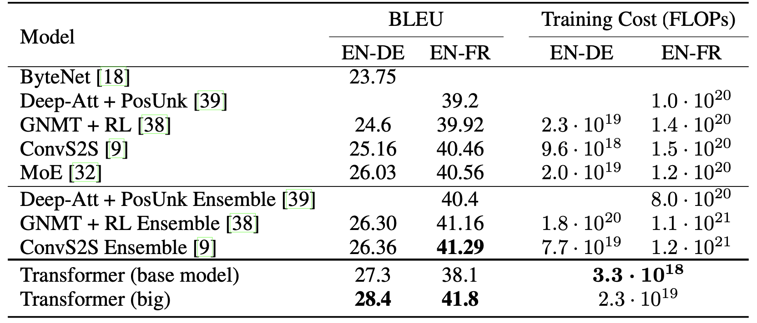
Experimental Results:
Machine Translation

Slide 39
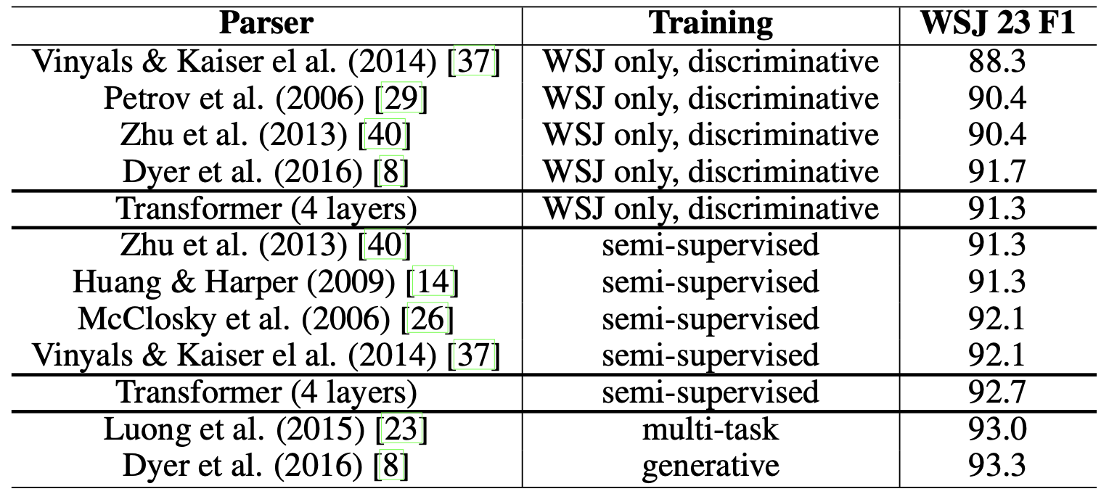
English Constituency Parsing

Slide 40
Summary:
The Transformer is the first sequence transduction model based entirely on self-attention
Strong parallel computing capability, extremely fast training speed
Achieves SOTA results on tasks like machine translation, demonstrating the power of attention mechanisms
Validates that attention is all you need to build efficient models

