Slide 1
When to Grow? A Fitting Risk-Aware Policy for Layer Growing in Deep Neural Networks
SPEAKER: NAGA SAI SIVANI, TUTIKA
AUTHOR: Haihang wu, wei wang, tamasha malepathirana, damith sanenayake, denny oetomo, saman halmuge
Notes:
Hello everyone! My name is Naga Sai Sivani, Tutika and I will be presenting this paper titles When to Grow? A Fitting Risk-Aware Policy for Layer Growing in Deep Neural Networks.

Slide 2
Agenda
Introduction
Background
Objectives
Neural Growth
Regularization effect of growth
When to Grow Policy
Experiments
Results
Ablation Study
Summary

Slide 3
Introduction
Deep Neural Networks (DNNs) have revolutionized computer vision, but training these large models is computationally intensive.
Neural growth - growing a small network into a larger one - offers a promising solution for efficient training.
While various aspects of neural growth have been studied, determining optimal growth timing remains largely unexplored.
This paper introduces FRAGrow: a novel approach that automatically determines growth timing based on model's fitting risk.
This method achieves up to 20% faster training while maintaining or improving accuracy compared to traditional approaches.
Notes:
DNNs are a subset of Artificial Neural Networks or ANN that have large architectures. They are widely used and require huge training data and are computationally intensive.
A solution to this problem can be Neural Growth. It offers a promising solution for efficient training.
The paper introduces FRAGrow policy, it’s a novel approach that automatically determines when to add layers and grow the model without overfitting or underfitting.
This method achieves up to 20% faster training without affecting accuracy and sometimes improving it.

Slide 4
Objective
This research makes three key contributions to the field of neural network growth:
First, it aims to demonstrate that neural growth has an inherent regularization effect on network training, and show how the strength of this regularization is directly controlled by the timing of growth.
Second, it proposes to develop a novel fitting risk-aware policy (FRAGrow) that can automatically adjust growth timing by evaluating the network's current fitting risks using the proposed overfitting risk level (ORL) metric.
Third, it seeks to create a growth strategy that maintains model accuracy across different scenarios, specifically addressing both overfitting and underfitting cases that challenge existing growth approaches.

Slide 5
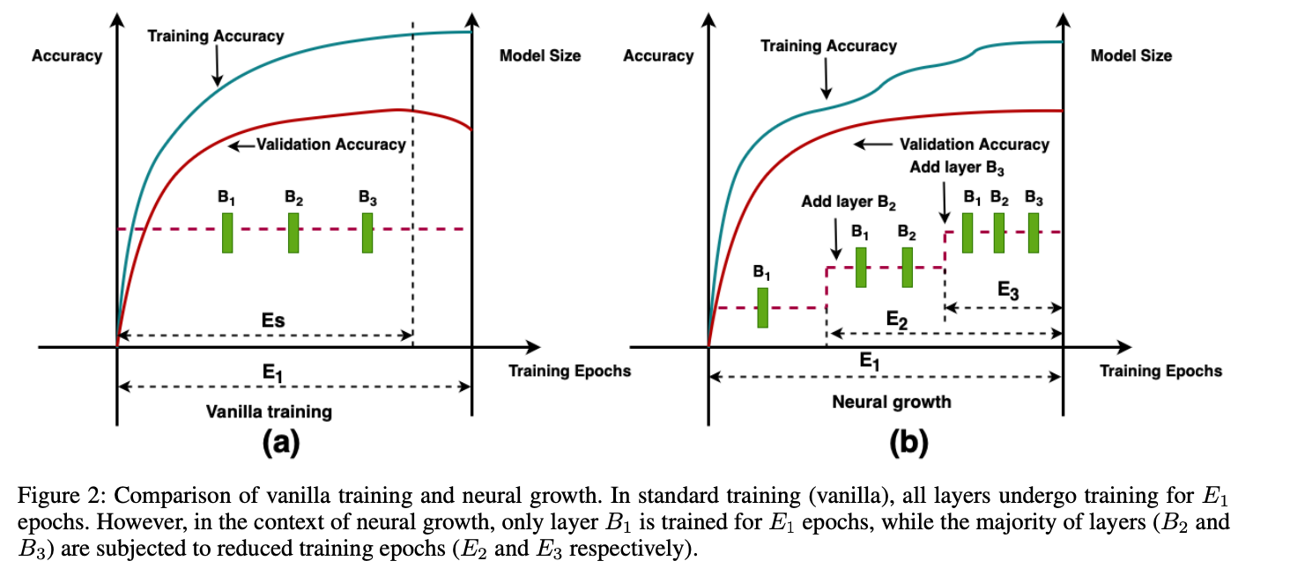
Neural Growth
What is neural growth? A process where a small neural network expands into a larger model, enhancing training efficiency.
How does it reduce training time? New layers (B2, B3) inherit weights from previous layers and require fewer epochs to converge, speeding up training.
Why does it cause a regularization effect? By training new layers for fewer epochs, neural growth reduces overfitting. It prevents noise memorization but may cause underfitting if growth is too slow, leading to decreased training accuracy while validation accuracy remains stable.

Slide 6
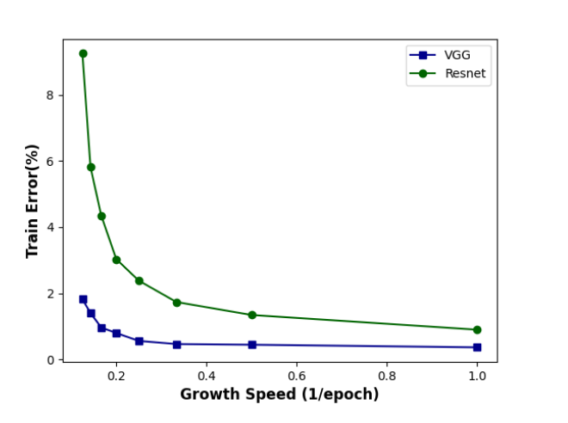
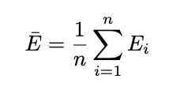
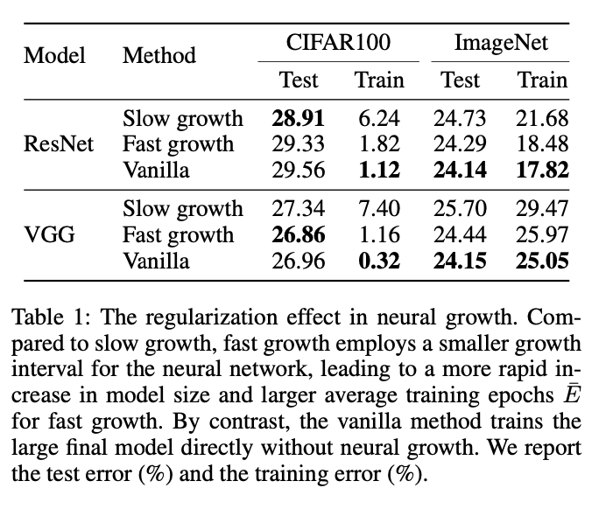
The Regularization Effect of Neural Growth
Neural growth-induced regularization strength is determined by the average training epochs Eˉ as given in following equation.
From the graph faster growth (larger Eˉ) weakens regularization, reducing training error, while slower growth (smaller Eˉ) strengthens regularization, increasing training error.
The same effect is seen in table1, where ResNet and VGG were trained with slow growth rate, fast growth rate and the standard method.
In overfitting scenarios (CIFAR100), neural growth improves test accuracy due to regularization. In underfitting scenarios (ImageNet), it harms performance by reducing the model's learning capability.
The regularization effect of neural growth helps mitigate overfitting but can worsen underfitting, highlighting the need for a balanced growth policy like FRAGrow.
Notes:
Let’s dive deeper into the regularization effect of neural growth.
How does regularization effect model’s performance.
Regularization is inversely propotional to the avg epochs (growth speed).
Faster growth rate – weakens regularization – reduces training error
Slower growth rate – strengthens regularization – increase training error
The experiment was done for slower growth rate, faster growth rate and standard method.

Slide 7
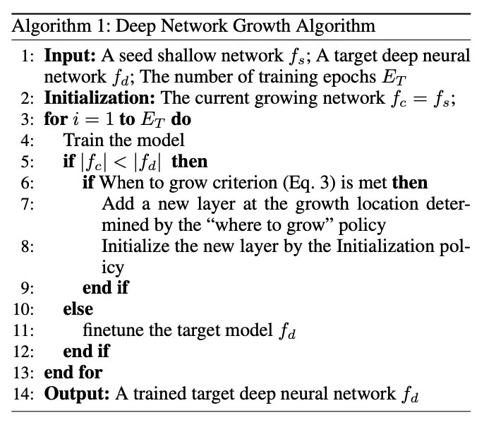

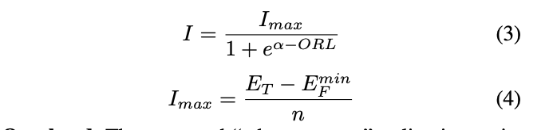
Proposed - When to Grow Policy
A “when to grow” policy determines the growth timing t1,...,tn for n added blocks, which in turn influences the average training epochs E ¯ and controls the regularization strength.
We use ORL to determine the risk of overfitting or underfitting.
Our algorithm appends network layers after the dynamic growth interval I specified by Equation 3 where Imax is the maximum allowed growth interval, and α is a hyperparameter.
High ORL indicates overfitting, while low ORL suggests underfitting.
The algorithm uses Eq 3 to decide when to grow a neural network. Handling the overfitting and underfitting problems.
Notes:
The proposed method also needs to consider when to grow.
And in this way we tried to build a fitting risk aware algorithm to decide when to grow a neural network.
ORL – Overfitting Risk Level
We use ORL, E bar for regularization, and alpha to determine when to grow.

Slide 8
Experiments - Datasets
Dataset | Classes | Training Images | Validation Images | Testing Images | Image Resolution
ImageNet | 1000 | 1.27 million | 10,000 | 50,000 | 224x224
CIFAR-10 | 10 | 49,500 | 500 | 10,000 | 32x32
CIFAR-100 | 100 | 49,500 | 500 | 10,000 | 32x32
Notes:
CIFAR - Canadian Institute for Advanced Research
ImageNet dataset contains 14,197,122 annotated images according to the WordNet hierarchy.

Slide 9
Experiments - Models
Model Type | Base Model (seed shallow network) | Architecture | Stages | Target Deep Model
Single-Branch | VGG-1-1-1-1-2 | VGGNet | 5 | VGG-2-2-4-4-4
Multi-Branch | ResNet-2-2-2-2 | ResNet | 4 | ResNet-8-8-8-8
Multi-Branch | MobileNetV2-1-1-1-1-1 | MobileNetV2 | 5 | MobileNetV2-2-3-4-3-3
Notes:
VGG → Visual Geometry Group
Named after the research group at the University of Oxford that developed the VGGNet architecture.
ResNet → Residual Network
Introduced by Microsoft Research, it uses residual connections (skip connections) to allow very deep networks to train effectively.
MobileNetV2 → Mobile Network Version 2
A lightweight deep learning model optimized for mobile and embedded devices, developed by Google.

Slide 10
Experiments – Growth Methods
Method | Description
Periodic Growth | Inserts new layers at fixed intervals of Imax.
Convergent Growth | Adds blocks only when accuracy stagnates.
LipGrow | Grows the model when the Lipschitz constant exceeds a threshold.
Proposed | FRAGrow model.
Notes:
Lipgrow (Dong et al. 2020) grows the model when the
Lipschitz constant of the model exceeds a threshold value
LipGrow (short for Lipschitz-based Growth) is a dynamic neural network expansion strategy that ensures stable training while progressively growing a network. It does this by controlling the Lipschitz constant of the network, which helps regulate gradient magnitudes and prevent instability during growth.
Lipschitz Constant Control:
The Lipschitz constant measures how much a function's output changes with respect to its input.
If a neural network has a high Lipschitz constant, small changes in input can cause large, unstable variations in output (exploding gradients).
LipGrow ensures that when adding new layers or neurons, the Lipschitz constant remains bounded, preventing drastic changes in feature representations.

Slide 11
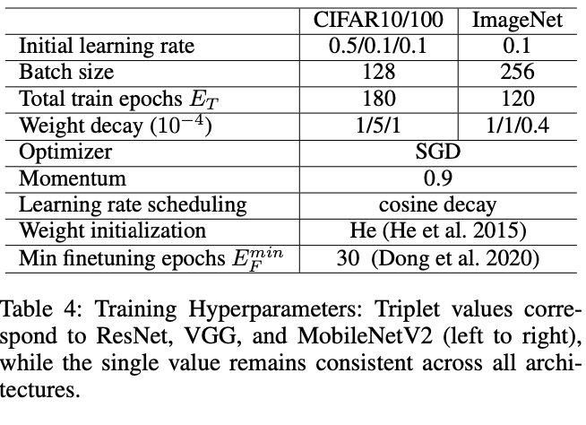
Experiments – Hyperparameters Used
Learning Rate
Two learning rates were investigated: constant large learning rate and cosine annealing with restart.
Constant large learning rate was selected as it outperformed cosine annealing.

Slide 12
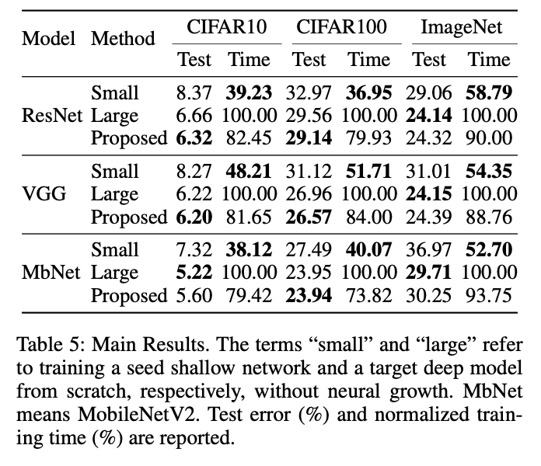
Results – small, large & proposed
First experiment, we compared neural growth method with traditional methods that train small or large models directly, results are in Table 5
Proposed model shows comparable accuracy to large models while requiring less training time.
On CIFAR10/100, neural growth improves test error by ~0.3% for ResNet and VGG while reducing training time by ~20%, due to its regularization effect on overfitting models like VGG-2-2-4-4-4 and ResNet-8-8-8-8.
On ImageNet, the method results in a minor accuracy drop (~0.32%) but still saves ~10% training time compared to directly training large models.
CIFAR10/100 benefits more from time savings than ImageNet because the method automatically adjusts growth speed—slower for overfitted datasets (CIFAR10/100) and faster for underfitted datasets (ImageNet), maximizing efficiency.

Slide 13
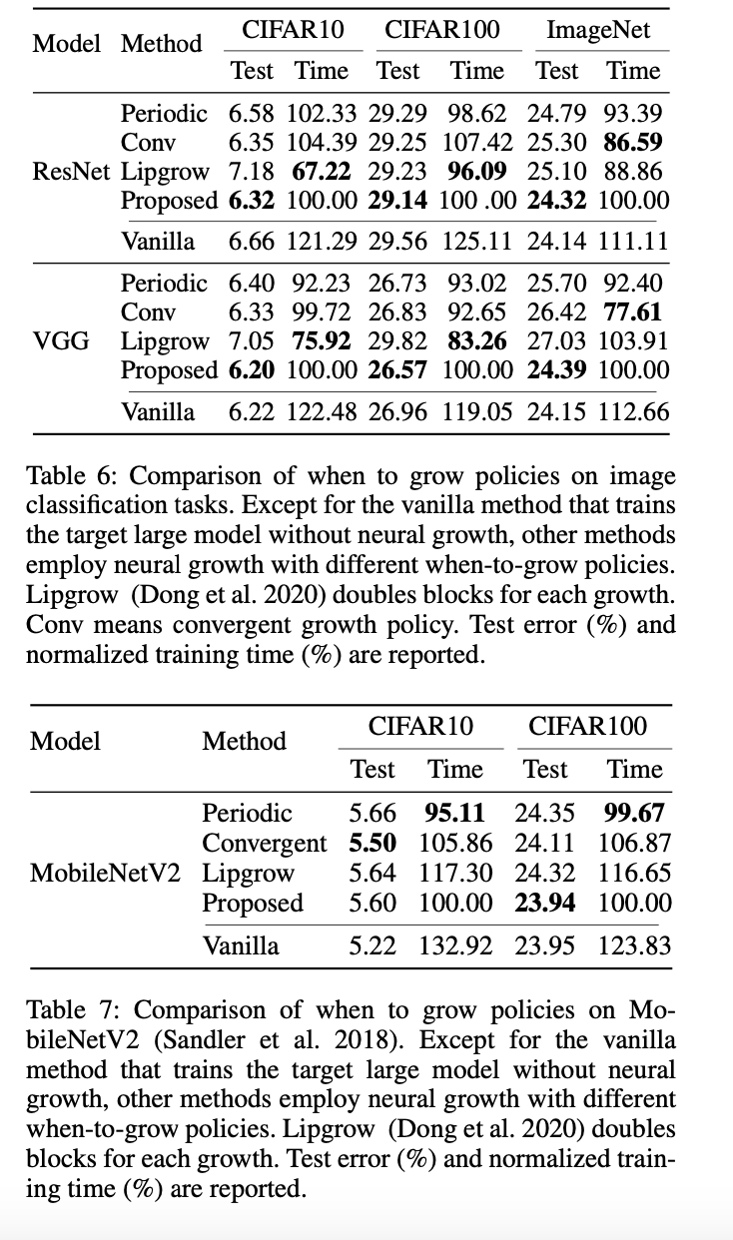
Results – Periodic, Convergent, LipGrow
In the next experiment, we compare our proposed model with three baseline methods: periodic, convergent, and LipGrow, along with the vanilla method. The results are shown in Table 6 and Table 7.
On the overfitting CIFAR-10/100 dataset, all methods except LipGrow (Dong et al., 2020) achieve similar accuracy with the target model, indicating balanced growth speed and regularization.
The proposed method outperforms periodic growth by 0.47% for ResNet and 1.31% for VGG on ImageNet due to its adaptive growth speed, reducing excessive regularization.
Periodic and convergent growth are too slow for ImageNet, leading to underfitting and lower accuracy, while faster growth is crucial for VGG due to its higher underfitting risk.
However, our method requires longer training time than periodic growth, as the growth interval never exceeds that of periodic growth, resulting in faster growth but less time saved overall.
In conclusion, the proposed method outperformed for CIFAR 10/100 datasets for VGG and ResNet. It didn’t beat other methods in training time but did give better accuracy in most cases.
Notes:
Next, we experimented with different baseline methods of when to grow.
Proposed model outperformed all methods in test error. But didn’t beat time.
In all scenarios it beat the original one.
In conclusion, the proposed method outperformed for CIFAR 10/100 datasets for VGG and ResNet. It didn’t beat other methods in training time but did give better accuracy in most cases.

Slide 14
Ablation Study
How does the choice of hyperparameters impact the performance of FRAGrow?
How robust is our growth timing policy to growth order and initialization of new layers of neural growth?

Slide 15
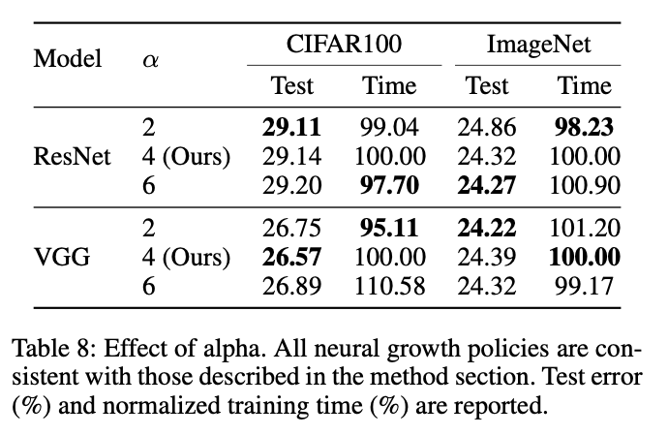
Effect of Hyperparameter ⍺
α in Equation 3 controls the growth interval, affecting training speed and regularization strength.
Reducing α from 6 to 2 caused accuracy drops (~0.6%) on ImageNet (ResNet) due to slower growth and stronger regularization, which negatively impacts underfitting datasets.
Smaller α values improve training efficiency by reducing computation time, as observed with VGG on CIFAR100.
An optimal α balances accuracy and efficiency, with α = 4 performing best across datasets.

Slide 16
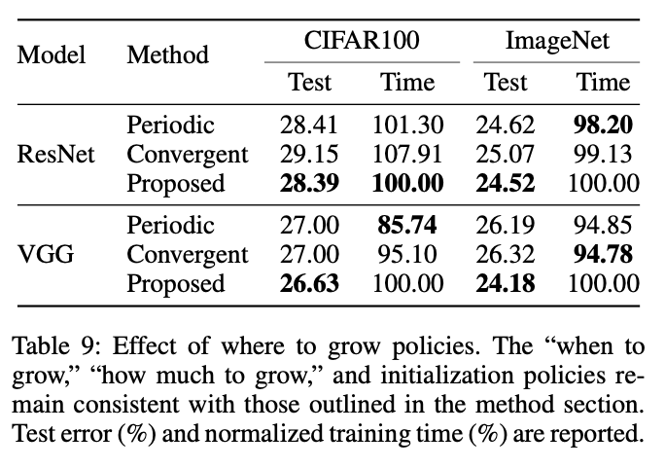
Effect of Growth Order
Replaces layer-wise growth with circulation growth (Wen et al. 2020), where new blocks are added as stages are visited.
Demonstrates robustness to growth order, achieving comparable or higher accuracy than baseline methods.
This method improves VGG accuracy by ~2% on underfitting ImageNet.
Although accuracy improved, the training time is slightly more than other methods.
Notes:
Circulation Growth Strategy (Wen et al., 2020)
Instead of expanding layers in a predefined order (like periodic growth), circulation growth iterates over different stages of the network and adds new layers dynamically.
This means that growth is distributed across the network instead of being confined to certain blocks first.

Slide 17
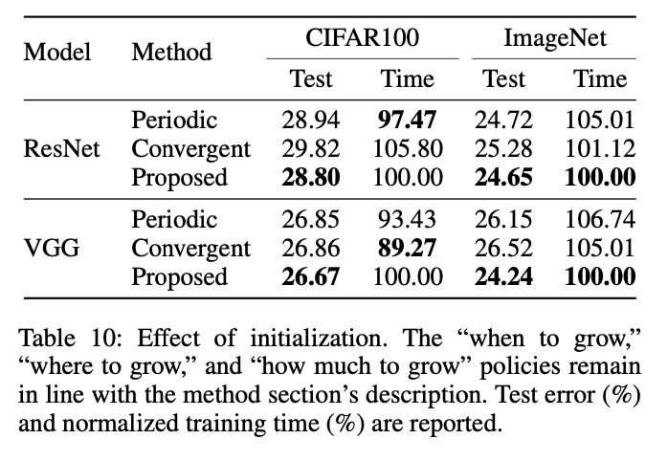
Effect of Initialization
To evaluate the influence of initialization, they used Moment growth (Li et al. 2022), it is a weight initialization strategy for expanding neural networks by copying weights from preceding layers and using historical moving averages. Ensuring smooth training.
While it performs similarly to baseline methods on CIFAR-100, it achieves ~1% higher accuracy on the underfitting ImageNet dataset.
Despite the added computational overhead from tracking weight averages, the faster model expansion on ImageNet offsets this, leading to slightly reduced training time.
Notes:
It increased the accuracy but not the training time always.

Slide 18
Summary
Conclusion
Neural growth introduces a regularization effect, which can be controlled by growth timing.
FRAGrow dynamically adjusts growth timing to address underfitting and overfitting risks.
And achieves superior accuracy on underfitting-prone models while maintaining performance on overfitting-prone models.
Future Scope
Extend FRAGrow to other vision tasks (e.g., dense prediction tasks).
Improve training efficiency for larger-scale models.

Slide 19
Thank you!

