Slide 1
Large Language Models for Anomaly Detection in
Computational Workflows: From Supervised
Fine-Tuning to In-Context Learning
Hongwei Jin, George Papadimitriou, Krishnan Raghavan, Pawel Zuk, Prasanna Balaprakash, Cong Wang, Anirban Mandal, Ewa Deelman
​
Presenter:
Sushil Raj Regmi
University of North Texas

Slide 2
Anomaly Detection in computational workflows
Anomalies arise due to high usage of computing resources, memory consumption and I/O operations
Traditional methods for anomaly detection:
Rule based systems ( Threshold-Based detection, Heuristics, Conditional logic)
Statistical Analysis ( Z-Score Analysis, IQR, Moving Average, Chi-Square Test)
Machine learning ( Autoencoders, Isolation Forest, PCA, Random Forest, LSTM)

Slide 3
Anomaly Detection in computational workflows
Limitations of Traditional Anomaly Detection Methods
Extensive Data Preprocessing requirements
Dependency on Expert Knowledge
Complexity of Machine Learning Techniques
ML model deployment and maintenance

Slide 4
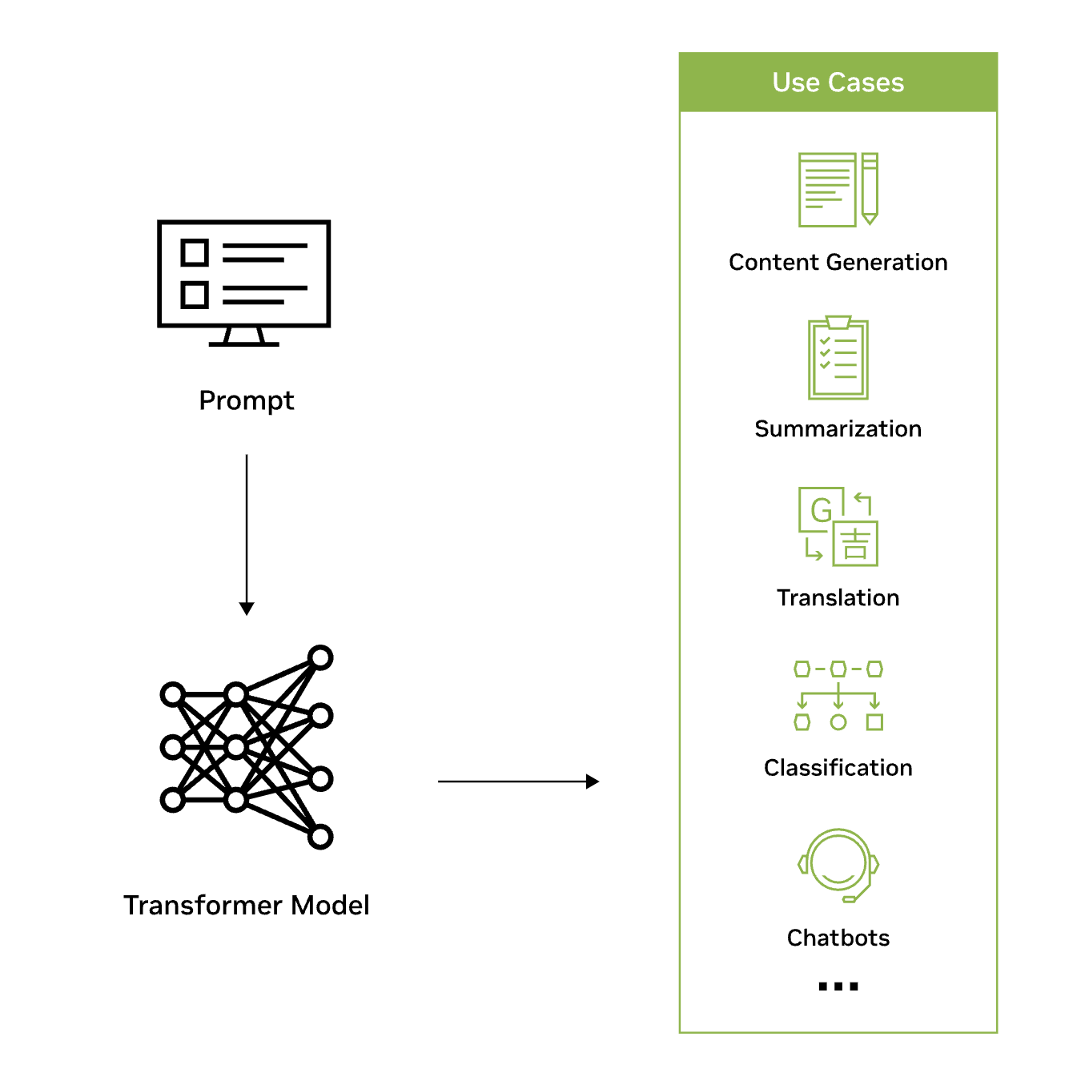
Large Language Models for Anomaly Detection
Large language models (LLMs) are deep learning algorithms (transformer networks) that can recognize, summarize, translate, predict, and generate content using very large datasets.
Benefits of using LLMs for AD:
Streamlined data preprocessing
Simplifying deployment of ML models
Real-time monitoring
Reduce the need for extensive expert knowledge

Slide 5
Large Language Models for Anomaly Detection
Use of pretrained LLMs to detect anomalies from log files generated during the execution of computational workflows.
pretrained LLM models – neural networks trained on massive text corpora to understand and generate human-like languages (eg. GPT, BERT)
https://huggingface.co/docs/transformers/index
Use of pretrained models in two way:
Supervised fine tuning(SFT)
In-context learning (ICL)

Slide 6
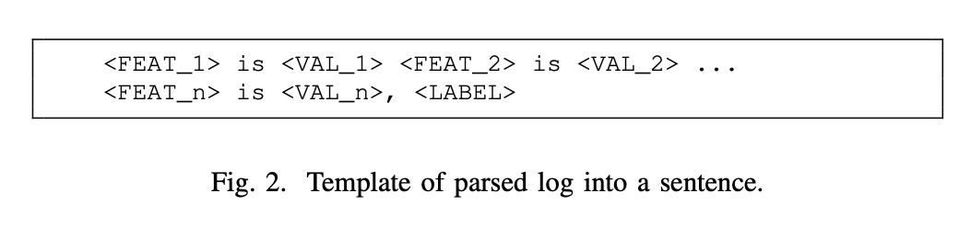
Large Language Models for Anomaly Detection
Supervised Fine-Tuning
Adapts pretrained language models to specific tasks or domain
Involves training on a smaller, labeled dataset specific to the target task
Adjust the model's parameters to optimize performance on new task
Application in Anomaly Detection
Logs from computational workflows are treated as sequence of sentences
Fine-tuned models classify each sentence as "normal" or "anomalous"

Slide 7
Large Language Models for Anomaly Detection
In-context Learning
LLMs perform tasks by leveraging examples provided in the query context
Relies on prompt engineering instead of supervised fine-tuning
Prompts includes task description, examples, and contextual cues to guide the model's output
Useful in a scenario with scarce labeled data or for improving model generalization
Application in Anomaly Detection
Prompt include job features, brief statistics, and labeled examples (e.g., normal or anomalous jobs)
Techniques
Zero-Shot prompts: Task description only, no examples
One-Shot prompts: Task description with a single example
Few-Shot prompts: Task description with a few examples

Slide 8
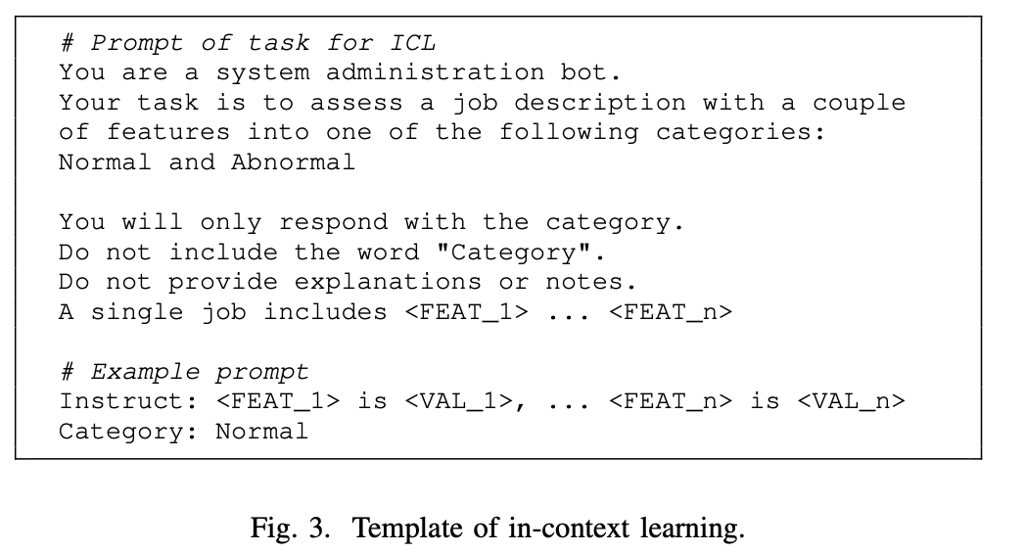
Large Language Models for Anomaly Detection
In-context Learning

Slide 9
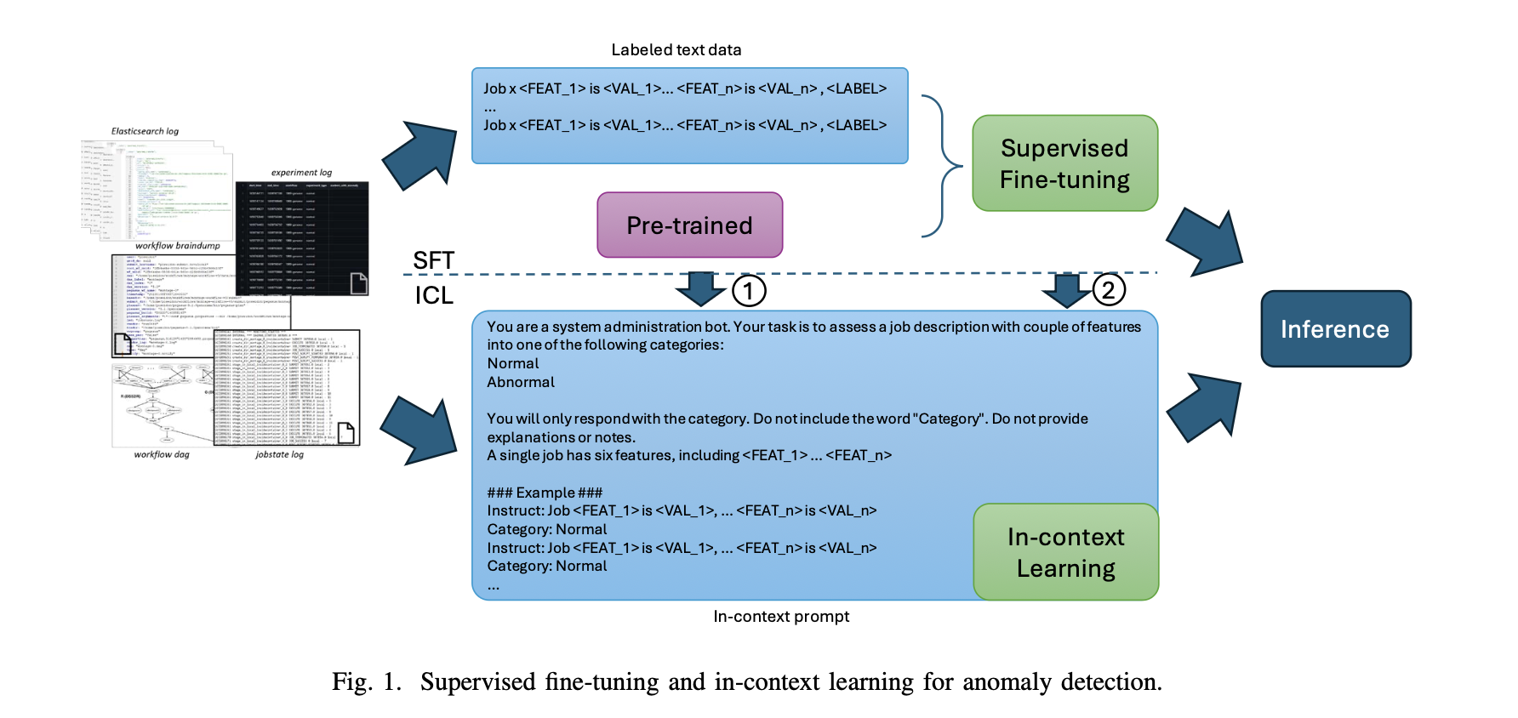
Large Language Models for Anomaly Detection

Slide 10
EXPERIMENT

Slide 11
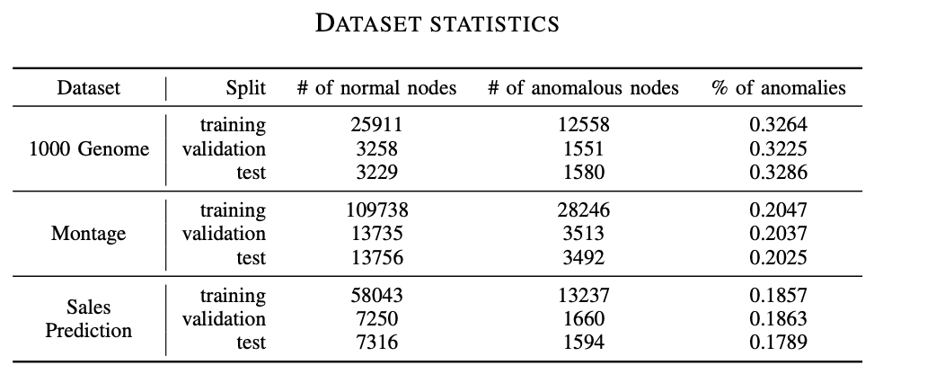
Experiment
Dataset:
Flowbench, a collection of three computational workflows for anomaly detection
1000-Genome Workflow
Montage Workflow
Predict Future Sales Workflow
Data Preprocessing:
Logs converted into tabular format
Each row represent log entry
Column consists of fields llike timestamps, job status, time duration, I/O operations

Slide 12
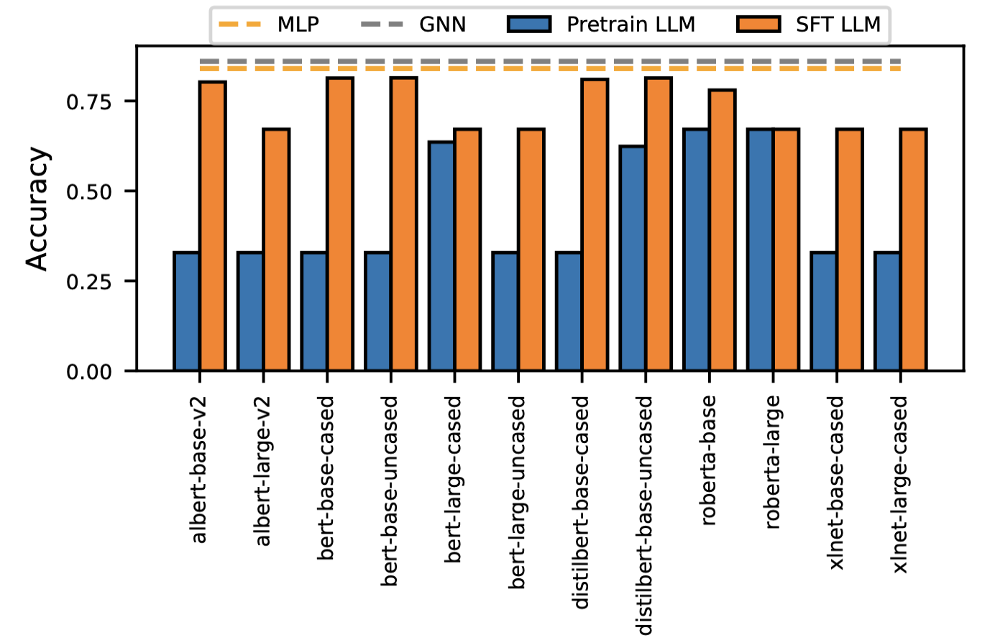
Experiment: SFT Models
Accuracy comparison after supervised fine tuining on each pretrained LLM models.
SFT models outperform pretrained models and the performance is comparable to ML models.

Slide 13
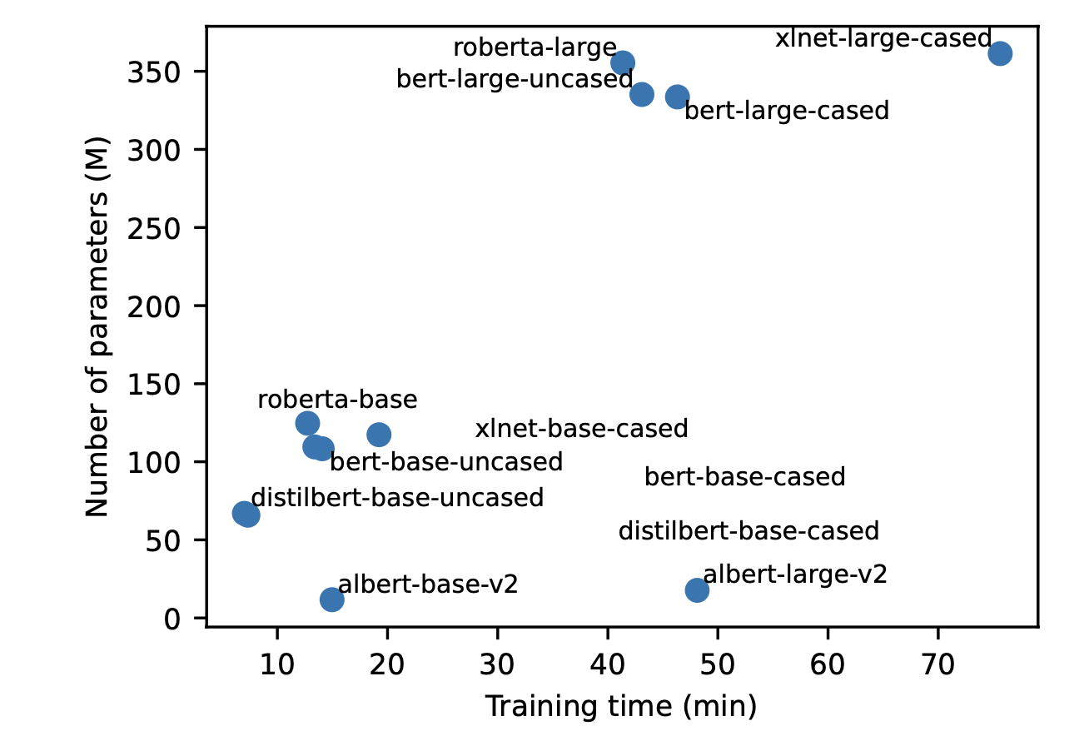
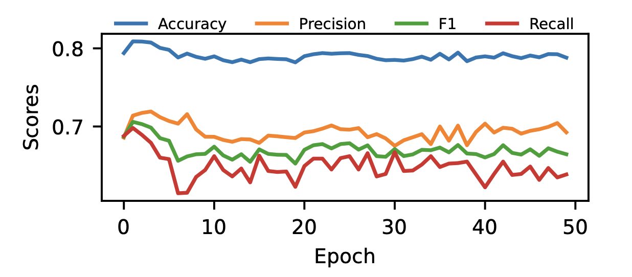
Experiment: SFT Models
Relationship between model size and performance
Training time per epoch = 260 seconds
Performance of SFT models does not necessarily increase with number of parameters

Slide 14
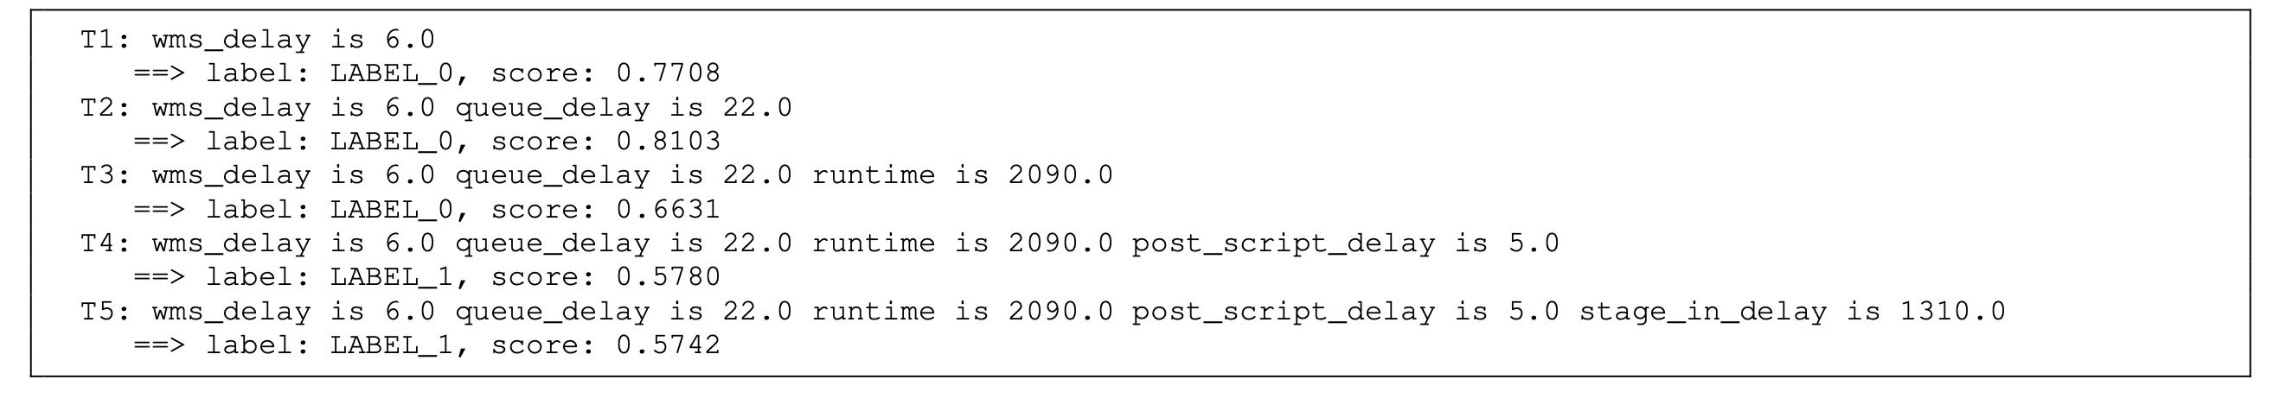
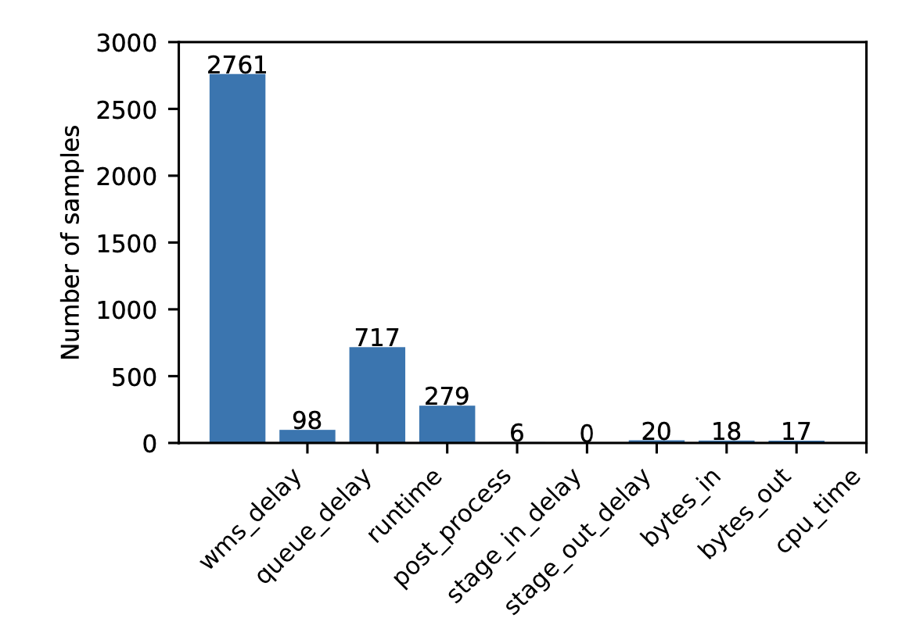
Experiment: Online Detection
Identifying system failures in real time
Early Detection
Checking the first time model predicts a correct label for job
SFT models can detect anomalies at the early stages of a job

Slide 15
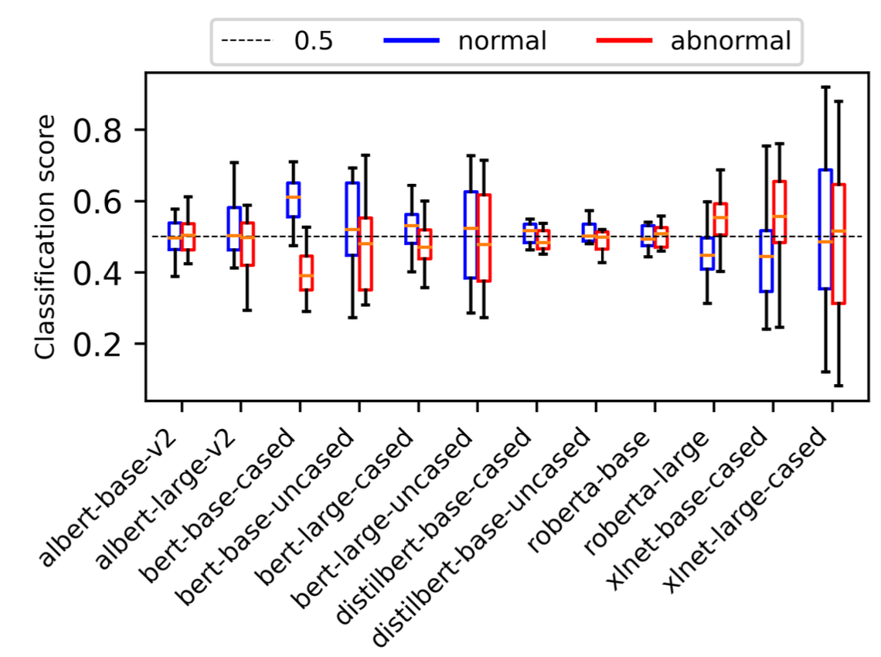
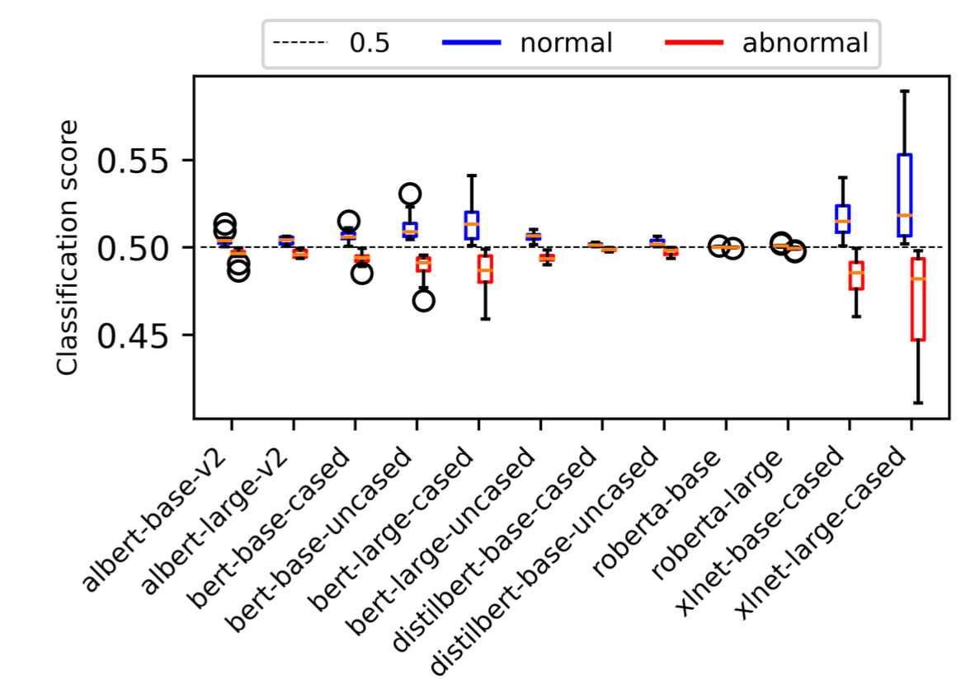
Experiment: Debiasing LLMs
Source of bias in SFT: Pretrained LLM itself, dataset utilized for fine-tuning
Ideally, for empty sentence, the model should predict normal and abnormal jobs with almost equal probability
Data Augmentation
Prediction is biased either toward normal or anomalous
Gap between normal and anomalous prediction is reduced

Slide 16
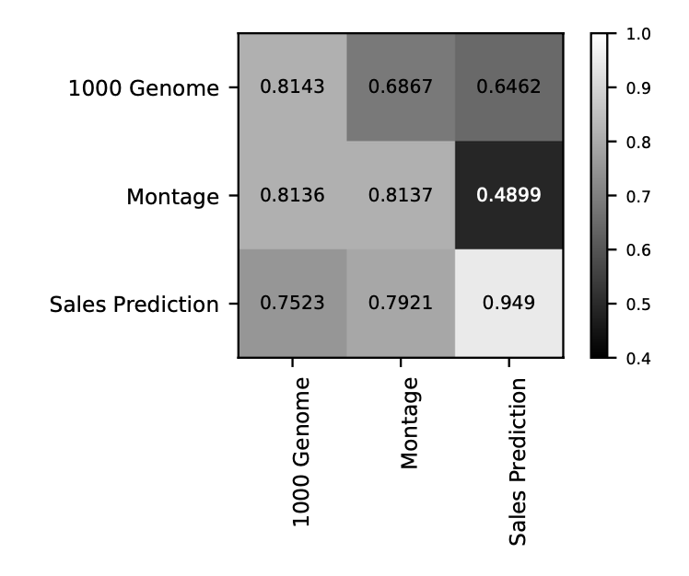
Experiment: Transfer Learning
Transfer learning: knowledge learned from one task to improve performance on another related task
Trained on
Tested on
Underlying hidden features learned from one dataset can be generalized to another dataset

Slide 17
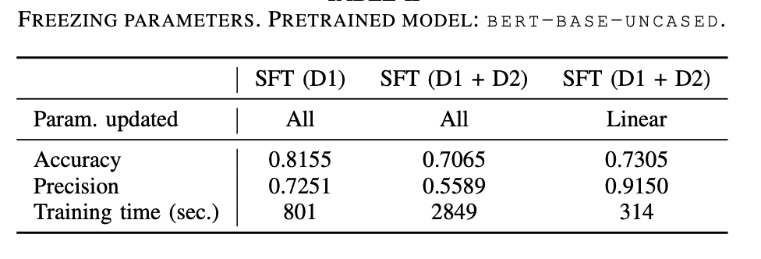
Experiment: Overcoming Catastrophic Forgetting
Catastrophic Forgetting: occurs when model forgets previously learned information as it learns new information, a common problem in SFT models
Solution: Freeze the parameters of the model that were learned during pretraining and update only the parameters that are specific to new task
Training by freezing pre-trained parameters

Slide 18
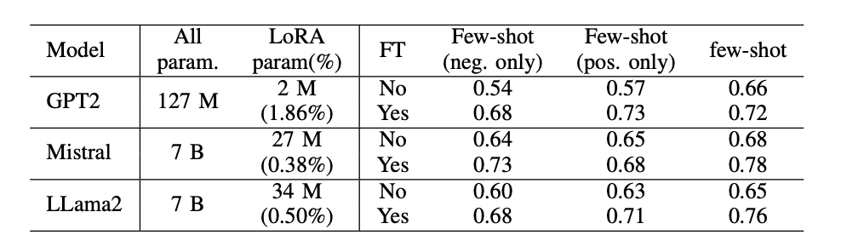
Experiment: In-context learning
ICL is a text generation task, so decoder-only models are used
To reduce training resource and time, following two techniques are applied
Quantization: converting the model's weights from floating-point to fixed point numbers
Low Rank Adaptation (LoRA): Instead of updating all the parameters during fine-tuning, LoRA modifies only a small subset of parameters.
Accuracy of ICL models on 1000 Genome dataset:

Slide 19
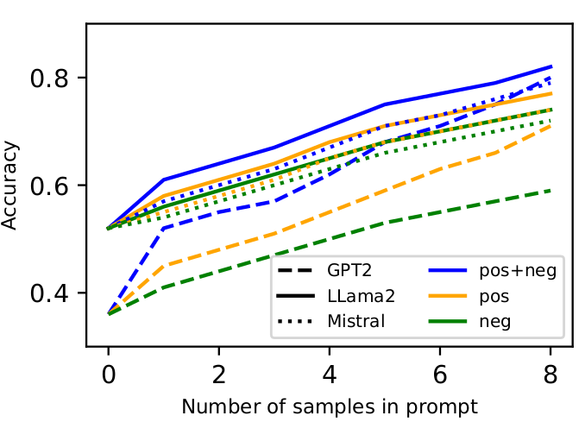
Experiment: In-context
Model's performance with increasing number of samples
GPT2 are more applicable under ICL because they require only a few examples to achieve a similar
performance compared with large models such as Mistral-7B and LLama2-7B.

Slide 20
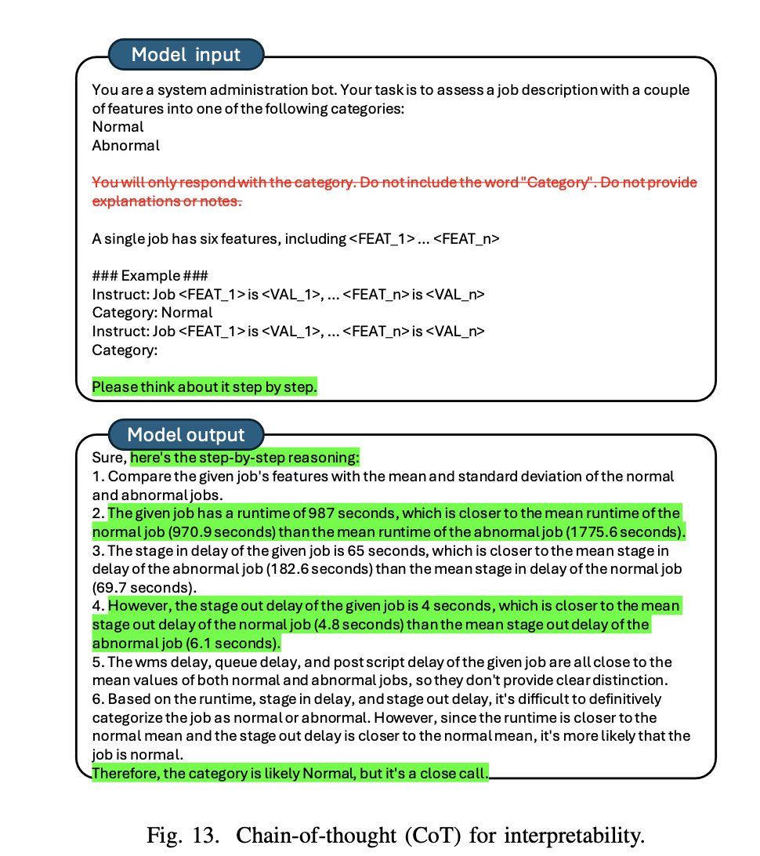
Experiment: Chain of Thought (CoT) Reasoning
CoT: breaking down the decision-making process into series of logical steps where the ICL models generate a sequence of intermediate steps.
ICL models become more interpretable and trustworthy

Slide 21
Conclusion
LLMs demonstrate effective anomaly detection using supervised fine-tuning (SFT) and in-context learning (ICL).
SFT achieves high accuracy with minimal labeled data and strong generalization via transfer learning.
ICL enables flexible few-shot and zero-shot detection using prompt engineering without fine-tuning.
Advancements in LLM optimization will enhance their scalability and applicability in real-time anomaly detection.

Slide 22
Limitations
Requirement of the labeled dataset which is a challenge in computational workflow
Does not explore how proposed methods perform on large and complex workflow
Feasibility of deploying the methods for real time anomaly detection in high throughput environments is not disscussed throughly.

Slide 23
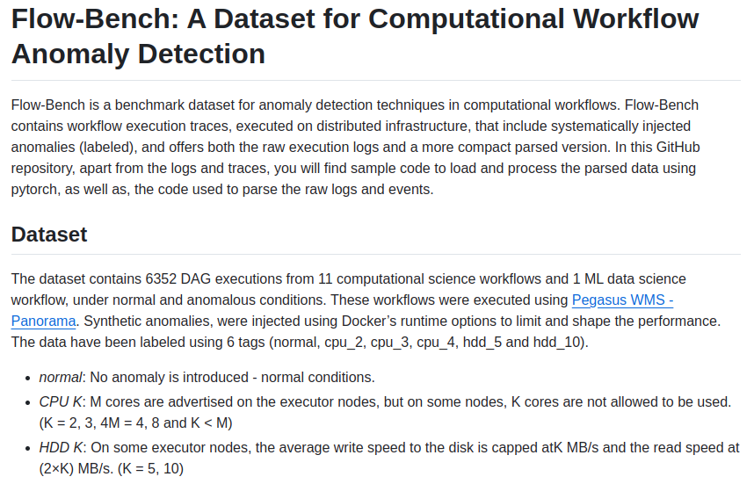
Experiment Artifacts

