Slide 1
SEAL: Link Prediction Based on Graph Neural Networks
Authors: Muhan Zhang and Yixin Chen
Presenter: Dhroov Pandey

Slide 2
Link Prediction Problem
Link?
Applications in Recommendation systems, Knowledge graph completion, metabolic network reconstruction, etc.

Slide 3
Heuristics Based Approach
Compute a Node similarity score based on some heuristic
related to the neighboring nodes.
Heuristic Degree is classified based on the size of the
neighborhood (in hops).
First order (1-hop) heuristics:
Common Neighbor, Preferential attachment
Second Order (2-hop) heuristics:
Adamic-Adar (AA), Resource Allocation
High Order (k-hop k>3) heuristics:
Katz, Rooted PageRank, SimRank
Link?
Common Neighbor Heuristic

Slide 4

Limitations with Heuristic Based approach
Requires a lot of Trial & Error to find the right heuristic for a particular network.
E.g., Common Neighbor heuristic works well in social networks but fails in protein-protein interaction (PPI) networks
This makes the approach non-generalizable since every network will require its own heuristic.
This Photo by Unknown Author is licensed under CC BY-SA

Slide 5
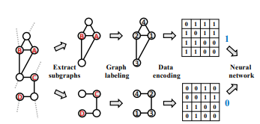
Using DNN to automatically study graph structure heuristics
First architecture to use this method – Weisfeiler-Lehman Neural Machine
Achieved state of the art prediction performance
Uses Weisfeiler-Lehman graph labeling kernel to encode structural information in node label order
Limitations:
DNN accepts fixed sized tensors, leading to loss of information due to truncating or dilution due to padding.
Adjacency matrix representations can’t fully encapsulate explicit graph features.

Slide 6
Latent Feature Extraction
Certain matrix factorizations extract low dimensional latent features of the network. E.g. Matrix factorization, stochastic
block model, etc.
Other embedding techniques like DeepWalk, and Node2Vec implicitly factorize the matrix.
The latent features can be combined with explicit and structural features to generate meaningful representations.

Slide 7
Computational Limitations
Very large graphs can be computationally infeasible for Neural processing.
Can process subgraphs around the target nodes to encapsulate graph context.
However, this might seem to cause a loss of high-order heuristic learning, and high
Order heuristics perform better than low order ones.
SEAL shows that high order heuristic can be sufficiently approximated by local enclosing subgraphs.

Slide 8
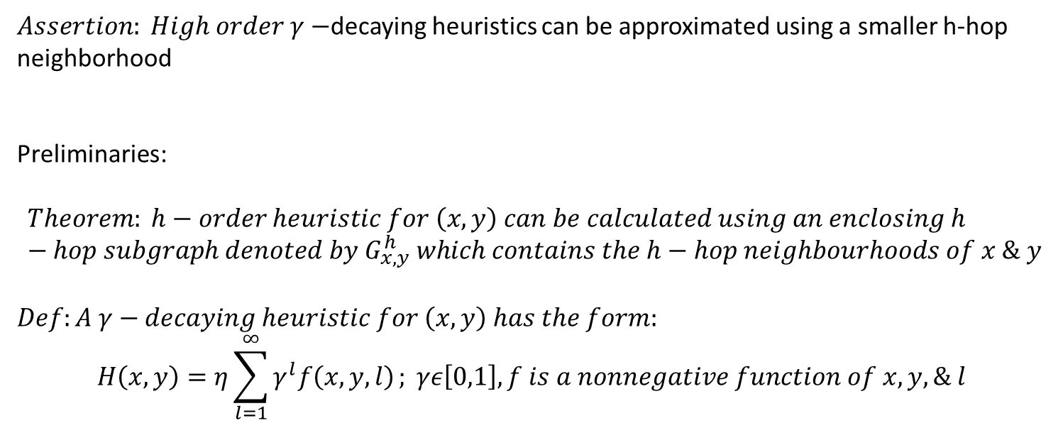

First Contribution: $γ−$decaying theory
$Assertion: High order γ−$decaying heuristics can be approximated using a smaller h-hop neighborhood
Preliminaries:
$$Theorem: h−order heuristic for \left(x,y\right) can be calculated using an enclosing h−hop subgraph denoted by G_{x,y}^{h} which contains the h−hop neighbourhoods of x \& y$$
$$Def:A γ−decaying heuristic for \left(x,y\right) has the form:$$
$$H\left(x,y\right)=η\sum_{l=1}^{∞}{γ^{l}f\left(x,y,l\right)}; γε\left[0,1\right], f is a nonnegative function of x, y, \& l$$

Slide 9
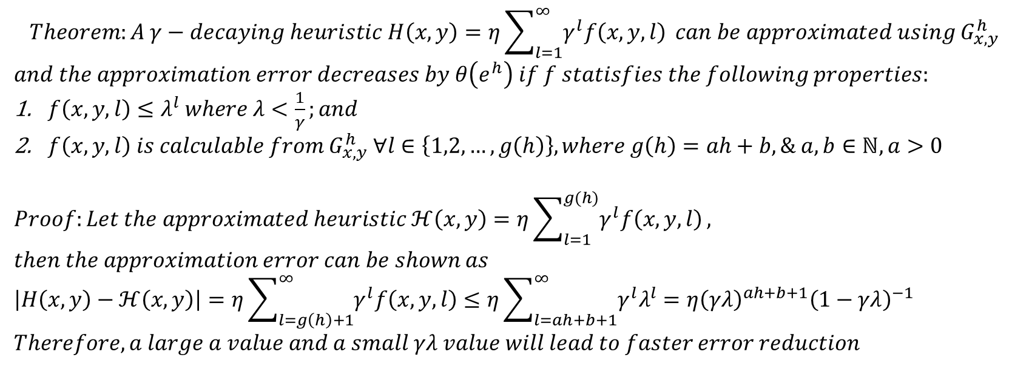
$$Theorem:A γ−decaying heuristic H\left(x,y\right)=η\sum_{l=1}^{∞}{γ^{l}f\left(x,y,l\right)} can be approximated using G_{x,y}^{h}$$
$$and the approximation error decreases by θ\left(e^{h}\right) if f statisfies the following properties:$$
$f\left(x,y,l\right)≤λ^{l} where λ<\frac{1}{γ};and$
$f\left(x,y,l\right) is calculable from G_{x,y}^{h} ∀l∈\left\{1,2,…,g\left(h\right)\right\}, where g\left(h\right)=ah+b, \& a,b∈ℕ, a>0$
$$Proof:Let the approximated heuristic ℋ\left(x,y\right)=η\sum_{l=1}^{g(h)}{γ^{l}f\left(x,y,l\right)},$$
$$then the approximation error can be shown as$$
$$\left|H\left(x,y\right)−ℋ\left(x,y\right)\right|=η\sum_{l=g\left(h\right)+1}^{∞}{γ^{l}f\left(x,y,l\right)}≤η\sum_{l=ah+b+1}^{∞}{γ^{l}λ^{l}}=η{\left(γλ\right)}^{ah+b+1}{\left(1−γλ\right)}^{−1}$$
$$Therefore, a large a value and a small γλ value will lead to faster error reduction$$

Slide 10
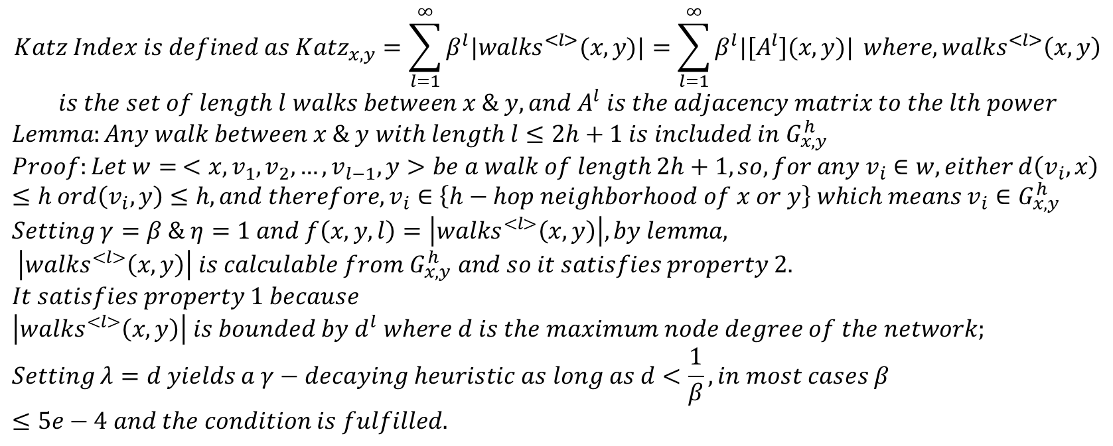

Proving that Katz index is $γ−decaying$
$$Katz Index is defined as {Katz}_{x,y}=\sum_{l=1}^{∞}{β^{l}|{walks}^{<l>}(x,y)|}=\sum_{l=1}^{∞}{β^{l}|{[A}^{l}](x,y)|} where, {walks}^{<l>}\left(x,y\right)$$
$$is the set of length l walks between x \& y, and A^{l} is the adjacency matrix to the lth power$$
$$Lemma:Any walk between x \& y with length l≤2h+1 is included in G_{x,y}^{h}$$
$$Proof:Let w= <x,v_{1},v_{2},…,v_{l−1},y>be a walk of length 2h+1, so, for any v_{i}∈w, either d\left(v_{i},x\right)≤h ord\left(v_{i},y\right)≤h, and therefore,v_{i}∈\left\{h−hop neighborhood of x or y\right\} which means{ v}_{i}∈G_{x,y}^{h}$$
$$Setting γ=β \& η=1 and f\left(x,y,l\right)=\left|{walks}^{<l>}\left(x,y\right)\right|, by lemma, \left|{walks}^{<l>}\left(x,y\right)\right| is calculable from{ G}_{x,y}^{h} and so it satisfies property 2.$$
$$It satisfies property 1 because$$
$$\left|{walks}^{<l>}\left(x,y\right)\right| is bounded by d^{l} where d is the maximum node degree of the network;$$
$$Setting λ=d yields a γ−decaying heuristic as long as d<\frac{1}{β}, in most cases β≤5e−4 and the condition is fulfilled.$$

Slide 11
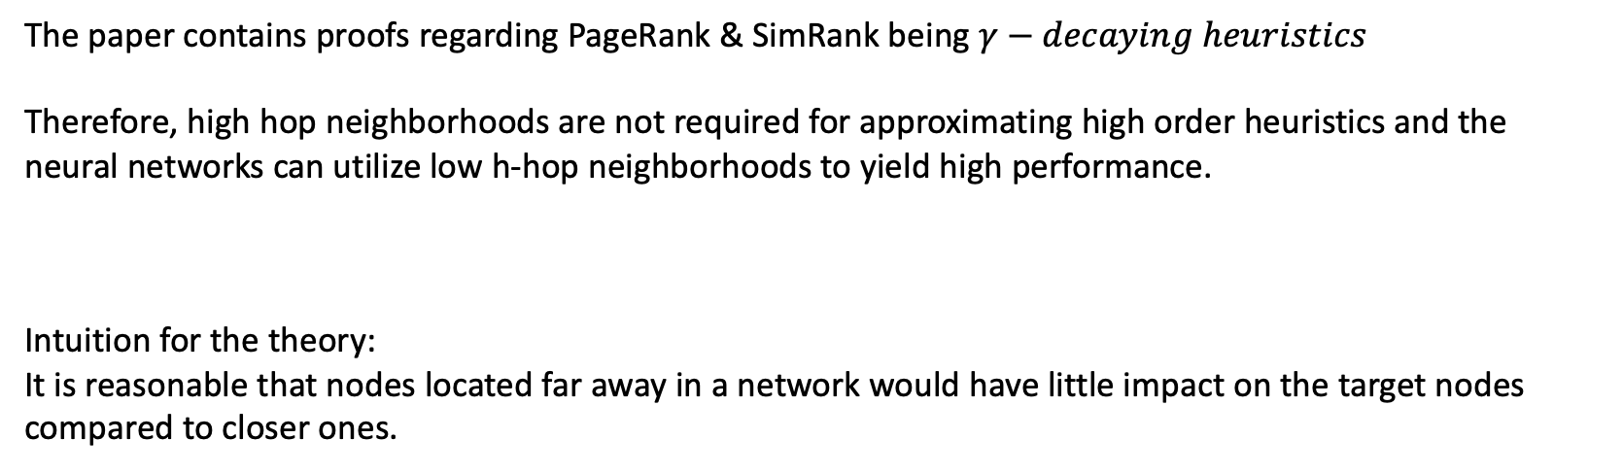
Important Conclusion
The paper contains proofs regarding PageRank & SimRank being $γ−decaying heuristics$
Therefore, high hop neighborhoods are not required for approximating high order heuristics and the neural networks can utilize low h-hop neighborhoods to yield high performance.
Intuition for the theory:
It is reasonable that nodes located far away in a network would have little impact on the target nodes compared to closer ones.

Slide 12
SEAL: Implementation
3 step process:
Subgraph Extraction
Node Information Matrix Construction
GNN Training

Slide 13
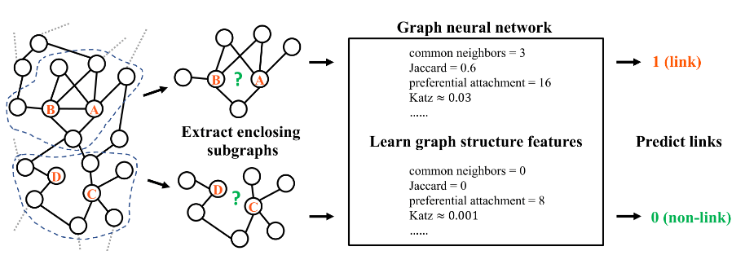
SEAL Execution Overview

Slide 14
Subgraph Extraction
Capture the h-hop neighborhood of
both the link prediction nodes and union the sets.
Can be extracted using BFT.

Slide 15
Node Information Matrix Construction
3 Main Components:
Structural Node Labels
Node Embeddings(Node2Vec)
Node Attributes
Structural Node Labels
One Hot encoded
Node Embeddings
Generated by Node2Vec
Standard Node feature
Vector

Slide 16
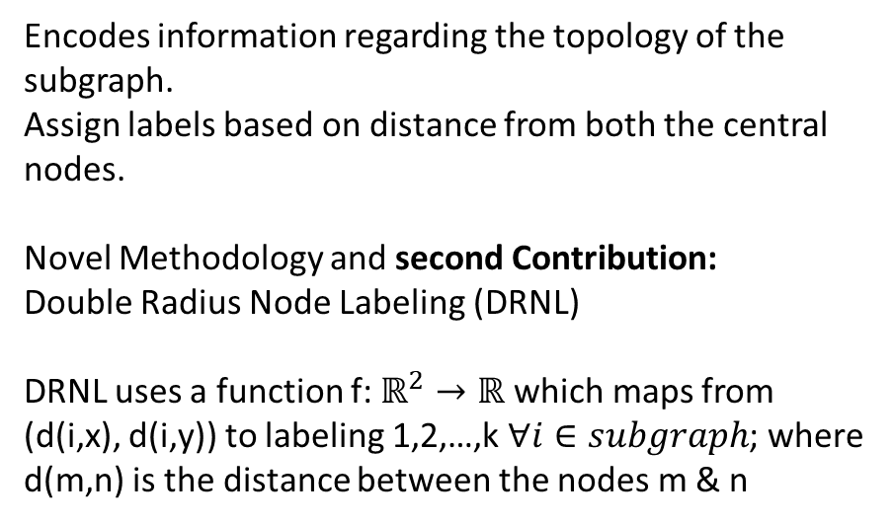
Structural Node Labeling
Encodes information regarding the topology of the subgraph.
Assign labels based on distance from both the central nodes.
Novel Methodology and second Contribution:
Double Radius Node Labeling (DRNL)
DRNL uses a function f: $ℝ^{2}→ℝ$ which maps from (d(i,x), d(i,y)) to labeling 1,2,…,k $∀i∈subgraph$; where d(m,n) is the distance between the nodes m & n
3
0
2
1
4
3
0
5

Slide 17
GNN
SEAL uses a standard DGCNN GNN and doesn’t make any innovations in this domain, leaving it to future work.
The Node Information Matrix and the Adjacency Matrix are passed as inputs to the GNN, which processes them through some convolution layers, followed by aggregation layers which generate a graph embedding vector, which is sent to a fully connected classifier.
Graph Neural Network
Fully Connected Layer
Node Information Matrix
Adjacency Matrix
Classification Result
Graph Embedding

Slide 18
DGCNN Architecture
GCN
Dense Classifier
GCN
Graph Aggregation Layer (Sort Aggr)
Concatenation
1-D Conv, Pooling Layers
GCN
GCN
Message Passing Scheme

