Slide 1
Habitat: A Runtime-Based Computational Performance Predictor for Deep Neural Network Training
Geoffrey X. Yu, University of Toronto/Vector Institute; Yubo Gao, University of Toronto; Pavel Golikov and Gennady Pekhimenko, University of Toronto/Vector Institute
https://www.usenix.org/system/files/atc21-yu.pdf
Presenter
Dipak Acharya
University of North Texas
Denton TX

Slide 2
Selecting GPU For Deep Learning Training
Desktop | Shared Cluster | Cloud
RTX 4090 RTX 2080 Ti GTX 1080 | RTX 6000 RTX A5500 | Nvidia H100 Nvidia A100 Nvidia V100
Build?
Buy?
Rent?
Performance
Solution: Predict the Performance of a GPU
Cost

Slide 3
Why Predict the Performance of DNN on a GPU
Measure performance directly
GPU Availability
Use publicly available Benchmarks
Only available for popular models
Use Heuristics
Proven to be not accurate
Always use the “Best” GPU
Performance changes based on model
Might be less cost effective

Slide 4
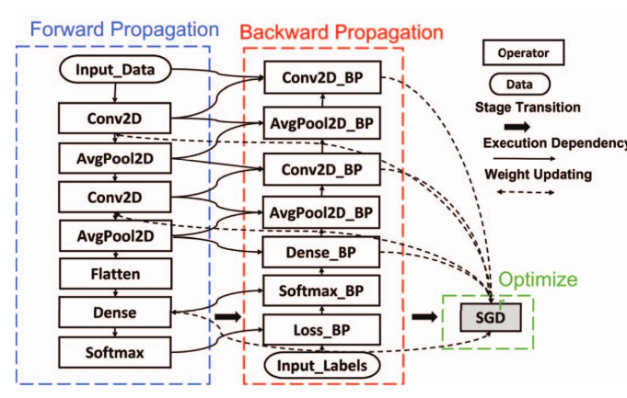
Observations
Repetitive computation
DNN training involves thousands repetitive forward and backward passes
Building blocks of DNN
DNNs are formed by combination of thousands of basic operators such as convolution, pooling, linear transform etc.
Runtime information available
DNN developers already have a lower tier GPU available to them which gives important runtime information
Fig. DNN model as a computational graph

Slide 5
Habitat
Profile information and runtime metadata of each operation
Predicted execution time of each operation on the target GPU
Model
Wave Scaling
Execution time for single iteration
Or
Combine
Origin GPU
Pre-trained MLPs

Slide 6
Habitat: Wave Scaling
GPU with 2 SM
Completes execution in 6 waves
Kernel (DNN operator)
12 Thread blocks
GPU with 4 SM
Completes execution in 3 waves
Other factors that affect the execution: Memory Bandwidth, Wave Size and Clock Frequency

Slide 7
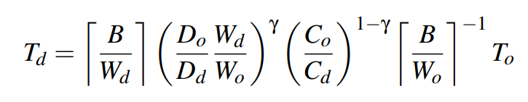
Wave Scaling
T_{i} = Execution Time
D_{i} = Memory Bandwidth
C_{i} = Clock Frequency
B = Number of thread Blocks in the Kernel
W_{i} = Number of thread Blocks in the Wave
𝛾 𝟄 [0, 1] - Memory bandwidth boundedness

Slide 8
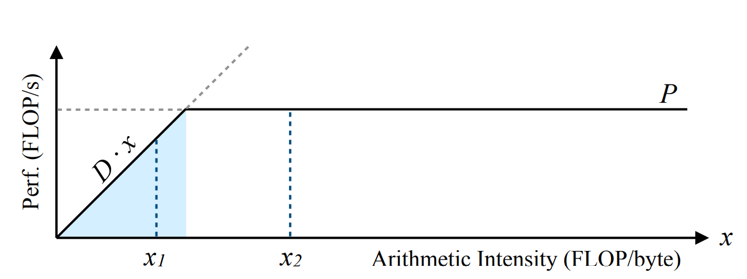
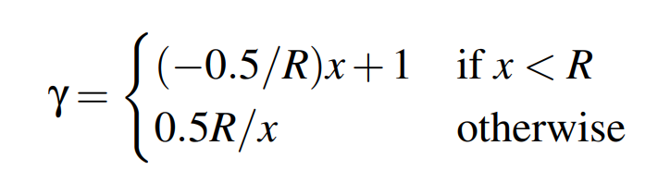
Selecting Gamma (γ)
Memory Bandwidth Bound
Roofline Model:
Number of floating point operations per byte of data read/write (x)
Kernel performance is minimum of
Hardware peak performance
OR
Bandwidth times kernel’s arithmetic intensity
Hardware Performance Bound

Slide 9
Habitat: MLP Predictor
Predict execution time of the kernel-varying operation using Multi Layer Perceptron(MLP)
Convolution, LSTMs, Batched matrix multiplication, linear layer
Input features
Layer dimensions (eg. input/output channels in convolution)
Memory capacity and Bandwidth of target GPU
Number of Streaming Multiprocessors (SMs) on target GPU
Peak FLOPS of the target GPU
Model architecture
Input layer, 8 hidden layers and output layer
Each hidden layer with ReLU activation with 1024 units

Slide 10
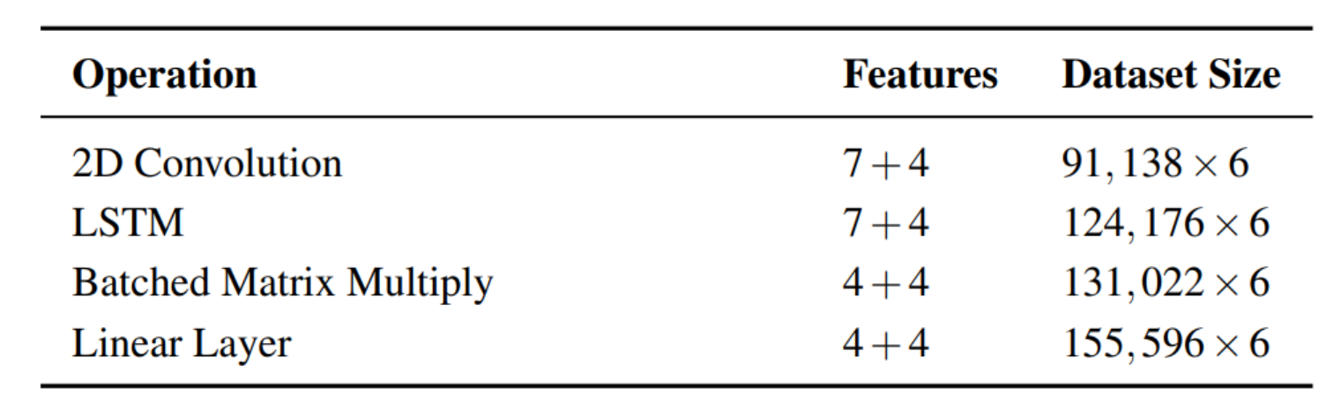
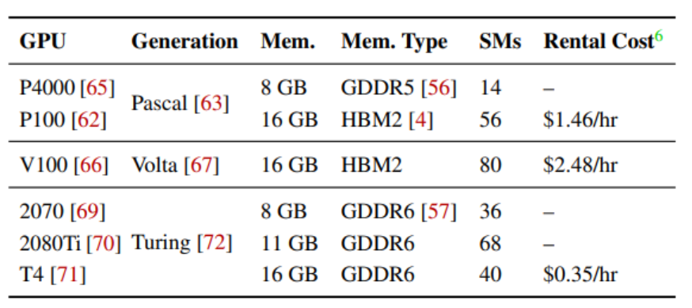
MLP: Data Collection
Data for the kernel-varying operations were collected from randomly sampled input configurations.
Each operator uses a predefined range of parameters.
Data is collected for 6 different GPUs ranging 3 generations.

Slide 11
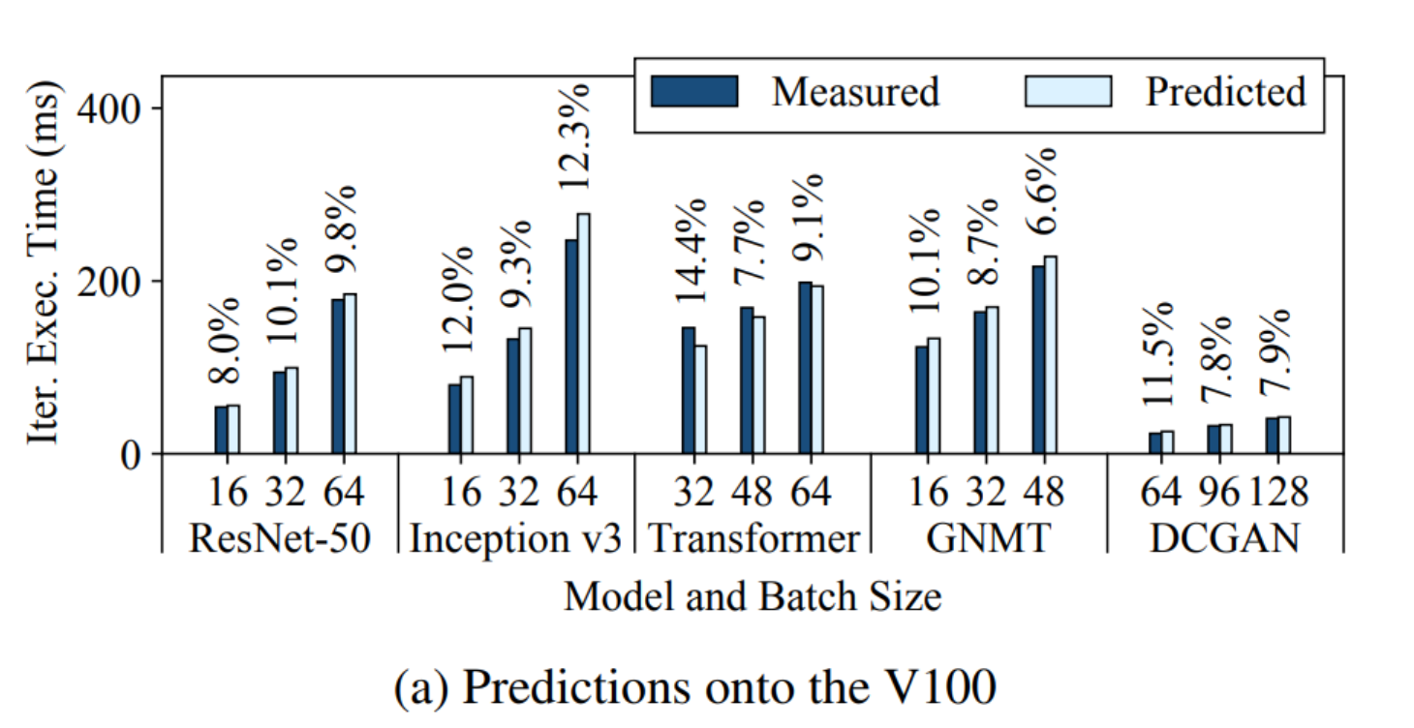
Evaluation: Accuracy
Evaluation for models
Resnet-50, Inception v3, Transformer, GNMT, DCGAN
Experiments done with GPUs
V100, 2080 Ti, T4, 2070, P100, P4000
Average end-to-end accuracy across all experiments is 11.8%
Fig: Prediction errors for V100 GPU for different models
Refer Paper for errors breakdown for other GPUs

Slide 12
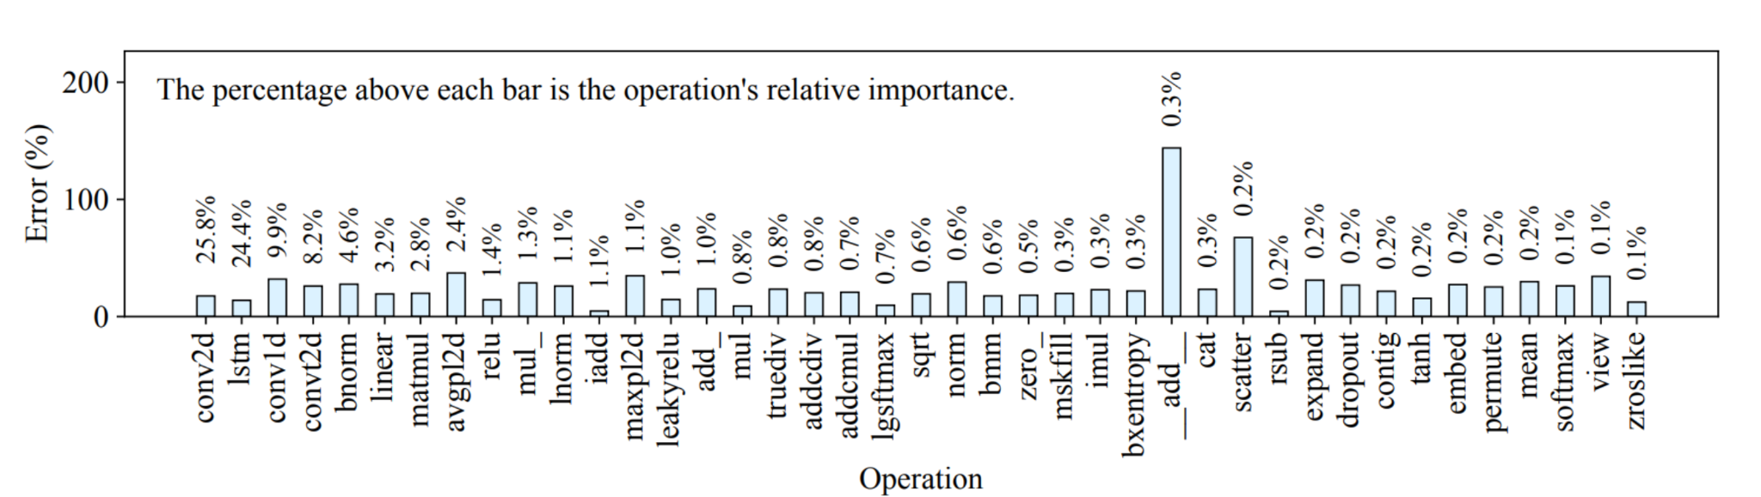
Evaluation: Error Contribution
MLP
Wave Scaling
Both MLP and Wave Scaling give prediction within acceptable error range

Slide 13
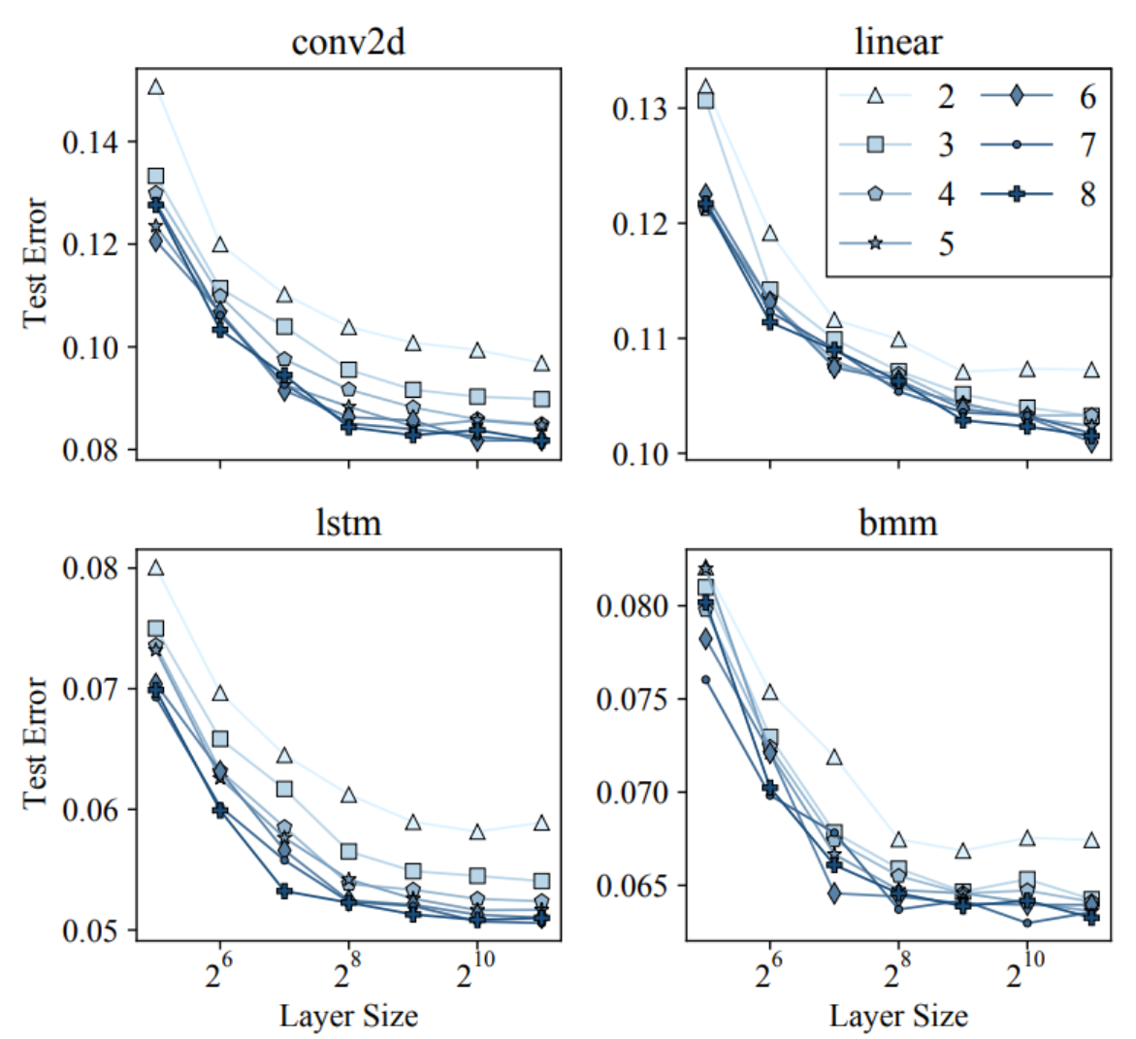
Evaluation: MLP Configuration
More layer size give better accuracy
But increasing layer size beyond 2¹⁰ does not give any more improvement
Increasing number of layers also increase the accuracy
Selecting 8 layers for the MLP gives acceptable accuracy

Slide 14
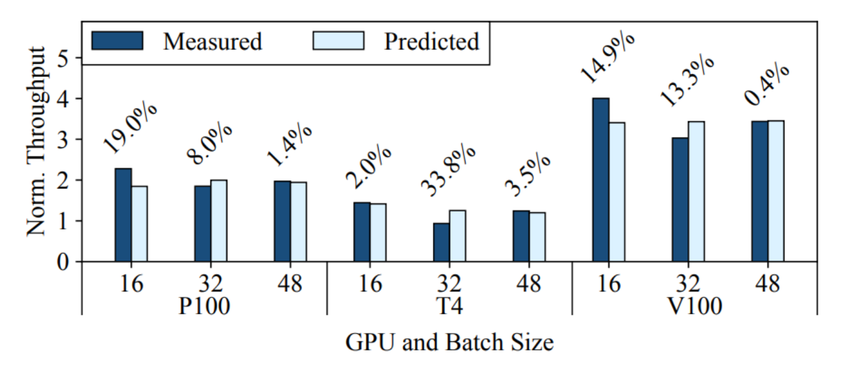
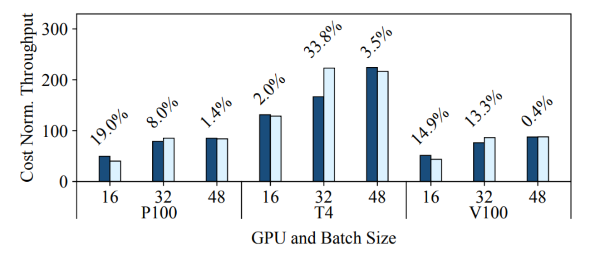
Evaluation: Making GPU Decisions
Selecting a GPU to rent, P100 or T4 or V100
Best overall performance
Best price for performance
Habitat leads to correct decisions for selecting a GPU for DNN training

Slide 15
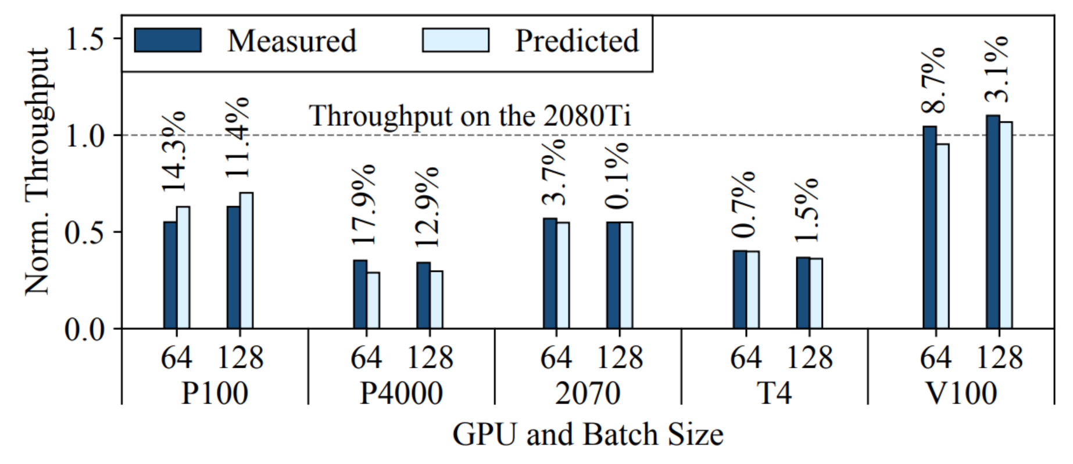
Evaluation: Is V100 Always Better?
V100 gives the best performance but is only marginally better than 2080 Ti, which is much more cost efficient.

Slide 16
Contributions
Wave Scaling
Proposed a novel technique for scaling execution time of a Kernel on one GPU to another GPU
Habitat
Implementation and evaluation of the tool that uses wave scaling combined with pre trained MLPs for predicting the end-to-end execution time of DNN training iteration from one GPU to another GPU.

Slide 17
Limitations
Evaluation based on limited number of GPUs.
While this work evaluates only 6 GPUs from Pascal, Volta and Turing, while it does not evaluates Ampere architecture.
Running this experiment with 2 Ampere GPUs gave higher error compared to what is claimed by the authors.
Potential scalability issues
With more complex GPU architectures in the future, more operators will become Kernel-varying.
The proposed solution may become unscalable as it will require training Large number of MLPs.
Furthermore compiler optimizations may result in more kernel varying operators
Distributed training
As most demanding GPU tasks require cluster of GPUs rather than single GPU, Habitat will have little to no application in these situations.

Slide 18
Thank You
Questions

