Slide 1
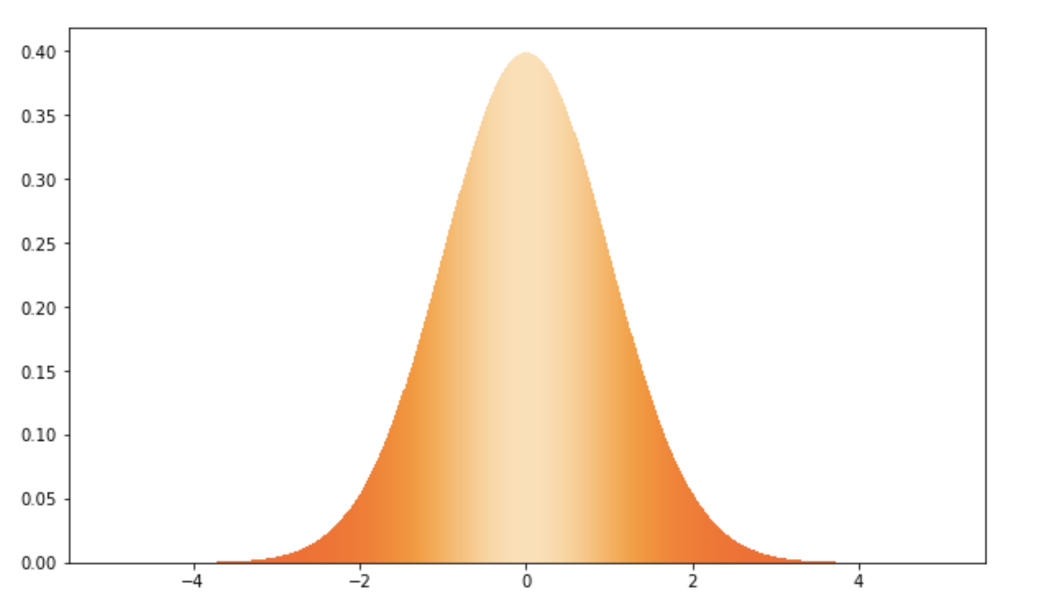
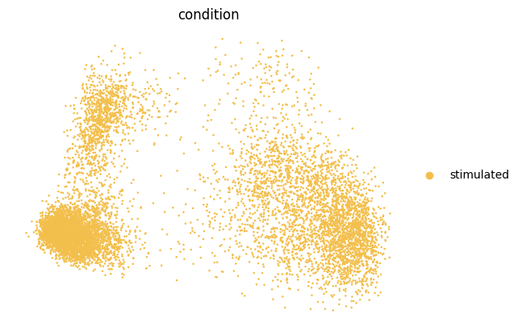
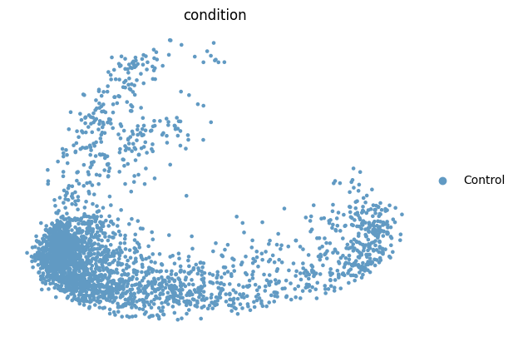










Style Vector
$E_{φ}^{s}\left(.\right)$
$Z_{c}^{style}$
+
${\hat{Z}}_{c}^{stim}$
Decoder
$$Z_{c}^{ctrl}$$
$X^{stim}$
^
${\hat{X}}^{stim}$
Smooth
L1Loss
$E_{θ}^{c}\left(.\right)$
$X^{ctrl}$
SmoothL1Loss
$Z_{c}^{stim}$
${\hat{X}}^{stim}$
Notes:
Fig1 模型结构图

Slide 2
b
c
a
d
e

Slide 3
a
c
b
d
e

Slide 4
a
b
c
d
e

Slide 5
a
b
c
d
e
f

