Slide 1
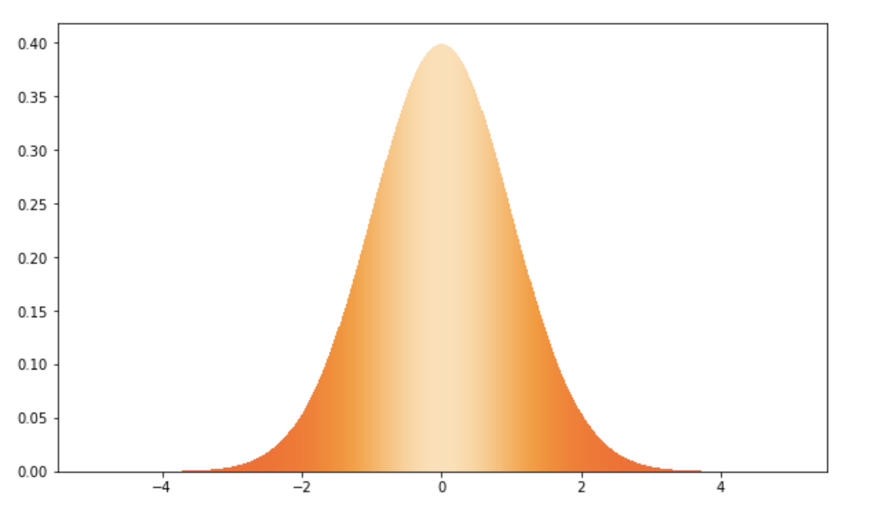
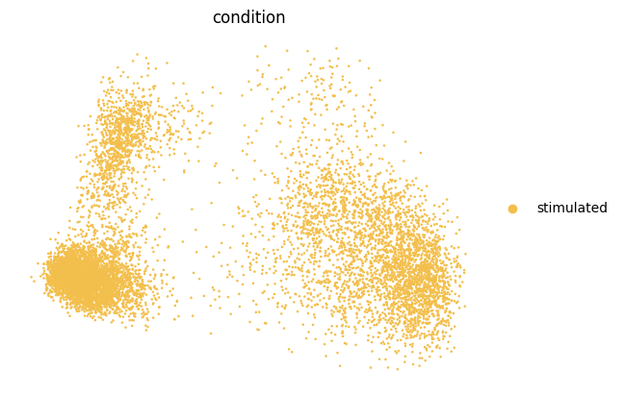
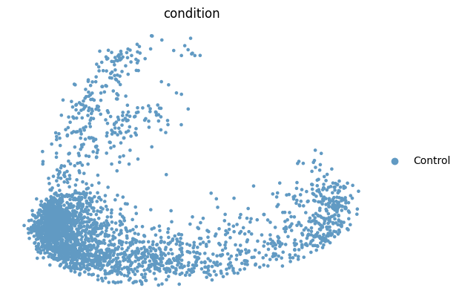
Style Vector
Style
Encoder
Z_{style}
+
Z_{predict}
Decoder
Z_{content_control}
stimulated
^
stimuluated
Content
Encoder
Smooth
L1Loss
control
SmoothL1Loss
Z_{content_Stimulated}
stimulated

Slide 2
Style
vector
Style
Encoder
Z_{style}
+
Z_{predict}
Z_{content_control}
stimulated
Content
Encoder
Smooth
L1Loss
control
Z_{content_Stimulated}
^
stimulated
stimulated
Z_{content_control}
Decoder
SmoothL1loss

Slide 3
Style
vector
Style
Encoder
Z_{style}
+
Z_{predict}
Decoder
Z_{content_control}
stimulated
^
stimuluated
Content
Encoder
Smooth
L1Loss
control
SmoothL1Loss
Z_{content_Stimulated}
stimulated

