Slide 1
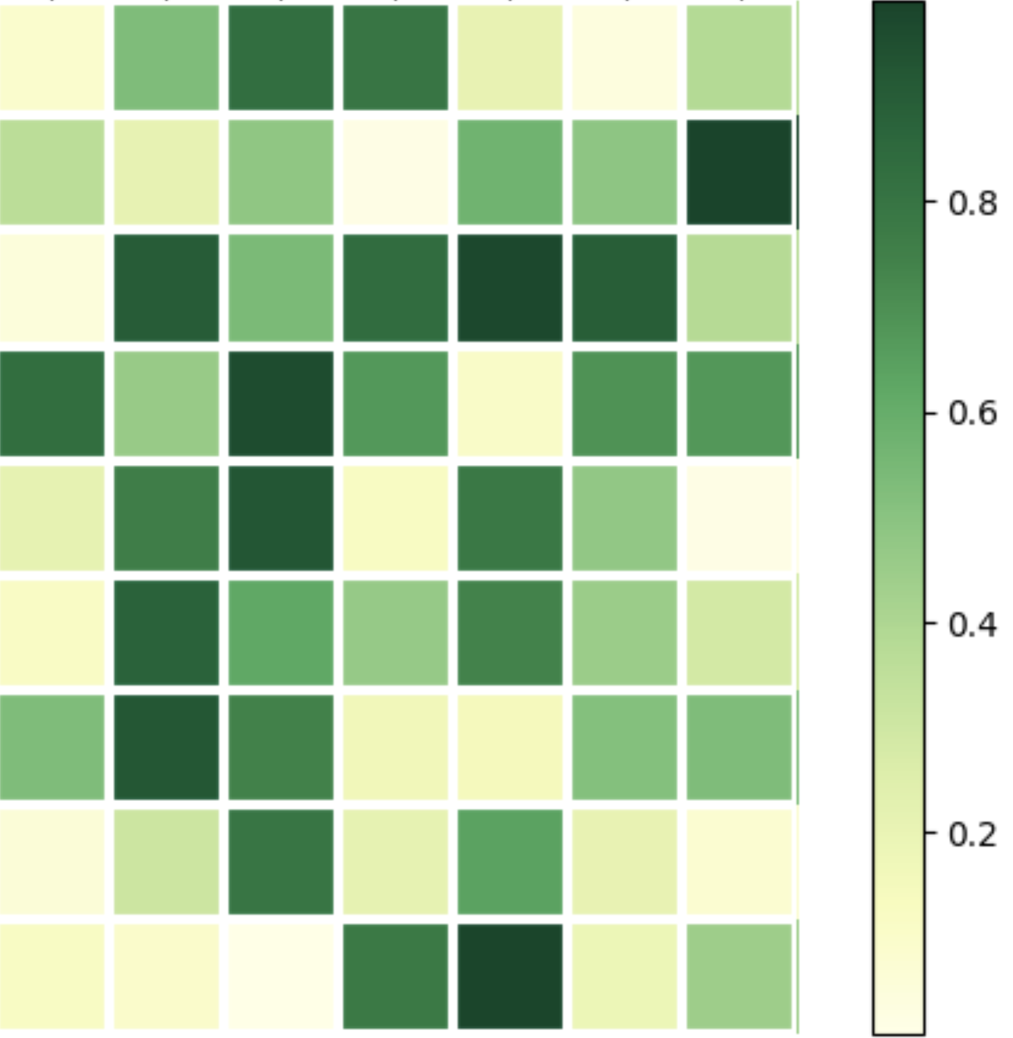





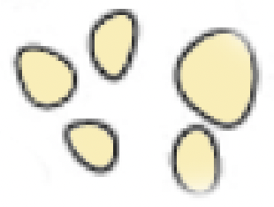












Style Vector ($s$)
$E_{φ}^{s}\left(.\right)$
$Z_{c}^{style}$
…
…
${\hat{X}}^{perb}$
${\hat{Z}}_{c}^{perb}$
+
$E_{θ}^{c}\left(.\right)$
$X^{ctrl}$
$Z_{c}^{ctrl}$
…
…
…
…
Generate Loss
$E_{θ}^{c}\left(.\right)$
$X^{perb}$
$X^{perb}$
$$Z_{c}^{perb}$$
Style Loss
…
…
Notes:
Fig1 模型结构图

