Slide 1
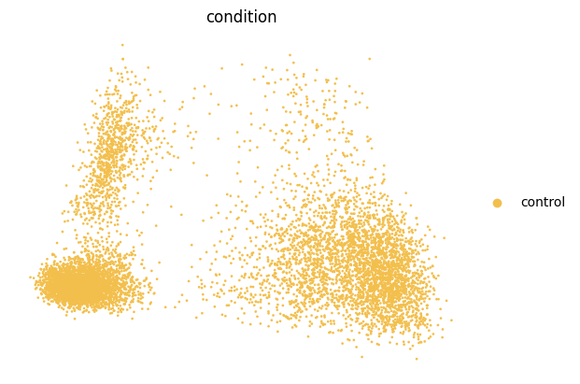
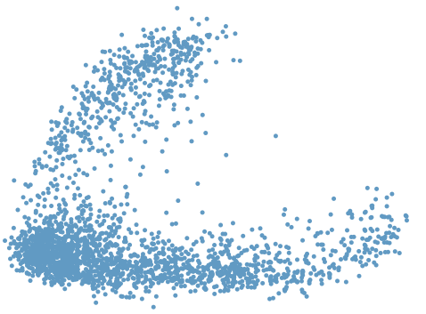
stimulated
Z_{content_Stimulated}
Content
Encoder
Smooth
L1Loss
Z_{content_control}
control
+
Z_{predict}
Style
vector
Style
Encoder
Z_{style}

Slide 2
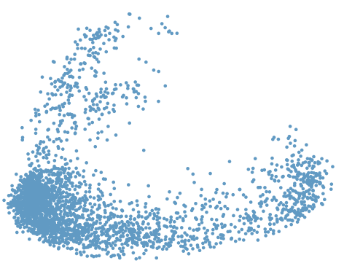
^
stimulated
stimulated
Z_{content_control}
Decoder
SmoothL1loss

