Slide 1
Lyric analysis of Sound Of Da Police by KRS-One

Slide 2
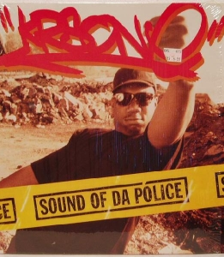
Sound Of Da Police
"Sound of da Police" is a song released by American rapper KRS-One in 1993.
Not only is it one of KRS-One's signature works, but it is also regarded as a classic in Hip Hop culture.
"Sound of da Police" explores social issues such as the police system, racial discrimination, and police violence against minority communities.
As a result, it has received widespread praise and recognition, being considered a symbol of resistance against racial discrimination and police brutality by many.
Notes:
《Sound of da Police》是由美国说唱艺人KRS-One于1993年发行的一首歌曲。这首歌不是是KRS-One的代表作之一，也被认为是Hip Hop文化中的经典之作。
Sound of da Police》探讨了警察制度、种族歧视和警察对少数族裔社区的暴力压迫等社会问题。因而受到广泛的赞誉和认可。被许多人视为反对种族歧视和警察暴力的象征。

Slide 3

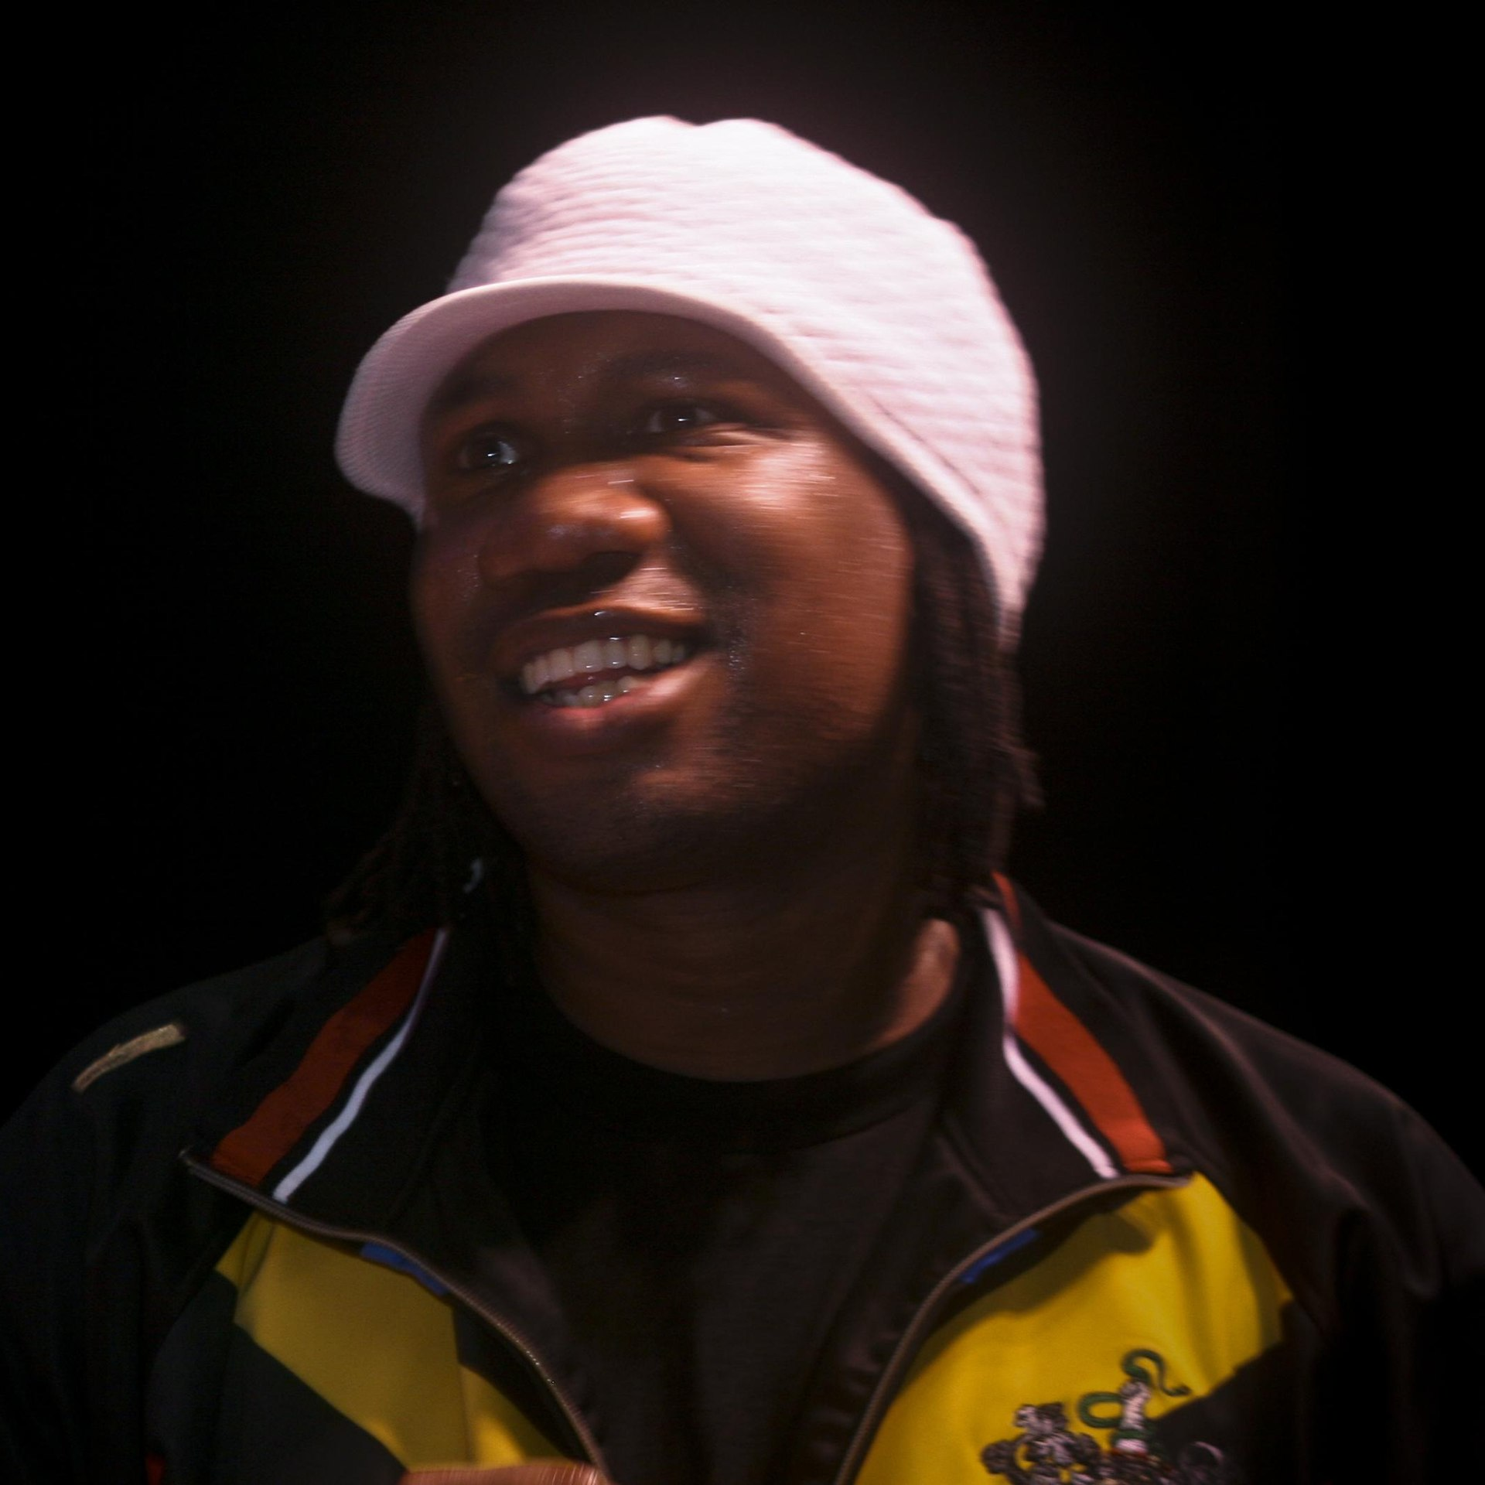
KRS-One’s historical
KRS-One, born Lawrence Parker on August 20, 1965, in Brooklyn, NY, United States, is widely acclaimed as one of the most influential rappers in history.
Renowned for his socially conscious lyrics, he eschews materialism in favor of addressing political and social issues through his music.
In recognition of his significant contributions to the Stop the Violence Movement and his pioneering role in shaping hip-hop music and culture.
He was honored with the Lifetime Achievement Award at the BET Awards in 2008.
Saquan Stimpson, KRS-1 Invades Wilmington (A Tribute To Bob Marley), https://www.flickr.com/photos/9892787@N05/2707834284
Notes:
总结了歌曲作者/歌手的传记

Slide 4
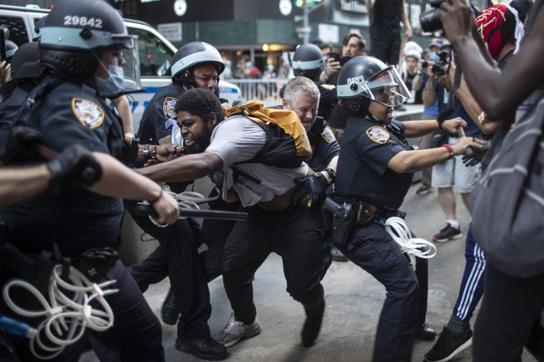
Creative inspiration
KRS-One was born in the Bronx borough of New York City, where he witnessed firsthand the unfair treatment and violent actions of the police towards minority communities during his upbringing.
Moreover, the American society at that time, particularly the black community, experienced severe riot incidents due to police brutality. There were even large-scale armed standoffs between the black community and the police.
Therefore, KRS-One attempted to raise awareness of these issues through this song and encourage people to resist and change social injustice."
Wong Maye, “New York officers could face suspension after street clashes, commissioner says”, NBC NEWS. June 4, 2020, https://www.nbcnews.com/news/us-news/new-york-officers-could-face-suspension-after-street-clashes-commissioner-n1225391.
Notes:
创作灵感
KRS-One本人出生于纽约市的布朗克斯区，他在成长过程中亲眼目睹了警察针对少数族裔社区的不公平对待和暴力行为。
并且当时的美国社会，特别是黑人社区，不断因为警察暴力执法而引发严重的暴动事件。甚至是大面积的黑人社区与警察的武装对峙。
所以，KRS-One试图通过这首歌来唤起人们对这些问题的关注，并鼓励他们对社会不公进行反抗和改变。

Slide 5
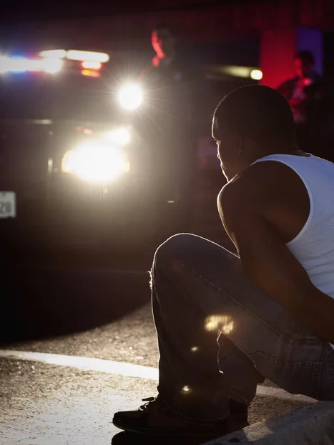
Lyrics Analysis: police & beast
Woop-woop!
That's the sound of da police!
Woop-woop!
That's the sound of the beast!
This passage of lyrics serves as the beginning of the song and recurs multiple times, reflecting how common the sound of police sirens has become in black lives, almost becoming a background noise to their daily existence.
The repeated alternation between "Da police" and "beast" underscores the deep-seated resentment of the police within the black community.
Hill Street Studios/Getty Images
Notes:
https://www.npr.org/2023/05/29/1178279383/for-black-drivers-a-police-officers-first-45-words-are-a-portent-of-whats-to-com
歌词分析
这段歌词及时整首歌的开头，也反复出现多次。
体现了黑人生活中，警车鸣笛的声音太常见了。
已经成为他们日常生活的背景音了。
其中Da police 和 beast 的反复交替出现。
也体现了黑人社区对警察的厌恶

Slide 6
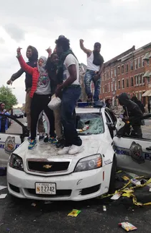
Lyrics Analysis: Cops Stop
My grand father had to deal with the cops
My great grandfather dealt with the cops
My great grandfather had to deal with the cops
And then my great, great, great, great... when it's gonna stop?!
As the lyrics depict, in the black community, the cycle of incarceration is a legacy passed down from one generation of black men to the next.
This sentiment is also the lament expressed in the final lines of the song, questioning when such life experiences will ever cease.
AP Photo/Juliet Linderman
Notes:
https://www.lubbockonline.com/story/news/nation-world/2015/04/28/riot-looting-prompt-state-emergency-curfew-baltimore/14980128007/
正如歌词唱的，在黑人社区，被捕入狱成为每一代黑人男子的
的传承。这也是歌词在最后发出的哀嚎，
这样的人生遭遇什么时候能够停止。

Slide 7
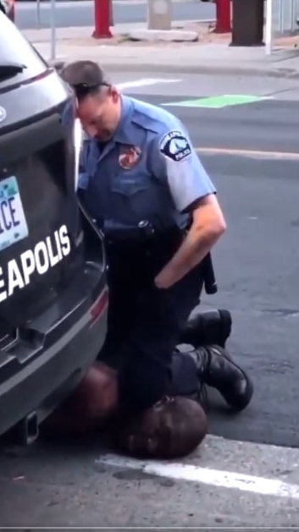


End Police Violence
The 1992 LA riots
It were a series of civil disturbances in Los Angeles County during April and May of that year. The unrest began in South Central LA on April 29, following the acquittal of four LAPD officers accused of excessive force in Rodney King's arrest and beating. Over six days, riots spread across the LA metropolitan area, with thousands engaging in violence and looting.
Black Lives Matter 2013-present
In 2013, Black Lives Matter had been founded, a political movement aimed at addressing systemic racism and violence against Black communities. The movement gained traction following the murder of a black person by a white police officer in Minneapolis in May 2020.
Dozier Mobley/AP https://www.npr.org/sections/codeswitch/2014/08/24/342170766/50-years-before-ferguson-a-summer-of-riots-racked-the-u-s
Notes:
与我的歌曲相关的社会问题，以及有关运动原因、日期、地点等的所有内容。

Slide 8
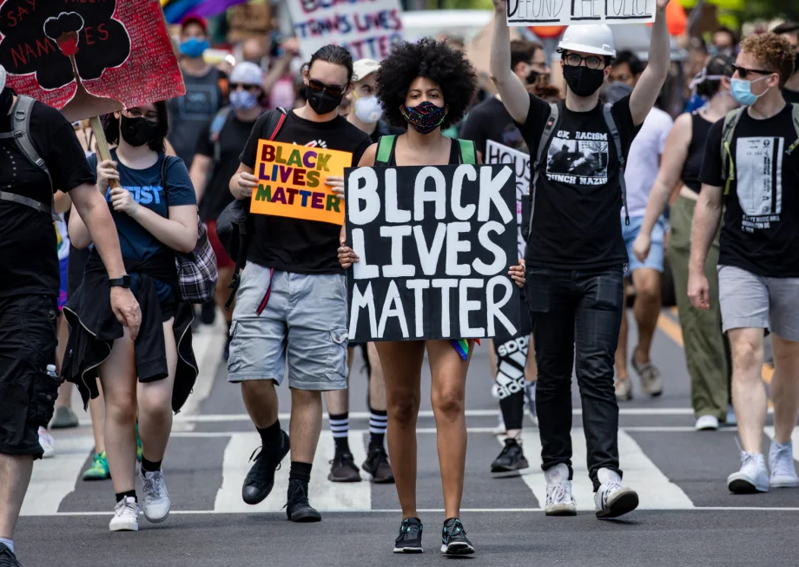
"Sound Of Da Police" reflects social issues
In the current situation, despite some progress made over the past few decades, police violence and racial discrimination remain realities in today's society.
In recent years, protests have erupted in many countries and regions, protesting against police violence against minority communities.
Furthermore, social media and news coverage increasingly highlight similar incidents, sparking broader attention and discussion.
Therefore, the issues reflected in "Sound Of Da Police" remain relevant and require ongoing attention and efforts to address.
Notes:
歌已经发表30年了，可是黑人的平权问题，警察暴力问题，仍然没有坚决。
93年的时候，因为警察暴力发生了骚乱。20年的时候，仍然是因为警察暴力。
让黑命贵运动再一次兴起。

