Slide 1
Southmaket.store
Web Team Project

Slide 2






Notes:
At the beginning of this project, I was excited but also a little unsure.
I expected to practice what we learned in class, but I didn’t realize how much responsibility I would take on in the team.
I thought I might just write some code—but I ended up doing much more than that.

Slide 3
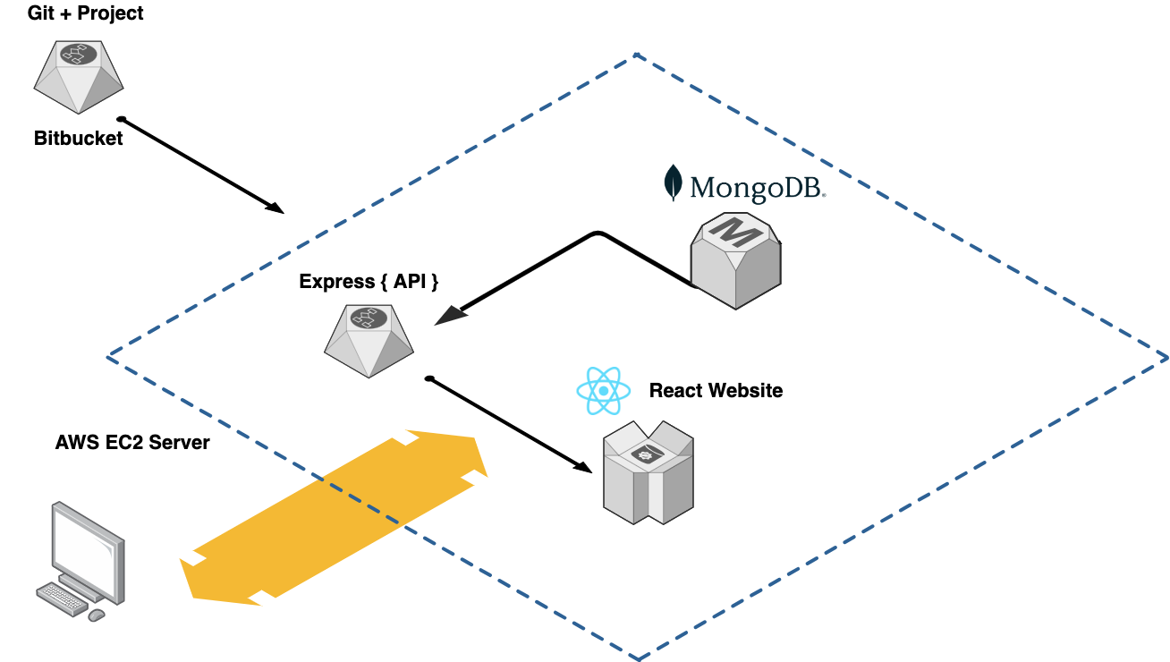
Notes:
In our team, I was mainly responsible for building the API service.
I took what we learned in the API server course this semester and combined it with the needs of an online store.
I created the full backend API logic to support the website.
I was also in charge of managing our GitHub repository, setting up the production server, and deploying the project.

Slide 4

Enjoyed
Notes:
(3. What You Enjoyed) The best part for me was applying a whole semester’s worth of knowledge to something real.
It made me really happy to see the entire API system come to life—from design to deployment.
It felt like I was turning theory into something useful, something people could actually use.

Slide 5

Challenges
Notes:
(4. Challenges You Faced) One of the biggest challenges was that I had never managed a team Git repository before, and I also had no experience in server operations.
I spent a lot of time figuring things out.
For example, I had to learn how to protect the main branch by using pull requests.
I also spent hours researching how to find a good production-ready MongoDB service.
In the end, I decided to use AWS EC2 and host MongoDB myself. It was stressful, but I learned a lot.

Slide 6

Notes:
(5. Thank You) I really want to thank my teammates for trusting me with these responsibilities, and I appreciate everything we achieved together. Thank you all for listening to my experience.

