Slide 1
The Combination of IGA and DG Method in Solving PDEs on Surface
March 12, 2013

Slide 2
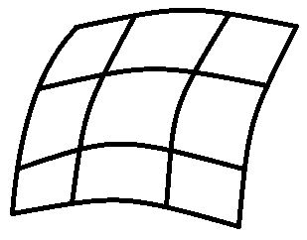
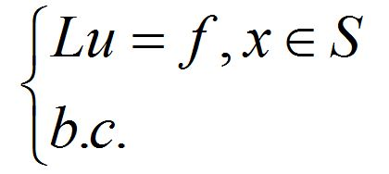

Ⅰ Description
Domain: S PDE

Slide 3

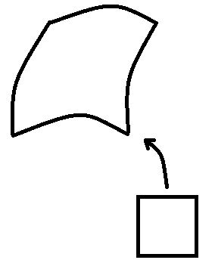


For every single patch ,

Slide 4
Ⅱ Method
● FEM on each patch.
● DG Method when dealing with spliced ​​ regions.

Slide 5


⑴ The FEM discrete space :
where .
⑵ The rest of the process is standard.
※ Be careful when choosing the numerical flux, and dealing with the computation of integral items.

Slide 6
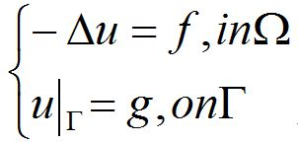

Ⅲ Numerical results
● Domain : rectangular area
(1) Single patch
PDE :
where ,
.

Slide 7
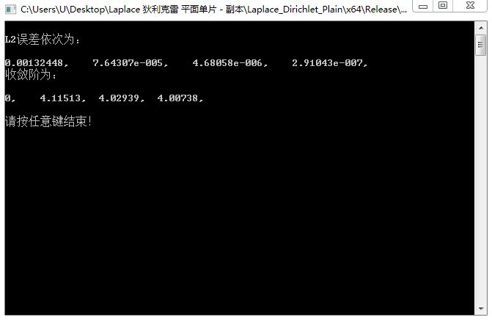

Slide 8
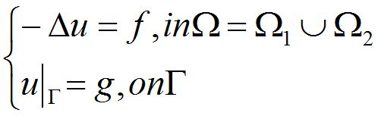
(2) Two patches
PDE :
where ,
.

Slide 9

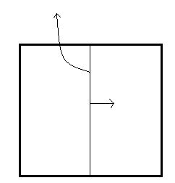



Slide 10
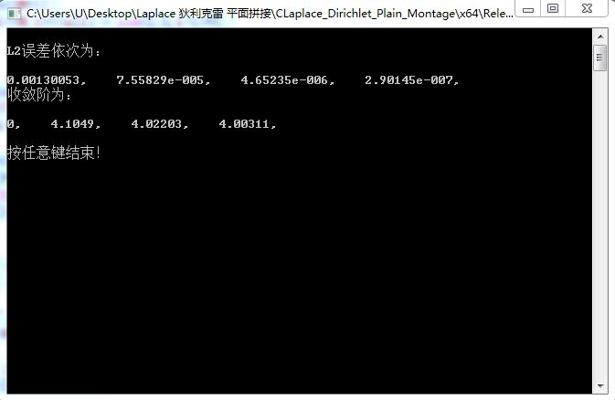

Slide 11
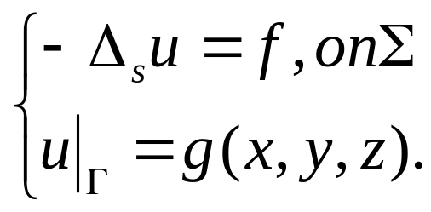
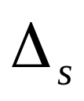
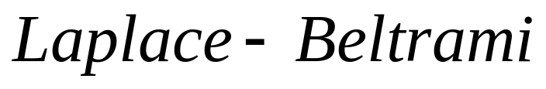
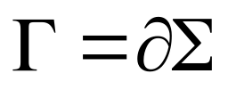
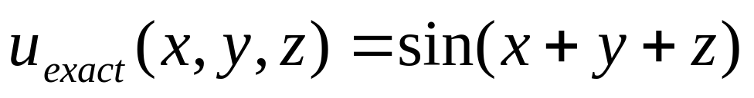
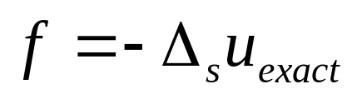
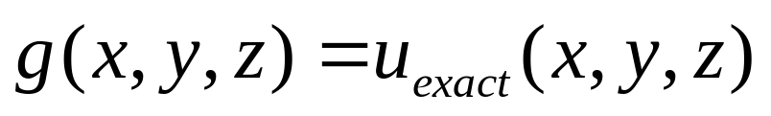
● Domain : Surface
(1) Single patch
PDE :
where is the operator,
.
Take , let
and .

Slide 12
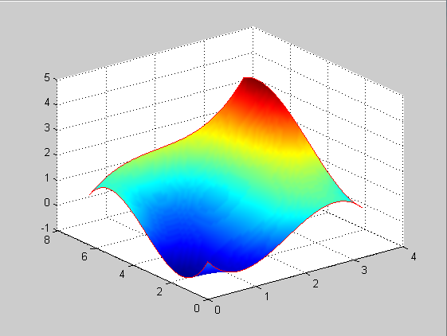
Domain :

Slide 13
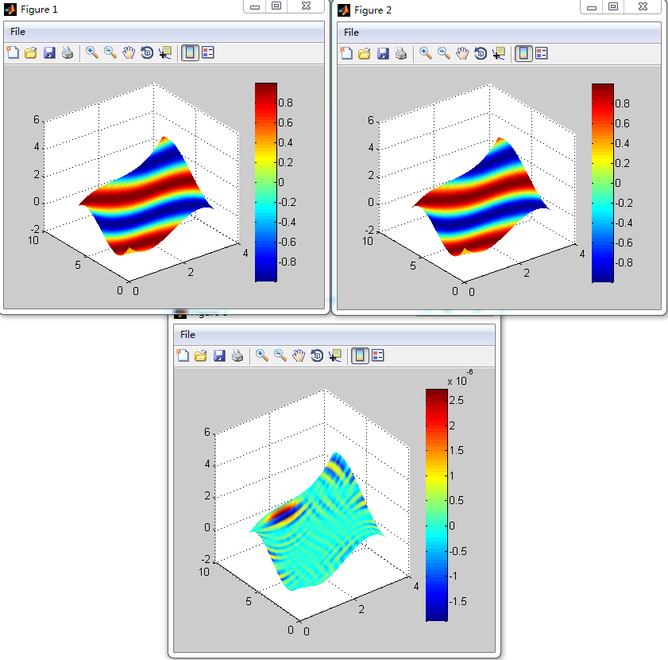
Figures (N = 64) :

Slide 14
L2-error and convergence order :
Mesh (N) | L2-error | order
4 | 0.0724076 | --
8 | 0.00290209 | 4.6410
16 | 0.000143194 | 4.3410
32 | 7.06083e-6 | 4.3420
64 | 4.80149e-7 | 3.8783

Slide 15
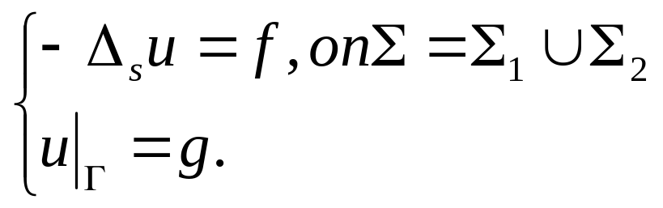
(2) Two patches
PDE :
where is the operator,
.
Take , let
and .

Slide 16
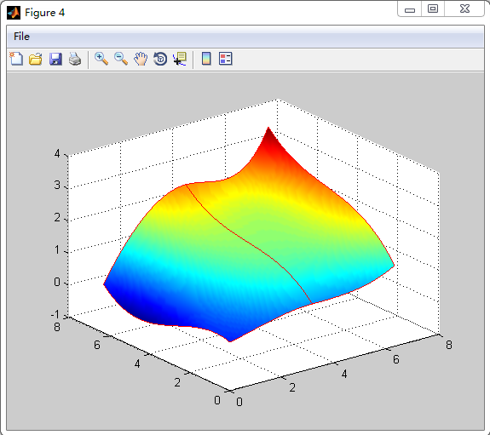
Domain :

Slide 17
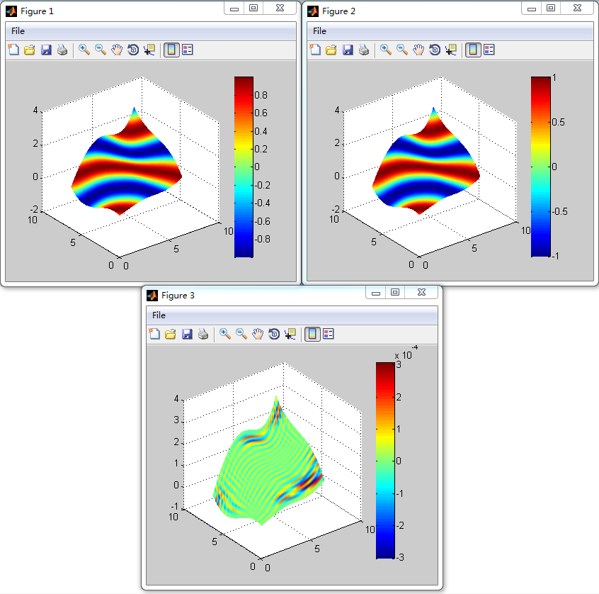
Figures (N = 16) :

Slide 18
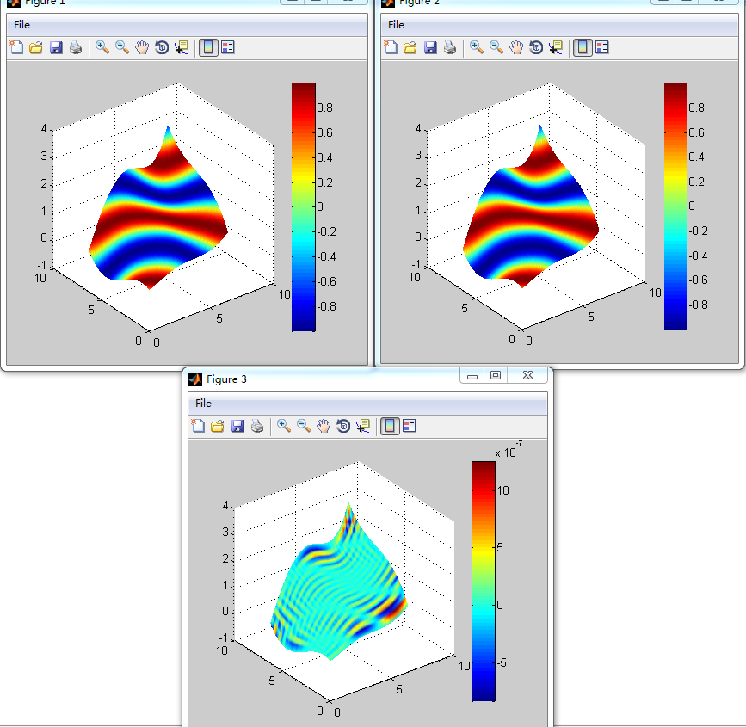
Figures (N = 64) :

Slide 19
L2-error and convergence order :
Mesh (N) | L2-error | order
4 | 0.022816 | --
8 | 0.0015515 | 3.8783
16 | 8.45565e-5 | 4.1976
32 | 4.75603e-6 | 4.1521
64 | 3.0756e-7 | 3.9508

Slide 20
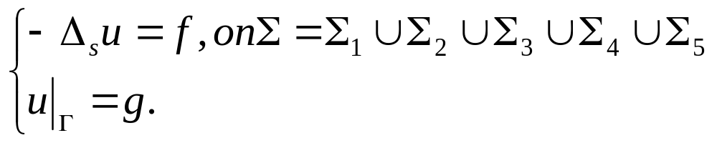
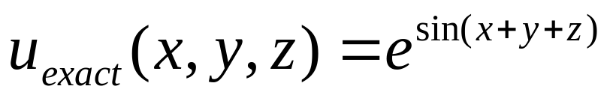
(3) Multi - patches
PDE :
where is the operator,
.
Take , let
and .

Slide 21
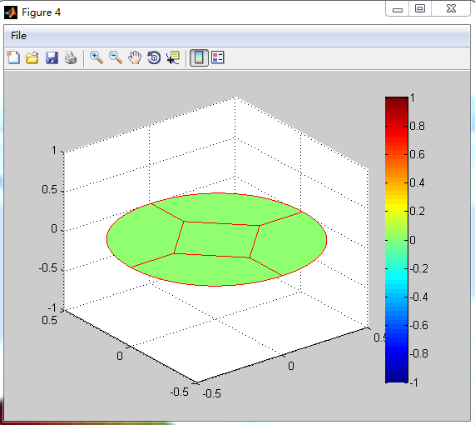
Domain :

Slide 22
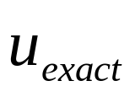
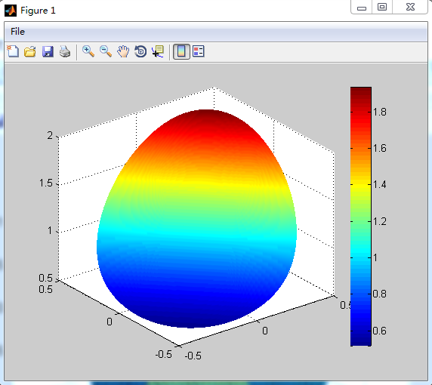
Figures (N = 24) :
:

Slide 23

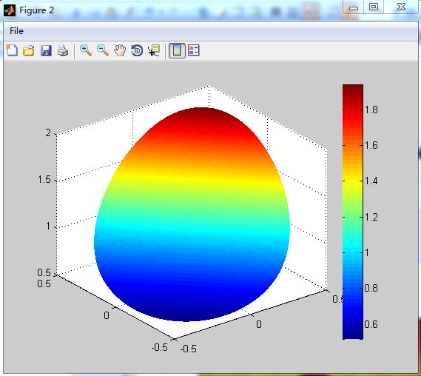
:

Slide 24

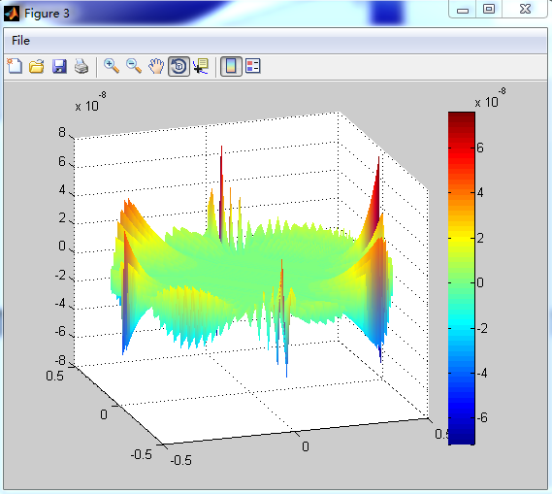
:

Slide 25
L2-error and convergence order :
Mesh | L2-error | order
3 | 7.88261e-5 | --
6 | 4.37866e-6 | 4.1701
12 | 2.75807e-7 | 3.9887
24 | 1.77071e-8 | 3.9613

Slide 26
Ⅳ Plan to do
— Applications in different fields.
Numerical experiences.
— Theoretical derivation .
Like error estimates, and stability analysis.

Slide 27
The end, thank you!

