Slide 1


Learning From Data
Lecture 6: Backpropagation and Neural Networks
Yang Li
Slides by Lichen Wang
4/7/2024

Slide 2

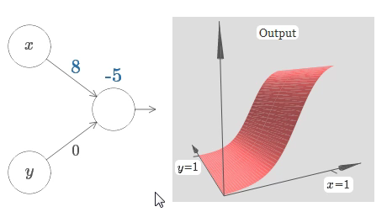
Learning From Data
Power of single neural

Slide 3
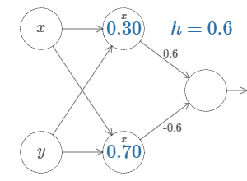
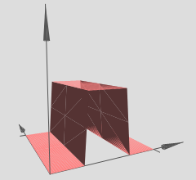
Learning From Data
Power of single neural
Two hidden units

Slide 4
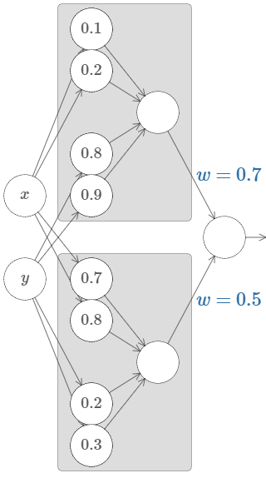
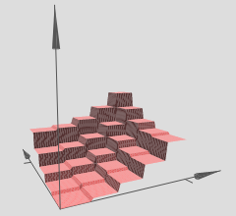
Learning From Data
Power of single neural
Many hidden units
Two hidden units

Slide 5
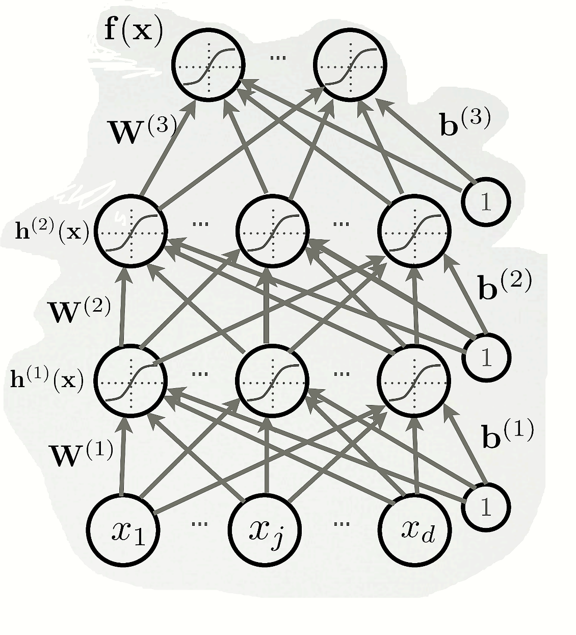
Multilayer Neural Network
Could have L hidden layers

Slide 6
Multilayer Neural Network
Could have L hidden layers
layer input activation for ,

Slide 7
Multilayer Neural Network
Could have L hidden layers
layer input activation for ,
hidden layer activation for

Slide 8
Multilayer Neural Network
Could have L hidden layers
layer input activation for ,
hidden layer activation for
output layer activation for

Slide 9
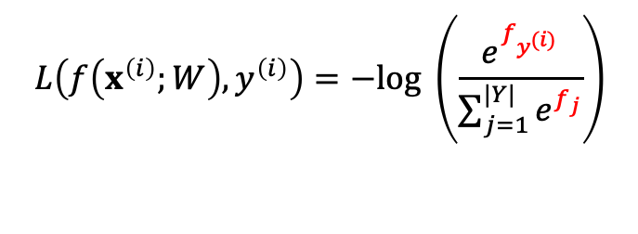
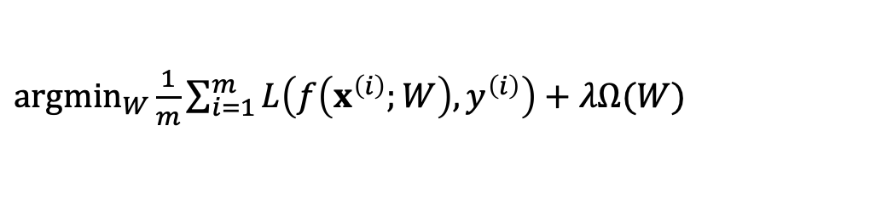

Empirical risk minimization
Empirical risk
Softmax example:
$\underset{W}{argmin}{\frac{1}{m}}\sum_{i=1}^{m}{L\left(f\left(x^{\left(i\right)};W\right),y^{\left(i\right)}\right)+λΩ(W)}$
Penalized version also known as Structured Risk Minimization
Unnormalized class probability of |Y| classes
$L\left(f\left(x^{\left(i\right)};W\right),y^{\left(i\right)}\right)$ is the loss function for sample ${(x}^{\left(i\right)},y^{\left(i\right)})$
$λΩ(W)$ is the regularizer
Class score vector
e. g. When L is cross entropy loss (log softmax+NLL)
$$L\left(f\left(x^{\left(i\right)};W\right),y^{\left(i\right)}\right)=−log \left(\frac{e^{f_{y^{(i)}}}}{\sum_{j=1}^{|Y|}{e^{f_{j}}}}\right)$$
$f_{j}$is the jth element of class score vector $f\left(x^{\left(i\right)};W\right)$

Slide 10

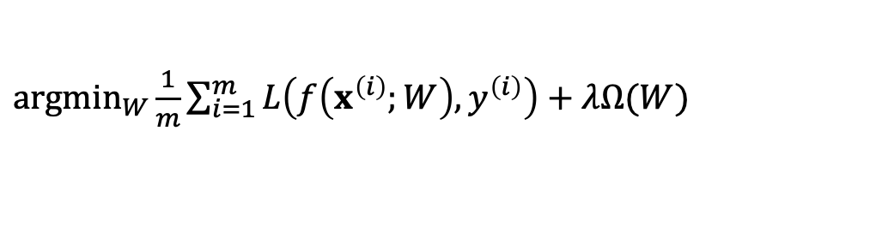
Optimization
Find the optimal parameter
$\underset{W}{argmin}{\frac{1}{m}}\sum_{i=1}^{m}{L\left(f\left(x^{\left(i\right)};W\right),y^{\left(i\right)}\right)+λΩ(W)}$

Slide 11
Optimization
Find the optimal parameter
To apply this algorithm, we need:
A procedure to compute the parameter gradient
The regularizer (and its gradient)
Updating rule
Initialization method
$\underset{W}{argmin}{\frac{1}{m}}\sum_{i=1}^{m}{L\left(f\left(x^{\left(i\right)};W\right),y^{\left(i\right)}\right)+λΩ(W)}$
Stochastic Gradient Descent (SGD)
Algorithm
Initialize W
repeat: for each training example (x^{(t)}, y^{(t)})
2a.
2b.
Animation:
Training epoch
=
Iterating over all examples
http://vision.stanford.edu/teaching/cs231n-demos/linear-classify/

Slide 12
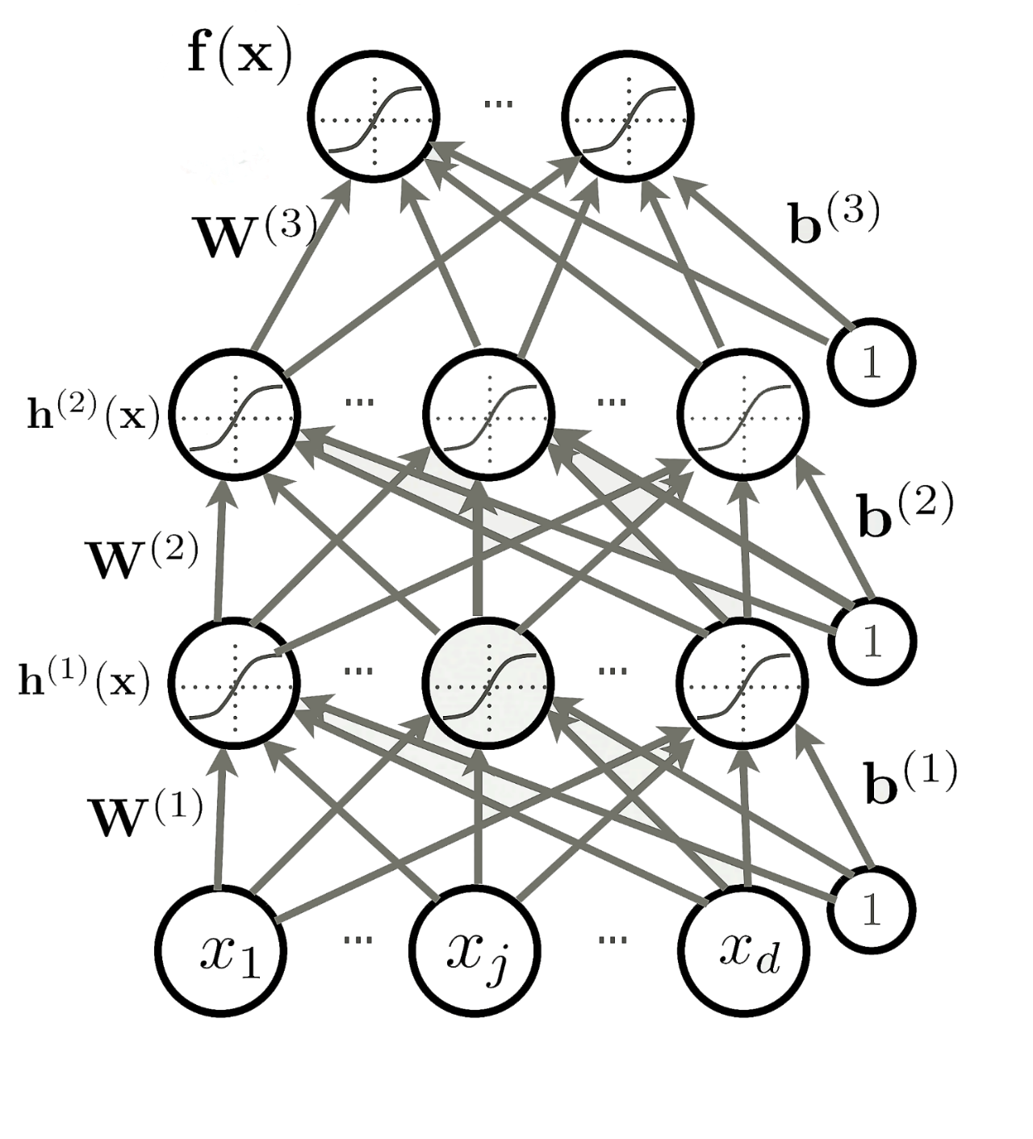
Follow the slope
How many parameter do we have?

Slide 13
Follow the slope
How many parameter do we have?
VGGNet [Simonyan and Zisserman, 2014] used 138M parameters

Slide 14
Follow the slope
How many parameter do we have?
VGGNet [Simonyan and Zisserman, 2014] used 138M parameters
In 1-dimension, the derivative of a function:

Slide 15
Follow the slope
How many parameter do we have?
VGGNet [Simonyan and Zisserman, 2014] used 138M parameters
In 1-dimension, the derivative of a function:

Slide 16
Numerical Gradient
Current W:
Gradient dW:

Slide 17
Numerical Gradient
Current W:
Gradient dW:
[0.25,
-1.56,
0.55,
3.8,
0.98,
0.77,
-0.11,
-2.9,…]
[2.1,
?,
?,
?,
?,
?,
?,
?,…]
?
Loss 1.25742

Slide 18
Numerical Gradient
Current W:
W + h (third dim):
Gradient dW:
[0.25,
-1.56,
0.55,
3.8,
0.98,
0.77,
-0.11,
-2.9,…]
[0.25 + 0.0001,
-1.56,
0.55,
3.8,
0.98,
0.77,
-0.11,
-2.9,…]
[2.1,
?,
?,
?,
?,
?,
?,
?,…]
?
Loss 1.25742
Loss 1.25763

Slide 19

Numerical Gradient
Current W:
W + h (third dim):
Gradient dW:
[0.25,
-1.56,
0.55,
3.8,
0.98,
0.77,
-0.11,
-2.9,…]
[0.25 + 0.0001,
-1.56,
0.55,
3.8,
0.98,
0.77,
-0.11,
-2.9,…]
[2.1,
?,
?,
?,
?,
?,
?,
?,…]
$$=\frac{(1.25763−1.25742) }{0.0001}$$
Loss 1.25742
Loss 1.25763
Notes:
Accurate: need really small h --- solve it analytically !

Slide 20
Follow the slope
How many parameter do we have?
VGGNet [Simonyan and Zisserman, 2014] used 138M parameters
In 1-dimension, the derivative of a function:

Slide 21
Follow the slope
How many parameter do we have?
VGGNet [Simonyan and Zisserman, 2014] used 138M parameters
In 1-dimension, the derivative of a function:
Numerical gradient: approximate, slow, easy to write

Slide 22
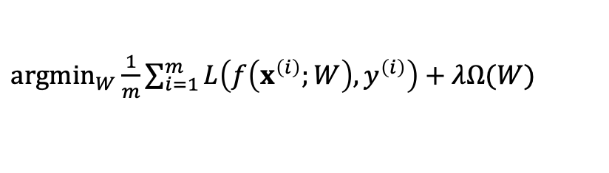
Follow the slope
How many parameter do we have?
VGGNet [Simonyan and Zisserman, 2014] used 138M parameters
In 1-dimension, the derivative of a function:
Numerical gradient: approximate, slow, easy to write
Calculus!
$\underset{W}{argmin}{\frac{1}{m}}\sum_{i=1}^{m}{L\left(f\left(x^{\left(i\right)};W\right),y^{\left(i\right)}\right)+λΩ(W)}$
Analytic gradient: exact, fast, error-prone

Slide 23











Backpropagation
$$x$$
We want
$$z$$
$$f$$
$$x$$
$$q$$
$$+$$
$$y$$
$$f$$
$$y$$
$$×$$
$$z$$

Slide 24
Backpropagation
$$x$$
We want
$$z$$
$$f$$
$$x$$
-2
$$q$$
$$+$$
$$y$$
5
$$f$$
$$y$$
$$×$$
$$z$$
-4

Slide 25
Backpropagation
$$x$$
We want
$$z$$
$$f$$
$$x$$
-2
$$q$$
$$+$$
3
$$y$$
5
$$f$$
$$y$$
$$×$$
$$z$$
-4

Slide 26
Backpropagation
$$x$$
We want
$$z$$
$$f$$
$$x$$
-2
$$q$$
$$+$$
3
$$y$$
5
$$f$$
-12
$$y$$
$$×$$
$$z$$
-4

Slide 27
Backpropagation
$$x$$
We want
$$z$$
$$f$$
$$x$$
-2
$$q$$
$$+$$
3
$$y$$
5
$$f$$
-12
$$y$$
$$×$$
1
$$z$$
-4

Slide 28
Backpropagation
$$x$$
We want
$$z$$
$$f$$
$$x$$
-2
$$q$$
$$+$$
3
-4
$$y$$
5
$$f$$
-12
$$y$$
$$×$$
1
$$z$$
-4
3

Slide 29
Backpropagation
$$x$$
We want
$$z$$
$$f$$
$$x$$
-2
-4
$$q$$
$$+$$
3
-4
$$y$$
5
$$f$$
-12
$$y$$
-4
$$×$$
1
$$z$$
-4
3

Slide 30


Backpropagation
$$x$$
We want
$$z$$
$$f$$
$$x$$
-2
-4
$$q$$
3
gradient
$$+$$
-4
$$\frac{dL}{dz}$$
$$y$$
5
$$f$$
-12
$$y$$
-4
$$×$$
1
$$z$$
-4
3

Slide 31


Backpropagation
$$x$$
We want
$$\frac{dz}{dx}$$
$$z$$
$$f$$
$$x$$
-2
-4
$$q$$
3
gradient
$$+$$
$$\frac{dz}{dy}$$
-4
$$\frac{dL}{dz}$$
$$y$$
5
$$f$$
-12
$$y$$
-4
$$×$$
1
$$z$$
-4
3
Notes:
Z = x * y.
Dz/dx= y
Dz/dy =x

Slide 32

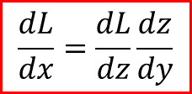

Backpropagation
$$x$$
$$\frac{dL}{dx}=\frac{dL}{dz}\frac{dz}{dx}$$
We want
$$\frac{dz}{dy}$$
$$z$$
$$f$$
$$x$$
-2
-4
$$q$$
3
gradient
$$+$$
$$\frac{dz}{dy}$$
-4
$$\frac{dL}{dz}$$
$$y$$
5
$$f$$
-12
$$y$$
-4
$$×$$
1
$$\frac{dL}{dx}=\frac{dL}{dz}\frac{dz}{dy}$$
$$z$$
-4
3

Slide 33












Backpropagation
$$w_{0}$$
$$×$$
$$x_{0}$$
$$+$$
$$w_{1}$$
$$×$$
$$+$$
$$×−1$$
$$exp$$
$$+1$$
$$1/x$$
$$x_{1}$$
$$w_{2}$$

Slide 34


Backpropagation
$$w_{0}$$
2.0
$$f\left(x\right)=ax$$
$$×$$
$$x_{0}$$
-1.0
$$+$$
$$w_{1}$$
-3.0
$$f\left(x\right)=ax$$
$$×$$
$$+$$
$$×−1$$
$$exp$$
$$+1$$
$$1/x$$
$$x_{1}$$
-2.0
$$w_{2}$$
-3.0

Slide 35

Backpropagation
$$w_{0}$$
2.0
$$×$$
-2.0
$$x_{0}$$
-1.0
$$f_{c}\left(x\right)=c+x$$
$$+$$
$$w_{1}$$
-3.0
$$×$$
6.0
$$+$$
$$×−1$$
$$exp$$
$$+1$$
$$1/x$$
$$x_{1}$$
-2.0
$$w_{2}$$
-3.0

Slide 36

Backpropagation
$$w_{0}$$
2.0
$$×$$
-2.0
$$x_{0}$$
-1.0
4.0
$$+$$
$$w_{1}$$
-3.0
$$f_{c}\left(x\right)=c+x$$
$$×$$
6.0
$$+$$
$$×−1$$
$$exp$$
$$+1$$
$$1/x$$
$$x_{1}$$
-2.0
$$w_{2}$$
-3.0

Slide 37
Backpropagation
$$w_{0}$$
2.0
$$×$$
-2.0
$$x_{0}$$
-1.0
4.0
$$+$$
$$w_{1}$$
-3.0
$$×$$
6.0
1.0
$$+$$
$$×−1$$
$$exp$$
$$+1$$
$$1/x$$
$$x_{1}$$
-2.0
$$w_{2}$$
-3.0

Slide 38


Backpropagation
$$w_{0}$$
2.0
$$×$$
-2.0
$$x_{0}$$
-1.0
4.0
$$+$$
$$w_{1}$$
-3.0
$$f\left(x\right)=ax$$
$$×$$
6.0
1.0
-1.0
$$+$$
$$×−1$$
$$exp$$
$$+1$$
$$1/x$$
$$x_{1}$$
-2.0
$$w_{2}$$
-3.0
${\left({w0 \atop \begin{aligned}w1 \\ w2\end{aligned}}\right)}^{T}\left({x0 \atop \begin{aligned}x1 \\ x2\end{aligned}}\right)$=

Slide 39

Backpropagation
$$w_{0}$$
2.0
$$×$$
-2.0
$$x_{0}$$
-1.0
4.0
$$+$$
$$w_{1}$$
-3.0
$$×$$
6.0
1.0
-1.0
0.37
$$+$$
$$×−1$$
$$exp$$
$$+1$$
$$1/x$$
$$x_{1}$$
-2.0
$$f\left(x\right)=e^{x}$$
$$w_{2}$$
-3.0

Slide 40

Backpropagation
$$w_{0}$$
2.0
$$×$$
-2.0
$$x_{0}$$
-1.0
4.0
$$+$$
$$w_{1}$$
-3.0
$$f_{c}\left(x\right)=c+x$$
$$×$$
6.0
1.0
-1.0
0.37
1.37
$$+$$
$$×−1$$
$$exp$$
$$+1$$
$$1/x$$
$$x_{1}$$
-2.0
$$w_{2}$$
-3.0

Slide 41

Backpropagation
$$w_{0}$$
2.0
$$×$$
-2.0
$$x_{0}$$
-1.0
4.0
$$+$$
$$w_{1}$$
-3.0
$$×$$
6.0
1.0
-1.0
0.37
1.37
0.729
$$+$$
$$×−1$$
$$exp$$
$$+1$$
$$1/x$$
$$x_{1}$$
-2.0
$$f\left(x\right)=\frac{1}{x}$$
$$w_{2}$$
-3.0

Slide 42
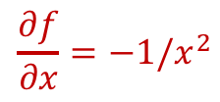

Backpropagation
$$w_{0}$$
2.0
$$×$$
-2.0
$$x_{0}$$
-1.0
4.0
$$+$$
$$w_{1}$$
-3.0
$$f\left(x\right)=\frac{1}{x}$$
$$×$$
6.0
1.0
-1.0
0.37
1.37
0.729
$$+$$
$$×−1$$
$$exp$$
$$+1$$
$$1/x$$
1.0
$$x_{1}$$
-2.0
$$\frac{∂f}{∂x}=−1/x^{2}$$
$$w_{2}$$
-3.0

Slide 43

Backpropagation
$$w_{0}$$
2.0
$$×$$
-2.0
$$x_{0}$$
-1.0
4.0
$$+$$
$$w_{1}$$
-3.0
$$f_{c}\left(x\right)=c+x$$
$$×$$
6.0
1.0
-1.0
0.37
1.37
0.729
$$+$$
$$×−1$$
$$exp$$
$$+1$$
$$1/x$$
-0.53
1.0
$$x_{1}$$
-2.0
$$\frac{∂fc}{∂x}=1$$
$$w_{2}$$
-3.0

Slide 44
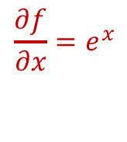

Backpropagation
$$w_{0}$$
2.0
$$×$$
-2.0
$$x_{0}$$
-1.0
4.0
$$+$$
$$w_{1}$$
-3.0
$$f\left(x\right)=e^{x}$$
$$×$$
6.0
1.0
-1.0
0.37
1.37
0.729
$$+$$
$$×−1$$
$$exp$$
-0.53
$$+1$$
$$1/x$$
-0.53
1.0
$$x_{1}$$
-2.0
$$\frac{∂f}{∂x}=e^{x}$$
$$w_{2}$$
-3.0

Slide 45
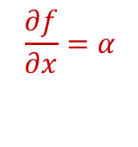
Backpropagation
$$w_{0}$$
2.0
$$×$$
-2.0
$$x_{0}$$
-1.0
4.0
$$+$$
$$w_{1}$$
-3.0
$$f\left(x\right)=ax$$
$$×$$
6.0
1.0
-1.0
0.37
1.37
0.729
$$+$$
$$×−1$$
-0.2
$$exp$$
-0.53
$$+1$$
$$1/x$$
-0.53
1.0
$$x_{1}$$
-2.0
$$\frac{∂f}{∂x}=α$$
$$w_{2}$$
-3.0

Slide 46
Backpropagation
$$w_{0}$$
2.0
$$×$$
-2.0
$$x_{0}$$
-1.0
4.0
$$+$$
$$w_{1}$$
-3.0
$$×$$
6.0
1.0
-1.0
0.37
1.37
0.729
$$+$$
$$×−1$$
-0.2
$$exp$$
-0.53
$$+1$$
$$1/x$$
0.2
-0.53
1.0
$$x_{1}$$
-2.0
$$w_{2}$$
-3.0

Slide 47
Backpropagation
$$w_{0}$$
2.0
$$×$$
-2.0
$$x_{0}$$
-1.0
4.0
$$+$$
0.2
$$w_{1}$$
-3.0
$$×$$
6.0
1.0
-1.0
0.37
1.37
0.729
$$+$$
$$×−1$$
-0.2
$$exp$$
-0.53
$$+1$$
$$1/x$$
0.2
-0.53
1.0
$$x_{1}$$
-2.0
$$w_{2}$$
-3.0

Slide 48
Backpropagation
$$w_{0}$$
2.0
$$×$$
-2.0
$$x_{0}$$
-1.0
4.0
$$+$$
0.2
$$w_{1}$$
-3.0
$$×$$
6.0
1.0
-1.0
0.37
1.37
0.729
$$+$$
$$×−1$$
-0.2
$$exp$$
-0.53
$$+1$$
$$1/x$$
0.2
-0.53
1.0
$$x_{1}$$
-2.0
$$w_{2}$$
-3.0
0.2

Slide 49
Backpropagation
$$w_{0}$$
2.0
$$×$$
-2.0
0.2
$$x_{0}$$
-1.0
4.0
$$+$$
0.2
$$w_{1}$$
-3.0
$$×$$
6.0
1.0
-1.0
0.37
1.37
0.729
0.2
$$+$$
$$×−1$$
-0.2
$$exp$$
-0.53
$$+1$$
$$1/x$$
0.2
-0.53
1.0
$$x_{1}$$
-2.0
$$w_{2}$$
-3.0
0.2

Slide 50
Backpropagation
$$w_{0}$$
2.0
-0.2
$$×$$
-2.0
0.2
$$x_{0}$$
-1.0
0.4
4.0
$$+$$
0.2
$$w_{1}$$
-3.0
-0.4
$$×$$
6.0
1.0
-1.0
0.37
1.37
0.729
0.2
$$+$$
$$×−1$$
-0.2
$$exp$$
-0.53
$$+1$$
$$1/x$$
0.2
-0.53
1.0
$$x_{1}$$
-2.0
-0.6
$$w_{2}$$
-3.0
0.2

Slide 51


Backpropagation
$$w_{0}$$
2.0
-0.2
$$×$$
-2.0
0.2
$$f(x,z,W)=\max{(−\left(w_{0}x_{0}+w_{1}{ x}_{1}+w_{2}\right),z)}$$
$$x_{0}$$
-1.0
0.4
4.0
$$+$$
0.2
$$w_{1}$$
-3.0
-0.4
$$×$$
6.0
1.0
-1.0
0.37
1.37
0.729
-0.2
$$+$$
$$×−1$$
-0.2
$$exp$$
-0.53
$$+1$$
$$1/x$$
0.2
-0.53
1.0
$$x_{1}$$
-2.0
-0.6
-1.0
$$max$$
-3.0
$$w_{2}$$
-3.0
max gate
0.2
$$z$$

Slide 52
Backpropagation
$$w_{0}$$
2.0
-0.2
$$×$$
-2.0
0.2
$$f(x,z,W)=\max{(−\left(w_{0}x_{0}+w_{1}{ x}_{1}+w_{2}\right),z)}$$
$$x_{0}$$
-1.0
0.4
4.0
$$+$$
0.2
$$w_{1}$$
-3.0
-0.4
$$×$$
6.0
1.0
-1.0
0.37
1.37
0.729
-0.2
$$+$$
$$×−1$$
-0.2
$$exp$$
-0.53
$$+1$$
$$1/x$$
0.2
-0.53
1.0
$$x_{1}$$
-2.0
-0.6
-1.0
-1.0
$$max$$
-3.0
$$w_{2}$$
-3.0
max gate
0.2
$$z$$

Slide 53
Backpropagation
$$w_{0}$$
2.0
$$×$$
-2.0
$$f(x,z,W)=\max{(−\left(w_{0}x_{0}+w_{1}{ x}_{1}+w_{2}\right),z)}$$
$$x_{0}$$
-1.0
4.0
$$+$$
$$w_{1}$$
-3.0
$$×$$
6.0
1.0
-1.0
0.37
1.37
0.729
$$+$$
$$×−1$$
-0.2
$$exp$$
-0.53
$$+1$$
$$1/x$$
-0.53
1.0
$$x_{1}$$
-2.0
-1.0
-1.0
$$max$$
-3.0
$$w_{2}$$
-3.0
max gate
$$z$$

Slide 54
Backpropagation
$$w_{0}$$
2.0
$$×$$
-2.0
$$f(x,z,W)=\max{(−\left(w_{0}x_{0}+w_{1}{ x}_{1}+w_{2}\right),z)}$$
$$x_{0}$$
-1.0
4.0
$$+$$
$$w_{1}$$
-3.0
$$×$$
6.0
1.0
-1.0
0.37
1.37
0.729
$$+$$
$$×−1$$
-0.2
$$exp$$
-0.53
$$+1$$
$$1/x$$
-0.53
1.0
$$x_{1}$$
-2.0
-1.0
-1.0
$$max$$
1.0
-3.0
$$w_{2}$$
-3.0
max gate
$$z$$

Slide 55
Backpropagation
$$w_{0}$$
2.0
$$×$$
-2.0
$$f(x,z,W)=\max{(−\left(w_{0}x_{0}+w_{1}{ x}_{1}+w_{2}\right),z)}$$
$$x_{0}$$
-1.0
4.0
$$+$$
$$w_{1}$$
-3.0
$$×$$
6.0
1.0
-1.0
0.37
1.37
0.729
$$+$$
$$×−1$$
-0.2
$$exp$$
-0.53
$$+1$$
$$1/x$$
-0.53
1.0
$$x_{1}$$
-2.0
1.0
-1.0
-1.0
$$max$$
1.0
-3.0
$$w_{2}$$
-3.0
0
max gate
$$z$$

Slide 56
Backpropagation
$$w_{0}$$
2.0
$$×$$
-2.0
$$f(x,z,W)=\max{(−\left(w_{0}x_{0}+w_{1}{ x}_{1}+w_{2}\right),z)}$$
$$x_{0}$$
-1.0
4.0
$$+$$
$$w_{1}$$
-3.0
branches
$$×$$
6.0
1.0
-1.0
0.37
1.37
0.729
$$+$$
$$×−1$$
-0.2
$$exp$$
-0.53
$$+1$$
$$1/x$$
-0.53
1.0
$$x_{1}$$
-2.0
1.0
-1.0
-1.0
$$max$$
1.0
-3.0
$$w_{2}$$
-3.0
0
max gate
$$z$$

Slide 57
Backpropagation
$$w_{0}$$
2.0
$$×$$
-2.0
$$f(x,z,W)=\max{(−\left(w_{0}x_{0}+w_{1}{ x}_{1}+w_{2}\right),z)}$$
$$x_{0}$$
-1.0
4.0
$$+$$
$$w_{1}$$
-3.0
branches
$$×$$
6.0
1.0
-1.0
0.37
1.37
0.729
$$+$$
$$×−1$$
-0.2
$$exp$$
-0.53
$$+1$$
$$1/x$$
-0.8
-0.53
1.0
$$x_{1}$$
-2.0
1.0
-1.0
-1.0
$$max$$
1.0
-3.0
$$w_{2}$$
-3.0
0
max gate
$$z$$

Slide 58




Backpropagation
Vectorized example
d
m
$$W$$
g
f
m
$$×$$
$L$2
d
$$x$$

Slide 59
Backpropagation
Vectorized example
d
m
$$W$$
m
$$×$$
$L$2
d
$$x$$

Slide 60
Backpropagation
Vectorized example
d
m
$$W$$
m
$$×$$
$L$2
d
$$x$$

Slide 61
Backpropagation
Vectorized example
d
m
$$W$$
m
$$×$$
$L$2
d
$$x$$

Slide 62
Backpropagation
Vectorized example
d
m
$$W$$
m
$$×$$
$L$2
d
$$x$$
Notes:
2x =2*[.74, 8.16]
Z= Wx dz/dw= x^T
dL/dw = dL/dz dz/dw = [1.48 1
Chain rule:

Slide 63
Backpropagation
Vectorized example
d
m
$$W$$
m
$$×$$
$L$2
d
$$x$$

