Slide 1
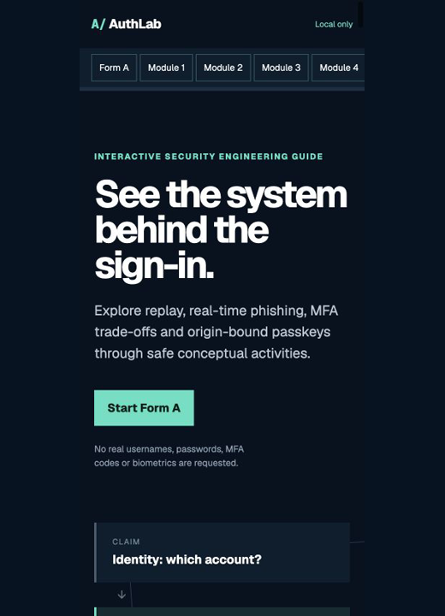
COMP6441 SECURITY ENGINEERING
FROM PASSWORDS
TO PASSKEYS
An interactive guide to authentication, phishing, MFA and WebAuthn
Name: ____________ zID: ____________
Teach Something · beginner audience · maximum 5 minutes
Notes:
20 seconds. AuthLab is a Teach Something project for university students and cybersecurity beginners. The problem is not that people have failed to memorise enough password advice. It is that one word—login—hides different decisions and different attack paths. My goal was to make those boundaries visible without asking anyone for a real credential.

Slide 2
AUTHLAB / PROBLEM
02
A login fails in three different places
The learning sequence names the boundary before it compares the technology.
IDENTIFY
ANALYSE
EXPLAIN
Which account is claimed?
How can proof be replayed or relayed?
Why does RP-bound proof resist phishing?
LO-01
LO-02–04
LO-05–06
Aim
A beginner should diagnose the failed layer, choose a control that changes the attack path, and state residual risk.
Notes:
25 seconds. The audience does not need prior cryptography or programming. Six stable learning objectives fit three moves. First, identify the difference between identity, authentication and authorisation. Second, analyse replay, credential stuffing and real-time phishing. Third, explain how public-key proof is bound to a relying party while still naming recovery, device and implementation risks.

Slide 3
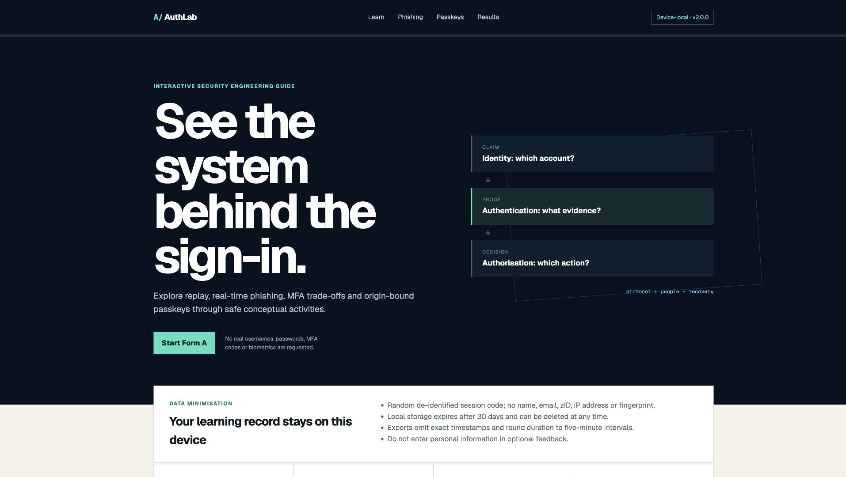
AUTHLAB / BUILD
03
One safe journey links four security decisions
Versioned, device-local and designed not to collect credentials.
01
Separate claim, proof and permission
02
Trace replay with fictional data
03
Inspect domain, context and route
04
Compare MFA with RP-bound passkeys
OUTPUT
Form A/B items · 4 scenarios · confidence · de-identified export
Notes:
I built a responsive web activity, learner workbook, separate facilitator guide, report, slides, a narrated demonstration and analysis tooling. [Play AuthLab_Presentation_Clip_25s.mp4 silently here; do not speak over the clip.] Form A and Form B use different wording but map to the same six objectives. The pre-test records answers without revealing correctness. Each module needs an explicit checkpoint, and Form B then gives the correct answer, rationale, distractor explanations and objective mapping.

Slide 4
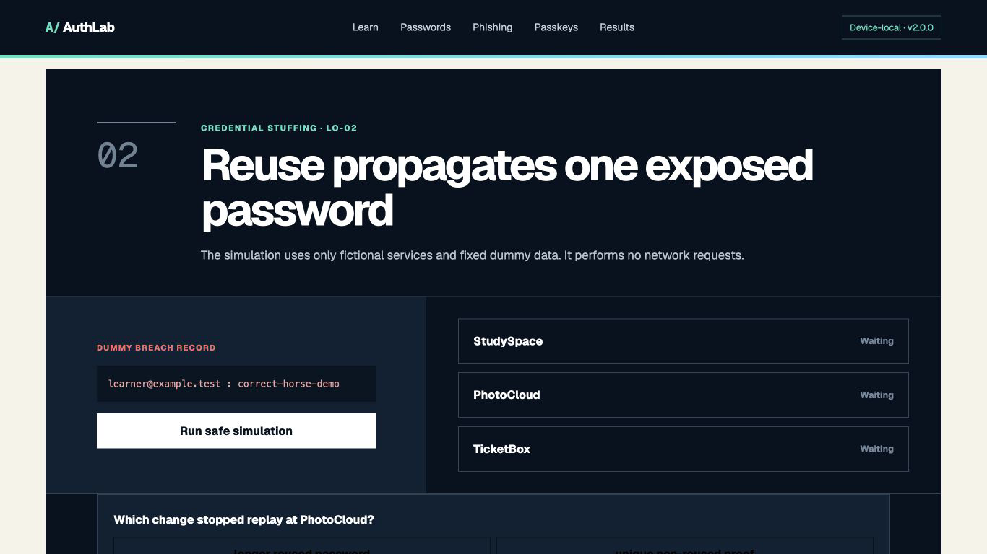
AUTHLAB / ANALYSIS
04
A strong reused password is still replayable proof
Fixed fictional data shows why reuse—not complexity alone—propagates a breach.
1
Exposure
Dummy pair only
2
Automated replay
Fixed local simulation
3
Cross-service acceptance
Reuse enables takeover
Control reuse and replay, not only length.
Source: OWASP Credential Stuffing; NIST SP 800-63B-4 (2025).
Notes:
40 seconds. The password lab changes one variable. A fixed fictional credential is exposed and tried against three fictional services, with no outbound request. Two services reuse the proof; one accepts a unique or non-replayable proof. The engineering lesson is propagation. Complexity can help guessing resistance, but a complex reused password is still a shared bearer secret. Controls must address exposure, automation, cross-service reuse and post-login privilege.

Slide 5
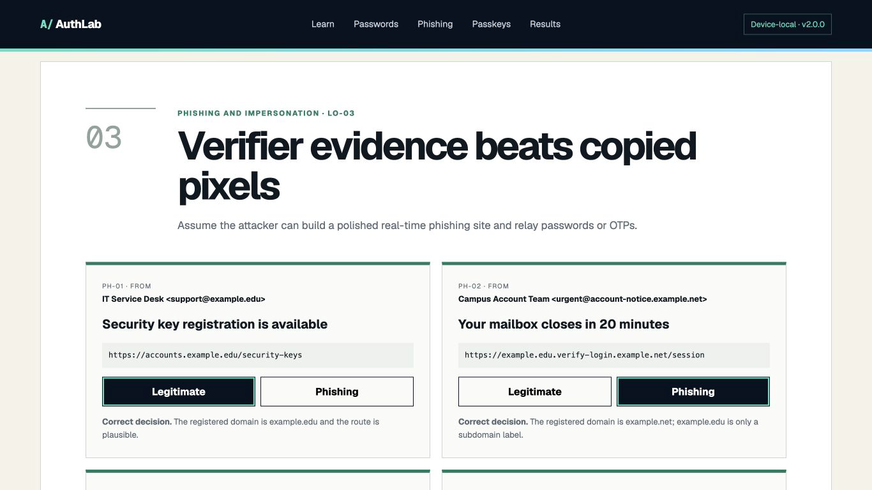
AUTHLAB / ANALYSIS
05
A live phishing proxy can relay passwords and TOTP
Learners inspect the registered domain, request context and a trusted route.
DECISION RULE
Inspect origin.
Verify context.
Use a trusted route.
Report safely.
Why this matters
TOTP is short-lived, not origin-bound. Passkeys change which verifier can receive valid proof.
Sources: CISA phishing guidance (2025); NIST phishing resistance.
Notes:
45 seconds. The phishing module does not rely on spelling mistakes or ugly pages. It asks who receives the proof: inspect the registered domain, verify whether the request fits the context, and use an independently trusted route. This also corrects a common MFA misconception. TOTP is short-lived and helps ordinary replay resistance, but a real-time adversary can relay it before expiry. Phishing resistance requires a protocol property, not merely another step.

Slide 6
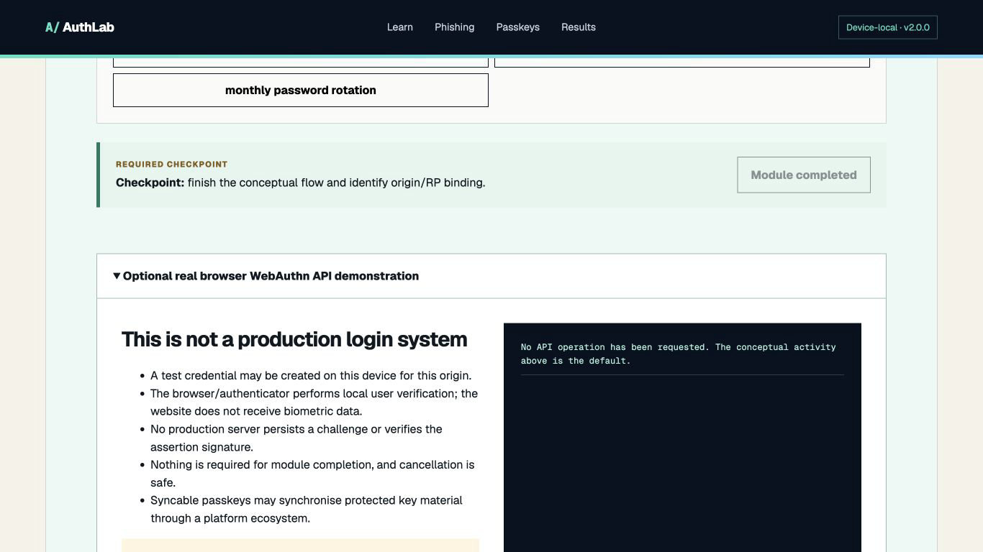
AUTHLAB / TECHNICALITY
06
A passkey signs a fresh challenge for one relying party
Private-key material stays protected; a look-alike origin cannot get valid proof for the legitimate RP.
MECHANISM
PROOF
ORIGIN-BOUND
PASSWORD
replayable
NO
TOTP
short-lived
NO
PASSKEY
signed challenge
YES
Residual risk remains
Device compromise · recovery · server design · excessive authorisation
Sources: W3C WebAuthn Level 3 CR Snapshot (26 May 2026); FIDO; NIST.
Notes:
45 seconds. In WebAuthn, a production server sends a fresh challenge. The authenticator signs for the relying party, while the relying party keeps public-key material. The private key is not sent during authentication. RP-ID and origin binding stop a copied domain from obtaining a valid assertion for the real domain. AuthLab teaches this conceptually by default. Its optional browser API call requires consent and is explicitly not a full login because no server persists or verifies the ceremony.

Slide 7
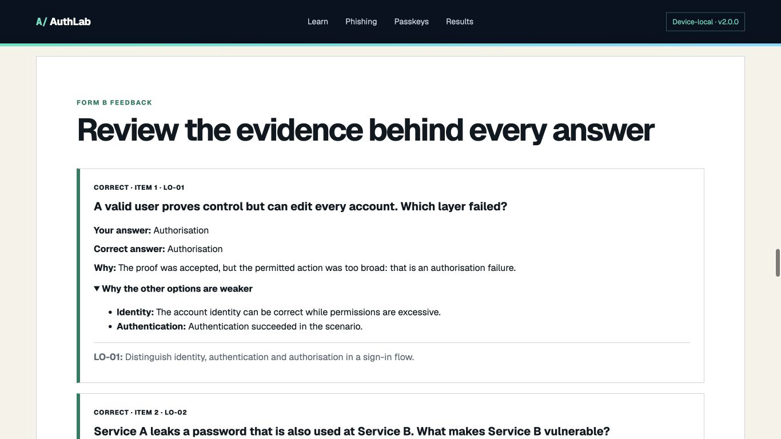
AUTHLAB / EVIDENCE
07
The engineering works; learning is still unmeasured
Technical checks and human learning evidence are kept separate.
TESTS
Final source and build checks
PASS
PATH
Deliberate developer path
6→5
HUMANS
No participant records supplied
0
Next: run the consented Form A/B protocol and report every outcome, including zero or negative change.
Notes:
40 seconds. The technical evidence is genuine: installation, lint, behavioural tests, production build, security headers and four viewport checks are preserved in the evidence folder. The browser path shown here deliberately answers one TOTP item incorrectly, producing six out of six then five out of six. That proves hidden and revealed feedback plus score change work. It does not prove learning. No participant records were supplied, so effectiveness remains unmeasured.

Slide 8
AUTHLAB / TAKEAWAY
Change the proof, then
test the teaching.
01
Diagnose
02
Design
03
Verify
Separate identity, authentication and authorisation.
Control replay and relay; bind proof to the verifier.
Tests prove function; genuine participants test learning.
Website · learner workbook · facilitator guide · report · 90–105 second demo
Public AuthLab site
Questions — backup evidence follows
Notes:
25 seconds. My conclusion is precise: security improves when the accepted proof changes, and project quality improves when evidence boundaries are explicit. AuthLab helps a beginner diagnose the failed layer, trace replay and relay, and explain RP-bound public-key authentication without entering real secrets. The artefact is complete and technically verified. Human effectiveness and my final personal reflection remain separate student responsibilities. Thank you.

Slide 9
AUTHLAB / Q&A
Q1
Phishing-resistant does not mean invulnerable
RP binding narrows one attack class; it does not secure the whole account lifecycle.
RISK
EXAMPLE
CONTROL
DEVICE
compromise
HARDEN
RECOVERY
weak fallback
MODEL
SERVER
logic error
VERIFY
Precise claim
Passkeys improve phishing resistance under the WebAuthn trust model.
Sources: W3C WebAuthn Level 3; NIST SP 800-63B-4.
Notes:
Backup. Passkeys reduce credential phishing through RP binding. They do not remove device compromise, weak recovery, malicious relying-party code, browser or authenticator defects, availability problems or excessive authorisation.

Slide 10
AUTHLAB / Q&A
Q2
Why can TOTP still be relayed in real time?
Expiry limits time; it does not bind the code to the intended verifier.
ATTACK PATH
Victim enters code.
Proxy sends it onward.
Real service accepts it.
Attacker receives session.
Key distinction
Short-lived output can resist later replay and still be phished through immediate relay.
Source: NIST SP 800-63B-4, phishing-resistance criteria.
Notes:
Backup. TOTP improves ordinary replay resistance because the code expires, but a live phishing proxy can forward it immediately. The missing property is verifier-name binding.

Slide 11
AUTHLAB / Q&A
Q3
The optional browser demo is not a secure login
It observes API boundaries but deliberately omits production server responsibilities.
MISSING
REQUIRED
STATUS
CHALLENGE
server state
NONE
CREDENTIAL
account record
NONE
ASSERTION
signature verify
NONE
Demo boundary
Client-only create/get is never described as production authentication.
Source: W3C WebAuthn Level 3 verification requirements.
Notes:
Backup. A production relying party must persist and verify challenge, origin, RP ID binding, credential record, flags and signature. AuthLab intentionally does none of those server-side tasks.

Slide 12
AUTHLAB / Q&A
Q4
The export is de-identified, not guaranteed anonymous
Data minimisation reduces risk; outside context can still re-identify a record.
IDENTITY
No name, email or zID
0
TIME
No exact timestamps
0
CONTROL
Learner exports and deletes
LOCAL
The file still needs restricted storage and a retention plan; do not call it fully anonymous.
Notes:
Backup. The random session code and item responses are de-identified because direct identity fields and exact timestamps are excluded. They are not guaranteed anonymous once combined with external context.

Slide 13
AUTHLAB / Q&A
Q5
Parallel forms reduce rehearsal, not every validity threat
Form A hides feedback; Form B explains answers only after submission.
FORM A
No score or answer reveal
HIDE
FORM B
Rationale + distractors + LO
SHOW
HUMANS
No effectiveness claim
0
Remaining threats: convenience sample, self-selection, practice effect, no retention test and facilitator influence.
Notes:
Backup. Parallel wording and delayed feedback improve internal validity, but a small convenience sample still cannot establish general or retained learning.

Slide 14
AUTHLAB / Q&A
Q6
The limitations narrow what the project can claim
Each gap belongs to a different evidence category.
MEASUREMENT
TECHNICAL
ACCESS
No participants or retention test
No production WebAuthn verifier
No screen-reader user study
Evidence gap
System boundary
QA boundary
Rule
Build tests prove implementation; sources support technical claims; only genuine participants support teaching effectiveness.
Notes:
Backup. The main limitations are an absent human dataset, no retention test, no production server-side WebAuthn, simplified phishing scenarios and no assistive-technology user study.

Slide 15
AUTHLAB / Q&A
Future work strengthens
evidence, not slogans.
01
Evaluate
02
Extend
03
Test
Run the consented protocol and report every outcome.
Build a controlled reference RP plus recovery threat model.
Add assistive-technology and browser/authenticator coverage.
Next: genuine participant evidence · server verification · accessibility matrix
No invented outcomes
End of backup Q&A
Notes:
Backup. Future work should improve evidence and system completeness: genuine consented evaluation, a controlled production-style relying party, recovery-path threat modelling and accessibility/browser testing.

